Slide 1
CS 4803 / 7643: Deep Learning
Topics:
  Automatic Differentiation
    (Finish) Forward mode vs Reverse mode AD
    Patterns in backprop
Dhruv Batra
Georgia Tech

Slide 2
Administrativia
HW1 Reminder
  Due: 09/09, 11:59pm
HW2 out on 9/10
    Schedule: https://www.cc.gatech.edu/classes/AY2021/cs7643_fall/
Project discussion next class

Slide 3
Recap from last time

Slide 4
How do we compute gradients?
Analytic or “Manual” Differentiation
Symbolic Differentiation
Numerical Differentiation
Automatic Differentiation
  Forward mode AD
  Reverse mode AD
    aka “backprop”

Slide 5
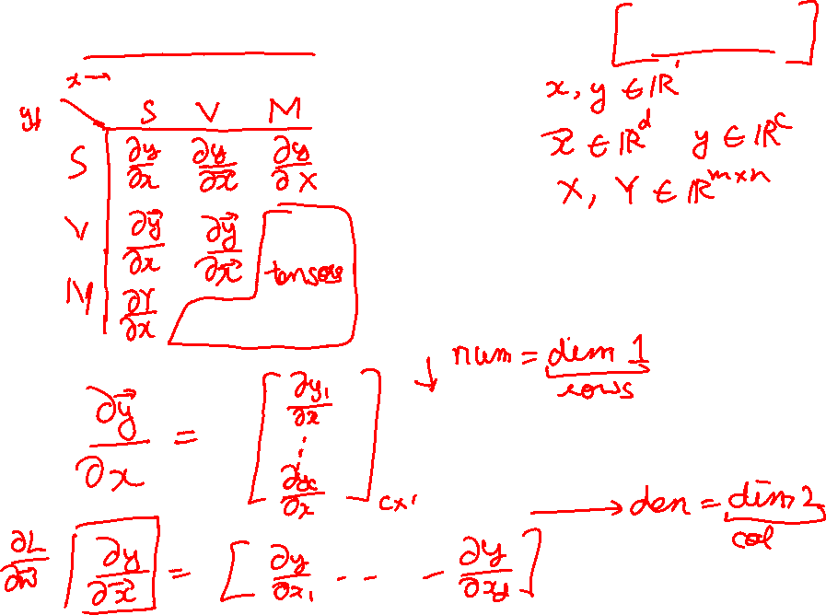
Vector/Matrix Derivatives Notation

Slide 6
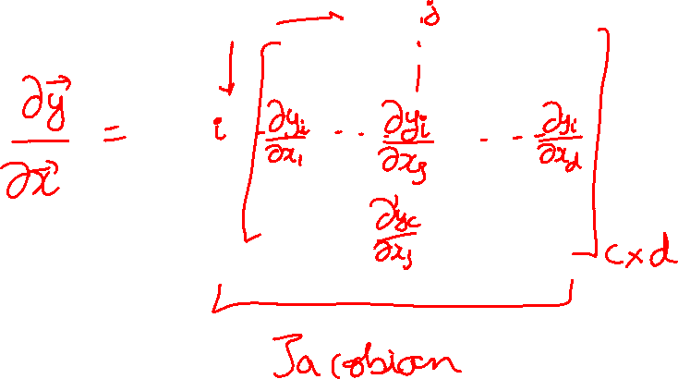
Vector/Matrix Derivatives Notation

Slide 7
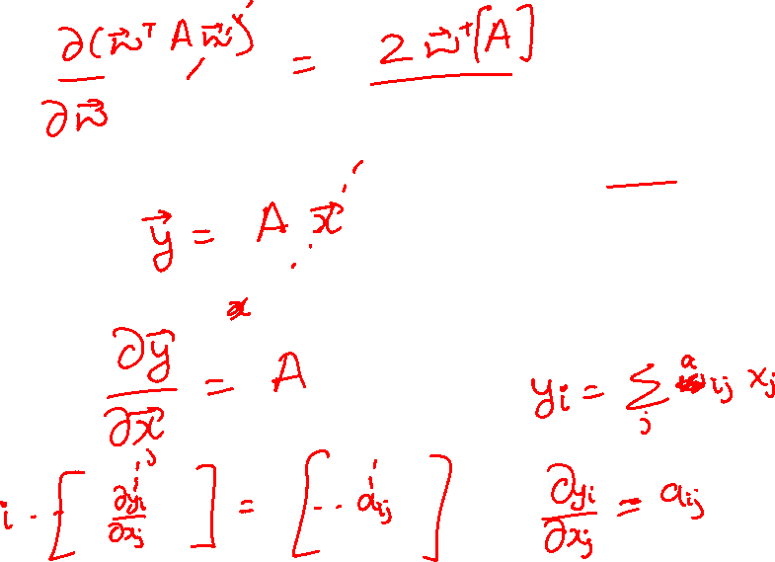
Vector Derivative Example

Slide 8
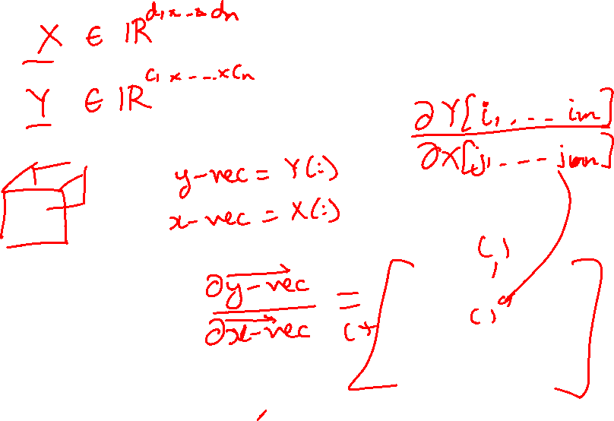
Extension to Tensors

Slide 9
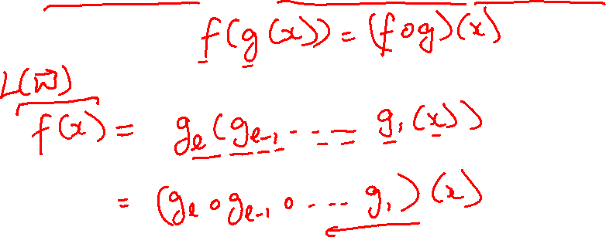
Chain Rule: Composite Functions

Slide 10
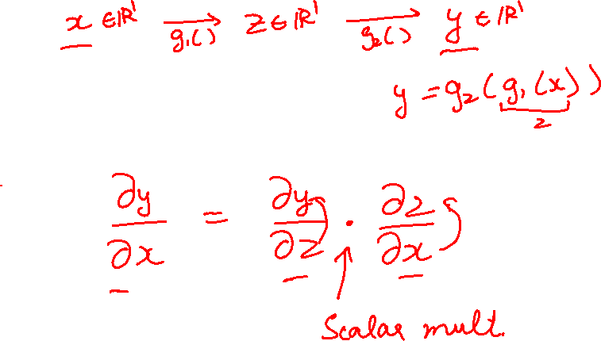
Chain Rule: Scalar Case

Slide 11
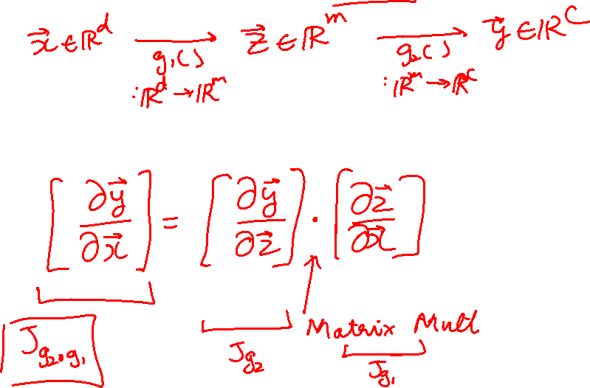
Chain Rule: Vector Case

Slide 12
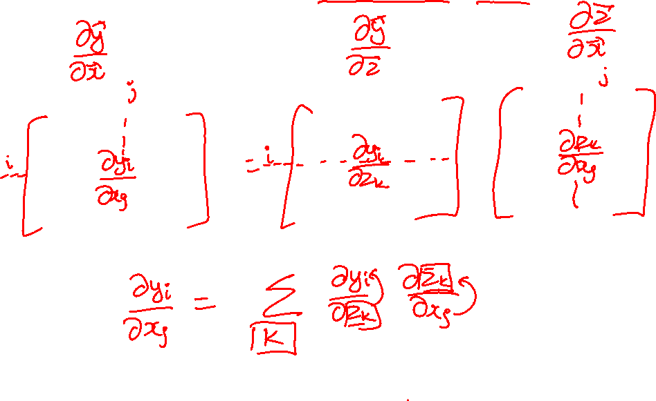
Chain Rule: Jacobian view

Slide 13
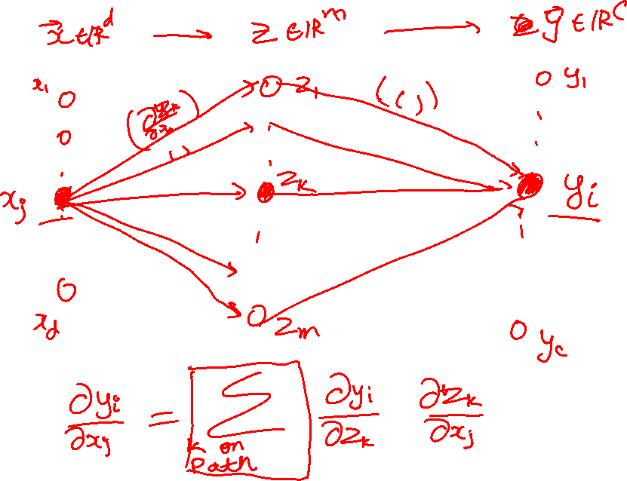
Chain Rule: Graphical view

Slide 14
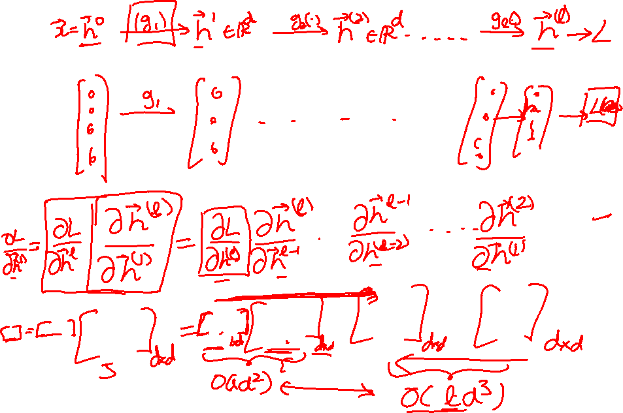
Chain Rule: Cascaded

Slide 15
Deep Learning = Differentiable Programming
Computation = Graph
  Input = Data + Parameters
  Output = Loss
  Scheduling = Topological ordering
Auto-Diff
  A family of algorithms for
  implementing chain-rule on computation graphs

Slide 16
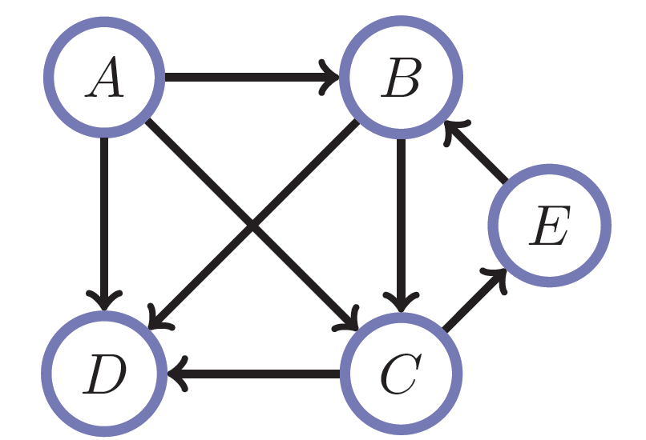
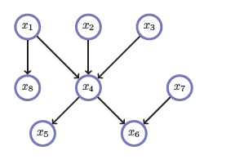
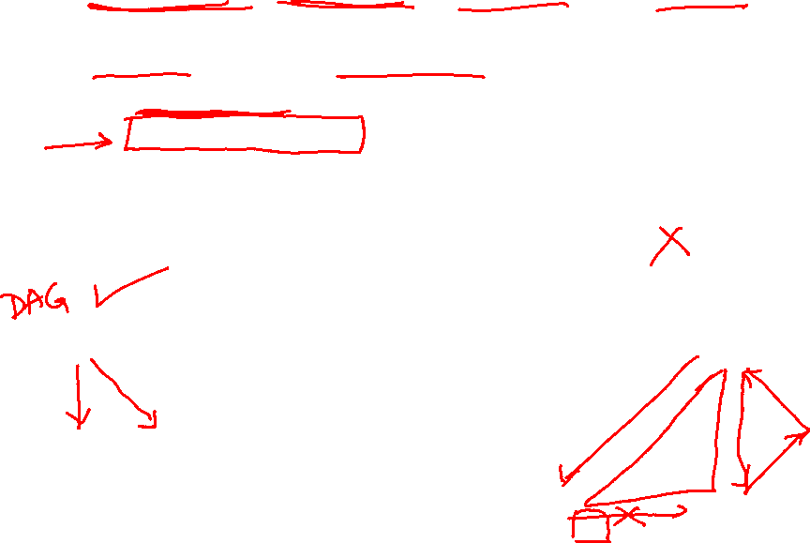
Directed Acyclic Graphs (DAGs)
Exactly what the name suggests
  Directed edges
  No (directed) cycles
  Underlying undirected cycles okay

Slide 17
Directed Acyclic Graphs (DAGs)
Concept
  Topological Ordering

Slide 18
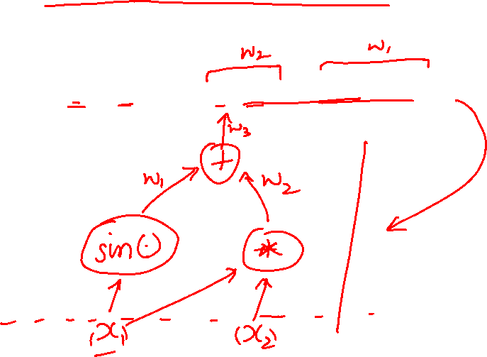
Computational Graphs
Notation

Slide 19
Deep Learning = Differentiable Programming
Computation = Graph
  Input = Data + Parameters
  Output = Loss
  Scheduling = Topological ordering
Auto-Diff
  A family of algorithms for
  implementing chain-rule on computation graphs

Slide 20
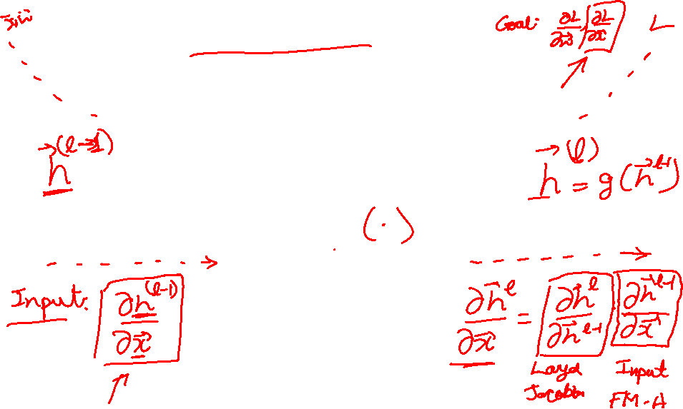
Forward mode AD
g
Notes:
What we’re doing in backprop is we have all these nodes in our computational graph, each node only aware of immediate surroundings
at each node have ...

Slide 21
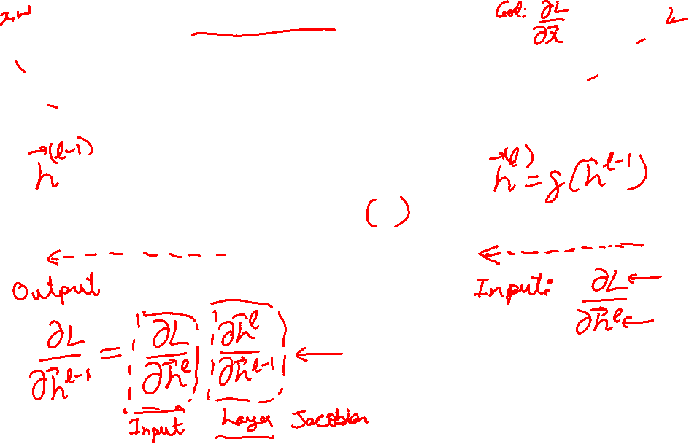
Reverse mode AD
g
Notes:
What we’re doing in backprop is we have all these nodes in our computational graph, each node only aware of immediate surroundings
at each node have ...

Slide 22
Plan for Today
Automatic Differentiation
  (Finish) Forward mode vs Reverse mode AD
  Backprop
  Patterns in backprop

Slide 23
Example: Forward mode AD
+
sin( )
*
x₁
x₂

Slide 24
Example: Forward mode AD
+
sin( )
*
x₁
x₂

Slide 25
Example: Forward mode AD
+
sin( )
*
x₁
x₂

Slide 26
Example: Forward mode AD
+
sin( )
*
x₁
x₂

Slide 27
Example: Forward mode AD
Q: What happens if there’s another input variable x₃?
+
sin( )
*
x₁
x₂

Slide 28
Example: Forward mode AD
Q: What happens if there’s another input variable x₃?
A: more sophisticated graph;
d+1 “passes” for d+1 variables
+
sin( )
*
x₁
x₂

Slide 29
Example: Forward mode AD
Q: What happens if there’s another output variable f₂?
+
sin( )
*
x₁
x₂

Slide 30
Example: Forward mode AD
Q: What happens if there’s another output variable f₂?
A: more sophisticated graph;
d “passes” for variables
+
sin( )
*
x₁
x₂

Slide 31
Example: Reverse mode AD
+
sin( )
*
x₁
x₂

Slide 32
Example: Reverse mode AD
+
sin( )
*
x₁
x₂

Slide 33
Gradients add at branches
+
Slide Credit: Fei-Fei Li, Justin Johnson, Serena Yeung, CS 231n
Notes:
Gradients add at branches, from multivariate chain rule
Since wiggling this node affects both connected nodes in the forward pass, then at backprop the upstream gradient coming into this node is the sum of the gradients flowing back from both nodes

Slide 34
Duality in Fprop and Bprop
FPROP
BPROP
SUM
+
COPY
+

Slide 35
Example: Reverse mode AD
+
sin( )
*
x₁
x₂

Slide 36
Example: Reverse mode AD
Q: What happens if there’s another input variable x₃?
+
sin( )
*
x₁
x₂

Slide 37
Example: Reverse mode AD
Q: What happens if there’s another input variable x₃?
A: more sophisticated graph;
single “backward prop”
+
sin( )
*
x₁
x₂

Slide 38
Example: Reverse mode AD
Q: What happens if there’s another output variable f₂?
+
sin( )
*
x₁
x₂

Slide 39
Example: Reverse mode AD
Q: What happens if there’s another output variable f₂?
A: more sophisticated graph;
c “backward props” for c vars
+
sin( )
*
x₁
x₂

Slide 40
Forward Pass vs
Forward mode AD vs Reverse Mode AD
+
sin( )
*
x₁
x₂
+
+
sin( )
*
sin( )
*
x₁
x₂
x₁
x₂

Slide 41
Forward mode vs Reverse Mode
What are the differences?
+
+
sin( )
*
sin( )
*
x₁
x₂
x₁
x₂

Slide 42
Forward mode vs Reverse Mode
What are the differences?
Which one is faster to compute?
  Forward or backward?

Slide 43
Forward mode vs Reverse Mode
x → Graph → L
Intuition of Jacobian

Slide 44
Forward mode vs Reverse Mode
What are the differences?
Which one is faster to compute?
  Forward or backward?
Which one is more memory efficient (less storage)?
  Forward or backward?

Slide 45
Plan for Today
Automatic Differentiation
  (Finish) Forward mode vs Reverse mode AD
  Backprop
  Patterns in backprop

Slide 46
Neural Network Computation Graph
Figure Credit: Andrea Vedaldi

Slide 47
Backprop
Figure Credit: Andrea Vedaldi

Slide 48
Computational Graph
Any DAG of differentiable modules is allowed!
Slide Credit: Marc'Aurelio Ranzato

Slide 49
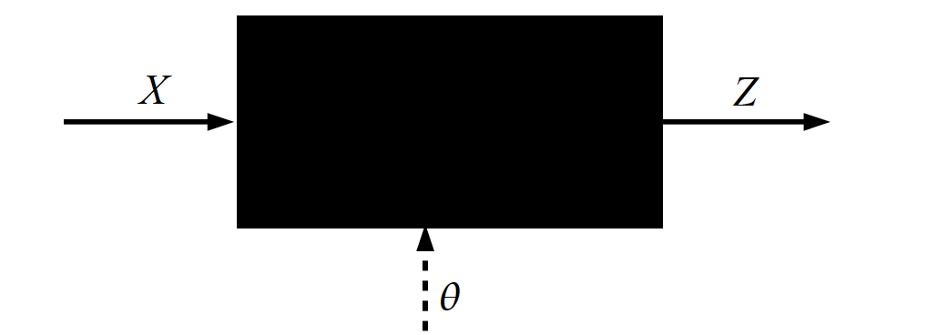
Key Computation: Forward-Prop
Slide Credit: Marc'Aurelio Ranzato, Yann LeCun

Slide 50
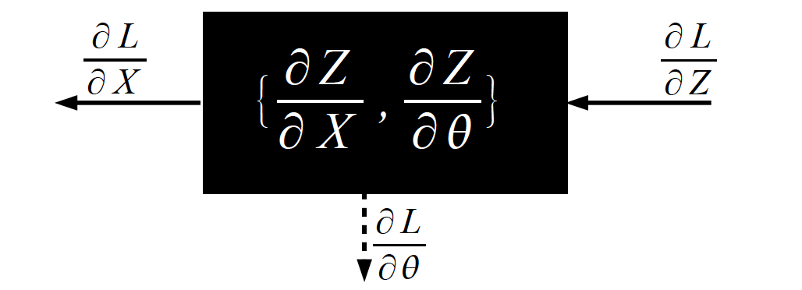
Key Computation: Back-Prop
Slide Credit: Marc'Aurelio Ranzato, Yann LeCun

Slide 51
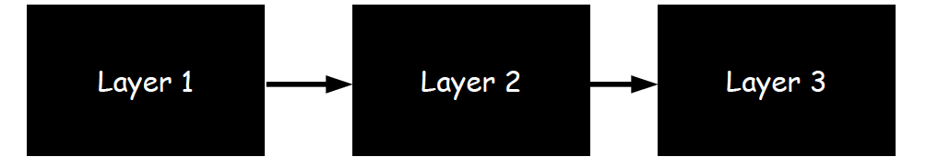
Neural Network Training
Step 1: Compute Loss on mini-batch [F-Pass]
Slide Credit: Marc'Aurelio Ranzato, Yann LeCun

Slide 52
Neural Network Training
Step 1: Compute Loss on mini-batch [F-Pass]
Slide Credit: Marc'Aurelio Ranzato, Yann LeCun

Slide 53
Neural Network Training
Step 1: Compute Loss on mini-batch [F-Pass]
Slide Credit: Marc'Aurelio Ranzato, Yann LeCun

Slide 54
Neural Network Training
Step 1: Compute Loss on mini-batch [F-Pass]
Step 2: Compute gradients wrt parameters [B-Pass]
Slide Credit: Marc'Aurelio Ranzato, Yann LeCun

Slide 55
Neural Network Training
Step 1: Compute Loss on mini-batch [F-Pass]
Step 2: Compute gradients wrt parameters [B-Pass]
Slide Credit: Marc'Aurelio Ranzato, Yann LeCun

Slide 56
Neural Network Training
Step 1: Compute Loss on mini-batch [F-Pass]
Step 2: Compute gradients wrt parameters [B-Pass]
Slide Credit: Marc'Aurelio Ranzato, Yann LeCun

Slide 57

Neural Network Training
Step 1: Compute Loss on mini-batch [F-Pass]
Step 2: Compute gradients wrt parameters [B-Pass]
Step 3: Use gradient to update parameters
Slide Credit: Marc'Aurelio Ranzato, Yann LeCun

Slide 58
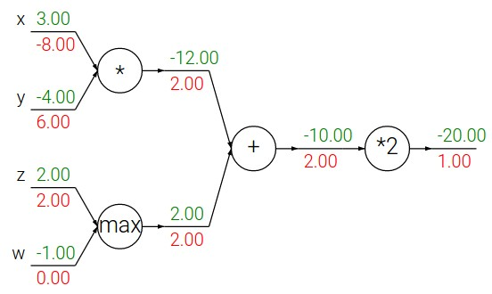
Backpropagation: a simple example
Slide Credit: Fei-Fei Li, Justin Johnson, Serena Yeung, CS 231n

Slide 59
Backpropagation: a simple example
Slide Credit: Fei-Fei Li, Justin Johnson, Serena Yeung, CS 231n

Slide 60
Patterns in backward flow
Slide Credit: Fei-Fei Li, Justin Johnson, Serena Yeung, CS 231n

Slide 61
Patterns in backward flow
Q: What is an add gate?
Slide Credit: Fei-Fei Li, Justin Johnson, Serena Yeung, CS 231n

Slide 62
Patterns in backward flow
add gate: gradient distributor
Slide Credit: Fei-Fei Li, Justin Johnson, Serena Yeung, CS 231n

Slide 63
Patterns in backward flow
add gate: gradient distributor
Q: What is a max gate?
Slide Credit: Fei-Fei Li, Justin Johnson, Serena Yeung, CS 231n

Slide 64
Patterns in backward flow
add gate: gradient distributor
max gate: gradient router
Slide Credit: Fei-Fei Li, Justin Johnson, Serena Yeung, CS 231n

Slide 65
Patterns in backward flow
add gate: gradient distributor
max gate: gradient router
Q: What is a mul gate?
Slide Credit: Fei-Fei Li, Justin Johnson, Serena Yeung, CS 231n

Slide 66
Patterns in backward flow
add gate: gradient distributor
max gate: gradient router
mul gate: gradient switcher
Slide Credit: Fei-Fei Li, Justin Johnson, Serena Yeung, CS 231n
Notes:
Gradient switcher and scaler
Mul: scale upstream gradient by value of other branch

Slide 67
Gradients add at branches
+
Slide Credit: Fei-Fei Li, Justin Johnson, Serena Yeung, CS 231n
Notes:
Gradients add at branches, from multivariate chain rule
Since wiggling this node affects both connected nodes in the forward pass, then at backprop the upstream gradient coming into this node is the sum of the gradients flowing back from both nodes

Slide 68
Duality in Fprop and Bprop
FPROP
BPROP
SUM
+
COPY
+

