Slide 1

CS 4803 / 7643
Deep Learning, Fall 2021
Reinforcement Learning Module: 3/3
Slides: Nirbhay Modhe

Slide 2
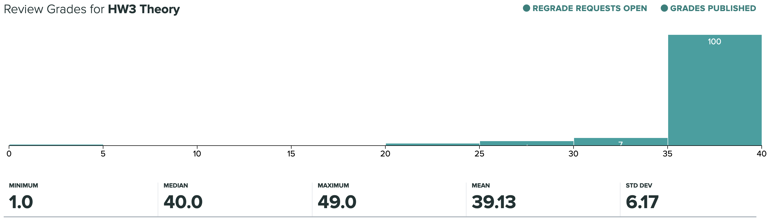
Administrativia
HW3 Grades Released
  Regrade requests close: 11/11, 11:59pm
Grade histogram: 7643
  Max possible: 40 (20+20) (regular credit) + 9 (extra credit)

Slide 3
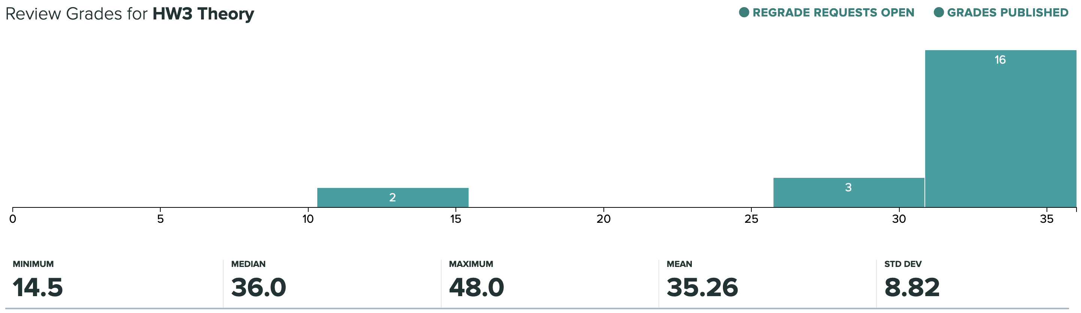
Administrativia
HW3 Grades Released
  Regrade requests close: 11/11, 11:59pm
Grade histogram: 4803
  Max possible: 36 (16+20) (regular credit) + 13 (extra credit)

Slide 4
Administrativia
HW5 released
  Due: 11/17, 11:59pm
  MDPs, (Deep) Reinforcement Learning.
    https://www.cc.gatech.edu/classes/AY2022/cs7643_fall/nvxGCX9GqdBkRqanv6bVQS/hw5-coding/
  Last homework of the semester.
  Focus on project after this.

Slide 5
Recap from last time

Slide 6
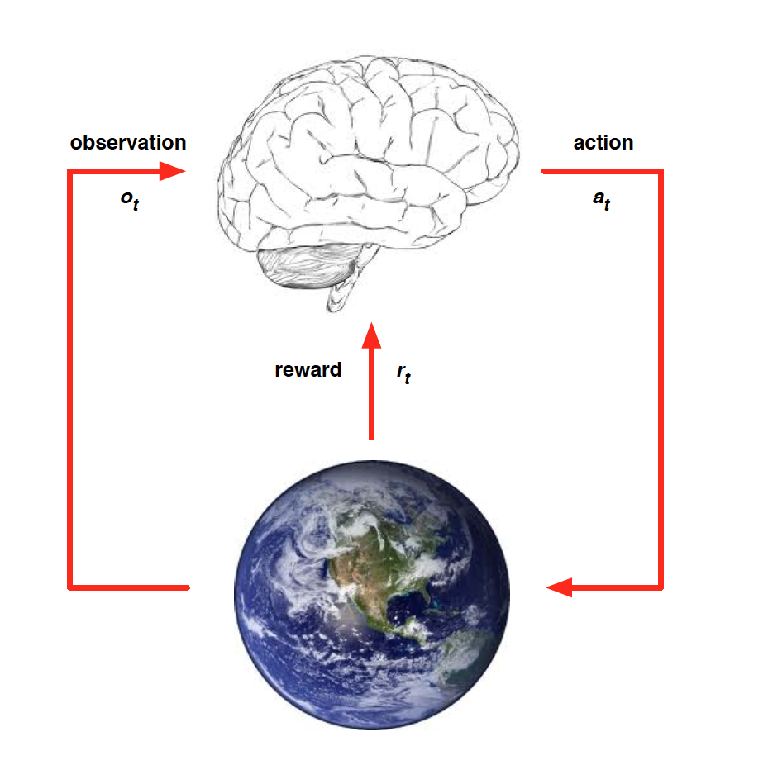
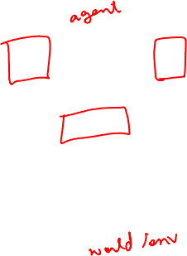
RL: Environment Interaction API
At each time step t, the agent:
  Receives observation o_{t}
  Executes action a_{t}
At each time step t, the environment:
  Receives action a_{t}
  Emits observation o_{t+1}
  Emits scalar reward r_{t+1}
Slide credit: David Silver
RL API

Slide 7
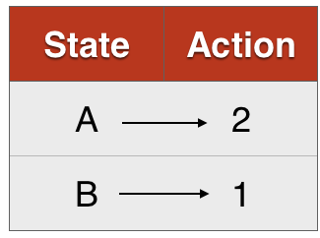
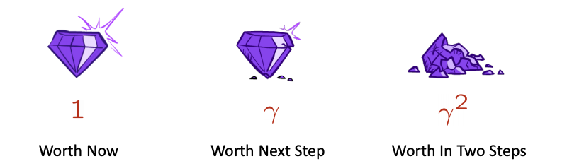

Markov Decision Processes (MDPs)
  States, Actions, Reward dist., Transition dist., Discount factor (gamma)
Policy:
  Mapping from states to actions (deterministic)
  Distribution of actions given states (stochastic)
What is a good policy?
  Maximize discounted sum of future rewards
    Discount factor:
MDP
Recap: MDPs, Policy

Slide 8
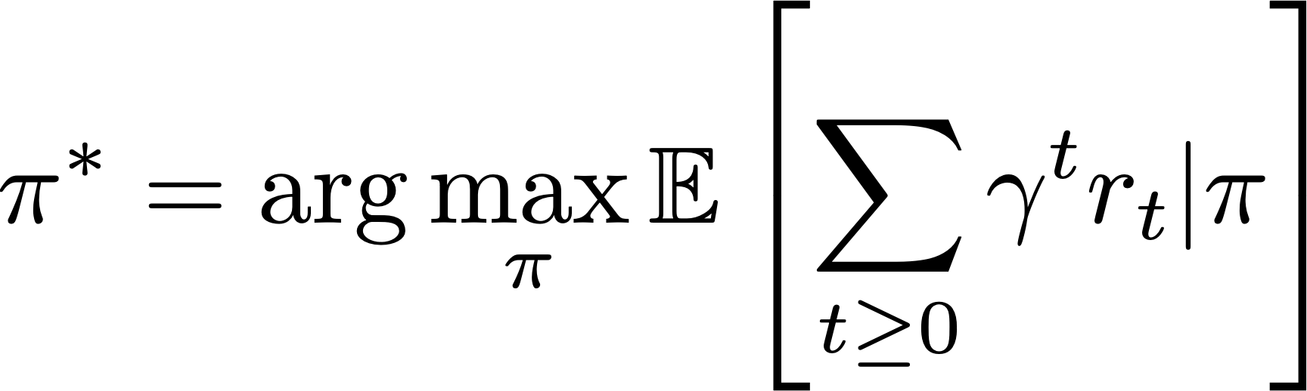
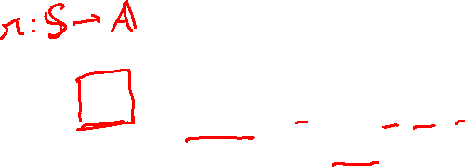
Formally, the optimal policy is defined as:
discounted sum of future rewards
Recap: Optimal policy

Slide 9
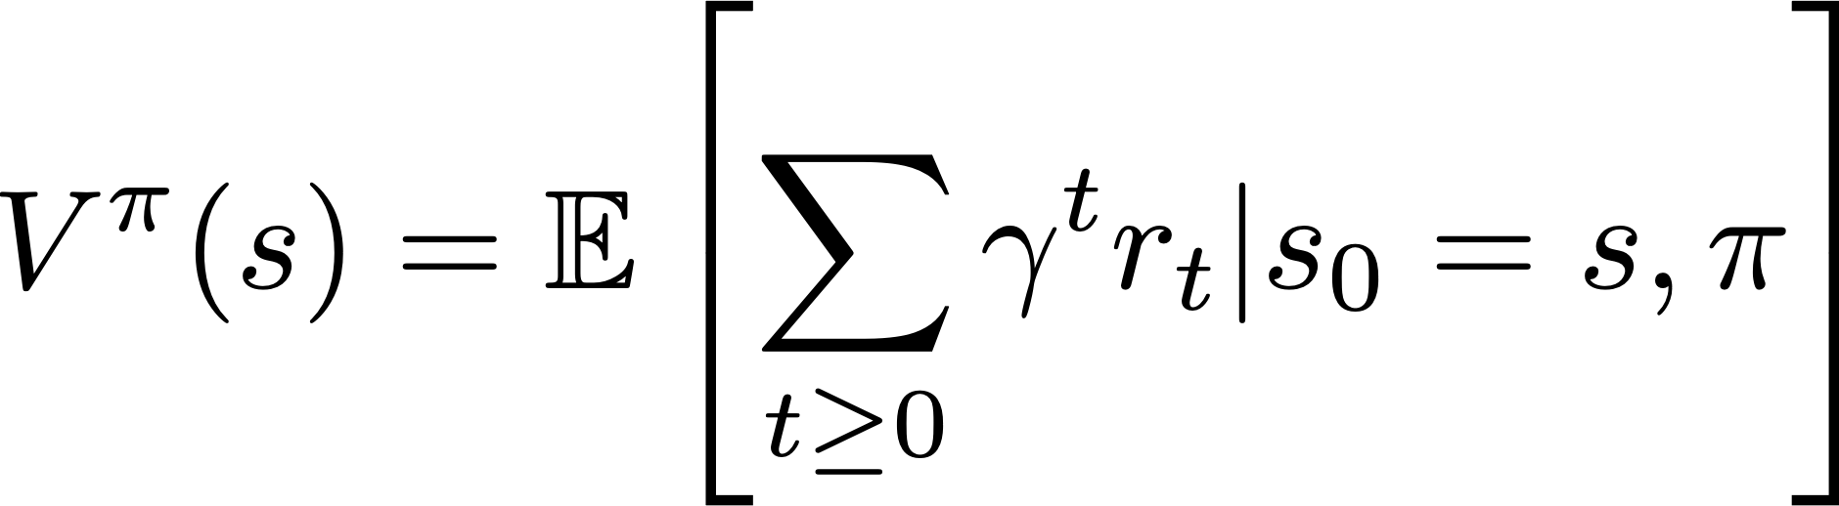
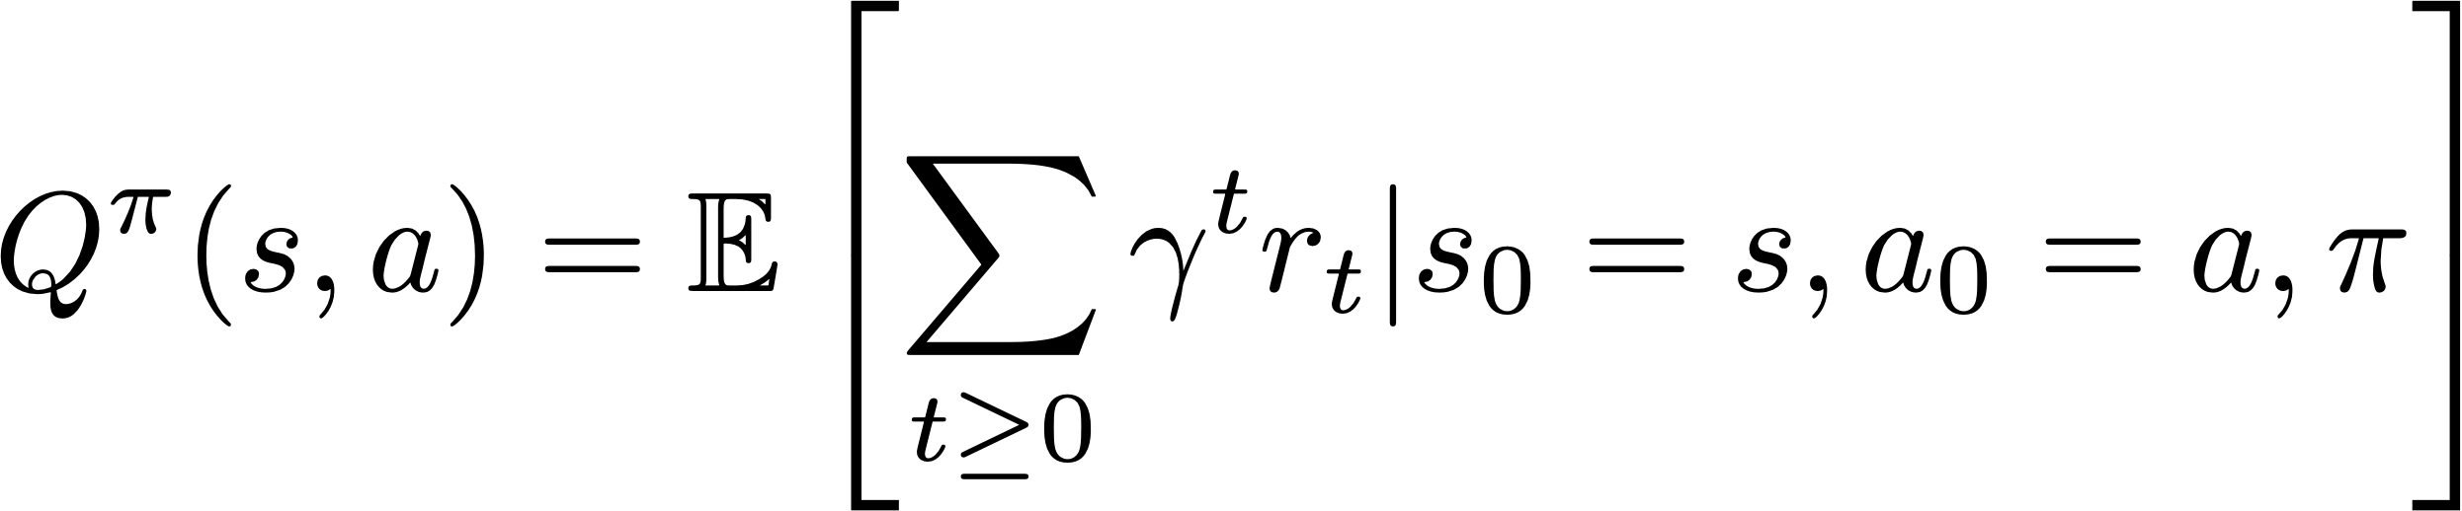
A value function is a prediction of discounted sum of future reward
State value function / V-function /
  How good is this state?
  Am I likely to win/lose the game from this state?
State-Action value function / Q-function /
  How good is this state-action pair?
  In this state, what is the impact of this action on my future?
Recap: Value Function

Slide 10
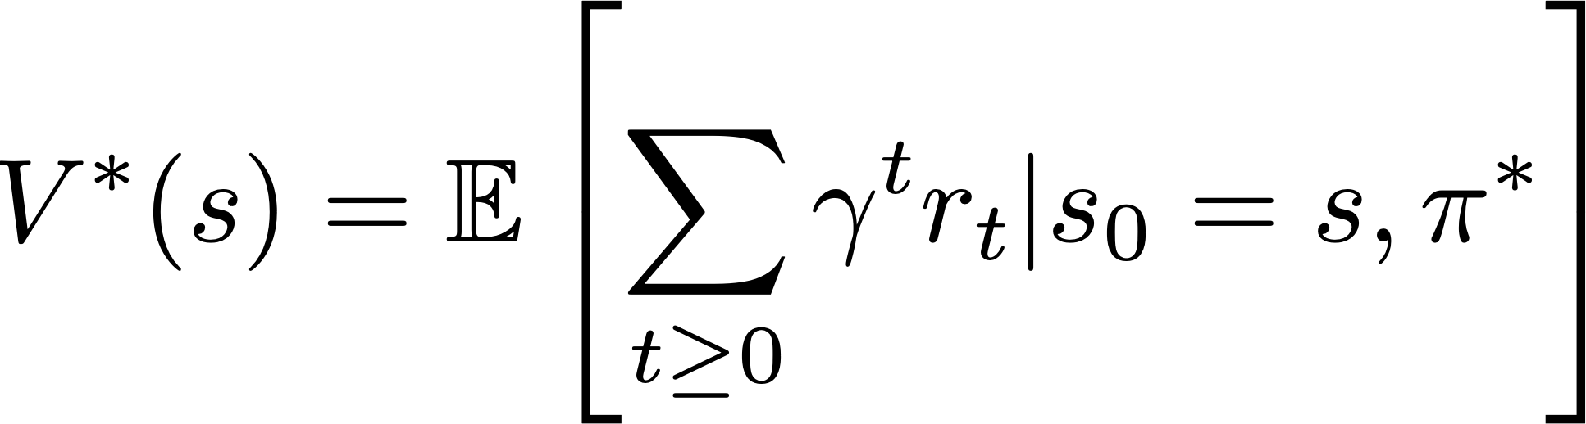
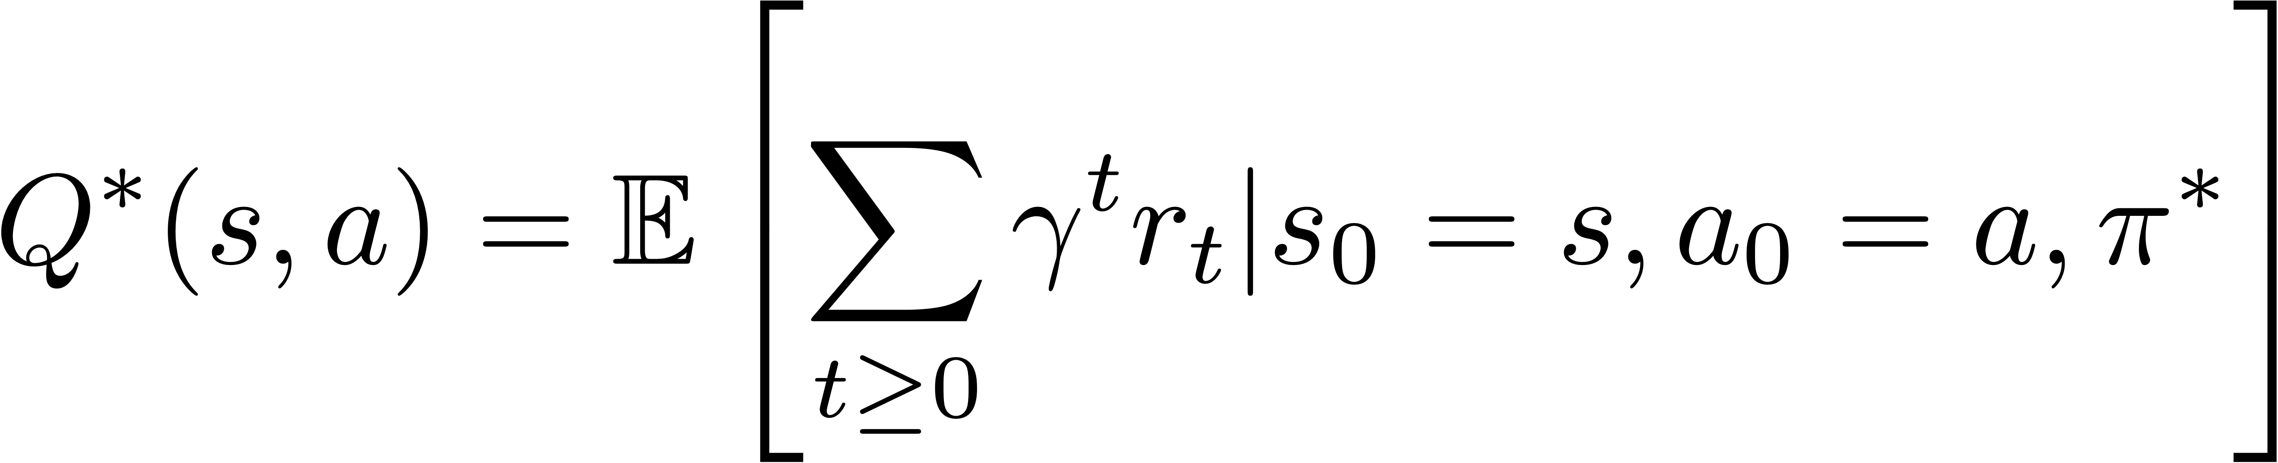
The V and Q functions corresponding to the optimal policy
Recap: Optimal V & Q functions

Slide 11
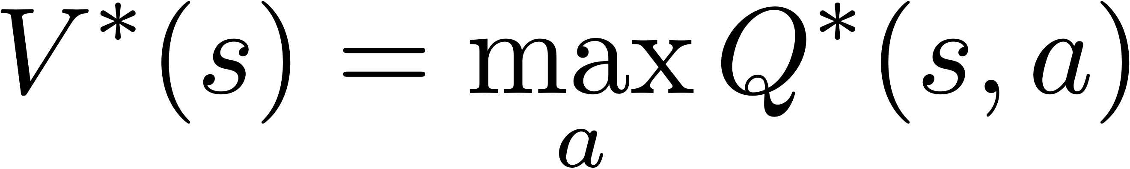
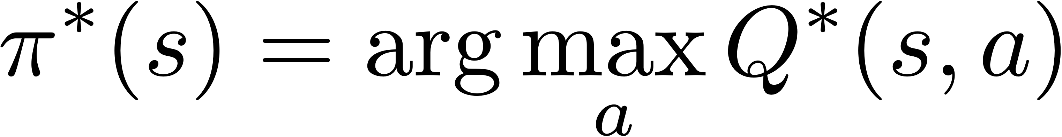
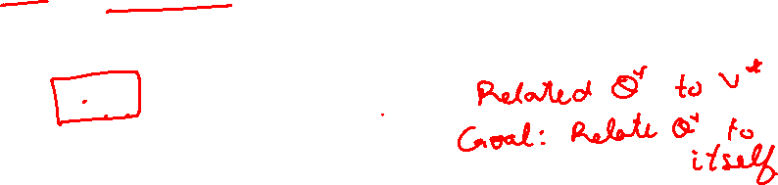
Equations relating optimal quantities
Recursive Bellman optimality equation
Recap: Bellman Optimality Equations

Slide 12
Equations relating optimal quantities
Recursive Bellman optimality equation
Recap: Bellman Optimality Equations

Slide 13
Value Iteration Update:
Q-Iteration Update:
The algorithm is same as value iteration, but it loops over actions as well as states
Recap: Q-Iteration

Slide 14
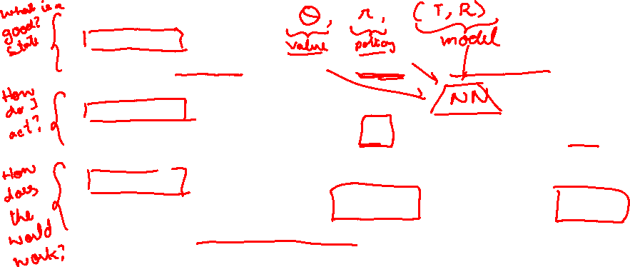
Value-based RL
  (Deep) Q-Learning, approximating with a deep Q-network
Policy-based RL
  Directly approximate optimal policy with a parametrized policy
Model-based RL
  Approximate transition function and reward function
  Solve the MDP with estimated T and R!
Recap: Algorithm Categories

Slide 15


Deep
Q-Learning

Slide 16
Assume we have collected a dataset:
We want a Q-function that satisfies bellman optimality (Q-value)
Loss for a single data point:
Predicted Q-Value
Target Q-Value
Deep Q-Learning

Slide 17
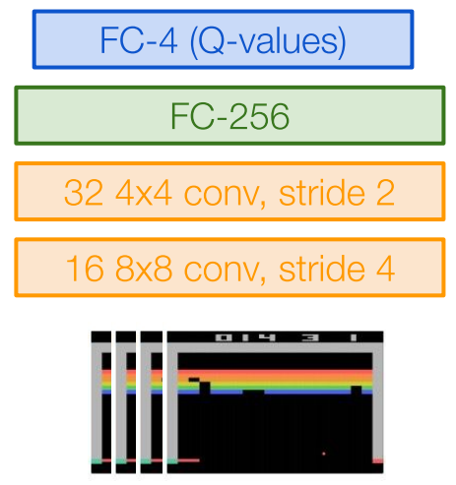
Minibatch of
Forward pass:
Compute loss:
Backward pass:
State
Q-Network
Q-Values per action
Q-Network
State
Deep Q-Learning

Slide 18
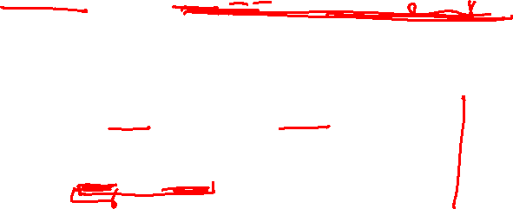
In practice, for stability:
  Freeze and update parameters
  Set at regular intervals
Deep Q-Learning

Slide 19
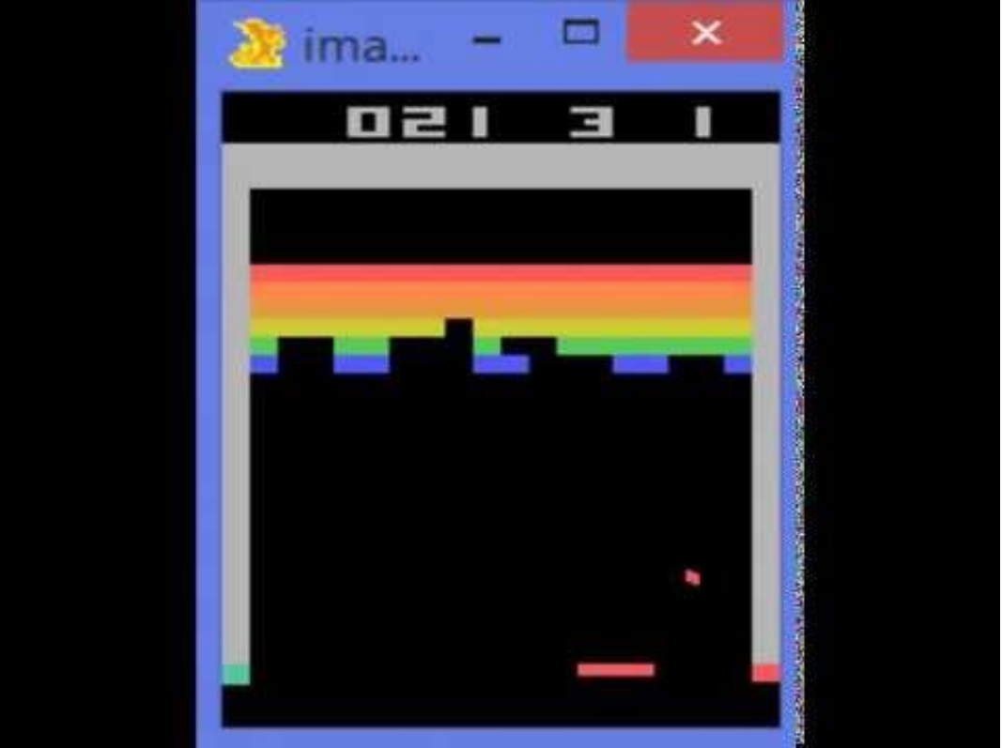
Environment
Data
Train
Update
Challenge 1: Exploration vs Exploitation
Challenge 2: Non iid, highly correlated data
How to gather experience?

Slide 20
What should be?
  Greedy? -> Local minimas, no exploration
An exploration strategy:
Exploration Problem

Slide 21
Plan for today
Value-based RL
  (Deep) Q-Learning, approximating with a deep Q-network
Policy-based RL
  Directly approximate optimal policy with a parametrized policy
Model-based RL
  Approximate transition function and reward function
  Solve the MDP with estimated T and R!

Slide 22
Policy Gradients, Actor-Critic

Slide 23
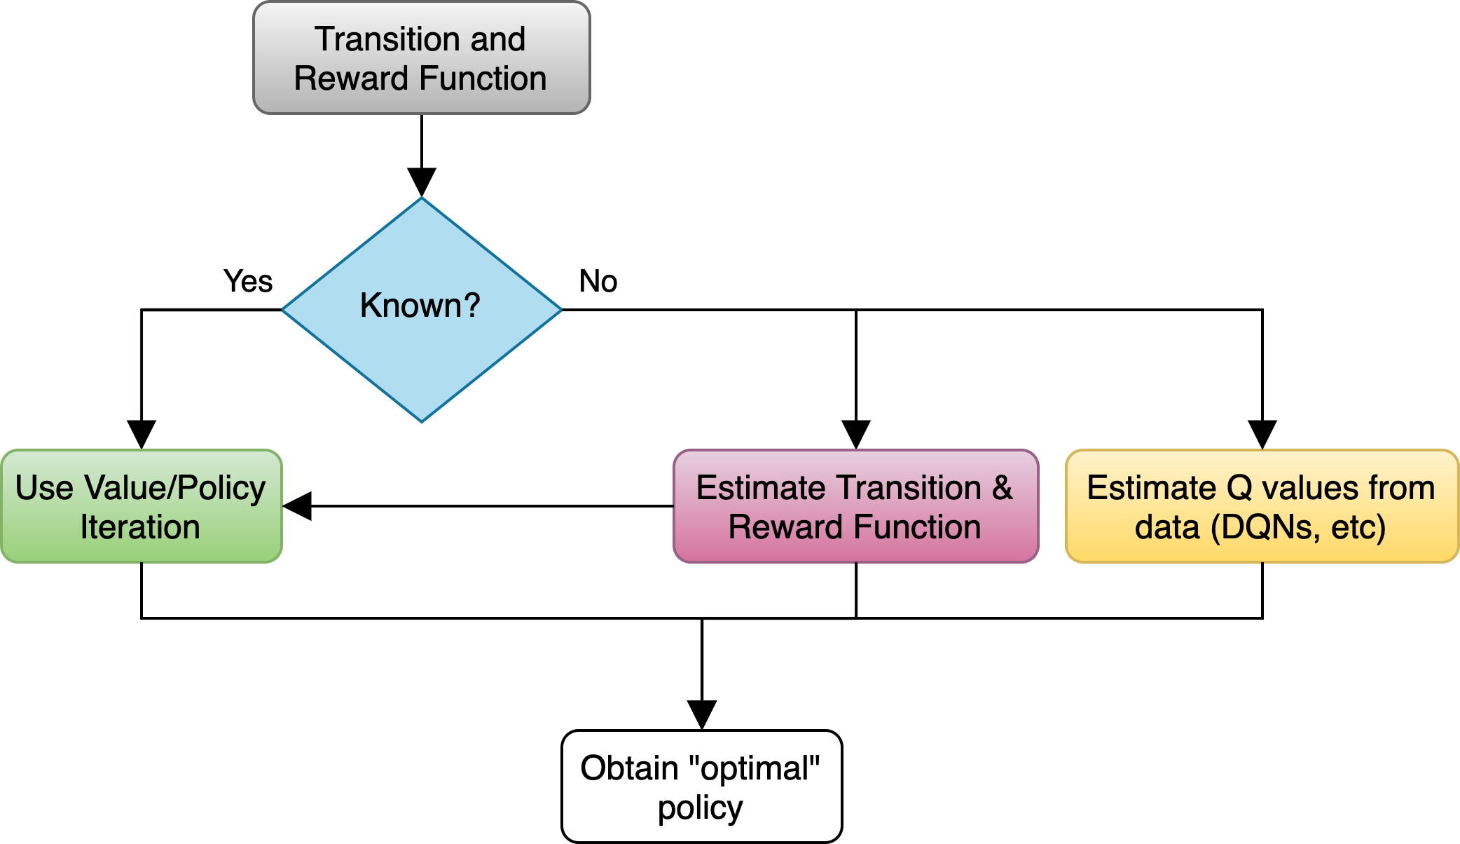
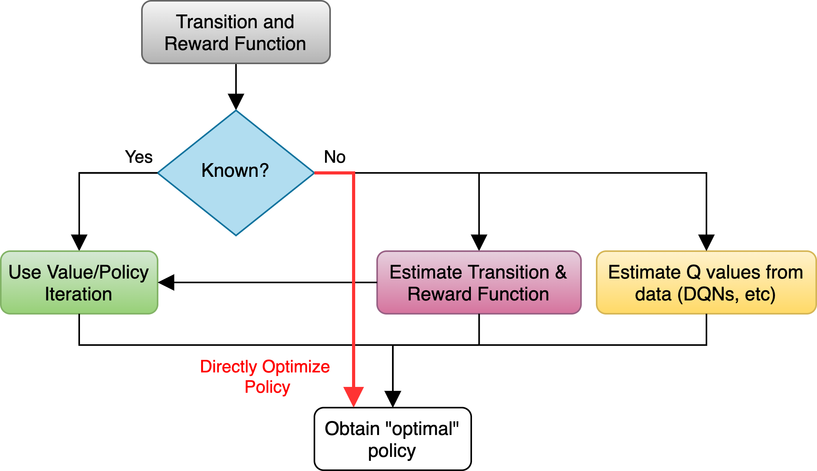
Overview

Slide 24
Class of policies defined by parameters
  Eg: can be parameters of linear transformation, deep network, etc.
Want to maximize:
In other words,
Parametrized Policy

Slide 25
Slightly re-writing the notation
Let denote a trajectory
Gathering Data/Experience

Slide 26
How to gather data?
  We already have a policy:
  Sample N trajectories by acting according to
Gathering Data/Experience

Slide 27
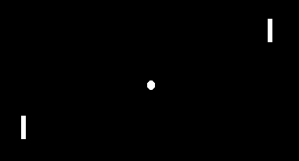
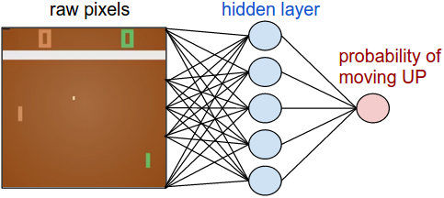
Pong from Pixels

Slide 28
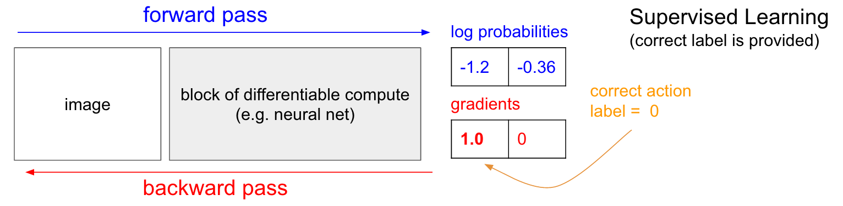
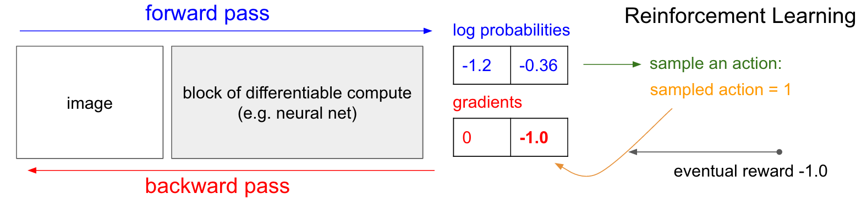
Image Source: http://karpathy.github.io/2016/05/31/rl/
Policy Gradient: Loss Function

Slide 29
Sample trajectories by acting according to
Compute policy gradient as
Update policy parameters:
Run the policy and sample trajectories
Compute policy gradient
Update policy
Slide credit: Sergey Levine
The REINFORCE Algorithm

Slide 30
Deriving The Policy Gradient

Slide 31
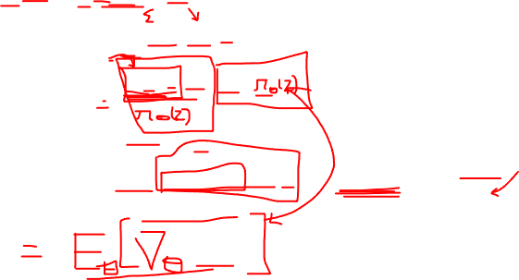
Expectation as integral
Exchange integral and gradient
Deriving The Policy Gradient

Slide 32
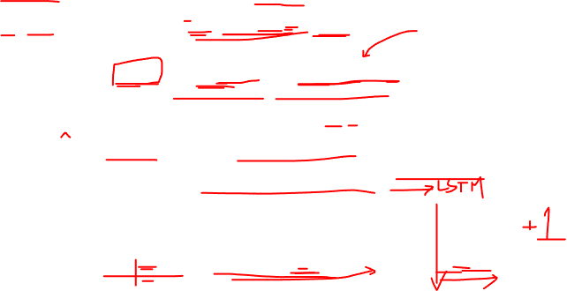
Doesn’t depend on
Transition probabilities!
Deriving The Policy Gradient

Slide 33
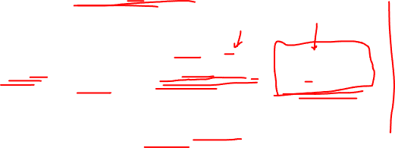
Sample trajectories by acting according to
Compute policy gradient as
Update policy parameters:
Run the policy and sample trajectories
Compute policy gradient
Update policy
Slide credit: Sergey Levine
The REINFORCE Algorithm

Slide 34
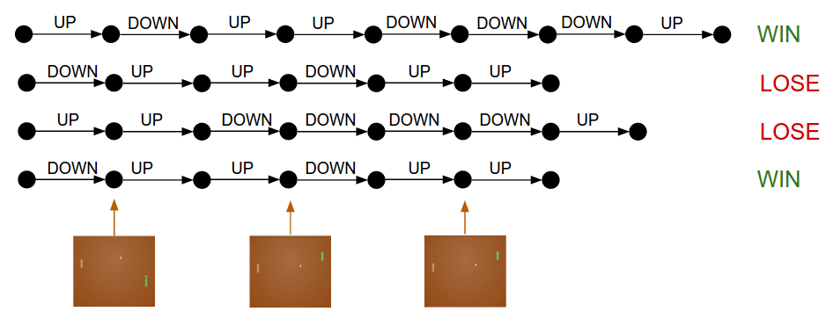
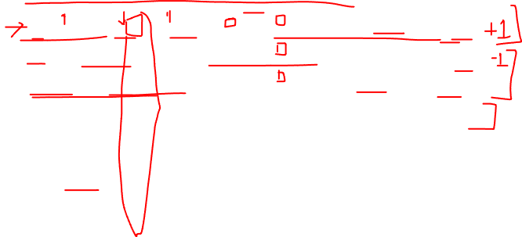
Slide credit: Dhruv Batra
Drawbacks of Policy Gradients

Slide 35
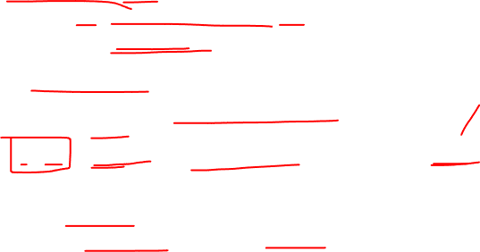
Credit assignment is hard!
  Which specific action led to increase in reward
  Suffers from high variance, leading to unstable training
How to reduce the variance?
  Subtract an action independent baseline from the reward
  Why does it work?
  What is the best choice of b?
Homework
Drawbacks of Policy Gradients

Slide 36
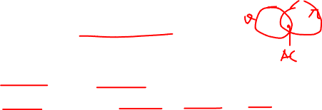
Actor Critic
Learn both policy and Q function
  Use the “actor” to sample trajectories
  Use the Q function to “evaluate” or “critic” the policy
Policy Gradient Variant: Actor Critic

Slide 37
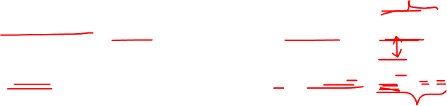
Actor Critic
Learn both policy and Q function
  Use the “actor” to sample trajectories
  Use the Q function to “evaluate” or “critic” the policy
REINFORCE:
Actor-critic:
Policy Gradient Variant: Actor Critic

Slide 38
Actor Critic
Learn both policy and Q function
  Use the “actor” to sample trajectories
  Use the Q function to “evaluate” or “critic” the policy
REINFORCE:
Actor-critic:
Q function is unknown too! Update using
Policy Gradient Variant: Actor Critic

Slide 39
Initialize s, (policy network) and (Q network)
sample action
For each step:
  Sample reward and next state
  evaluate “actor” using “critic”
  Update “critic”:
    Recall Q-learning
Policy Gradient Variant: Actor Critic

Slide 40
Initialize s, (policy network) and (Q network)
sample action
For each step:
  Sample reward and next state
  evaluate “actor” using “critic”
  Update “critic”:
    Recall Q-learning
Policy Gradient Variant: Actor Critic

Slide 41
Initialize s, (policy network) and (Q network)
sample action
For each step:
  Sample reward and next state
  evaluate “actor” using “critic”
  Update “critic”:
    Recall Q-learning
Policy Gradient Variant: Actor Critic

Slide 42
Initialize s, (policy network) and (Q network)
sample action
For each step:
  Sample reward and next state
  evaluate “actor” using “critic”
  Update “critic”:
    Recall Q-learning
Policy Gradient Variant: Actor Critic

Slide 43
Initialize s, (policy network) and (Q network)
sample action
For each step:
  Sample reward and next state
  evaluate “actor” using “critic” and update policy:
  Update “critic”:
    Recall Q-learning
Policy Gradient Variant: Actor Critic

Slide 44

Initialize s, (policy network) and (Q network)
sample action
For each step:
  Sample reward and next state
  evaluate “actor” using “critic” and update policy:
  Update “critic”:
    Recall Q-learning
Policy Gradient Variant: Actor Critic

Slide 45
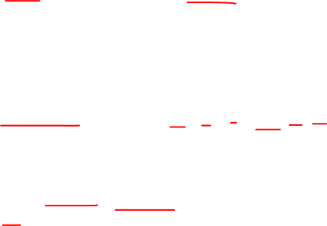
Initialize s, (policy network) and (Q network)
sample action
For each step:
  Sample reward and next state
  evaluate “actor” using “critic” and update policy:
  Update “critic”:
    Recall Q-learning
    Update Accordingly
Policy Gradient Variant: Actor Critic

Slide 46
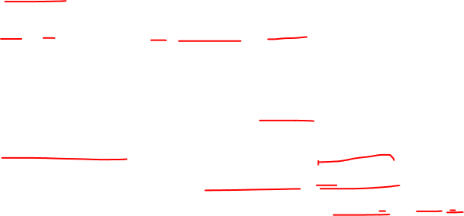
REINFORCE, use raw reward values
Actor-critic, use Q-values (learnt from data)
Advantage actor-critic, use Q minus V values (i.e. Advantage)
“how much better is an action than expected?
Policy Gradient Variants

Slide 47
Summary
Policy Learning:
  Policy gradients
  REINFORCE
  Reducing Variance (Homework!)
Actor-Critic:
  Other ways of performing “policy evaluation”
  Variants of Actor-critic

