Slide 1
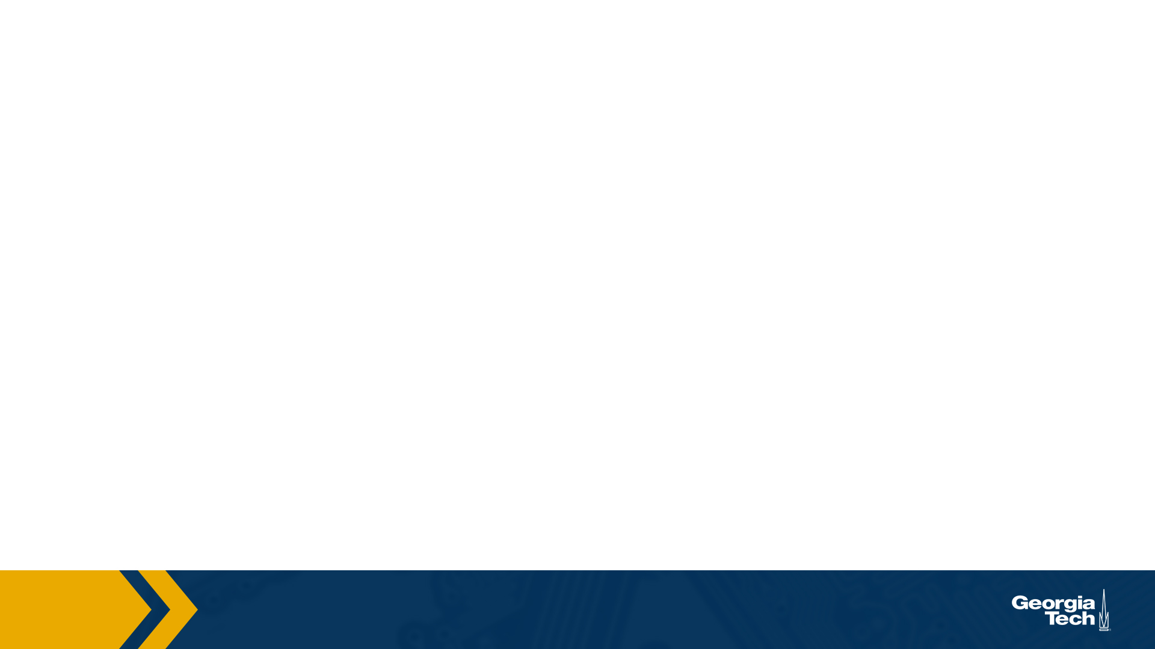
CS 4803 / 7643
Deep Learning, Fall 2021
Reinforcement Learning: Module 2/3
Slides: Nirbhay Modhe

Slide 2
Administrativia
HW5 released
  Due: 11/17, 11:59pm
  MDPs, (Deep) Reinforcement Learning.
    https://www.cc.gatech.edu/classes/AY2022/cs7643_fall/nvxGCX9GqdBkRqanv6bVQS/hw5-coding/
  Last homework of the semester.
  Focus on project after this.

Slide 3

Previous Lecture
RL: Definitions, interaction API, tasks/challenges
MDPs: Theoretical framework underlying RL, solving MDPs
Policy (continued): How an agents acts at states
Value function (Utility): How good is a particular state or state-action pair?
Today
Algorithms for solving MDPs (Value Iteration)
Departure from known rewards and transitions: Reinforcement Learning (RL), Deep RL
Recap & Overview

Slide 4
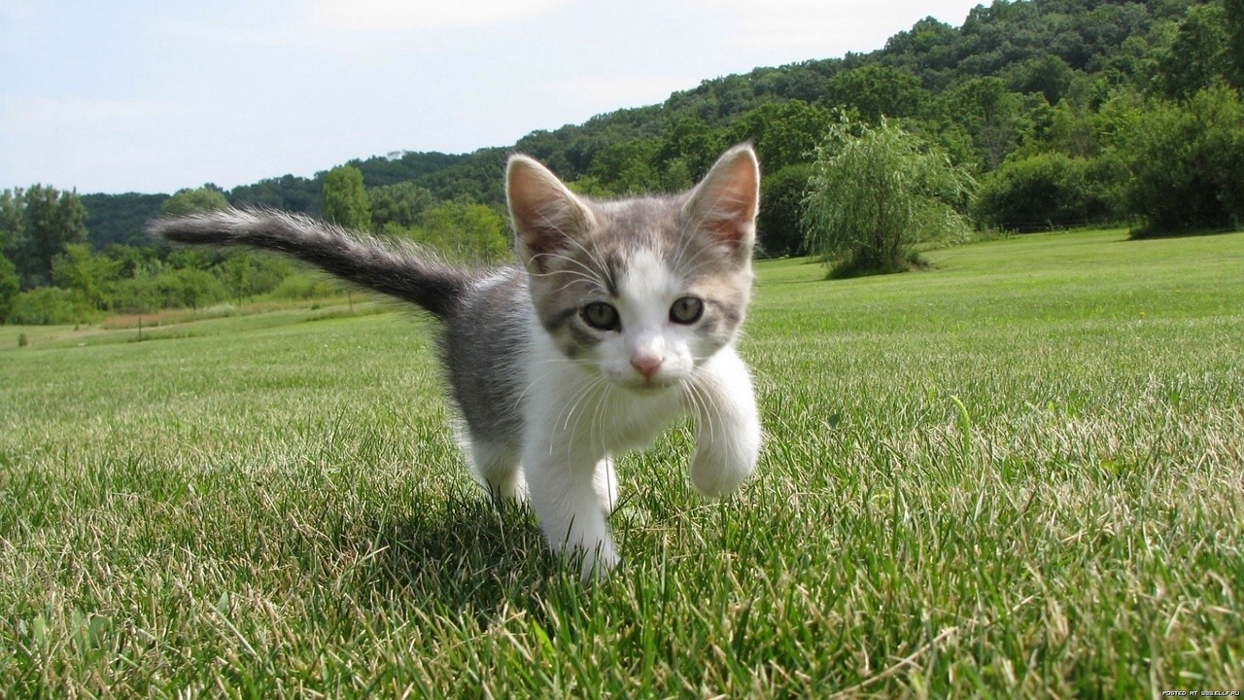
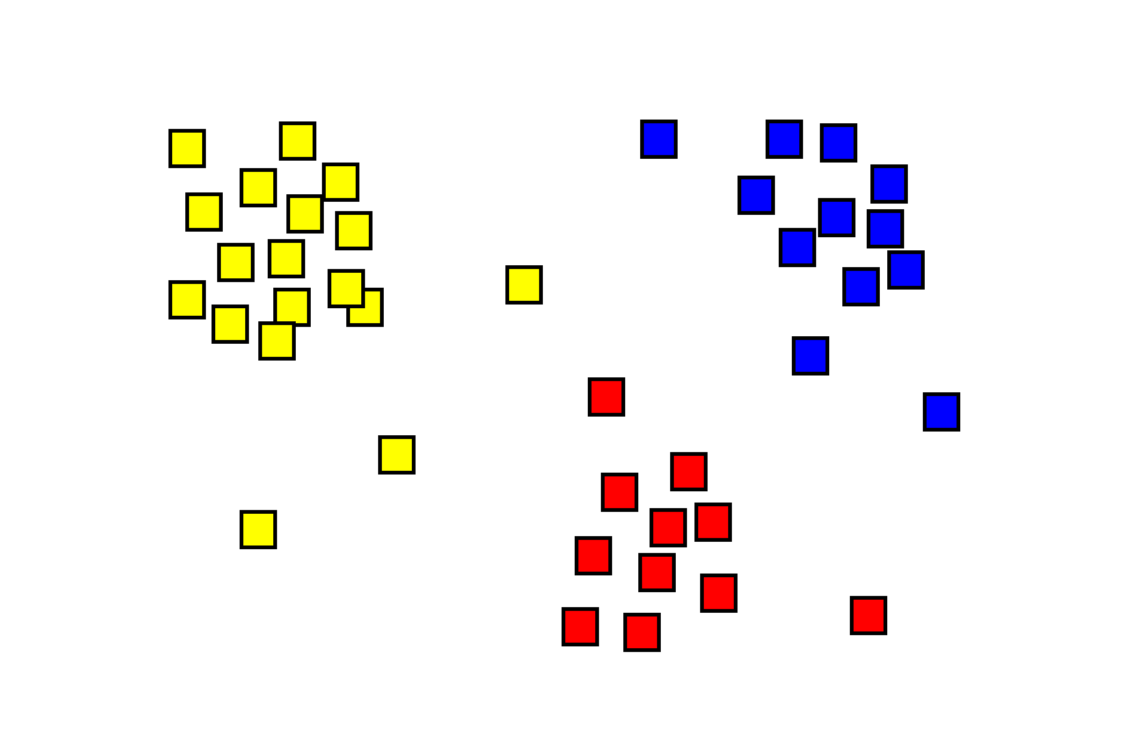
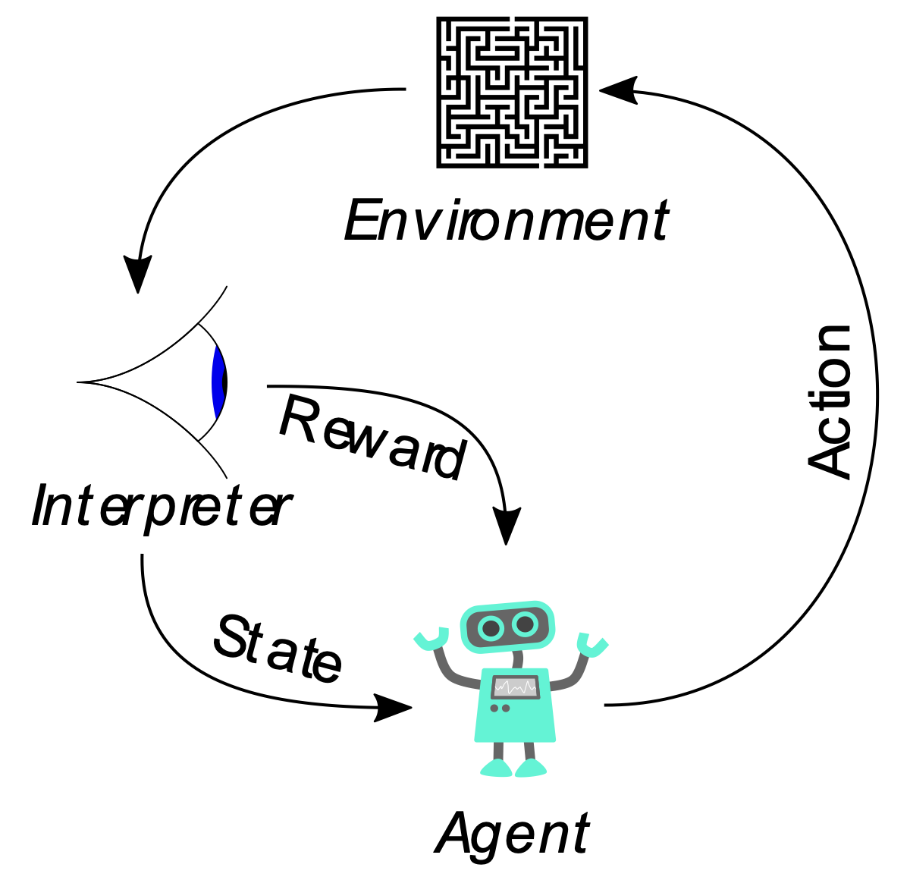
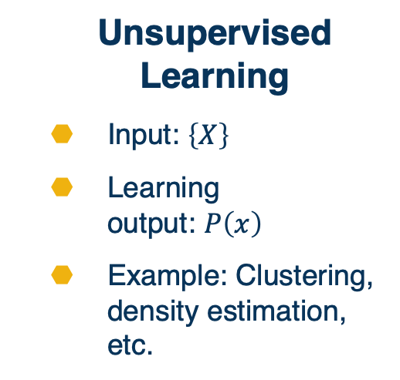
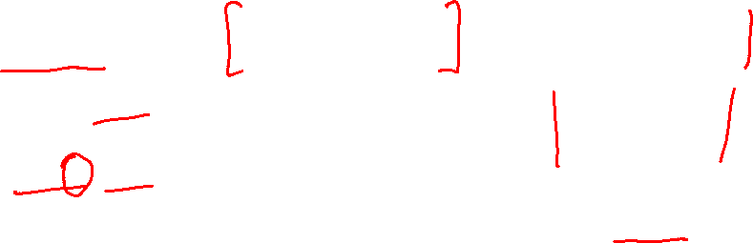
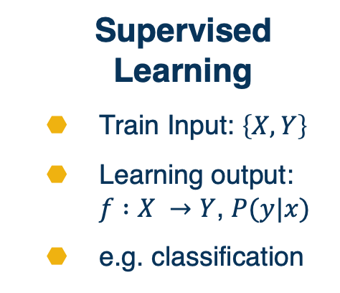
Supervised Learning
Train Input: $\left\{X,Y\right\}$
Learning output: $f :X →Y$, $P(y|x)$
e.g. classification
Unsupervised Learning
Input: $\left\{X\right\}$
Learning
output: $P\left(x\right)$
Example: Clustering, density estimation, etc.
Reinforcement Learning
Evaluative feedback in the form of reward
No supervision on the right action
Sheep
Dog
Cat
Lion
Giraffe
Types of Machine Learning
Notes:
We will focus on supervised learning for foundational concepts

Slide 5
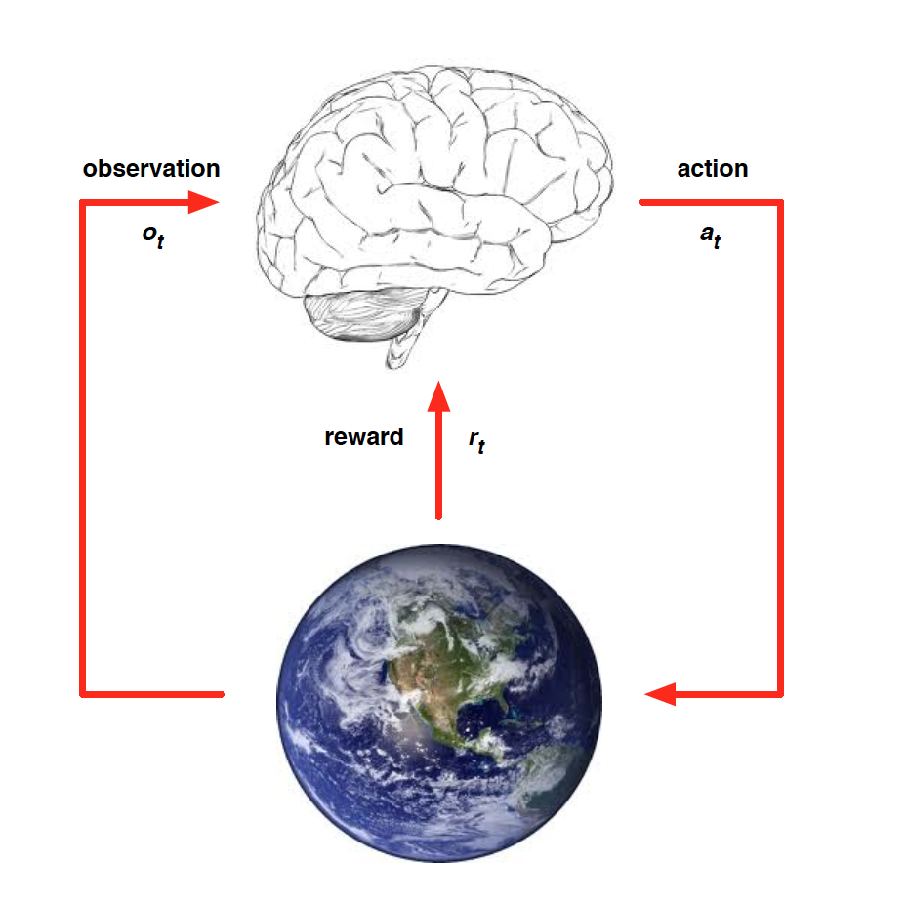
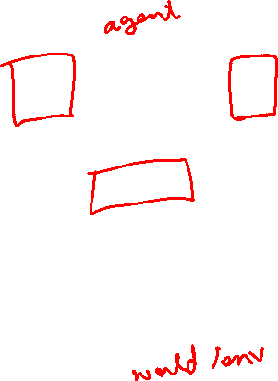
RL: Environment Interaction API
At each time step t, the agent:
  Receives observation o_{t}
  Executes action a_{t}
At each time step t, the environment:
  Receives action a_{t}
  Emits observation o_{t+1}
  Emits scalar reward r_{t+1}
Slide credit: David Silver
RL API

Slide 6
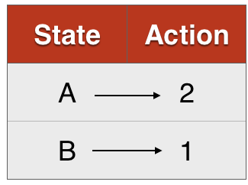
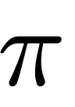
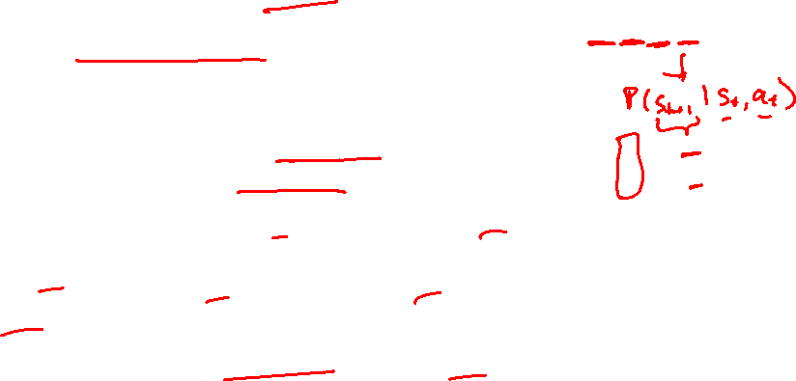
Markov Decision Processes (MDPs)
  States, Actions, Reward dist., Transition dist., Discount factor (gamma)
Policy:
  Mapping from states to actions (deterministic)
  Distribution of actions given states (stochastic)
MDP
Deterministic
Stochastic
Recap: MDPs, Policy

Slide 7
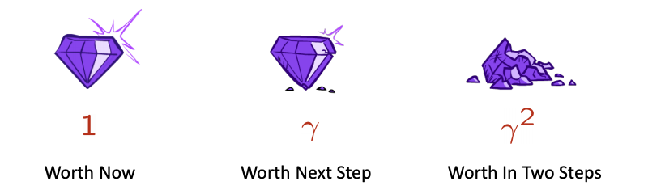

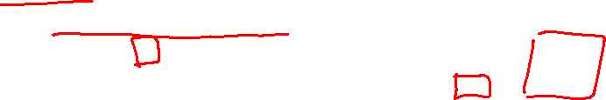
Markov Decision Processes (MDPs)
  States, Actions, Reward dist., Transition dist., Discount factor (gamma)
Policy:
  Mapping from states to actions (deterministic)
  Distribution of actions given states (stochastic)
What is a good policy?
  Maximize discounted sum of future rewards
    Discount factor:
MDP
Recap: MDPs, Policy

Slide 8
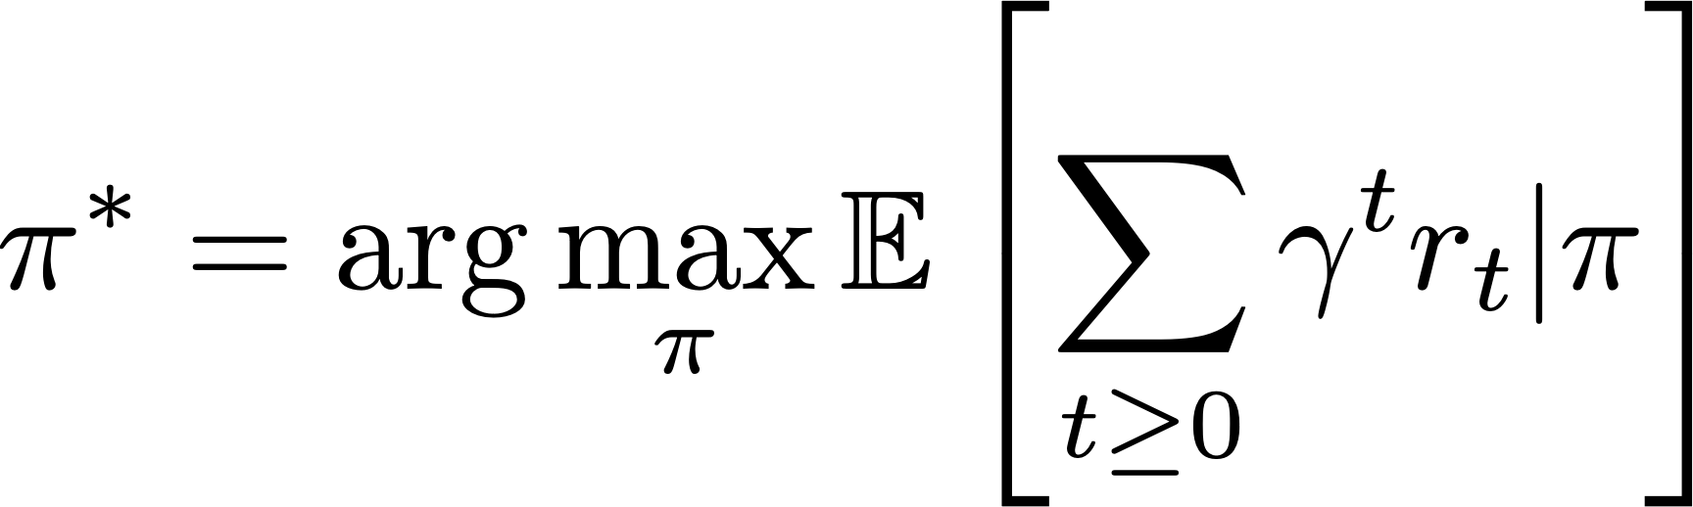
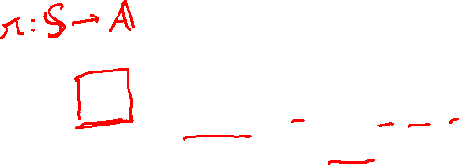
Formally, the optimal policy is defined as:
discounted sum of future rewards
Solving MDPs: Optimal policy

Slide 9
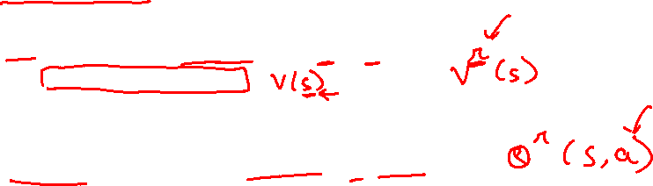
A value function is a prediction of discounted sum of future reward
State value function / V-function /
  How good is this state?
  Am I likely to win/lose the game from this state?
State-Action value function / Q-function /
  How good is this state-action pair?
  In this state, what is the impact of this action on my future?
Value Function

Slide 10
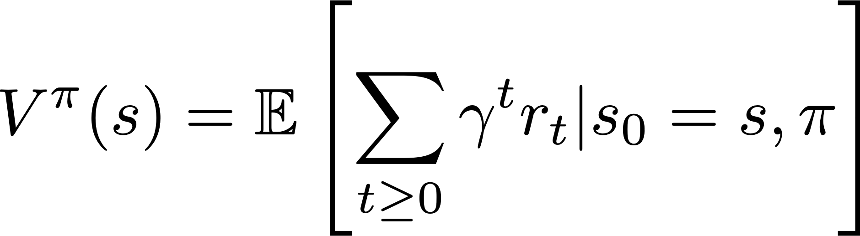

For a policy that produces a trajectory sample
The V-function of the policy at state s, is the expected cumulative reward from state s:
Value Function

Slide 11
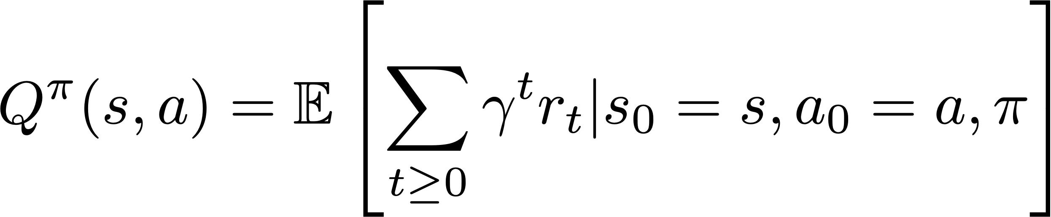
For a policy that produces a trajectory sample
The Q-function of the policy at state s and action a, is the expected cumulative reward upon taking action a in state s (and following policy thereafter):
Action-Value Function

Slide 12
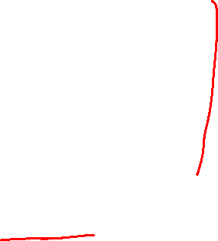
Previous Lecture
RL: Definitions, interaction API, tasks/challenges
MDPs: Theoretical framework underlying RL, solving MDPs
Policy (continued): How an agents acts at states
Value function (Utility): How good is a particular state or state-action pair?
Today
Algorithms for solving MDPs (Value Iteration)
Departure from known rewards and transitions: Reinforcement Learning (RL), Deep RL
Recap & Overview

Slide 13
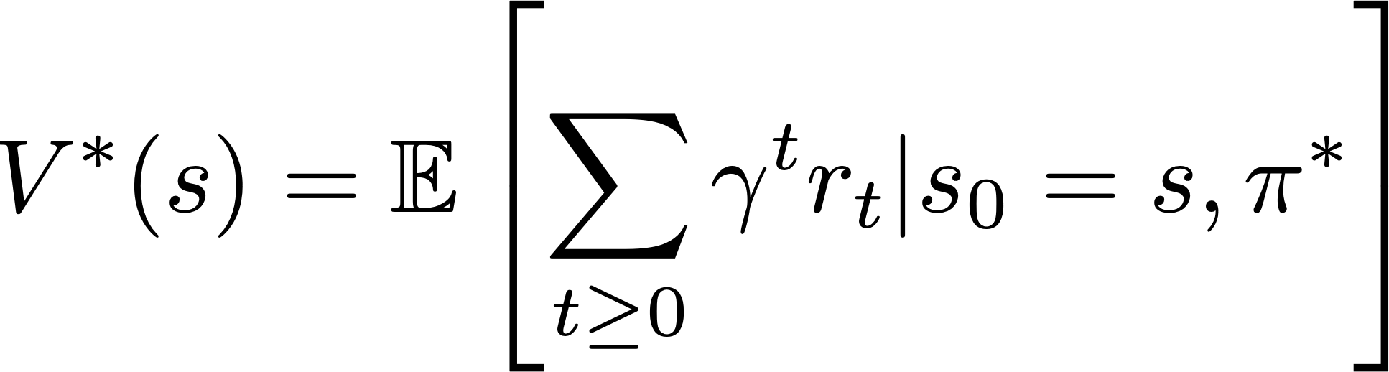
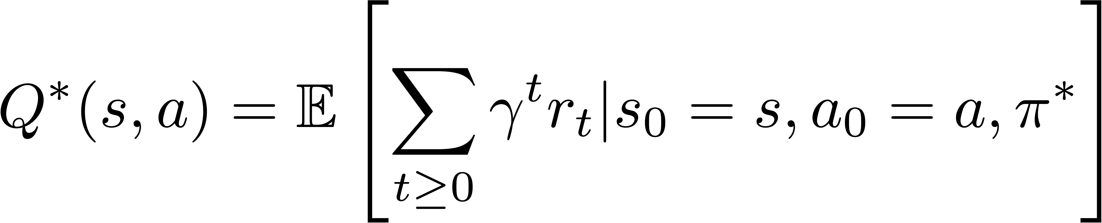
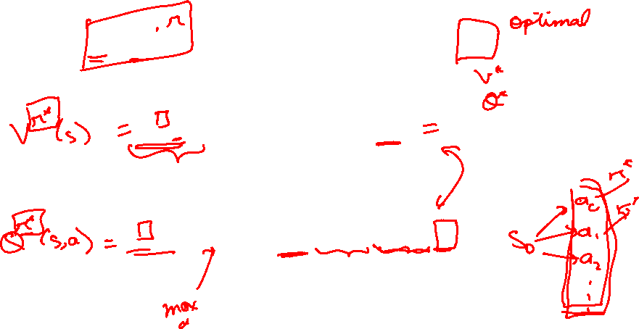
The V and Q functions corresponding to the optimal policy
Optimal V & Q functions

Slide 14
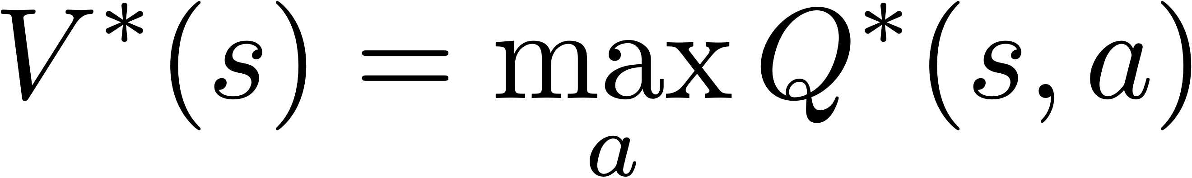
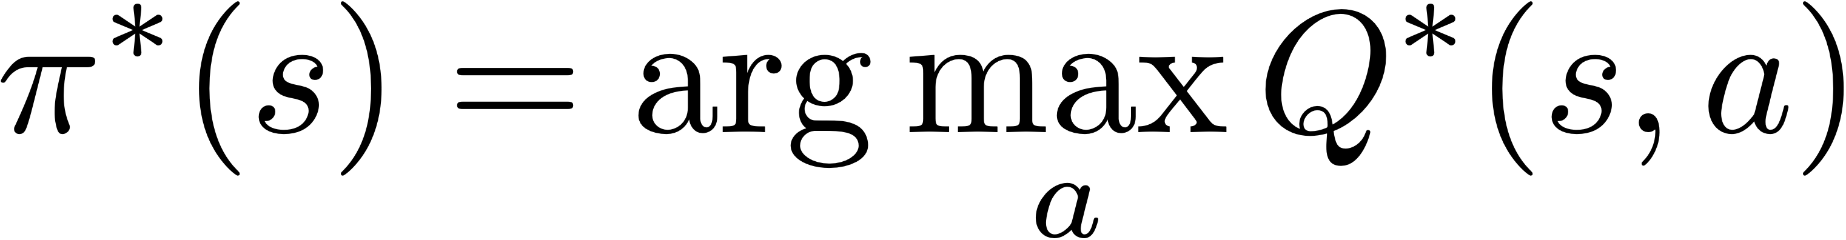
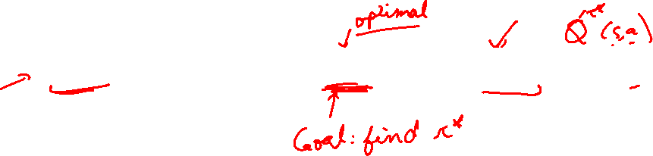
Equations relating optimal quantities
Bellman Optimality Equations

Slide 15
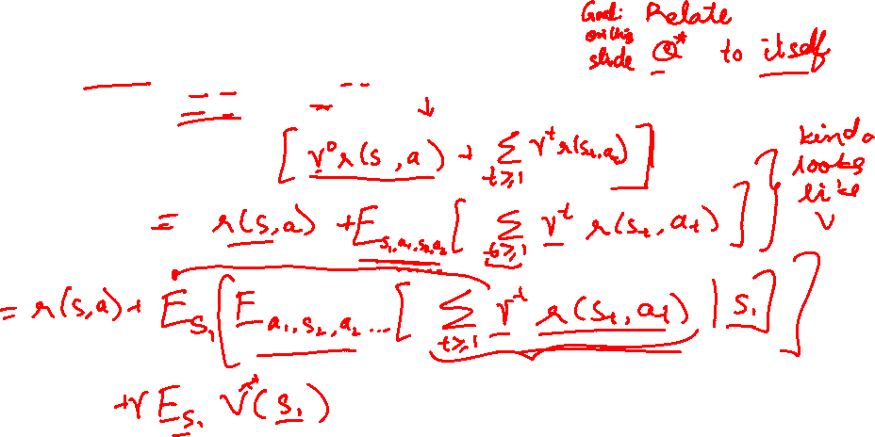
Recursive Bellman expansion (from definition of Q)
Bellman Optimality Equations

Slide 16
Recursive Bellman expansion (from definition of Q)
Bellman Optimality Equations

Slide 17
Recursive Bellman expansion (from definition of Q)
(Expected) return from t = 0
(Reward at t = 0) + gamma * (Return from expected state at t=1)
Bellman Optimality Equations

Slide 18
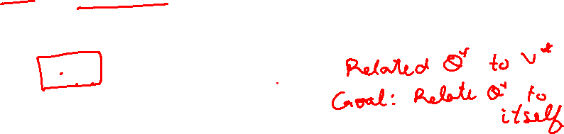
Equations relating optimal quantities
Recursive Bellman optimality equation
Bellman Optimality Equations

Slide 19
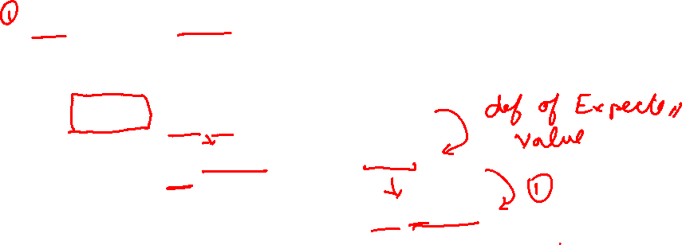
Equations relating optimal quantities
Recursive Bellman optimality equation
Bellman Optimality Equations

Slide 20
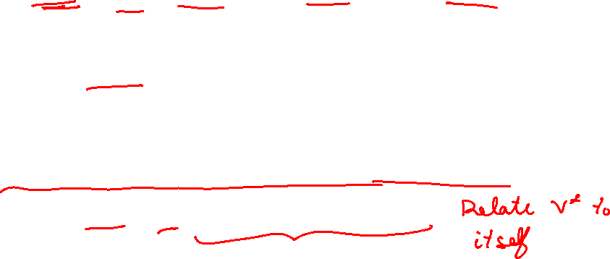
Equations relating optimal quantities
Recursive Bellman optimality equation
Bellman Optimality Equations

Slide 21
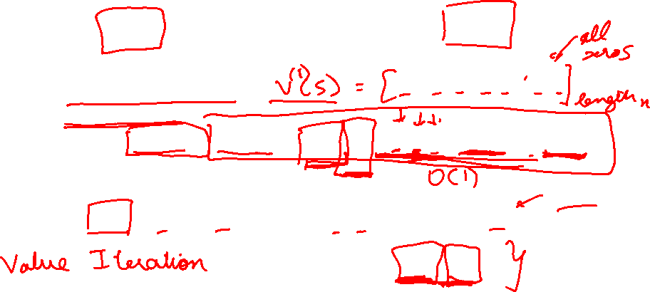
Based on the bellman optimality equation
Algorithm
Initialize values of all states
While not converged:
  For each state:
Repeat until convergence (no change in values)
Homework
Time complexity per iteration
Value Iteration

Slide 22
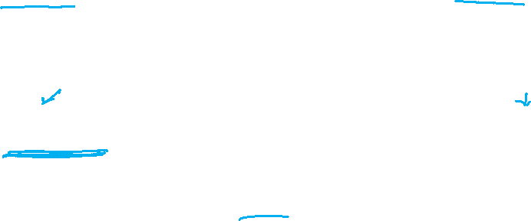
Value Iteration Update:
Q-Iteration Update:
The algorithm is same as value iteration, but it loops over actions as well as states
Q-Iteration

Slide 23
Dynamic Programming Demo
  https://cs.stanford.edu/people/karpathy/reinforcejs/gridworld_dp.html
Learning Based Methods: RL

Slide 24
Policy iteration: Start with arbitrary and refine it.
Involves repeating two steps:
  Policy Evaluation: Compute (similar to Value Iteration)
  Policy Refinement: Greedily change actions as per
Why do policy iteration?
  often converges to much sooner than to
Policy Iteration

Slide 25
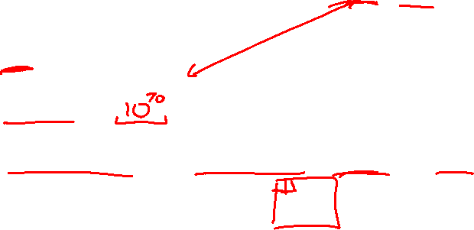
For Value Iteration:
3x4 Grid world?
Chess/Go?
Atari Games with integer image pixel values [0, 255] of size 16x16 as state?
Time complexity per iteration
State Spaces & Time Complexity

Slide 26
Value Iteration
  Bellman update to state value estimates
Q-Value Iteration
  Bellman update to (state, action) value estimates
Policy Iteration
  Policy evaluation + refinement
Summary: MDP Algorithms

Slide 27


Reinforcement Learning, Deep RL

Slide 28
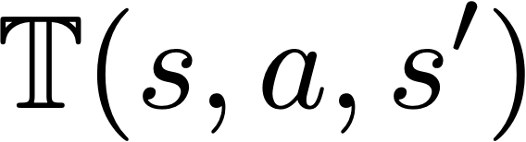
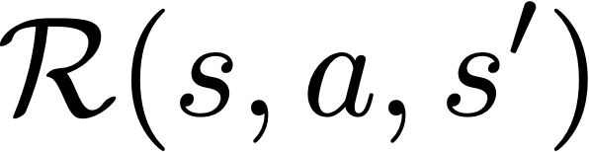
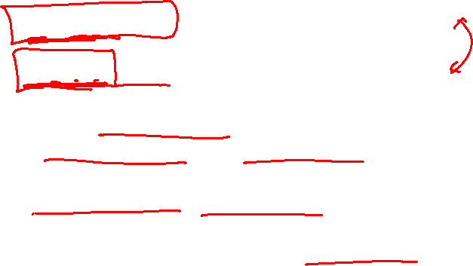
Recall RL assumptions:
  unknown, how actions affect the environment.
  unknown, what/when are the good actions?
But, we can learn by trial and error.
  Gather experience (data) by performing actions.
  Approximate unknown quantities from data.
Reinforcement Learning
Learning Based Methods: RL

Slide 29
Old Dynamic Programming Demo
  https://cs.stanford.edu/people/karpathy/reinforcejs/gridworld_dp.html
RL Demo
  https://cs.stanford.edu/people/karpathy/reinforcejs/gridworld_td.html
Learning Based Methods: RL

Slide 30
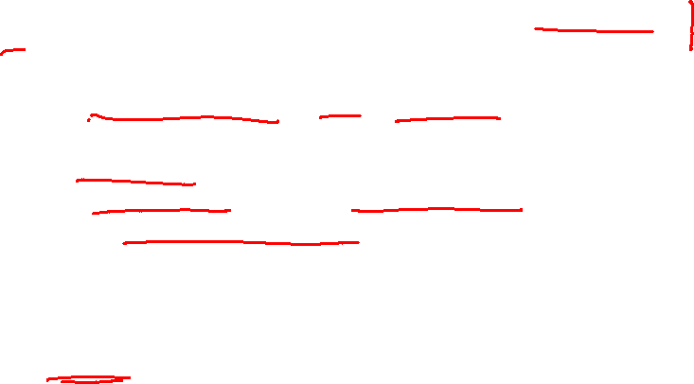
In addition to not knowing the environment, sometimes the state space is too large.
Recall: Value iteration not scalable (chess, RGB images as state space, etc)
Solution: Deep Learning! … more precisely, function approximation.
  Use deep neural networks to learn state representations
  Useful for continuous action spaces as well
Deep Reinforcement Learning
Learning Based Methods: Deep RL

Slide 31
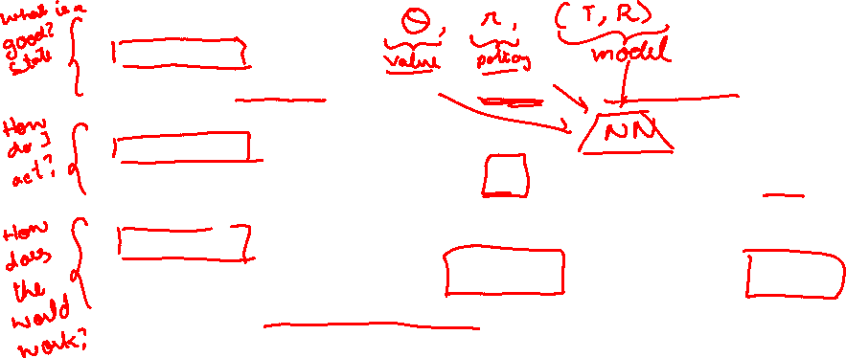
Value-based RL
  (Deep) Q-Learning, approximating with a deep Q-network
Policy-based RL
  Directly approximate optimal policy with a parametrized policy
Model-based RL
  Approximate transition function and reward function
  Solve the MDP with estimated T and R!
Homework
RL: Algorithm Categories

Slide 32

Deep
Q-Learning

Slide 33
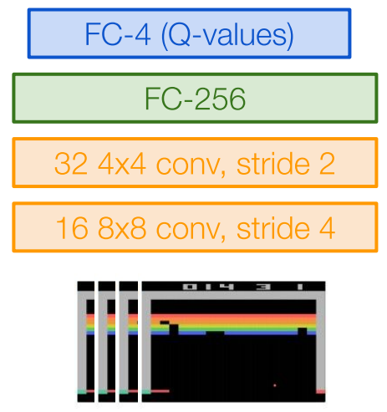
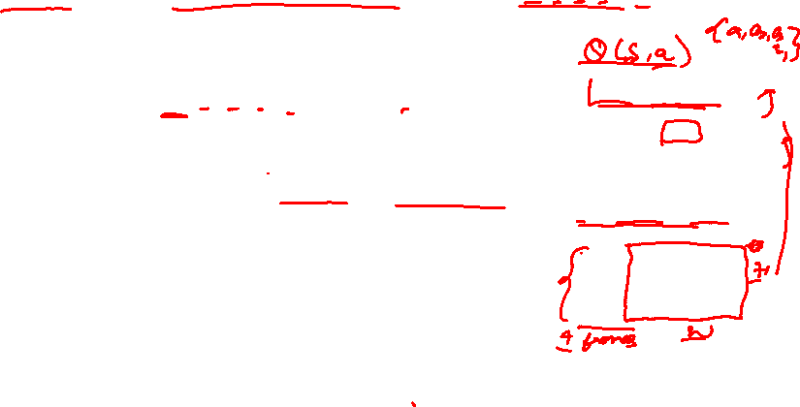
Intuition: Learn a parametrized Q-function from data
Q-Learning with linear function approximators
Deep Q-Learning: Fit a deep Q-Network
  Works well in practice
  Q-Network can take RGB images
Image Credits: Fei-Fei Li, Justin Johnson,
Serena Yeung, CS 231n
Deep Q-Learning

Slide 34
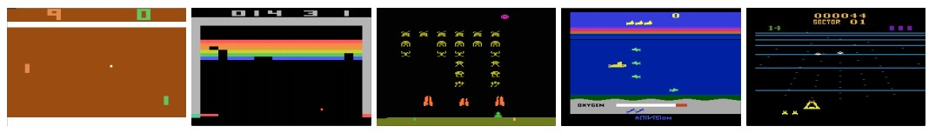
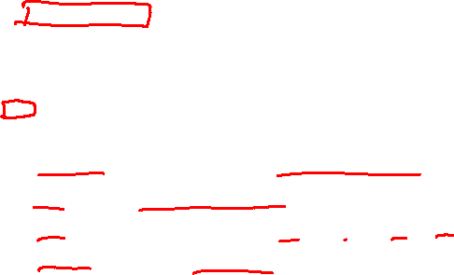
Atari Games
Objective: Complete the game with the highest score
State: Raw pixel inputs of the game state
Action: Game controls e.g. Left, Right, Up, Down
Reward: Score increase/decrease at each time step
Figures copyright Volodymyr Mnih et al., 2013. Reproduced with permission.
Slide Credit: Fei-Fei Li, Justin Johnson, Serena Yeung, CS 231n
Case study: Playing Atari Games

Slide 35
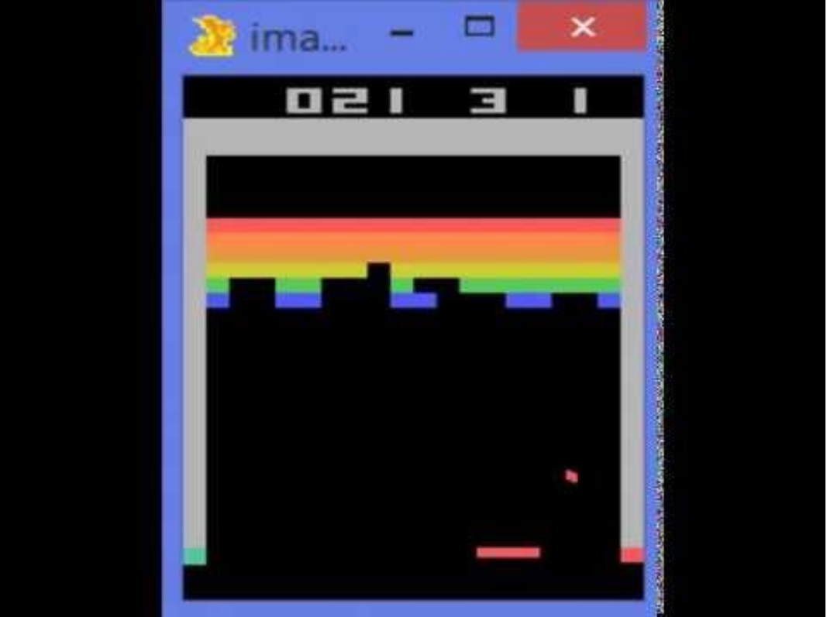
Atari Games
https://www.youtube.com/watch?v=V1eYniJ0Rnk
Slide Credit: Fei-Fei Li, Justin Johnson, Serena Yeung, CS 231n
Case study: Playing Atari Games

Slide 36
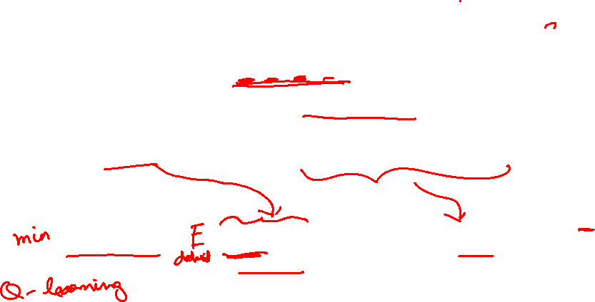
Assume we have collected a dataset:
We want a Q-function that satisfies bellman optimality (Q-value)
Loss for a single data point:
Predicted Q-Value
Target Q-Value
Deep Q-Learning

Slide 37
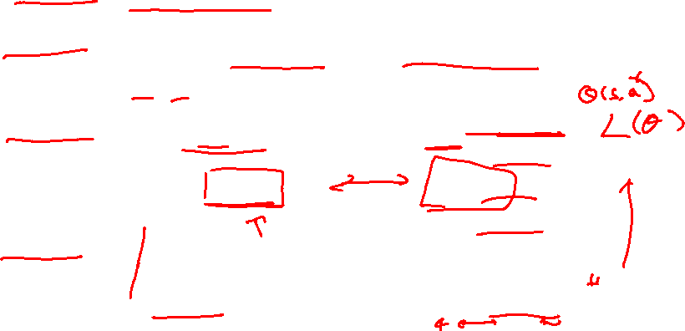
Minibatch of
Forward pass:
Compute loss:
Backward pass:
State
Q-Network
Q-Values per action
Q-Network
State
Deep Q-Learning

Slide 38
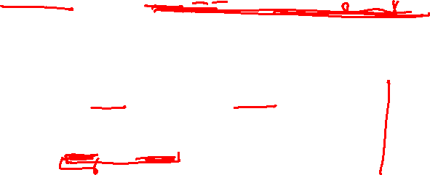
In practice, for stability:
  Freeze and update parameters
  Set at regular intervals
Deep Q-Learning

Slide 39
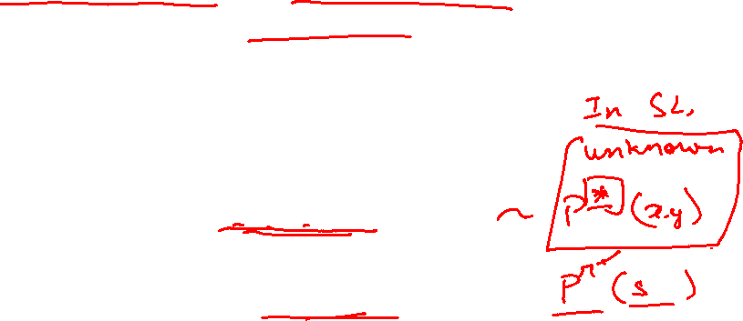
Assuming a fixed dataset, the MSE Loss can be optimized
  This is known as the Fitted Q-Iteration algorithm
However…
How to gather experience or “data”?
This is why RL is hard
Deep Q-Learning

Slide 40
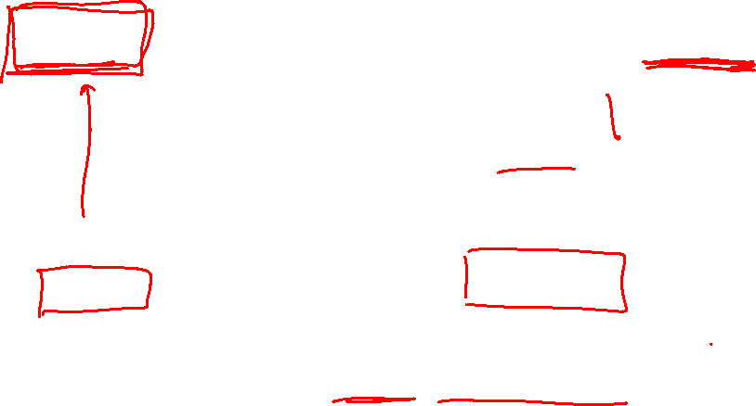
Environment
Data
Train
Update
Challenge 1: Exploration vs Exploitation
Challenge 2: Non iid, highly correlated data
How to gather experience?

Slide 41
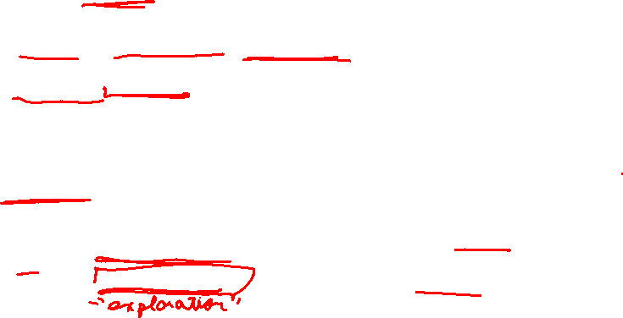
What should be?
  Greedy? -> Local minimas, no exploration
An exploration strategy:
Exploration Problem

Slide 42
Samples are correlated => high variance gradients => inefficient learning
Current Q-network parameters determines next training samples => can lead to bad feedback loops
  e.g. if maximizing action is to move right, training samples will be dominated by samples going right, may fall into local minima
R=10 |  |  |  | R=1
Correlated Data Problem

Slide 43
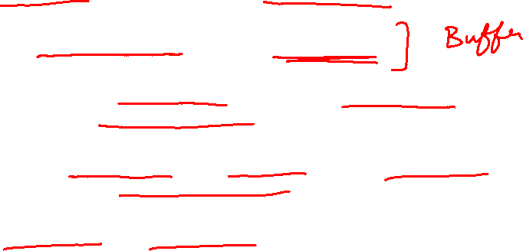
Correlated data: addressed by using experience replay
  A replay buffer stores transitions
  Continually update replay buffer as game (experience) episodes are played, older samples discarded
  Train Q-network on random minibatches of transitions from the replay memory, instead of consecutive samples
Larger the buffer, lower the correlation
Experience Replay

Slide 44

Experience Replay
Epsilon-greedy
Q Update
Source: Mnih, Volodymyr, et al. "Playing atari with deep reinforcement learning."
Deep Q-Learning Algorithm

Slide 45

In today’s class, we looked at
Dynamic Programming
  Value, Q-Value Iteration
  Policy Iteration
Reinforcement Learning (RL)
  The challenges of (deep) learning based methods
  Value-based RL algorithms
    Deep Q-Learning
Next class:
Policy-based RL algorithms (policy gradients)
Summary

