Slide 1
CS 4803 / 7643: Deep Learning
Topics:
Reinforcement Learning
Basic concepts
Dhruv Batra
Georgia Tech

Slide 2
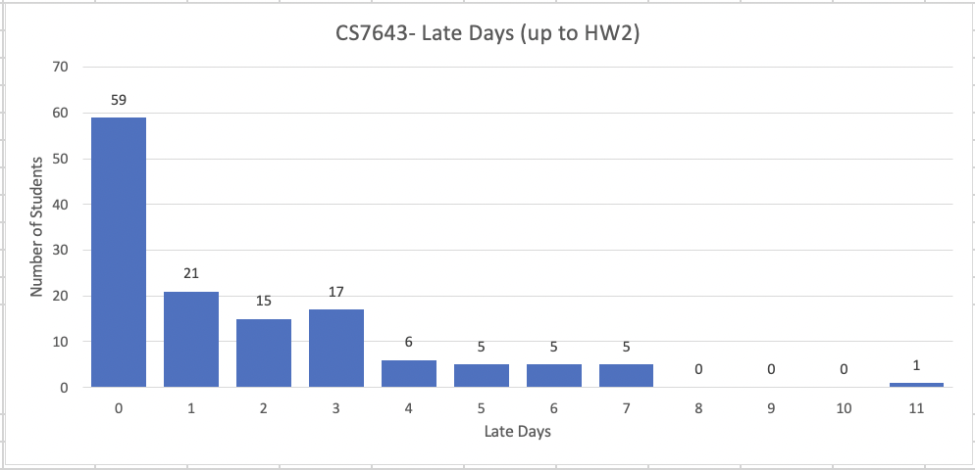
Late Day Usage

Slide 3
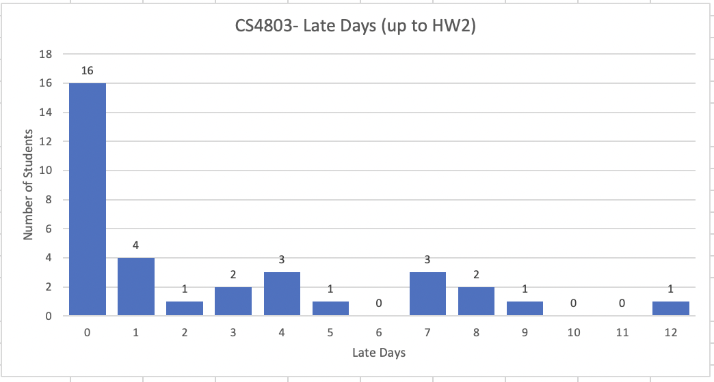
Late Day Usage

Slide 4
Administrativia
HW4 due
Due: 11/03, 11:59pm
RNNs, LSTMs, Transformers.

Slide 5
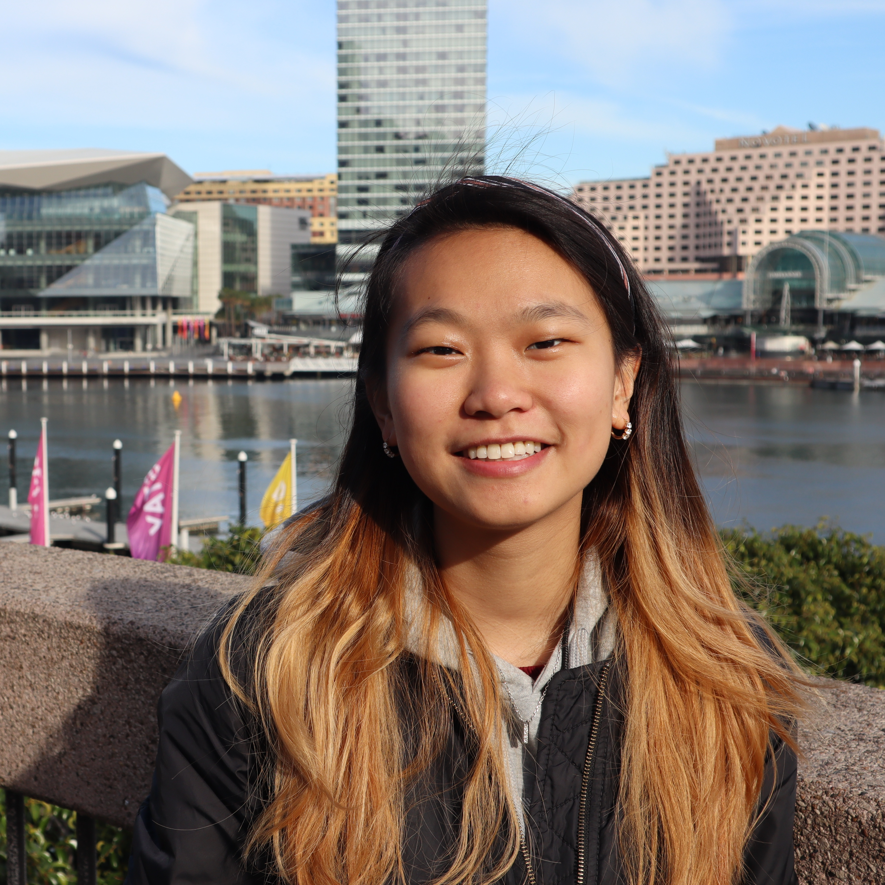
Administrativia
Guest Lecture: Joanne Truong (GT)
After RL module 11/11
Embodied AI
https://www.joannetruong.com/

Slide 6
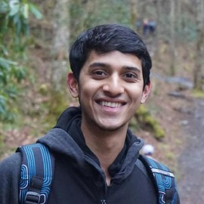
Administrativia
Guest Lecture: Nirbhay Modhe
Reinforcement Learning
https://nirbhayjm.github.io/

Slide 7
RL Demo
https://cs.stanford.edu/people/karpathy/reinforcejs/gridworld_dp.html

