Slide 1
CS 4803 / 7643: Deep Learning
Topics:
Transformers!
Dhruv Batra
Georgia Tech

Slide 2
Administrativia
HW2 Grades Released
Regrade requests close: 10/28, 11:59pm
Grade histogram: 7643
Max possible: 51 (35+16) (regular credit) + 16 (extra credit)

Slide 3
Administrativia
HW2 Grades Released
Regrade requests close: 10/28, 11:59pm
Grade histogram: 4803
Max possible: 41 (25+16) (regular credit) + 26 (extra credit)

Slide 4
Administrativia
HW4 Released
Due: 11/03, 11:59pm
RNNs, LSTMs, Transformers.
I am aware of the issues with RNN.py and LSTM.py
Also aware of issues with Beam Search question

Slide 5
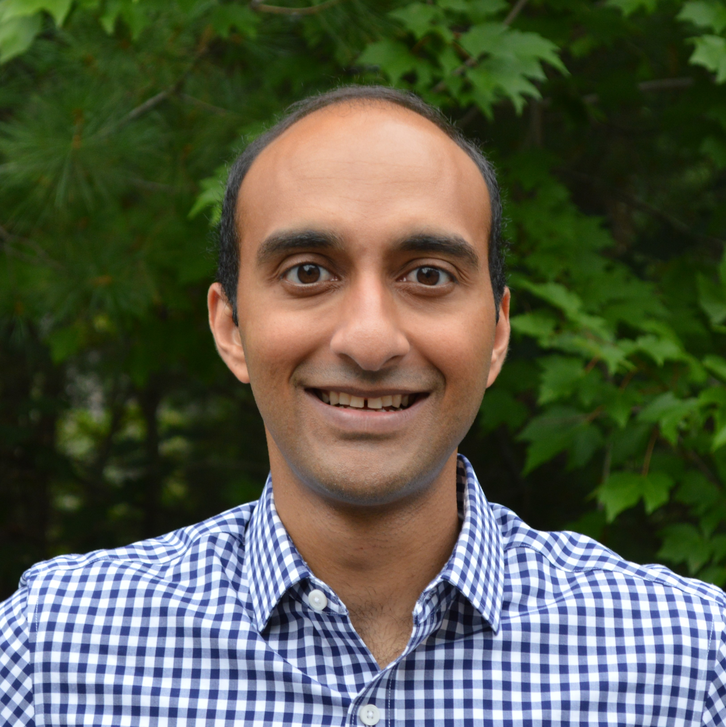
Administrativia
Guest Lecture: Arjun Majumdar
Transformers, BERT, ViLBERT
https://arjunmajum.github.io/

