Slide 1

CS 4803 / 7643
Deep Learning, Fall 2020
Reinforcement Learning: Module 1/3
Presented by Nirbhay Modhe
Notes:
We will focus on supervised learning for foundational concepts

Slide 2

Reinforcement Learning Introduction

Slide 3
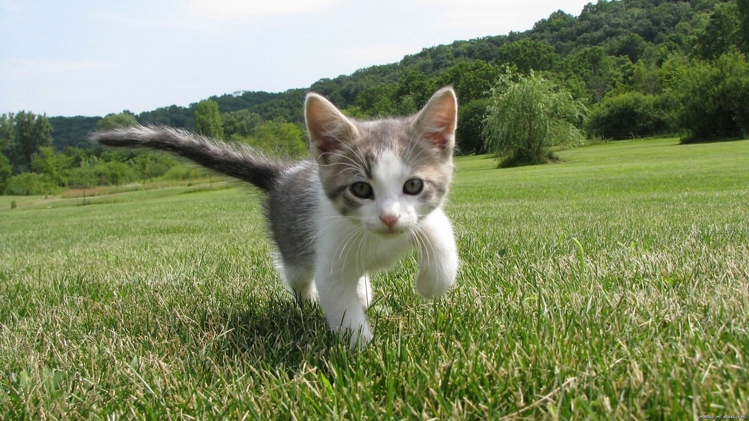
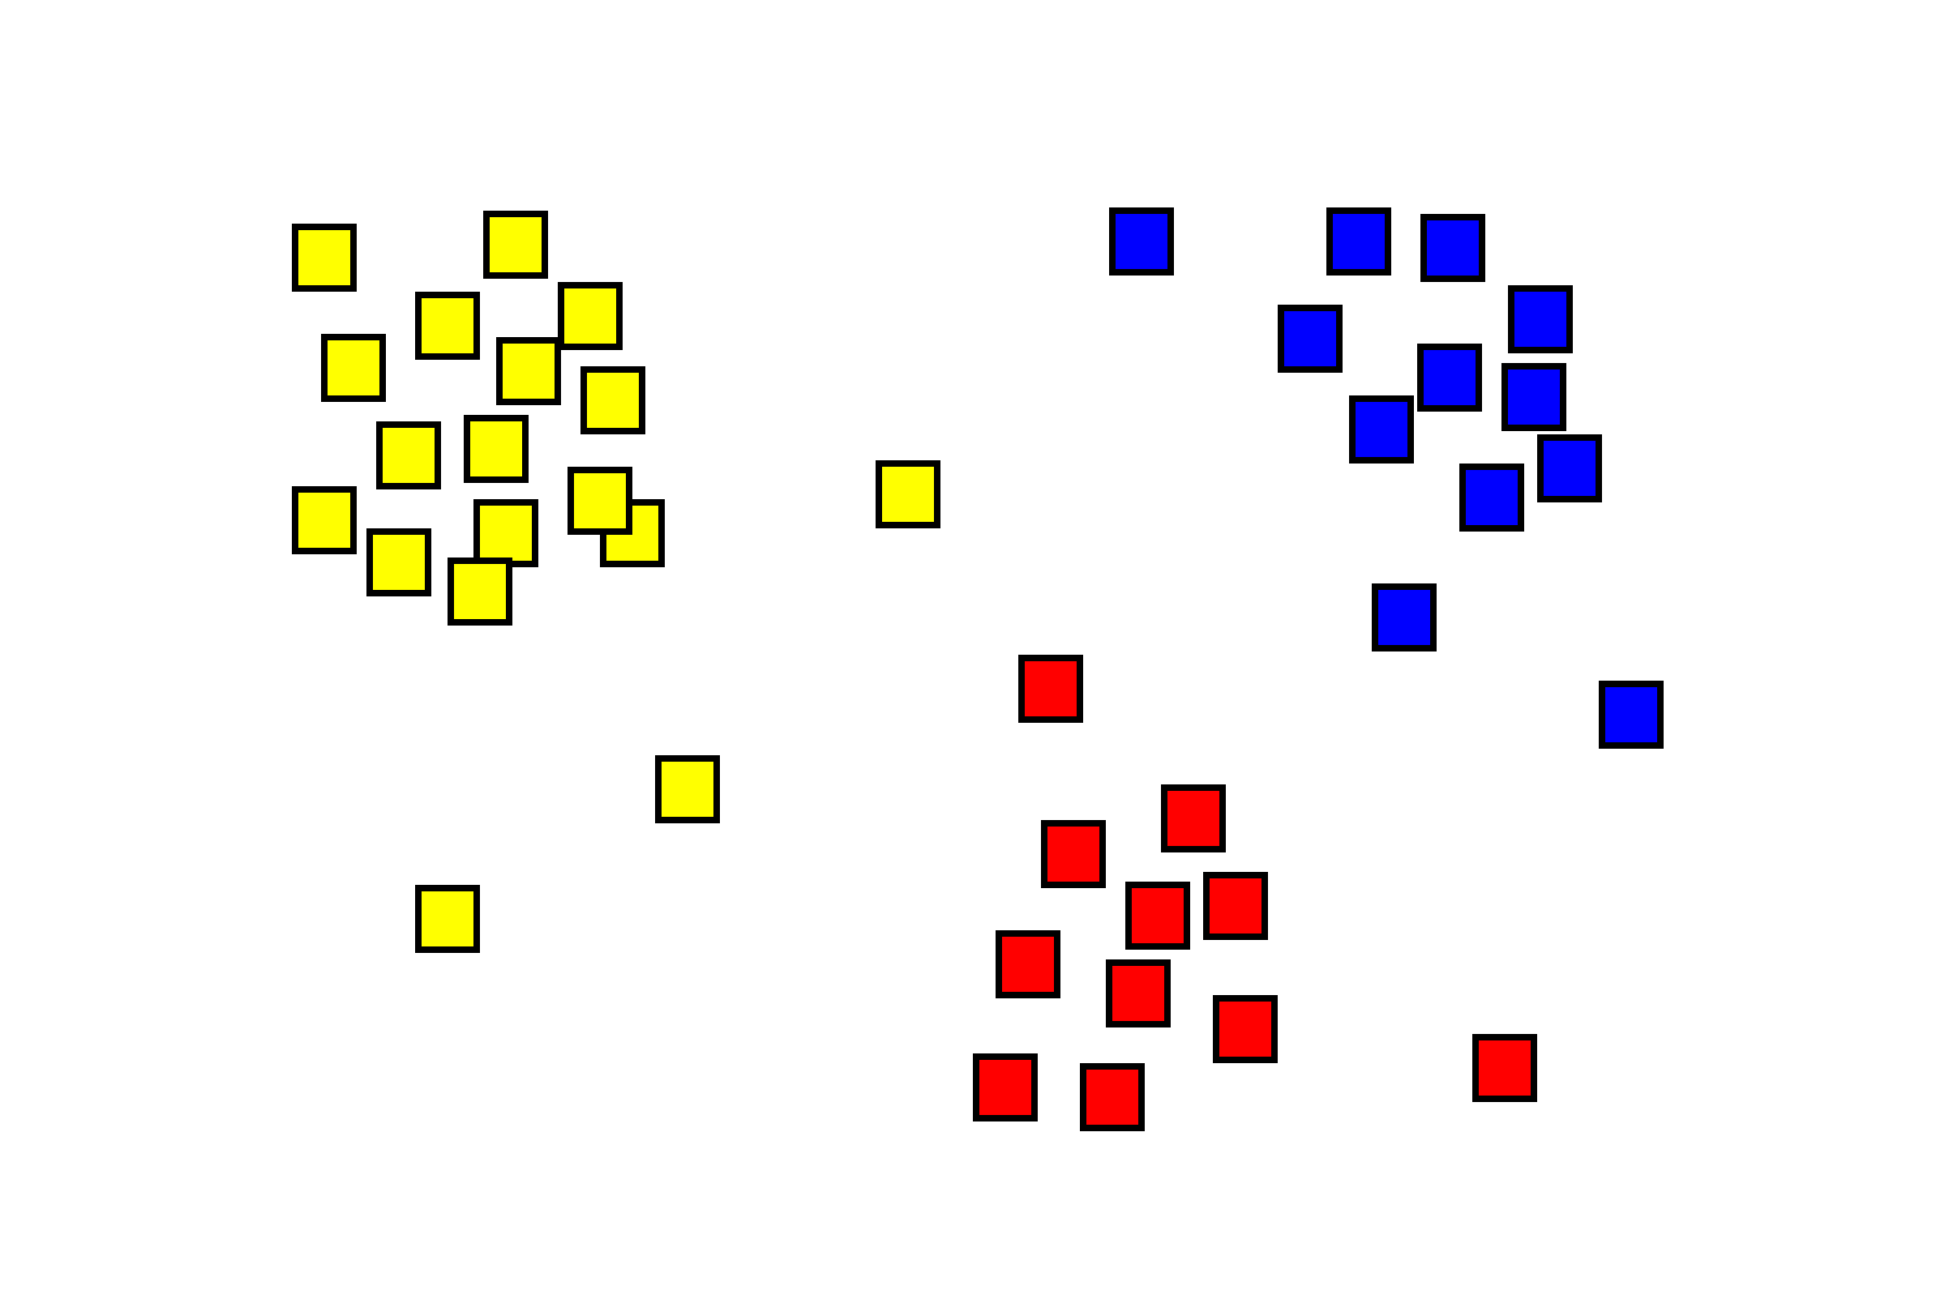
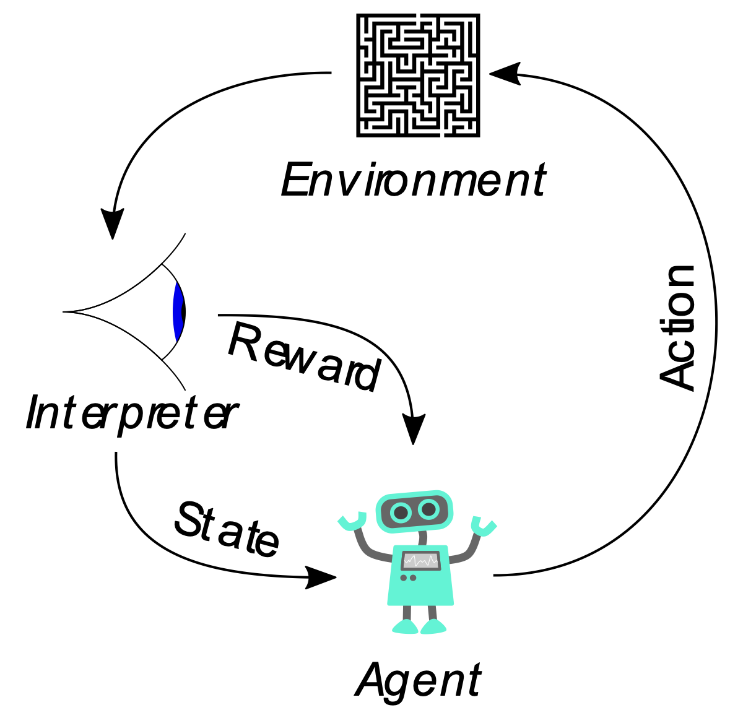
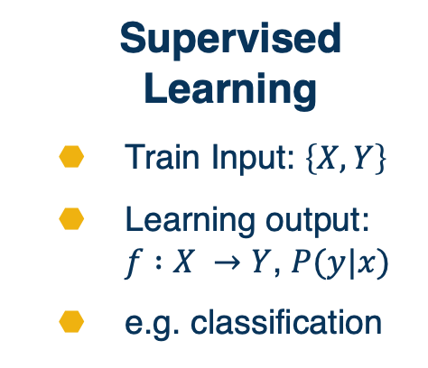
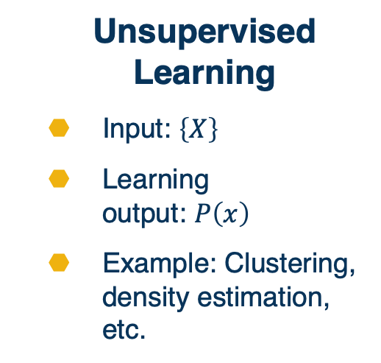
Supervised Learning
Train Input: $\left\{X,Y\right\}$
Learning output: $f :X →Y$, $P(y|x)$
e.g. classification
Unsupervised Learning
Input: $\left\{X\right\}$
Learning
output: $P\left(x\right)$
Example: Clustering, density estimation, etc.
Reinforcement Learning
Evaluative feedback in the form of reward
No supervision on the right action
Sheep
Dog
Cat
Lion
Giraffe
Types of Machine Learning
Notes:
We will focus on supervised learning for foundational concepts

Slide 4
RL: Sequential decision making in an environment with evaluative feedback.
Agent
State,
Stimulus,
Situation
Reward,
Gain, Payoff,
Cost
Action,
Response,
Control
Environment
(world)
Figure Credit: Rich Sutton
Environment may be unknown, non-linear, stochastic and complex.
Agent learns a policy to map states of the environments to actions.
  Seeking to maximize cumulative reward in the long run.
What is Reinforcement Learning?

Slide 5
RL: Sequential decision making in an environment with evaluative feedback.
Evaluative Feedback
Sequential Decisions
Pick an action, receive a reward (positive or negative)
No supervision for what the “correct” action is or would have been, unlike supervised learning
Plan and execute actions over a sequence of states
Reward may be delayed, requiring optimization of future rewards (long-term planning).
What is Reinforcement Learning?

Slide 6
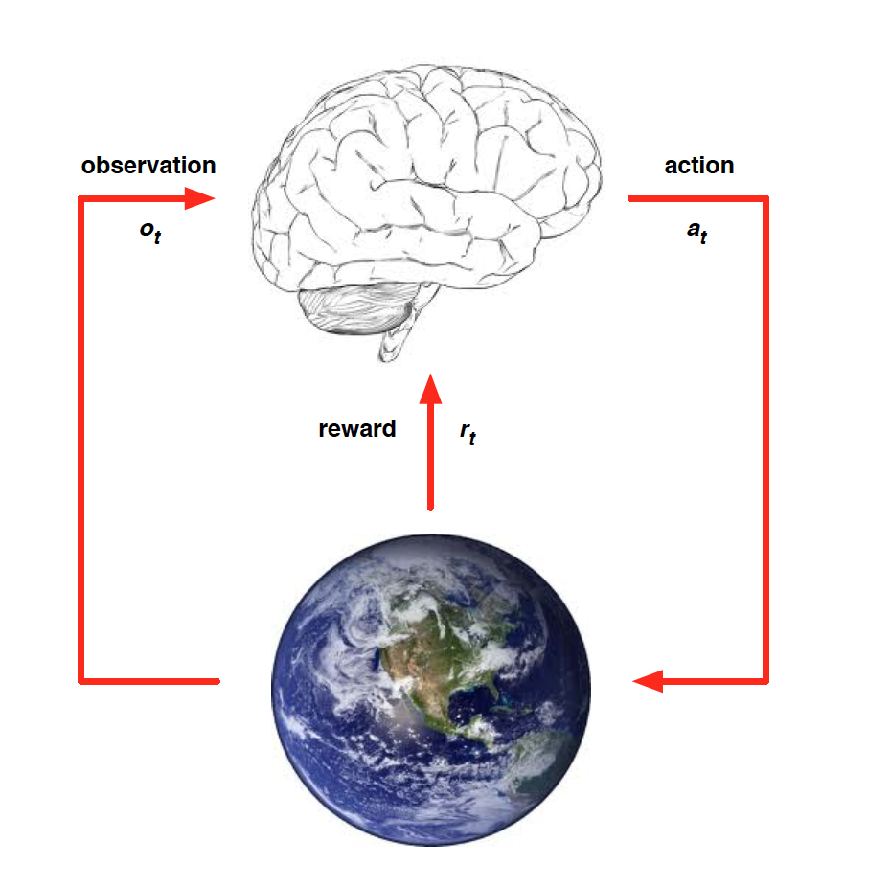
RL: Environment Interaction API
At each time step t, the agent:
  Receives observation o_{t}
  Executes action a_{t}
At each time step t, the environment:
  Receives action a_{t}
  Emits observation o_{t+1}
  Emits scalar reward r_{t+1}
Slide credit: David Silver
RL API

Slide 7
Signature Challenges in Reinforcement Learning
Evaluative feedback: Need trial and error to find the right action
Delayed feedback: Actions may not lead to immediate reward
Non-stationarity: Data distribution of visited states changes when the policy changes
Fleeting nature of time and online data
Slide adapted from: Richard Sutton
RL: Challenges

Slide 8
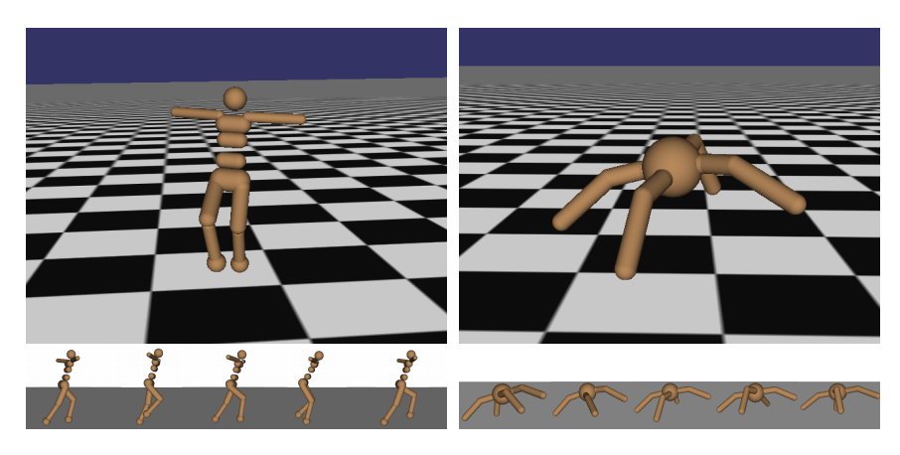
Robot Locomotion
Objective: Make the robot move forward
State: Angle and position of the joints
Action: Torques applied on joints
Reward: +1 at each time step upright and moving forward
Figures copyright John Schulman et al., 2016. Reproduced with permission.
Slide Credit: Fei-Fei Li, Justin Johnson, Serena Yeung, CS 231n
Examples of RL tasks

Slide 9
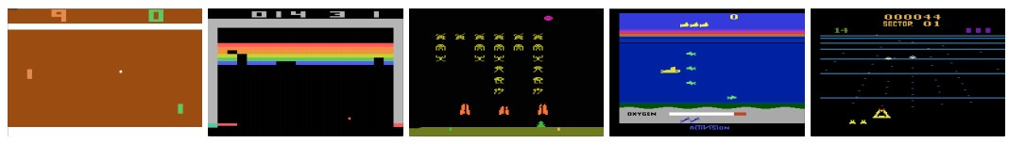
Atari Games
Objective: Complete the game with the highest score
State: Raw pixel inputs of the game state
Action: Game controls e.g. Left, Right, Up, Down
Reward: Score increase/decrease at each time step
Figures copyright Volodymyr Mnih et al., 2013. Reproduced with permission.
Slide Credit: Fei-Fei Li, Justin Johnson, Serena Yeung, CS 231n
Examples of RL tasks

Slide 10
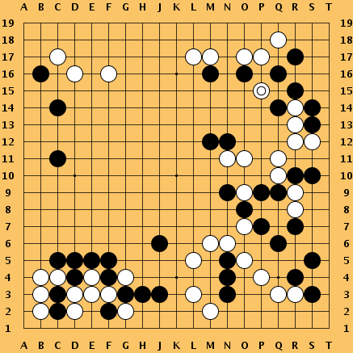
Go
Objective: Defeat opponent
State: Board pieces
Action: Where to put next piece down
Reward: +1 if win at the end of game, 0 otherwise
Slide Credit: Fei-Fei Li, Justin Johnson, Serena Yeung, CS 231n
Examples of RL tasks

Slide 11
Markov Decision Processes

Slide 12
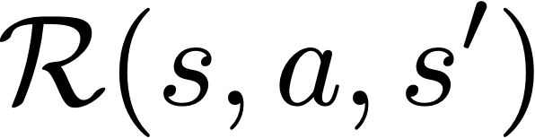
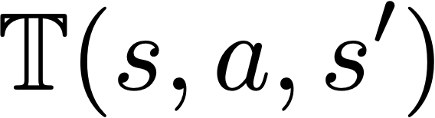

MDPs: Theoretical framework underlying RL
An MDP is defined as a tuple
: Set of possible states
: Set of possible actions
: Distribution of reward
: Transition probability distribution, also written as p(s’|s,a)
: Discount factor
Interaction trajectory:
Markov property: Current state completely characterizes state of the environment
Assumption: Most recent observation is a sufficient statistic of history
Markov Decision Processes (MDPs)

Slide 13
MDPs: Theoretical framework underlying RL
An MDP is defined as a tuple
: Set of possible states
: Set of possible actions
: Distribution of reward
: Transition probability distribution, also written as p(s’|s,a)
: Discount factor
Interaction trajectory:
Markov property: Current state completely characterizes state of the environment
Assumption: Most recent observation is a sufficient statistic of history
Markov Decision Processes (MDPs)

Slide 14
MDPs: Theoretical framework underlying RL
An MDP is defined as a tuple
: Set of possible states
: Set of possible actions
: Distribution of reward
: Transition probability distribution, also written as p(s’|s,a)
: Discount factor
Interaction trajectory:
Markov property: Current state completely characterizes state of the environment
Assumption: Most recent observation is a sufficient statistic of history
Markov Decision Processes (MDPs)

Slide 15
MDPs: Theoretical framework underlying RL
An MDP is defined as a tuple
: Set of possible states
: Set of possible actions
: Distribution of reward
: Transition probability distribution, also written as p(s’|s,a)
: Discount factor
Interaction trajectory:
Markov property: Current state completely characterizes state of the environment
Assumption: Most recent observation is a sufficient statistic of history
Markov Decision Processes (MDPs)

Slide 16
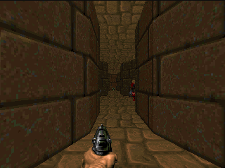
Fully observed MDP
Partially observed MDP
Agent receives the true state s_{t} at time t
Example: Chess, Go
Agent perceives its own partial observation o_{t} of the state s_{t} at time t, using past states e.g. with an RNN
Example: Poker, First-person games (e.g. Doom)
Source: https://github.com/mwydmuch/ViZDoom
MDP Variations

Slide 17
Fully observed MDP
Partially observed MDP
Agent receives the true state s_{t} at time t
Example: Chess, Go
Agent perceives its own partial observation o_{t} of the state s_{t} at time t, using past states e.g. with an RNN
Example: Poker, First-person games (e.g. Doom)
We will assume fully observed MDPs for this lecture
Source: https://github.com/mwydmuch/ViZDoom
MDP Variations

Slide 18

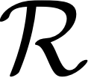
In Reinforcement Learning, we assume an underlying MDP with unknown:
  Transition probability distribution
  Reward distribution
Evaluative feedback comes into play, trial and error necessary
Let’s first assume that we know the true reward and transition distribution and look at algorithms for solving MDPs i.e. finding the best policy
MDP
MDPs in the context of RL

Slide 19
In Reinforcement Learning, we assume an underlying MDP with unknown:
  Transition probability distribution
  Reward distribution
Evaluative feedback comes into play, trial and error necessary
Let’s first assume that we know the true reward and transition distribution and look at algorithms for solving MDPs i.e. finding the best policy
MDP
MDPs in the context of RL

Slide 20
In Reinforcement Learning, we assume an underlying MDP with unknown:
  Transition probability distribution
  Reward distribution
Evaluative feedback comes into play, trial and error necessary
For this lecture, assume that we know the true reward and transition distribution and look at algorithms for solving MDPs i.e. finding the best policy
  Rewards known everywhere, no evaluative feedback
  Know how the world works i.e. all transitions
MDP
MDPs in the context of RL

Slide 21
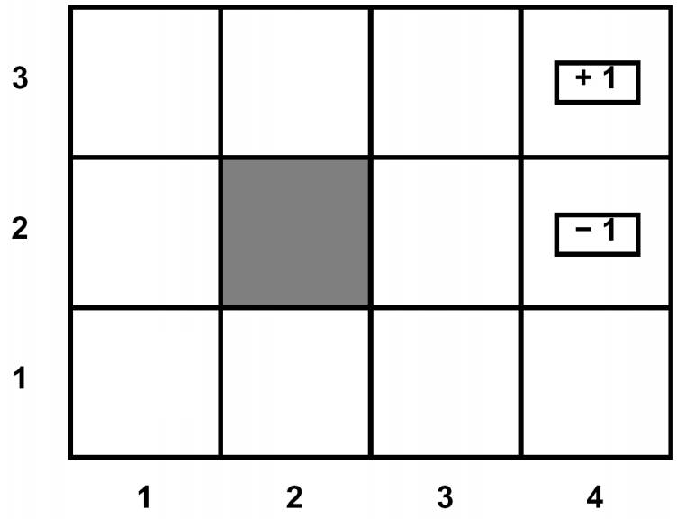
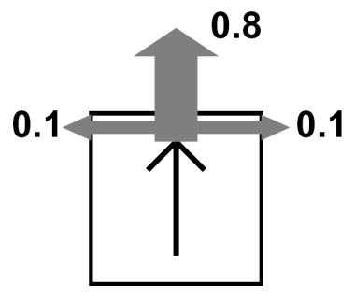
Agent lives in a 2D grid environment
State: Agent’s 2D coordinates
Actions: N, E, S, W
Rewards: +1/-1 at absorbing states
Walls block agent’s path
Actions to not always go as planned
  20% chance that agent drifts one cell left or right of direction of motion (except when blocked by wall).
Figure credits: Pieter Abbeel
A Grid World MDP

Slide 22
Agent lives in a 2D grid environment
State: Agent’s 2D coordinates
Actions: N, E, S, W
Rewards: +1/-1 at absorbing states
Walls block agent’s path
Actions to not always go as planned
  20% chance that agent drifts one cell left or right of direction of motion (except when blocked by wall).
Figure credits: Pieter Abbeel
A Grid World MDP

Slide 23
Agent lives in a 2D grid environment
State: Agent’s 2D coordinates
Actions: N, E, S, W
Rewards: +1/-1 at absorbing states
Walls block agent’s path
Actions to not always go as planned
  20% chance that agent drifts one cell left or right of direction of motion (except when blocked by wall).
Figure credits: Pieter Abbeel
A Grid World MDP

Slide 24
Agent lives in a 2D grid environment
State: Agent’s 2D coordinates
Actions: N, E, S, W
Rewards: +1/-1 at absorbing states
Walls block agent’s path
Actions to not always go as planned
  20% chance that agent drifts one cell left or right of direction of motion (except when blocked by wall).
Figure credits: Pieter Abbeel
A Grid World MDP
Notes:
What is the optimal policy?

Slide 25
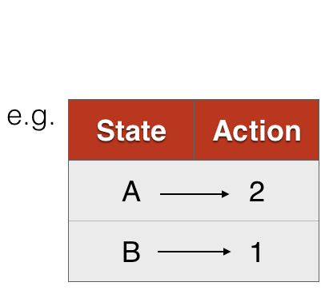
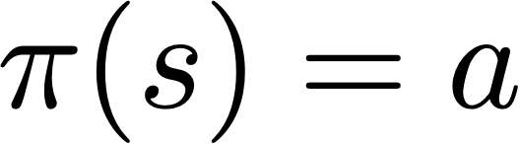
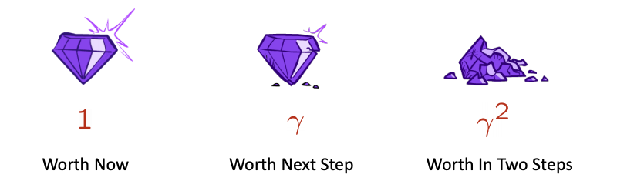
Solving MDPs by finding the best/optimal policy
Formally, a policy is a mapping from states to actions
  Deterministic
  Stochastic
What is a good policy?
  Maximize current reward? Sum of all future rewards?
  Discounted sum of future rewards!
Solving MDPs: Optimal policy

Slide 26
Solving MDPs by finding the best/optimal policy
Formally, a policy is a mapping from states to actions
  Deterministic
  Stochastic
What is a good policy?
  Maximize current reward? Sum of all future rewards?
  Discounted sum of future rewards!
Solving MDPs: Optimal policy

Slide 27
Solving MDPs by finding the best/optimal policy
Formally, a policy is a mapping from states to actions
  Deterministic
  Stochastic
What is a good policy?
  Maximize current reward? Sum of all future rewards?
  Discounted sum of future rewards!
Solving MDPs: Optimal policy

Slide 28
Solving MDPs by finding the best/optimal policy
Formally, a policy is a mapping from states to actions
  Deterministic
  Stochastic
What is a good policy?
  Maximize current reward? Sum of all future rewards?
  Discounted sum of future rewards!
Solving MDPs: Optimal policy

Slide 29
Solving MDPs by finding the best/optimal policy
Formally, a policy is a mapping from states to actions
  Deterministic
  Stochastic
What is a good policy?
  Maximize current reward? Sum of all future rewards?
  Discounted sum of future rewards!
Solving MDPs: Optimal policy

Slide 30
Solving MDPs by finding the best/optimal policy
Formally, a policy is a mapping from states to actions
  Deterministic
  Stochastic
What is a good policy?
  Maximize current reward? Sum of all future rewards?
  Discounted sum of future rewards!
Solving MDPs: Optimal policy

Slide 31
Solving MDPs by finding the best/optimal policy
Formally, a policy is a mapping from states to actions
  Deterministic
  Stochastic
What is a good policy?
  Maximize current reward? Sum of all future rewards?
  Discounted sum of future rewards!
    Discount factor:
Solving MDPs: Optimal policy

Slide 32
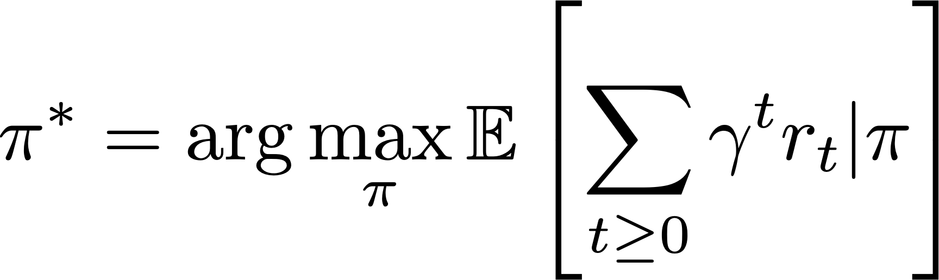
Formally, the optimal policy is defined as:
Solving MDPs: Optimal policy

Slide 33
Formally, the optimal policy is defined as:
discounted sum of future rewards
Solving MDPs: Optimal policy

Slide 34
Formally, the optimal policy is defined as:
discounted sum of future rewards
Solving MDPs: Optimal policy

Slide 35
Formally, the optimal policy is defined as:
discounted sum of future rewards
Expectation over initial state, actions from policy, next states from transition distribution
Solving MDPs: Optimal policy

Slide 36
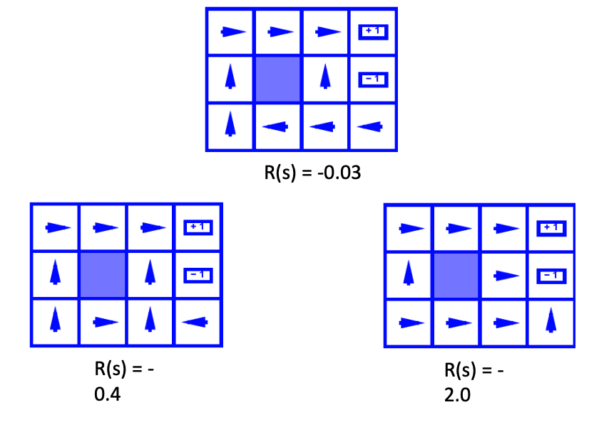
Some optimal policies for three different grid world MDPs (gamma=0.99)
  Varying reward for non-absorbing states (states other than +1/-1)
R(s) = -0.03
R(s) = -0.4
R(s) = -2.0
Image Credit: Byron Boots, CS 7641
Optimal policy examples

Slide 37
For example, with an MDP with 5 states as shown, starting at the middle cell:
Actions: (Right, Left)
Deterministic transitions
What is the optimal policy for:
10 |  |  |  | 1
Slides adapted from: Byron Boots, CS 7641
Discounting future rewards

Slide 38
For example, with an MDP with 5 states as shown, starting at the middle cell:
Actions: (Right, Left)
Deterministic transitions
What is the optimal policy for:
10 |  |  |  | 1
Slides adapted from: Byron Boots, CS 7641
Discounting future rewards

Slide 39
Value Function

Slide 40
A value function is a prediction of discounted sum of future reward
State value function / V-function /
  How good is this state?
  Am I likely to win/lose the game from this state?
State-Action value function / Q-function /
  How good is this state-action pair?
  In this state, what is the impact of this action on my future?
Value Function

Slide 41
A value function is a prediction of discounted sum of future reward
State value function / V-function /
  How good is this state?
  Am I likely to win/lose the game from this state?
State-Action value function / Q-function /
  How good is this state-action pair?
  In this state, what is the impact of this action on my future?
Value Function

Slide 42
A value function is a prediction of discounted sum of future reward
State value function / V-function /
  How good is this state?
  Am I likely to win/lose the game from this state?
State-Action value function / Q-function /
  How good is this state-action pair?
  In this state, what is the impact of this action on my future?
Value Function

Slide 43
A value function is a prediction of discounted sum of future reward
State value function / V-function /
  How good is this state?
  Am I likely to win/lose the game from this state?
State-Action value function / Q-function /
  How good is this state-action pair?
  In this state, what is the impact of this action on my future?
Value Function

Slide 44
A value function is a prediction of discounted sum of future reward
State value function / V-function /
  How good is this state?
  Am I likely to win/lose the game from this state?
State-Action value function / Q-function /
  How good is this state-action pair?
  In this state, what is the impact of this action on my future?
Value Function

Slide 45
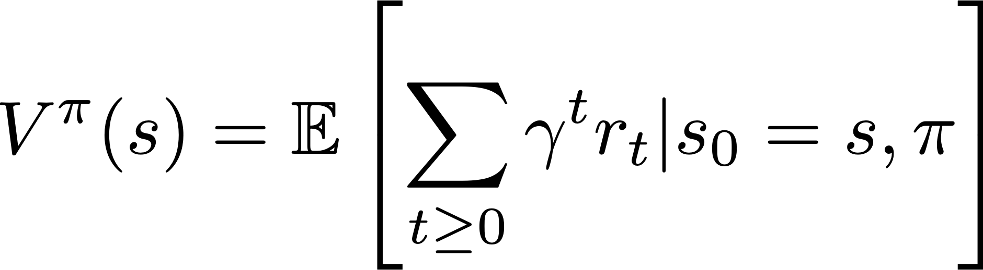
For a policy that produces a trajectory sample
The V-function of the policy at state s, is the expected cumulative reward from state s:
Value Function

Slide 46
For a policy that produces a trajectory sample
The V-function of the policy at state s, is the expected cumulative reward from state s:
Value Function

Slide 47
For a policy that produces a trajectory sample
The V-function of the policy at state s, is the expected cumulative reward from state s:
Value Function

Slide 48
For a policy that produces a trajectory sample
The V-function of the policy at state s, is the expected cumulative reward from state s:
Value Function

Slide 49
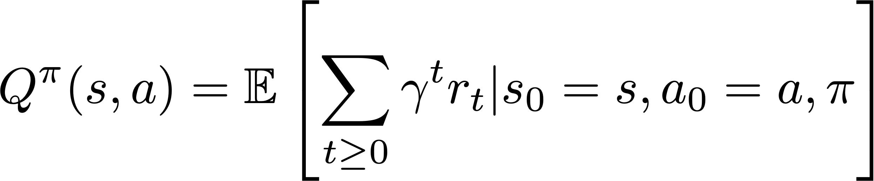
For a policy that produces a trajectory sample
The Q-function of the policy at state s and action a, is the expected cumulative reward upon taking action a in state s (and following policy thereafter):
Action-Value Function

Slide 50
For a policy that produces a trajectory sample
The Q-function of the policy at state s and action a, is the expected cumulative reward upon taking action a in state s (and following policy thereafter):
Action-Value Function

Slide 51
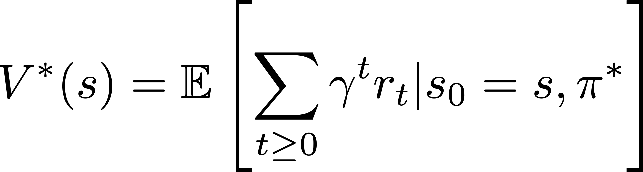
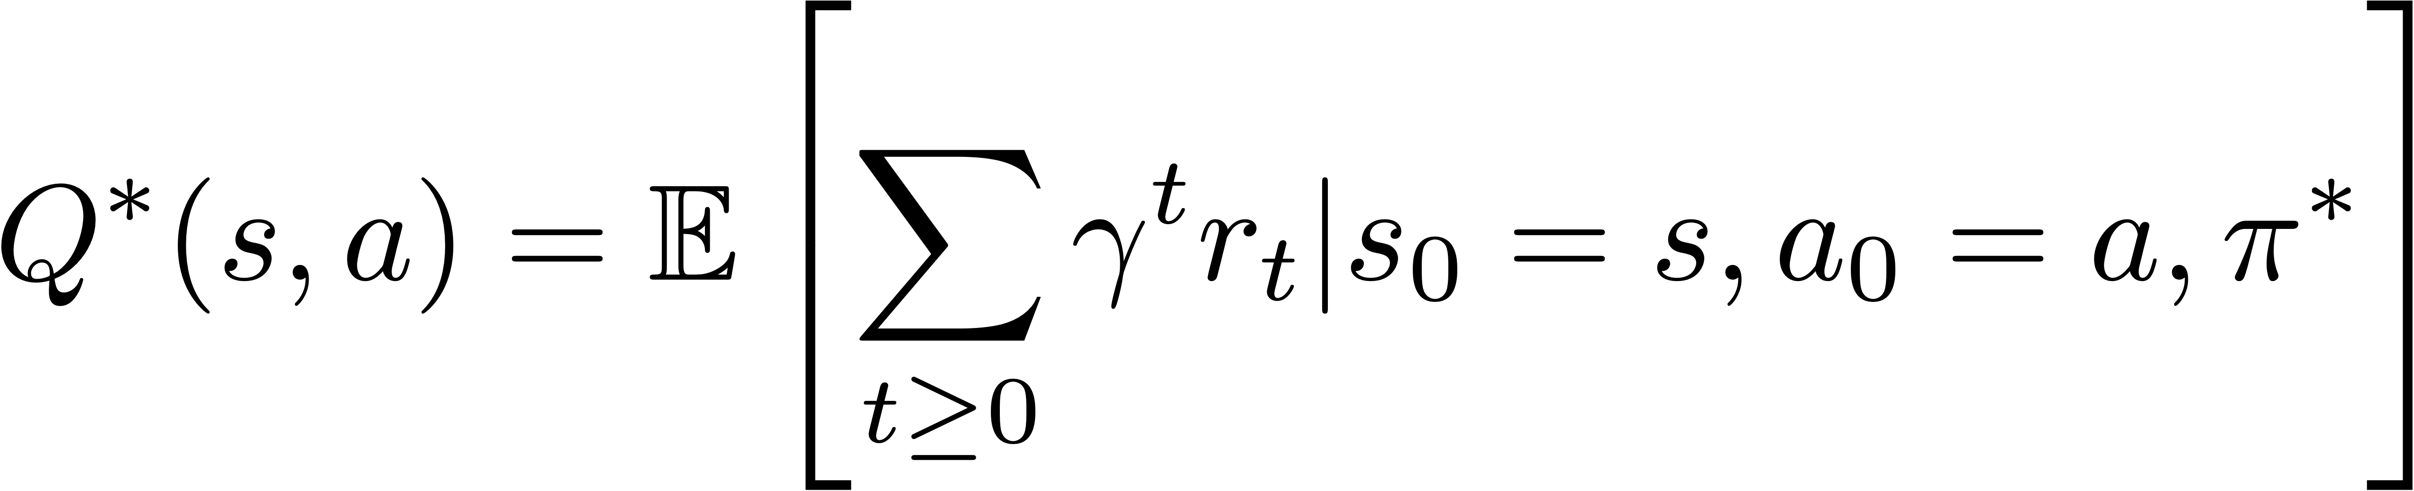
The V and Q functions corresponding to the optimal policy
Optimal V & Q functions

Slide 52
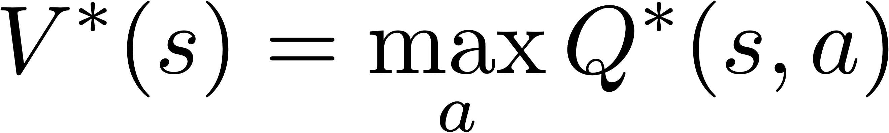
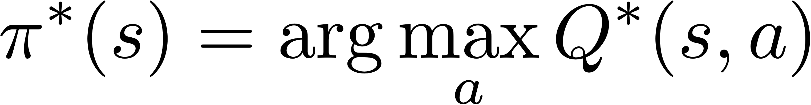
Equations relating optimal quantities
Recursive Bellman optimality equation
Bellman Optimality Equations

Slide 53
Equations relating optimal quantities
Recursive Bellman optimality equation
Bellman Optimality Equations

Slide 54
Equations relating optimal quantities
Recursive Bellman optimality equation
Bellman Optimality Equations

Slide 55
Equations relating optimal quantities
Recursive Bellman optimality equation
Bellman Optimality Equations

Slide 56
Equations relating optimal quantities
Recursive Bellman optimality equation
Bellman Optimality Equations

Slide 57
Today, we saw
MDPs: Theoretical framework underlying RL, solving MDPs
Policy: How an agents acts at states
Value function (Utility): How good is a particular state or state-action pair?
Next Lecture:
Algorithms for solving MDPs (Value Iteration)
Departure from known rewards and transitions: Reinforcement Learning
Recap & Next Lecture

Slide 58
Today, we saw
MDPs: Theoretical framework underlying RL, solving MDPs
Policy: How an agents acts at states
Value function (Utility): How good is a particular state or state-action pair?
Next Lecture:
Algorithms for solving MDPs (Value Iteration)
Departure from known rewards and transitions: Reinforcement Learning
Recap & Next Lecture

