Slide 1
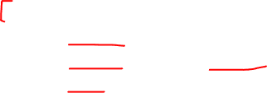
CS 4803 / 7643: Deep Learning
Topics:
  Recurrent Neural Networks (RNNs)
    RNN visualizations
    Image Captioning, Beam Search
    LSTMs
Dhruv Batra
Georgia Tech

Slide 2

Administrativia
HW3 Reminder
  Due: 10/20 11:59pm
  Theory: Convolutions, Representation Capacity, Double Descent
  Implementation: Saliency methods (e.g. Grad-CAM) in Python and PyTorch/Captum
HW2 grades coming soon

Slide 3
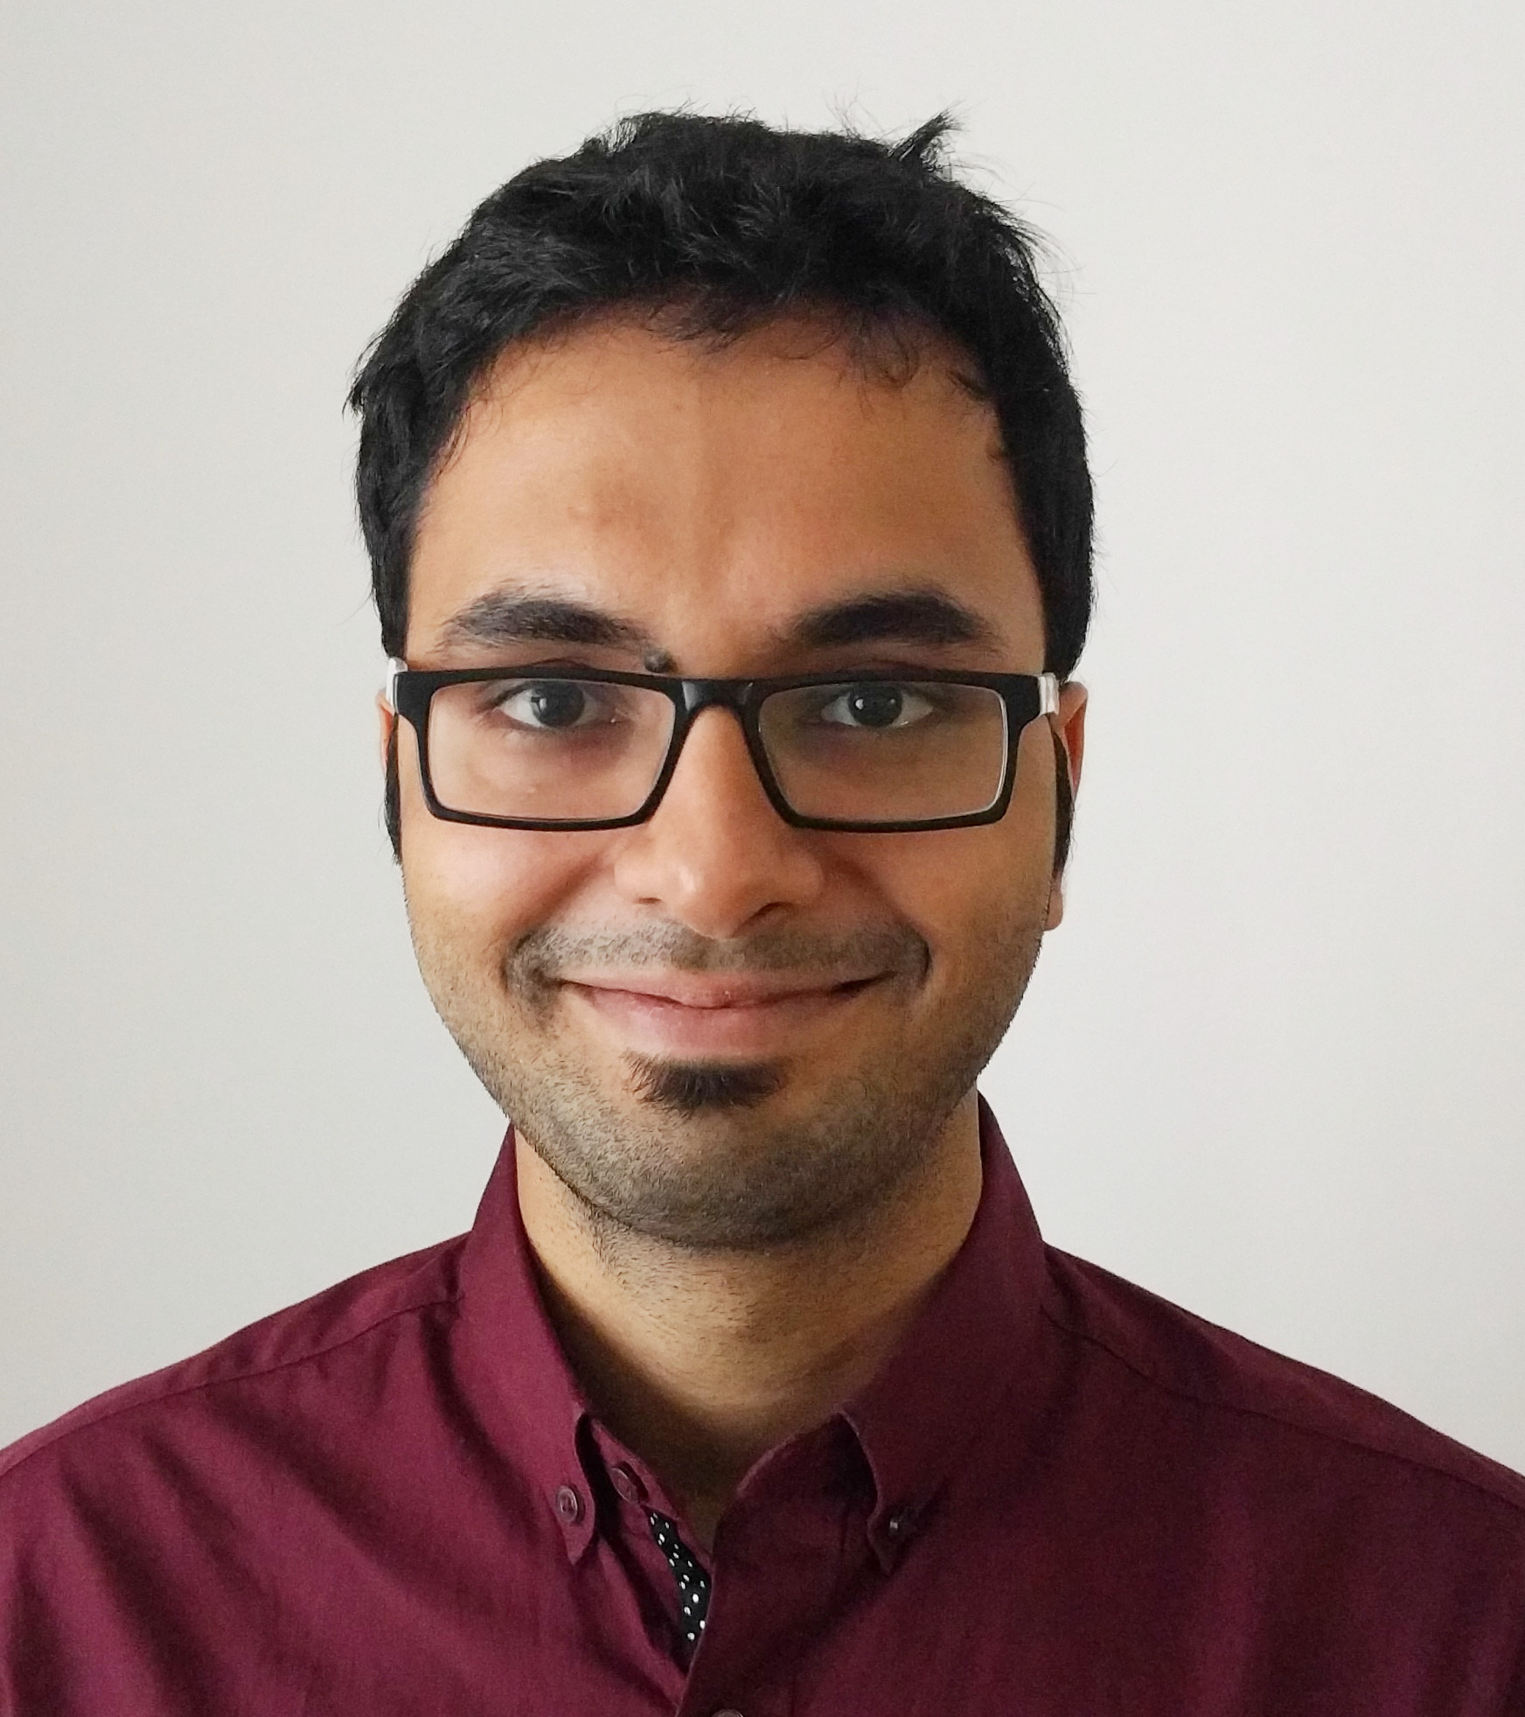

Administrativia
Guest Lecture: Ishan Misra (FAIR)
  Thurs 10/21
  Self-Supervised Learning for Vision
http://imisra.github.io/

Slide 4
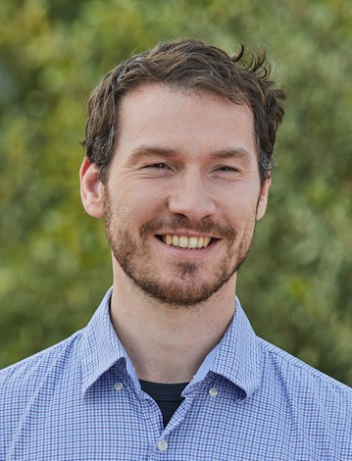

Administrativia
Guest Lecture: Michael Auli (FAIR)
  Tue 10/26
  Self-Supervised Learning for Speech
https://michaelauli.github.io/

Slide 5
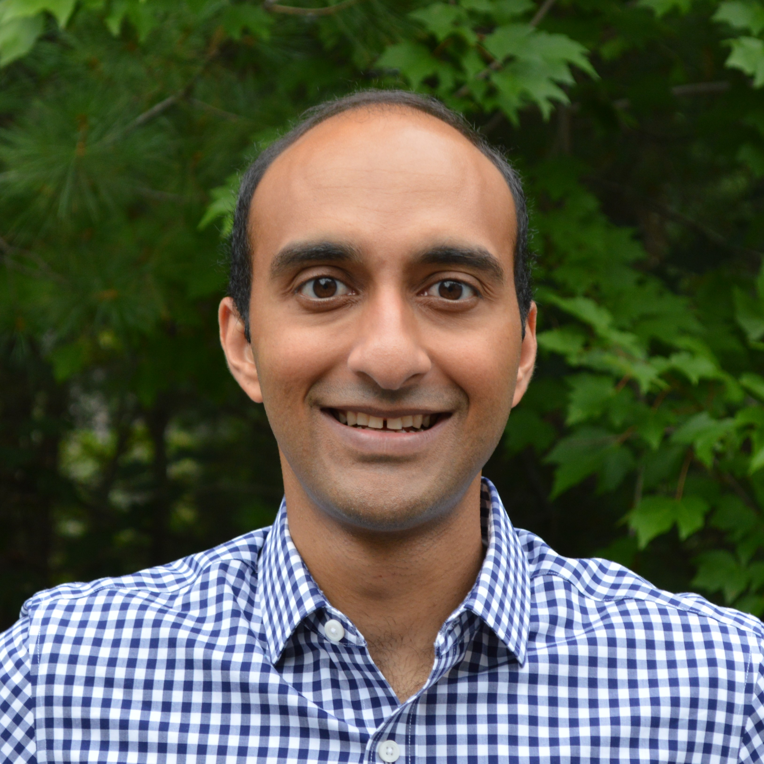

Administrativia
Guest Lecture: Arjun Majumdar
  Thurs 10/28
  Transformers, BERT, ViLBERT
https://arjunmajum.github.io/

Slide 6
Recap from last time

Slide 7
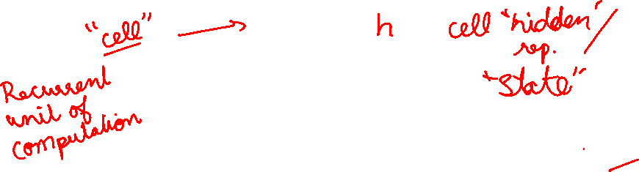
Recurrent Neural Network
y
usually want to predict a vector at some time steps
RNN
x
Slide Credit: Fei-Fei Li, Justin Johnson, Serena Yeung, CS 231n

Slide 8

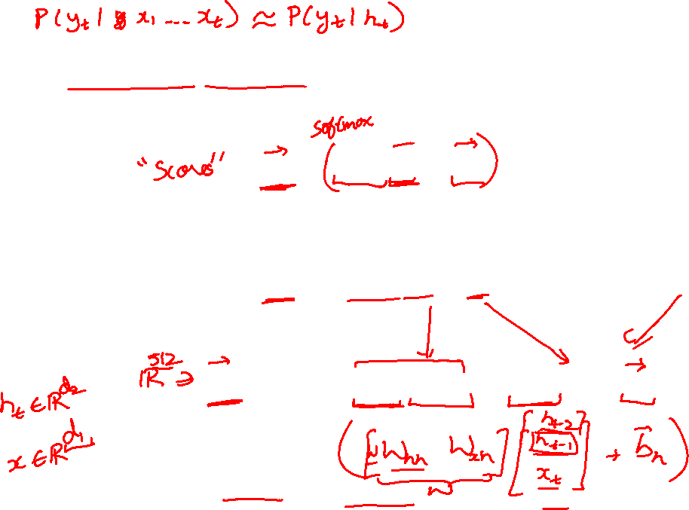
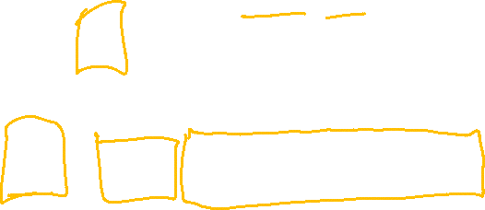
(Vanilla) Recurrent Neural Network
The state consists of a single “hidden” vector h:
y
RNN
x
Sometimes called a “Vanilla RNN” or an “Elman RNN” after Prof. Jeffrey Elman
Slide Credit: Fei-Fei Li, Justin Johnson, Serena Yeung, CS 231n

Slide 9
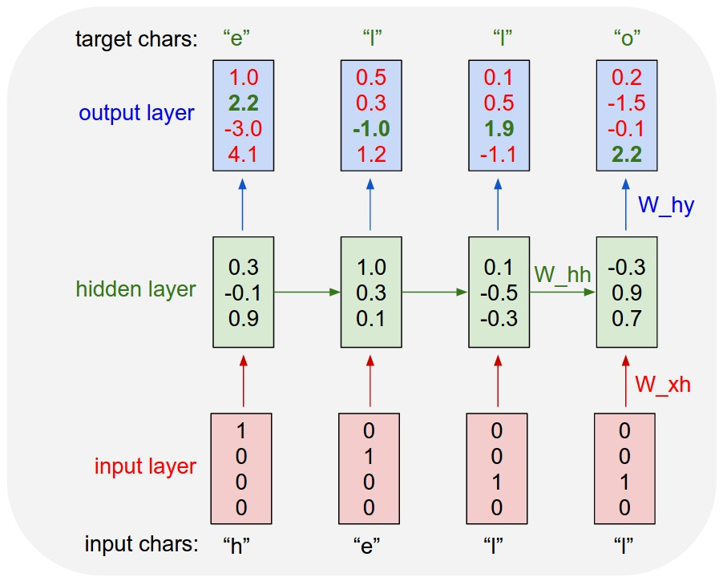

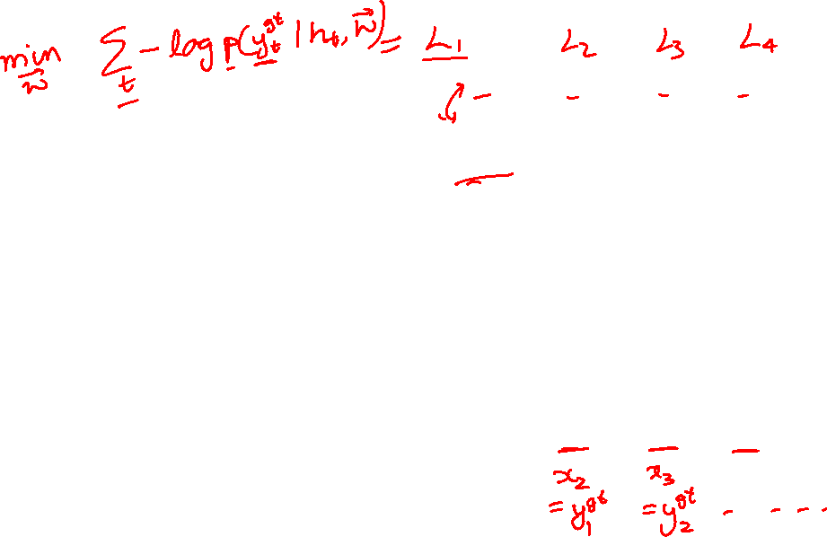
Example: Character-level
Language Model
Vocabulary:
[h,e,l,o]
Example training
sequence:
“hello”
Slide Credit: Fei-Fei Li, Justin Johnson, Serena Yeung, CS 231n

Slide 10

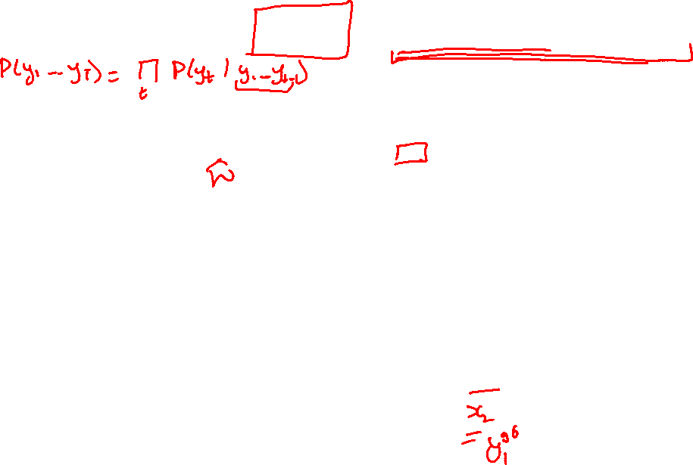
Training Time: MLE / “Teacher Forcing”
Example: Character-level
Language Model
Vocabulary:
[h,e,l,o]
Example training
sequence:
“hello”
Slide Credit: Fei-Fei Li, Justin Johnson, Serena Yeung, CS 231n

Slide 11

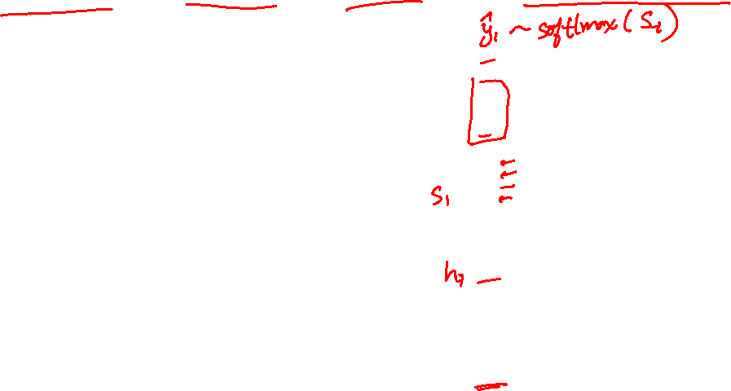
Test Time: Sample / Argmax / Beam Search
Example: Character-level
Language Model
Sampling
Vocabulary:
[h,e,l,o]
At test-time sample characters one at a time, feed back to model
“e”
“l”
“l”
“o”
Sample
.03
.13
.00
.84
.25
.20
.05
.50
.11
.17
.68
.03
.11
.02.08
.79
Softmax
Slide Credit: Fei-Fei Li, Justin Johnson, Serena Yeung, CS 231n

Slide 12


Test Time: Sample / Argmax / Beam Search
Example: Character-level
Language Model
Sampling
Vocabulary:
[h,e,l,o]
At test-time sample characters one at a time, feed back to model
“e”
“l”
“l”
“o”
Sample
.03
.13
.00
.84
.25
.20
.05
.50
.11
.17
.68
.03
.11
.02.08
.79
Softmax
Slide Credit: Fei-Fei Li, Justin Johnson, Serena Yeung, CS 231n

Slide 13

Test Time: Sample / Argmax / Beam Search
Example: Character-level
Language Model
Sampling
Vocabulary:
[h,e,l,o]
At test-time sample characters one at a time, feed back to model
“e”
“l”
“l”
“o”
Sample
.03
.13
.00
.84
.25
.20
.05
.50
.11
.17
.68
.03
.11
.02.08
.79
Softmax
Slide Credit: Fei-Fei Li, Justin Johnson, Serena Yeung, CS 231n

Slide 14
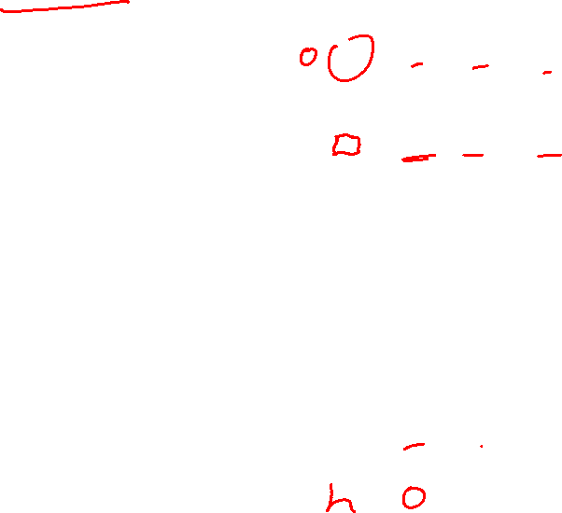
Test Time: Sample / Argmax / Beam Search
Example: Character-level
Language Model
Sampling
Vocabulary:
[h,e,l,o]
At test-time sample characters one at a time, feed back to model
“e”
“l”
“l”
“o”
Sample
.03
.13
.00
.84
.25
.20
.05
.50
.11
.17
.68
.03
.11
.02.08
.79
Softmax
Slide Credit: Fei-Fei Li, Justin Johnson, Serena Yeung, CS 231n

Slide 15
Plan for Today
Recurrent Neural Networks (RNNs)
  (Finish) Visualization in Character RNNs
  Inference: Beam Search
    Example: Image Captioning
  Multilayer RNNs
  Problems with gradients in “vanilla” RNNs
  LSTMs (and other RNN variants)

Slide 16
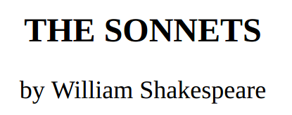
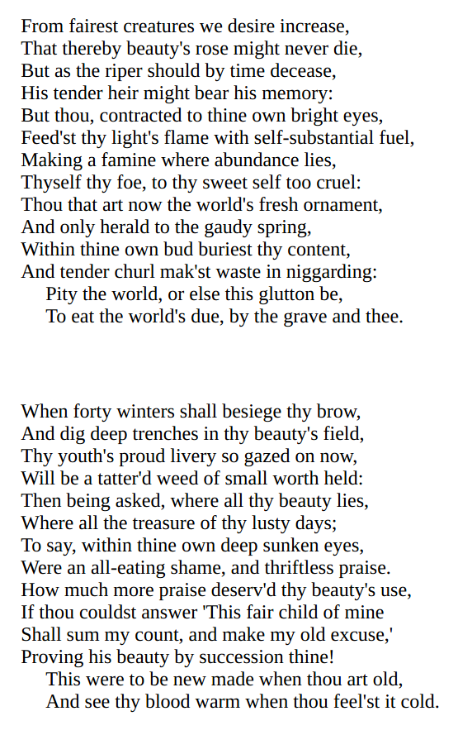
y
RNN
x
Slide Credit: Fei-Fei Li, Justin Johnson, Serena Yeung, CS 231n

Slide 17
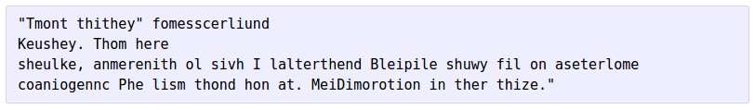



at first:
train more
train more
train more
Slide Credit: Fei-Fei Li, Justin Johnson, Serena Yeung, CS 231n

Slide 18
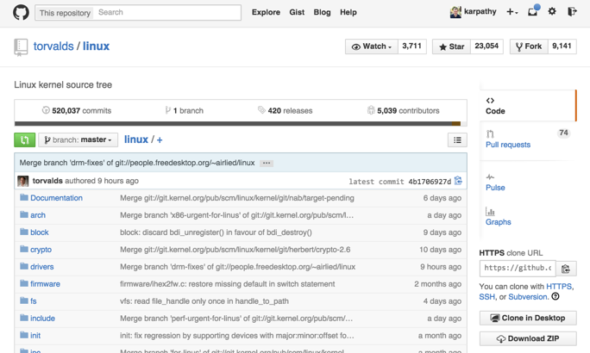
Slide Credit: Fei-Fei Li, Justin Johnson, Serena Yeung, CS 231n

Slide 19
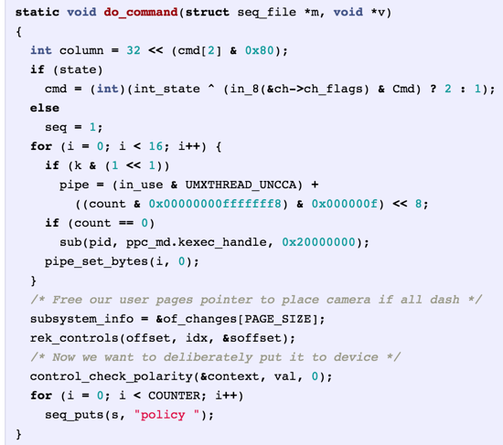
Generated
C code
Slide Credit: Fei-Fei Li, Justin Johnson, Serena Yeung, CS 231n

Slide 20
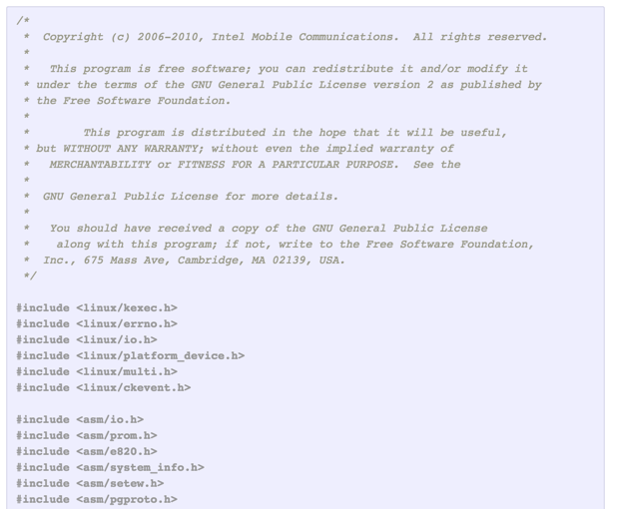
Slide Credit: Fei-Fei Li, Justin Johnson, Serena Yeung, CS 231n

Slide 21
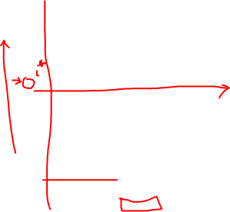
Searching for interpretable cells
Karpathy, Johnson, and Fei-Fei: Visualizing and Understanding Recurrent Networks, ICLR Workshop 2016
Slide Credit: Fei-Fei Li, Justin Johnson, Serena Yeung, CS 231n

Slide 22
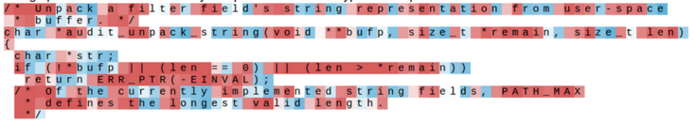
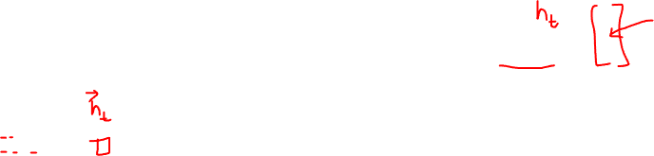
Searching for interpretable cells
Karpathy, Johnson, and Fei-Fei: Visualizing and Understanding Recurrent Networks, ICLR Workshop 2016
Figures copyright Karpathy, Johnson, and Fei-Fei, 2015; reproduced with permission
Slide Credit: Fei-Fei Li, Justin Johnson, Serena Yeung, CS 231n

Slide 23
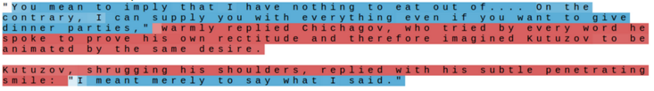
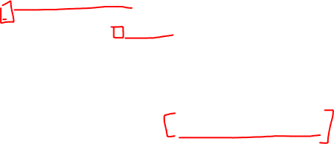
Searching for interpretable cells
quote detection cell
Karpathy, Johnson, and Fei-Fei: Visualizing and Understanding Recurrent Networks, ICLR Workshop 2016
Figures copyright Karpathy, Johnson, and Fei-Fei, 2015; reproduced with permission
Slide Credit: Fei-Fei Li, Justin Johnson, Serena Yeung, CS 231n

Slide 24
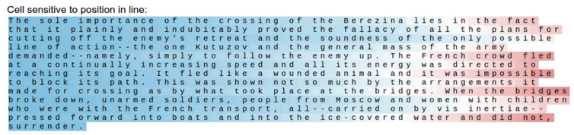
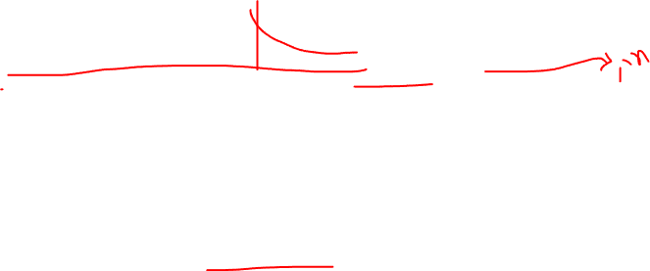
Searching for interpretable cells
line length tracking cell
Karpathy, Johnson, and Fei-Fei: Visualizing and Understanding Recurrent Networks, ICLR Workshop 2016
Figures copyright Karpathy, Johnson, and Fei-Fei, 2015; reproduced with permission
Slide Credit: Fei-Fei Li, Justin Johnson, Serena Yeung, CS 231n

Slide 25
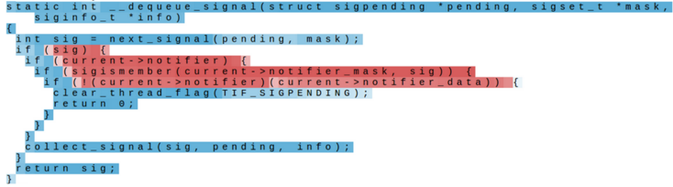
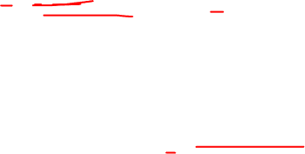
Searching for interpretable cells
if statement cell
Karpathy, Johnson, and Fei-Fei: Visualizing and Understanding Recurrent Networks, ICLR Workshop 2016
Figures copyright Karpathy, Johnson, and Fei-Fei, 2015; reproduced with permission
Slide Credit: Fei-Fei Li, Justin Johnson, Serena Yeung, CS 231n

Slide 26
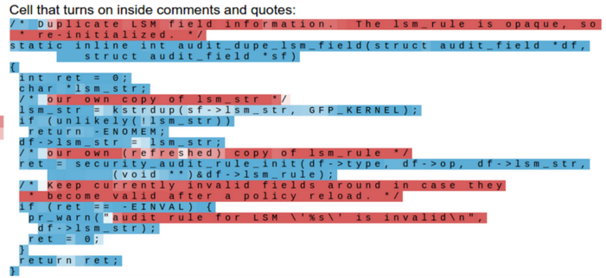
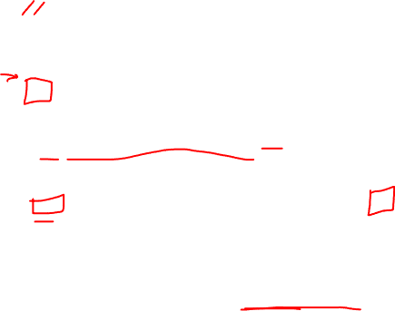
Searching for interpretable cells
quote/comment cell
Karpathy, Johnson, and Fei-Fei: Visualizing and Understanding Recurrent Networks, ICLR Workshop 2016
Figures copyright Karpathy, Johnson, and Fei-Fei, 2015; reproduced with permission
Slide Credit: Fei-Fei Li, Justin Johnson, Serena Yeung, CS 231n

Slide 27
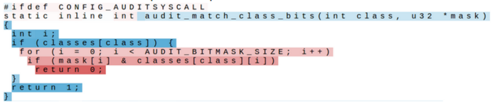
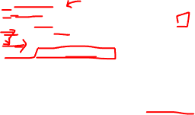
Searching for interpretable cells
code depth cell
Karpathy, Johnson, and Fei-Fei: Visualizing and Understanding Recurrent Networks, ICLR Workshop 2016
Figures copyright Karpathy, Johnson, and Fei-Fei, 2015; reproduced with permission
Slide Credit: Fei-Fei Li, Justin Johnson, Serena Yeung, CS 231n

Slide 28
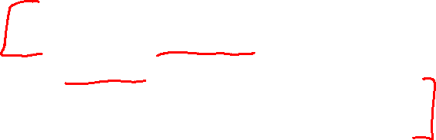
Plan for Today
Recurrent Neural Networks (RNNs)
  Inference: Beam Search
    Example: Image Captioning
  Multilayer RNNs
  Problems with gradients in “vanilla” RNNs
  LSTMs (and other RNN variants)

Slide 29
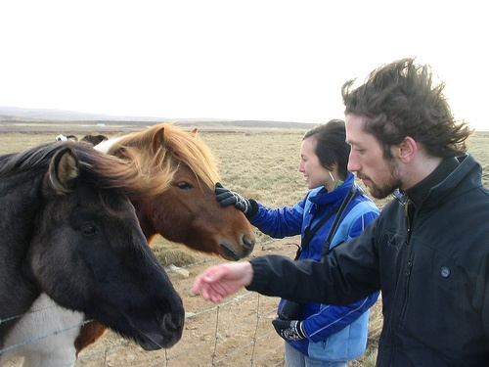
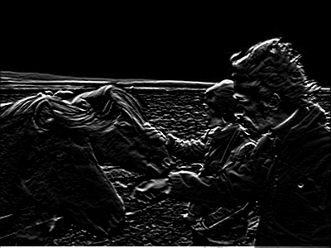
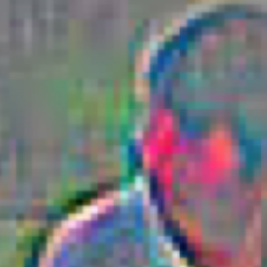
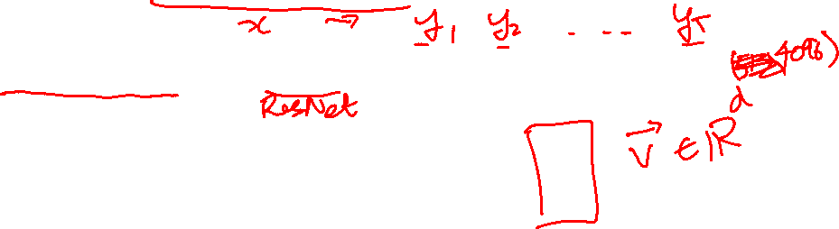
Neural Image Captioning
Image Embedding (VGGNet)
4096-dim
Convolution Layer
+ Non-Linearity
Pooling Layer
Convolution Layer
+ Non-Linearity
Pooling Layer
Fully-Connected MLP

Slide 30

Neural Image Captioning
Image Embedding (VGGNet)
4096-dim
Convolution Layer
+ Non-Linearity
Pooling Layer
Convolution Layer
+ Non-Linearity
Pooling Layer
Fully-Connected MLP

Slide 31
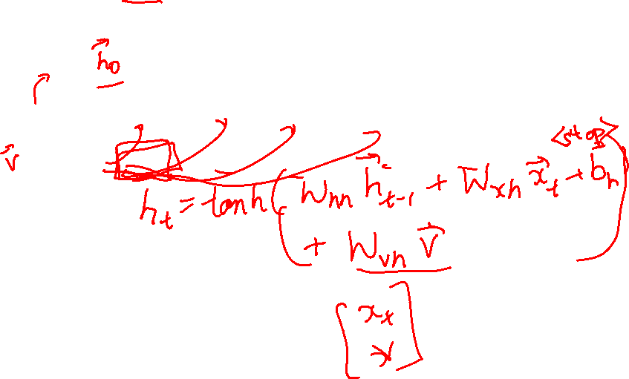
Neural Image Captioning
P(next)
P(next)
P(next)
P(next)
P(next)
P(next)
Linear
RNN
RNN
RNN
RNN
RNN
RNN
<start>
Two
people
and
two
horses.

Slide 32
Neural Image Captioning
P(next)
P(next)
P(next)
P(next)
P(next)
P(next)
Linear
RNN
RNN
RNN
RNN
RNN
RNN
<start>
Two
people
and
two
horses.

Slide 33
Sequence Model Factor Graph

Slide 34
Beam Search Demo
http://dbs.cloudcv.org/captioning&mode=interactive

Slide 35

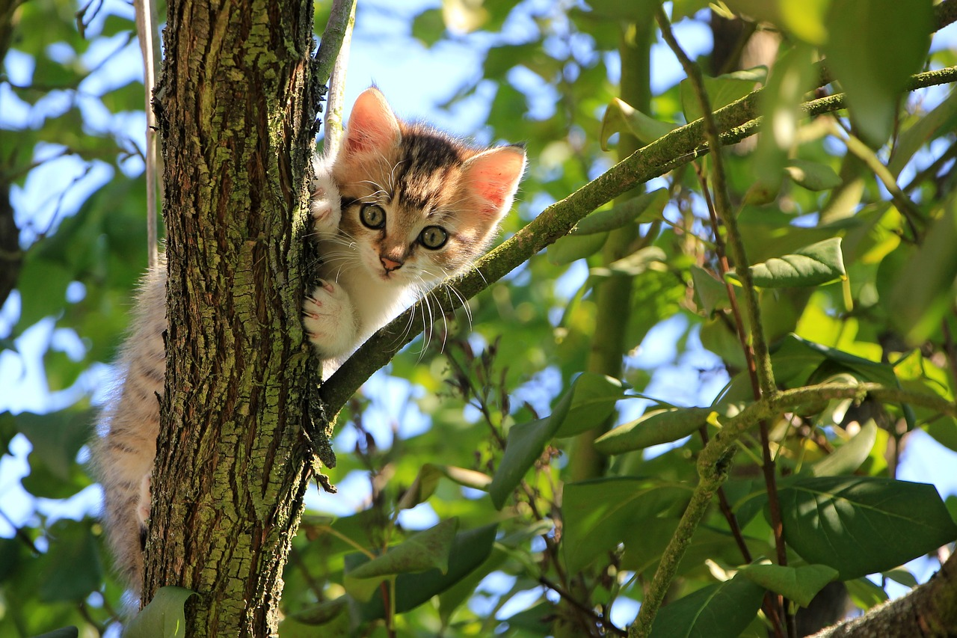
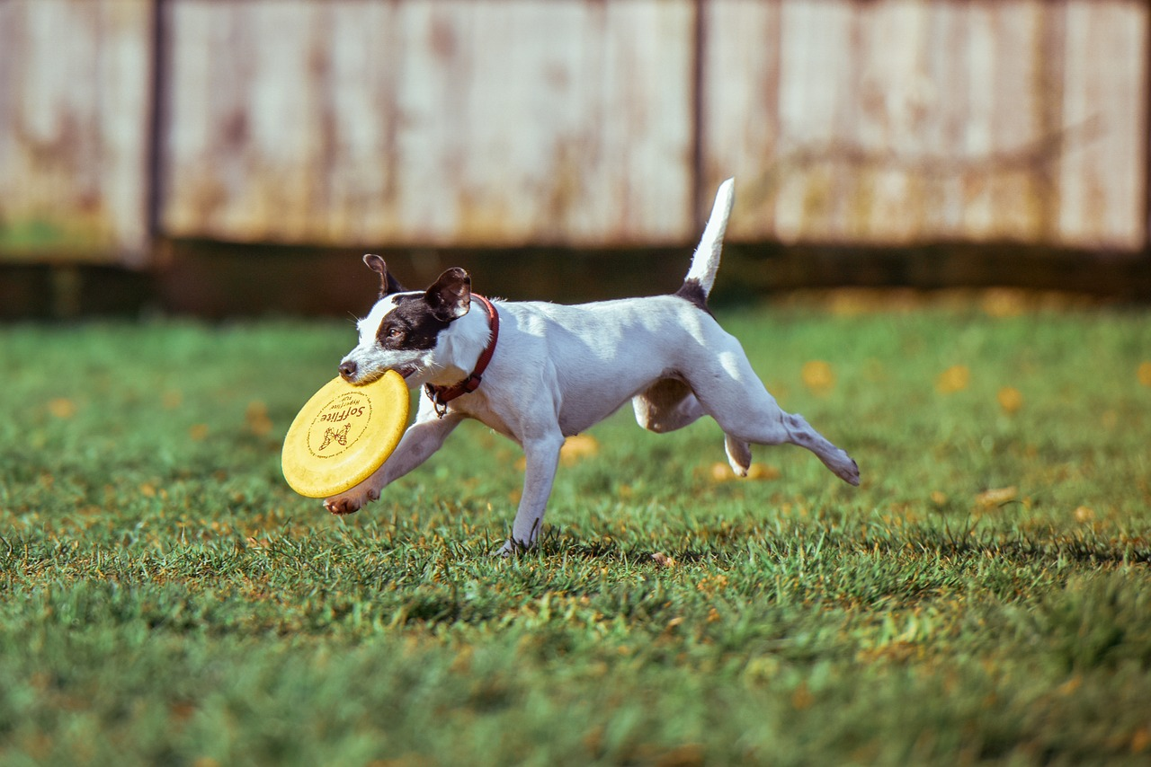


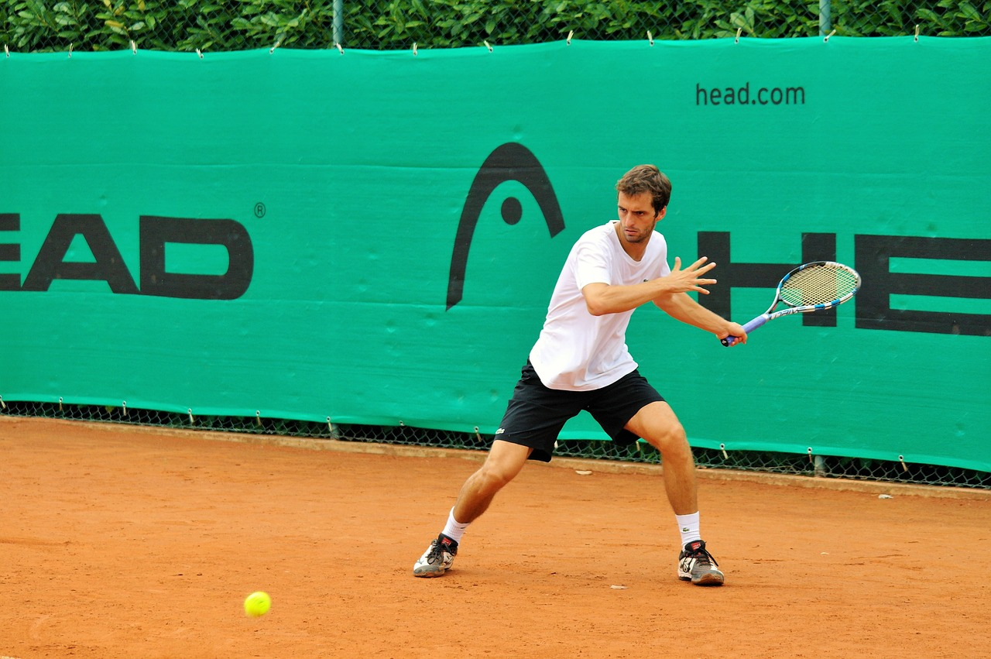
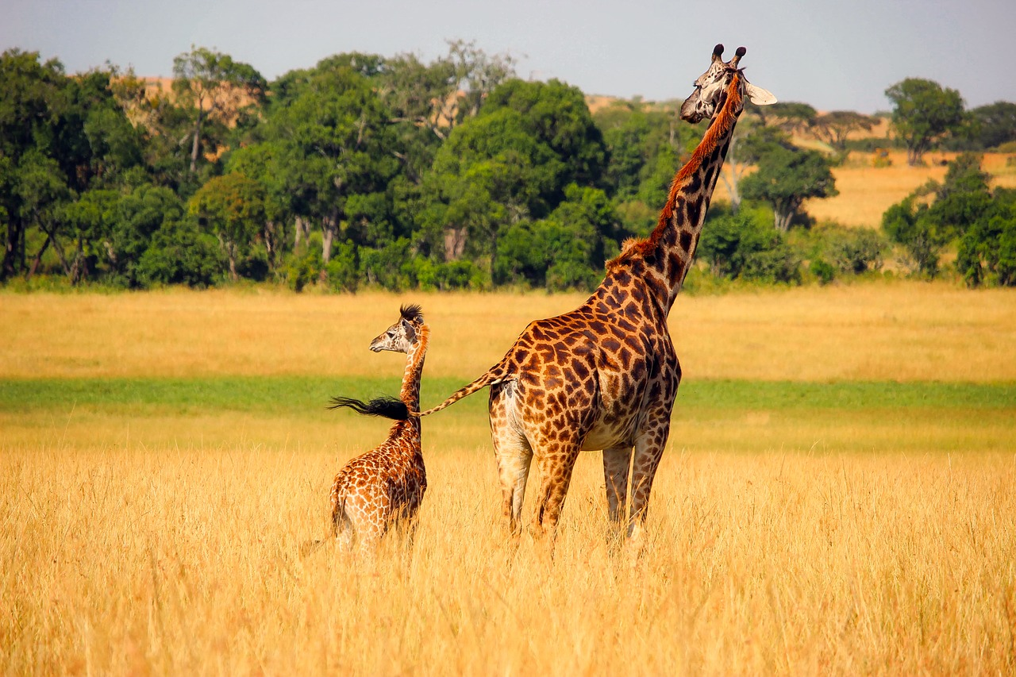
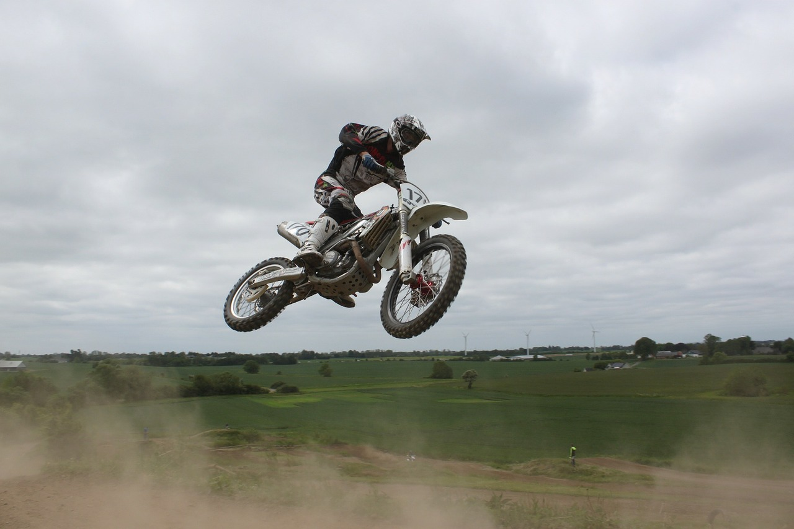
Image Captioning: Example Results
Captions generated using neuraltalk2
All images are CC0 Public domain: cat suitcase, cat tree, dog, bear, surfers, tennis, giraffe, motorcycle
A cat sitting on a suitcase on the floor
A cat is sitting on a tree branch
A dog is running in the grass with a frisbee
A white teddy bear sitting in the grass
Two people walking on the beach with surfboards
A tennis player in action on the court
Two giraffes standing in a grassy field
A man riding a dirt bike on a dirt track
Slide Credit: Fei-Fei Li, Justin Johnson, Serena Yeung, CS 231n

Slide 36


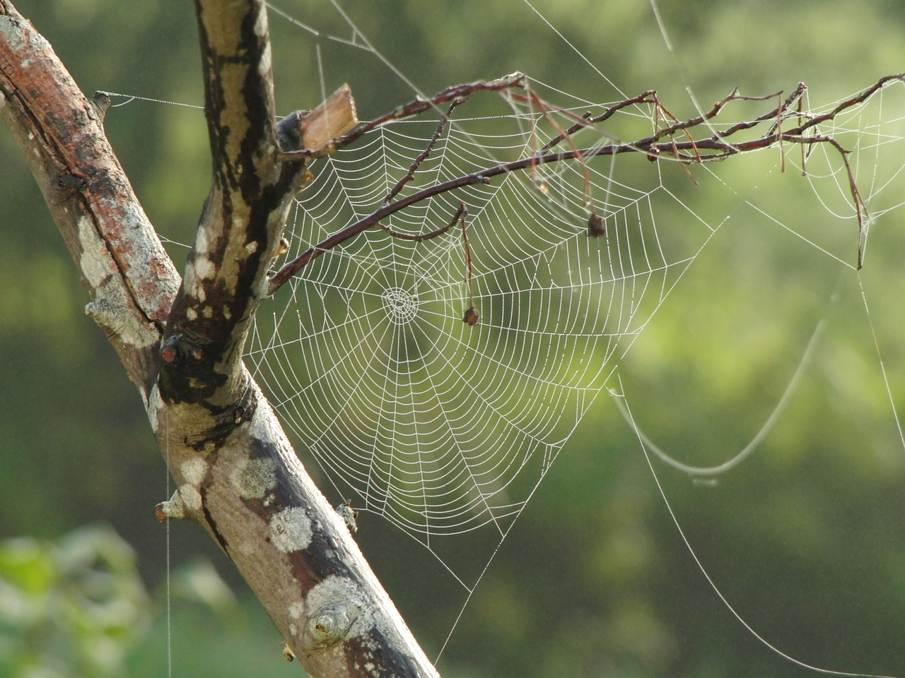


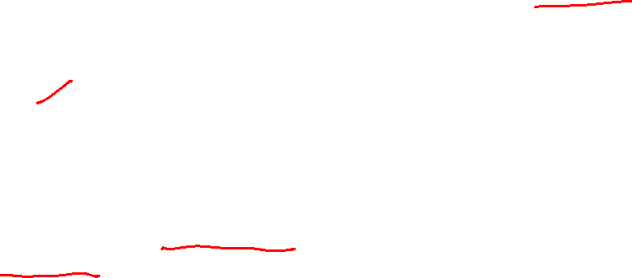
Image Captioning: Failure Cases
Captions generated using neuraltalk2
All images are CC0 Public domain: fur coat, handstand, spider web, baseball
A bird is perched on a tree branch
A woman is holding a cat in her hand
A man in a baseball uniform throwing a ball
A woman standing on a beach holding a surfboard
A person holding a computer mouse on a desk
Slide Credit: Fei-Fei Li, Justin Johnson, Serena Yeung, CS 231n

Slide 37
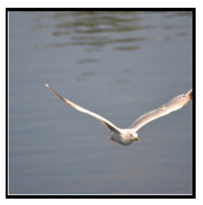
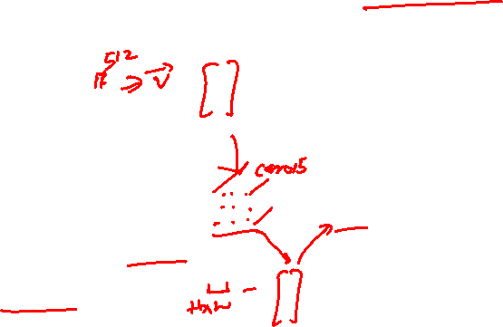
Image Captioning with Attention
CNN
h0
Features:
L x D
Image:
H x W x 3
Xu et al, “Show, Attend and Tell: Neural Image Caption Generation with Visual Attention”, ICML 2015
Slide Credit: Fei-Fei Li, Justin Johnson, Serena Yeung, CS 231n

Slide 38
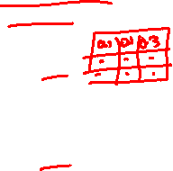
Image Captioning with Attention
Distribution over L locations
a1
CNN
h0
Features:
L x D
Image:
H x W x 3
Xu et al, “Show, Attend and Tell: Neural Image Caption Generation with Visual Attention”, ICML 2015
Slide Credit: Fei-Fei Li, Justin Johnson, Serena Yeung, CS 231n

Slide 39
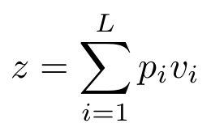
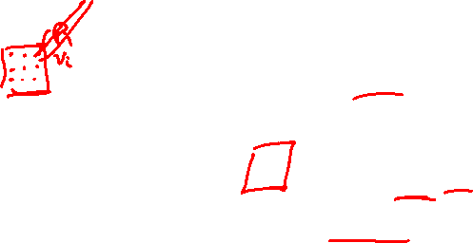
Image Captioning with Attention
Distribution over L locations
a1
CNN
h0
Features:
L x D
Image:
H x W x 3
Weighted features: D
z1
Weighted combination of features
Xu et al, “Show, Attend and Tell: Neural Image Caption Generation with Visual Attention”, ICML 2015
Slide Credit: Fei-Fei Li, Justin Johnson, Serena Yeung, CS 231n

Slide 40

Image Captioning with Attention
Distribution over L locations
a1
CNN
h0
h1
Features:
L x D
Image:
H x W x 3
Weighted features: D
z1
y1
Weighted combination of features
Xu et al, “Show, Attend and Tell: Neural Image Caption Generation with Visual Attention”, ICML 2015
First word
Slide Credit: Fei-Fei Li, Justin Johnson, Serena Yeung, CS 231n

Slide 41

Image Captioning with Attention
Distribution over L locations
Distribution
over vocab
a1
a2
d1
CNN
h0
h1
Features:
L x D
Image:
H x W x 3
Weighted features: D
z1
y1
Weighted combination of features
Xu et al, “Show, Attend and Tell: Neural Image Caption Generation with Visual Attention”, ICML 2015
First word
Slide Credit: Fei-Fei Li, Justin Johnson, Serena Yeung, CS 231n

Slide 42
Image Captioning with Attention
Distribution over L locations
Distribution
over vocab
a1
a2
d1
CNN
h0
h1
h2
Features:
L x D
Image:
H x W x 3
Weighted features: D
z1
y1
z2
y2
Weighted combination of features
Xu et al, “Show, Attend and Tell: Neural Image Caption Generation with Visual Attention”, ICML 2015
First word
Slide Credit: Fei-Fei Li, Justin Johnson, Serena Yeung, CS 231n

Slide 43
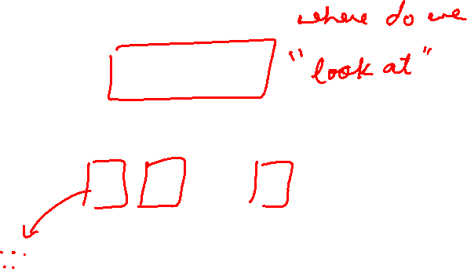
Image Captioning with Attention
Distribution over L locations
Distribution
over vocab
a1
a2
d1
a3
d2
CNN
h0
h1
h2
Features:
L x D
Image:
H x W x 3
Weighted features: D
z1
y1
z2
y2
Weighted combination of features
Xu et al, “Show, Attend and Tell: Neural Image Caption Generation with Visual Attention”, ICML 2015
First word
Slide Credit: Fei-Fei Li, Justin Johnson, Serena Yeung, CS 231n

Slide 44


Image Captioning with Attention
Soft attention
Hard attention
Xu et al, “Show, Attend, and Tell: Neural Image Caption Generation with Visual Attention”, ICML 2015
Figure copyright Kelvin Xu, Jimmy Lei Ba, Jamie Kiros, Kyunghyun Cho, Aaron Courville, Ruslan Salakhutdinov, Richard S. Zemel, and Yoshua Benchio, 2015. Reproduced with permission.
Slide Credit: Fei-Fei Li, Justin Johnson, Serena Yeung, CS 231n

Slide 45


Image Captioning with Attention
Xu et al, “Show, Attend, and Tell: Neural Image Caption Generation with Visual Attention”, ICML 2015
Figure copyright Kelvin Xu, Jimmy Lei Ba, Jamie Kiros, Kyunghyun Cho, Aaron Courville, Ruslan Salakhutdinov, Richard S. Zemel, and Yoshua Benchio, 2015. Reproduced with permission.
Slide Credit: Fei-Fei Li, Justin Johnson, Serena Yeung, CS 231n

Slide 46


Typical VQA Models
Neural Network
Softmax
over top K answers
Embedding (VGGNet)
Image
4096-dim
Convolution Layer
+ Non-Linearity
Pooling Layer
Convolution Layer
+ Non-Linearity
Pooling Layer
Fully-Connected MLP
Question
Embedding (LSTM)
“How many horses are in this image?”

Slide 47



Visual Question Answering: RNNs with Attention
Zhu et al, “Visual 7W: Grounded Question Answering in Images”, CVPR 2016
Figures from Zhu et al, copyright IEEE 2016. Reproduced for educational purposes.
Slide Credit: Fei-Fei Li, Justin Johnson, Serena Yeung, CS 231n

Slide 48

Plan for Today
Recurrent Neural Networks (RNNs)
  Inference: Beam Search
    Example: Image Captioning
  Multilayer RNNs
  Problems with gradients in “vanilla” RNNs
  LSTMs (and other RNN variants)

Slide 49


Multilayer RNNs
depth
time
Slide Credit: Fei-Fei Li, Justin Johnson, Serena Yeung, CS 231n

Slide 50


Vanilla RNN Gradient Flow
Bengio et al, “Learning long-term dependencies with gradient descent is difficult”, IEEE Transactions on Neural Networks, 1994
Pascanu et al, “On the difficulty of training recurrent neural networks”, ICML 2013
W
tanh
h_{t-1}
h_{t}
stack
x_{t}
Slide Credit: Fei-Fei Li, Justin Johnson, Serena Yeung, CS 231n

Slide 51

Vanilla RNN Gradient Flow
Bengio et al, “Learning long-term dependencies with gradient descent is difficult”, IEEE Transactions on Neural Networks, 1994
Pascanu et al, “On the difficulty of training recurrent neural networks”, ICML 2013
Backpropagation from h_{t} to h_{t-1} multiplies by W (actually W_{hh})
W
tanh
h_{t-1}
h_{t}
stack
x_{t}
Slide Credit: Fei-Fei Li, Justin Johnson, Serena Yeung, CS 231n

Slide 52


Vanilla RNN Gradient Flow
Bengio et al, “Learning long-term dependencies with gradient descent is difficult”, IEEE Transactions on Neural Networks, 1994
Pascanu et al, “On the difficulty of training recurrent neural networks”, ICML 2013
h₀
h₁
h₂
h₃
h₄
x₁
x₂
x₃
x₄
Computing gradient of h₀ involves many factors of W
(and repeated tanh)
Slide Credit: Fei-Fei Li, Justin Johnson, Serena Yeung, CS 231n

Slide 53

Vanilla RNN Gradient Flow
Bengio et al, “Learning long-term dependencies with gradient descent is difficult”, IEEE Transactions on Neural Networks, 1994
Pascanu et al, “On the difficulty of training recurrent neural networks”, ICML 2013
h₀
h₁
h₂
h₃
h₄
x₁
x₂
x₃
x₄
Largest singular value > 1: Exploding gradients
Largest singular value < 1:
Vanishing gradients
Computing gradient of h₀ involves many factors of W
(and repeated tanh)
Slide Credit: Fei-Fei Li, Justin Johnson, Serena Yeung, CS 231n

Slide 54


Vanilla RNN Gradient Flow
Bengio et al, “Learning long-term dependencies with gradient descent is difficult”, IEEE Transactions on Neural Networks, 1994
Pascanu et al, “On the difficulty of training recurrent neural networks”, ICML 2013
h₀
h₁
h₂
h₃
h₄
x₁
x₂
x₃
x₄
Largest singular value > 1: Exploding gradients
Largest singular value < 1:
Vanishing gradients
Gradient clipping: Scale gradient if its norm is too big
Computing gradient of h₀ involves many factors of W
(and repeated tanh)
Slide Credit: Fei-Fei Li, Justin Johnson, Serena Yeung, CS 231n

Slide 55
Vanilla RNN Gradient Flow
Bengio et al, “Learning long-term dependencies with gradient descent is difficult”, IEEE Transactions on Neural Networks, 1994
Pascanu et al, “On the difficulty of training recurrent neural networks”, ICML 2013
h₀
h₁
h₂
h₃
h₄
x₁
x₂
x₃
x₄
Largest singular value > 1: Exploding gradients
Largest singular value < 1:
Vanishing gradients
Computing gradient of h₀ involves many factors of W
(and repeated tanh)
Change RNN architecture
Slide Credit: Fei-Fei Li, Justin Johnson, Serena Yeung, CS 231n

Slide 56



Long Short Term Memory (LSTM)
Vanilla RNN
LSTM
Hochreiter and Schmidhuber, “Long Short Term Memory”, Neural Computation 1997
Slide Credit: Fei-Fei Li, Justin Johnson, Serena Yeung, CS 231n

Slide 57



Meet LSTMs
Image Credit: Christopher Olah (http://colah.github.io/posts/2015-08-Understanding-LSTMs/)

Slide 58


LSTMs Intuition: Memory
Cell State / Memory
Image Credit: Christopher Olah (http://colah.github.io/posts/2015-08-Understanding-LSTMs/)

Slide 59


LSTMs Intuition: Forget Gate
Should we continue to remember this “bit” of information or not?
Image Credit: Christopher Olah (http://colah.github.io/posts/2015-08-Understanding-LSTMs/)

Slide 60


LSTMs Intuition: Input Gate
Should we update this “bit” of information or not?
  If so, with what?
Image Credit: Christopher Olah (http://colah.github.io/posts/2015-08-Understanding-LSTMs/)

Slide 61


LSTMs Intuition: Memory Update
Forget that + memorize this
Image Credit: Christopher Olah (http://colah.github.io/posts/2015-08-Understanding-LSTMs/)

Slide 62


LSTMs Intuition: Output Gate
Should we output this “bit” of information to “deeper” layers?
Image Credit: Christopher Olah (http://colah.github.io/posts/2015-08-Understanding-LSTMs/)

Slide 63

LSTMs Intuition: Additive Updates
Backpropagation from c_{t} to c_{t-1} only elementwise multiplication by f, no matrix multiply by W
Image Credit: Christopher Olah (http://colah.github.io/posts/2015-08-Understanding-LSTMs/)

Slide 64
LSTMs Intuition: Additive Updates
Uninterrupted gradient flow!
Image Credit: Christopher Olah (http://colah.github.io/posts/2015-08-Understanding-LSTMs/)

Slide 65

LSTMs Intuition: Additive Updates
Uninterrupted gradient flow!
Similar to ResNet!
3x3 conv, 128
...
3x3 conv, 128
3x3 conv, 128
3x3 conv, 64
3x3 conv, 128
3x3 conv, 64
3x3 conv, 64
7x7 conv, 64 / 2
3x3 conv, 64
FC 1000
3x3 conv, 128 / 2
3x3 conv, 128
3x3 conv, 64
3x3 conv, 64
3x3 conv, 64
Pool
3x3 conv, 64
3x3 conv, 64
Input
3x3 conv, 64
3x3 conv, 64
3x3 conv, 64
Pool
Softmax
Image Credit: Christopher Olah (http://colah.github.io/posts/2015-08-Understanding-LSTMs/)

Slide 66
LSTMs
A pretty sophisticated cell
Image Credit: Christopher Olah (http://colah.github.io/posts/2015-08-Understanding-LSTMs/)

Slide 67


LSTM Variants #1: Peephole Connections
Let gates see the cell state / memory
Image Credit: Christopher Olah (http://colah.github.io/posts/2015-08-Understanding-LSTMs/)

Slide 68


LSTM Variants #2: Coupled Gates
Only memorize new if forgetting old
Image Credit: Christopher Olah (http://colah.github.io/posts/2015-08-Understanding-LSTMs/)

Slide 69

LSTM Variants #3: Gated Recurrent Units
Changes:
  No explicit memory; memory = hidden output
  Z = memorize new and forget old
Image Credit: Christopher Olah (http://colah.github.io/posts/2015-08-Understanding-LSTMs/)

Slide 70


Other RNN Variants
[An Empirical Exploration of
Recurrent Network Architectures,
Jozefowicz et al., 2015]

Slide 71
Summary
RNNs allow a lot of flexibility in architecture design
Vanilla RNNs are simple but don’t work very well
Common to use LSTM or GRU: their additive interactions improve gradient flow
Backward flow of gradients in RNN can explode or vanish. Exploding is controlled with gradient clipping. Vanishing is controlled with additive interactions (LSTM)
Better/simpler architectures are a hot topic of current research
Better understanding (both theoretical and empirical) is needed.

