Slide 1
CS 4803 / 7643: Deep Learning
Topics:
  (Finish) Convolutional Neural Networks
    Transposed convolutions
  Recurrent Neural Networks (RNNs)
Dhruv Batra
Georgia Tech

Slide 2
Administrativia
5 min talk by Vadini Agrawal (of CS + Social Good)
  Talk on Ethical considerations within deep learning
Notes:
Vadini Agrawal is a fourth year CS major at Tech. She is part of an organization called CS + Social Good. The presentation covers some of the ethical considerations within deep learning. CS + Social Good is an organization on campus that aims to show how computing can be utilized for good in our academic and professional lives. They also hope to incorporate more ethics into the CS coursework at Tech, which is why they are presenting today.

Slide 3
Administrativia
HW3 Reminder
  Due: 10/07 11:59pm
  Theory: Convolutions, Representation Capacity, Double Descent
  Implementation: Saliency methods (e.g. Grad-CAM) in Python and PyTorch/Captum

Slide 4
Thoughts on Zhang et al. ICLR17

Slide 5
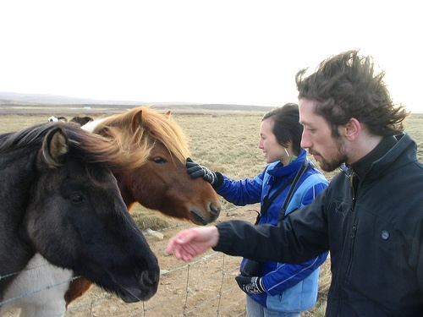
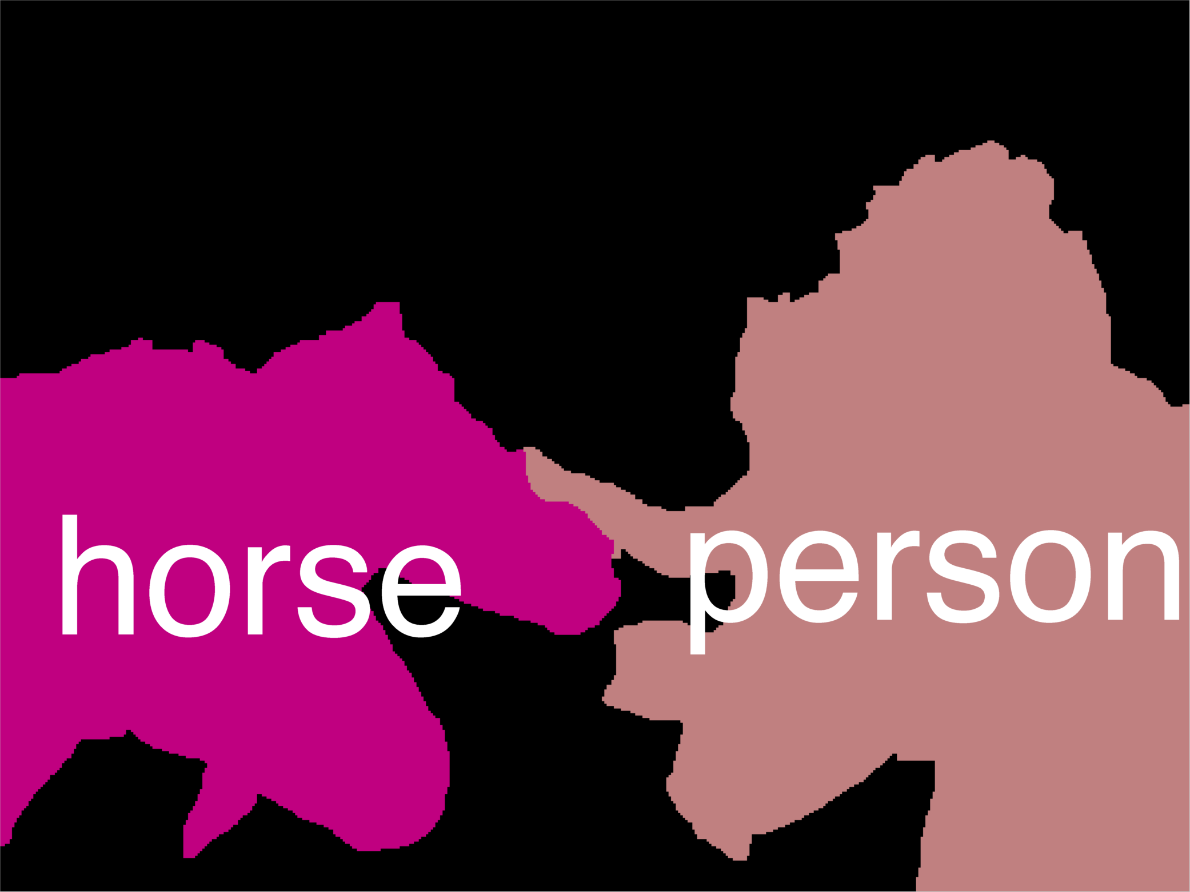
Error Decomposition
Reality
Multi-class Logistic Regression
Modeling Error
Softmax
FC HxWx3
Input
Estimation
Error
Optimization
Error = 0
model class

Slide 6
Regularization: Prefer Simpler Models
f₁
f₂
y
x
Regularization pushes against fitting the data too well so we don’t fit noise in the data
Slide Credit: Fei-Fei Li, Justin Johnson, Serena Yeung, CS 231n

Slide 7
Thoughts on Zhang et al. ICLR17
Randomization testing is a powerful tool
What does 0 training error on random labels mean?
  No optimization error
  No approximation/modeling error
Explicit regularization is helpful, but not essential
Inductive bias
  Conv is a specific inductive bias, but even when data doesn’t satisfy that, the model class is expressive enough
Implicit regularization of SGD
  See HW3 Q6
These results are not specific to deep learning / NN
  Also known to happen for decision trees

Slide 8
Plan for Today
(Finish) Convolutional Neural Networks
  Transposed convolutions
Recurrent Neural Networks (RNNs)
  A new model class
  Learning: BackProp Through Time (BPTT)

Slide 9
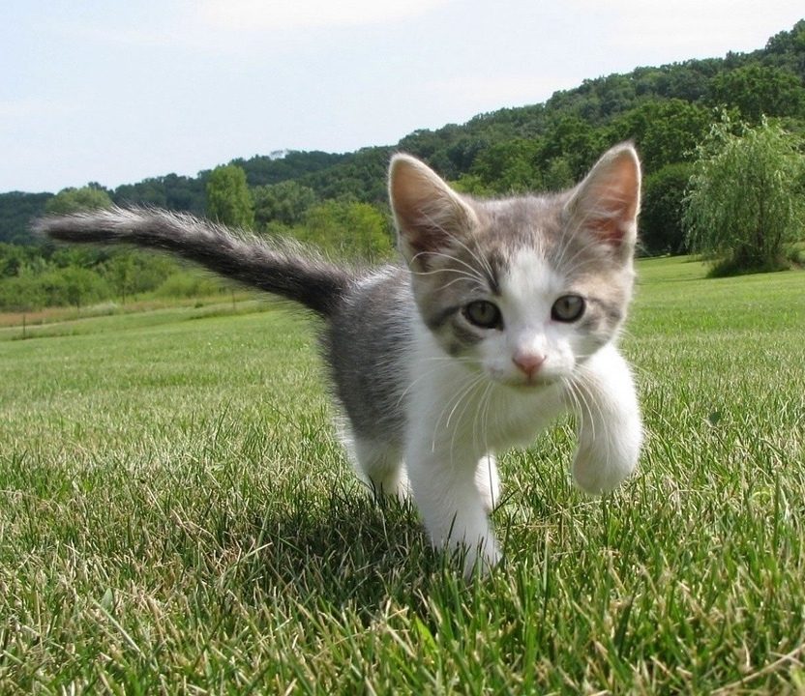
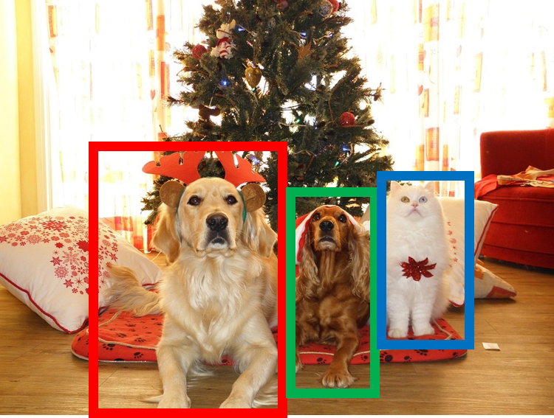
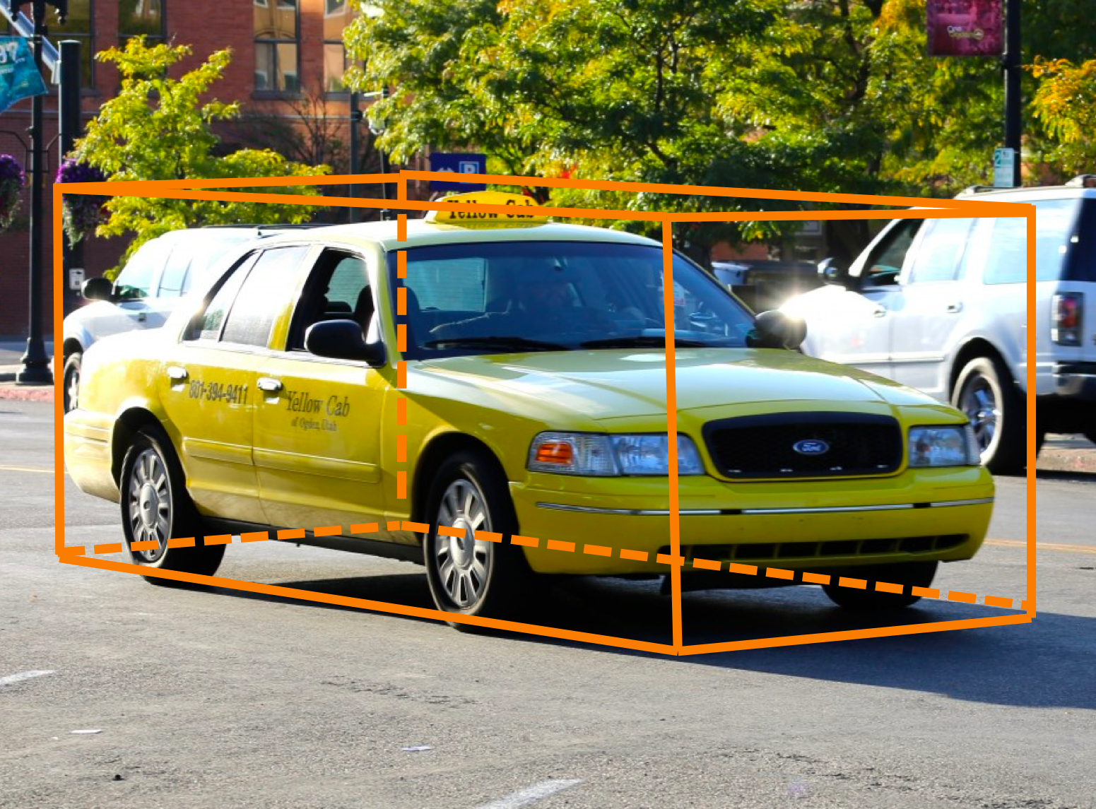
Other Computer Vision Tasks
Semantic
Segmentation
2D Object
Detection
3D Object
Detection
GRASS, CAT, TREE, SKY
DOG, DOG, CAT
Car
Object categories +
2D bounding boxes
Object categories +
3D bounding boxes
No objects, just pixels
This image is CC0 public domain
Slide Credit: Fei-Fei Li, Justin Johnson, Serena Yeung, CS 231n

Slide 10
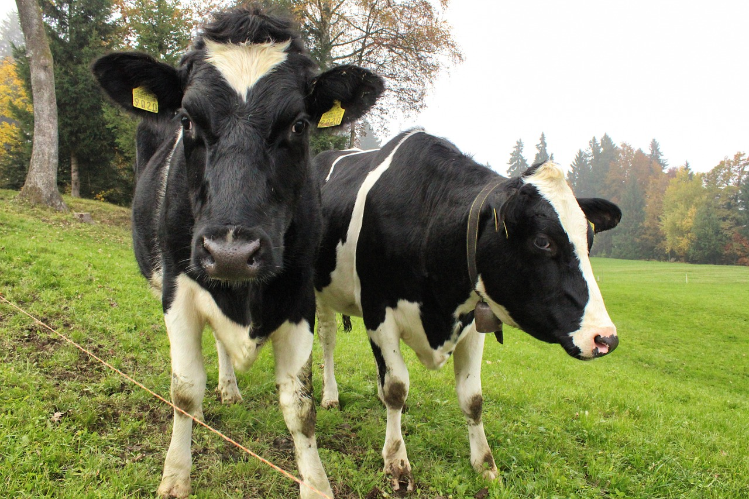
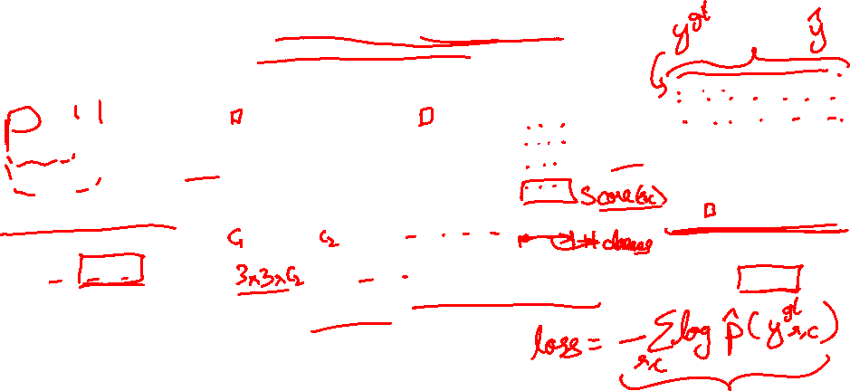
Semantic Segmentation Idea: Fully Convolutional
Design a network as a bunch of convolutional layers to make predictions for pixels all at once!
Conv
Conv
Conv
Conv
argmax
Input:
3 x H x W
Predictions:
H x W
Scores:
C x H x W
Problem: convolutions at original image resolution will be very expensive ...
Convolutions:
D x H x W
Slide Credit: Fei-Fei Li, Justin Johnson, Serena Yeung, CS 231n

Slide 11
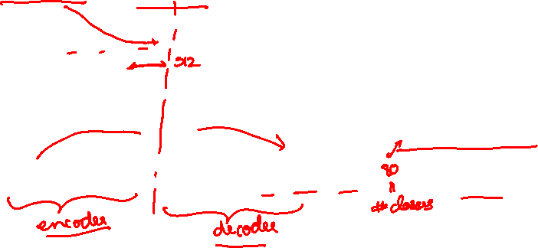
Semantic Segmentation Idea: Fully Convolutional
Design network as a bunch of convolutional layers, with downsampling and upsampling inside the network!
Med-res:
D₂ x H/4 x W/4
Med-res:
D₂ x H/4 x W/4
Low-res:
D₃ x H/4 x W/4
Input:
3 x H x W
High-res:
D₁ x H/2 x W/2
High-res:
D₁ x H/2 x W/2
Predictions:
H x W
Long, Shelhamer, and Darrell, “Fully Convolutional Networks for Semantic Segmentation”, CVPR 2015
Noh et al, “Learning Deconvolution Network for Semantic Segmentation”, ICCV 2015
Slide Credit: Fei-Fei Li, Justin Johnson, Serena Yeung, CS 231n

Slide 12

Semantic Segmentation Idea: Fully Convolutional
Downsampling:
Pooling, strided convolution
Design network as a bunch of convolutional layers, with downsampling and upsampling inside the network!
Upsampling:
???
Med-res:
D₂ x H/4 x W/4
Med-res:
D₂ x H/4 x W/4
Low-res:
D₃ x H/4 x W/4
Input:
3 x H x W
High-res:
D₁ x H/2 x W/2
High-res:
D₁ x H/2 x W/2
Predictions:
H x W
Long, Shelhamer, and Darrell, “Fully Convolutional Networks for Semantic Segmentation”, CVPR 2015
Noh et al, “Learning Deconvolution Network for Semantic Segmentation”, ICCV 2015
Slide Credit: Fei-Fei Li, Justin Johnson, Serena Yeung, CS 231n

Slide 13
In-Network upsampling: “Unpooling”
Nearest Neighbor
“Bed of Nails”
1 | 0 | 2 | 0
0 | 0 | 0 | 0
3 | 0 | 4 | 0
0 | 0 | 0 | 0
1 | 1 | 2 | 2
1 | 1 | 2 | 2
3 | 3 | 4 | 4
3 | 3 | 4 | 4
1 | 2
3 | 4
1 | 2
3 | 4
Input: 2 x 2
Output: 4 x 4
Input: 2 x 2
Output: 4 x 4
Slide Credit: Fei-Fei Li, Justin Johnson, Serena Yeung, CS 231n

Slide 14
In-Network upsampling: “Max Unpooling”
Max Pooling
Remember which element was max!
Max Unpooling
Use positions from pooling layer
1 | 2 | 6 | 3
3 | 5 | 2 | 1
1 | 2 | 2 | 1
7 | 3 | 4 | 8
0 | 0 | 2 | 0
0 | 1 | 0 | 0
0 | 0 | 0 | 0
3 | 0 | 0 | 4
5 | 6
7 | 8
…
1 | 2
3 | 4
Rest of the network
Input: 4 x 4
Output: 2 x 2
Input: 2 x 2
Output: 4 x 4
Corresponding pairs of downsampling and upsampling layers
Slide Credit: Fei-Fei Li, Justin Johnson, Serena Yeung, CS 231n

Slide 15
Transposed Convolutions
Deconvolution (bad)
Upconvolution
Fractionally strided convolution
Backward strided convolution

Slide 16

Learnable Upsampling: Transpose Convolution
Recall: Normal 3 x 3 convolution, stride 1 pad 1
Dot product between filter and input
Input: 4 x 4
Output: 4 x 4
Slide Credit: Fei-Fei Li, Justin Johnson, Serena Yeung, CS 231n

Slide 17
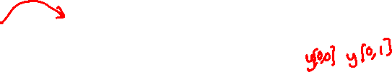
Learnable Upsampling: Transpose Convolution
Recall: Normal 3 x 3 convolution, stride 2 pad 1
Filter moves 2 pixels in the input for every one pixel in the output
Stride gives ratio between movement in input and output
Dot product between filter and input
Input: 4 x 4
Output: 2 x 2
Slide Credit: Fei-Fei Li, Justin Johnson, Serena Yeung, CS 231n

Slide 18
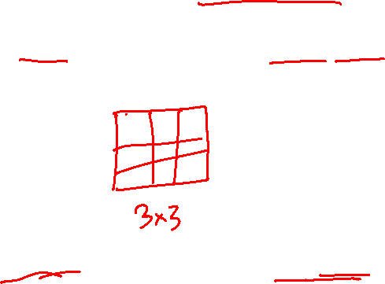
Learnable Upsampling: Transpose Convolution
3 x 3 transpose convolution, stride 2 pad 1
Input: 2 x 2
Output: 4 x 4
Slide Credit: Fei-Fei Li, Justin Johnson, Serena Yeung, CS 231n

Slide 19
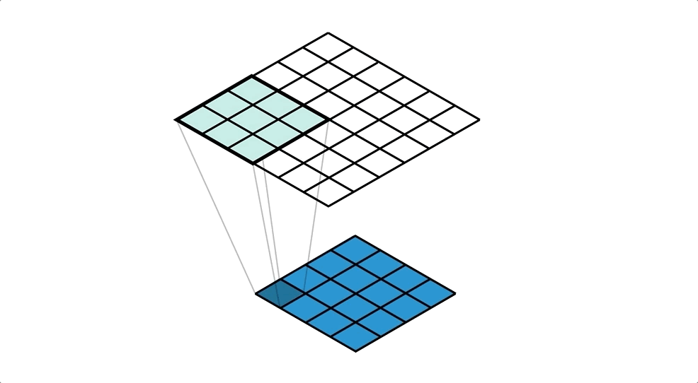
Figure Credit: https://medium.com/apache-mxnet/transposed-convolutions-explained-with-ms-excel-52d13030c7e8

Slide 20
Transpose Convolution: 1D Example
Output
Input
Filter
ax
ay
az + bx
by
bz
Output contains copies of the filter weighted by the input, summing at where at overlaps in the output
Need to crop one pixel from output to make output exactly 2x input
x
y
z
a
b
Slide Credit: Fei-Fei Li, Justin Johnson, Serena Yeung, CS 231n

Slide 21
In-Network upsampling: “Unpooling”
Nearest Neighbor
“Bed of Nails”
1 | 0 | 2 | 0
0 | 0 | 0 | 0
3 | 0 | 4 | 0
0 | 0 | 0 | 0
1 | 1 | 2 | 2
1 | 1 | 2 | 2
3 | 3 | 4 | 4
3 | 3 | 4 | 4
1 | 2
3 | 4
1 | 2
3 | 4
Input: 2 x 2
Output: 4 x 4
Input: 2 x 2
Output: 4 x 4
Slide Credit: Fei-Fei Li, Justin Johnson, Serena Yeung, CS 231n

Slide 22
Why this operation?

Slide 23
Why is it called “transposed convolution”?

Slide 24
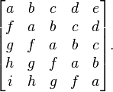
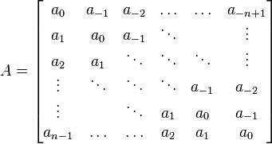
Toeplitz Matrix
Diagonals are constants
A_{ij} = a_{i-j}

Slide 25
Why do we care?
(Discrete) Convolution = Matrix Multiplication
  with Toeplitz Matrices
. . .

Slide 26
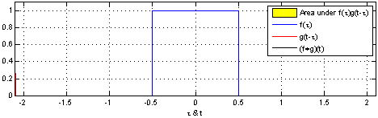
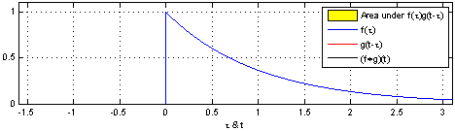
"Convolution of box signal with itself2" by Convolution_of_box_signal_with_itself.gif: Brian Ambergderivative work: Tinos (talk) - Convolution_of_box_signal_with_itself.gif. Licensed under CC BY-SA 3.0 via Commons - https://commons.wikimedia.org/wiki/File:Convolution_of_box_signal_with_itself2.gif#/media/File:Convolution_of_box_signal_with_itself2.gif

Slide 27
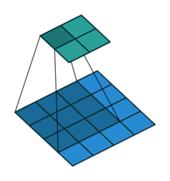
Figure Credit: Dumoulin and Visin, https://arxiv.org/pdf/1603.07285.pdf

Slide 28
Why is it called “transposed convolution”

Slide 29
Transpose Convolution: 1D Example
Output
Input
Filter
ax
ay
az + bx
by
bz
Output contains copies of the filter weighted by the input, summing at where at overlaps in the output
Need to crop one pixel from output to make output exactly 2x input
x
y
z
a
b
Slide Credit: Fei-Fei Li, Justin Johnson, Serena Yeung, CS 231n

Slide 30
What is deconvolution?
(Non-blind) Deconvolution

Slide 31
What is deconvolution?
(Non-blind) Deconvolution
. . .

Slide 32
What does “deconvolution” have to do with “transposed convolution”?

Slide 33

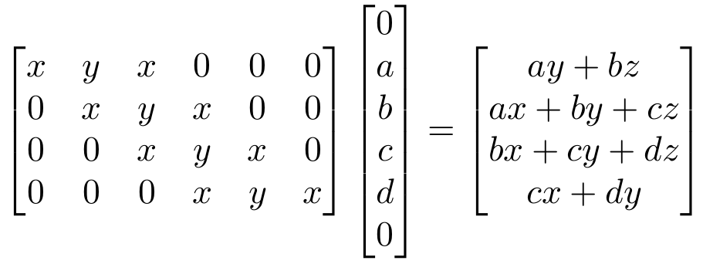
“transposed convolution” is a convolution!
We can express convolution in terms of a matrix multiplication
Example: 1D conv, kernel size=3, stride=1, padding=1
Slide Credit: Fei-Fei Li, Justin Johnson, Serena Yeung, CS 231n

Slide 34

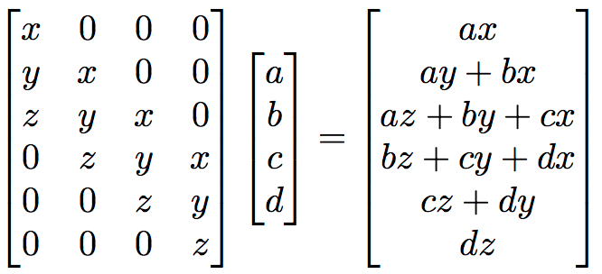
“transposed convolution” is a convolution!
We can express convolution in terms of a matrix multiplication
Convolution transpose multiplies by the transpose of the same matrix:
Example: 1D conv, kernel size=3, stride=1, padding=1
Slide Credit: Fei-Fei Li, Justin Johnson, Serena Yeung, CS 231n

Slide 35
“transposed convolution” is a convolution!
We can express convolution in terms of a matrix multiplication
Convolution transpose multiplies by the transpose of the same matrix:
Example: 1D conv, kernel size=3, stride=1, padding=1
When stride=1, convolution transpose is just a regular convolution (with different padding rules)
Slide Credit: Fei-Fei Li, Justin Johnson, Serena Yeung, CS 231n

Slide 36
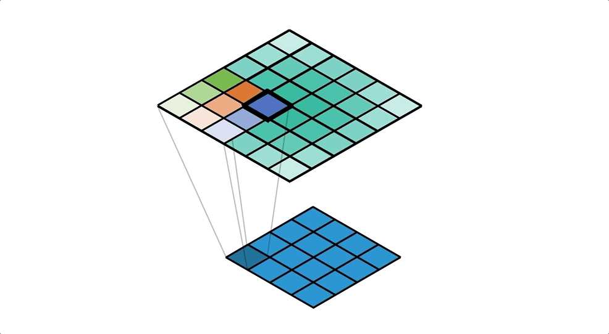
Figure Credit: https://medium.com/apache-mxnet/transposed-convolutions-explained-with-ms-excel-52d13030c7e8

Slide 37
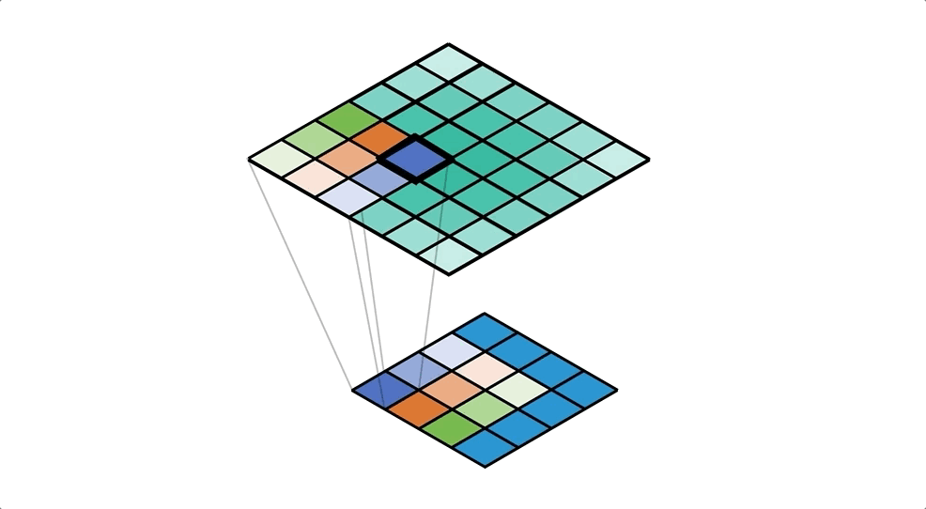
Figure Credit: https://medium.com/apache-mxnet/transposed-convolutions-explained-with-ms-excel-52d13030c7e8

Slide 38
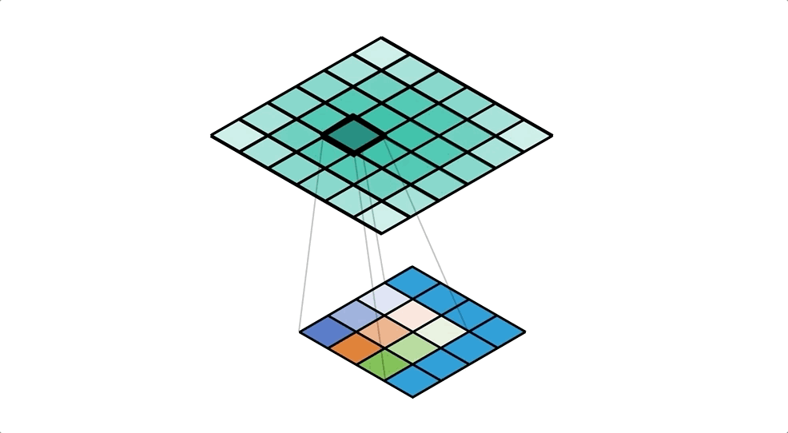
Figure Credit: https://medium.com/apache-mxnet/transposed-convolutions-explained-with-ms-excel-52d13030c7e8

Slide 39
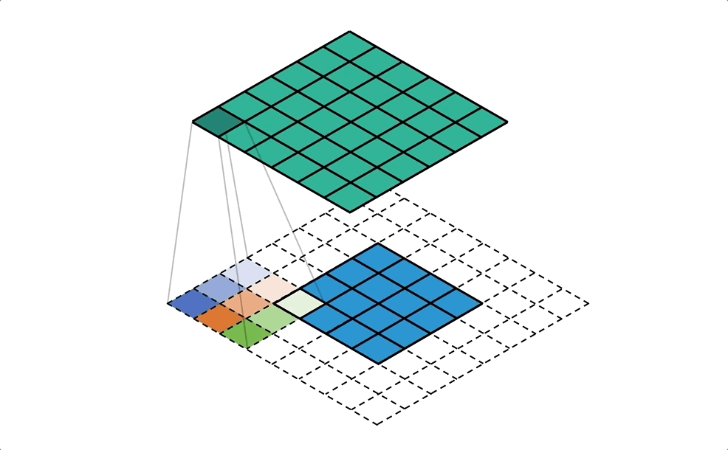
Figure Credit: https://medium.com/apache-mxnet/transposed-convolutions-explained-with-ms-excel-52d13030c7e8

Slide 40
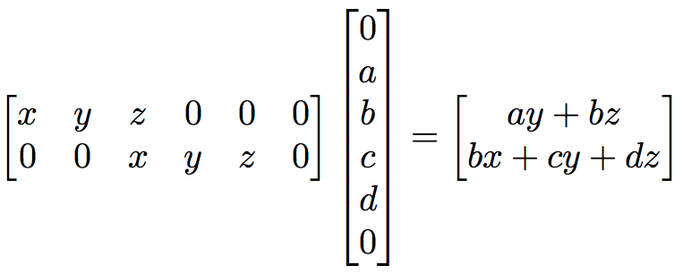
But not always
We can express convolution in terms of a matrix multiplication
Example: 1D conv, kernel size=3, stride=2, padding=1
Slide Credit: Fei-Fei Li, Justin Johnson, Serena Yeung, CS 231n

Slide 41
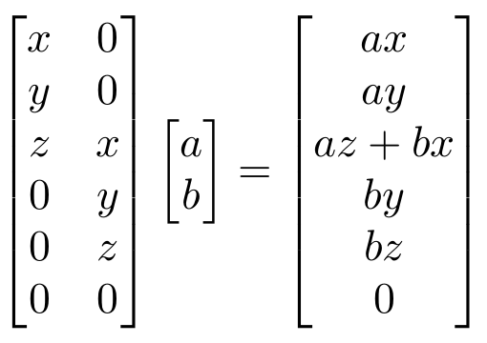
But not always
We can express convolution in terms of a matrix multiplication
Convolution transpose multiplies by the transpose of the same matrix:
Example: 1D conv, kernel size=3, stride=2, padding=1
When stride>1, convolution transpose is no longer a normal convolution!
Slide Credit: Fei-Fei Li, Justin Johnson, Serena Yeung, CS 231n

Slide 42
Plan for Today
(Finish) Convolutional Neural Networks
  Transposed convolutions
Recurrent Neural Networks (RNNs)
  A new model class
  Learning: BackProp Through Time (BPTT)

Slide 43
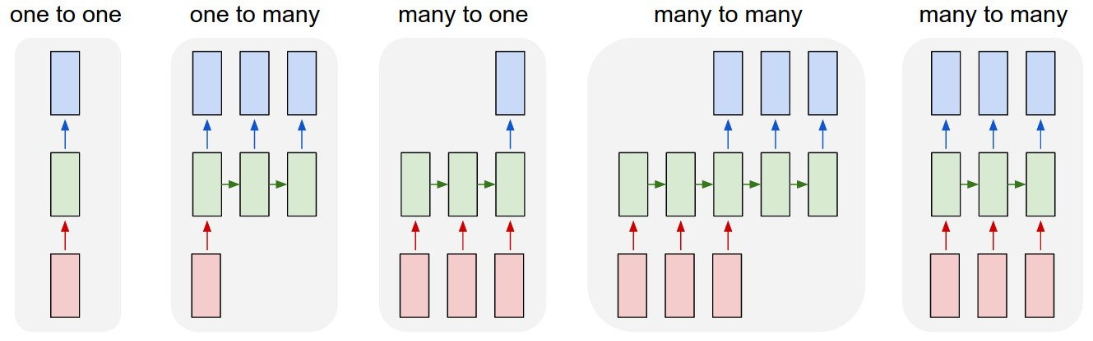
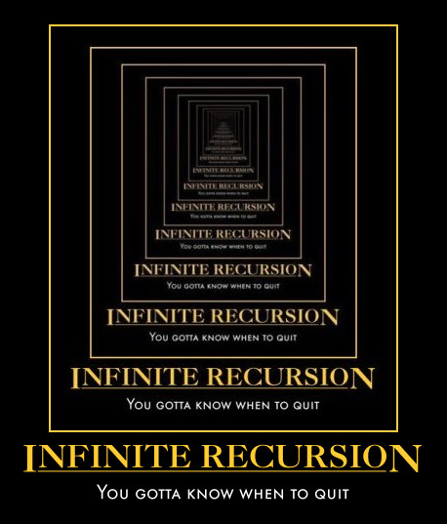
New Topic: RNNs
Image Credit: Andrej Karpathy

Slide 44
New Words
Recurrent Neural Networks (RNNs)
Recursive Neural Networks
  General family; think graphs instead of chains
Types:
  “Vanilla” RNNs (Elman Networks)
  Long Short Term Memory (LSTMs)
  Gated Recurrent Units (GRUs)
  …
Algorithms
  BackProp Through Time (BPTT)
  BackProp Through Structure (BPTS)

Slide 45
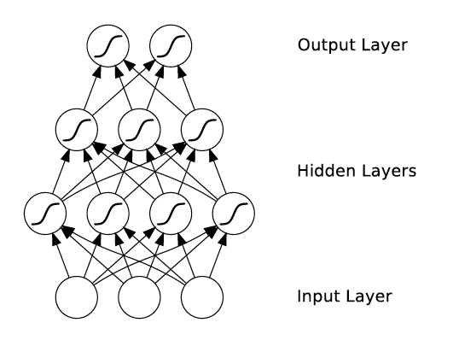
What’s wrong with MLPs?
Problem 1: Can’t model sequences
  Fixed-sized Inputs & Outputs
  No temporal structure
Image Credit: Alex Graves, book

Slide 46
What’s wrong with MLPs?
Problem 1: Can’t model sequences
  Fixed-sized Inputs & Outputs
  No temporal structure
Problem 2: Pure feed-forward processing
  No “memory”, no feedback
Image Credit: Alex Graves, book

Slide 47
Why model sequences?
Figure Credit: Carlos Guestrin

Slide 48
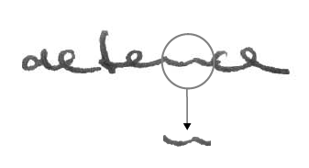
Why model sequences?
Image Credit: Alex Graves

Slide 49
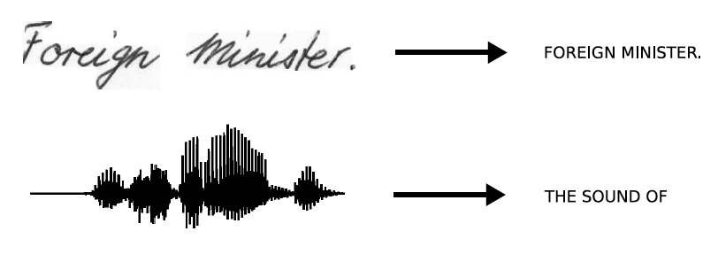
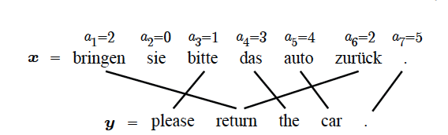
Sequences are everywhere…
Image Credit: Alex Graves and Kevin Gimpel

Slide 50
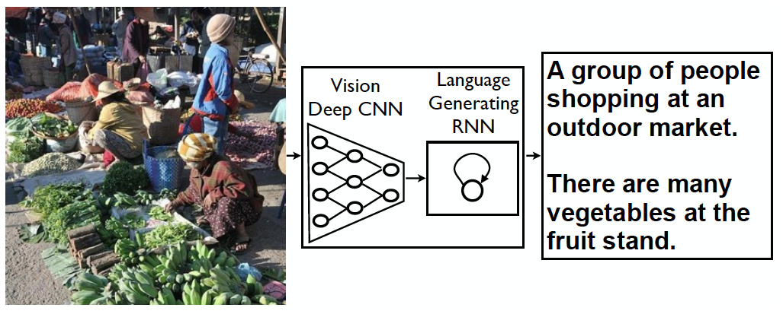
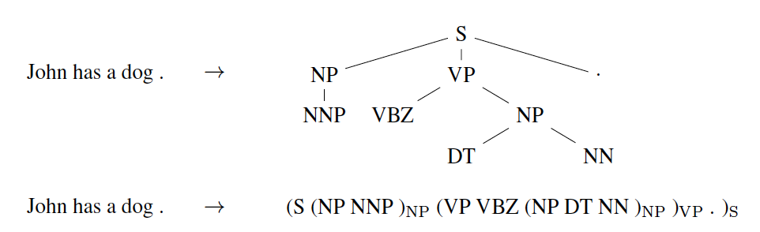
Even where you might not expect a sequence…
Image Credit: Vinyals et al.

Slide 51
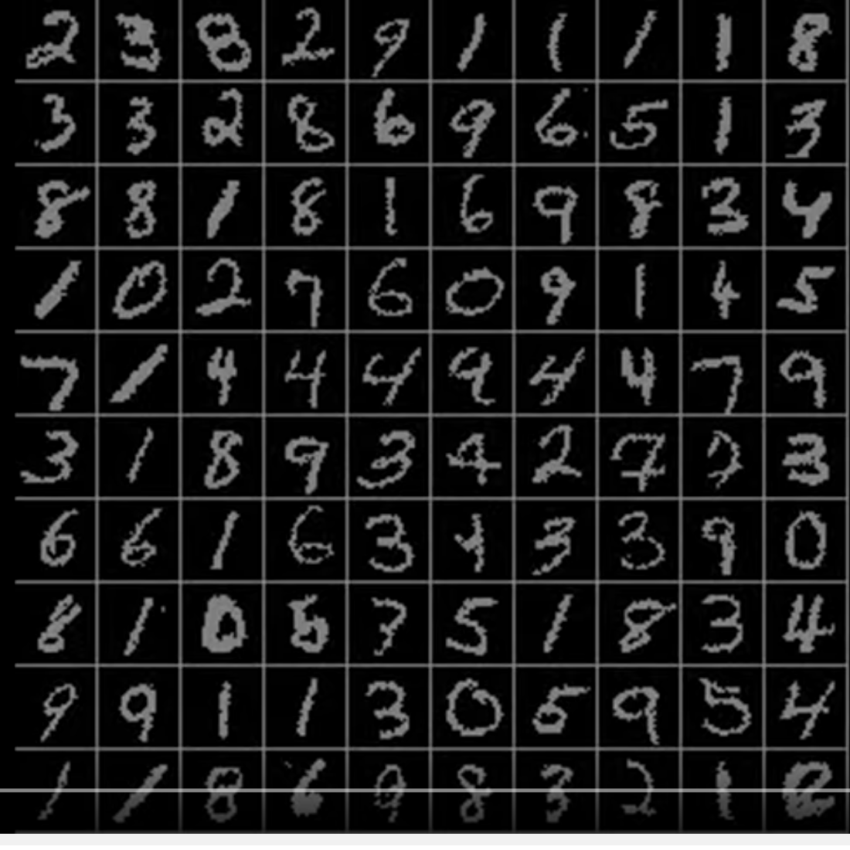
Even where you might not expect a sequence…
Classify images by taking a series of “glimpses”
Ba, Mnih, and Kavukcuoglu, “Multiple Object Recognition with Visual Attention”, ICLR 2015.
Gregor et al, “DRAW: A Recurrent Neural Network For Image Generation”, ICML 2015
Figure copyright Karol Gregor, Ivo Danihelka, Alex Graves, Danilo Jimenez Rezende, and Daan Wierstra, 2015. Reproduced with permission.
Slide Credit: Fei-Fei Li, Justin Johnson, Serena Yeung, CS 231n

Slide 52
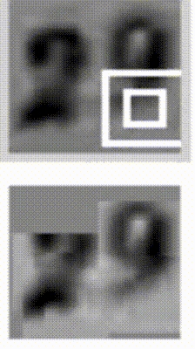
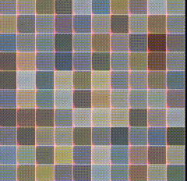
Even where you might not expect a sequence…
Output ordering = sequence
Image Credit: Ba et al.; Gregor et al

Slide 53
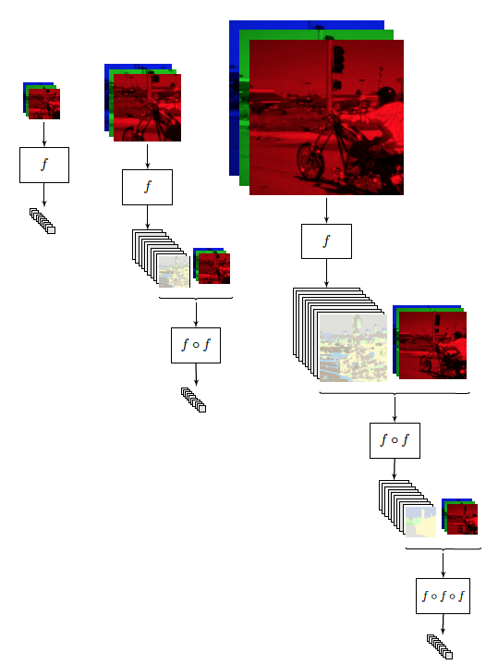
Image Credit: [Pinheiro and Collobert, ICML14]

Slide 54
Sequences in Input or Output?
It’s a spectrum…
Input: No sequence
Output: No sequence
Example: “standard” classification /
regression problems
Image Credit: Andrej Karpathy

Slide 55
Sequences in Input or Output?
It’s a spectrum…
Input: No sequence
Output: No sequence
Example: “standard” classification /
regression problems
Input: No sequence
Output: Sequence
Example: Im2Caption
Image Credit: Andrej Karpathy

Slide 56
Sequences in Input or Output?
It’s a spectrum…
Input: No sequence
Output: No sequence
Example: “standard” classification /
regression problems
Input: No sequence
Output: Sequence
Example: Im2Caption
Input: Sequence
Output: No sequence
Example: sentence classification, multiple-choice question answering
Image Credit: Andrej Karpathy

Slide 57
Sequences in Input or Output?
It’s a spectrum…
Input: No sequence
Output: No sequence
Example: “standard” classification /
regression problems
Input: No sequence
Output: Sequence
Example: Im2Caption
Input: Sequence
Output: No sequence
Example: sentence classification, multiple-choice question answering
Input: Sequence
Output: Sequence
Example: machine translation, video classification,
video captioning, open-ended question answering
Image Credit: Andrej Karpathy

Slide 58
2 Key Ideas
Parameter Sharing
  in computation graphs = adding gradients

Slide 59
Computational Graph
Slide Credit: Marc'Aurelio Ranzato

Slide 60
Gradients add at branches
+
Slide Credit: Fei-Fei Li, Justin Johnson, Serena Yeung, CS 231n
Notes:
Gradients add at branches, from multivariate chain rule
Since wiggling this node affects both connected nodes in the forward pass, then at backprop the upstream gradient coming into this node is the sum of the gradients flowing back from both nodes

Slide 61
Duality in Fprop and Bprop
FPROP
BPROP
SUM
+
COPY
+

Slide 62
2 Key Ideas
Parameter Sharing
  in computation graphs = adding gradients
“Unrolling”
  in computation graphs with parameter sharing

Slide 63

How do we model sequences?
No input
Image Credit: Bengio, Goodfellow, Courville

Slide 64
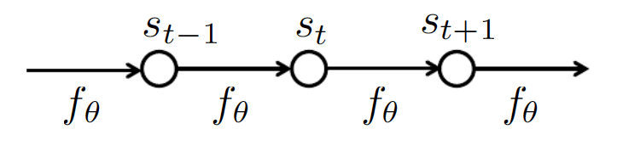
How do we model sequences?
No input
Image Credit: Bengio, Goodfellow, Courville

Slide 65

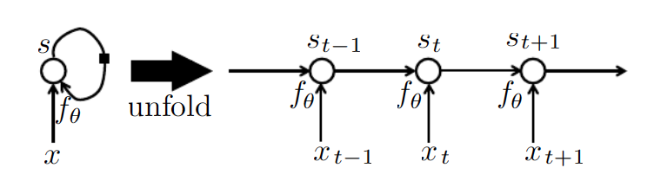
How do we model sequences?
With inputs
Image Credit: Bengio, Goodfellow, Courville

Slide 66
2 Key Ideas
Parameter Sharing
  in computation graphs = adding gradients
“Unrolling”
  in computation graphs with parameter sharing
Parameter sharing + Unrolling
  Allows modeling arbitrary sequence lengths!
  Keeps numbers of parameters in check

Slide 67
Recurrent Neural Network
RNN
x
Slide Credit: Fei-Fei Li, Justin Johnson, Serena Yeung, CS 231n

Slide 68
Recurrent Neural Network
y
usually want to predict a vector at some time steps
RNN
x
Slide Credit: Fei-Fei Li, Justin Johnson, Serena Yeung, CS 231n

Slide 69

Recurrent Neural Network
We can process a sequence of vectors x by applying a recurrence formula at every time step:
y
RNN
new state
old state
input vector at some time step
some function
with parameters W
x
Slide Credit: Fei-Fei Li, Justin Johnson, Serena Yeung, CS 231n

Slide 70
Recurrent Neural Network
We can process a sequence of vectors x by applying a recurrence formula at every time step:
y
RNN
Notice: the same function and the same set of parameters are used at every time step.
x
Slide Credit: Fei-Fei Li, Justin Johnson, Serena Yeung, CS 231n

Slide 71
(Vanilla) Recurrent Neural Network
The state consists of a single “hidden” vector h:
y
RNN
x
Sometimes called a “Vanilla RNN” or an “Elman RNN” after Prof. Jeffrey Elman
Slide Credit: Fei-Fei Li, Justin Johnson, Serena Yeung, CS 231n

Slide 72
RNN: Computational Graph
h₀
f_{W}
h₁
x₁
Slide Credit: Fei-Fei Li, Justin Johnson, Serena Yeung, CS 231n

Slide 73
RNN: Computational Graph
h₀
f_{W}
h₁
f_{W}
h₂
x₁
x₂
Slide Credit: Fei-Fei Li, Justin Johnson, Serena Yeung, CS 231n

Slide 74
RNN: Computational Graph
h₀
h₁
h₂
h₃
…
h_{T}
f_{W}
f_{W}
f_{W}
x₁
x₂
x₃
Slide Credit: Fei-Fei Li, Justin Johnson, Serena Yeung, CS 231n

Slide 75
RNN: Computational Graph
Re-use the same weight matrix at every time-step
h₀
h₁
h₂
h₃
…
h_{T}
f_{W}
f_{W}
f_{W}
x₁
x₂
x₃
W
Slide Credit: Fei-Fei Li, Justin Johnson, Serena Yeung, CS 231n

Slide 76
RNN: Computational Graph: Many to Many
y₁
y₂
y₃
y_{T}
h₀
h₁
h₂
h₃
…
h_{T}
f_{W}
f_{W}
f_{W}
x₁
x₂
x₃
W
Slide Credit: Fei-Fei Li, Justin Johnson, Serena Yeung, CS 231n

Slide 77
RNN: Computational Graph: Many to Many
y₁
y₂
y₃
y_{T}
L₁
L₂
L₃
L_{T}
h₀
h₁
h₂
h₃
…
h_{T}
f_{W}
f_{W}
f_{W}
x₁
x₂
x₃
W
Slide Credit: Fei-Fei Li, Justin Johnson, Serena Yeung, CS 231n

Slide 78
L
RNN: Computational Graph: Many to Many
y₁
y₂
y₃
y_{T}
L₁
L₂
L₃
L_{T}
h₀
h₁
h₂
h₃
…
h_{T}
f_{W}
f_{W}
f_{W}
x₁
x₂
x₃
W
Slide Credit: Fei-Fei Li, Justin Johnson, Serena Yeung, CS 231n

Slide 79
RNN: Computational Graph: Many to One
y
h₀
h₁
h₂
h₃
…
h_{T}
f_{W}
f_{W}
f_{W}
x₁
x₂
x₃
W
Slide Credit: Fei-Fei Li, Justin Johnson, Serena Yeung, CS 231n

Slide 80
RNN: Computational Graph: One to Many
y₁
y₂
y₃
y_{T}
h₀
h₁
h₂
h₃
…
h_{T}
f_{W}
f_{W}
f_{W}
x
W
Slide Credit: Fei-Fei Li, Justin Johnson, Serena Yeung, CS 231n

Slide 81
Sequence to Sequence: Many-to-one + one-to-many
Many to one: Encode input sequence in a single vector
h₀
f_{W}
h₁
f_{W}
h₂
f_{W}
h₃
…
h_{T}
x₁
x₂
x₃
W₁
Slide Credit: Fei-Fei Li, Justin Johnson, Serena Yeung, CS 231n

Slide 82
Sequence to Sequence: Many-to-one + one-to-many
One to many: Produce output sequence from single input vector
Many to one: Encode input sequence in a single vector
y₁
y₂
h₀
f_{W}
h₁
f_{W}
h₂
f_{W}
h₃
…
h_{T}
h₁
h₂
…
f_{W}
f_{W}
f_{W}
x₁
x₂
x₃
W₁
W₂
Slide Credit: Fei-Fei Li, Justin Johnson, Serena Yeung, CS 231n

Slide 83
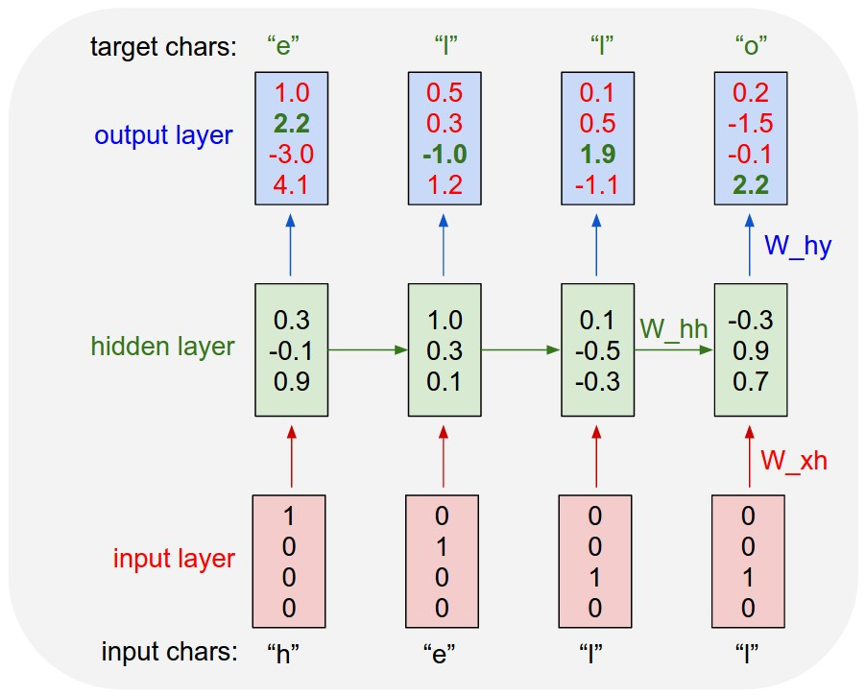
Example: Character-level
Language Model
Vocabulary:
[h,e,l,o]
Example training
sequence:
“hello”
Slide Credit: Fei-Fei Li, Justin Johnson, Serena Yeung, CS 231n

Slide 84
Example: Character-level
Language Model
Vocabulary:
[h,e,l,o]
Example training
sequence:
“hello”
Slide Credit: Fei-Fei Li, Justin Johnson, Serena Yeung, CS 231n

Slide 85
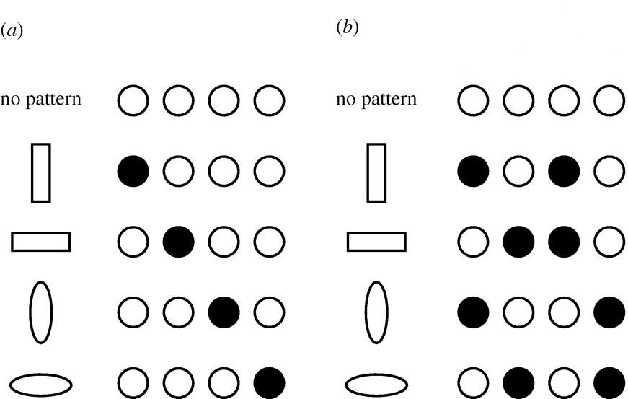
Distributed Representations Toy Example
Local vs Distributed
Slide Credit: Moontae Lee

Slide 86
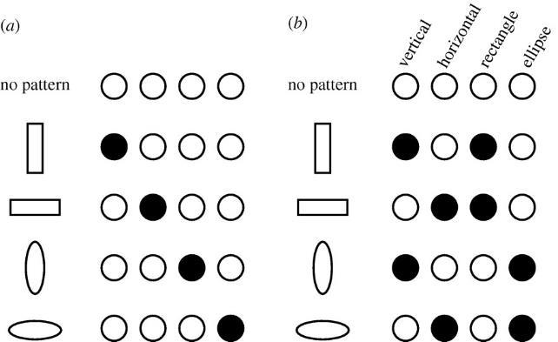
Distributed Representations Toy Example
Can we interpret each dimension?
Slide Credit: Moontae Lee

Slide 87
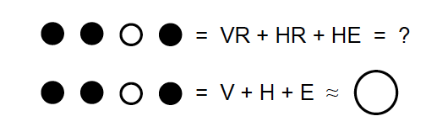
Power of distributed representations!
Local
Distributed
Slide Credit: Moontae Lee

