Slide 1

Language Civility 2
Seema Baddam, Richard Huang, Ananya Malik, Kai McKeever
CS 6471, Spring 2022

Slide 2
A Quick Summary of the Papers
Paper | "A computational approach to politeness with application to social factors" | "Condolence and Empathy in Online Communities"
Year published | 2013 | 2020
Main topic | Politeness | Distress & Condolence
Context | Wikipedia, Stack Exchange | Reddit
ML problem | Binary classification | Binary classification, Topic modeling, Regression
Main features | Politeness strategies, Relationship with social power | Recognition, Structure, Trends, Empathy, Quality

Slide 3
Presentation Outline
  Politeness Paper
    Discussion
    Details
    Strengths and Weaknesses
  Condolences and Empathy Paper
    Discussion
    Details
    Strengths and Weaknesses
  Put it all together
    Online information seeking
    Choices the authors made
    Online/offline implications

Slide 4
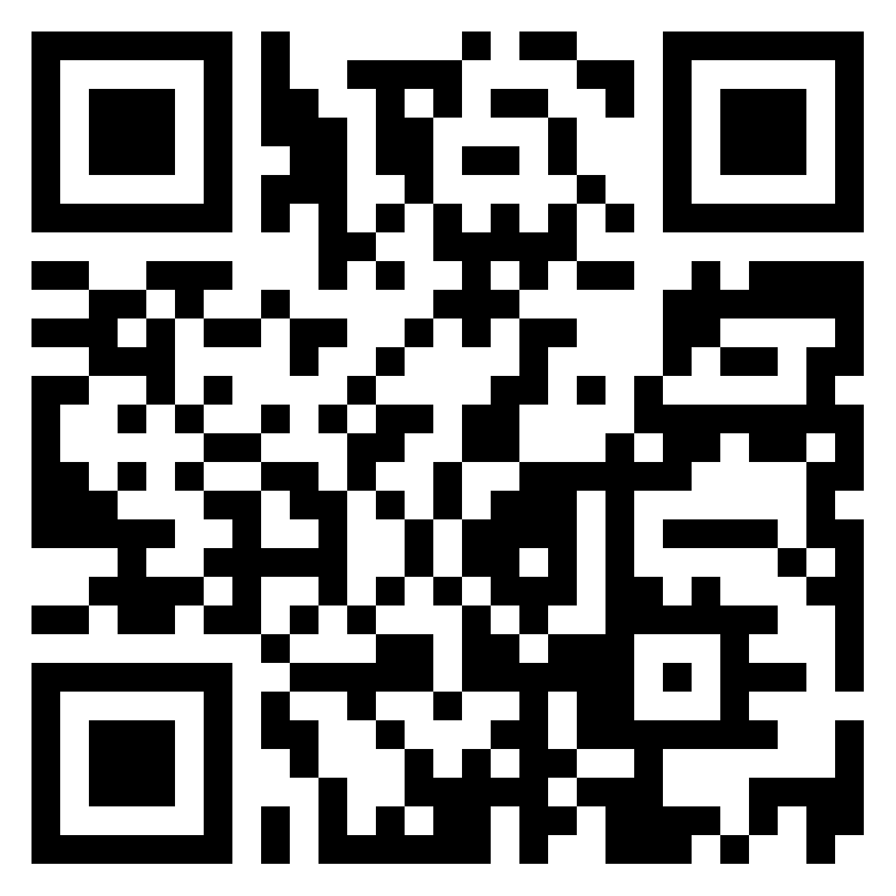
Discuss Politeness
https://padlet.com/cs6471/discuss
Do you agree with the idea that politeness can
be considered a "payment of respect"? (Kaplan 1999)

Slide 5
A computational approach to politeness with application to social factors
Danescu-Niculescu-Mizil, Cristian, Moritz Sudhof, Dan Jurafsky, Jure Leskovec, and Christopher Potts.
In Proceedings of the 51st Annual Meeting of the Association for Computational Linguistics (Volume 1: Long Papers), pp. 250-259. 2013.

Slide 6
Politeness, noun.
Politeness Theory
Dataset
Politeness Strategies
Predicting Politeness
Social Factors
Strengths & Weaknesses
behavior that is respectful and considerate of other people
showing or characterized by correct social usage
marked by an appearance of consideration, tact, deference, or courtesy

Slide 7
Politeness Theory: Face
Politeness Theory
Dataset
Politeness Strategies
Predicting Politeness
Social Factors
Strengths & Weaknesses
First proposed by Brown and Levinson (1987)
  Builds off the idea of a face
Face: "The public self-image that every member wants to claim for himself"
  Positive Face: desire to be accepted and respected
  Negative Face: desire to not be imposed on

Slide 8
Definition of Positive and Negative Politeness
Politeness Theory
Dataset
Politeness Strategies
Predicting Politeness
Social Factors
Strengths & Weaknesses
Politeness is a face-saving act
Positive Politeness: A strategy to increase acceptance and respect
Negative Politeness: A strategy to decrease imposition on others

Slide 9
Positive or Negative Politeness?
Politeness Theory
Dataset
Politeness Strategies
Predicting Politeness
Social Factors
Strengths & Weaknesses
I’m sorry it’s a lot to ask, but can you lend me a thousand dollars?
You look so sad. Is there anything I can do?

Slide 10
Positive or Negative Politeness?
Politeness Theory
Dataset
Politeness Strategies
Predicting Politeness
Social Factors
Strengths & Weaknesses
I’m sorry it’s a lot to ask, but can you lend me a thousand dollars?
You look so sad. Is there anything I can do?

Slide 11
Politeness and Power
Politeness Theory
Dataset
Politeness Strategies
Predicting Politeness
Social Factors
Strengths & Weaknesses
What do we mean by power?
  Broadly includes “social status, authority, and autonomy.” (Brown and Levinson, 1987)
Politeness Theory predicts a negative correlation between the position and politeness of the speaker

Slide 12
The Dataset: Politeness Annotated Requests
Politeness Theory
Dataset
Politeness Strategies
Predicting Politeness
Social Factors
Strengths & Weaknesses
Requests in online communities
  Requests give rise to more negative politeness strategies
  Wikipedia and Stack Exchange
 | # Requests | # Annotated
Wikipedia | 35,661 | 4,353
Stack Exchange | 373,519 | 6,604
Total | 409,180 | 10,957

Slide 13
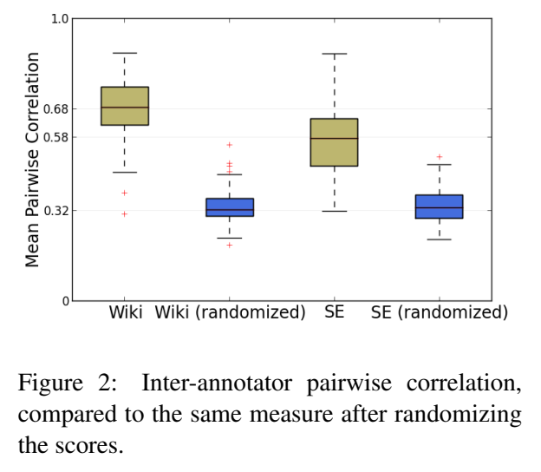
The Dataset: Politeness Annotated Requests
Politeness Theory
Dataset
Politeness Strategies
Predicting Politeness
Social Factors
Strengths & Weaknesses
Annotations using Amazon Mechanical Turks
  Each request labeled by 5 different
  annotators
  Politeness score: normalized
  and averaged score
  Inter-annotator pairwise correlation
  compared for reliability

Slide 14
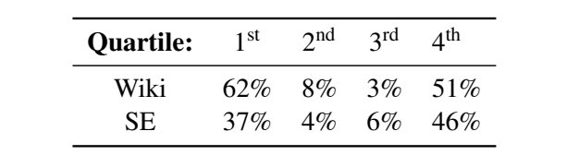
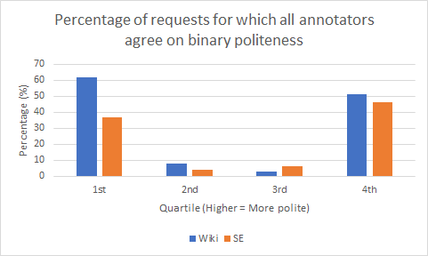
The Dataset: Politeness Annotated Requests
Politeness Theory
Dataset
Politeness Strategies
Predicting Politeness
Social Factors
Strengths & Weaknesses
Binary perception:
  Annotated requests broken into four groups by quartile
  Full agreement more common in first and fourth quartile
  Chose to use top politeness quartile as referenced in later discussions

Slide 15
Politeness Strategies
Politeness Theory
Dataset
Politeness Strategies
Predicting Politeness
Social Factors
Strengths & Weaknesses
From Wikipedia requests
Extracted using Stanford Dependency Parser (de Marneffe et al., 2006)
Politeness Score
  positive value indicate politeness
Top Politeness Quartile Membership
  Gives a more robust and intuitive measure of politeness
Notes:
Explain negative politeness:
"understanding of negative and positive face from Goffman and the Politeness Theory of Brown and Levinson"

Slide 16
Politeness Theory
Dataset
Politeness Strategies
Strategy | Politeness Score | Top Quartile Membership
1. Gratitude | 0.87 | 78%
2. Deference | 0.78 | 70%
3. Greeting | 0.43 | 45%
4. Positive Lexicon | 0.12 | 32%
5. Negative Lexicon | -0.13 | 22%
6. Apologizing | 0.36 | 53%
7. Please | 0.49 | 57%
8. Please start | -0.30 | 22%
9. Indirect (btw) | 0.63 | 58%
10. Direct Question | -0.43 | 15%
Strategy | Politeness Score | Top Quartile Membership
11. Direct start | -0.43 | 9%
12. Counterfactual modal | 0.47 | 52%
13. Indicative modal | 0.09 | 27%
14. 1st person start | 0.12 | 29%
15. 1st person pl. | 0.08 | 27%
16. 1st person | 0.08 | 28%
17. 2nd person | 0.05 | 30%
18. 2nd person start | -0.30 | 17%
19. Hedges | 0.14 | 28%
20. Factuality | -0.38 | 13%
Not Polite |  | More Polite
Positive Politeness Strategies
Negative Politeness Strategies

Slide 17

Politeness Theory
Dataset
Politeness Strategies
Predicting Politeness
Social Factors
Strengths & Weaknesses
9. Indirect (btw)
“By the way, where did you find . . .”
Is this sentence more polite?
15. 1st person pl.
Could we find a less complex name . . .
“By the way, could we find a less complex name?”
7. Please
“Could you please say more. . .”
Which phrase is more polite?
8. Please Start
“Please do not remove warnings . . .”

Slide 18
Training dataset and Experiments
Politeness Theory
Dataset
Politeness Strategies
Predicting Politeness
Social Factors
Strengths & Weaknesses
Binary labels:
  Polite = Top politeness quartile
  Impolite = Bottom politeness quartile
4 different experiments:
  2 In-Domain
  2 Cross-Domain
Training/Validation set
Test set
Wikipedia
Wikipedia
ID
Stack Exchange
Stack Exchange
Wikipedia
Stack Exchange
CD
Stack Exchange
Wikipedia

Slide 19
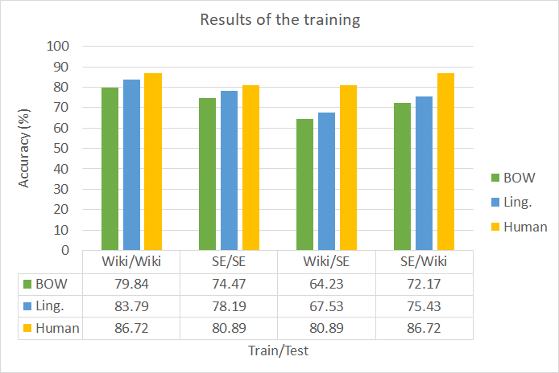
The Training Phase
Politeness Theory
Dataset
Politeness Strategies
Predicting Politeness
Social Factors
Strengths & Weaknesses
Main goal of the training:
Evaluate the robustness and domain-independence of the politeness strategies.
Two classifiers:
  Bag-of-Words (BOW) :
  SVM + unigram features
  Ling. :
  SVM + linguistic features + unigram features
Notes:
Improvement of 3-4% over the BOW model.

Slide 20
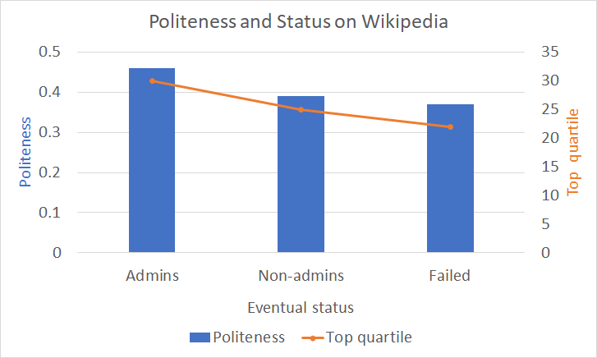
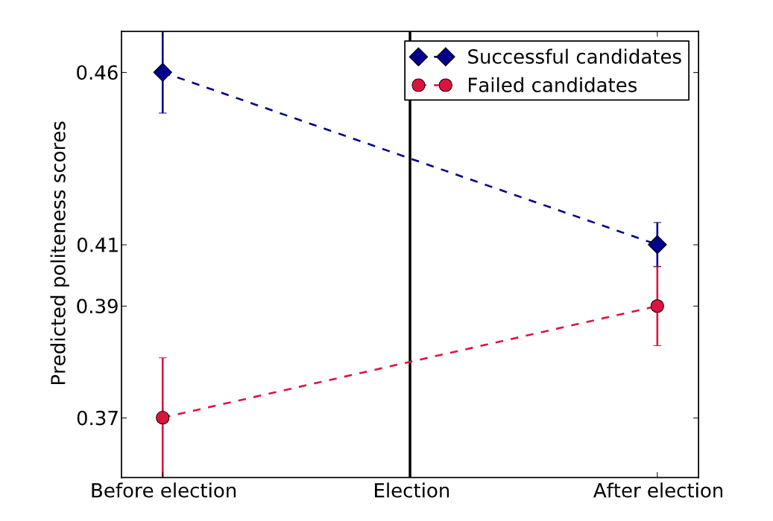
Relationship between Politeness and Power
Politeness Theory
Dataset
Politeness Strategies
Predicting Politeness
Social Factors
Strengths & Weaknesses
Politeness before and after the election results:
Change in social status
Request to become admin:
Potential social status outcome
Notes:
1. Aspiring Wikipedia editors become admins through public elections
Editors who will eventually become admins are more polite than non-admins.
We might wonder if every user who wants to become admin are more polite? NO -> Introduce Eventual status: Failed
These users are also significantly less polite than their successful counterparts, indicating that politeness indeed correlates with a positive social outcome here.
2. Successful and failed candidates before and after elections. Editors that will eventually succeed (diamond marker) are significantly more polite than those that will fail (circle markers). Following the elections, successful editors become less polite while unsuccessful editors become more polite.

Slide 21
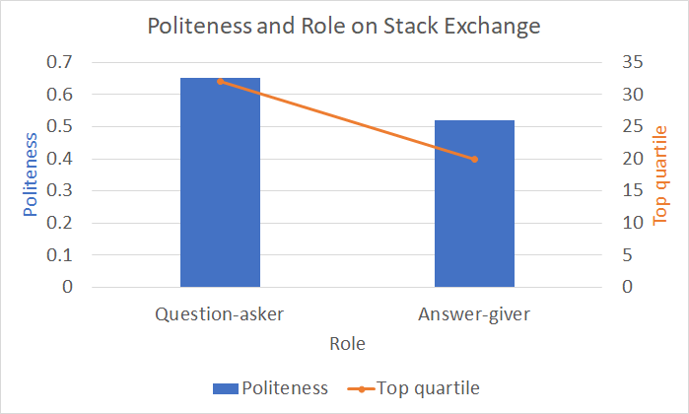
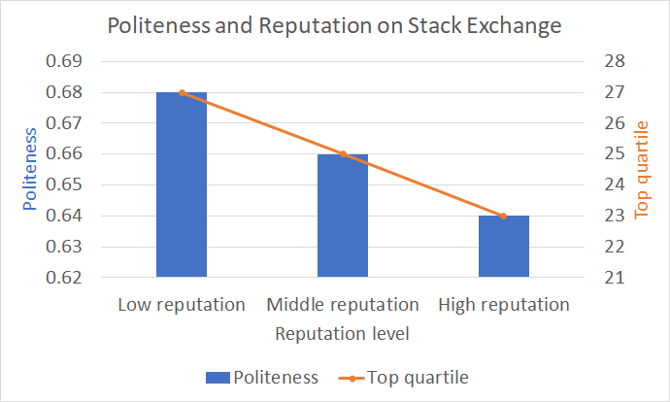
Relationship between Politeness and Power
Politeness Theory
Dataset
Politeness Strategies
Predicting Politeness
Social Factors
Strengths & Weaknesses
Observations:
Status ↑ => Politeness ↓
Status ↓ => Politeness ↑

Slide 22
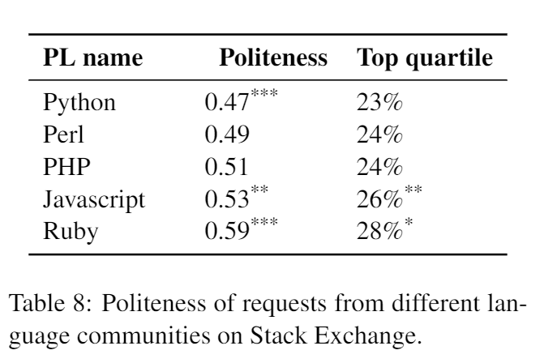
Other social factors on politeness
Politeness Theory
Dataset
Politeness Strategies
Predicting Politeness
Social Factors
Strengths & Weaknesses
Preliminary results:
- Wikipedians from the U.S. Midwest are the most polite
- Female Wikipedians are generally more polite
- Programming language communities on Stack Exchange vary significantly by politeness
Notes:
Plot popularity of programing languages?

Slide 23
Strengths
Politeness Theory
Dataset
Politeness Strategies
Predicting Politeness
Social Factors
Strengths & Weaknesses
Machine Learning application to Politeness theory
Supported power and politeness relationship hypothesis
Created unique Request corpus annotated for politeness

Slide 24
Weaknesses
Politeness Theory
Dataset
Politeness Strategies
Predicting Politeness
Social Factors
Strengths & Weaknesses
Cross cultural criticism of politeness theory
  English dataset
  Western culture
Amazon Mechanical Turk (AMT) for annotations
Notes:
Cross cultural criticism to elaborate

Slide 25
Condolence and Empathy in Online Communities
Zhou, Naitian, and David Jurgens.
In Proceedings of the 2020 Conference on Empirical Methods in Natural Language Processing (EMNLP), pp. 609-626. 2020.

Slide 26
More definitions, gleaned from paper
Distress:
expression of unhappiness or pain
Condolence:
expression of emotional support, often in response to distress

Slide 27
Paper topic walkthrough
Recognizing Distress/Condolence
Condolence Behavior
Condolence Structure
Empathy
Quality of Condolence
Strengths & Weaknesses

Slide 28
Recognizing Distress/Condolence
Condolence Behavior
Condolence Structure
Empathy
Quality of Condolence
Strengths & Weaknesses
DISTRESS
Condolence
I lost my job
I am sorry about your situation
I broke my hand today
Sending my thoughts and prayers
I lost my cat
I am sorry for your loss

Slide 29
Discuss Distress/Condolence
https://padlet.com/cs6471/discuss
How does the concept of condolence relate to politeness?

Slide 30
How did the paper recognize distress and condolence?
Recognizing Distress/Condolence
Condolence Behavior
Condolence Structure
Empathy
Quality of Condolence
Strengths & Weaknesses
Distress | Condolence
Reddit 2017 Dataset SVM Based Classifier BERT Based Classifier | Reddit 2016 Dataset SVM Based Classifier BERT Based Classifier

Slide 31
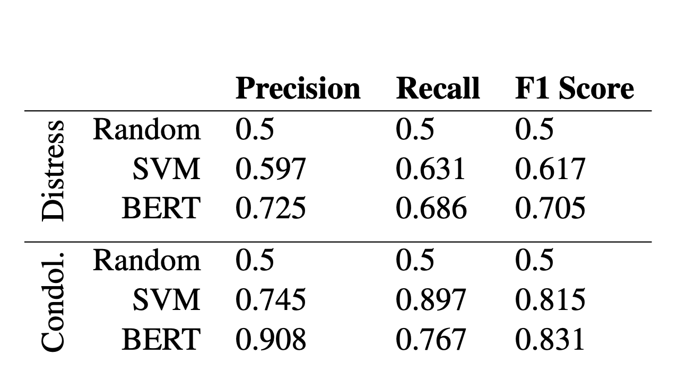
Metrics achieved
Recognizing Distress/Condolence
Condolence Behavior
Condolence Structure
Empathy
Quality of Condolence
Strengths & Weaknesses

Slide 32
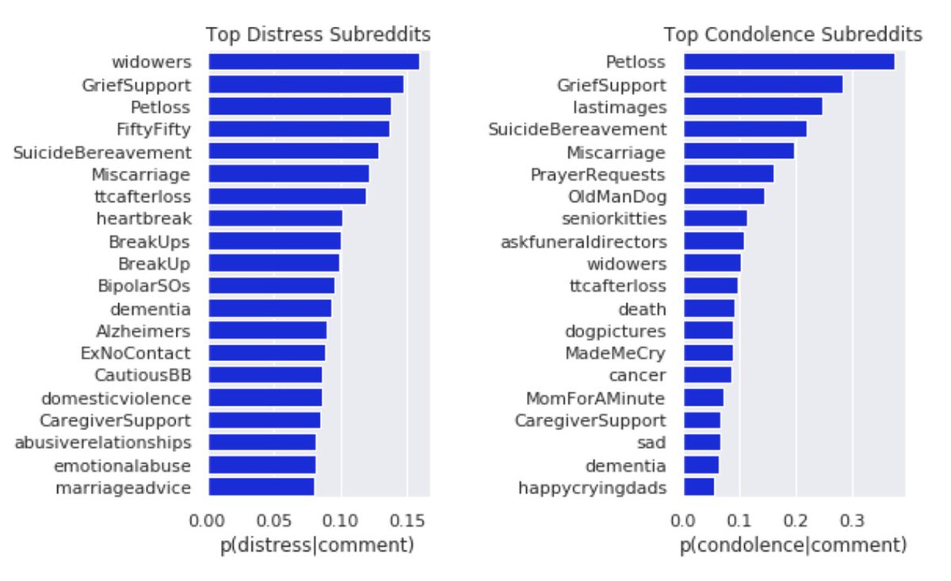
Is condolence directly proportional to distress?
Recognizing Distress/Condolence
Condolence Behavior
Condolence Structure
Empathy
Quality of Condolence
Strengths & Weaknesses

Slide 33
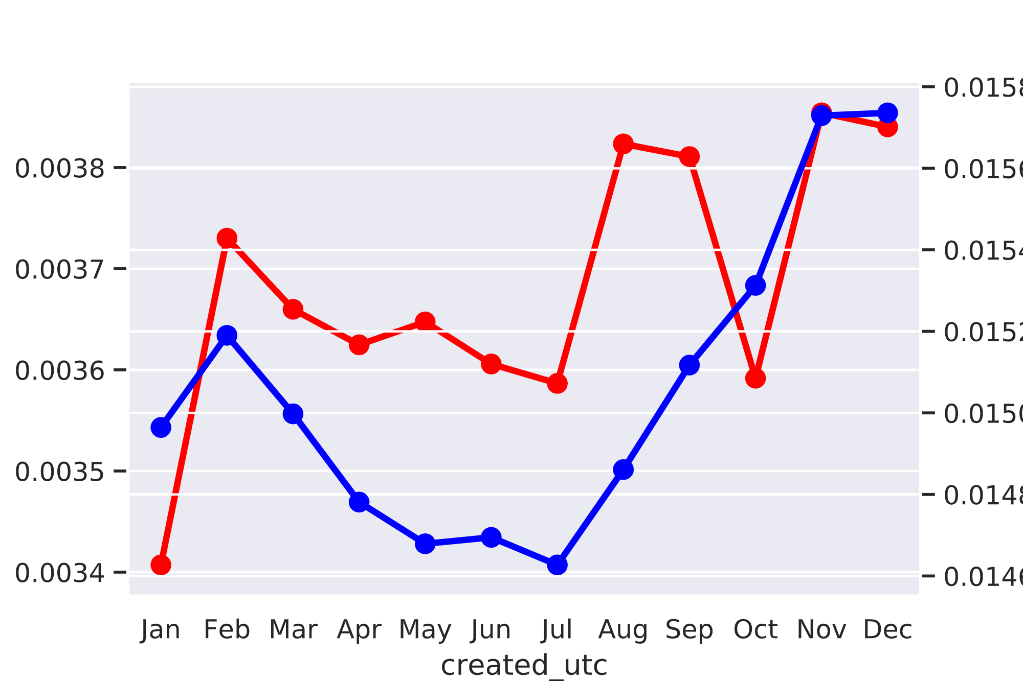
When do we receive condolence the most?
Recognizing Distress/Condolence
Condolence Behavior
Condolence Structure
Empathy
Quality of Condolence
Actor Stefan Stefansson
dies
Stoneman-Douglas School
Shooting
Slide derived from Zhou & Jurgens’s EMNLP 2020 presentation deck:
https://slideslive.com/38939143/condolences-and-empathy-in-online-communities

Slide 34
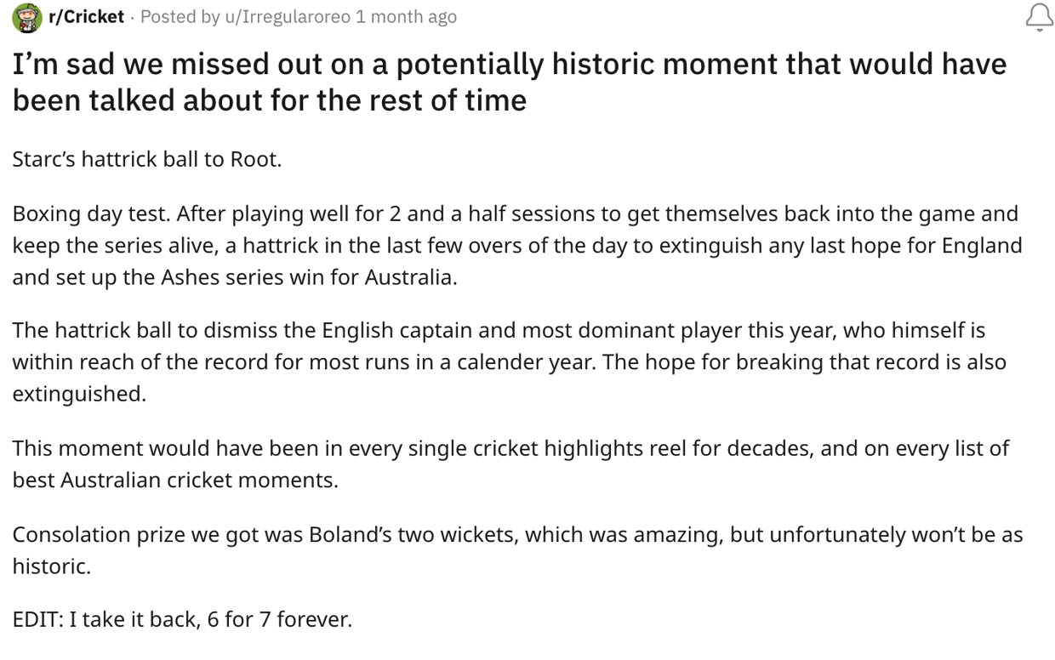
Is every reply a condolence?
Recognizing Distress/Condolence
Condolence Behavior
Condolence Structure
Empathy
Quality of Condolence

Slide 35
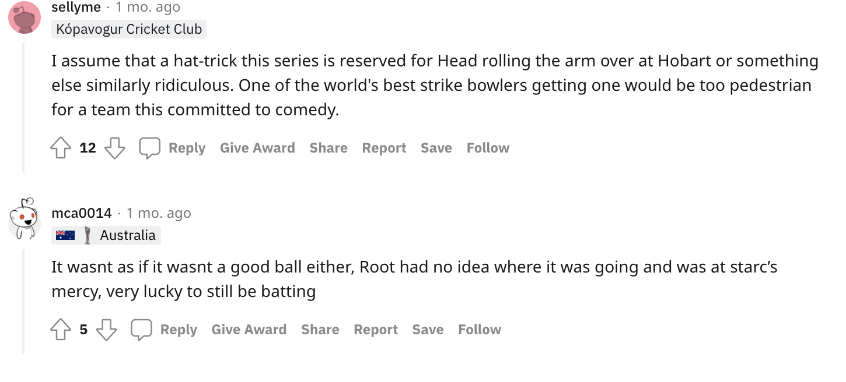
Is every reply a condolence?
Recognizing Distress/Condolence
Condolence Behavior
Condolence Structure
Empathy
Quality of Condolence
      Distress
    Is this Condolence?

Slide 36
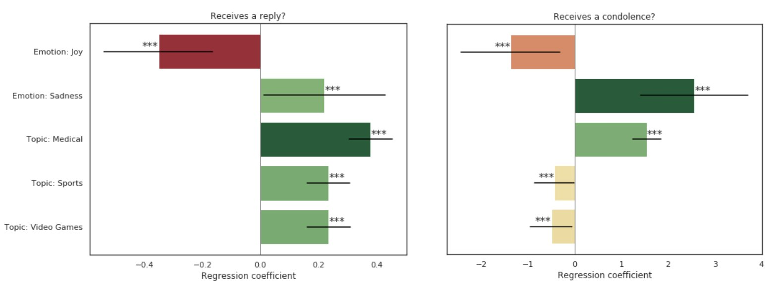
Is every reply a condolence?
Recognizing Distress/Condolence
Condolence Behavior
Condolence Structure
Empathy
Quality of Condolence
Notes:
Ananya ends here

Slide 37
Condolence structure
Recognizing Distress/Condolence
Condolence Behavior
Condolence Structure
Empathy
Quality of Condolence
Strengths & Weaknesses
20-topic LDA for theme identification—measuring probability of topic
Trends observed from this analysis
  Shorter condolences = more sympathy
  Middle-length condolences = more personal experiences
  Longer condolences = more advice and reframing
Notes:
Kai starts here

Slide 38
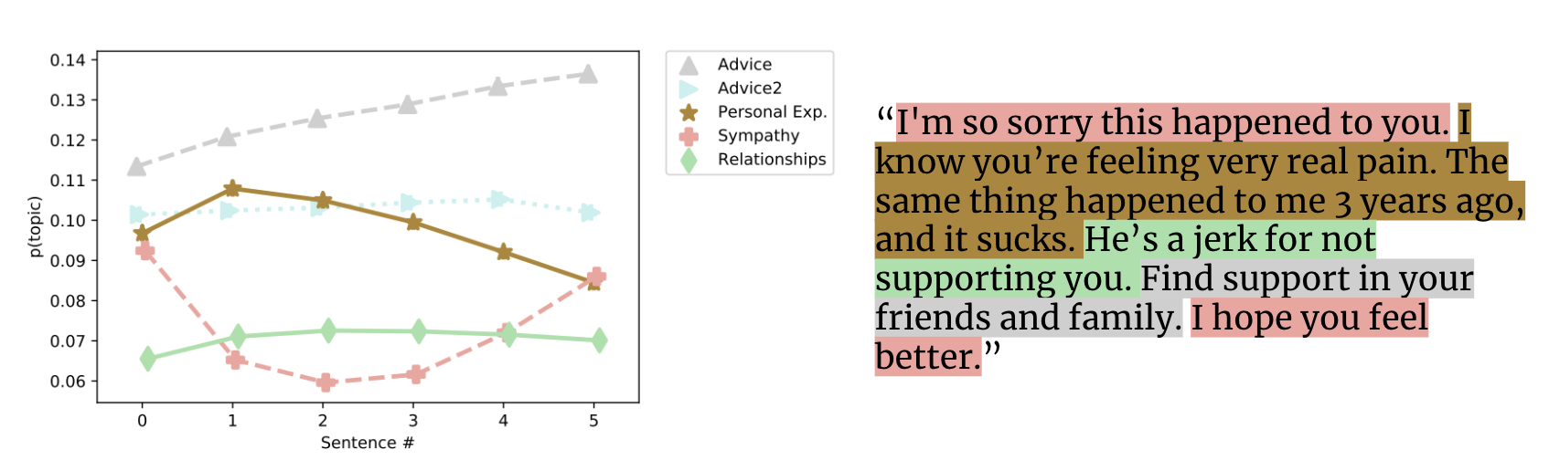
Condolence structure
Recognizing Distress/Condolence
Condolence Behavior
Condolence Structure
Empathy
Quality of Condolence
Strengths & Weaknesses
Sympathy as bookends / “sympathy sandwich”
Image from Zhou & Jurgens’s project webpage:
https://blablablab.si.umich.edu/projects/condolence/

Slide 39
What is Empathy?
Recognizing Distress/Condolence
Condolence Behavior
Condolence Structure
Empathy
Quality of Condolence
Strengths & Weaknesses
Varying definitions
  Most computational approaches: mirroring emotional state
Empathetic Concern vs Personal Distress (Batson et al., 1987)
Zhou & Jurgens use definition based on appraisal theory
  “Observer appraises a person’s situation in the same way as the person experiencing the distress”
Batson et al. (1987) as cited in Sven Buechel’s EMNLP talk: https://vimeo.com/306137544

Slide 40
How Zhou & Jurgens model empathy
Recognizing Distress/Condolence
Condolence Behavior
Condolence Structure
Empathy
Quality of Condolence
Strengths & Weaknesses
Regression models: Random Forest and RoBERTa
Compared two treatments:
  Target Comments + Observer Text
  Observer Text Only
Target = Person expressing distress
Observer = Person offering condolence

Slide 41
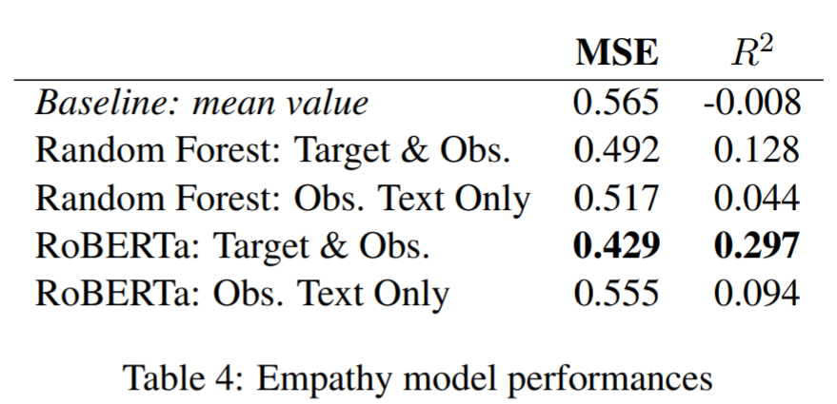
How Zhou & Jurgens model empathy
Recognizing Distress/Condolence
Condolence Behavior
Condolence Structure
Empathy
Quality of Condolence
Strengths & Weaknesses
Being able to align inputs between target and observer benefits performance of both models

Slide 42
Condolence Effectiveness on Reddit
Recognizing Distress/Condolence
Condolence Behavior
Condolence Structure
Empathy
Quality of Condolence
Strengths & Weaknesses
Sampling positive and negative examples of condolences
  “Your comment made my day”
Logistic Regression
  Whether response of gratitude is received
Helpful/Unhelpful/Control Features
Notes:
“While some of the negative examples are likely effective condolences, these false negatives only result in an underestimate of the effect of the explanatory coefficients”

Slide 43
Condolence Effectiveness on Reddit
Recognizing Distress/Condolence
Condolence Behavior
Condolence Structure
Empathy
Quality of Condolence
Strengths & Weaknesses
Good condolences
Poor condolences
Lexical alignment
Person-centered responses*
Buechel et al. empathy*
  Compassionate empathy
Religion
Sympathy
Advice
* Less likely to receive gratitude

Slide 44
Reddit’s context
Recognizing Distress/Condolence
Condolence Behavior
Condolence Structure
Empathy
Quality of Condolence
Strengths & Weaknesses
“We speculate that people may turn to Reddit for lighter, less-personal forms of support in times of distress, whereas the more compassion-like empathy of Buechel et al. (2018) is helpful when more personal responses are not licensed by the relative anonymity of the platform.” (emphasis ours)
To what extent do you agree?

Slide 45
Strengths
Recognizing Distress/Condolence
Condolence Behavior
Condolence Structure
Empathy
Quality of Condolence
Strengths & Weaknesses
Created a large dataset from scratch
Connected methods/results to social psychology
  Congruent with existing theory
Suggestions for enhancing support in online communities
Notes:
Stuff about sports receiving replies and not condolences, the non-correspondence of distress and condolences

Slide 46
Weaknesses
Recognizing Distress/Condolence
Condolence Behavior
Condolence Structure
Empathy
Quality of Condolence
Strengths & Weaknesses
Heuristics to generate dataset
  How well do seed phrases recognize/assess condolence?
  Assumption of common statements in condolence statements
Generalizability
  Across cultures, languages, regions

Slide 47
Putting it together

Slide 48
Why do people ask questions online?
Is it empathy?
  Zhou & Jurgens: distressed indiv didn’t find empathetic comments helpful
Is it information-seeking?
Concrete suggestions?
Domain-specific expectations (Wikipedia vs StackOverflow vs Reddit)

Slide 49
Modeling social constructs
Zhou and Jurgens: “a fixed set of phrases to identify thanks in replies”
Danescu-Niculescu-Mizil et al.: politeness as average of five scores of crowdworker annotators
What alternatives are available?
How might we assess those choices in light of alternatives?
What other choices are worth discussing?

Slide 50
Do these findings matter offline?
Influence of Reddit/Wikipedia/StackOverflow moderators
What is lost in online speech?
Factors of
  Anonymity
  Context
  Tone
  Spontaneity

Slide 51
More Discussion Questions
If you were to run the politeness study again, would you use crowdworkers for annotators?
  What sorts of safeguards should be considered?
  How might you communicate the ethics that were followed?
Do you find it difficult to console others?
  Do you agree with the explanation this difficulty is “due to the emotional and mental effort…”?
How might Zhou & Jurgen’s results generalize to other platforms?
  Facebook? Instagram? … LinkedIn? 😬
Notes:
Section 3 might have answer to generalize question—about different communities

