Slide 1
Bias, Fairness, and Ethics 2
CS 6471 Presentation
Sarthak Behl, Aurimas Racas, Farzin Gholamrezae

Slide 2
Bias, n.
partiality: an inclination or predisposition for or against something.
any tendency or preference, such as a response bias or test bias.
systematic error arising during sampling, data collection, or data analysis. See biased estimator; biased sampling.
any deviation of a measured or calculated quantity from its actual (true) value, such that the measurement or calculation is unrepresentative of the item of interest. —biased adj.

Slide 3
Is it that simple?
Let’s see the responses on Piazza!

Slide 4
Automatically Neutralizing Subjective Bias in Text
Reid Pryzant, Richard Diehl Martinez, Nathan Dass,
Sadao Kurohashi, Dan Jurafsky, Diyi Yang (2021)

Slide 5
Subjective biases
There are situations where unbiased (objective) text is necessary to build trust and gain the right information. Prime examples include news sources, encyclopedias. Yet 62% of Americans believe their news are biased.
Can CSS methods help identify and reduce such biases?

Slide 6
Selected Prior Research: identifying subjective bias
2013
2015
2017
2017
Recasens, et al: Detecting framing and epistemological bias
Dataset: Wikipedia’s POV-tagged changes
Results: Logistic regression model that detects single-word biases nearly as accurately as MTurk workers
Morstatter, 2015: Identifying Framing Bias in Online News
Dataset: Expert-labeled news on missile defense system in Europe, identifying 10 possible frames on the subject
Results: NLP-feature based approach using Random Forests / logistic regression achieves 32-47% accuracy in detecting frames
Hube, Fetahu, 2017: identifying biased phrasing (partial / inflammatory phrases)
Dataset: Wikipedia’s POV-tagged changes + crowdsourcing evaluation
Results: RNN-based approach achieves 77% F-1 score
Rashkin et al, 2017: classifying statements for their factuality
Dataset: PolitiFact.com 6-point scale factuality judgements
Results: LSTM model performs best, achieving 56% F-1 score in a 2-class classification, but only 20% F-1 score in a 6-class classification
For a survey of NLP bias research (and certain criticisms of such research) see: Language (Technology) is Power: A Critical Survey of "Bias" in NLP (review of 146 papers)

Slide 7
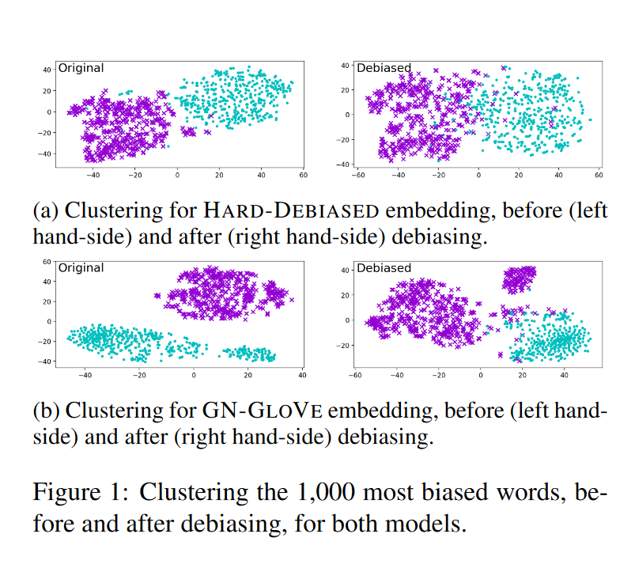
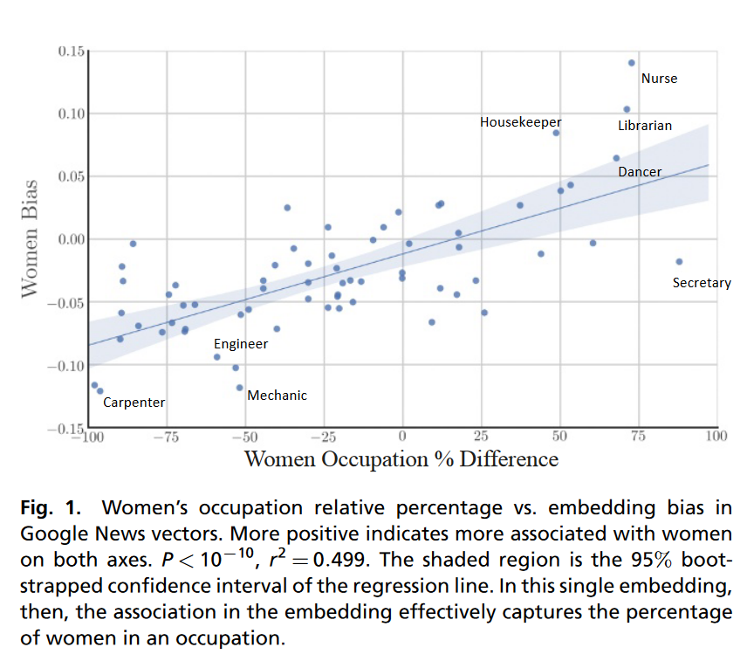
Another line of research: removing bias from word embeddings
Garg et al, 2018: Word embeddings quantify 100 years of gender and ethnic stereotypes
Gonen and Goldberg, 2019: Lipstick on a Pig: Debiasing Methods Cover up Systematic Gender Biases in Word Embeddings But do not Remove Them

Slide 8
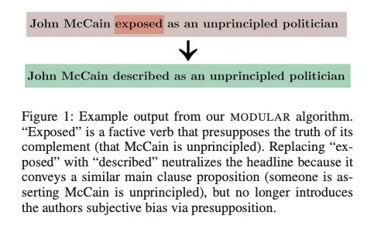
Key focus areas and contributions of this paper
Paper focuses on inappropriate subjectivity
Researchers identify subjective bias via Wikipedia NPOV Policy
This paper extends prior research as:
Unlike prior research, the focus is not on identification but also debiasing text by suggesting edits to make it more neutral
It achieves it through other methods than by removing dimensions of prejudice from word embeddings

Slide 9
Quick Activity Neutralize this sentence!
Bitcoin is the greatest scam in history

Slide 10
Outline of Paper
Reframing the Task: neutralizing subjectively biased text
Dataset – Wiki Neutrality Corpus
Focused on inappropriate subjectivity
Parallel Corpus of 180,000 sentence pairs that comes from Wikipedia edits that removed the following from biased sentences
Two methods
1. MODULAR algorithm enables human control and interpretability
2. CONCURRENT algorithm is simple to train and operate
Long-term Goal: Automatically managing bias in the real world

Slide 11
The Dataset
Wiki Neutrality Corpus (WNC)

Slide 12
Wiki Neutrality Corpus
180,000
Biased sentences and their neutral counterparts
25%
Of the corpus limited to single-word edits
3 bias types
Framing (58%), Epistemological (25%), Demographic (12%), Noise (6%)

Slide 13
Relationship between dataset attributes and extent of debiasing edits
Relationship between Topic and Bias
Relationship between Tenure and Bias
Most prevalent topics
History, politics,
philosophy,
sports, language
15%
Newcomer editors
Vs
(sample of 685k edits)
34%
Experienced editors
Meteorology, science,
landforms,
broadcasting, art
Least prevalent topics

Slide 14
Methods for Neutralizing Text
MODULAR and CONCURRENT algorithms

Slide 15
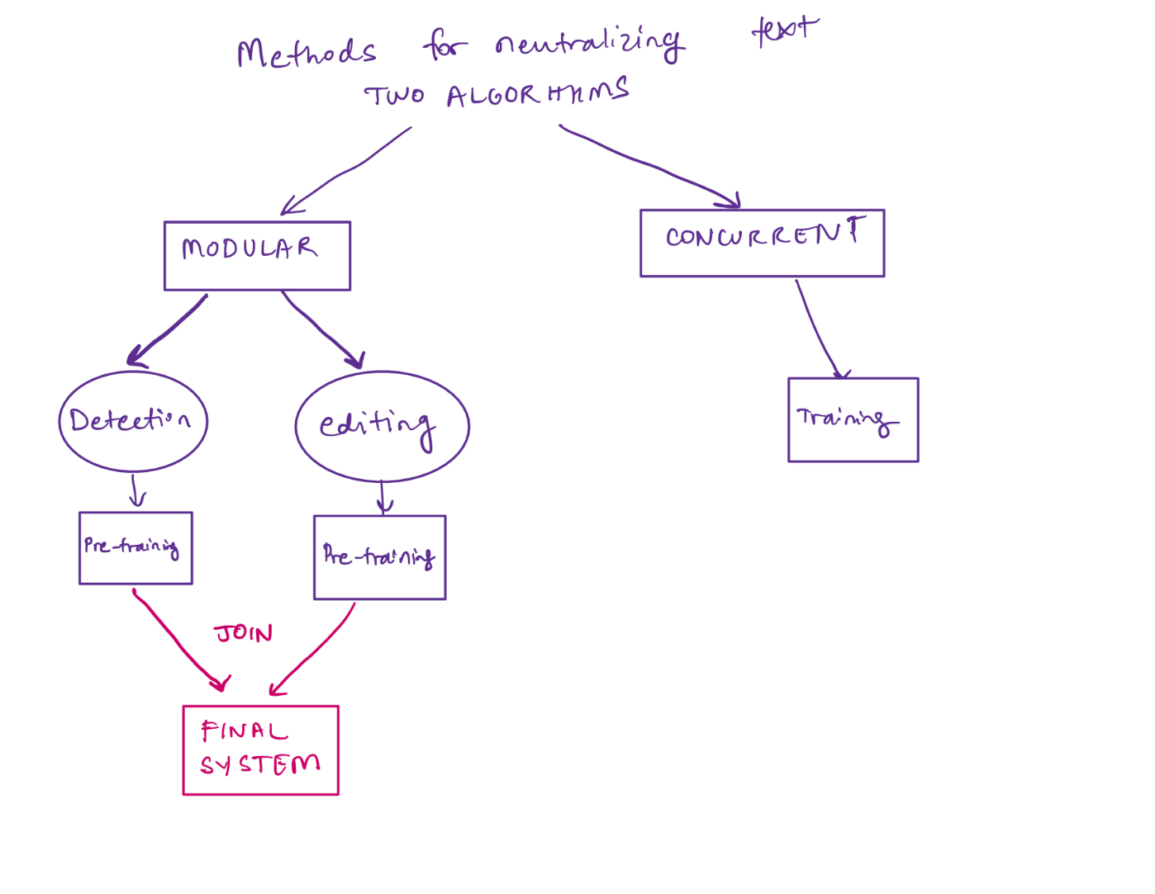
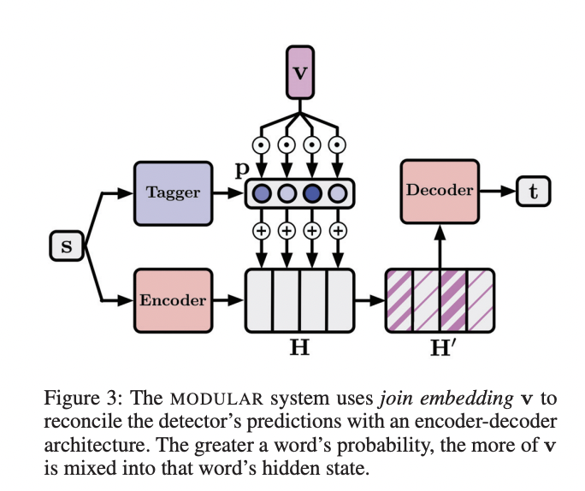
Two architectures
MODULAR
BERT-based detection and LSTM-based editing
Pretrain model for each stage and then combine into joint system to end-to-end fine tuning on the overall neutralizing task
CONCURRENT
Takes the problematic source s and directly generates a neutralized t
Encoder-decoder neutral network (BERT and LSTM, respectively)
Notes:
Given that the Task is to Neutralize text: algorithm is given an input sentence and must produce an output sentence whose meaning is as similar as possible to the original with the subjective biased removed. Here are the two methods

Slide 16
Modular - Detection Module
Module description
Neutral sequence tagger that estimates $p_{i}$: the probability that each input word $w_{i}^{s}$ is subjectively biased
$b_{i}$i represents words semantic meaning: contextualized word vector produced by BERT
$e_{i}$ represents expert features of bias
$W_{i}$and $W_{e}$ are learnable parameters
Module pre-training
A label $p_{i}^{∗}$is 1 if $w_{i}^{s}$ was deleted or modified, 0 if it was unchanged
Loss function: Average NLL of labels
Notes:
Add LaTeX here

Slide 17
Modular - Editing Module
Module description: takes a subjective source sentence s and is trained to edit it into a more neutral compliment t
Bi-LSTM encoder turns s into sequence hidden states
LSTM decoder generates text one token at a time by repeatedly attending to H and producing probability distributions over the vocabulary
Added 2 mechanisms
Copy mechanism
Coverage mechanism
Module pre-training
Pre-train decoder as a language model of neutral text using the neutral portion of WNC
Notes:
Add LaTeX here
Explain NLL

Slide 18
Modular: Final System
After pre-training detection and editing modules, join
Join embedding mechanism – join embedding is a vector that was added to each encoder hidden state in the editing module
Operation is gated by detector’s output probabilities
Condition the decoder on the new hidden states which are enriched by v
This tells the decoder what language should be changed and what is safe to be be copied during the neutralization process
Token-weighted loss function

Slide 19
Modular Algorithm Summary
Detection module
Estimates $p_{i}$: the probability that each input word $w_{i}^{s}$ is subjectively biased
Inputs:
$b_{i}$ that represent semantic meaning: contextualized word vector (BERT)
$e_{i}$ represents expert features of bias (a lexicon of words that indicate bias)
Pre-training: Biased portion of WNC, standard loss function (average negative log-likelihood)
Editing Module
Takes a subjective source sentence s and is trained to edit it into a more neutral compliment t
Underlying architecture
Bi-LSTM encoder
LSTM decoder with copy and coverage mechanisms
Pre-training: decoder pre-trained using the neutral portion of WNC
Final system
Hidden states produced by the Bi-LSTM encoder are enriched with probabilities generated by detection module
Enriched hidden states are used by the decoder to determine neutralization word substitutes
Token-weighted loss function is used

Slide 20
Concurrent
Model Description
Takes the problematic source s and directly generates a neutralized t
Encoder-decoder neutral network (BERT and LSTM, respectively)
The decoder’s inputs are set to:
Model Training
Concurrent model is pre-trained with the same autoencoding or procedure from Modular and uses same NLL loss

Slide 21
Break Time!

Slide 22
Experiments and Results

Slide 23
Model performance
DATASET
25% of the WNC (single-word edits)
53k training pairs, 1000 test pairs
EVALUATION
2 Quantitative metrics
BLEU
Accuracy
3 Qualitative metrics evaluated by qualified crowdworkers on MTurk
Fluency
Bias
Meaning
MODULAR is better at reducing bias
CONCURRENT preserves meaning and fluency best
(same pattern persisted in 3 other out-of-domain datasets)

Slide 24
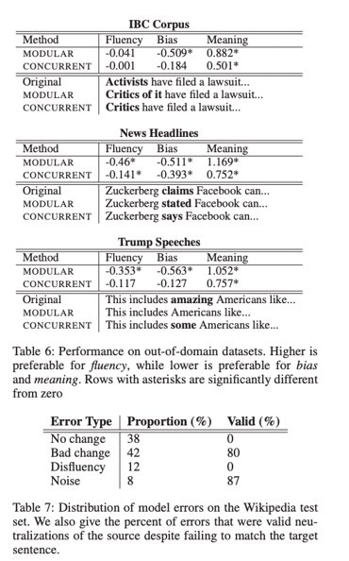
Error Analysis

Slide 25
Discussion / Future Work

Slide 26
Potential extensions of this research (1 out of 3)
Scope of current paper was limited to single-word edits (only 25% of edits in their data and simplest to fix). Future should tackle broader instances of multi-word, multi-lingual, cross-sentence bias
Ruibo et al, 2021: A Transformer-based Framework for Neutralizing and Reversing the Political Polarity of News Articles
Uses expert-labeled benchmark datasets with news articles
Implements a two step approach:
A polarity detector (transfer learning using XLNET as the base language model)
Polarity flipper (encoder-decoder structure modified to a GAN network)
Results:
Statistically significant differences in neutralized vs original headlines based on evaluation of MTurk workers
Somewhat better results (based on automatic evaluation) compared to Pryzant et al methodology

Slide 27
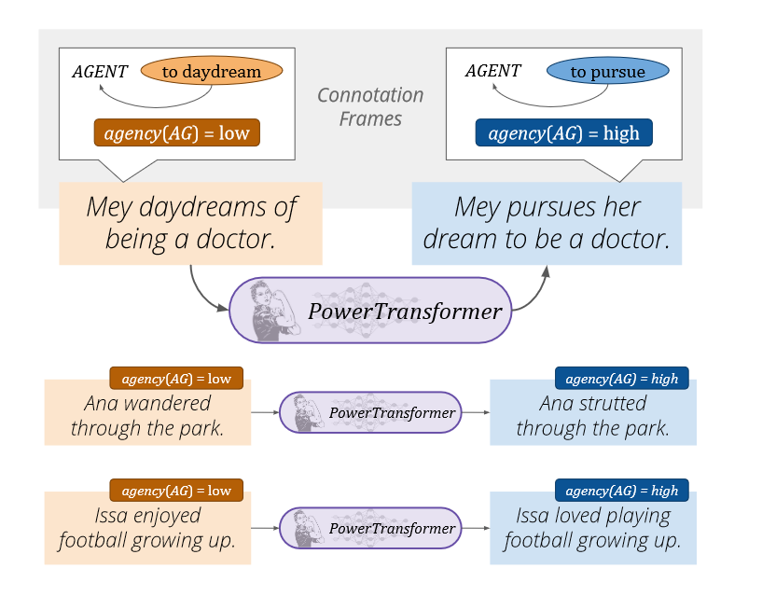
Potential extensions of this research (2 out of 3)
Avoiding the need for labeled datasets by adopting unsupervised approaches
Ma et al, 2020: PowerTransformer: Unsupervised Controllable Revision for Biased Language Correction
An Unsupervised approach that does not require labels
Primary focus on reducing gender bias via paraphrasing verbs with weak agency

Slide 28
Do these edits preserve meaning?
Input: “ has worked in pro - abortion organizations for more than 20 years , mainly in policy and communications”
Output: “has worked in pro - choice organizations for more than 20 years , mainly in policy and communications”
Input: event grew from gay rights parades held annually since 1978 , when numerous participants had been contentiously arrested by new south wales police
Output: event grew from gay rights parades held annually since 1978 , when numerous participants had been arrested by new south wales police
Input: the political organization of the country was defined by the only tolerated political party, the communist party of the soviet union
Output: the political organization of the country was defined by the only political party, the communist party of the soviet union

Slide 29
Potential extensions of this research (3 out of 3)
Further exploration of the robustness of the results
Quality of MTurk evaluations
When MTurk workers were asked to evaluate results, their inter-rater agreement (measured by Krippendorf’s alpha) was only 0.51 for bias and 0.33 for meaning.
Further research area: Would the results be as robust if assessed by professional journalists / editors? Is it possible to achieve high inter-rater agreement rates for bias/meaning and, if not, what is the implication on such approaches to begin with?
Detection module & “expert features”
Recall that detection module uses lexicons to indicate potentially biased words
Mostly contain framing verbs (“think”, “believe”, “assure”, “allege”, “doubt”, “doubtful”)
One specific lexicon was generated by the 2013 paper and contains words that were often replaced in WNC corpus. They contain words such as “abortion”, “same-sex”, “Vietnamese”
Further research area: are there differences in how well do such approaches perform in controversial / non-controversial topics, and do they differentiate well between bias and controversy?

Slide 30
Beyond Fair Pay
Ethical Implications of NLP Crowdsourcing
Schmueli, Fell, Ray and Ku, 2021

Slide 31
Crowdsourcing is increasingly important in NLP research, but ethical considerations are often limited to fair pay
NLP researchers increasingly often engage crowdsourced workers for a variety of tasks:
Text labeling (34%)
Text evaluation (43%)
Text generation (23%)
Multiple platforms: Amazon Mechanical Turk, Appen, Upwork, Prolific, Hybrid, and Tencent Questionnaire
Most discussions about ethics of using crowdworkers in NLP are typically limited to fair pay (23% of recent NLP papers mention payment)
This paper makes the case that there are other ethical considerations, too

Slide 32
Research ethics are governed by a legal framework
1971
Formalization and restructuring of research ethics, introduction of IRBs
Three guiding Belmont principles
Respect for Persons – acknowledge autonomy and protect those with diminished autonomy
Beneficence – benefits of the research has to outweigh the risks
Justice – equal sharing of burden and benefits among potential subjects
1978
Belmont Report and Belmont Principles
1991
National legislation in the US (Common Rule)
Requires most research that involves human subjects to obtain IRB approval
Applies independently from:
Whether workers are compensated or not
Whether research is published or not
Whether PII is collected or not
Exemptions (or qualification for expedited reviews) are granted by the IRB and not determined by the researcher themselves
2019
The Final Rule supersedes the Common Rule
Notes:
While previously the roles of labeling, evaluating, and producing data were assigned to expert annotators or linguistics students a shift has occurred due to lower costs, convenience, speed, and scalability
Generally IRB approval is not needed for paid labeling, most institution’s IRB’s are deeming the involvement of crowdworkers as outside the current scope of the employment of human subjects in the research study

Slide 33
Let’s talk about ethical standards in research
Q1: Raise your hand if you knew what IRB is before reading these papers
Q2: Raise your hand if you ever used the IRB review process in GT (or another institution)
Q3: What was the most surprising thing you learned about IRB policies when reading the paper?

Slide 34
GT’s IRB approval process
https://oria.gatech.edu/institutional-review-boards-submitting-protocol/submission-decision-tree

Slide 35
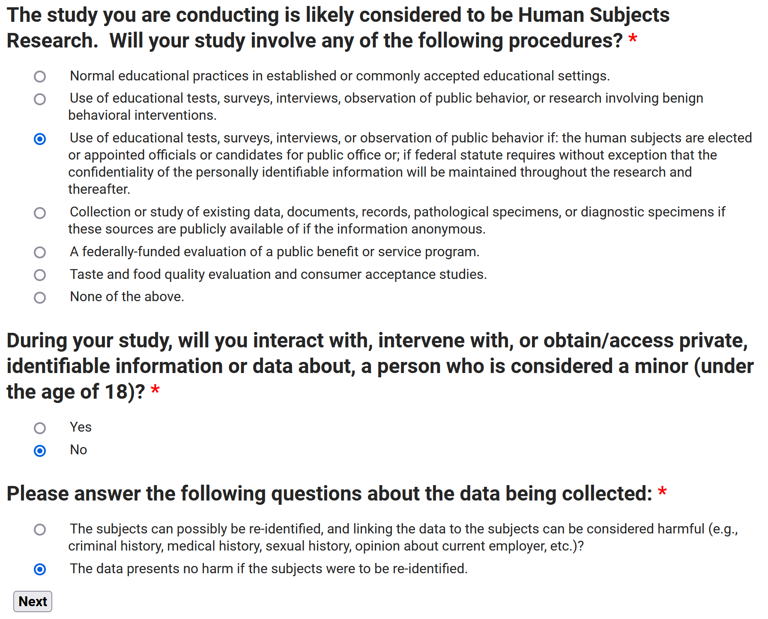

Slide 36
Do NLP Tasks Constitute Research Involving Human Subjects?
Q1: Are Crowdsourcing Tasks Research?
Yes, as crowdsourced workers form part of the overall research project that is designed to contribute to generalizable knowledge.
Q2: Are Crowdsourced Workers Human Subjects?
Yes, if:
A researcher obtains information about them through interaction with the individual, and uses, studies, or analyzes the information
Obtains, uses, studies, analyzes, or generates identifiable private information about them.
Q3: Do NLP tasks qualify for Final Rule exemptions?
Only if:
Research involves only benign behavioral interventions in conjunction with the collection of information from an adult subject through verbal or written responses (including data entry) or audiovisual recording (only written and verbal data entry)
The subject has prospectively agreed to information collection
The collected information is recorded in a way that does not allow directly identifying subjects through identifiers or other means (or IRB has provided its approval that adequate provisions are in place to protect privacy)
Notes:
1. Are crowdsourcing tasks research?
Obviously the first sentence, does anybody remember what the roles crowdworkers fill are?
Rather than a concrete research behavior on part of the NLP researcher, it is the purpose of the research behavior that classifies said behavior as research under the Final Rule - Make a point while this is not convenient to us too often our society has lended itself to kicking the can down the road
2. Are crowdworkers human subjects?
Both these definitions are from the Final Rule

Slide 37
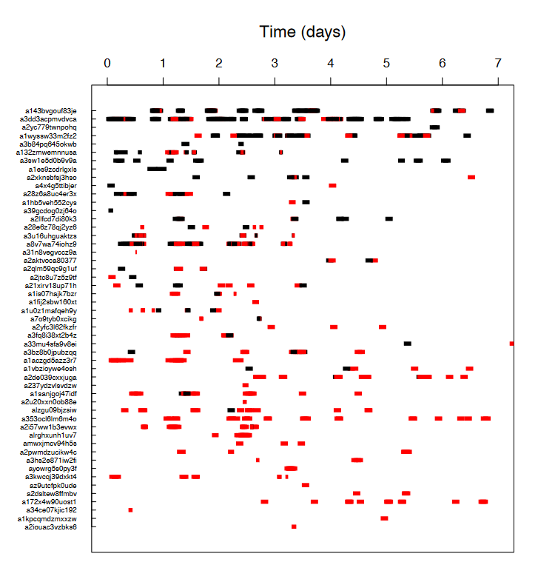
Risks to Crowdsourced Workers Privacy
Gao et al (2015) paper exposed MTurk worker IDs which are directly linkable to their personal details (and in the past could even be linked to Amazon.com account)
Worker IDs are unique identifiers linking them to their personal details
Further risks to privacy may arise if researchers extensively use built-in qualification attributes including financial situation, physical fitness, gender, purchasing habits, political affiliation, handedness, marital status, and education level
Importantly, research can only be exempted if data obtained is anonymous (vs. simply held confidentially)

Slide 38
Psychological Harms for Crowdworkers
Non-benign interventions
Psychological harms resulting from the content reviewed
Triggers of addictive behavior (esp. if gamification techniques are employed)
Stress resulting from long working hours / pressure to meet productivity requirements
“Employees have been found having sex inside stairwells and a room reserved for lactating mothers, in what one employee describes as “trauma bonding.”. […] Moderators cope with seeing traumatic images and videos by telling dark jokes about committing suicide, then smoking weed during breaks to numb their emotions. Moderators are routinely high at work.
“
The secret lives of Facebook moderators in America (The Verge, 2019)
Notes:
Let’s say fair pay, and privacy are addressed
Belmont report takes these three issues into consideration to guide our actions as we pursue future work in research
Labeling and text evaluation have greater risk levels in Psychological Harm as the data may be offensive, graphic, or traumatic in nature.
Evaluating and Labeling Text reveals more about workers, as most of the work is subjective. ?? would like more clarification
The breadth of knowledge is really thorough

Slide 40
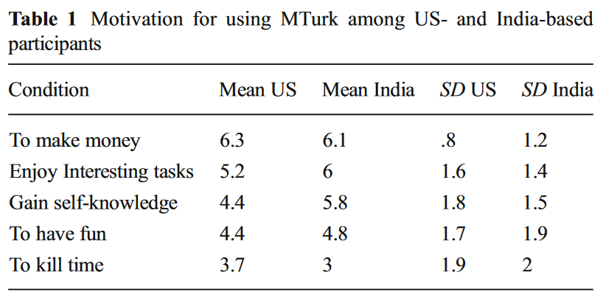
Risks and Harms for Crowdworkers – Vulnerable Populations
Research on crowdsourcing platforms such as MTurk is inherently prone to the inclusion of vulnerable populations (which is specifically prohibited by the final rule)
Children
Prisoners
Individuals with impaired decision-making capacity, or economically or educationally disadvantaged persons
Litman, Robinson, Rozenzweig (2015): The relationship between motivation, monetary compensation, and data quality among US- and India-based workers on Mechanical Turk
Showed that that data quality is directly affected by compensation rates for India-based participants. Found that data were of a lesser quality among India-based than among US participants, even when optimal payment strategies were utilized.
Notes:
A large percentage of MTurk workers are in developing countries, making the income attractive, but there are no safeguards in place to ensure that who you are hiring is actually who they say they are
Large power imbalances between the researchers and those being hired, to them this income is worth sometimes a whole year’s salary, and it could be obtained within a day
A worker ID is used also as the identifier of a crowdworker’s account on other Amazon assets and properties, thereby making them identifiable if looked up.

Slide 41
Ways Forward – all stakeholders have a role to play
Researchers - Are we meeting the Belmont Report’s guidelines?
Respect for Persons – acknowledge autonomy and protect those with diminished autonomy
Beneficence – benefits of the research has to outweigh the risks
Justice – equal sharing of burden and benefits among potential subjects
Universities - Need to have the operating procedures necessary to streamline crowdsourced research to ensure all researchers receive a timely IRB review
Crowdsourcing Platforms – Implement processes to help protect crowdsourced workers from privacy risks as well as psychological harms they may experience
You

Slide 42
Ensuring Wellness of Crowdworkers
Steiger et al (2021) consider multiple strategies to improve psychological wellbeing of commercial moderators which may also be applicable to crowdworkers
Programmatic interventions | Technological interventions
Wellness on-boarding | Preventing exposure via automatic detection of problematic content
Resiliency training | Reducing exposure via appropriate interface designs
Interpersonal clinical care | Supporting treatment with technological means (e.g. VR)

