Slide 1
CS 4803 / 7643: Deep Learning
Topics:
Convolutional Neural Networks
What is a convolution?
FC vs Conv Layers
Dhruv Batra
Georgia Tech

Slide 2
Administrativia
HW2 Reminder
Due: 09/23, 11:59pm
https://evalai.cloudcv.org/web/challenges/challenge-page/684/leaderboard/1853
Project Teams
https://gtvault-my.sharepoint.com/:x:/g/personal/dbatra8_gatech_edu/EY4_65XOzWtOkXSSz2WgpoUBY8ux2gY9PsRzR6KnglIFEQ?e=4tnKWI
Project Title
1-3 sentence project summary TL;DR
Team member names

Slide 3
Thoughts on Gaier & Ha NeurIPS19

Slide 4
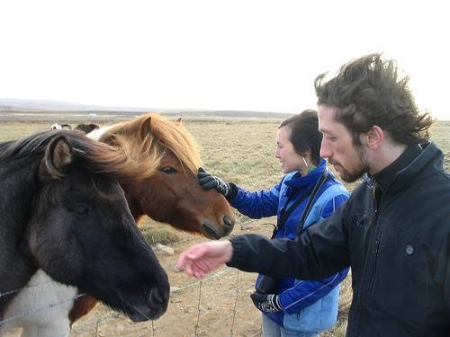
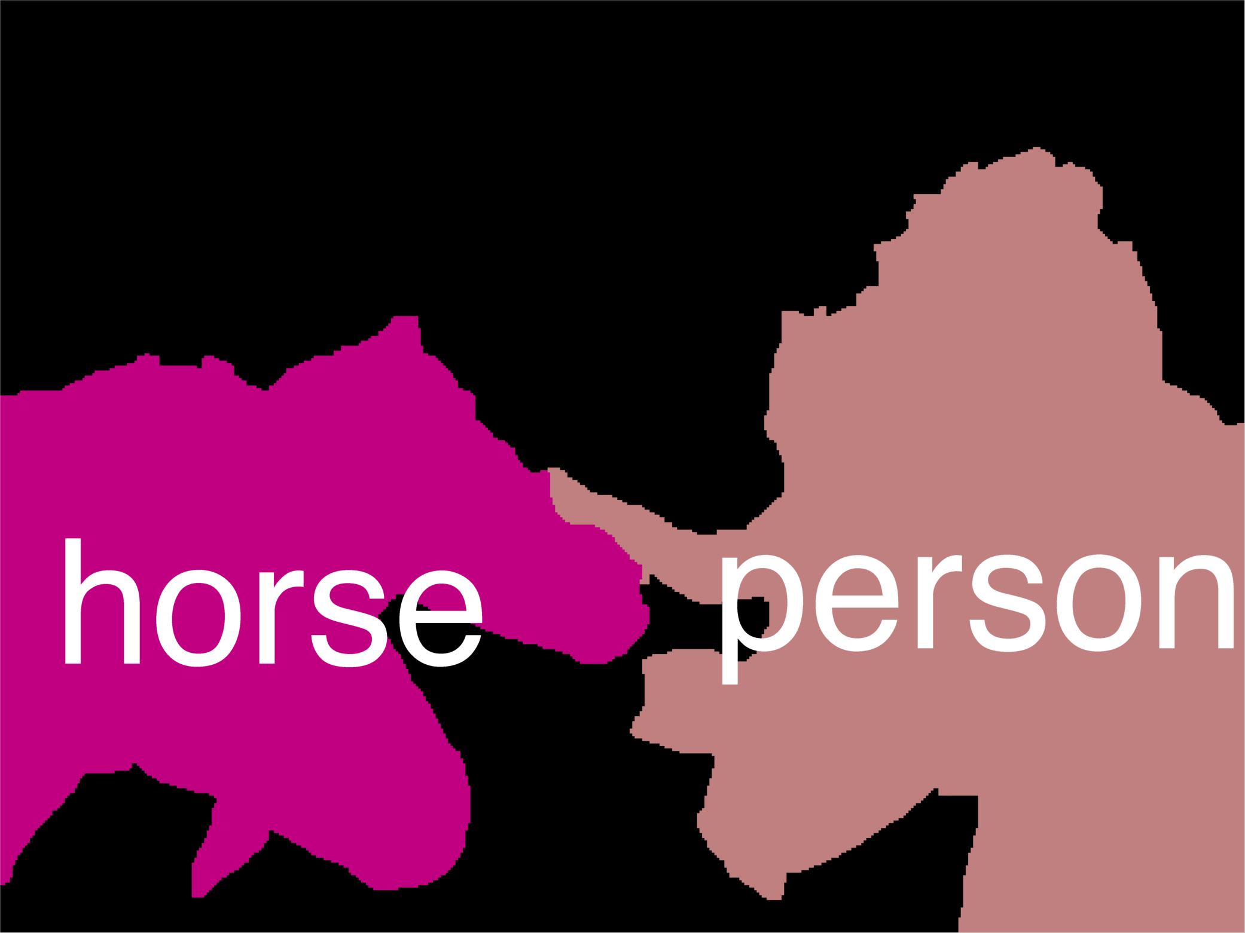
Error Decomposition
Reality
Multi-class Logistic Regression
Modeling Error
Softmax
FC HxWx3
Input
Estimation Error
Optimization Error = 0
model class

Slide 5
Thoughts on Gaier & Ha NeurIPS19
Inductive biases
Nice timing wrt CNNs
See HW2 Q4
Architecture elements as lego blocks
Guest lecture on Neural Architecture Search
Learned vs innate?

Slide 6
Plan for Today
(Finish) Automatic Differentiation
Jacobians in FC+ReLU NNs
Convolutional Neural Networks
What is a convolution?
FC vs Conv Layers

Slide 7
Jacobian of ReLU
g(x) = max(0,x)
(elementwise)
4096-d
input vector
4096-d
output vector
Slide Credit: Fei-Fei Li, Justin Johnson, Serena Yeung, CS 231n

Slide 8
Jacobian of ReLU
g(x) = max(0,x)
(elementwise)
4096-d
input vector
4096-d
output vector
Q1: what is the size of the Jacobian matrix?
Slide Credit: Fei-Fei Li, Justin Johnson, Serena Yeung, CS 231n
Notes:
Partial deriv. Of each dimension of output with respect to each dimension of input

Slide 9
Jacobian of ReLU
g(x) = max(0,x)
(elementwise)
4096-d
input vector
4096-d
output vector
Q1: what is the size of the Jacobian matrix?
[4096 x 4096!]
Slide Credit: Fei-Fei Li, Justin Johnson, Serena Yeung, CS 231n

Slide 10
Jacobian of ReLU
g(x) = max(0,x)
(elementwise)
4096-d
input vector
4096-d
output vector
Q1: what is the size of the Jacobian matrix?
[4096 x 4096!]
in practice we process an entire minibatch (e.g. 100) of examples at one time:
i.e. Jacobian would technically be a
[409,600 x 409,600] matrix :\
Slide Credit: Fei-Fei Li, Justin Johnson, Serena Yeung, CS 231n

Slide 11
Jacobian of ReLU
g(x) = max(0,x)
(elementwise)
4096-d
input vector
4096-d
output vector
Q1: what is the size of the Jacobian matrix?
[4096 x 4096!]
Q2: what does it look like?
Slide Credit: Fei-Fei Li, Justin Johnson, Serena Yeung, CS 231n
Notes:
For each elem in input, for each elem in output

Slide 12
Jacobians of FC-Layer

Slide 13
Jacobians of FC-Layer

Slide 14
Jacobians of FC-Layer

Slide 15
Plan for Today
(Finish) Automatic Differentiation
Jacobians in FC+ReLU NNs
Convolutional Neural Networks
What is a convolution?
FC vs Conv Layers

Slide 16
Plan for Today
Convolutional Neural Networks
What is a convolution?
FC vs Conv Layers

Slide 17
Recall: Linear Classifier
3072x1
f(x,W) = Wx + b
10x1
Image
10x1
10x3072
f(x,W)
10 numbers giving class scores
Array of 32x32x3 numbers
(3072 numbers total)
W
parameters
or weights
Slide Credit: Fei-Fei Li, Justin Johnson, Serena Yeung, CS 231n

Slide 18
Example with an image with 4 pixels, and 3 classes (cat/dog/ship)
Stretch pixels into column
56
231
24
2
0.2 | -0.5 | 0.1 | 2.0
1.5 | 1.3 | 2.1 | 0.0
0 | 0.25 | 0.2 | -0.3
1.1
3.2
-1.2
-96.8
437.9
61.95
Cat score
56 | 231
24 | 2
+
=
Dog score
Ship score
Input image
W
b
Slide Credit: Fei-Fei Li, Justin Johnson, Serena Yeung, CS 231n

Slide 19
Recall: (Fully-Connected) Neural networks
(Before) Linear score function:
(Now) 2-layer Neural Network
x
h
W1
W2
s
3072
100
10
Slide Credit: Fei-Fei Li, Justin Johnson, Serena Yeung, CS 231n
Notes:
Biological inspirations to neurons in brain that we’ll discuss later
Looking at it mathematically first, one thing this can help solve, is if we look back to our linear score function, each row of W corresponded to a template
Problem that there can be only one template per class, can’t look for multiple modes
Now intermediate layers can represent anonymous templates that later get recombined
Intermediate layers anonymous templates that get recombined. solves mode problems

Slide 20
Convolutional Neural Networks
(without the brain stuff)
Slide Credit: Fei-Fei Li, Justin Johnson, Serena Yeung, CS 231n

Slide 21
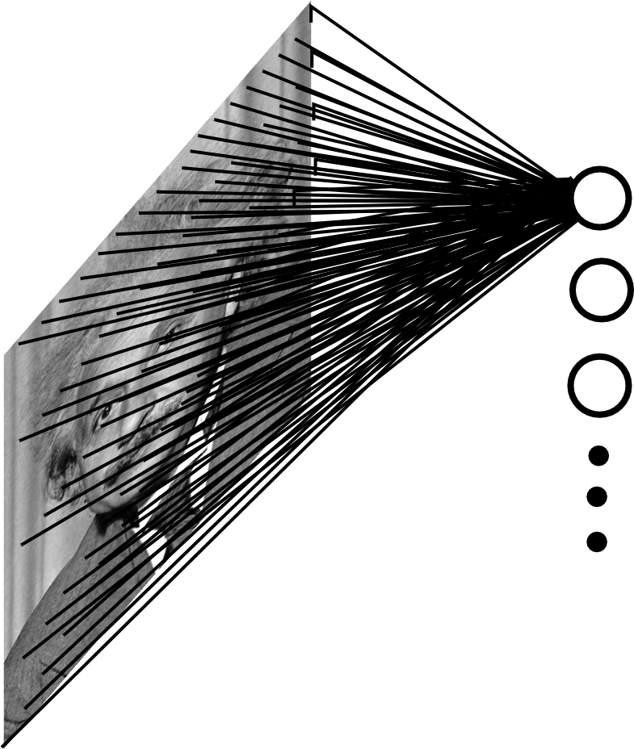
Fully Connected Layer
Example: 200x200 image
40K hidden units
Q: what is the number of parameters in this FC layer?
Slide Credit: Marc'Aurelio Ranzato

Slide 22
Fully Connected Layer
Example: 200x200 image
40K hidden units
Q: what is the number of parameters in this FC layer?
A: ~2 Billion
- Spatial correlation is local
- Waste of resources + we have not enough training samples anyway..
Slide Credit: Marc'Aurelio Ranzato

Slide 23
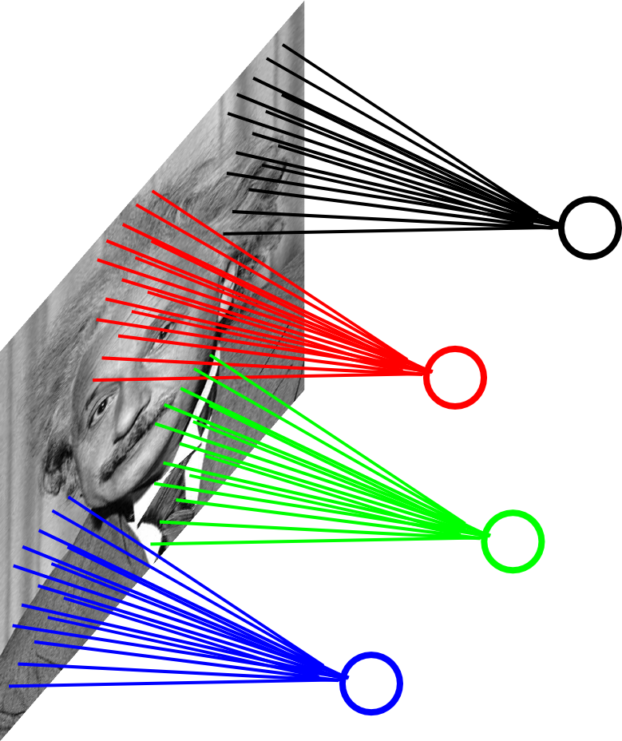
Assumption 1: Locally Connected Layer
Example: 200x200 image
40K hidden units
Connection size: 10x10
4M parameters
Note: This parameterization is good when input image is registered (e.g., face recognition).
Slide Credit: Marc'Aurelio Ranzato

Slide 24
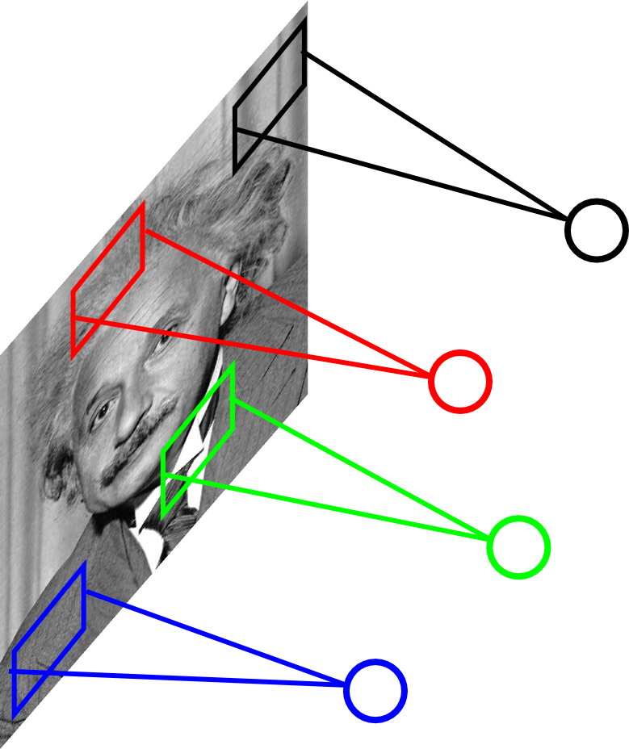
Assumption 2: Stationarity / Parameter Sharing
STATIONARITY? Statistics similar at all locations
Slide Credit: Marc'Aurelio Ranzato

Slide 25
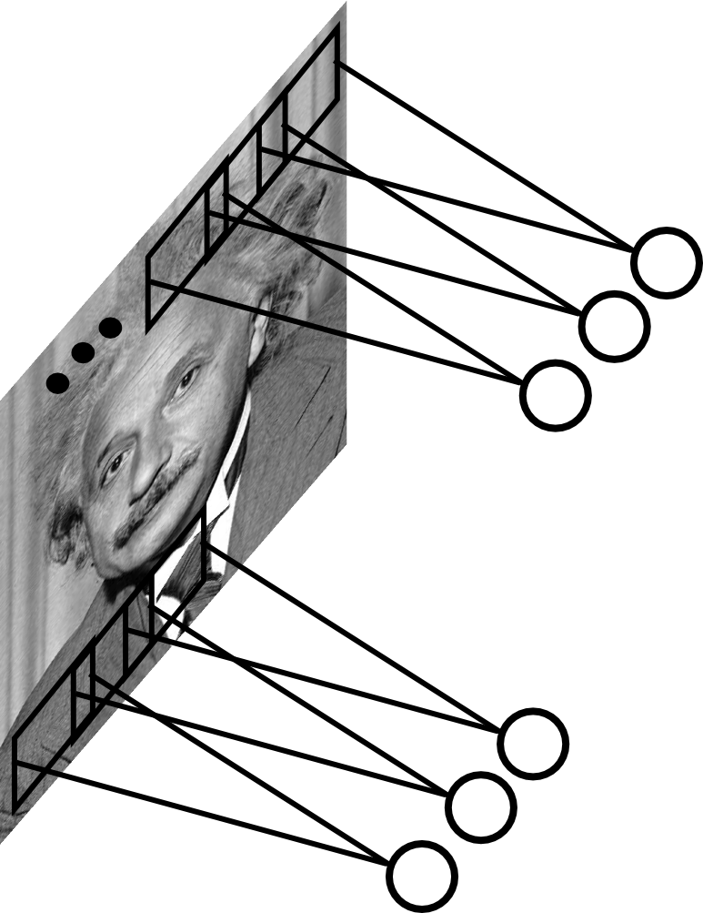
Convolutional Layer
Share the same parameters across different locations (assuming input is stationary):
Convolutions with learned kernels
Slide Credit: Marc'Aurelio Ranzato

Slide 26
Convolutions!

Slide 27
Convolutions for mathematicians

Slide 28
Convolutions for mathematicians

Slide 29
"Convolution of box signal with itself2" by Convolution_of_box_signal_with_itself.gif: Brian Ambergderivative work: Tinos (talk) - Convolution_of_box_signal_with_itself.gif. Licensed under CC BY-SA 3.0 via Commons - https://commons.wikimedia.org/wiki/File:Convolution_of_box_signal_with_itself2.gif#/media/File:Convolution_of_box_signal_with_itself2.gif

Slide 30
"Convolution of box signal with itself2" by Convolution_of_box_signal_with_itself.gif: Brian Ambergderivative work: Tinos (talk) - Convolution_of_box_signal_with_itself.gif. Licensed under CC BY-SA 3.0 via Commons - https://commons.wikimedia.org/wiki/File:Convolution_of_box_signal_with_itself2.gif#/media/File:Convolution_of_box_signal_with_itself2.gif

Slide 31
Convolutions for mathematicians
One dimension
Two dimensions

Slide 32
Convolutions for computer scientists

Slide 33
Convolutions for computer scientists

Slide 34
Convolutions for programmers

Slide 35
Convolutions for programmers

Slide 36
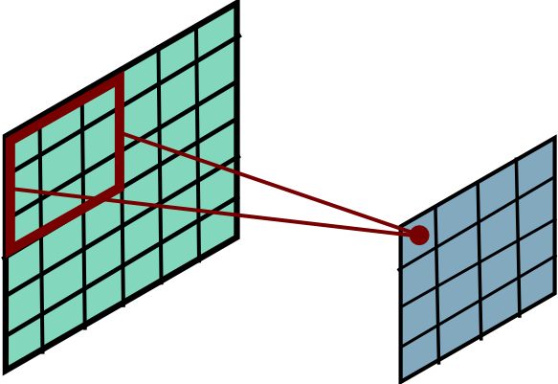
Convolutional Layer
Slide Credit: Marc'Aurelio Ranzato

Slide 37
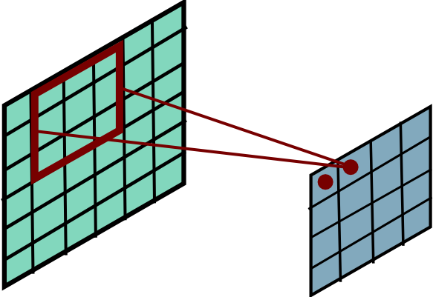
Convolutional Layer
Slide Credit: Marc'Aurelio Ranzato

Slide 38
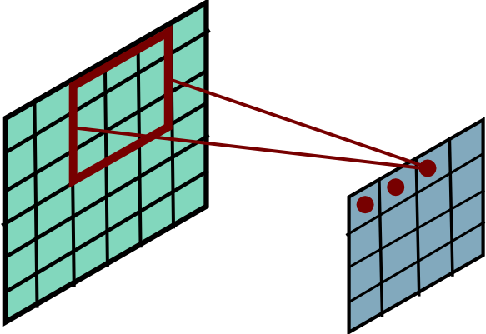
Convolutional Layer
Slide Credit: Marc'Aurelio Ranzato

Slide 39
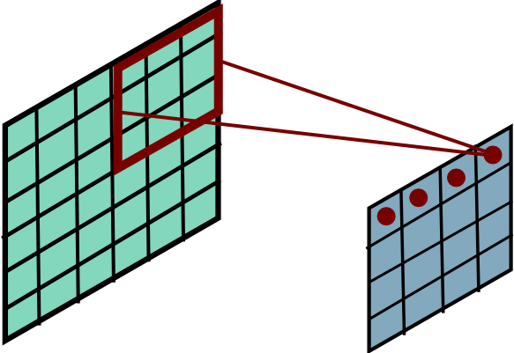
Convolutional Layer
Slide Credit: Marc'Aurelio Ranzato

Slide 40
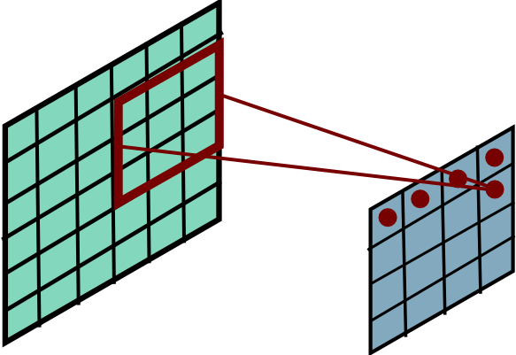
Convolutional Layer
Slide Credit: Marc'Aurelio Ranzato

Slide 41
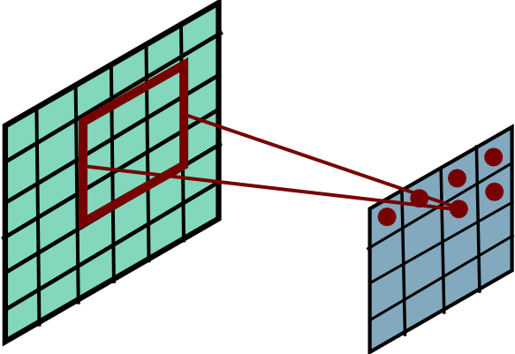
Convolutional Layer
Slide Credit: Marc'Aurelio Ranzato

Slide 42
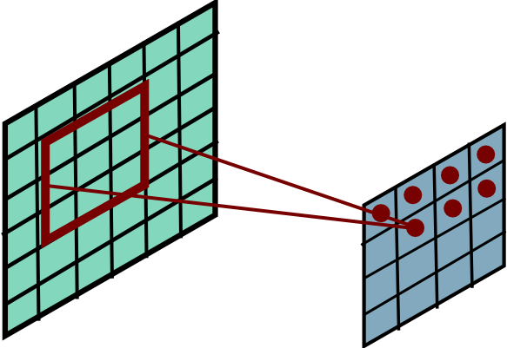
Convolutional Layer
Slide Credit: Marc'Aurelio Ranzato

Slide 43
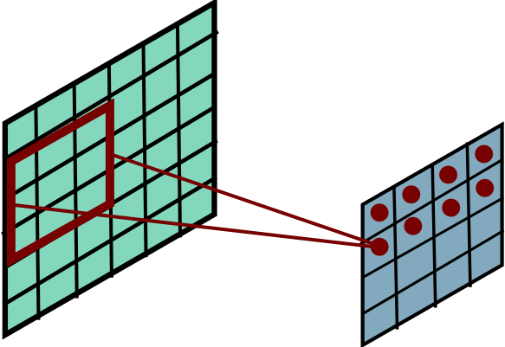
Convolutional Layer
Slide Credit: Marc'Aurelio Ranzato

Slide 44
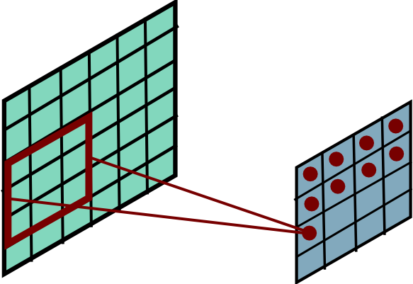
Convolutional Layer
Slide Credit: Marc'Aurelio Ranzato

Slide 45
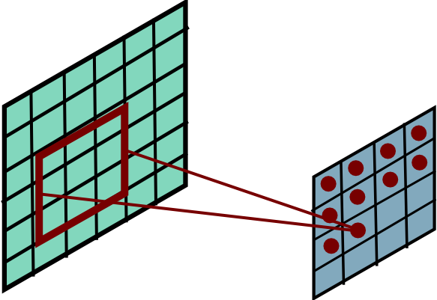
Convolutional Layer
Slide Credit: Marc'Aurelio Ranzato

Slide 46
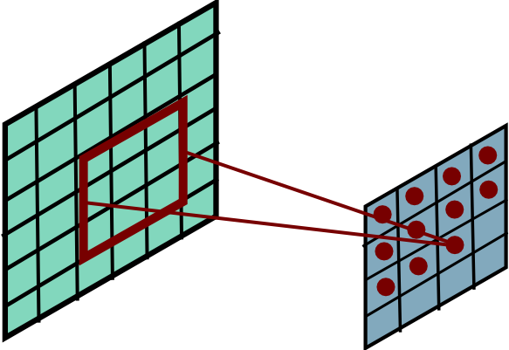
Convolutional Layer
Slide Credit: Marc'Aurelio Ranzato

Slide 47
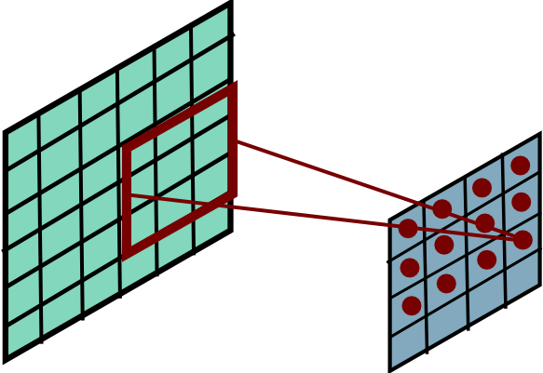
Convolutional Layer
Slide Credit: Marc'Aurelio Ranzato

Slide 48
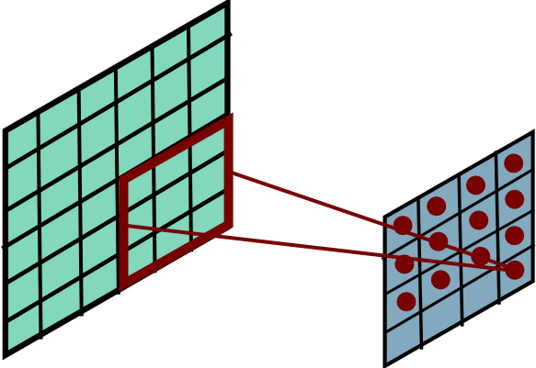
Convolutional Layer
Slide Credit: Marc'Aurelio Ranzato

Slide 49
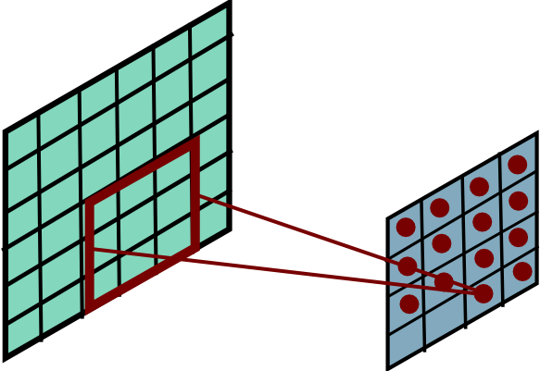
Convolutional Layer
Slide Credit: Marc'Aurelio Ranzato

Slide 50
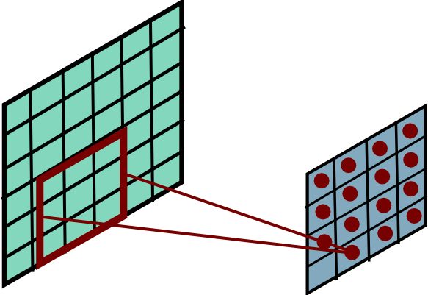
Convolutional Layer
Slide Credit: Marc'Aurelio Ranzato

Slide 51
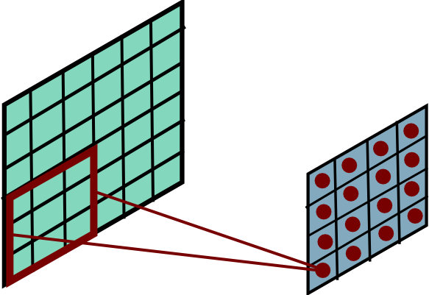
Convolutional Layer
Slide Credit: Marc'Aurelio Ranzato

Slide 52
Convolution Explained
http://setosa.io/ev/image-kernels/
https://github.com/bruckner/deepViz

Slide 53
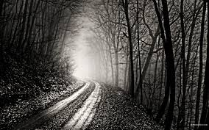
Convolutional Layer
-1 0 1
-1 0 1
-1 0 1
=
*
Slide Credit: Marc'Aurelio Ranzato

Slide 54
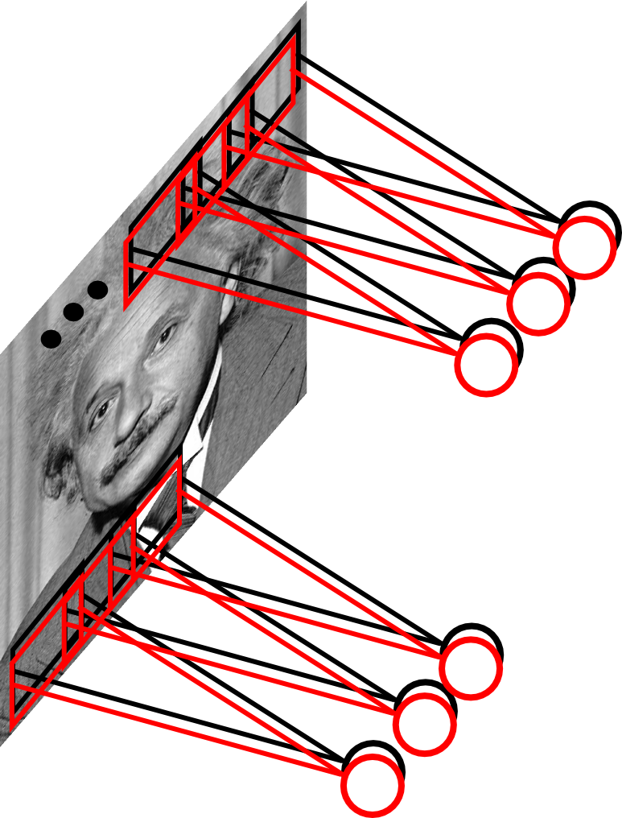
Convolutional Layer
Learn multiple filters.
E.g.: 200x200 image
100 Filters
Filter size: 10x10
10K parameters
Slide Credit: Marc'Aurelio Ranzato

Slide 55
FC vs Conv Layer

Slide 56
FC vs Conv Layer

Slide 57
Convolution Layer
32x32x3 image
32
height
32
width
3
depth
Slide Credit: Fei-Fei Li, Justin Johnson, Serena Yeung, CS 231n
Notes:
Preserve spatial structure of input

Slide 58
Convolution Layer
32x32x3 image
5x5x3 filter
32
Convolve the filter with the image
i.e. “slide over the image spatially, computing dot products”
32
3
Slide Credit: Fei-Fei Li, Justin Johnson, Serena Yeung, CS 231n

Slide 59
Convolution Layer
Filters always extend the full depth of the input volume
32x32x3 image
5x5x3 filter
32
Convolve the filter with the image
i.e. “slide over the image spatially, computing dot products”
32
3
Slide Credit: Fei-Fei Li, Justin Johnson, Serena Yeung, CS 231n

Slide 60
Convolution Layer
32x32x3 image
5x5x3 filter
32
1 number:
the result of taking a dot product between the filter and a small 5x5x3 chunk of the image
(i.e. 5*5*3 = 75-dimensional dot product + bias)
32
3
Slide Credit: Fei-Fei Li, Justin Johnson, Serena Yeung, CS 231n

Slide 61
Convolution Layer
activation map
32x32x3 image
5x5x3 filter
32
28
convolve (slide) over all spatial locations
32
28
3
1
Slide Credit: Fei-Fei Li, Justin Johnson, Serena Yeung, CS 231n

Slide 62
consider a second, green filter
Convolution Layer
32x32x3 image
5x5x3 filter
activation maps
32
28
convolve (slide) over all spatial locations
32
28
3
1
Slide Credit: Fei-Fei Li, Justin Johnson, Serena Yeung, CS 231n

Slide 63
For example, if we had 6 5x5 filters, we’ll get 6 separate activation maps:
activation maps
32
28
Convolution Layer
32
28
3
6
We stack these up to get a “new image” of size 28x28x6!
Slide Credit: Fei-Fei Li, Justin Johnson, Serena Yeung, CS 231n

Slide 64
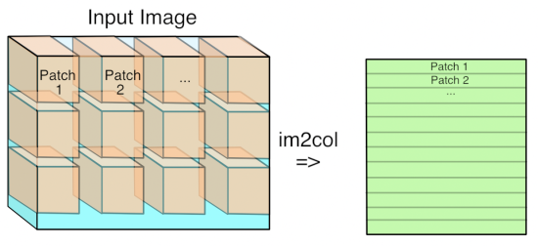
Im2Col
Figure Credit: https://petewarden.com/2015/04/20/why-gemm-is-at-the-heart-of-deep-learning/

Slide 65
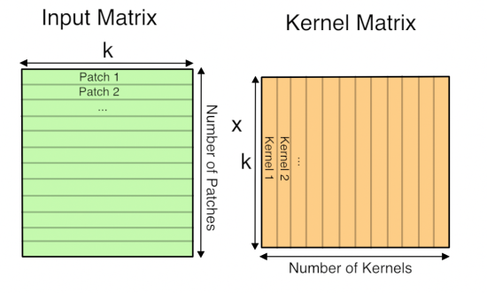
GEMM
Figure Credit: https://petewarden.com/2015/04/20/why-gemm-is-at-the-heart-of-deep-learning/

Slide 66
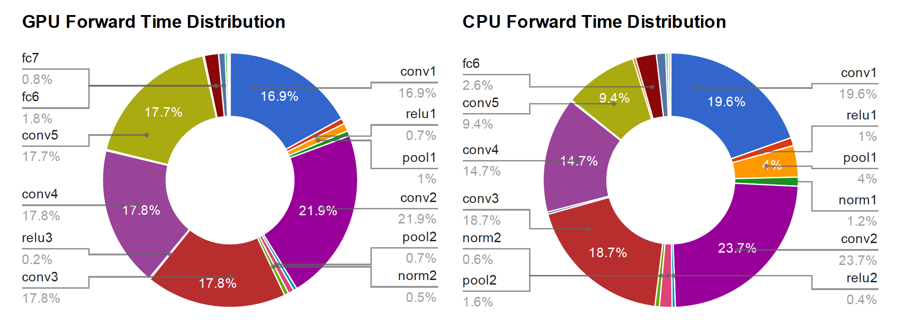
Time Distribution of AlexNet
Figure Credit: Yangqing Jia, PhD Thesis

Slide 67
Preview: ConvNet is a sequence of Convolution Layers, interspersed with activation functions
32
28
CONV,
ReLU
e.g. 6 5x5x3 filters
32
28
3
6
Slide Credit: Fei-Fei Li, Justin Johnson, Serena Yeung, CS 231n

Slide 68
Preview: ConvNet is a sequence of Convolutional Layers, interspersed with activation functions
32
28
24
….
CONV,
ReLU
e.g. 6 5x5x3 filters
CONV,
ReLU
e.g. 10 5x5x6 filters
CONV,
ReLU
32
28
24
3
6
10
Slide Credit: Fei-Fei Li, Justin Johnson, Serena Yeung, CS 231n

