Slide 1
CS 4803 / 7643: Deep Learning
Topics:
  (Finish) Automatic Differentiation
    Patterns in backprop
    Jacobians in FC+ReLU NNs
Dhruv Batra
Georgia Tech

Slide 2
Administrativia
HW2 out
  Due: 09/23 11:59pm
  Theory: Gradient descent, Hessians, Auto-diff, Convolutions
    https://www.overleaf.com/project/5f4c143e06061d00013dd4f0
  Implementation: ConvNets in Python and PyTorch
  Bonus: Challenge on EvalAI
    https://evalai.cloudcv.org/web/challenges/challenge-page/684/overview

Slide 3
Project
Goal
  Chance to take on something open-ended
  Encouraged to apply to your research
  (computer vision, NLP, robotics,…)
Main categories
  Reproducibility
    Pick a paper from a recent conference. Attempt to reproduce the method and validate claims.
  Application/Survey
    Compare a collection of existing algorithms on a new application domain of your interest
  Formulation/Development
    Formulate a new model or algorithm for a new or old problem
  Theory
    Theoretically analyze an existing algorithm

Slide 4
Project
Rules
  Combine with other classes / research / credits / anything
    You have our blanket permission
    Get permission from other instructors; delineate different parts
  Must be done this semester.
  Groups of 3-4
Expectations
  20% of final grade = individual effort equivalent to 1 HW
  Expectation scales with team size
  Most work will be done in Nov but please plan early.

Slide 5

Project Ideas
ML Reproducibility Challenge 2020
  https://paperswithcode.com/rc2020

Slide 6
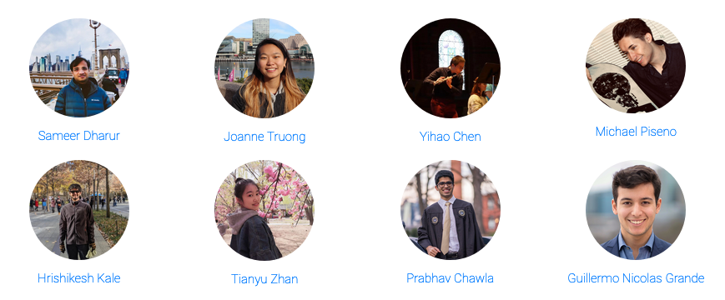
TAs

Slide 7
Computing
Major bottleneck
  GPUs
Options
  Your own / group / advisor’s resources
  Google Cloud Credits
    $50 credits to every registered student courtesy Google
  Google Colab
    jupyter-notebook + free GPU instance

Slide 8
Administrativia
Project Teams
  https://gtvault-my.sharepoint.com/:x:/g/personal/dbatra8_gatech_edu/EY4_65XOzWtOkXSSz2WgpoUBY8ux2gY9PsRzR6KnglIFEQ?e=4tnKWI
  Project Title
  1-3 sentence project summary TL;DR
  Team member names

Slide 9
Recap from last time

Slide 10
Deep Learning = Differentiable Programming
Computation = Graph
  Input = Data + Parameters
  Output = Loss
  Scheduling = Topological ordering
Auto-Diff
  A family of algorithms for
  implementing chain-rule on computation graphs

Slide 11
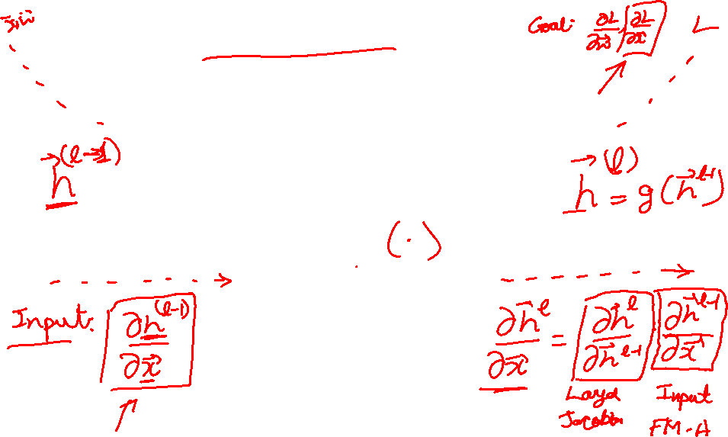
Forward mode AD
g
Notes:
What we’re doing in backprop is we have all these nodes in our computational graph, each node only aware of immediate surroundings
at each node have ...

Slide 12
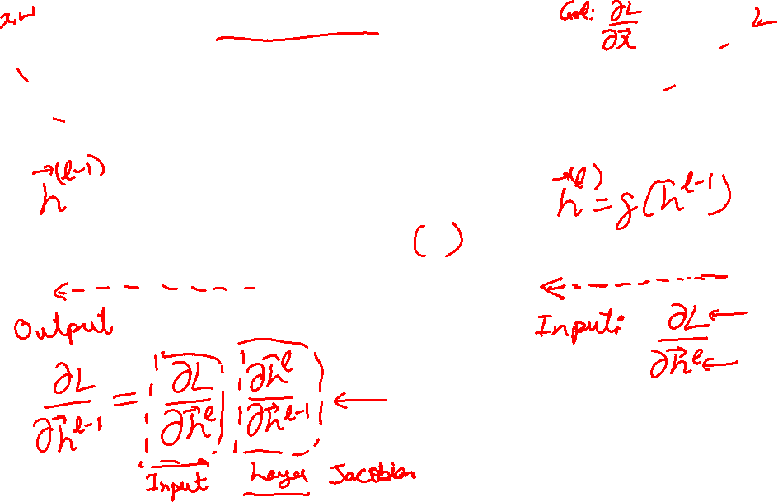
Reverse mode AD
g
Notes:
What we’re doing in backprop is we have all these nodes in our computational graph, each node only aware of immediate surroundings
at each node have ...

Slide 13
Example: Forward mode AD
+
sin( )
*
x₁
x₂

Slide 14
Example: Forward mode AD
+
sin( )
*
x₁
x₂

Slide 15
Example: Reverse mode AD
+
sin( )
*
x₁
x₂

Slide 16
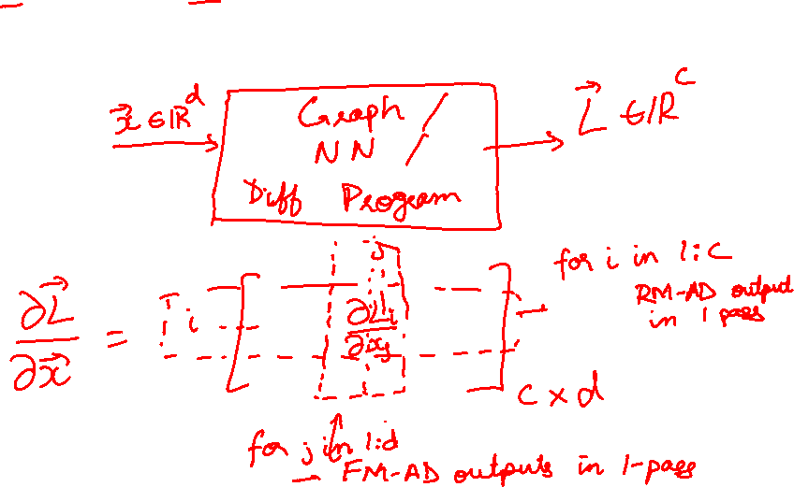
Forward mode vs Reverse Mode
x → Graph → L
Intuition of Jacobian

Slide 17
Forward mode vs Reverse Mode
What are the differences?
Which one is faster to compute?
  Forward or backward?
Which one is more memory efficient (less storage)?
  Forward or backward?

Slide 18
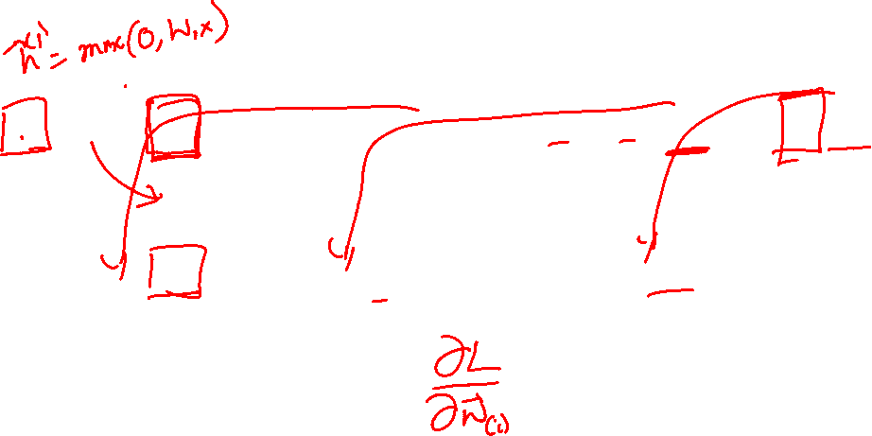
Neural Network Computation Graph
Figure Credit: Andrea Vedaldi

Slide 19
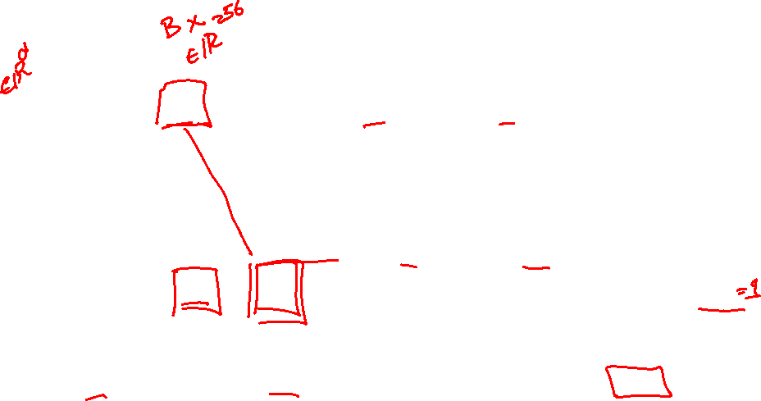
Backprop
Figure Credit: Andrea Vedaldi

Slide 20
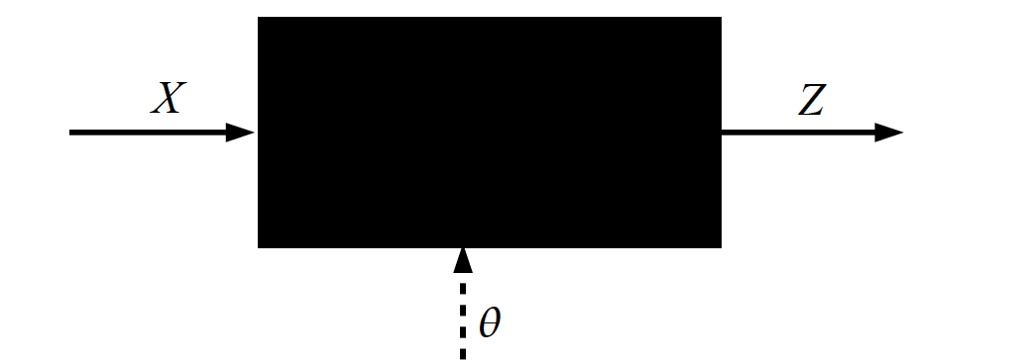
Key Computation: Forward-Prop
Slide Credit: Marc'Aurelio Ranzato, Yann LeCun

Slide 21
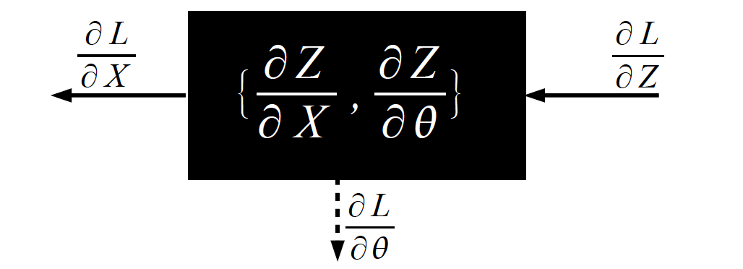
Key Computation: Back-Prop
Slide Credit: Marc'Aurelio Ranzato, Yann LeCun

Slide 22
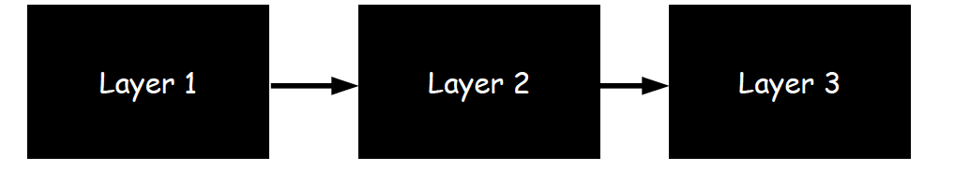
Neural Network Training
Step 1: Compute Loss on mini-batch [F-Pass]
Slide Credit: Marc'Aurelio Ranzato, Yann LeCun

Slide 23
Neural Network Training
Step 1: Compute Loss on mini-batch [F-Pass]
Slide Credit: Marc'Aurelio Ranzato, Yann LeCun

Slide 24
Neural Network Training
Step 1: Compute Loss on mini-batch [F-Pass]
Slide Credit: Marc'Aurelio Ranzato, Yann LeCun

Slide 25
Neural Network Training
Step 1: Compute Loss on mini-batch [F-Pass]
Step 2: Compute gradients wrt parameters [B-Pass]
Slide Credit: Marc'Aurelio Ranzato, Yann LeCun

Slide 26
Neural Network Training
Step 1: Compute Loss on mini-batch [F-Pass]
Step 2: Compute gradients wrt parameters [B-Pass]
Slide Credit: Marc'Aurelio Ranzato, Yann LeCun

Slide 27
Neural Network Training
Step 1: Compute Loss on mini-batch [F-Pass]
Step 2: Compute gradients wrt parameters [B-Pass]
Slide Credit: Marc'Aurelio Ranzato, Yann LeCun

Slide 28

Neural Network Training
Step 1: Compute Loss on mini-batch [F-Pass]
Step 2: Compute gradients wrt parameters [B-Pass]
Step 3: Use gradient to update parameters
Slide Credit: Marc'Aurelio Ranzato, Yann LeCun

Slide 29
Computational Graph
Any DAG of differentiable modules is allowed!
Slide Credit: Marc'Aurelio Ranzato

Slide 30
Plan for Today
Automatic Differentiation
  Patterns in backprop
  Jacobians in FC+ReLU NNs

Slide 31
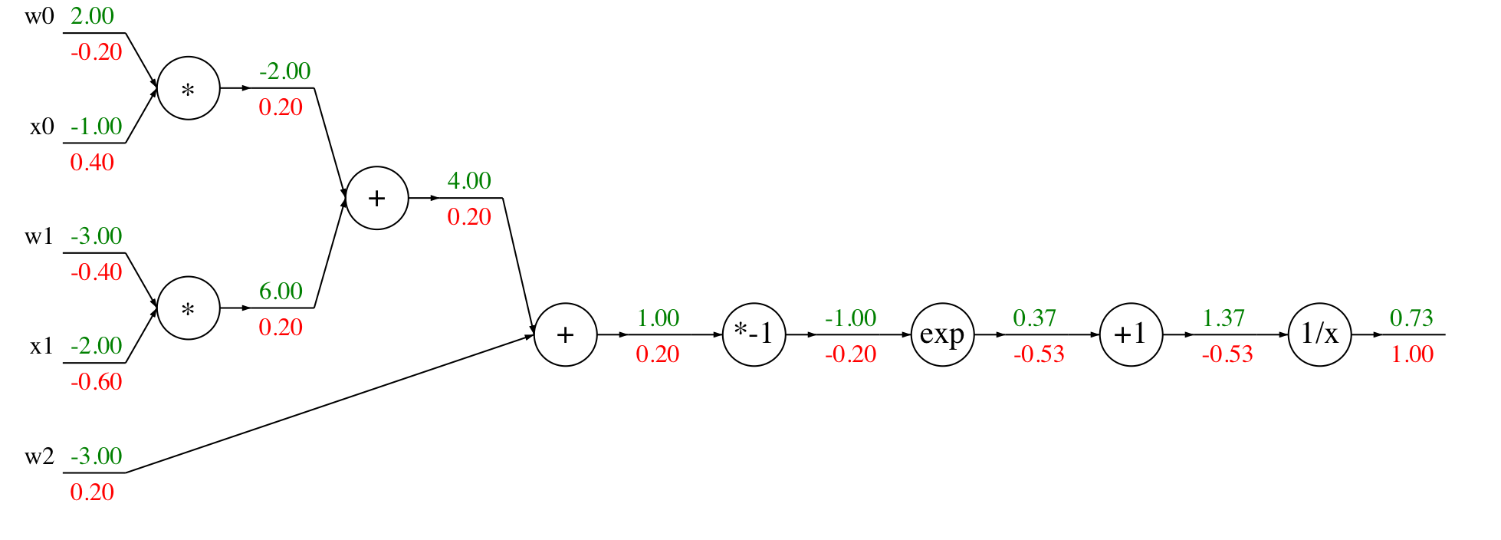
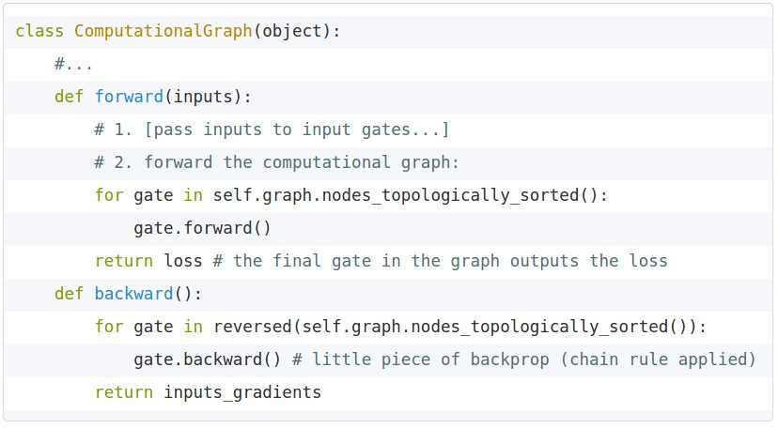
Modularized implementation: forward / backward API
Graph (or Net) object (rough psuedo code)
Slide Credit: Fei-Fei Li, Justin Johnson, Serena Yeung, CS 231n
Notes:
During forward pass cache intermediary computation

Slide 32
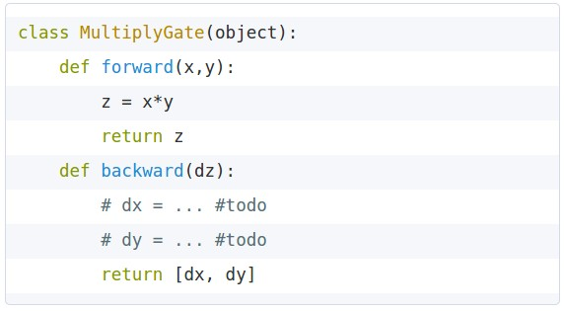


Modularized implementation: forward / backward API
x
z
*
y
(x,y,z are scalars)
Slide Credit: Fei-Fei Li, Justin Johnson, Serena Yeung, CS 231n
Notes:
The implementation exactly mirrors the algorithm in that it’s completely local

Slide 33
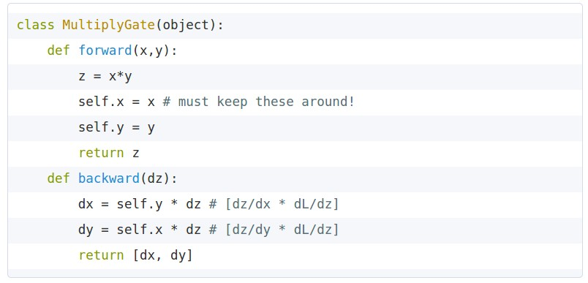
Modularized implementation: forward / backward API
x
z
*
y
(x,y,z are scalars)
Slide Credit: Fei-Fei Li, Justin Johnson, Serena Yeung, CS 231n

Slide 34
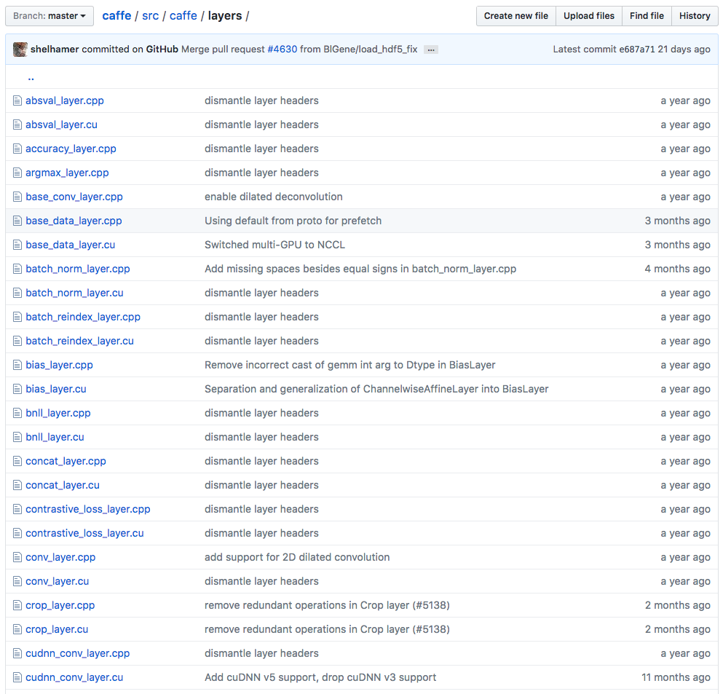
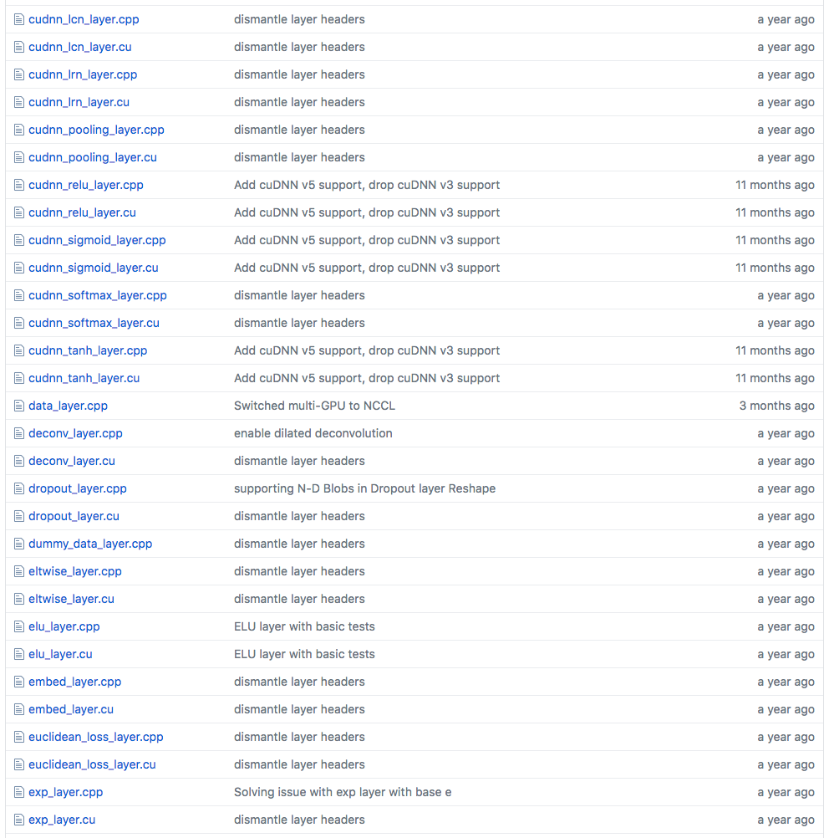
Example: Caffe layers
Caffe is licensed under BSD 2-Clause
Slide Credit: Fei-Fei Li, Justin Johnson, Serena Yeung, CS 231n
Notes:
Higher level node
Beautiful thing is only need to implement forward and backward

Slide 35
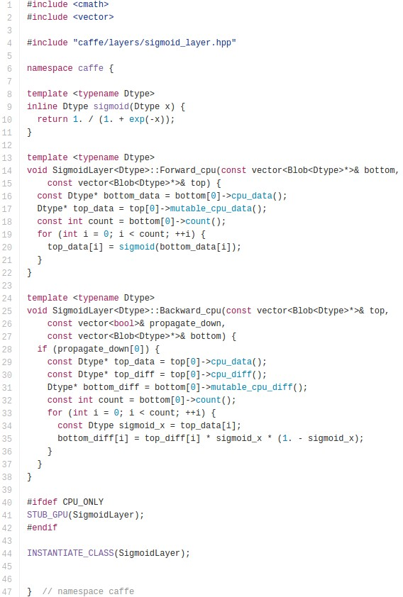

Caffe Sigmoid Layer
* top_diff (chain rule)
Caffe is licensed under BSD 2-Clause
Slide Credit: Fei-Fei Li, Justin Johnson, Serena Yeung, CS 231n

Slide 36
Plan for Today
Automatic Differentiation
  Patterns in backprop
  Jacobians in FC+ReLU NNs

Slide 37
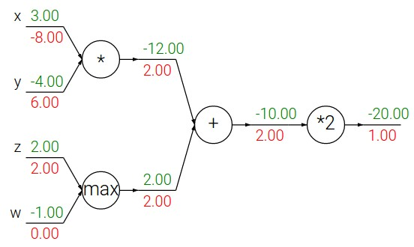
Backpropagation: a simple example
Slide Credit: Fei-Fei Li, Justin Johnson, Serena Yeung, CS 231n

Slide 38
Forward pass
Slide Credit: Fei-Fei Li, Justin Johnson, Serena Yeung, CS 231n

Slide 39
Patterns in backprop
Slide Credit: Fei-Fei Li, Justin Johnson, Serena Yeung, CS 231n

Slide 40
Patterns in backprop
Q: What is an add gate?
Slide Credit: Fei-Fei Li, Justin Johnson, Serena Yeung, CS 231n

Slide 41
Patterns in backprop
add gate: gradient distributor
Slide Credit: Fei-Fei Li, Justin Johnson, Serena Yeung, CS 231n

Slide 42
Patterns in backprop
add gate: gradient distributor
Q: What is a max gate?
Slide Credit: Fei-Fei Li, Justin Johnson, Serena Yeung, CS 231n

Slide 43
Patterns in backprop
add gate: gradient distributor
max gate: gradient router
Slide Credit: Fei-Fei Li, Justin Johnson, Serena Yeung, CS 231n

Slide 44
Patterns in backprop
add gate: gradient distributor
max gate: gradient router
Q: What is a mul gate?
Slide Credit: Fei-Fei Li, Justin Johnson, Serena Yeung, CS 231n

Slide 45
Patterns in backprop
add gate: gradient distributor
max gate: gradient router
mul gate: gradient switcher
Slide Credit: Fei-Fei Li, Justin Johnson, Serena Yeung, CS 231n
Notes:
Gradient switcher and scaler
Mul: scale upstream gradient by value of other branch

Slide 46
Gradients add at branches
+
Slide Credit: Fei-Fei Li, Justin Johnson, Serena Yeung, CS 231n
Notes:
Gradients add at branches, from multivariate chain rule
Since wiggling this node affects both connected nodes in the forward pass, then at backprop the upstream gradient coming into this node is the sum of the gradients flowing back from both nodes

Slide 47
Duality in Fprop and Bprop
FPROP
BPROP
SUM
+
COPY
+

Slide 48
Plan for Today
Automatic Differentiation
  Patterns in backprop
  Jacobians in FC+ReLU NNs

Slide 49
Backprop
Figure Credit: Andrea Vedaldi

Slide 50
Jacobian of ReLU
g(x) = max(0,x)
(elementwise)
4096-d
input vector
4096-d
output vector
Slide Credit: Fei-Fei Li, Justin Johnson, Serena Yeung, CS 231n

Slide 51
Jacobian of ReLU
g(x) = max(0,x)
(elementwise)
4096-d
input vector
4096-d
output vector
Q1: what is the size of the Jacobian matrix?
Slide Credit: Fei-Fei Li, Justin Johnson, Serena Yeung, CS 231n
Notes:
Partial deriv. Of each dimension of output with respect to each dimension of input

Slide 52
Jacobian of ReLU
g(x) = max(0,x)
(elementwise)
4096-d
input vector
4096-d
output vector
Q1: what is the size of the Jacobian matrix?
[4096 x 4096!]
Slide Credit: Fei-Fei Li, Justin Johnson, Serena Yeung, CS 231n

Slide 53
Jacobian of ReLU
g(x) = max(0,x)
(elementwise)
4096-d
input vector
4096-d
output vector
Q1: what is the size of the Jacobian matrix?
[4096 x 4096!]
in practice we process an entire minibatch (e.g. 100) of examples at one time:
i.e. Jacobian would technically be a
[409,600 x 409,600] matrix :\
Slide Credit: Fei-Fei Li, Justin Johnson, Serena Yeung, CS 231n

Slide 54
Jacobian of ReLU
g(x) = max(0,x)
(elementwise)
4096-d
input vector
4096-d
output vector
Q1: what is the size of the Jacobian matrix?
[4096 x 4096!]
Q2: what does it look like?
Slide Credit: Fei-Fei Li, Justin Johnson, Serena Yeung, CS 231n
Notes:
For each elem in input, for each elem in output

Slide 55
Jacobians of FC-Layer

Slide 56
Jacobians of FC-Layer

Slide 57
Jacobians of FC-Layer

Slide 58
Jacobians of FC-Layer

