Slide 1
CS 4803 / 7643: Deep Learning
Topics:
  Automatic Differentiation
    Patterns in backprop
    Jacobians in FC+ReLU NNs
Dhruv Batra
Georgia Tech

Slide 2
Administrativia
HW1 Reminder
  Due: 09/26, 11:55pm
Project Teams Google Doc
  https://docs.google.com/spreadsheets/d/1ouD6ctaemV_3nb2MQHs7rUOAaW9DFLu8I5Zd3yOFs7E/edit?usp=sharing
  Project Title
  1-3 sentence project summary TL;DR
  Team member names

Slide 3
Recap from last time

Slide 4
Deep Learning = Differentiable Programming
Computation = Graph
  Input = Data + Parameters
  Output = Loss
  Scheduling = Topological ordering
Auto-Diff
  A family of algorithms for
  implementing chain-rule on computation graphs

Slide 5
Forward mode AD
g
Notes:
What we’re doing in backprop is we have all these nodes in our computational graph, each node only aware of immediate surroundings
at each node have ...

Slide 6
Reverse mode AD
g
Notes:
What we’re doing in backprop is we have all these nodes in our computational graph, each node only aware of immediate surroundings
at each node have ...

Slide 7
Example: Forward mode AD
+
sin( )
*
x₁
x₂

Slide 8
Example: Forward mode AD
+
sin( )
*
x₁
x₂

Slide 9
Example: Reverse mode AD
+
sin( )
*
x₁
x₂

Slide 10
Forward mode vs Reverse Mode
x → Graph → L
Intuition of Jacobian

Slide 11
Forward mode vs Reverse Mode
What are the differences?
Which one is faster to compute?
  Forward or backward?
Which one is more memory efficient (less storage)?
  Forward or backward?

Slide 12
Computational Graph
Any DAG of differentiable modules is allowed!
Slide Credit: Marc'Aurelio Ranzato

Slide 13
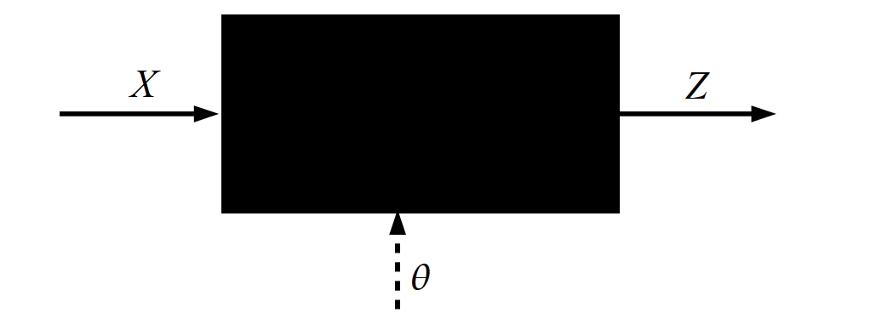
Key Computation: Forward-Prop
Slide Credit: Marc'Aurelio Ranzato, Yann LeCun

Slide 14
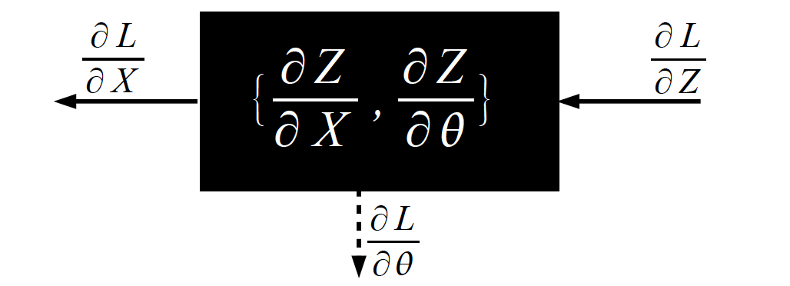
Key Computation: Back-Prop
Slide Credit: Marc'Aurelio Ranzato, Yann LeCun

Slide 15
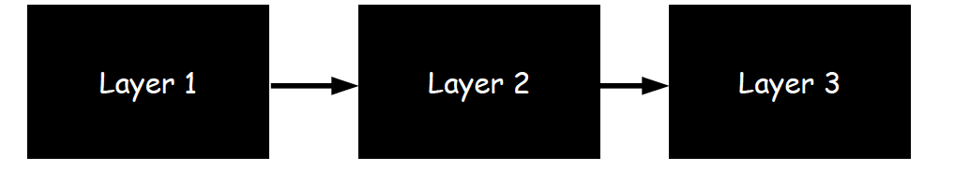
Neural Network Training
Step 1: Compute Loss on mini-batch [F-Pass]
Slide Credit: Marc'Aurelio Ranzato, Yann LeCun

Slide 16
Neural Network Training
Step 1: Compute Loss on mini-batch [F-Pass]
Slide Credit: Marc'Aurelio Ranzato, Yann LeCun

Slide 17
Neural Network Training
Step 1: Compute Loss on mini-batch [F-Pass]
Slide Credit: Marc'Aurelio Ranzato, Yann LeCun

Slide 18
Neural Network Training
Step 1: Compute Loss on mini-batch [F-Pass]
Step 2: Compute gradients wrt parameters [B-Pass]
Slide Credit: Marc'Aurelio Ranzato, Yann LeCun

Slide 19
Neural Network Training
Step 1: Compute Loss on mini-batch [F-Pass]
Step 2: Compute gradients wrt parameters [B-Pass]
Slide Credit: Marc'Aurelio Ranzato, Yann LeCun

Slide 20
Neural Network Training
Step 1: Compute Loss on mini-batch [F-Pass]
Step 2: Compute gradients wrt parameters [B-Pass]
Slide Credit: Marc'Aurelio Ranzato, Yann LeCun

Slide 21

Neural Network Training
Step 1: Compute Loss on mini-batch [F-Pass]
Step 2: Compute gradients wrt parameters [B-Pass]
Step 3: Use gradient to update parameters
Slide Credit: Marc'Aurelio Ranzato, Yann LeCun

Slide 22
Plan for Today
Automatic Differentiation
  Patterns in backprop
  Jacobians in FC+ReLU NNs

Slide 23
Neural Network Computation Graph
Figure Credit: Andrea Vedaldi

Slide 24
Backprop
Figure Credit: Andrea Vedaldi

Slide 25
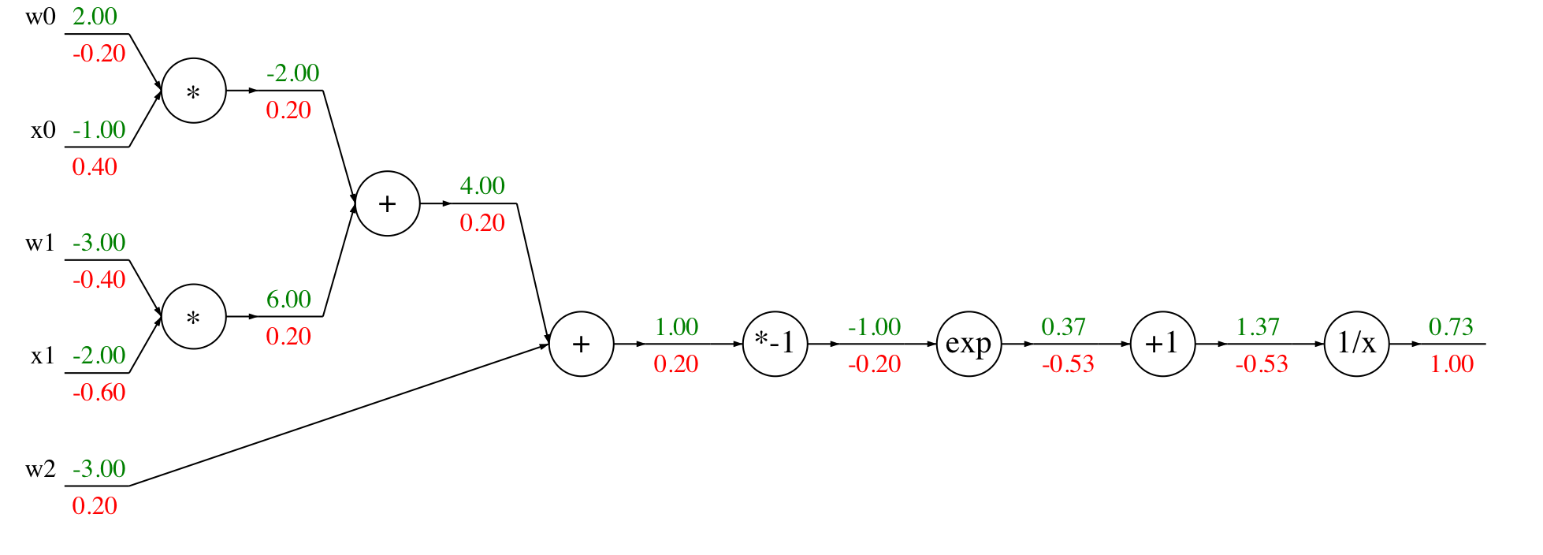
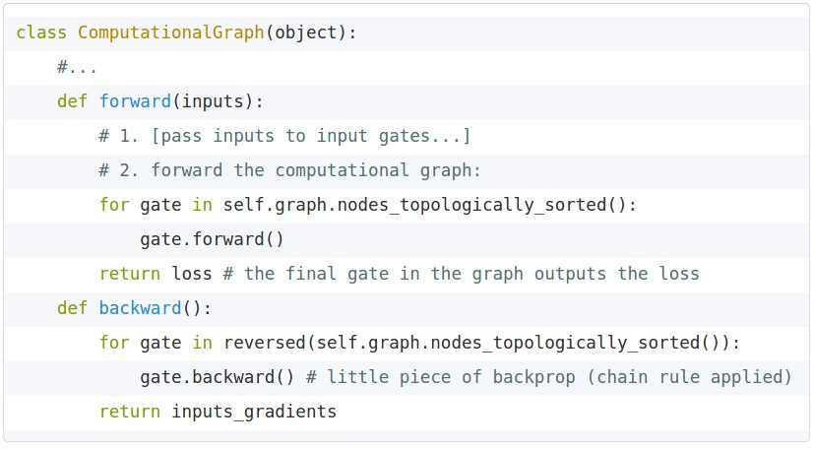
Modularized implementation: forward / backward API
Graph (or Net) object (rough psuedo code)
Slide Credit: Fei-Fei Li, Justin Johnson, Serena Yeung, CS 231n
Notes:
During forward pass cache intermediary computation

Slide 26
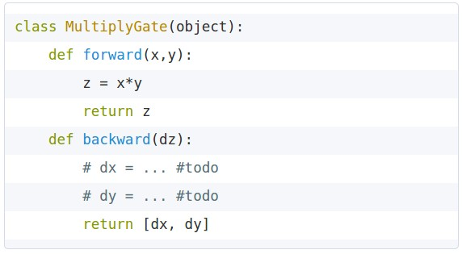


Modularized implementation: forward / backward API
x
z
*
y
(x,y,z are scalars)
Slide Credit: Fei-Fei Li, Justin Johnson, Serena Yeung, CS 231n
Notes:
The implementation exactly mirrors the algorithm in that it’s completely local

Slide 27
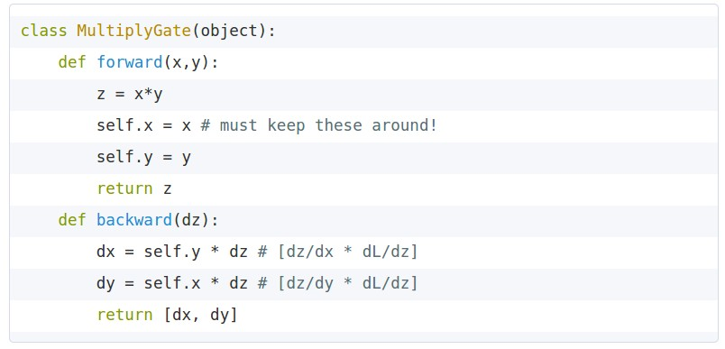
Modularized implementation: forward / backward API
x
z
*
y
(x,y,z are scalars)
Slide Credit: Fei-Fei Li, Justin Johnson, Serena Yeung, CS 231n

Slide 28
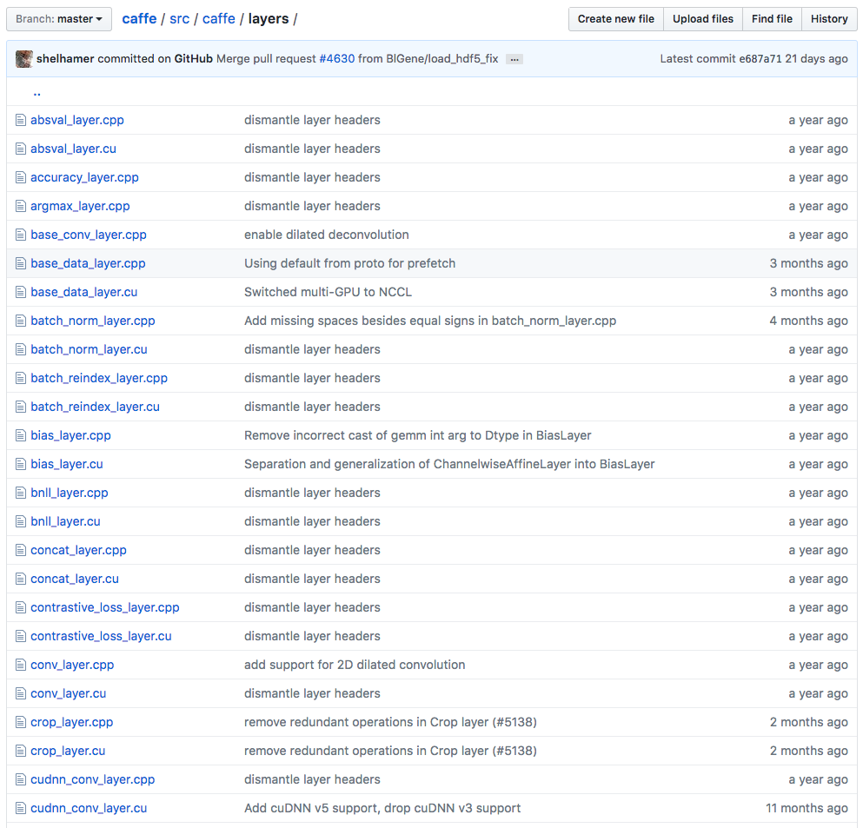
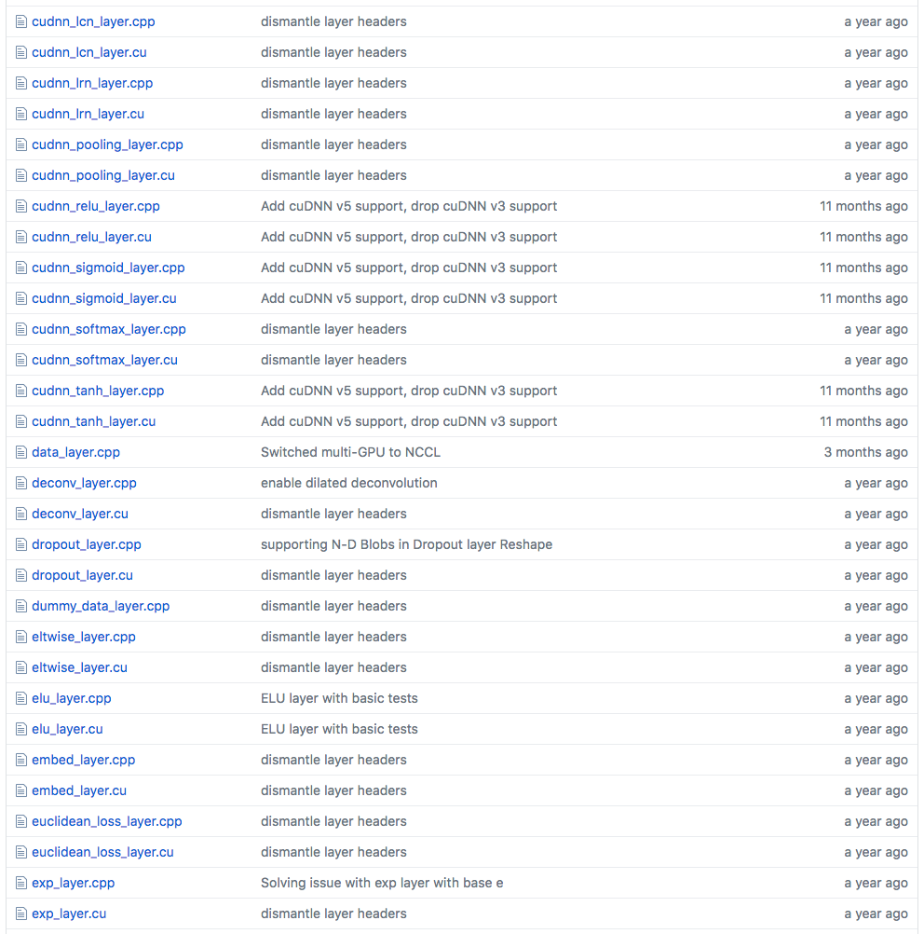
Example: Caffe layers
Caffe is licensed under BSD 2-Clause
Slide Credit: Fei-Fei Li, Justin Johnson, Serena Yeung, CS 231n
Notes:
Higher level node
Beautiful thing is only need to implement forward and backward

Slide 29
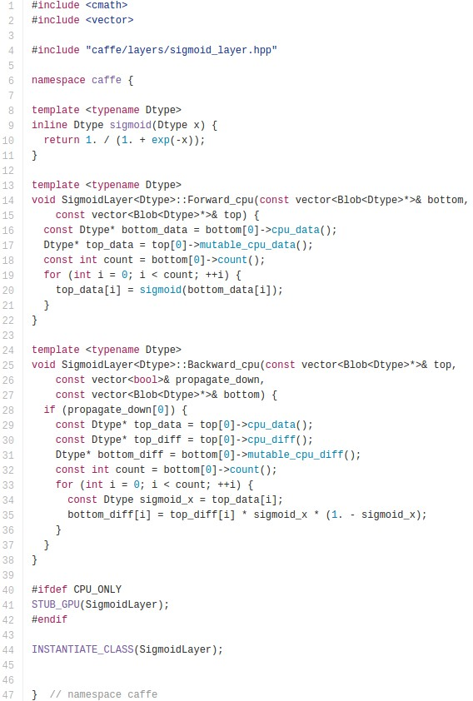

Caffe Sigmoid Layer
* top_diff (chain rule)
Caffe is licensed under BSD 2-Clause
Slide Credit: Fei-Fei Li, Justin Johnson, Serena Yeung, CS 231n

Slide 30
Plan for Today
Automatic Differentiation
  Patterns in backprop
  Jacobians in FC+ReLU NNs

Slide 31
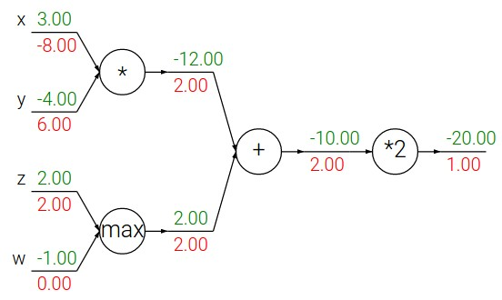
Backpropagation: a simple example
Slide Credit: Fei-Fei Li, Justin Johnson, Serena Yeung, CS 231n

Slide 32
Backpropagation: a simple example
Slide Credit: Fei-Fei Li, Justin Johnson, Serena Yeung, CS 231n

Slide 33
Patterns in backward flow
Slide Credit: Fei-Fei Li, Justin Johnson, Serena Yeung, CS 231n

Slide 34
Patterns in backward flow
Q: What is an add gate?
Slide Credit: Fei-Fei Li, Justin Johnson, Serena Yeung, CS 231n

Slide 35
Patterns in backward flow
add gate: gradient distributor
Slide Credit: Fei-Fei Li, Justin Johnson, Serena Yeung, CS 231n

Slide 36
Patterns in backward flow
add gate: gradient distributor
Q: What is a max gate?
Slide Credit: Fei-Fei Li, Justin Johnson, Serena Yeung, CS 231n

Slide 37
Patterns in backward flow
add gate: gradient distributor
max gate: gradient router
Slide Credit: Fei-Fei Li, Justin Johnson, Serena Yeung, CS 231n

Slide 38
Patterns in backward flow
add gate: gradient distributor
max gate: gradient router
Q: What is a mul gate?
Slide Credit: Fei-Fei Li, Justin Johnson, Serena Yeung, CS 231n

Slide 39
Patterns in backward flow
add gate: gradient distributor
max gate: gradient router
mul gate: gradient switcher
Slide Credit: Fei-Fei Li, Justin Johnson, Serena Yeung, CS 231n
Notes:
Gradient switcher and scaler
Mul: scale upstream gradient by value of other branch

Slide 40
Gradients add at branches
+
Slide Credit: Fei-Fei Li, Justin Johnson, Serena Yeung, CS 231n
Notes:
Gradients add at branches, from multivariate chain rule
Since wiggling this node affects both connected nodes in the forward pass, then at backprop the upstream gradient coming into this node is the sum of the gradients flowing back from both nodes

Slide 41
Duality in Fprop and Bprop
FPROP
BPROP
SUM
+
COPY
+

Slide 42
Plan for Today
Automatic Differentiation
  Patterns in backprop
  Jacobians in FC+ReLU NNs

Slide 43
Backprop
Figure Credit: Andrea Vedaldi

Slide 44
Jacobian of ReLU
g(x) = max(0,x)
(elementwise)
4096-d
input vector
4096-d
output vector
Slide Credit: Fei-Fei Li, Justin Johnson, Serena Yeung, CS 231n

Slide 45
Jacobian of ReLU
g(x) = max(0,x)
(elementwise)
4096-d
input vector
4096-d
output vector
Q: what is the size of the Jacobian matrix?
Slide Credit: Fei-Fei Li, Justin Johnson, Serena Yeung, CS 231n
Notes:
Partial deriv. Of each dimension of output with respect to each dimension of input

Slide 46
Jacobian of ReLU
g(x) = max(0,x)
(elementwise)
4096-d
input vector
4096-d
output vector
Q: what is the size of the Jacobian matrix?
[4096 x 4096!]
Slide Credit: Fei-Fei Li, Justin Johnson, Serena Yeung, CS 231n

Slide 47
Jacobian of ReLU
g(x) = max(0,x)
(elementwise)
4096-d
input vector
4096-d
output vector
Q: what is the size of the Jacobian matrix?
[4096 x 4096!]
in practice we process an entire minibatch (e.g. 100) of examples at one time:
i.e. Jacobian would technically be a
[409,600 x 409,600] matrix :\
Slide Credit: Fei-Fei Li, Justin Johnson, Serena Yeung, CS 231n

Slide 48
Jacobian of ReLU
g(x) = max(0,x)
(elementwise)
4096-d
input vector
4096-d
output vector
Q: what is the size of the Jacobian matrix?
[4096 x 4096!]
Q2: what does it look like?
Slide Credit: Fei-Fei Li, Justin Johnson, Serena Yeung, CS 231n
Notes:
For each elem in input, for each elem in output

Slide 49
Jacobians of FC-Layer

Slide 50
Jacobians of FC-Layer

Slide 51
Jacobians of FC-Layer

Slide 52
Jacobians of FC-Layer

