Slide 1
CS 4803 / 7643: Deep Learning
Topics:
  (Finish) Analytical Gradients
  Automatic Differentiation
    Computational Graphs
    Forward mode vs Reverse mode AD
Dhruv Batra
Georgia Tech

Slide 2
Administrativia
HW1 Reminder
  Due: 09/26, 11:55pm
Fuller schedule + future reading posted
  https://www.cc.gatech.edu/classes/AY2020/cs7643_fall/
  Caveat: subject to change;
  please don’t make irreversible decisions based on this.

Slide 3
Recap from last time

Slide 4
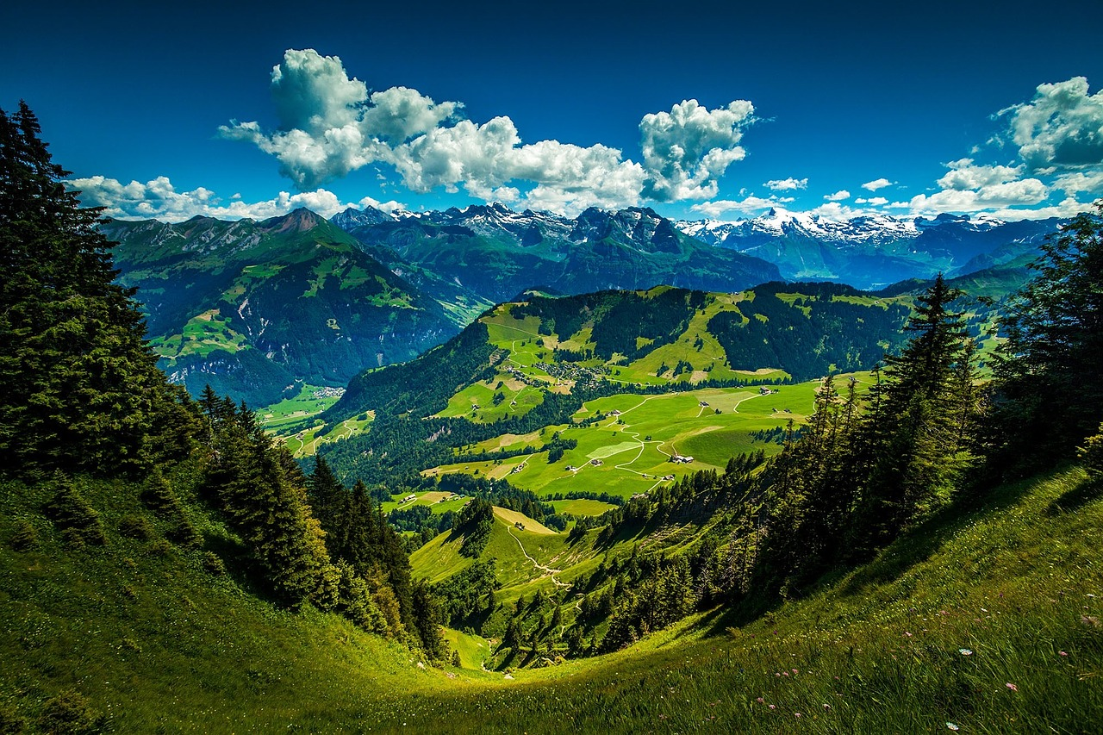

Strategy: Follow the slope
Slide Credit: Fei-Fei Li, Justin Johnson, Serena Yeung, CS 231n

Slide 5
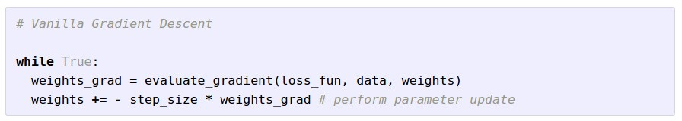

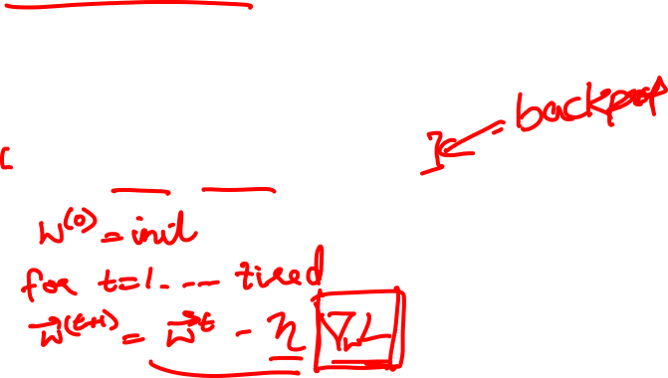
Gradient Descent
Slide Credit: Fei-Fei Li, Justin Johnson, Serena Yeung, CS 231n

Slide 6
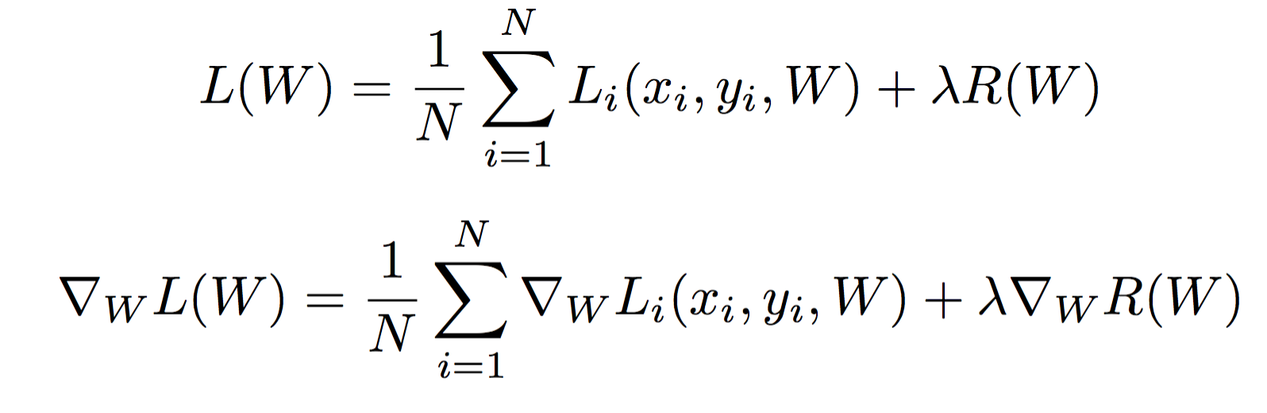
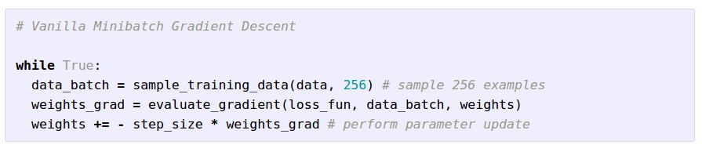
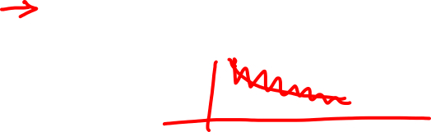
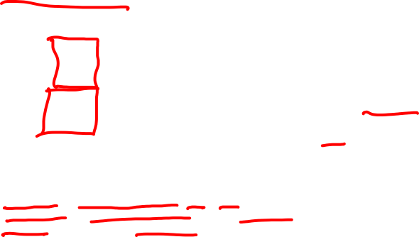
Stochastic Gradient Descent (SGD)
Full sum expensive when N is large!
Approximate sum using a minibatch of examples
32 / 64 / 128 common
Slide Credit: Fei-Fei Li, Justin Johnson, Serena Yeung, CS 231n

Slide 7
How do we compute gradients?
Analytic or “Manual” Differentiation
Symbolic Differentiation
Numerical Differentiation
Automatic Differentiation
  Forward mode AD
  Reverse mode AD
    aka “backprop”

Slide 8
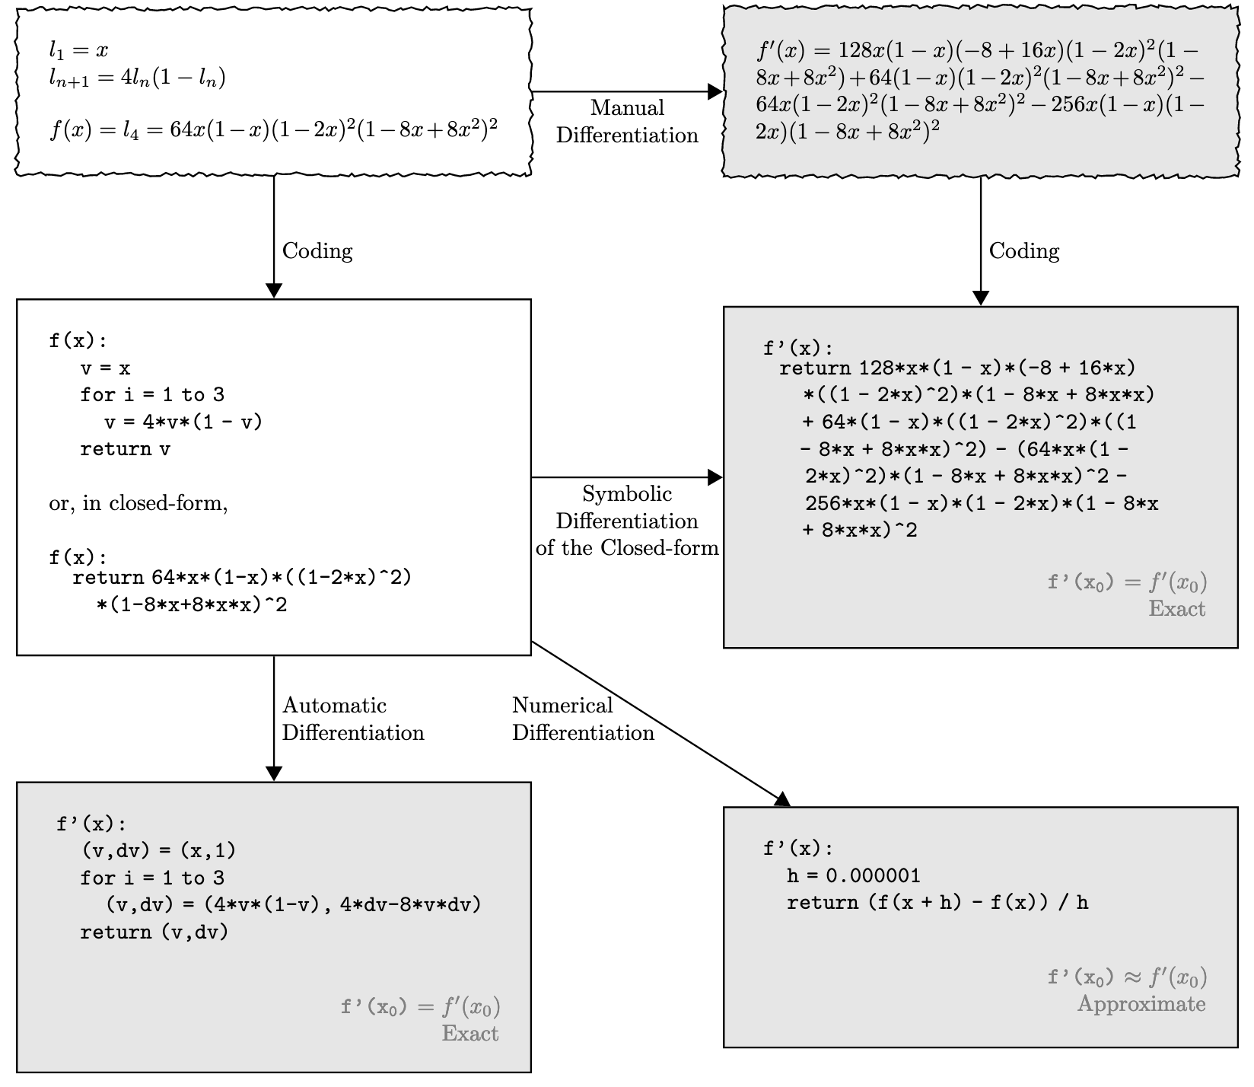
Figure Credit: Baydin et al. https://arxiv.org/abs/1502.05767

Slide 9
How do we compute gradients?
Analytic or “Manual” Differentiation
Symbolic Differentiation
Numerical Differentiation
Automatic Differentiation
  Forward mode AD
  Reverse mode AD
    aka “backprop”

Slide 10
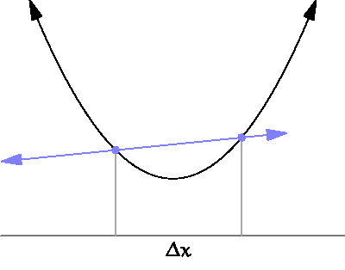
By Brnbrnz (Own work) [CC BY-SA 4.0 (http://creativecommons.org/licenses/by-sa/4.0)]

Slide 11

current W:
[0.34,
-1.11,
0.78,
0.12,
0.55,
2.81,
-3.1,
-1.5,
0.33,…]
loss 1.25347
W + h (first dim):
[0.34 + 0.0001,
-1.11,
0.78,
0.12,
0.55,
2.81,
-3.1,
-1.5,
0.33,…]
loss 1.25322
gradient dW:
[-2.5,
?,
?,
?,
?,
?,
?,
?,
?,…]
(1.25322 - 1.25347)/0.0001
= -2.5
Slide Credit: Fei-Fei Li, Justin Johnson, Serena Yeung, CS 231n

Slide 12
current W:
[0.34,
-1.11,
0.78,
0.12,
0.55,
2.81,
-3.1,
-1.5,
0.33,…]
loss 1.25347
W + h (second dim):
[0.34,
-1.11 + 0.0001,
0.78,
0.12,
0.55,
2.81,
-3.1,
-1.5,
0.33,…]
loss 1.25353
gradient dW:
[-2.5,
0.6,
?,
?,
?,
?,
?,
?,
?,…]
(1.25353 - 1.25347)/0.0001
= 0.6
Slide Credit: Fei-Fei Li, Justin Johnson, Serena Yeung, CS 231n

Slide 13
Numerical vs Analytic Gradients
Numerical gradient: slow :(, approximate :(, easy to write :)
Analytic gradient: fast :), exact :), error-prone :(
In practice: Derive analytic gradient, check your implementation with numerical gradient.
This is called a gradient check.
Slide Credit: Fei-Fei Li, Justin Johnson, Serena Yeung, CS 231n

Slide 14
How do we compute gradients?
Analytic or “Manual” Differentiation
Symbolic Differentiation
Numerical Differentiation
Automatic Differentiation
  Forward mode AD
  Reverse mode AD
    aka “backprop”

Slide 15
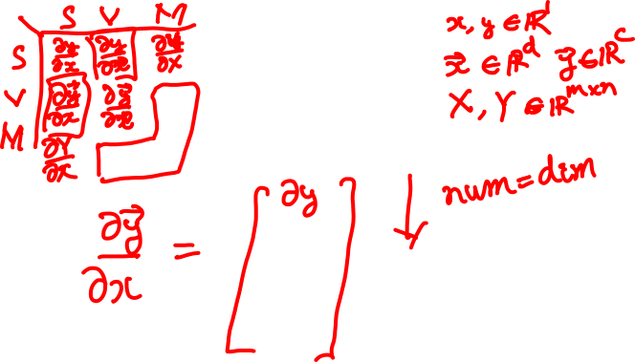
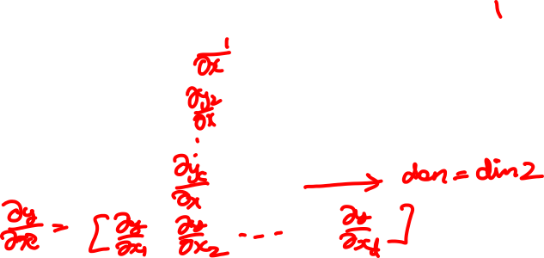
Matrix/Vector Derivatives Notation

Slide 16
Vector/Matrix Derivatives Notation

Slide 17
Vector Derivative Example

Slide 18
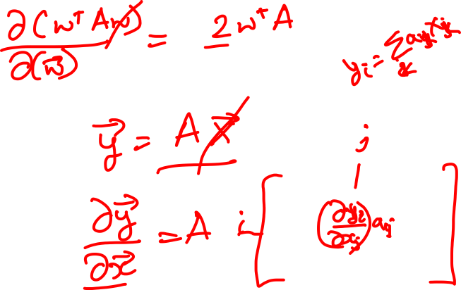
Vector Derivative Example

Slide 19
Extension to Tensors

Slide 20
Plan for Today
(Finish) Analytical Gradients
Automatic Differentiation
  Computational Graphs
  Forward mode vs Reverse mode AD
  Patterns in backprop

Slide 21
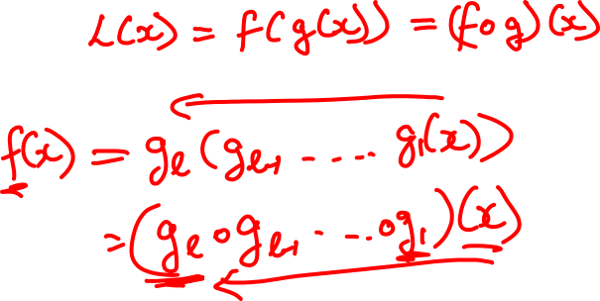
Chain Rule: Composite Functions

Slide 22
Chain Rule: Scalar Case

Slide 23
Chain Rule: Vector Case

Slide 24
Chain Rule: Jacobian view

Slide 25
Chain Rule: Graphical view

Slide 26
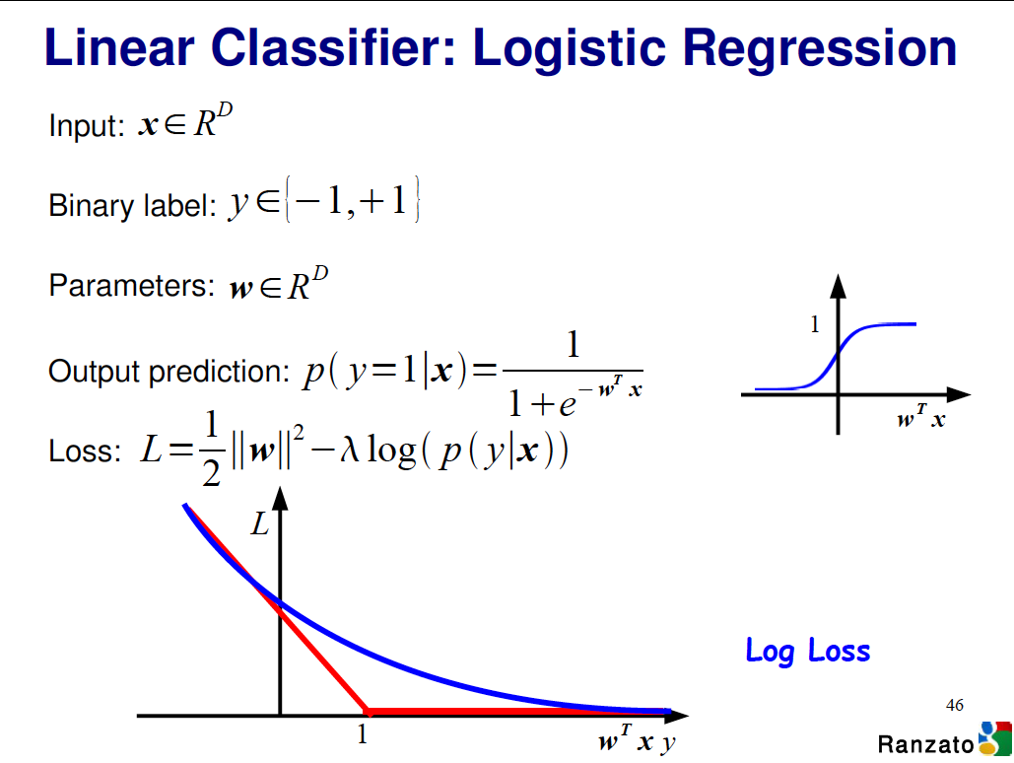

Slide 27
Logistic Regression Derivatives

Slide 28
Logistic Regression Derivatives

Slide 29
Chain Rule: Cascaded

Slide 30
Chain Rule: How should we multiply?

Slide 31
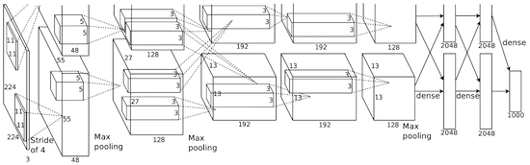
Convolutional network (AlexNet)
input image
weights
loss
Figure copyright Alex Krizhevsky, Ilya Sutskever, and Geoffrey Hinton, 2012. Reproduced with permission.
Slide Credit: Fei-Fei Li, Justin Johnson, Serena Yeung, CS 231n
Notes:
Becomes very useful when we work with complex functions

Slide 32
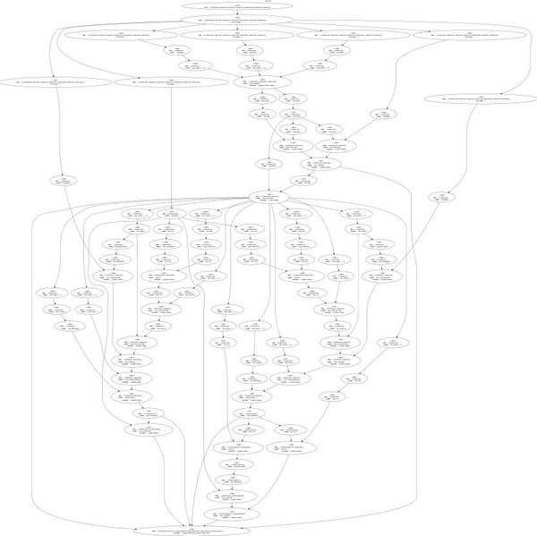
Neural Turing Machine
input image
loss
Figure reproduced with permission from a Twitter post by Andrej Karpathy.
Slide Credit: Fei-Fei Li, Justin Johnson, Serena Yeung, CS 231n
Notes:
Things get even crazier

Slide 33
How do we compute gradients?
Analytic or “Manual” Differentiation
Symbolic Differentiation
Numerical Differentiation
Automatic Differentiation
  Forward mode AD
  Reverse mode AD
    aka “backprop”

Slide 34
Plan for Today
(Finish) Analytical Gradients
Automatic Differentiation
  Computational Graphs
  Forward mode vs Reverse mode AD

Slide 35
Deep Learning = Differentiable Programming
Computation = Graph
  Input = Data + Parameters
  Output = Loss
  Scheduling = Topological ordering
Auto-Diff
  A family of algorithms for
  implementing chain-rule on computation graphs

Slide 36



Computational Graph
x
*
s (scores)
hinge loss
+
L
W
R
Slide Credit: Fei-Fei Li, Justin Johnson, Serena Yeung, CS 231n
Notes:
How to compute the analytic gradient for arbitrarily complex functions using frame called computational graph
Can use computational graph to represent any function, where the nodes of the graph are steps of computation that we go through
Linear classifier example
Advantage is that once we express a function using a computational graph, can use a technique called backpropagation which recursively uses the chain rule to efficient compute gradient

Slide 37
Computational Graph
Any DAG of differentiable modules is allowed!
Slide Credit: Marc'Aurelio Ranzato

Slide 38
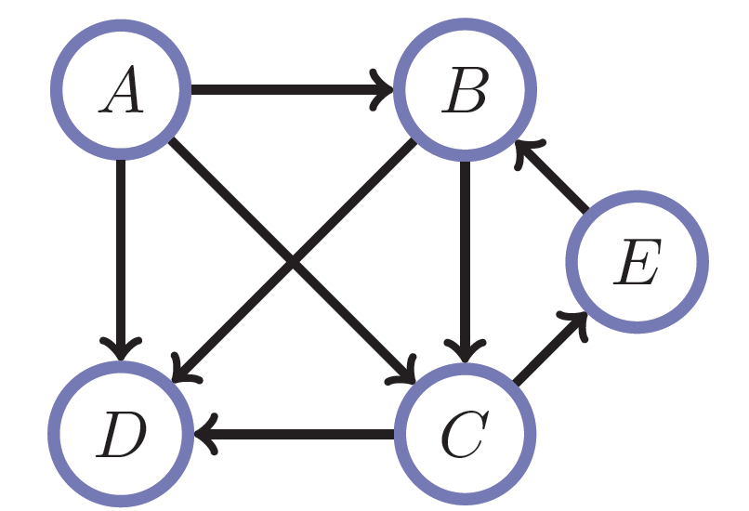
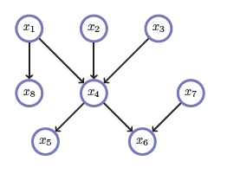
Directed Acyclic Graphs (DAGs)
Exactly what the name suggests
  Directed edges
  No (directed) cycles
  Underlying undirected cycles okay

Slide 39
Directed Acyclic Graphs (DAGs)
Concept
  Topological Ordering

Slide 40
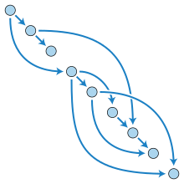
Directed Acyclic Graphs (DAGs)

Slide 41
Computational Graphs
Notation

Slide 42
Example
+
sin( )
*
x₁
x₂

Slide 43
HW0

Slide 44
HW0 Submission by Samyak Datta

Slide 45
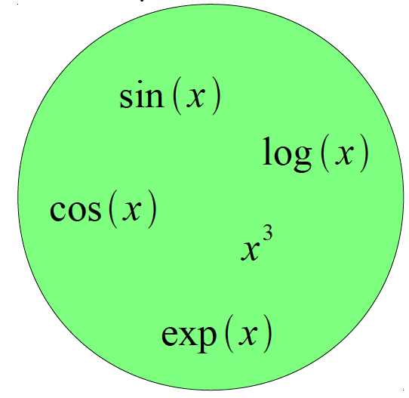
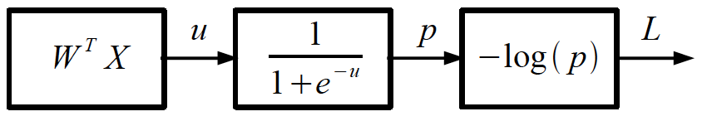
Logistic Regression as a Cascade
Given a library of simple functions
Compose into a
complicate function
Slide Credit: Marc'Aurelio Ranzato, Yann LeCun

Slide 46
Deep Learning = Differentiable Programming
Computation = Graph
  Input = Data + Parameters
  Output = Loss
  Scheduling = Topological ordering
Auto-Diff
  A family of algorithms for
  implementing chain-rule on computation graphs

Slide 47
Forward mode vs Reverse Mode
Key Computations

Slide 48
Forward mode AD
g
Notes:
What we’re doing in backprop is we have all these nodes in our computational graph, each node only aware of immediate surroundings
at each node have ...

Slide 49
Reverse mode AD
g
Notes:
What we’re doing in backprop is we have all these nodes in our computational graph, each node only aware of immediate surroundings
at each node have ...

Slide 50
Example: Forward mode AD
+
sin( )
*
x₁
x₂

Slide 51
Example: Forward mode AD
+
sin( )
*
x₁
x₂

Slide 52
Example: Forward mode AD
+
sin( )
*
x₁
x₂

Slide 53
Example: Forward mode AD
+
sin( )
*
x₁
x₂

Slide 54
Example: Forward mode AD
+
sin( )
*
x₁
x₂

Slide 55
Example: Reverse mode AD
+
sin( )
*
x₁
x₂

Slide 56
Example: Reverse mode AD
+
sin( )
*
x₁
x₂

Slide 57
Example: Reverse mode AD
+
sin( )
*
x₁
x₂

Slide 58
Forward Pass vs
Forward mode AD vs Reverse Mode AD
+
sin( )
*
x₁
x₂
+
+
sin( )
*
sin( )
*
x₁
x₂
x₁
x₂

Slide 59
Forward mode vs Reverse Mode
What are the differences?
+
+
sin( )
*
sin( )
*
x₁
x₂
x₁
x₂

Slide 60
Forward mode vs Reverse Mode
What are the differences?
Which one is faster to compute?
  Forward or backward?

Slide 61
Forward mode vs Reverse Mode
What are the differences?
Which one is faster to compute?
  Forward or backward?
Which one is more memory efficient (less storage)?
  Forward or backward?

