Slide 1
CS 4803 / 7643: Deep Learning
Topics:
  Regularization
  Neural Networks
Dhruv Batra
Georgia Tech

Slide 2
Administrativia
PS1/HW1 out
  Available later today on Canvas
  Due in 4 weeks
  Asks about topics coming in the next couple of weeks
  Please please please please start early
  More details next class

Slide 3
Recap from last time

Slide 4
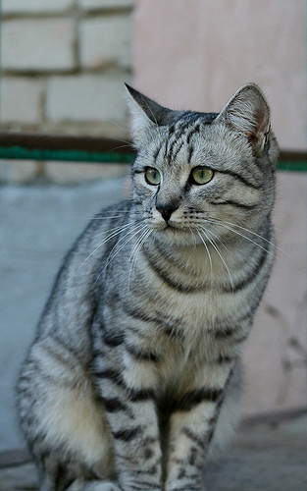
Parametric Approach: Linear Classifier
3072x1
f(x,W) = Wx + b
10x1
Image
10x1
10x3072
f(x,W)
10 numbers giving class scores
Array of 32x32x3 numbers
(3072 numbers total)
W
parameters
or weights
Slide Credit: Fei-Fei Li, Justin Johnson, Serena Yeung, CS 231n

Slide 5
Example with an image with 4 pixels, and 3 classes (cat/dog/ship)
Stretch pixels into column
56
231
24
2
56 | 231
24 | 2
Input image
Slide Credit: Fei-Fei Li, Justin Johnson, Serena Yeung, CS 231n

Slide 6
Example with an image with 4 pixels, and 3 classes (cat/dog/ship)
Stretch pixels into column
56
231
24
2
0.2 | -0.5 | 0.1 | 2.0
1.5 | 1.3 | 2.1 | 0.0
0 | 0.25 | 0.2 | -0.3
1.1
3.2
-1.2
-96.8
437.9
61.95
Cat score
56 | 231
24 | 2
+
=
Dog score
Ship score
Input image
W
b
Slide Credit: Fei-Fei Li, Justin Johnson, Serena Yeung, CS 231n

Slide 7
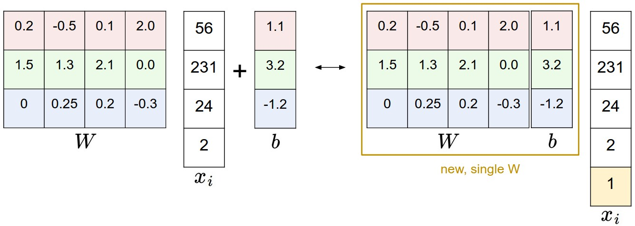
Image Credit: Andrej Karpathy, CS231n

Slide 8
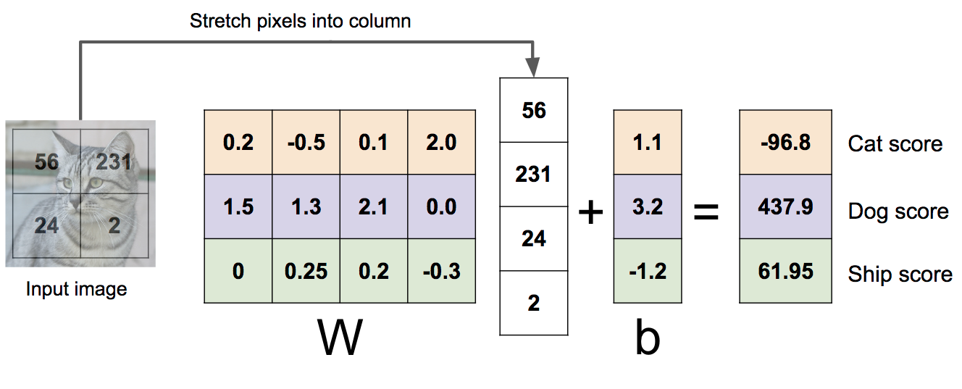

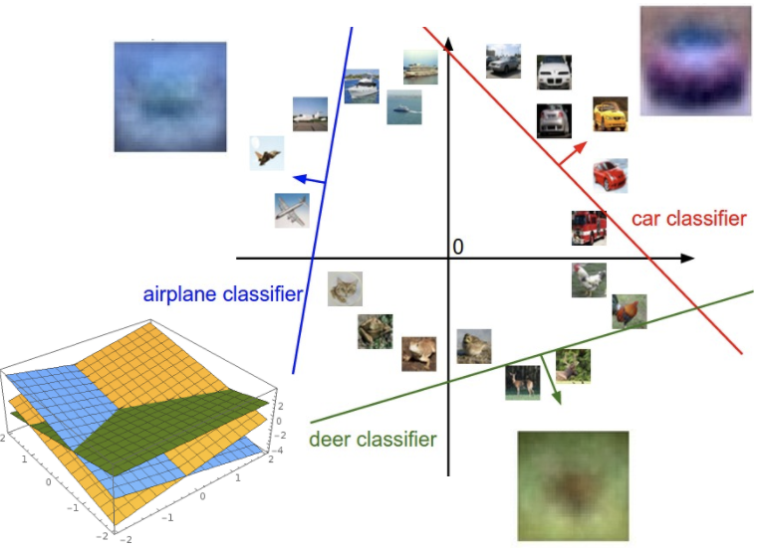
Linear Classifier: Three Viewpoints
Algebraic Viewpoint
Visual Viewpoint
Geometric Viewpoint
f(x,W) = Wx
One template per class
Hyperplanes cutting up space
Slide Credit: Fei-Fei Li, Justin Johnson, Serena Yeung, CS 231n

Slide 9
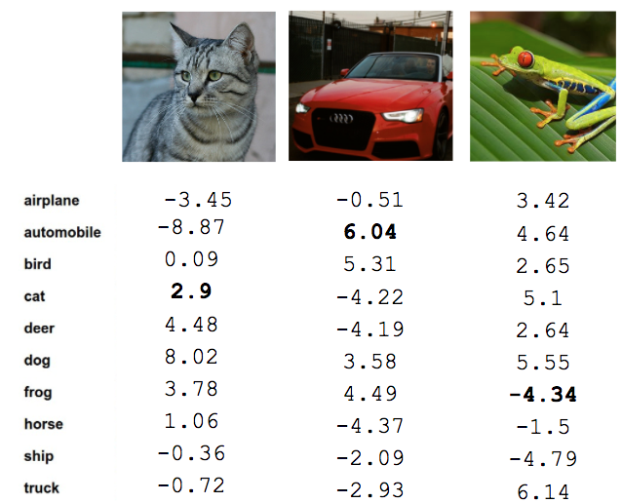
Recall from last time: Linear Classifier
TODO:
Define a loss function that quantifies our unhappiness with the scores across the training data.
Come up with a way of efficiently finding the parameters that minimize the loss function. (optimization)
Cat image by Nikita is licensed under CC-BY 2.0; Car image is CC0 1.0 public domain; Frog image is in the public domain
Slide Credit: Fei-Fei Li, Justin Johnson, Serena Yeung, CS 231n

Slide 10


Softmax vs. SVM
Slide Credit: Fei-Fei Li, Justin Johnson, Serena Yeung, CS 231n

Slide 11


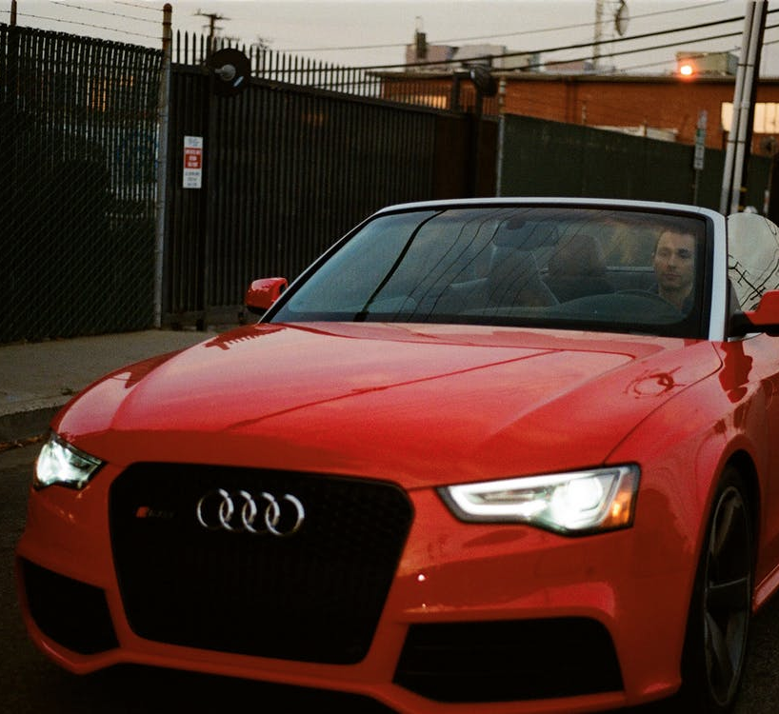
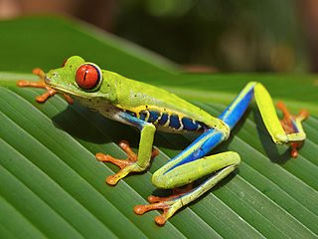




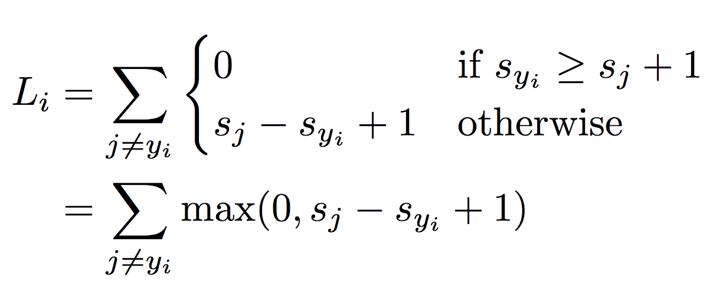

Suppose: 3 training examples, 3 classes.
With some W the scores are:
Multiclass SVM loss:
Given an example
where is the image and
where is the (integer) label,
and using the shorthand for the scores vector:
the SVM loss has the form:
“Hinge loss”
cat
3.2
1.3
2.2
car
5.1
4.9
2.5
frog
-1.7
2.0
-3.1
Slide Credit: Fei-Fei Li, Justin Johnson, Serena Yeung, CS 231n

Slide 12
Softmax vs. SVM
Slide Credit: Fei-Fei Li, Justin Johnson, Serena Yeung, CS 231n

Slide 13


Softmax Classifier (Multinomial Logistic Regression)
Want to interpret raw classifier scores as probabilities
Softmax Function
cat
3.2
car
5.1
frog
-1.7
Slide Credit: Fei-Fei Li, Justin Johnson, Serena Yeung, CS 231n

Slide 14
Softmax Classifier (Multinomial Logistic Regression)
Want to interpret raw classifier scores as probabilities
Softmax Function
Probabilities must be >= 0
cat
3.2
24.5
exp
car
5.1
164.0
frog
-1.7
0.18
unnormalized probabilities
Slide Credit: Fei-Fei Li, Justin Johnson, Serena Yeung, CS 231n

Slide 15
Softmax Classifier (Multinomial Logistic Regression)
Want to interpret raw classifier scores as probabilities
Softmax Function
Probabilities must be >= 0
Probabilities must sum to 1
cat
3.2
24.5
0.13
exp
normalize
car
5.1
164.0
0.87
frog
-1.7
0.18
0.00
unnormalized probabilities
probabilities
Slide Credit: Fei-Fei Li, Justin Johnson, Serena Yeung, CS 231n

Slide 16
Softmax Classifier (Multinomial Logistic Regression)
Want to interpret raw classifier scores as probabilities
Softmax Function
Probabilities must be >= 0
Probabilities must sum to 1
cat
3.2
24.5
0.13
exp
normalize
car
5.1
164.0
0.87
frog
-1.7
0.18
0.00
Unnormalized log-probabilities / logits
unnormalized probabilities
probabilities
Slide Credit: Fei-Fei Li, Justin Johnson, Serena Yeung, CS 231n

Slide 17

Softmax Classifier (Multinomial Logistic Regression)
Want to interpret raw classifier scores as probabilities
Softmax Function
Probabilities must be >= 0
Probabilities must sum to 1
cat
3.2
24.5
0.13
L_{i} = -log(0.13)
= 2.04
exp
normalize
car
5.1
164.0
0.87
frog
-1.7
0.18
0.00
Unnormalized log-probabilities / logits
unnormalized probabilities
probabilities
Slide Credit: Fei-Fei Li, Justin Johnson, Serena Yeung, CS 231n

Slide 18
Softmax Classifier (Multinomial Logistic Regression)
Want to interpret raw classifier scores as probabilities
Softmax Function
Probabilities must be >= 0
Probabilities must sum to 1
cat
3.2
24.5
0.13
L_{i} = -log(0.13)
= 2.04
exp
normalize
car
5.1
164.0
0.87
-1.7
0.18
0.00
Maximum Likelihood Estimation
Choose probabilities to maximize the likelihood of the observed data
frog
Unnormalized log-probabilities / logits
unnormalized probabilities
probabilities
Slide Credit: Fei-Fei Li, Justin Johnson, Serena Yeung, CS 231n

Slide 19
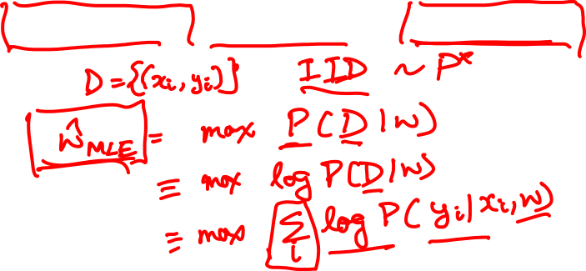
Log-Likelihood / KL-Divergence / Cross-Entropy

Slide 20
Softmax Classifier (Multinomial Logistic Regression)
Want to interpret raw classifier scores as probabilities
Softmax Function
Probabilities must be >= 0
Probabilities must sum to 1
cat
3.2
24.5
0.13
compare
1.00
exp
normalize
car
5.1
164.0
0.87
0.00
frog
-1.7
0.18
0.00
0.00
Unnormalized log-probabilities / logits
unnormalized probabilities
probabilities
Correct
probs
Slide Credit: Fei-Fei Li, Justin Johnson, Serena Yeung, CS 231n

Slide 21
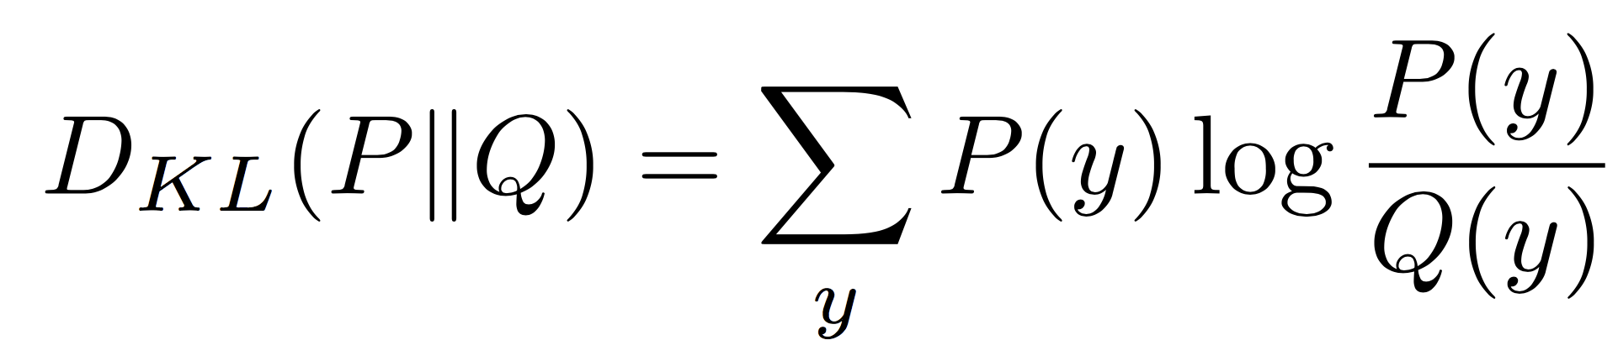
Softmax Classifier (Multinomial Logistic Regression)
Want to interpret raw classifier scores as probabilities
Softmax Function
Probabilities must be >= 0
Probabilities must sum to 1
cat
3.2
24.5
0.13
compare
1.00
exp
normalize
Kullback–Leibler divergence
car
5.1
164.0
0.87
0.00
frog
-1.7
0.18
0.00
0.00
Unnormalized log-probabilities / logits
unnormalized probabilities
probabilities
Correct
probs
Slide Credit: Fei-Fei Li, Justin Johnson, Serena Yeung, CS 231n
Notes:
Mention that this is useful for cases where you might have some target probability distribution instead of just one correct class, due to uncertainty in the model; also mention distillation

Slide 22
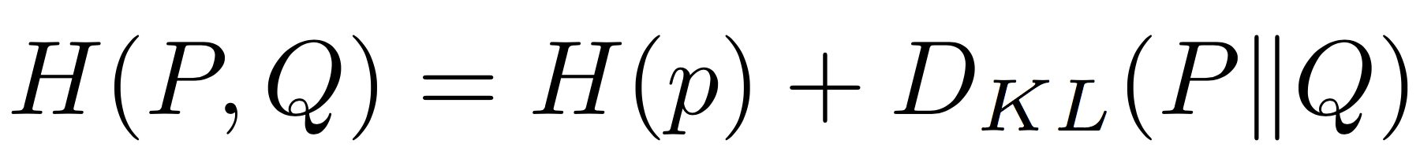
Softmax Classifier (Multinomial Logistic Regression)
Want to interpret raw classifier scores as probabilities
Softmax Function
Probabilities must be >= 0
Probabilities must sum to 1
cat
3.2
24.5
0.13
compare
1.00
exp
normalize
car
5.1
164.0
0.87
Cross Entropy
0.00
frog
-1.7
0.18
0.00
0.00
Unnormalized log-probabilities / logits
unnormalized probabilities
probabilities
Correct
probs
Slide Credit: Fei-Fei Li, Justin Johnson, Serena Yeung, CS 231n
Notes:
Mention that this is useful for cases where you might have some target probability distribution instead of just one correct class, due to uncertainty in the model; also mention distillation

Slide 23
Plan for Today
(Finish) Loss Functions
Regularization
Neural Networks

Slide 24
Softmax Classifier (Multinomial Logistic Regression)
Want to interpret raw classifier scores as probabilities
Softmax Function
Maximize probability of correct class
Putting it all together:
cat
3.2
car
5.1
Q: What is the min/max possible loss L_i?
frog
-1.7
Slide Credit: Fei-Fei Li, Justin Johnson, Serena Yeung, CS 231n

Slide 25
Softmax Classifier (Multinomial Logistic Regression)
Want to interpret raw classifier scores as probabilities
Softmax Function
Maximize probability of correct class
Putting it all together:
cat
3.2
car
5.1
Q: What is the min/max possible loss L_i?
A: min 0, max infinity
frog
-1.7
Slide Credit: Fei-Fei Li, Justin Johnson, Serena Yeung, CS 231n

Slide 26
Softmax Classifier (Multinomial Logistic Regression)
Want to interpret raw classifier scores as probabilities
Softmax Function
Maximize probability of correct class
Putting it all together:
cat
3.2
car
5.1
Q2: At initialization all s will be approximately equal; what is the loss?
frog
-1.7
Slide Credit: Fei-Fei Li, Justin Johnson, Serena Yeung, CS 231n

Slide 27
Softmax Classifier (Multinomial Logistic Regression)
Want to interpret raw classifier scores as probabilities
Softmax Function
Maximize probability of correct class
Putting it all together:
cat
3.2
car
5.1
Q2: At initialization all s will be approximately equal; what is the loss?
A: log(C), eg log(10) ≈ 2.3
frog
-1.7
Slide Credit: Fei-Fei Li, Justin Johnson, Serena Yeung, CS 231n

Slide 28
Softmax vs. SVM
Slide Credit: Fei-Fei Li, Justin Johnson, Serena Yeung, CS 231n

Slide 29
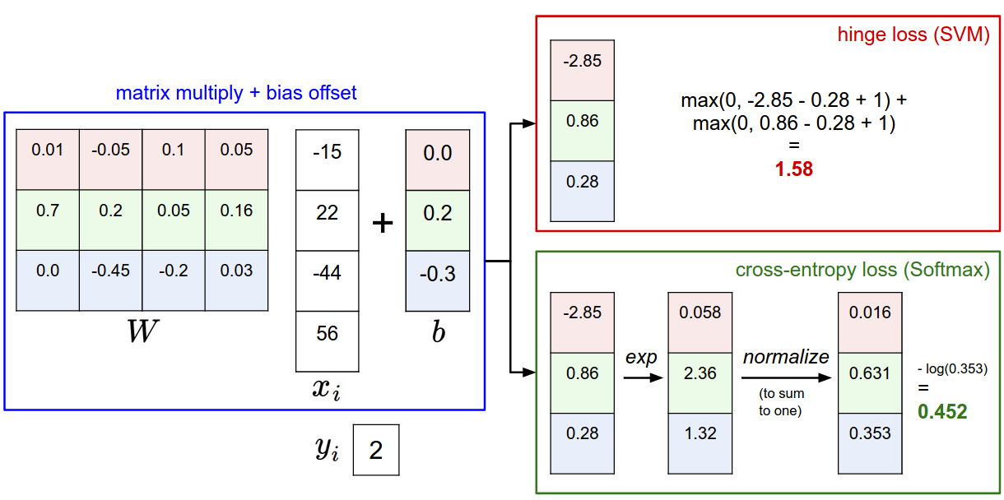
Softmax vs. SVM
Slide Credit: Fei-Fei Li, Justin Johnson, Serena Yeung, CS 231n

Slide 30

Softmax vs. SVM
assume scores:
[10, -2, 3]
[10, 9, 9]
[10, -100, -100]
and
Q: Suppose I take a datapoint and I jiggle a bit (changing its score slightly). What happens to the loss in both cases?
Slide Credit: Fei-Fei Li, Justin Johnson, Serena Yeung, CS 231n

Slide 31
Plan for Today
(Finish) Loss Functions
Regularization
Neural Networks

Slide 32
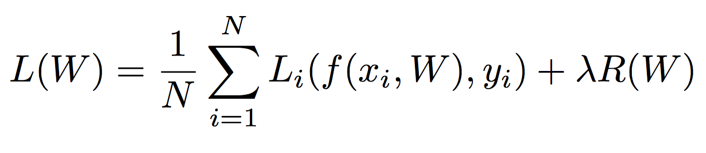
Regularization
Data loss: Model predictions should match training data
Slide Credit: Fei-Fei Li, Justin Johnson, Serena Yeung, CS 231n

Slide 33
Regularization
Data loss: Model predictions should match training data
Regularization: Prevent the model from doing too well on training data
Slide Credit: Fei-Fei Li, Justin Johnson, Serena Yeung, CS 231n

Slide 34

Regularization
= regularization strength
(hyperparameter)
Data loss: Model predictions should match training data
Regularization: Prevent the model from doing too well on training data
Slide Credit: Fei-Fei Li, Justin Johnson, Serena Yeung, CS 231n

Slide 35
Regularization Intuition in
Polynomial Regression
y
x
Slide Credit: Fei-Fei Li, Justin Johnson, Serena Yeung, CS 231n

Slide 36
Polynomial Regression
f
y
x
Slide Credit: Fei-Fei Li, Justin Johnson, Serena Yeung, CS 231n

Slide 37
Polynomial Regression

Slide 38
Polynomial Regression

Slide 39
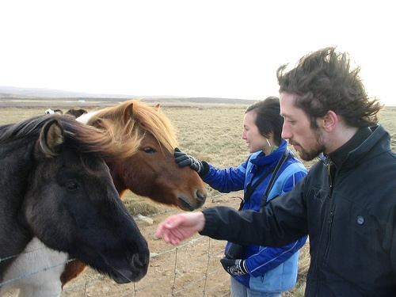
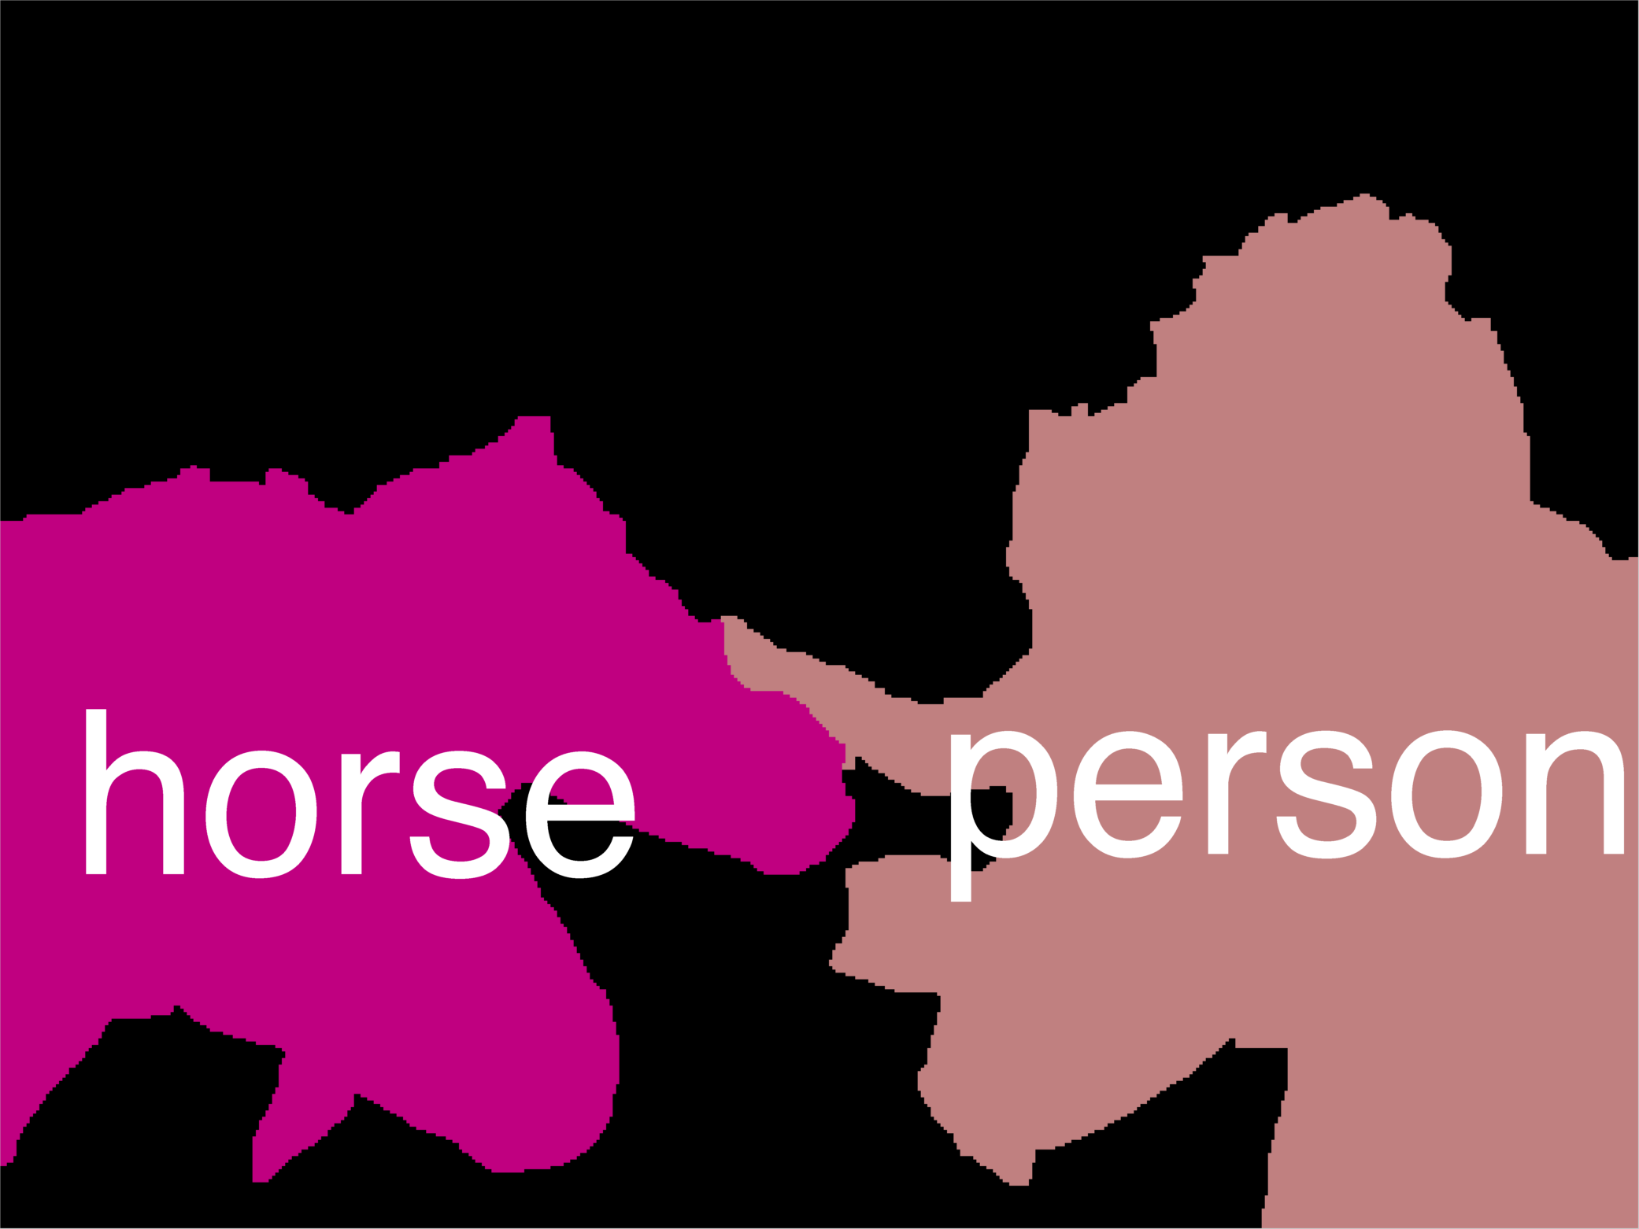
Error Decomposition
Reality
Multi-class Logistic Regression
Modeling Error
Softmax
FC HxWx3
Input
Estimation
Error
Optimization
Error = 0
model class

Slide 40
Polynomial Regression
Demo: https://arachnoid.com/polysolve/
You are a scientist studying runners.
  You measure average speeds of the best runners at different ages.
Data: Age (years), Speed (mph)
  10 6
  15 9
  20 11
  25 12
  29 13
  40 11
  50 10
  60 9

Slide 41
Regularization: Prefer Simpler Models
f₁
f₂
y
x
Regularization pushes against fitting the data too well so we don’t fit noise in the data
Slide Credit: Fei-Fei Li, Justin Johnson, Serena Yeung, CS 231n

Slide 42
Regularization
= regularization strength
(hyperparameter)
Data loss: Model predictions should match training data
Regularization: Prevent the model from doing too well on training data
Slide Credit: Fei-Fei Li, Justin Johnson, Serena Yeung, CS 231n

Slide 43



Regularization
= regularization strength
(hyperparameter)
Data loss: Model predictions should match training data
Regularization: Prevent the model from doing too well on training data
Simple examples
L2 regularization:
L1 regularization:
Elastic net (L1 + L2):
Slide Credit: Fei-Fei Li, Justin Johnson, Serena Yeung, CS 231n

Slide 44
Regularization
= regularization strength
(hyperparameter)
Data loss: Model predictions should match training data
Regularization: Prevent the model from doing too well on training data
Simple examples
L2 regularization:
L1 regularization:
Elastic net (L1 + L2):
More complex:
Dropout
Batch normalization
Stochastic depth, fractional pooling, etc
Slide Credit: Fei-Fei Li, Justin Johnson, Serena Yeung, CS 231n

Slide 45
Regularization
= regularization strength
(hyperparameter)
Data loss: Model predictions should match training data
Regularization: Prevent the model from doing too well on training data
Why regularize?
Express preferences over weights
Make the model simple so it works on test data
Improve optimization by adding curvature
Slide Credit: Fei-Fei Li, Justin Johnson, Serena Yeung, CS 231n

Slide 46




Regularization: Expressing Preferences
L2 Regularization
Slide Credit: Fei-Fei Li, Justin Johnson, Serena Yeung, CS 231n

Slide 47
Regularization: Expressing Preferences
L2 Regularization
L2 regularization likes to “spread out” the weights
Slide Credit: Fei-Fei Li, Justin Johnson, Serena Yeung, CS 231n

Slide 48

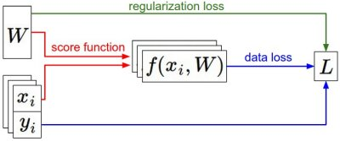

Recap
We have some dataset of (x,y)
We have a score function:
We have a loss function:
e.g.
Softmax
SVM
Full loss
Slide Credit: Fei-Fei Li, Justin Johnson, Serena Yeung, CS 231n

Slide 49
Recap
How do we find the best W?
We have some dataset of (x,y)
We have a score function:
We have a loss function:
e.g.
Softmax
SVM
Full loss
Slide Credit: Fei-Fei Li, Justin Johnson, Serena Yeung, CS 231n

Slide 50
Next: Neural Networks
Slide Credit: Fei-Fei Li, Justin Johnson, Serena Yeung, CS 231n

Slide 51
So far: Linear Classifiers
Class scores
f(x) = Wx

Slide 52
Hard cases for a linear classifier
Class 1:
First and third quadrants
Class 2:
Second and fourth quadrants
Class 1:
1 <= L2 norm <= 2
Class 2:
Everything else
Class 1:
Three modes
Class 2:
Everything else
Slide Credit: Fei-Fei Li, Justin Johnson, Serena Yeung, CS 231n

Slide 53
Aside: Image Features
f(x) = Wx
Class scores
Feature Representation

Slide 54
Image Features: Motivation
y
x
Cannot separate red and blue points with linear classifier

Slide 55
Image Features: Motivation
y
θ
f(x, y) = (r(x, y), θ(x, y))
x
r
Cannot separate red and blue points with linear classifier
After applying feature transform, points can be separated by linear classifier

Slide 56

Example: Color Histogram
+1

Slide 57

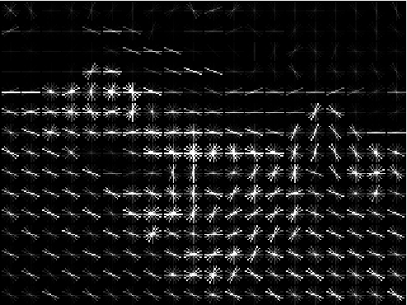
Example: Histogram of Oriented Gradients (HoG)
Divide image into 8x8 pixel regions
Within each region quantize edge direction into 9 bins
Example: 320x240 image gets divided into 40x30 bins; in each bin there are 9 numbers so feature vector has 30*40*9 = 10,800 numbers
Lowe, “Object recognition from local scale-invariant features”, ICCV 1999
Dalal and Triggs, "Histograms of oriented gradients for human detection," CVPR 2005

Slide 58

Example: Bag of Words
Step 1: Build codebook
Cluster patches to form “codebook” of “visual words”
Extract random patches
Step 2: Encode images
Fei-Fei and Perona, “A bayesian hierarchical model for learning natural scene categories”, CVPR 2005

Slide 59
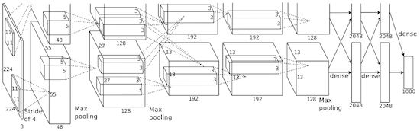
Image features vs Neural Nets
f
Feature Extraction
10 numbers giving scores for classes
training
Krizhevsky, Sutskever, and Hinton, “Imagenet classification with deep convolutional neural networks”, NIPS 2012.
Figure copyright Krizhevsky, Sutskever, and Hinton, 2012. Reproduced with permission.
10 numbers giving scores for classes
training

Slide 60
Error Decomposition
Reality
Multi-class Logistic Regression
Modeling Error
Softmax
FC HxWx3
Input
Estimation
Error
Optimization
Error = 0
model class

Slide 61

Neural networks: without the brain stuff
(Before) Linear score function:
Slide Credit: Fei-Fei Li, Justin Johnson, Serena Yeung, CS 231n
Notes:
Have been using linear score function as running example of function to optimize

Slide 62

Neural networks: without the brain stuff
(Before) Linear score function:
(Now) 2-layer Neural Network
Slide Credit: Fei-Fei Li, Justin Johnson, Serena Yeung, CS 231n
Notes:
Instead of using single linear transformation, stack 2 together, get 2-layer network

Slide 63
Neural networks: without the brain stuff
(Before) Linear score function:
(Now) 2-layer Neural Network
x
h
W1
W2
s
3072
100
10
Slide Credit: Fei-Fei Li, Justin Johnson, Serena Yeung, CS 231n
Notes:
First have W1*x, then nonlinear function, then second linear layer
More broadly speaking, NN are class of functions where simpler functions are stacked on top of each other in a hierarchical way to make up a more complex, nonlinear function. Have multiple stages of hierarchical computation.

Slide 64
Neural networks: without the brain stuff
(Before) Linear score function:
(Now) 2-layer Neural Network
x
h
W1
W2
s
3072
100
10
Slide Credit: Fei-Fei Li, Justin Johnson, Serena Yeung, CS 231n
Notes:
Biological inspirations to neurons in brain that we’ll discuss later
Looking at it mathematically first, one thing this can help solve, is if we look back to our linear score function, each row of W corresponded to a template
Problem that there can be only one template per class, can’t look for multiple modes
Now intermediate layers can represent anonymous templates that later get recombined
Intermediate layers anonymous templates that get recombined. solves mode problems

Slide 65
Neural networks: without the brain stuff
(Before) Linear score function:
(Now) 2-layer Neural Network
or 3-layer Neural Network
Slide Credit: Fei-Fei Li, Justin Johnson, Serena Yeung, CS 231n
Notes:
Can stack more of these layers to get deeper networks, where the term deep NN comes from

Slide 66
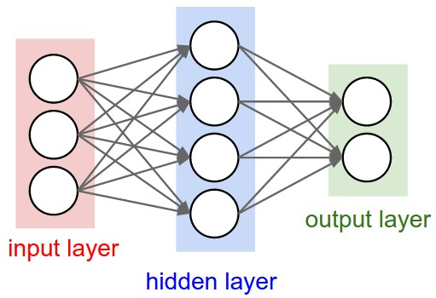
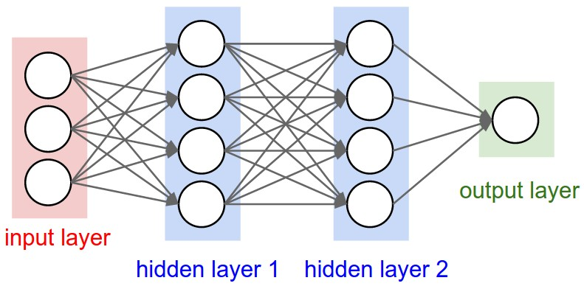
Multilayer Networks
Cascaded “neurons”
The output from one layer is the input to the next
Each layer has its own sets of weights
Image Credit: Andrej Karpathy, CS231n

Slide 67
Neural networks: Architectures
“3-layer Neural Net”, or
“2-hidden-layer Neural Net”
“2-layer Neural Net”, or
“1-hidden-layer Neural Net”
“Fully-connected” layers
Slide Credit: Fei-Fei Li, Justin Johnson, Serena Yeung, CS 231n

Slide 68
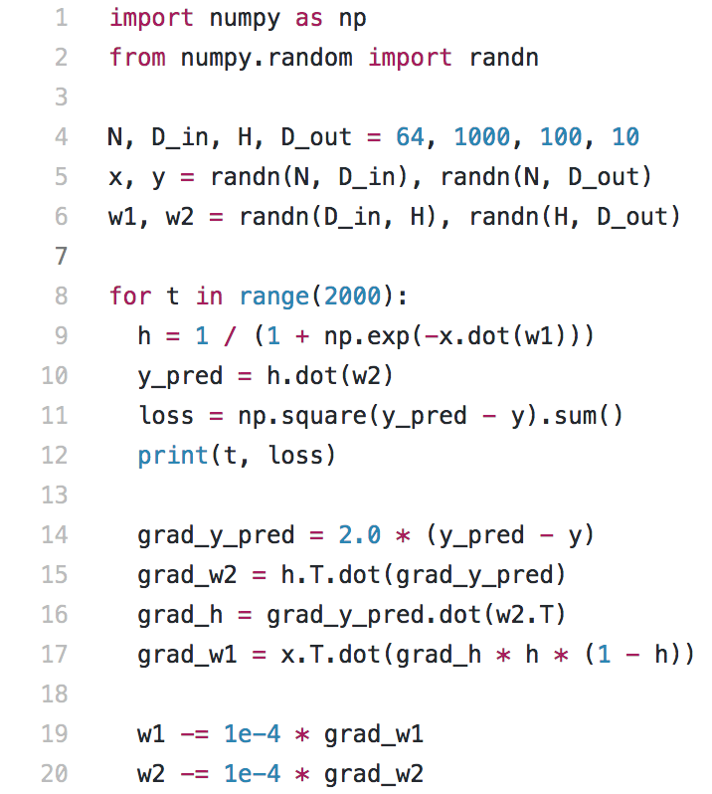
Full implementation of training a 2-layer Neural Network needs ~20 lines:
Slide Credit: Fei-Fei Li, Justin Johnson, Serena Yeung, CS 231n

Slide 69
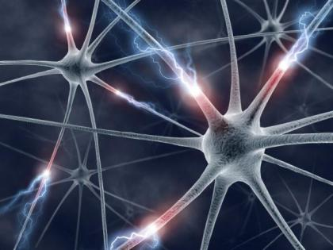
This image by Fotis Bobolas is licensed under CC-BY 2.0
Slide Credit: Fei-Fei Li, Justin Johnson, Serena Yeung, CS 231n
Notes:
Even though… still loosely inspired by brain, still interesting to understand where this comes from

Slide 70
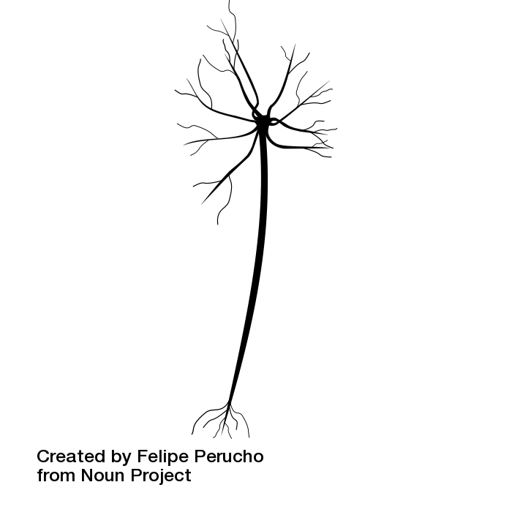
Impulses carried toward cell body
dendrite
presynaptic
terminal
axon
cell body
Impulses carried away from cell body
This image by Felipe Perucho
is licensed under CC-BY 3.0
Slide Credit: Fei-Fei Li, Justin Johnson, Serena Yeung, CS 231n

Slide 71
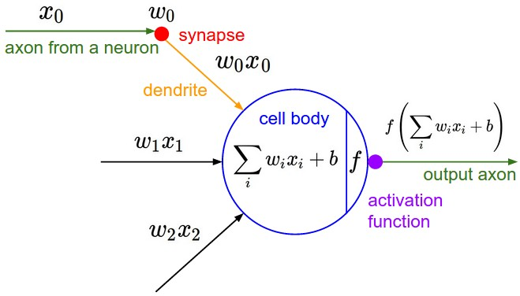
Impulses carried toward cell body
dendrite
presynaptic
terminal
axon
cell body
Impulses carried away from cell body
This image by Felipe Perucho
is licensed under CC-BY 3.0
Slide Credit: Fei-Fei Li, Justin Johnson, Serena Yeung, CS 231n

Slide 72
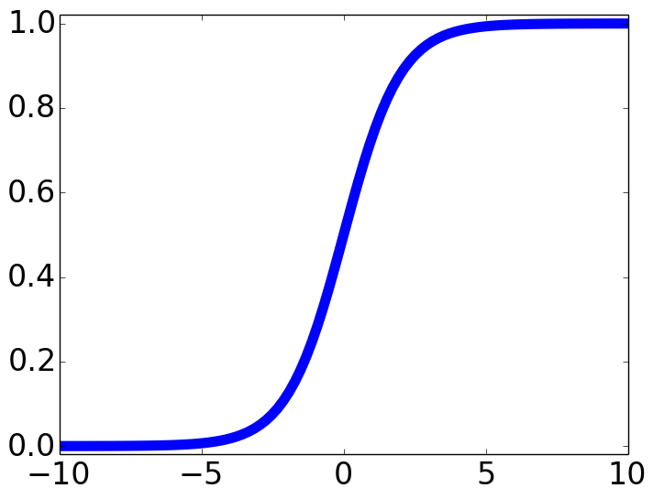

Impulses carried toward cell body
dendrite
presynaptic
terminal
axon
cell body
Impulses carried away from cell body
This image by Felipe Perucho
is licensed under CC-BY 3.0
sigmoid activation function
Slide Credit: Fei-Fei Li, Justin Johnson, Serena Yeung, CS 231n

Slide 73
Be very careful with your brain analogies!
Biological Neurons:
Many different types
Dendrites can perform complex non-linear computations
Synapses are not a single weight but a complex non-linear dynamical system
Rate code may not be adequate
[Dendritic Computation. London and Hausser]
Slide Credit: Fei-Fei Li, Justin Johnson, Serena Yeung, CS 231n

Slide 74
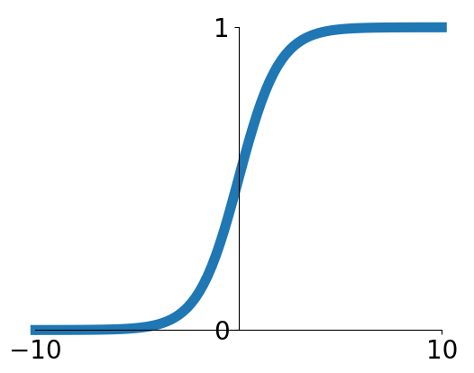
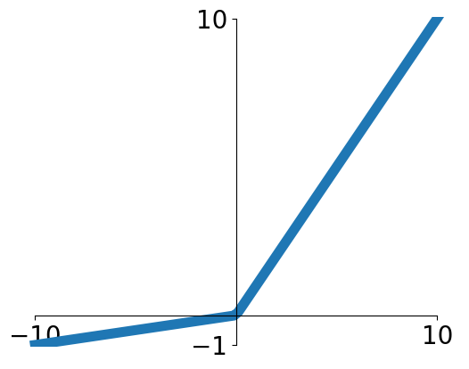


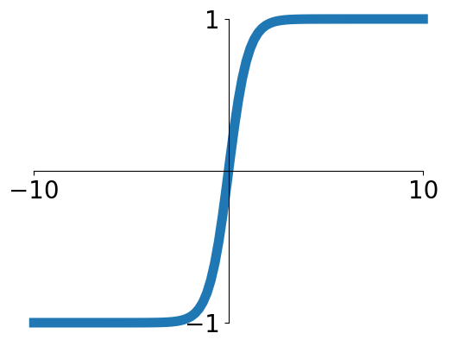


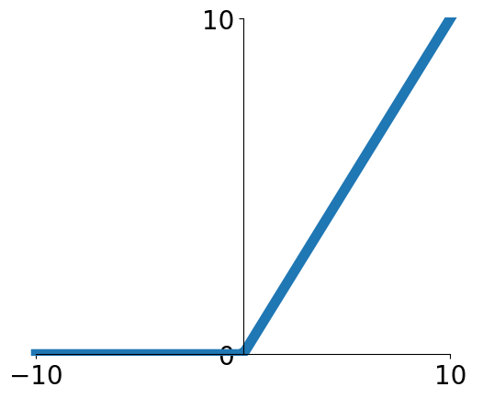
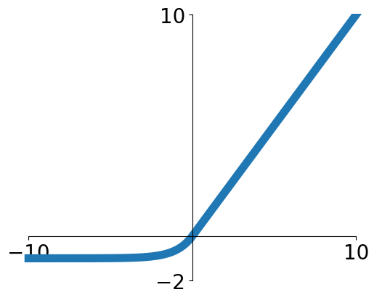

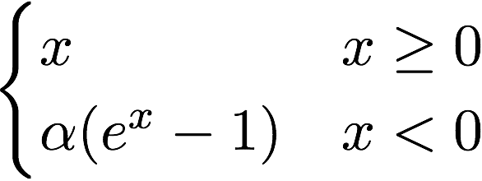
Activation functions
Sigmoid
Leaky ReLU
tanh
Maxout
ReLU
ELU
Slide Credit: Fei-Fei Li, Justin Johnson, Serena Yeung, CS 231n

Slide 75
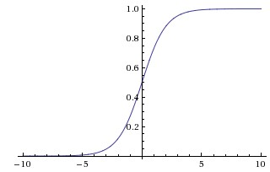
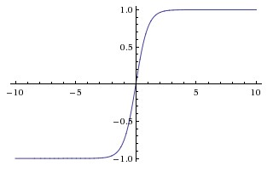
Activation Functions
sigmoid vs tanh

Slide 76
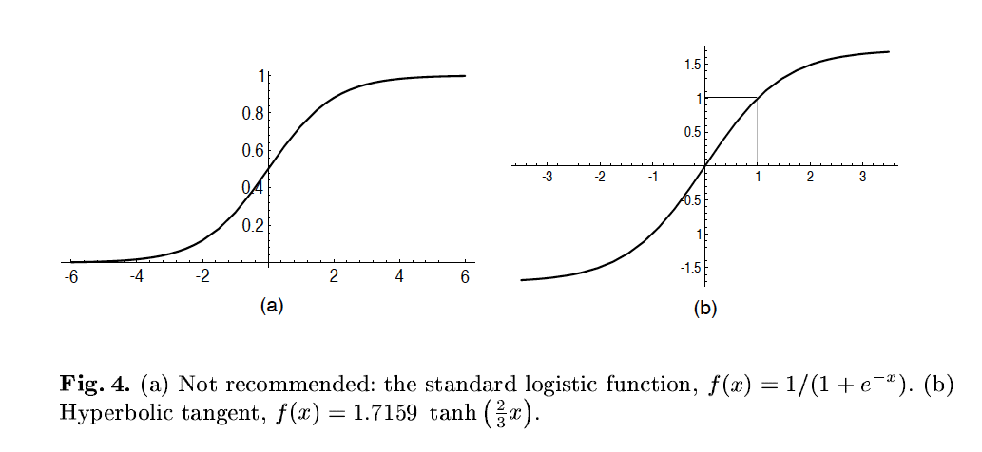
A quick note
Image Credit: LeCun et al. ‘98

Slide 77
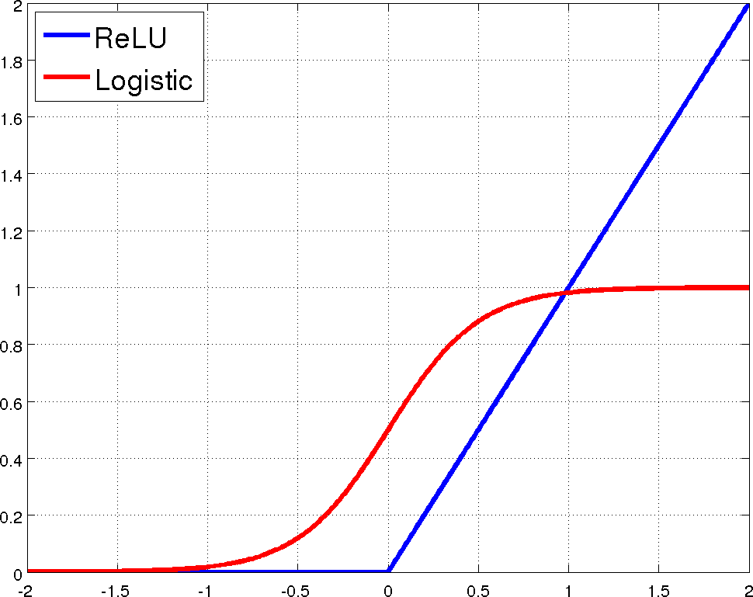
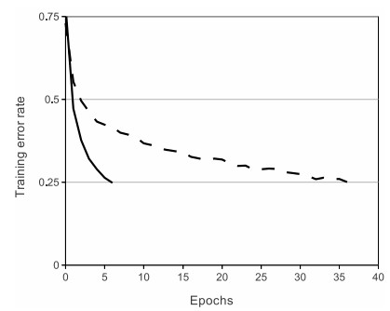
Rectified Linear Units (ReLU)
[Krizhevsky et al., NIPS12]

Slide 78
Demo Time
https://playground.tensorflow.org

Slide 79
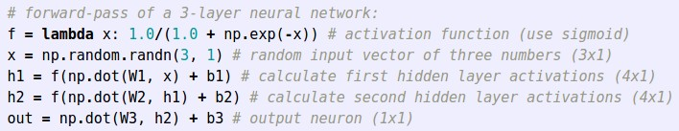
Example feed-forward computation of a neural network
Slide Credit: Fei-Fei Li, Justin Johnson, Serena Yeung, CS 231n

