Slide 1
CS 4803 / 7643: Deep Learning
Topics:
  Linear Classifiers
  Loss Functions
Dhruv Batra
Georgia Tech

Slide 2
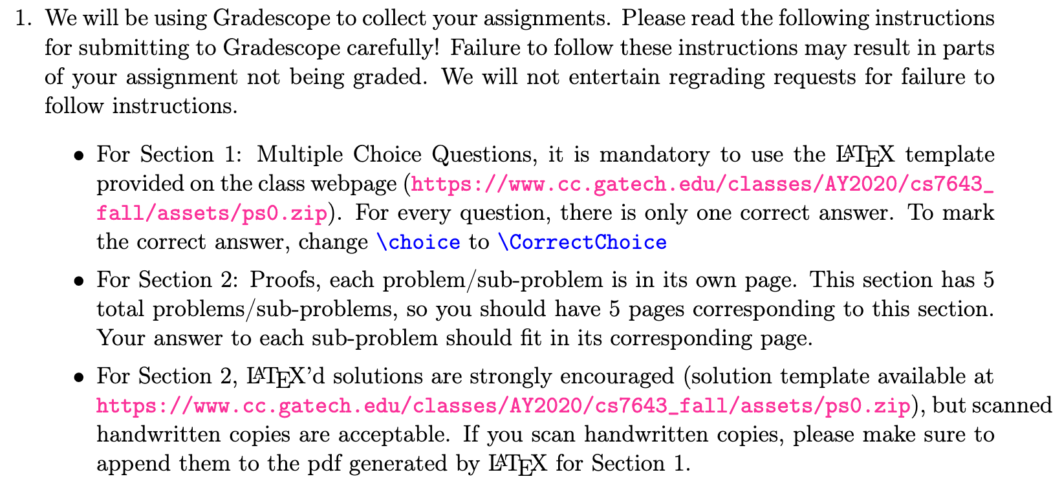
Administrativia
Notes and readings on class webpage
  https://www.cc.gatech.edu/classes/AY2020/cs7643_fall/
Issues from PS0 submission
  Instructions not followed = not graded

Slide 3
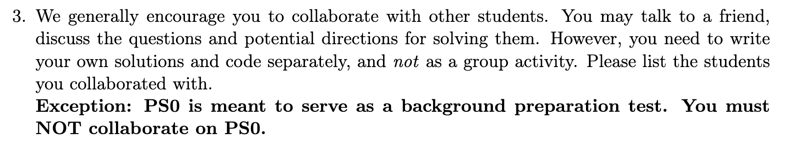

What is the collaboration policy?
Collaboration
  Only on HWs and project (not allowed in HW0).
  You may discuss the questions
  Each student writes their own answers & code
  Write on your homework anyone with whom you collaborate
Zero tolerance on plagiarism
  Neither ethical nor in your best interest
  Always credit your sources
  Don’t cheat. We will find out.

Slide 4
Recap from last time

Slide 5
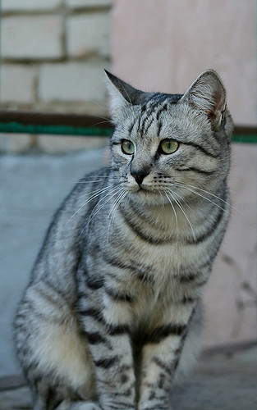
Image Classification: A core task in Computer Vision
(assume given set of discrete labels)
{dog, cat, truck, plane, ...}
cat
This image by Nikita is licensed under CC-BY 2.0
Slide Credit: Fei-Fei Li, Justin Johnson, Serena Yeung, CS 231n

Slide 6
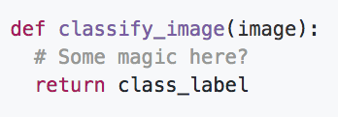
An image classifier
Unlike e.g. sorting a list of numbers,
no obvious way to hard-code the algorithm for recognizing a cat, or other classes.
Slide Credit: Fei-Fei Li, Justin Johnson, Serena Yeung, CS 231n

Slide 7
Supervised Learning
Input: x (images, text, emails…)
Output: y (spam or non-spam…)
(Unknown) Target Function
  f: X → Y (the “true” mapping / reality)
Data
  { (x₁,y₁), (x₂,y₂), …, (x_{N},y_{N}) }
Model / Hypothesis Class
  H = {h: X → Y}
  e.g. y = h(x) = sign(w^{T}x)
Loss Function
  How good is a model wrt my data D?
Learning = Search in hypothesis space
  Find best h in model class.

Slide 8
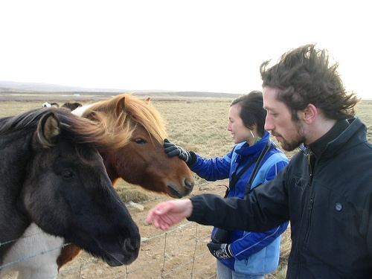
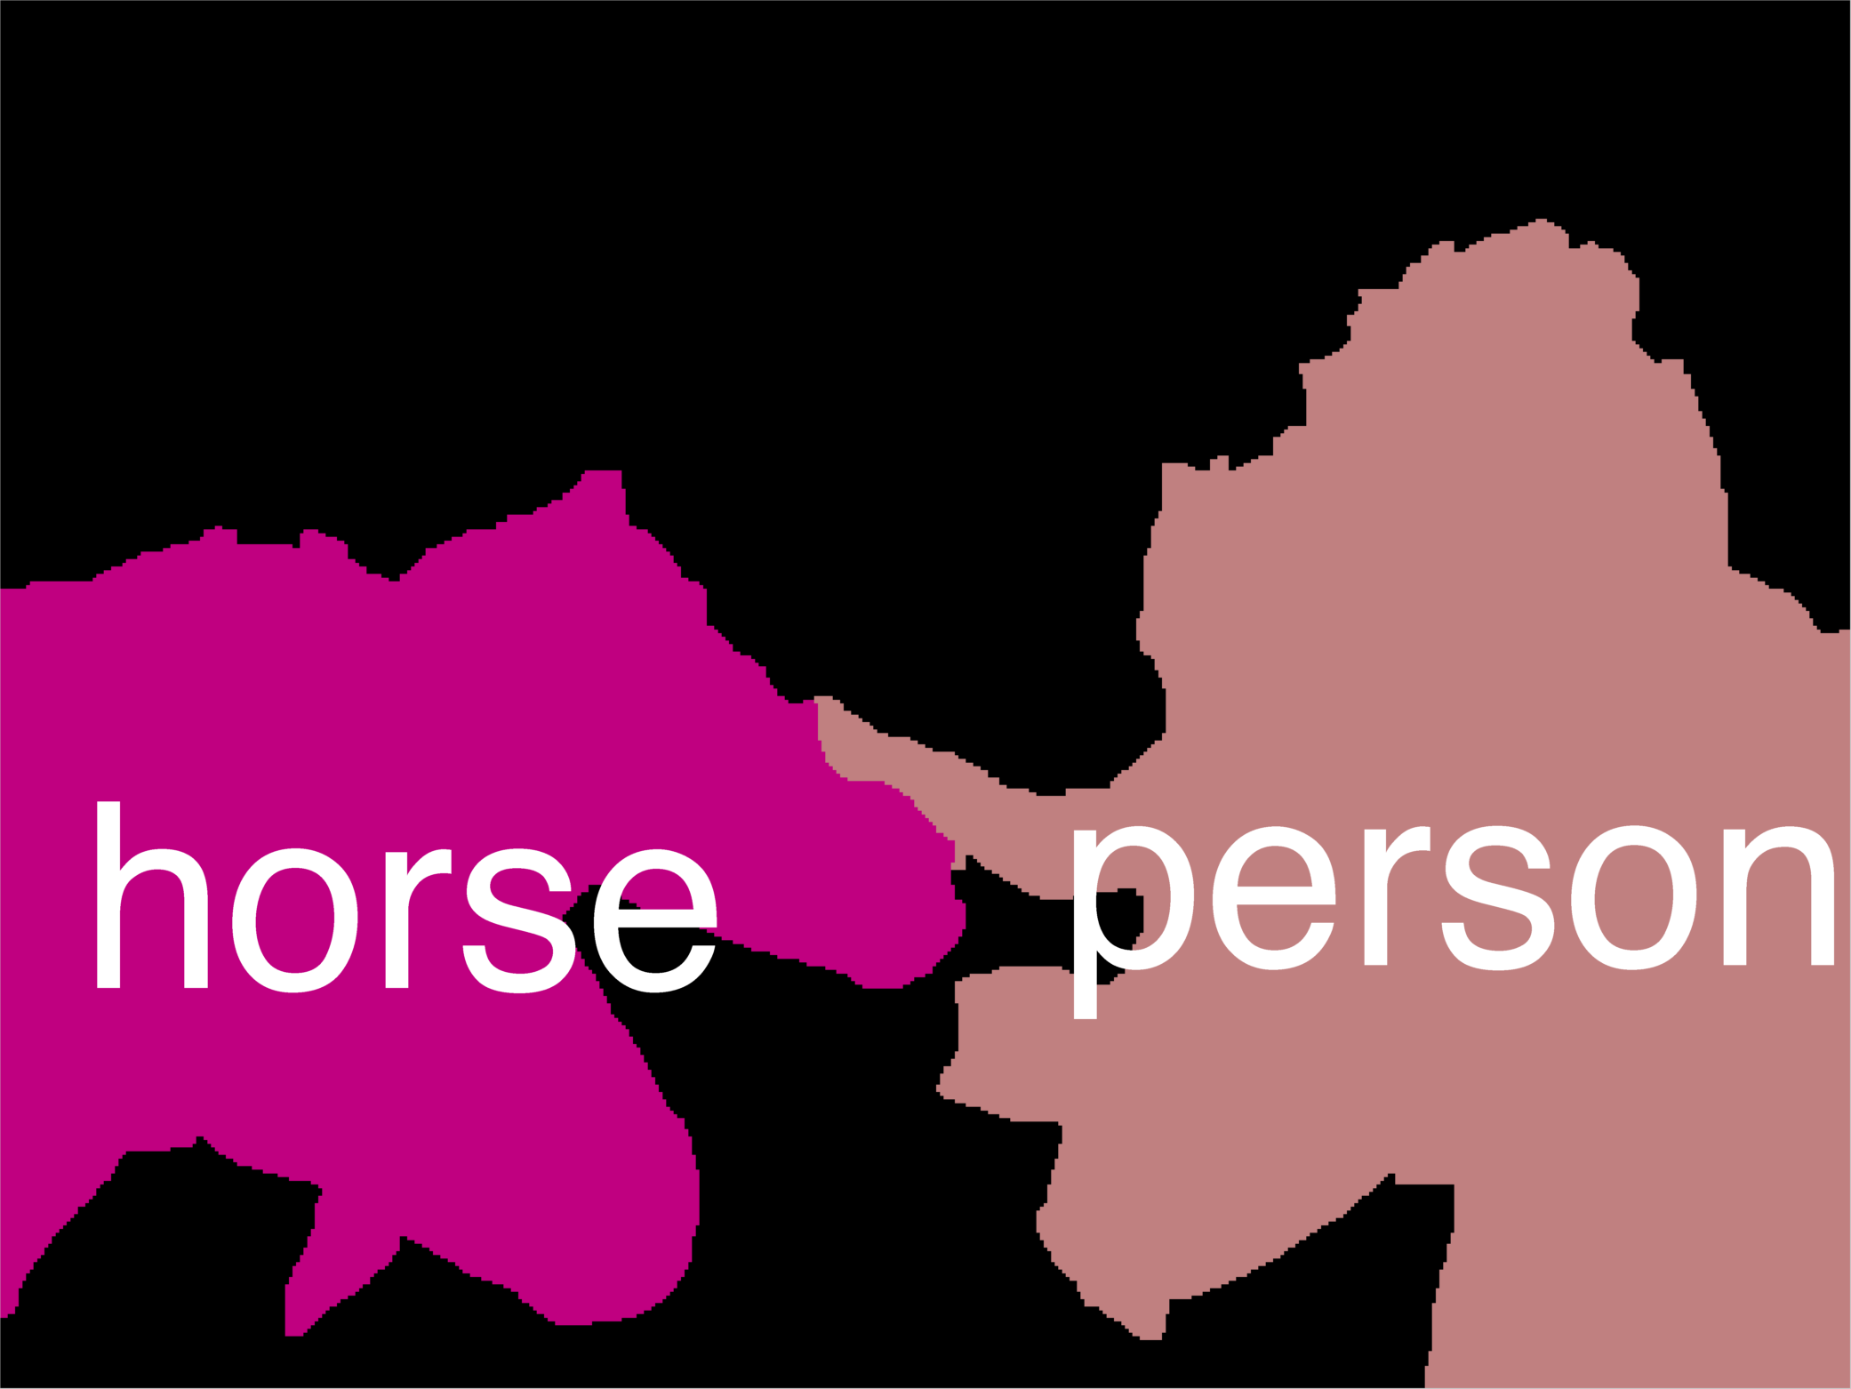
Error Decomposition
AlexNet
Softmax
Reality
FC 1000
FC 4096
FC 4096
Modeling Error
Pool
3x3 conv, 256
model class
3x3 conv, 384
Pool
3x3 conv, 384
Pool
Estimation
Error
5x5 conv, 256
11x11 conv, 96
Input
Optimization
Error

Slide 9
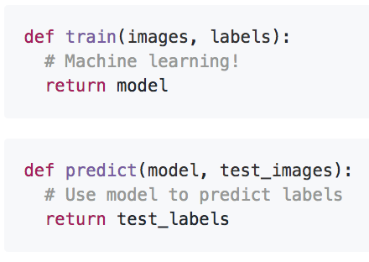
First classifier: Nearest Neighbor
Memorize all data and labels
Predict the label of the most similar training image
Slide Credit: Fei-Fei Li, Justin Johnson, Serena Yeung, CS 231n

Slide 10
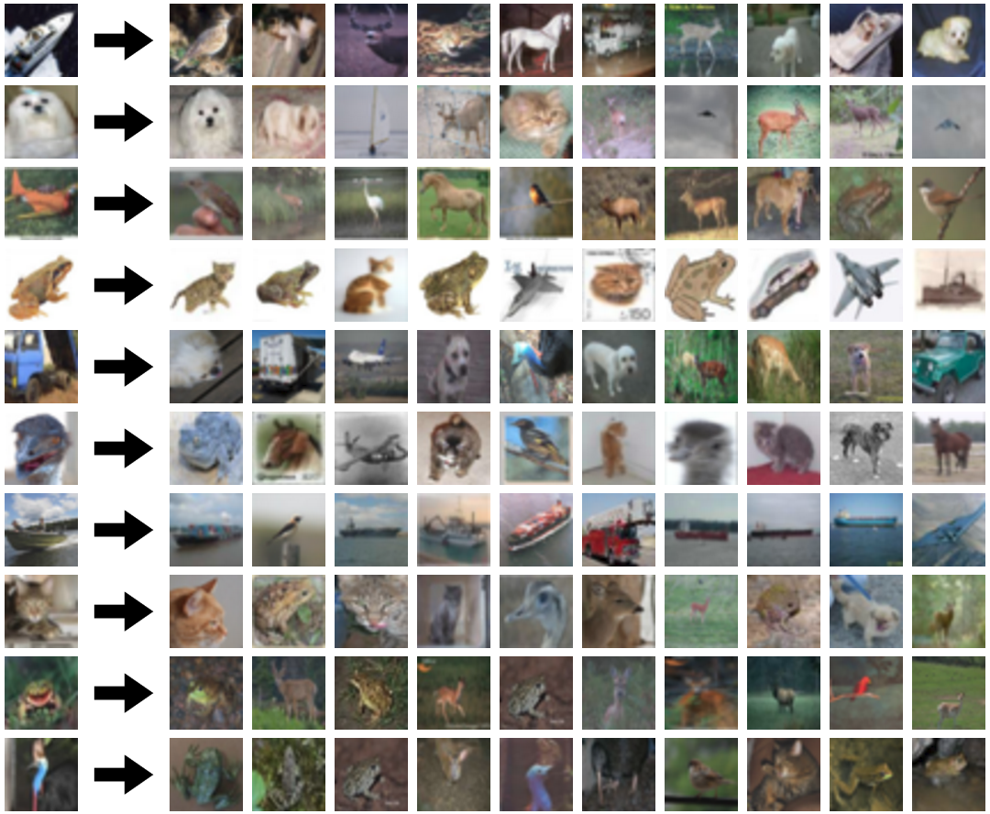
Nearest Neighbours

Slide 11
Instance/Memory-based Learning
Four things make a memory based learner:
A distance metric
How many nearby neighbors to look at?
A weighting function (optional)
How to fit with the local points?
Slide Credit: Carlos Guestrin

Slide 12
Hyperparameters
Your Dataset
Idea #4: Cross-Validation: Split data into folds, try each fold as validation and average the results
fold 1
fold 2
fold 3
fold 4
fold 5
test
fold 1
fold 2
fold 3
fold 4
fold 5
test
fold 1
fold 2
fold 3
fold 4
fold 5
test
Useful for small datasets, but not used too frequently in deep learning
Slide Credit: Fei-Fei Li, Justin Johnson, Serena Yeung, CS 231n

Slide 13
Problems with Instance-Based Learning
Expensive
  No Learning: most real work done during testing
  For every test sample, must search through all dataset – very slow!
  Must use tricks like approximate nearest neighbour search
Doesn’t work well when large number of irrelevant features
  Distances overwhelmed by noisy features
Curse of Dimensionality
  Distances become meaningless in high dimensions
  (See proof in next lecture)

Slide 14
Plan for Today
Linear Classifiers
  Linear scoring functions
Loss Functions
  Multi-class hinge loss
  Softmax cross-entropy loss

Slide 15
Linear Classification

Slide 16

Neural Network
Linear classifiers
This image is CC0 1.0 public domain
Slide Credit: Fei-Fei Li, Justin Johnson, Serena Yeung, CS 231n

Slide 17
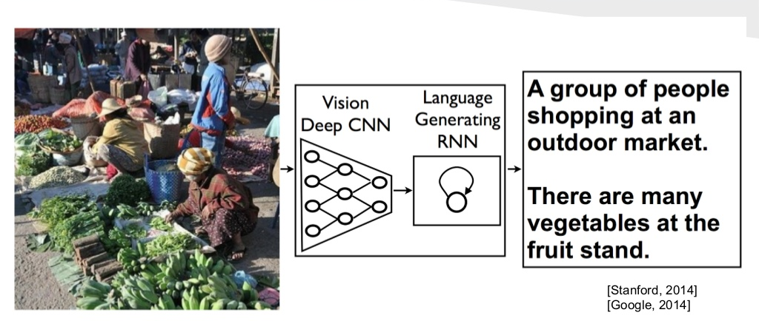
Image Captioning
Image Credit: [Vinyals et al. CVPR15]

Slide 18
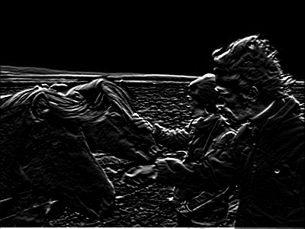
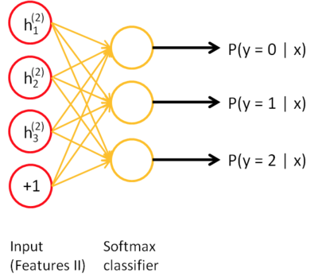
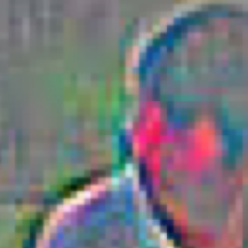
Visual Question Answering
Neural Network
Softmax
over top K answers
Embedding (VGGNet)
Image
4096-dim
Convolution Layer
+ Non-Linearity
Pooling Layer
Convolution Layer
+ Non-Linearity
Pooling Layer
Fully-Connected MLP
Question
Embedding (LSTM)
“How many horses are in this image?”

Slide 19
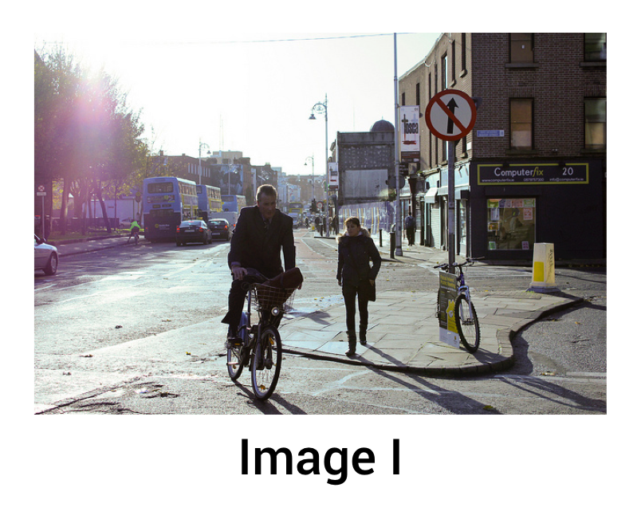

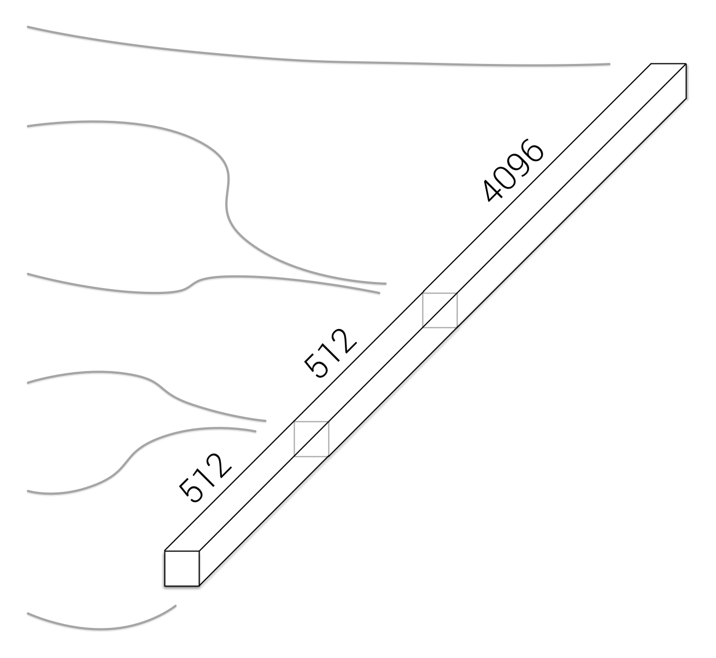
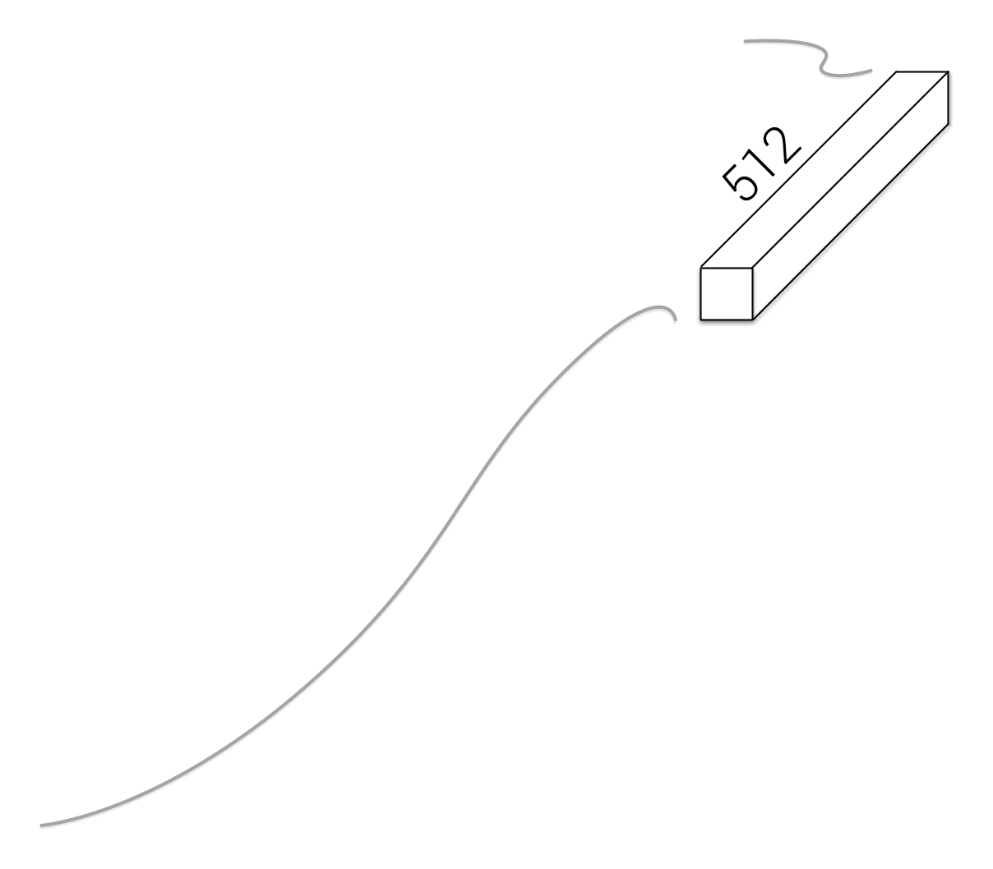
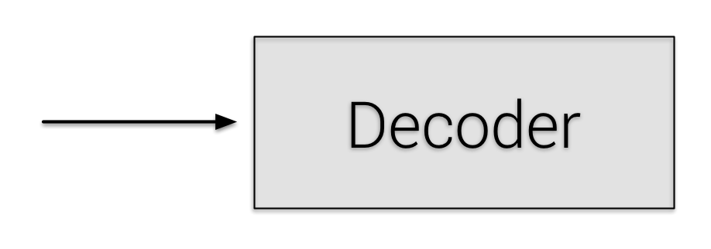
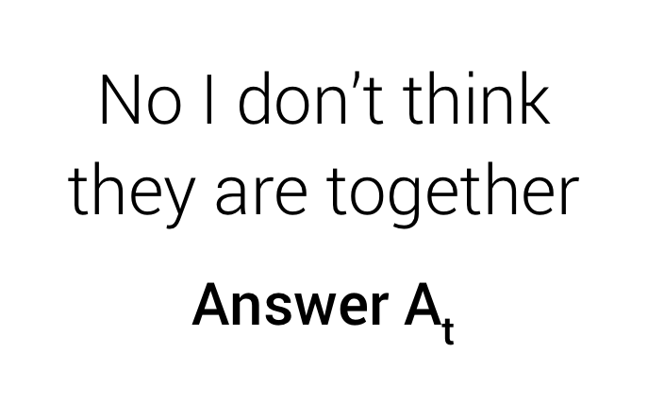
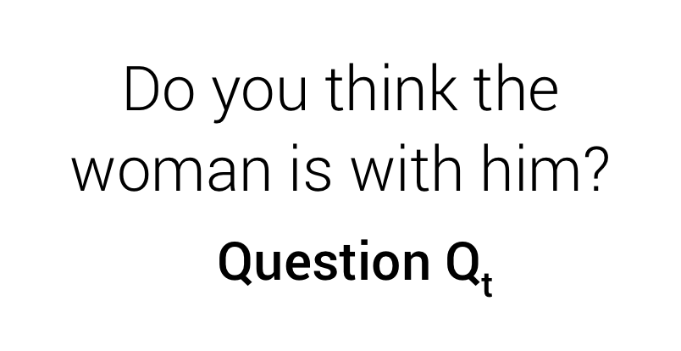
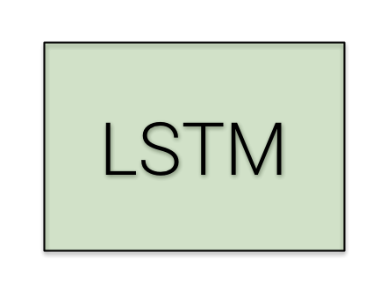
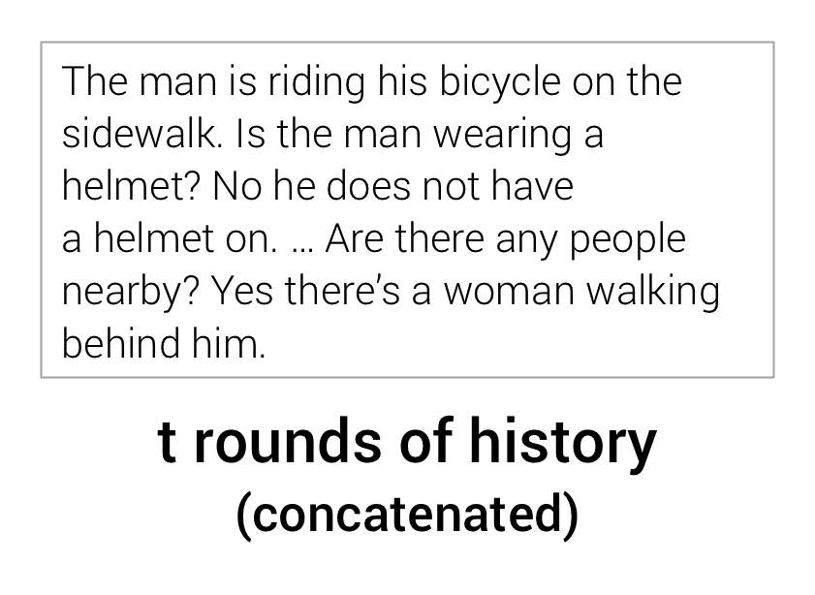
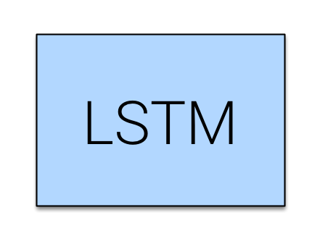
Visual Dialog
Late Fusion Encoder
Slide Credit: Abhishek Das

Slide 20
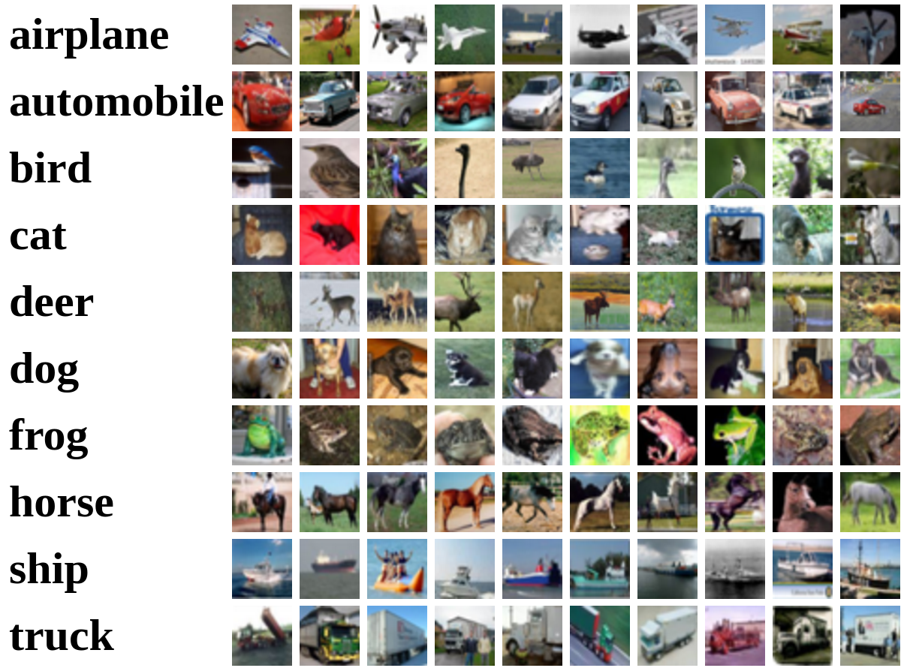
Recall CIFAR10
50,000 training images
each image is 32x32x3
10,000 test images.
Slide Credit: Fei-Fei Li, Justin Johnson, Serena Yeung, CS 231n

Slide 21
Parametric Approach
Image
f(x,W)
10 numbers giving class scores
Array of 32x32x3 numbers
(3072 numbers total)
W
parameters
or weights
Slide Credit: Fei-Fei Li, Justin Johnson, Serena Yeung, CS 231n

Slide 22
Parametric Approach: Linear Classifier
f(x,W) = Wx
Image
f(x,W)
10 numbers giving class scores
Array of 32x32x3 numbers
(3072 numbers total)
W
parameters
or weights
Slide Credit: Fei-Fei Li, Justin Johnson, Serena Yeung, CS 231n

Slide 23
Example with an image with 4 pixels, and 3 classes (cat/dog/ship)
Stretch pixels into column
56
231
24
2
56 | 231
24 | 2
Input image
Slide Credit: Fei-Fei Li, Justin Johnson, Serena Yeung, CS 231n

Slide 24
Example with an image with 4 pixels, and 3 classes (cat/dog/ship)
Stretch pixels into column
56
231
24
2
0.2 | -0.5 | 0.1 | 2.0
1.5 | 1.3 | 2.1 | 0.0
0 | 0.25 | 0.2 | -0.3
1.1
3.2
-1.2
-96.8
437.9
61.95
Cat score
56 | 231
24 | 2
+
=
Dog score
Ship score
Input image
W
b
s
Slide Credit: Fei-Fei Li, Justin Johnson, Serena Yeung, CS 231n

Slide 25
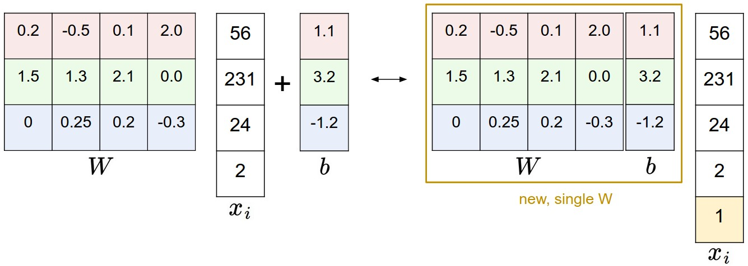
Image Credit: Andrej Karpathy, CS231n

Slide 26
Parametric Approach: Linear Classifier
3072x1
f(x,W) = Wx
Image
10x1
10x3072
f(x,W)
10 numbers giving class scores
Array of 32x32x3 numbers
(3072 numbers total)
W
parameters
or weights
Slide Credit: Fei-Fei Li, Justin Johnson, Serena Yeung, CS 231n

Slide 27
Parametric Approach: Linear Classifier
3072x1
f(x,W) = Wx + b
10x1
Image
10x1
10x3072
f(x,W)
10 numbers giving class scores
Array of 32x32x3 numbers
(3072 numbers total)
W
parameters
or weights
Slide Credit: Fei-Fei Li, Justin Johnson, Serena Yeung, CS 231n

Slide 28
Error Decomposition
AlexNet
Softmax
Reality
FC 1000
FC 4096
FC 4096
Modeling Error
Pool
3x3 conv, 256
model class
3x3 conv, 384
Pool
3x3 conv, 384
Pool
Estimation
Error
5x5 conv, 256
11x11 conv, 96
Input
Optimization
Error

Slide 29
Error Decomposition
Reality
Multi-class Logistic Regression
Modeling Error
Softmax
FC HxWx3
Input
Estimation
Error
Optimization
Error = 0
model class

Slide 30
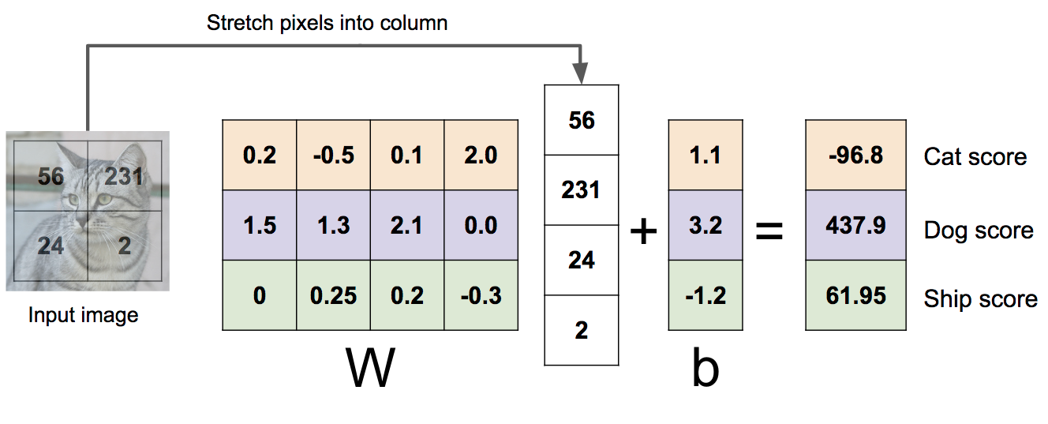
Example with an image with 4 pixels, and 3 classes (cat/dog/ship)
Algebraic Viewpoint
f(x,W) = Wx
Slide Credit: Fei-Fei Li, Justin Johnson, Serena Yeung, CS 231n

Slide 31
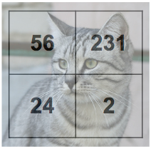
Example with an image with 4 pixels, and 3 classes (cat/dog/ship)
Input image
Algebraic Viewpoint
f(x,W) = Wx
0.2 | -0.5
0.1 | 2.0
1.5 | 1.3
2.1 | 0.0
0 | .25
0.2 | -0.3
W
b
1.1
3.2
-1.2
Score
-96.8
437.9
61.95
Slide Credit: Fei-Fei Li, Justin Johnson, Serena Yeung, CS 231n

Slide 32
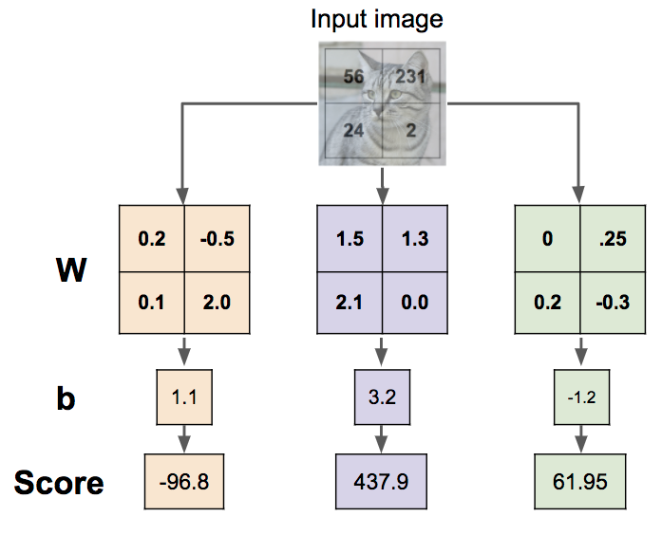
Interpreting a Linear Classifier
Slide Credit: Fei-Fei Li, Justin Johnson, Serena Yeung, CS 231n

Slide 33

Interpreting a Linear Classifier:
Visual Viewpoint
Slide Credit: Fei-Fei Li, Justin Johnson, Serena Yeung, CS 231n

Slide 34
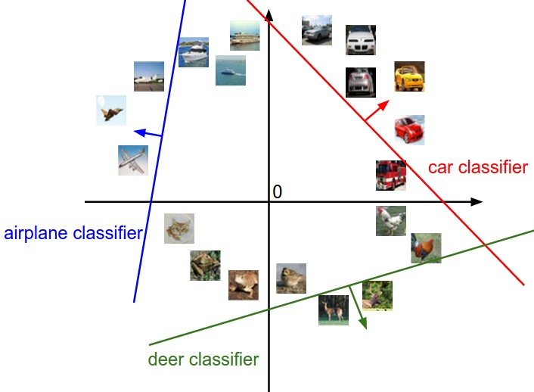
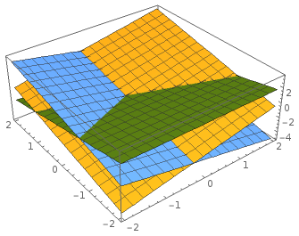
Interpreting a Linear Classifier: Geometric Viewpoint
f(x,W) = Wx + b
Array of 32x32x3 numbers
(3072 numbers total)
Plot created using Wolfram Cloud
Cat image by Nikita is licensed under CC-BY 2.0
Slide Credit: Fei-Fei Li, Justin Johnson, Serena Yeung, CS 231n

Slide 35
Hard cases for a linear classifier
Class 1:
First and third quadrants
Class 2:
Second and fourth quadrants
Class 1:
1 <= L2 norm <= 2
Class 2:
Everything else
Class 1:
Three modes
Class 2:
Everything else
Slide Credit: Fei-Fei Li, Justin Johnson, Serena Yeung, CS 231n

Slide 36
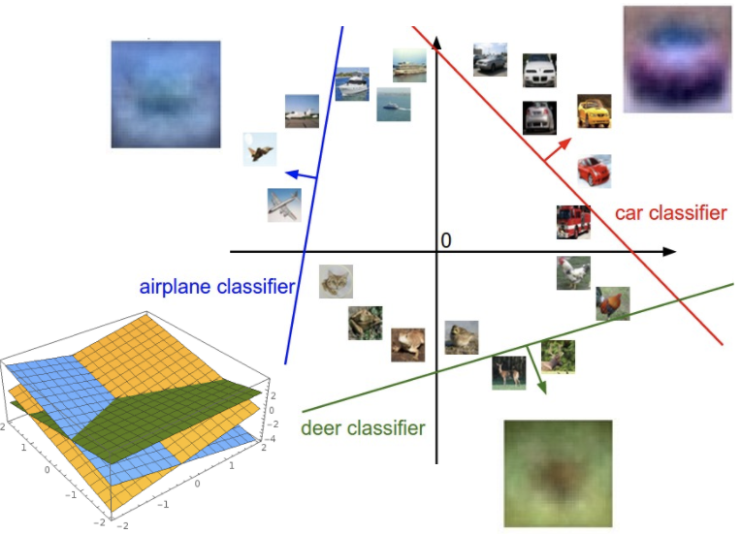
Linear Classifier: Three Viewpoints
Algebraic Viewpoint
Visual Viewpoint
Geometric Viewpoint
f(x,W) = Wx
One template per class
Hyperplanes cutting up space
Slide Credit: Fei-Fei Li, Justin Johnson, Serena Yeung, CS 231n

Slide 37
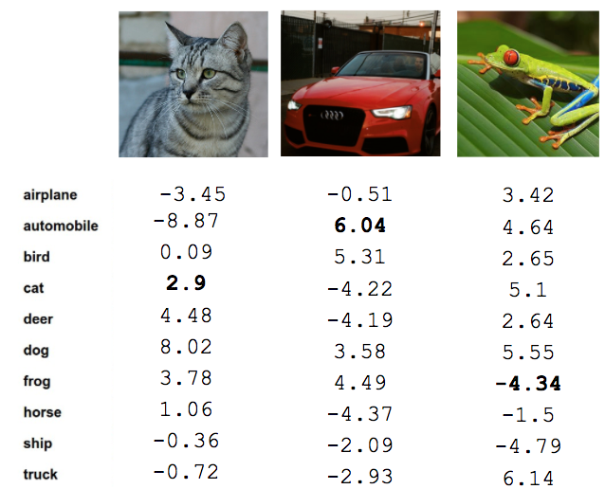
So far: Defined a (linear) score function
f(x,W) = Wx + b
Example class scores for 3 images for some W:
How can we tell whether this W is good or bad?
Cat image by Nikita is licensed under CC-BY 2.0; Car image is CC0 1.0 public domain; Frog image is in the public domain
Slide Credit: Fei-Fei Li, Justin Johnson, Serena Yeung, CS 231n

Slide 38
So far: Defined a (linear) score function
TODO:
Define a loss function that quantifies our unhappiness with the scores across the training data.
Come up with a way of efficiently finding the parameters that minimize the loss function. (optimization)
Cat image by Nikita is licensed under CC-BY 2.0; Car image is CC0 1.0 public domain; Frog image is in the public domain
Slide Credit: Fei-Fei Li, Justin Johnson, Serena Yeung, CS 231n

Slide 39
Supervised Learning
Input: x (images, text, emails…)
Output: y (spam or non-spam…)
(Unknown) Target Function
  f: X → Y (the “true” mapping / reality)
Data
  (x₁,y₁), (x₂,y₂), …, (x_{N},y_{N})
Model / Hypothesis Class
  {h: X → Y}
  e.g. y = h(x) = sign(w^{T}x)
Loss Function
  How good is a model wrt my data D?
Learning = Search in hypothesis space
  Find best h in model class.

Slide 40
Loss Functions

Slide 41

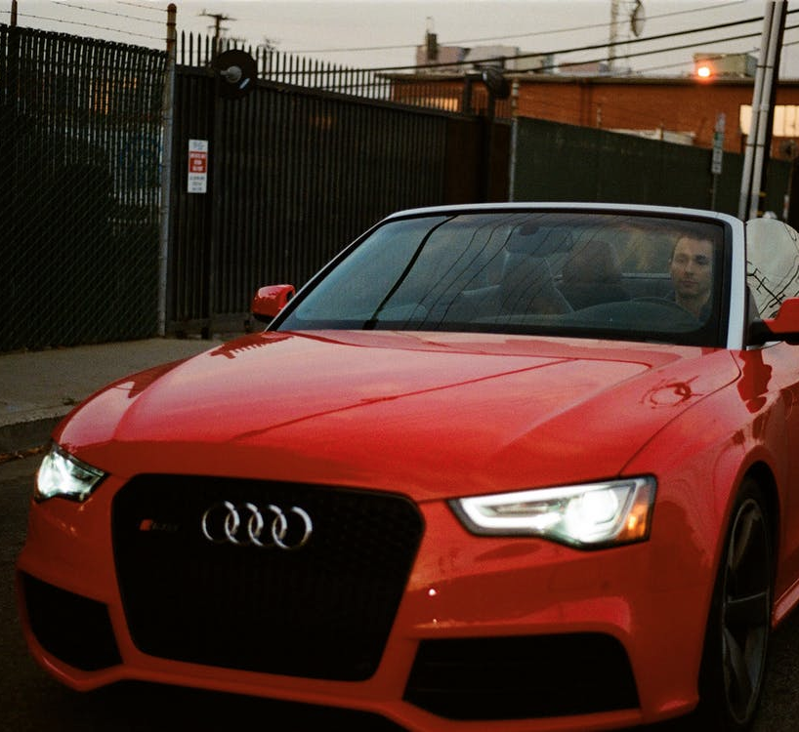
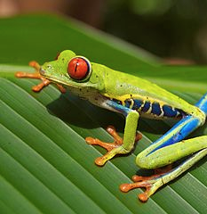
Suppose: 3 training examples, 3 classes.
With some W the scores are:
cat
3.2
1.3
2.2
car
5.1
4.9
2.5
frog
-1.7
2.0
-3.1
Slide Credit: Fei-Fei Li, Justin Johnson, Serena Yeung, CS 231n

Slide 42
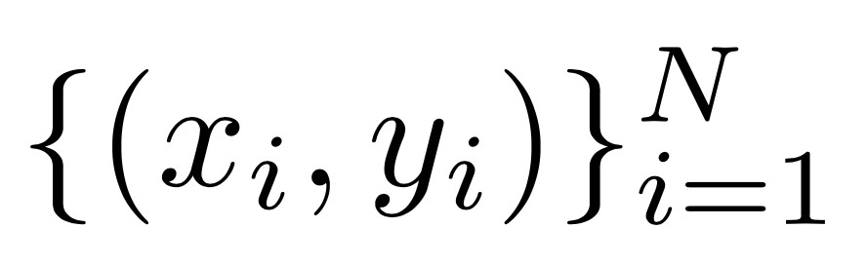

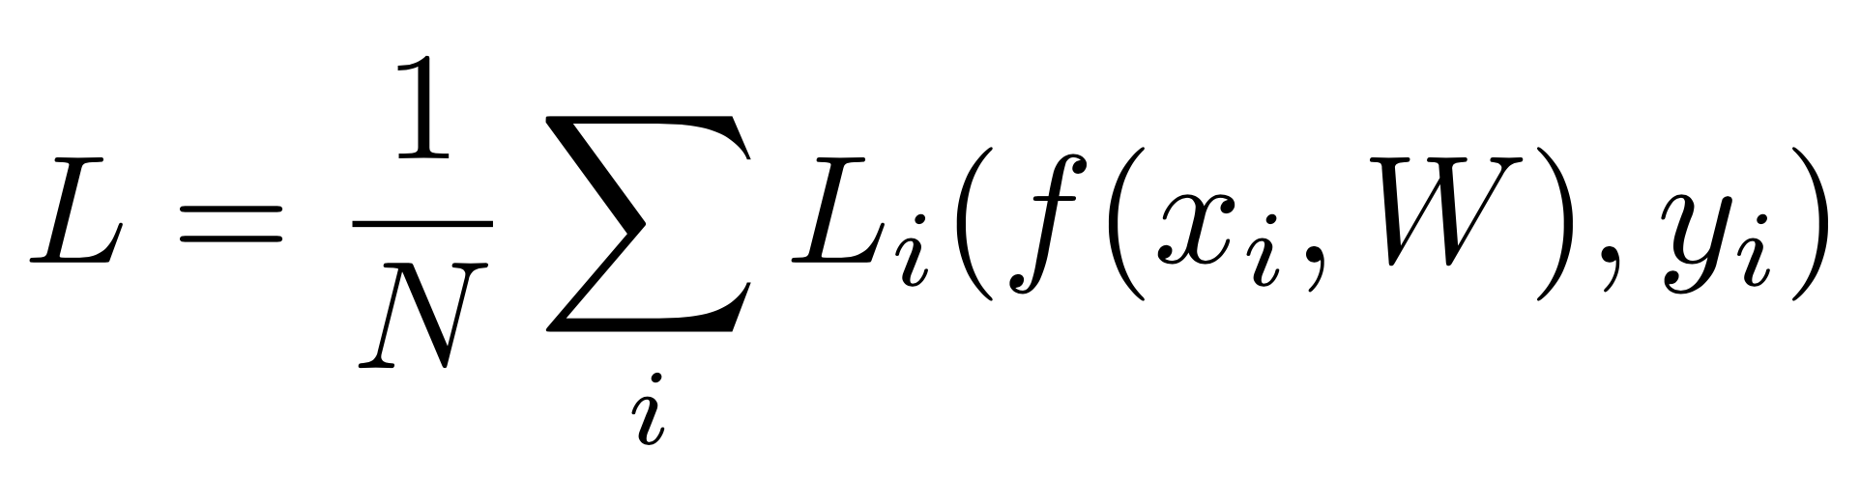
Suppose: 3 training examples, 3 classes.
With some W the scores are:
A loss function tells how good our current classifier is
Given a dataset of examples
Where is image and
is (integer) label
Loss over the dataset is a sum of loss over examples:
cat
3.2
1.3
2.2
car
5.1
4.9
2.5
frog
-1.7
2.0
-3.1
Slide Credit: Fei-Fei Li, Justin Johnson, Serena Yeung, CS 231n

Slide 43

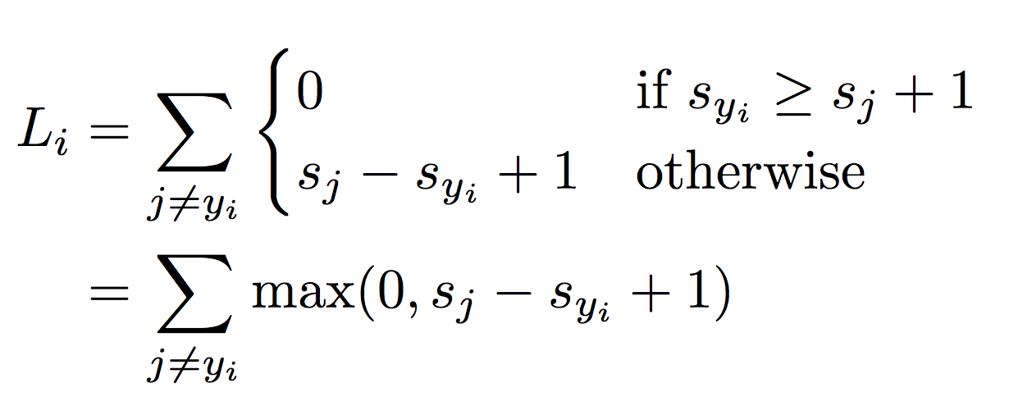
Suppose: 3 training examples, 3 classes.
With some W the scores are:
Multiclass SVM loss:
Given an example
where is the image and
where is the (integer) label,
and using the shorthand for the scores vector:
the SVM loss has the form:
cat
3.2
1.3
2.2
car
5.1
4.9
2.5
frog
-1.7
2.0
-3.1
Slide Credit: Fei-Fei Li, Justin Johnson, Serena Yeung, CS 231n

Slide 44
Suppose: 3 training examples, 3 classes.
With some W the scores are:
Multiclass SVM loss:
Given an example
where is the image and
where is the (integer) label,
and using the shorthand for the scores vector:
the SVM loss has the form:
cat
3.2
1.3
2.2
car
5.1
4.9
2.5
frog
-1.7
2.0
-3.1
Slide Credit: Fei-Fei Li, Justin Johnson, Serena Yeung, CS 231n

Slide 45
Suppose: 3 training examples, 3 classes.
With some W the scores are:
Multiclass SVM loss:
Given an example
where is the image and
where is the (integer) label,
and using the shorthand for the scores vector:
the SVM loss has the form:
cat
3.2
1.3
2.2
car
5.1
4.9
2.5
frog
-1.7
2.0
-3.1
Slide Credit: Fei-Fei Li, Justin Johnson, Serena Yeung, CS 231n

Slide 46
Suppose: 3 training examples, 3 classes.
With some W the scores are:
Multiclass SVM loss:
Given an example
where is the image and
where is the (integer) label,
and using the shorthand for the scores vector:
the SVM loss has the form:
cat
3.2
1.3
2.2
car
5.1
4.9
2.5
frog
-1.7
2.0
-3.1
Slide Credit: Fei-Fei Li, Justin Johnson, Serena Yeung, CS 231n

Slide 47



Suppose: 3 training examples, 3 classes.
With some W the scores are:
Multiclass SVM loss:
Given an example
where is the image and
where is the (integer) label,
and using the shorthand for the scores vector:
the SVM loss has the form:
“Hinge loss”
cat
3.2
1.3
2.2
car
5.1
4.9
2.5
frog
-1.7
2.0
-3.1
Slide Credit: Fei-Fei Li, Justin Johnson, Serena Yeung, CS 231n

Slide 48

Suppose: 3 training examples, 3 classes.
With some W the scores are:
Multiclass SVM loss:
Given an example
where is the image and
where is the (integer) label,
and using the shorthand for the scores vector:
the SVM loss has the form:
“Hinge loss”
cat
3.2
1.3
2.2
car
5.1
4.9
2.5
frog
-1.7
2.0
-3.1
Slide Credit: Fei-Fei Li, Justin Johnson, Serena Yeung, CS 231n

Slide 49

Suppose: 3 training examples, 3 classes.
With some W the scores are:
Multiclass SVM loss:
Given an example
where is the image and
where is the (integer) label,
and using the shorthand for the scores vector:
the SVM loss has the form:
cat
3.2
1.3
2.2
car
5.1
4.9
2.5
frog
-1.7
2.0
-3.1
Slide Credit: Fei-Fei Li, Justin Johnson, Serena Yeung, CS 231n

Slide 50
Suppose: 3 training examples, 3 classes.
With some W the scores are:
Multiclass SVM loss:
Given an example
where is the image and
where is the (integer) label,
and using the shorthand for the scores vector:
the SVM loss has the form:
cat
3.2
1.3
2.2
car
5.1
4.9
2.5
= max(0, 5.1 - 3.2 + 1)
+max(0, -1.7 - 3.2 + 1)
= max(0, 2.9) + max(0, -3.9)
= 2.9 + 0
= 2.9
frog
-1.7
2.0
-3.1
Losses:
2.9
Slide Credit: Fei-Fei Li, Justin Johnson, Serena Yeung, CS 231n

Slide 51
Suppose: 3 training examples, 3 classes.
With some W the scores are:
Multiclass SVM loss:
Given an example
where is the image and
where is the (integer) label,
and using the shorthand for the scores vector:
the SVM loss has the form:
cat
3.2
1.3
2.2
car
5.1
4.9
2.5
= max(0, 1.3 - 4.9 + 1)
+max(0, 2.0 - 4.9 + 1)
= max(0, -2.6) + max(0, -1.9)
= 0 + 0
= 0
frog
-1.7
2.0
-3.1
Losses:
2.9
0
Slide Credit: Fei-Fei Li, Justin Johnson, Serena Yeung, CS 231n

Slide 52
Suppose: 3 training examples, 3 classes.
With some W the scores are:
Multiclass SVM loss:
Given an example
where is the image and
where is the (integer) label,
and using the shorthand for the scores vector:
the SVM loss has the form:
cat
3.2
1.3
2.2
car
5.1
4.9
2.5
= max(0, 2.2 - (-3.1) + 1)
+max(0, 2.5 - (-3.1) + 1)
= max(0, 6.3) + max(0, 6.6)
= 6.3 + 6.6
= 12.9
frog
-1.7
2.0
-3.1
Losses:
2.9
0
12.9
Slide Credit: Fei-Fei Li, Justin Johnson, Serena Yeung, CS 231n

Slide 53

Suppose: 3 training examples, 3 classes.
With some W the scores are:
Multiclass SVM loss:
Given an example
where is the image and
where is the (integer) label,
and using the shorthand for the scores vector:
the SVM loss has the form:
Loss over full dataset is average:
cat
3.2
1.3
2.2
car
5.1
4.9
2.5
frog
-1.7
2.0
-3.1
Losses:
2.9
0
12.9
L = (2.9 + 0 + 12.9)/3
= 5.27
Slide Credit: Fei-Fei Li, Justin Johnson, Serena Yeung, CS 231n

Slide 54
Suppose: 3 training examples, 3 classes.
With some W the scores are:
Multiclass SVM loss:
Given an example
where is the image and
where is the (integer) label,
and using the shorthand for the scores vector:
the SVM loss has the form:
Q: What happens to loss if car image scores change a bit?
cat
3.2
1.3
2.2
car
5.1
4.9
2.5
frog
-1.7
2.0
-3.1
Losses:
2.9
0
12.9
Slide Credit: Fei-Fei Li, Justin Johnson, Serena Yeung, CS 231n

Slide 55
Suppose: 3 training examples, 3 classes.
With some W the scores are:
Multiclass SVM loss:
Given an example
where is the image and
where is the (integer) label,
and using the shorthand for the scores vector:
the SVM loss has the form:
Q2: what is the min/max possible loss?
cat
3.2
1.3
2.2
car
5.1
4.9
2.5
frog
-1.7
2.0
-3.1
Losses:
2.9
0
12.9
Slide Credit: Fei-Fei Li, Justin Johnson, Serena Yeung, CS 231n
Notes:
Min is 0, max is infinity

Slide 56
Suppose: 3 training examples, 3 classes.
With some W the scores are:
Multiclass SVM loss:
Given an example
where is the image and
where is the (integer) label,
and using the shorthand for the scores vector:
the SVM loss has the form:
Q3: At initialization W is small so all s ≈ 0.
What is the loss?
cat
3.2
1.3
2.2
car
5.1
4.9
2.5
frog
-1.7
2.0
-3.1
Losses:
2.9
0
12.9
Slide Credit: Fei-Fei Li, Justin Johnson, Serena Yeung, CS 231n
Notes:
Min is 0, max is infinity

Slide 57
Suppose: 3 training examples, 3 classes.
With some W the scores are:
Multiclass SVM loss:
Given an example
where is the image and
where is the (integer) label,
and using the shorthand for the scores vector:
the SVM loss has the form:
Q4: What if the sum was over all classes?
(including j = y_i)
cat
3.2
1.3
2.2
car
5.1
4.9
2.5
frog
-1.7
2.0
-3.1
Losses:
2.9
0
12.9
Slide Credit: Fei-Fei Li, Justin Johnson, Serena Yeung, CS 231n

Slide 58
Suppose: 3 training examples, 3 classes.
With some W the scores are:
Multiclass SVM loss:
Given an example
where is the image and
where is the (integer) label,
and using the shorthand for the scores vector:
the SVM loss has the form:
Q5: What if we used mean instead of sum?
cat
3.2
1.3
2.2
car
5.1
4.9
2.5
frog
-1.7
2.0
-3.1
Losses:
2.9
0
12.9
Slide Credit: Fei-Fei Li, Justin Johnson, Serena Yeung, CS 231n

Slide 59

Suppose: 3 training examples, 3 classes.
With some W the scores are:
Multiclass SVM loss:
Given an example
where is the image and
where is the (integer) label,
and using the shorthand for the scores vector:
the SVM loss has the form:
Q6: What if we used
cat
3.2
1.3
2.2
car
5.1
4.9
2.5
frog
-1.7
2.0
-3.1
Losses:
2.9
0
12.9
Slide Credit: Fei-Fei Li, Justin Johnson, Serena Yeung, CS 231n
Notes:
Minima could change

Slide 60
E.g. Suppose that we found a W such that L = 0.
Q7: Is this W unique?
Slide Credit: Fei-Fei Li, Justin Johnson, Serena Yeung, CS 231n

Slide 61
E.g. Suppose that we found a W such that L = 0.
Q7: Is this W unique?
No! 2W is also has L = 0!
Slide Credit: Fei-Fei Li, Justin Johnson, Serena Yeung, CS 231n

Slide 62
Suppose: 3 training examples, 3 classes.
With some W the scores are:
Before:
= max(0, 1.3 - 4.9 + 1)
+max(0, 2.0 - 4.9 + 1)
= max(0, -2.6) + max(0, -1.9)
= 0 + 0
= 0
cat
3.2
1.3
2.2
With W twice as large:
car
5.1
4.9
2.5
= max(0, 2.6 - 9.8 + 1)
+max(0, 4.0 - 9.8 + 1)
= max(0, -6.2) + max(0, -4.8)
= 0 + 0
= 0
frog
-1.7
2.0
-3.1
Losses:
2.9
0
Slide Credit: Fei-Fei Li, Justin Johnson, Serena Yeung, CS 231n

Slide 63
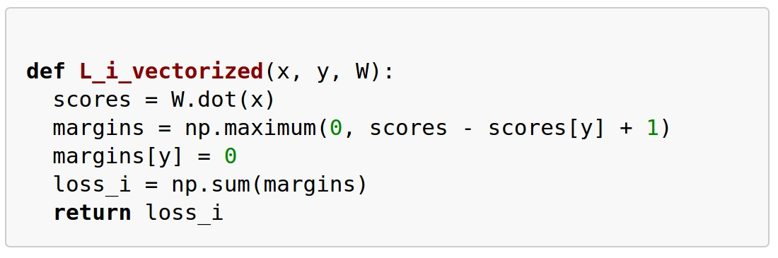
Multiclass SVM Loss: Example code
Slide Credit: Fei-Fei Li, Justin Johnson, Serena Yeung, CS 231n

Slide 64
Softmax Classifier (Multinomial Logistic Regression)
Want to interpret raw classifier scores as probabilities
cat
3.2
car
5.1
frog
-1.7
Slide Credit: Fei-Fei Li, Justin Johnson, Serena Yeung, CS 231n

Slide 65


Softmax Classifier (Multinomial Logistic Regression)
Want to interpret raw classifier scores as probabilities
Softmax function
cat
3.2
car
5.1
frog
-1.7
Slide Credit: Fei-Fei Li, Justin Johnson, Serena Yeung, CS 231n

Slide 66
Softmax Classifier (Multinomial Logistic Regression)
Want to interpret raw classifier scores as probabilities
Softmax Function
Probabilities must be >= 0
cat
3.2
24.5
exp
car
5.1
164.0
frog
-1.7
0.18
unnormalized probabilities
Slide Credit: Fei-Fei Li, Justin Johnson, Serena Yeung, CS 231n

Slide 67
Softmax Classifier (Multinomial Logistic Regression)
Want to interpret raw classifier scores as probabilities
Softmax Function
Probabilities must be >= 0
Probabilities must sum to 1
cat
3.2
24.5
0.13
exp
normalize
car
5.1
164.0
0.87
frog
-1.7
0.18
0.00
unnormalized probabilities
probabilities
Slide Credit: Fei-Fei Li, Justin Johnson, Serena Yeung, CS 231n

Slide 68
Softmax Classifier (Multinomial Logistic Regression)
Want to interpret raw classifier scores as probabilities
Softmax Function
Probabilities must be >= 0
Probabilities must sum to 1
cat
3.2
24.5
0.13
exp
normalize
car
5.1
164.0
0.87
frog
-1.7
0.18
0.00
Unnormalized log-probabilities / logits
unnormalized probabilities
probabilities
Slide Credit: Fei-Fei Li, Justin Johnson, Serena Yeung, CS 231n

Slide 69


Softmax Classifier (Multinomial Logistic Regression)
Want to interpret raw classifier scores as probabilities
cat
3.2
car
5.1
frog
-1.7
in summary:
Maximize log-prob of the correct class =
Maximize the log likelihood =
Minimize the negative log likelihood
Slide Credit: Fei-Fei Li, Justin Johnson, Serena Yeung, CS 231n

Slide 70
Softmax Classifier (Multinomial Logistic Regression)
Want to interpret raw classifier scores as probabilities
Softmax Function
Probabilities must be >= 0
Probabilities must sum to 1
cat
3.2
24.5
0.13
exp
normalize
car
5.1
164.0
0.87
frog
-1.7
0.18
0.00
Unnormalized log-probabilities / logits
unnormalized probabilities
probabilities
Slide Credit: Fei-Fei Li, Justin Johnson, Serena Yeung, CS 231n

Slide 71
Softmax Classifier (Multinomial Logistic Regression)
Want to interpret raw classifier scores as probabilities
Softmax Function
Probabilities must be >= 0
Probabilities must sum to 1
cat
3.2
24.5
0.13
L_{i} = -log(0.13)
= 2.04
exp
normalize
car
5.1
164.0
0.87
frog
-1.7
0.18
0.00
Unnormalized log-probabilities / logits
unnormalized probabilities
probabilities
Slide Credit: Fei-Fei Li, Justin Johnson, Serena Yeung, CS 231n

Slide 72
Log-Likelihood / KL-Divergence / Cross-Entropy

Slide 73
Log-Likelihood / KL-Divergence / Cross-Entropy

Slide 74
Log-Likelihood / KL-Divergence / Cross-Entropy

Slide 75
Softmax Classifier (Multinomial Logistic Regression)
Want to interpret raw classifier scores as probabilities
Softmax Function
Probabilities must be >= 0
Probabilities must sum to 1
cat
3.2
24.5
0.13
compare
1.00
exp
normalize
car
5.1
164.0
0.87
0.00
frog
-1.7
0.18
0.00
0.00
Unnormalized log-probabilities / logits
unnormalized probabilities
probabilities
Correct
probs
Slide Credit: Fei-Fei Li, Justin Johnson, Serena Yeung, CS 231n

Slide 76
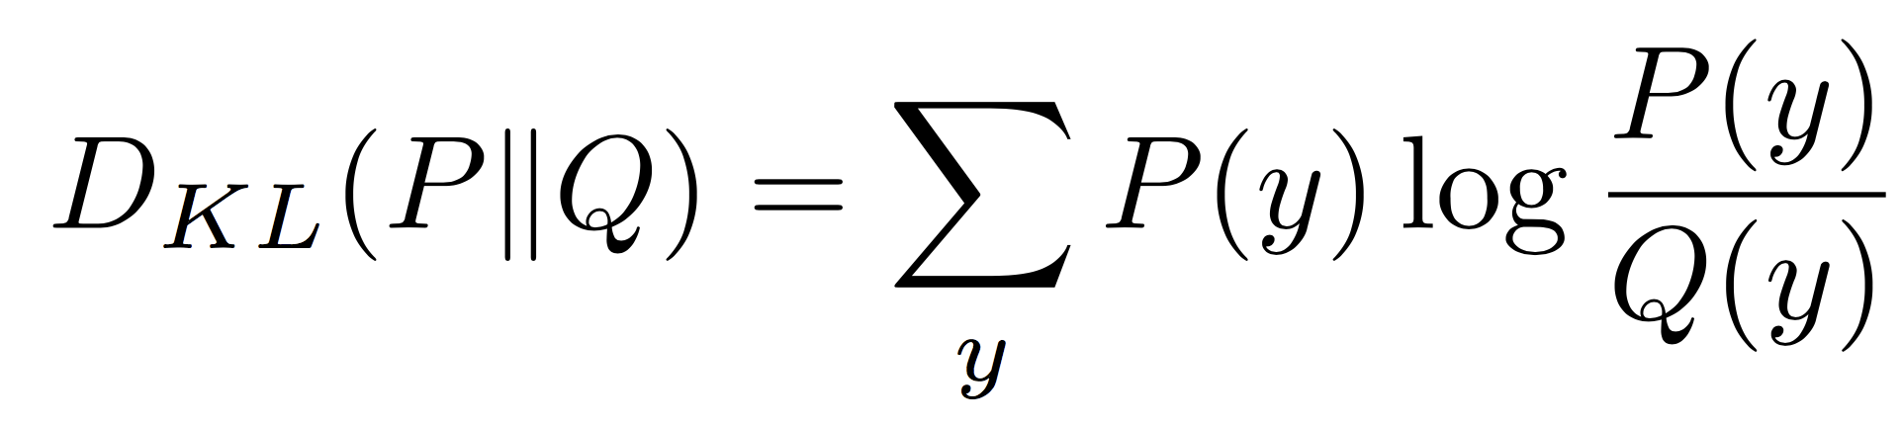
Softmax Classifier (Multinomial Logistic Regression)
Want to interpret raw classifier scores as probabilities
Softmax Function
Probabilities must be >= 0
Probabilities must sum to 1
cat
3.2
24.5
0.13
compare
1.00
exp
normalize
Kullback–Leibler divergence
car
5.1
164.0
0.87
0.00
frog
-1.7
0.18
0.00
0.00
Unnormalized log-probabilities / logits
unnormalized probabilities
probabilities
Correct
probs
Slide Credit: Fei-Fei Li, Justin Johnson, Serena Yeung, CS 231n
Notes:
Mention that this is useful for cases where you might have some target probability distribution instead of just one correct class, due to uncertainty in the model; also mention distillation

Slide 77
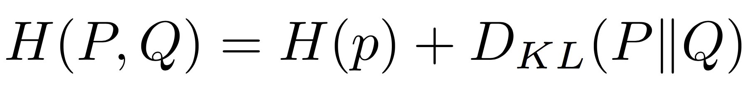
Softmax Classifier (Multinomial Logistic Regression)
Want to interpret raw classifier scores as probabilities
Softmax Function
Probabilities must be >= 0
Probabilities must sum to 1
cat
3.2
24.5
0.13
compare
1.00
exp
normalize
car
5.1
164.0
0.87
Cross Entropy
0.00
frog
-1.7
0.18
0.00
0.00
Unnormalized log-probabilities / logits
unnormalized probabilities
probabilities
Correct
probs
Slide Credit: Fei-Fei Li, Justin Johnson, Serena Yeung, CS 231n
Notes:
Mention that this is useful for cases where you might have some target probability distribution instead of just one correct class, due to uncertainty in the model; also mention distillation

Slide 78
Softmax Classifier (Multinomial Logistic Regression)
Want to interpret raw classifier scores as probabilities
Softmax Function
Maximize probability of correct class
Putting it all together:
cat
3.2
car
5.1
frog
-1.7
Slide Credit: Fei-Fei Li, Justin Johnson, Serena Yeung, CS 231n

Slide 79
Softmax Classifier (Multinomial Logistic Regression)
Want to interpret raw classifier scores as probabilities
Softmax Function
Maximize probability of correct class
Putting it all together:
cat
3.2
car
5.1
Q: What is the min/max possible loss L_i?
frog
-1.7
Slide Credit: Fei-Fei Li, Justin Johnson, Serena Yeung, CS 231n

Slide 80
Softmax Classifier (Multinomial Logistic Regression)
Want to interpret raw classifier scores as probabilities
Softmax Function
Maximize probability of correct class
Putting it all together:
cat
3.2
car
5.1
Q: What is the min/max possible loss L_i?
A: min 0, max infinity
frog
-1.7
Slide Credit: Fei-Fei Li, Justin Johnson, Serena Yeung, CS 231n

Slide 81
Softmax Classifier (Multinomial Logistic Regression)
Want to interpret raw classifier scores as probabilities
Softmax Function
Maximize probability of correct class
Putting it all together:
cat
3.2
car
5.1
Q2: At initialization all s will be approximately equal; what is the loss?
frog
-1.7
Slide Credit: Fei-Fei Li, Justin Johnson, Serena Yeung, CS 231n

Slide 82
Softmax Classifier (Multinomial Logistic Regression)
Want to interpret raw classifier scores as probabilities
Softmax Function
Maximize probability of correct class
Putting it all together:
cat
3.2
car
5.1
Q2: At initialization all s will be approximately equal; what is the loss?
A: log(C), eg log(10) ≈ 2.3
frog
-1.7
Slide Credit: Fei-Fei Li, Justin Johnson, Serena Yeung, CS 231n

Slide 83
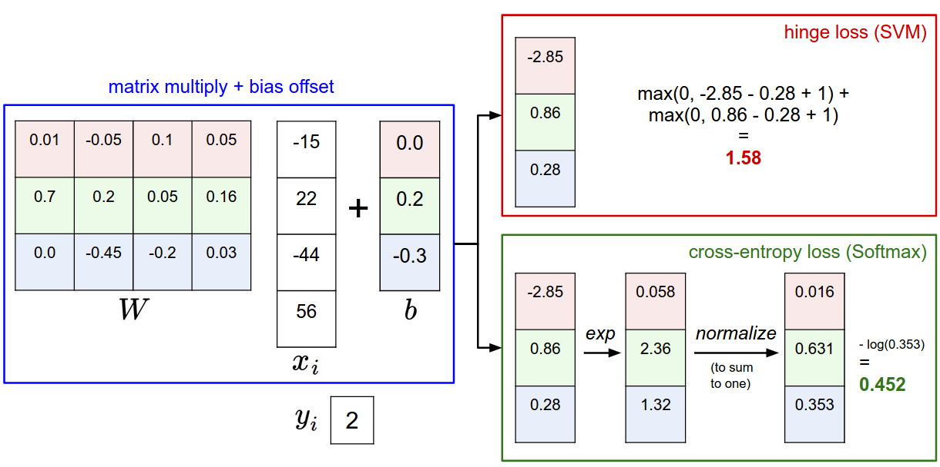
Softmax vs. SVM
Slide Credit: Fei-Fei Li, Justin Johnson, Serena Yeung, CS 231n

Slide 84
Softmax vs. SVM
Slide Credit: Fei-Fei Li, Justin Johnson, Serena Yeung, CS 231n

Slide 85

Softmax vs. SVM
assume scores:
[10, -2, 3]
[10, 9, 9]
[10, -100, -100]
and
Q: Suppose I take a datapoint and I jiggle a bit (changing its score slightly). What happens to the loss in both cases?
Slide Credit: Fei-Fei Li, Justin Johnson, Serena Yeung, CS 231n

Slide 86

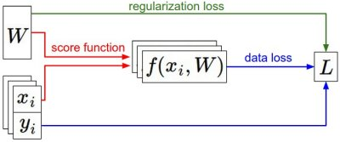

Recap
We have some dataset of (x,y)
We have a score function:
We have a loss function:
e.g.
Softmax
SVM
Full loss
Slide Credit: Fei-Fei Li, Justin Johnson, Serena Yeung, CS 231n

Slide 87
Recap
How do we find the best W?
We have some dataset of (x,y)
We have a score function:
We have a loss function:
e.g.
Softmax
SVM
Full loss
Slide Credit: Fei-Fei Li, Justin Johnson, Serena Yeung, CS 231n

