Slide 1
CS 4803 / 7643: Deep Learning
Topics:
  Variational Auto-Encoders (VAEs)
    Reparameterization trick
Dhruv Batra
Georgia Tech

Slide 2
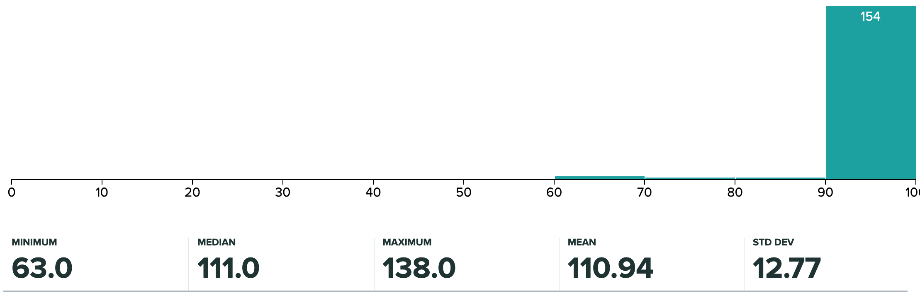
Administrativia
HW4 Grades Released
  Regrade requests close: 12/03, 11:55pm
  Please check solutions first!
Grade histogram: 7643
  Max possible: 100 (regular credit) + 40 (extra credit)

Slide 3
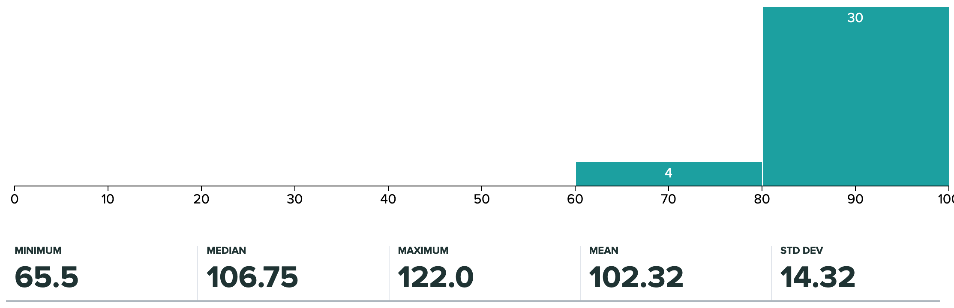
Administrativia
HW4 Grades Released
  Regrade requests close: 12/03, 11:55pm
  Please check solutions first!
Grade histogram: 4803
  Max possible: 100 (regular credit) + 40 (extra credit)

Slide 4
Recap from last time

Slide 5
Variational Autoencoders (VAE)

Slide 6
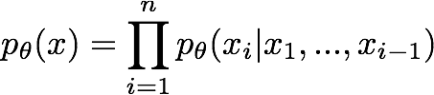

So far...
PixelCNNs define tractable density function, optimize likelihood of training data:
VAEs define intractable density function with latent z:
Slide Credit: Fei-Fei Li, Justin Johnson, Serena Yeung, CS 231n

Slide 7
Variational Auto Encoders
VAEs are a combination of the following ideas:
Auto Encoders
Variational Approximation
  Variational Lower Bound / ELBO
Amortized Inference Neural Networks
“Reparameterization” Trick

Slide 8
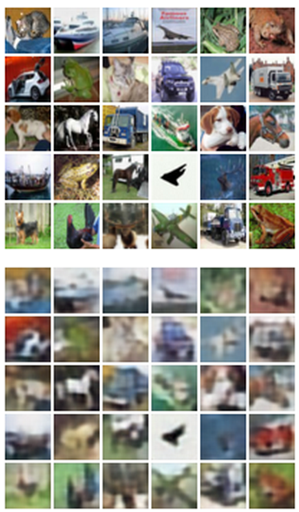

Autoencoders
Reconstructed data
Train such that features can be used to reconstruct original data
Doesn’t use labels!
L2 Loss function:
Reconstructed input data
Encoder: 4-layer conv
Decoder: 4-layer upconv
Decoder
Input data
Features
Encoder
Input data
Slide Credit: Fei-Fei Li, Justin Johnson, Serena Yeung, CS 231n

Slide 9
Autoencoders
Autoencoders can reconstruct data, and can learn features to initialize a supervised model
Features capture factors of variation in training data. Can we generate new images from an autoencoder?
Reconstructed input data
Decoder
Features
Encoder
Input data
Slide Credit: Fei-Fei Li, Justin Johnson, Serena Yeung, CS 231n

Slide 10
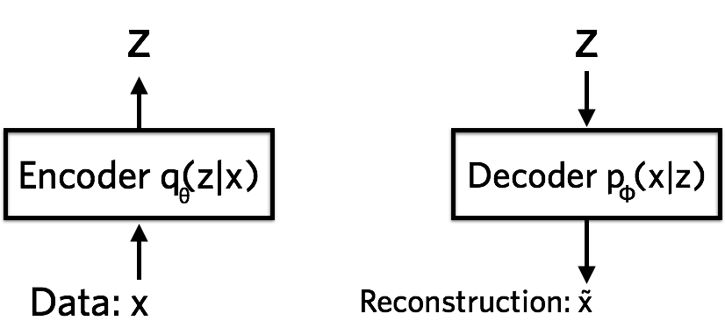


Variational Autoencoders
Probabilistic spin on autoencoders - will let us sample from the model to generate data!
$$qφ\left(z | x\right)$$
$$pθ\left(x | z\right)$$
Image Credit: https://jaan.io/what-is-variational-autoencoder-vae-tutorial/

Slide 11
Variational Auto Encoders
VAEs are a combination of the following ideas:
Auto Encoders
Variational Approximation
  Variational Lower Bound / ELBO
Amortized Inference Neural Networks
“Reparameterization” Trick

Slide 12
Key problem
P(z|x)

Slide 13
What is Variational Inference?
Key idea
  Reality is complex
  Can we approximate it with something “simple”?
  Just make sure simple thing is “close” to the complex thing.

Slide 14
Intuition

Slide 15
The general learning problem with missing data
Marginal likelihood – x is observed, z is missing:

Slide 16
Jensen’s inequality
Use: log ∑_{z} P(z) g(z) ≥ ∑_{z} P(z) log g(z)

Slide 17
Applying Jensen’s inequality
Use: log ∑_{z} P(z) g(z) ≥ ∑_{z} P(z) log g(z)

Slide 18
Evidence Lower Bound
Define potential function F(θ,Q):

Slide 19
ELBO: Factorization #1 (GMMs)

Slide 20
ELBO: Factorization #2 (VAEs)

Slide 21
Variational Auto Encoders
VAEs are a combination of the following ideas:
Auto Encoders
Variational Approximation
  Variational Lower Bound / ELBO
Amortized Inference Neural Networks
“Reparameterization” Trick

Slide 22
Amortized Inference Neural Networks

Slide 23
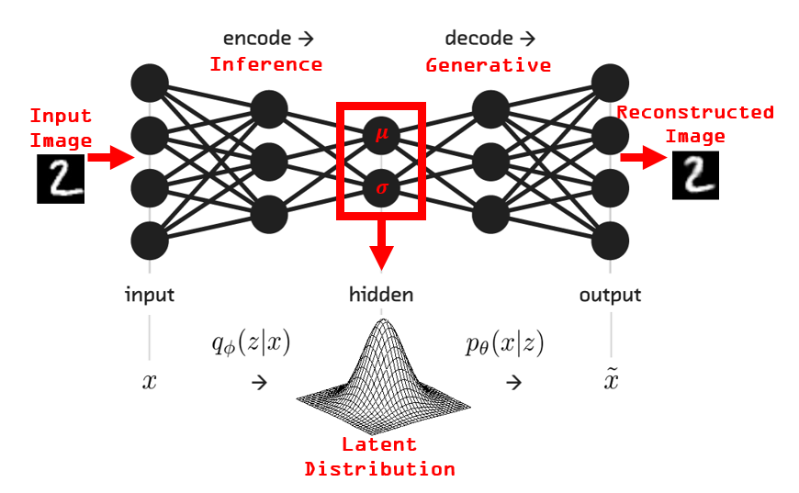
VAEs
Image Credit: https://www.kaggle.com/rvislaywade/visualizing-mnist-using-a-variational-autoencoder

Slide 24
Variational Autoencoders
Probabilistic spin on autoencoders - will let us sample from the model to generate data!
$$qφ\left(z | x\right)$$
$$pθ\left(x | z\right)$$
Image Credit: https://jaan.io/what-is-variational-autoencoder-vae-tutorial/

Slide 25
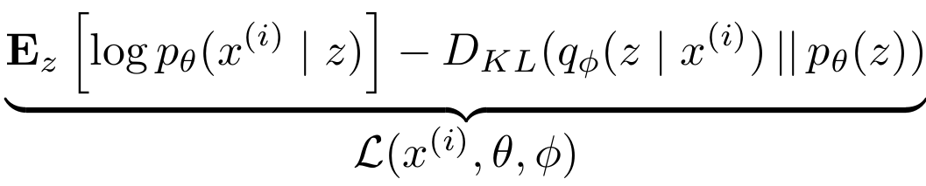



Variational Auto Encoders
Putting it all together: maximizing the likelihood lower bound
Encoder network
Input Data
Slide Credit: Fei-Fei Li, Justin Johnson, Serena Yeung, CS 231n

Slide 26
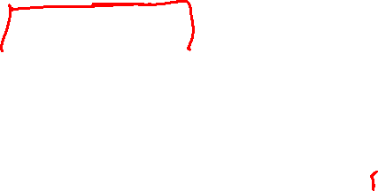
Variational Auto Encoders
Putting it all together: maximizing the likelihood lower bound
Make approximate posterior distribution close to prior
Encoder network
Input Data
Slide Credit: Fei-Fei Li, Justin Johnson, Serena Yeung, CS 231n

Slide 27

Variational Auto Encoders
Putting it all together: maximizing the likelihood lower bound
Sample z from
Make approximate posterior distribution close to prior
Encoder network
Input Data
Slide Credit: Fei-Fei Li, Justin Johnson, Serena Yeung, CS 231n

Slide 28


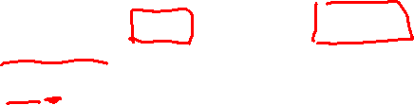
Variational Auto Encoders
Putting it all together: maximizing the likelihood lower bound
Decoder network
Sample z from
Make approximate posterior distribution close to prior
Encoder network
Input Data
Slide Credit: Fei-Fei Li, Justin Johnson, Serena Yeung, CS 231n

Slide 29

Variational Auto Encoders
Putting it all together: maximizing the likelihood lower bound
Maximize likelihood of original input being reconstructed
Sample x|z from
Decoder network
Sample z from
Make approximate posterior distribution close to prior
Encoder network
Input Data
Slide Credit: Fei-Fei Li, Justin Johnson, Serena Yeung, CS 231n

Slide 30
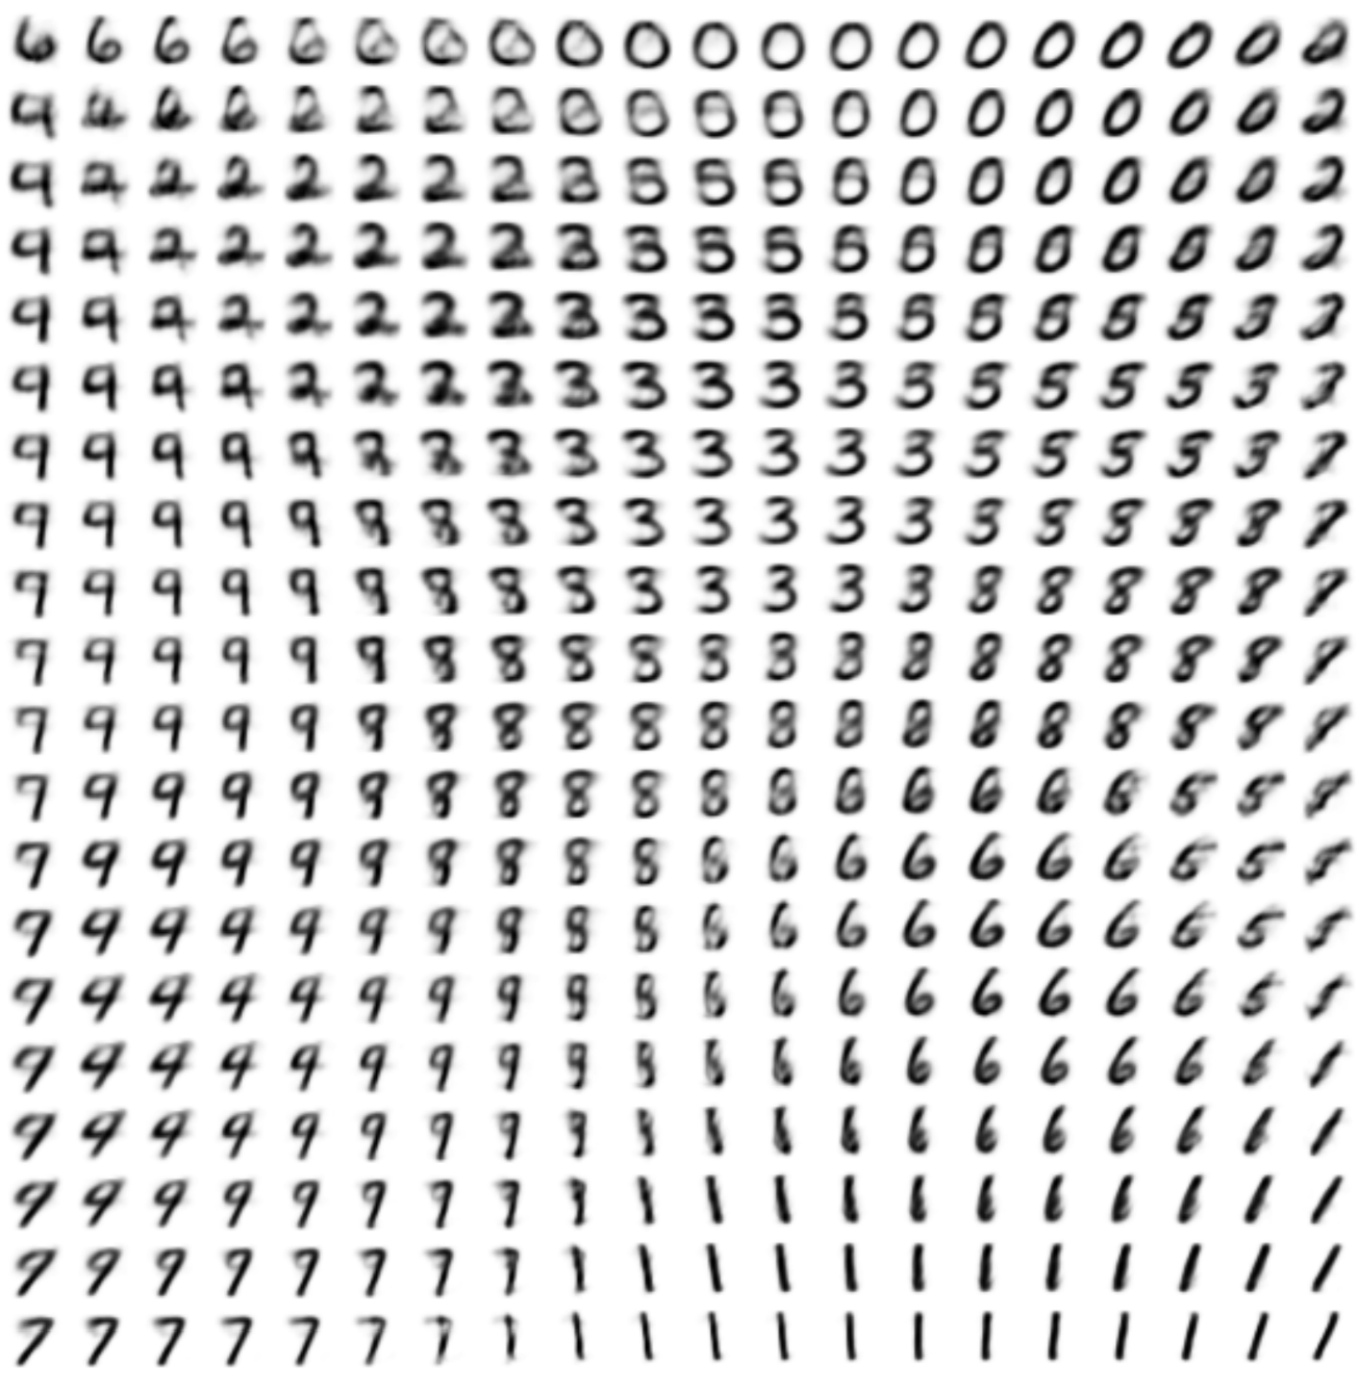

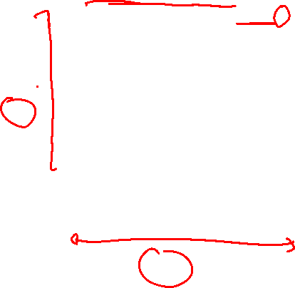
Variational Auto Encoders: Generating Data
Use decoder network. Now sample z from prior!
Data manifold for 2-d z
Sample x|z from
Vary z₁
Decoder network
Sample z from
Kingma and Welling, “Auto-Encoding Variational Bayes”, ICLR 2014
Vary z₂
Slide Credit: Fei-Fei Li, Justin Johnson, Serena Yeung, CS 231n

Slide 31
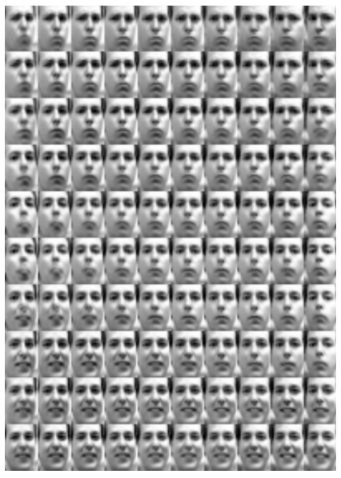
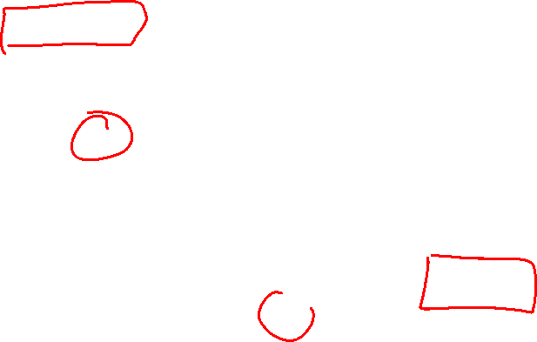
Variational Auto Encoders: Generating Data
Diagonal prior on z => independent latent variables
Different dimensions of z encode interpretable factors of variation
Degree of smile
Vary z₁
Vary z₂
Head pose
Kingma and Welling, “Auto-Encoding Variational Bayes”, ICLR 2014
Slide Credit: Fei-Fei Li, Justin Johnson, Serena Yeung, CS 231n

Slide 32
Plan for Today
VAEs
  Reparameterization trick

Slide 33
Variational Auto Encoders
VAEs are a combination of the following ideas:
Auto Encoders
Variational Approximation
  Variational Lower Bound / ELBO
Amortized Inference Neural Networks
“Reparameterization” Trick

Slide 34
Variational Auto Encoders
Putting it all together: maximizing the likelihood lower bound
Maximize likelihood of original input being reconstructed
Sample x|z from
Decoder network
Sample z from
Make approximate posterior distribution close to prior
Encoder network
Input Data
Slide Credit: Fei-Fei Li, Justin Johnson, Serena Yeung, CS 231n

Slide 35
Variational Auto Encoders
Putting it all together: maximizing the likelihood lower bound
Slide Credit: Fei-Fei Li, Justin Johnson, Serena Yeung, CS 231n

Slide 36
Basic Problem

Slide 37
Basic Problem
Goal

Slide 38
Basic Problem
Goal
Need to compute:

Slide 39
Basic Problem
Need to compute:

Slide 40
Example

Slide 41
Does this happen in supervised learning?
Goal

Slide 42
But what about other kinds of learning?
Goal

Slide 43
Two Options
Score Function based Gradient Estimator
aka REINFORCE (and variants)
Path Derivative Gradient Estimator
aka “reparameterization trick”

Slide 44
Option 1
Score Function based Gradient Estimator
aka REINFORCE (and variants)

Slide 45
Recall: Policy Gradients
Expand expectation
Exchange integration and expectation

Slide 46
Example

Slide 47
Mental Break!
VAE Demo
  https://www.siarez.com/projects/variational-autoencoder

Slide 48
Two Options
Score Function based Gradient Estimator
aka REINFORCE (and variants)
Path Derivative Gradient Estimator
aka “reparameterization trick”

Slide 49
Option 2
Path Derivative Gradient Estimator
aka “reparameterization trick”

Slide 50
Option 2
Path Derivative Gradient Estimator
aka “reparameterization trick”

Slide 51
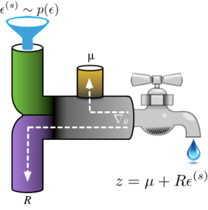
Reparameterization Intuition
Figure Credit: http://blog.shakirm.com/2015/10/machine-learning-trick-of-the-day-4-reparameterisation-tricks/

Slide 52
Reparameterization Intuition
Image Credit: https://www.kaggle.com/rvislaywade/visualizing-mnist-using-a-variational-autoencoder

Slide 53
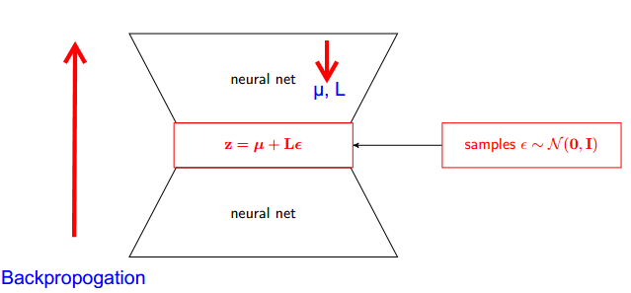
Reparameterization Intuition
Figure Credit: https://stats.stackexchange.com/questions/199605/how-does-the-reparameterization-trick-for-vaes-work-and-why-is-it-important

Slide 54
Example

Slide 55
Two Options
Score Function based Gradient Estimator
aka REINFORCE (and variants)
Path Derivative Gradient Estimator
aka “reparameterization trick”

Slide 56
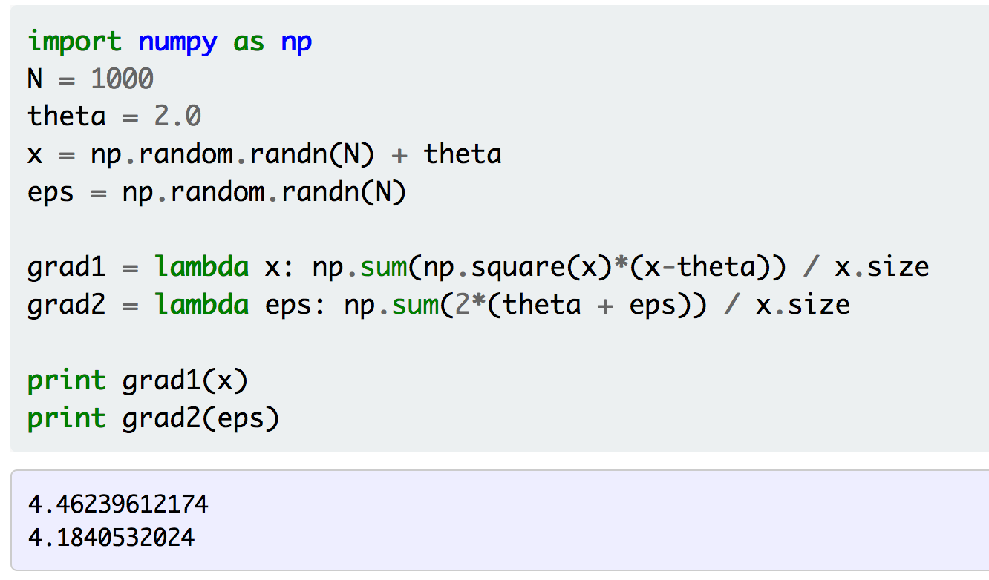
Example
Figure Credit: http://gokererdogan.github.io/2016/07/01/reparameterization-trick/

Slide 57
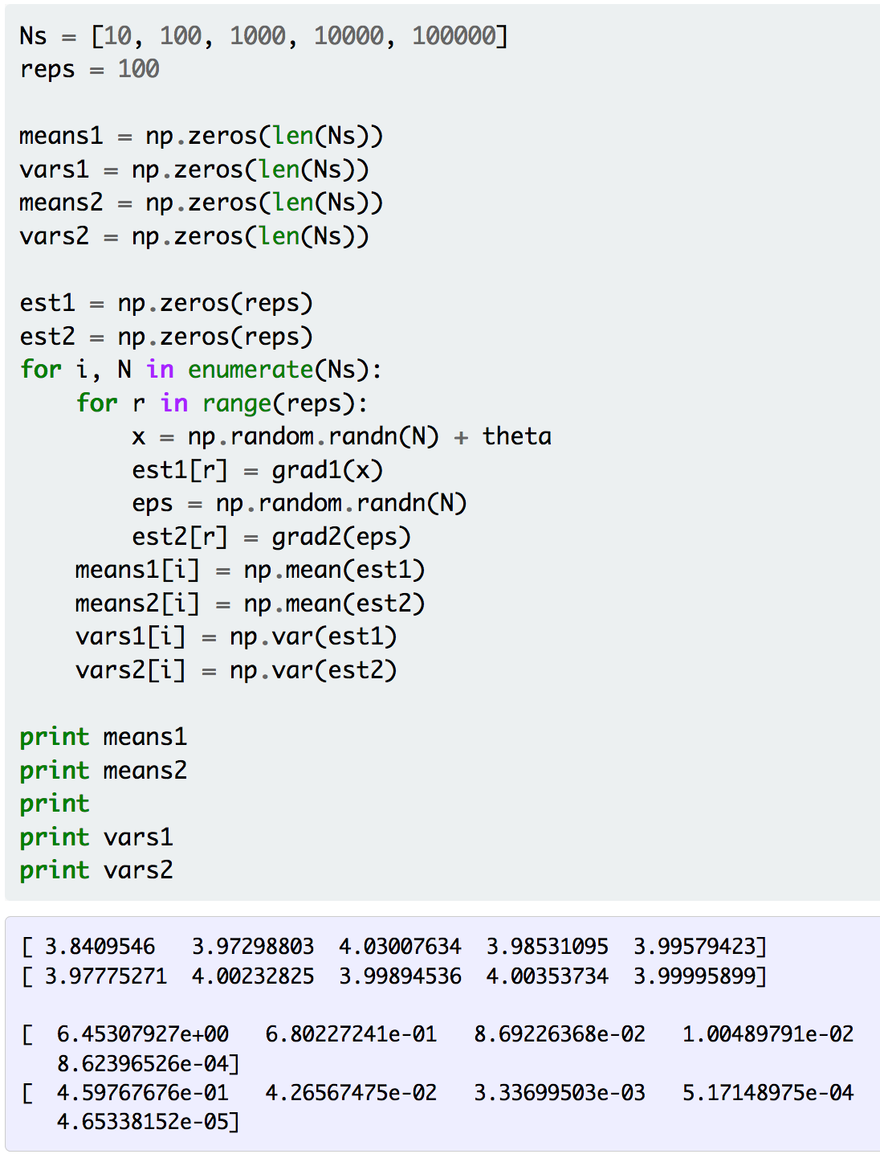
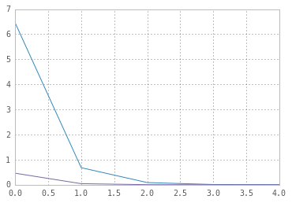
Example
Figure Credit: http://gokererdogan.github.io/2016/07/01/reparameterization-trick/

Slide 58
Aside: Gumbel Softmax
Meet the Gumbel Softmax “trick”

Slide 59
Aside: Gumbel Softmax
Sampling on the Simplex

Slide 60
Variational Auto Encoders
VAEs are a combination of the following ideas:
Auto Encoders
Variational Approximation
  Variational Lower Bound / ELBO
Amortized Inference Neural Networks
“Reparameterization” Trick

Slide 61
Variational Auto Encoders
Putting it all together: maximizing the likelihood lower bound
Encoder network
Input Data
Slide Credit: Fei-Fei Li, Justin Johnson, Serena Yeung, CS 231n

Slide 62
Variational Auto Encoders
Putting it all together: maximizing the likelihood lower bound
Make approximate posterior distribution close to prior
Encoder network
Input Data
Slide Credit: Fei-Fei Li, Justin Johnson, Serena Yeung, CS 231n

Slide 63
Variational Auto Encoders
Putting it all together: maximizing the likelihood lower bound
Sample z from
Make approximate posterior distribution close to prior
Encoder network
Input Data
Slide Credit: Fei-Fei Li, Justin Johnson, Serena Yeung, CS 231n

Slide 64
Variational Auto Encoders
Putting it all together: maximizing the likelihood lower bound
Decoder network
Sample z from
Make approximate posterior distribution close to prior
Encoder network
Input Data
Slide Credit: Fei-Fei Li, Justin Johnson, Serena Yeung, CS 231n

