Slide 1
CS 4803 / 7643: Deep Learning
Topics:
  Policy Gradients
  Actor Critic
Ashwin Kalyan
Georgia Tech

Slide 2
Topics we’ll cover
Overview of RL
  RL vs other forms of learning
  RL “API”
  Applications
Framework: Markov Decision Processes (MDP’s)
  Definitions and notations
  Policies and Value Functions
  Solving MDP’s
    Value Iteration (recap)
    Q-Value Iteration (new)
    Policy Iteration
Reinforcement learning
  Value-based RL (Q-learning, Deep-Q Learning)
  Policy-based RL (Policy gradients)
  Actor-Critic

Slide 3
Recap: MDPs
Markov Decision Processes (MDP):
  States:
  Actions:
  Rewards:
  Transition Function:
  Discount Factor:

Slide 4
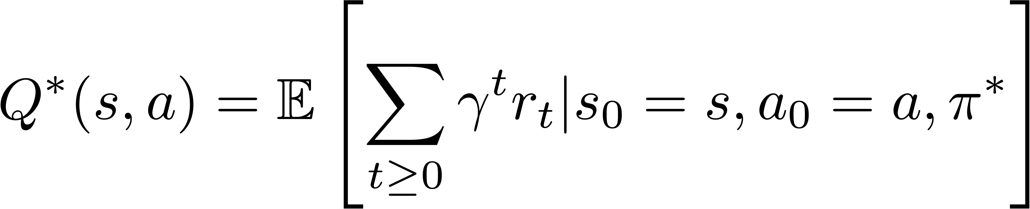
Recap: Optimal Value Function
The optimal Q-value function at state s and action a, is the expected cumulative reward from taking action a in state s and acting optimally thereafter

Slide 5
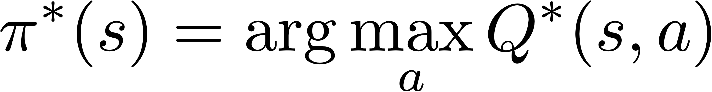
Recap: Optimal Value Function
The optimal Q-value function at state s and action a, is the expected cumulative reward from taking action a in state s and acting optimally thereafter
Optimal policy:

Slide 6
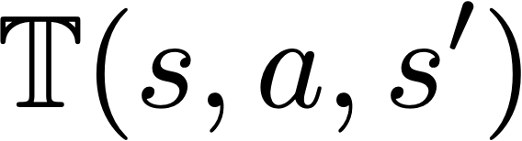
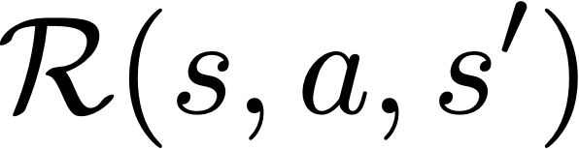
Recap: Learning Based Methods
Typically, we don’t know the environment
  unknown, how actions affect the environment.
  unknown, what/when are the good actions?

Slide 7
Recap: Learning Based Methods
Typically, we don’t know the environment
  unknown, how actions affect the environment.
  unknown, what/when are the good actions?
But, we can learn by trial and error.
  Gather experience (data) by performing actions.
  Approximate unknown quantities from data.

Slide 8
Recap: Deep Q-Learning
Collect a dataset
Loss for a single data point:
Act according optimally according to the learnt Q function:
Predicted Q-Value
Target Q-Value
Pick action with best Q value

Slide 9
Getting to the optimal policy
Use value / policy iteration
known
Transition function
and reward function
Obtain “optimal” policy

Slide 10
Getting to the optimal policy
Use value / policy iteration
known
Transition function
and reward function
Obtain “optimal” policy
unknown
Previous class:
Q - learning
Estimate Q values
From data

Slide 11
Getting to the optimal policy
Use value / policy iteration
known
Transition function
and reward function
Obtain “optimal” policy
Estimate and from data
unknown
Estimate Q values
From data
Homework!

Slide 12
Getting to the optimal policy
Use value / policy iteration
known
unknown
Transition function
and reward function
Obtain “optimal” policy
Estimate and from data
unknown
Estimate Q values
From data
This class!

Slide 13
Learning the optimal policy
Class of policies defined by parameters
  Eg: can be parameters of linear transformation, deep network, etc.

Slide 14
Learning the optimal policy
Class of policies defined by parameters
  Eg: can be parameters of linear transformation, deep network, etc.
Want to maximize:
In other words,

Slide 15
Learning the optimal policy
Class of policies defined by parameters
  Eg: can be parameters of linear transformation, deep network, etc.
Want to maximize:
In other words,

Slide 16
Learning the optimal policy
Slightly rewriting the notation:
  Let , the trajectory

Slide 17
Learning the optimal policy
Sample a few trajectories by acting according to

Slide 18
REINFORCE
Sample trajectories by acting according to
Compute policy gradient as
Update policy
Run the policy and sample trajectories
Compute policy gradient
Update policy
Slide credit: Sergey Levine

Slide 19
Policy Gradients
Expand expectation

Slide 20
Policy Gradients
Expand expectation
Exchange integration and expectation

Slide 21
Policy Gradients
Expand expectation
Exchange integration and expectation

Slide 22
Policy Gradients
Expand expectation
Exchange integration and expectation

Slide 23
Policy Gradients
Expand expectation
Exchange integration and expectation

Slide 24
Policy Gradients
Expand expectation
Exchange integration and expectation

Slide 25
Policy Gradients

Slide 26
Policy Gradients
Doesn’t depend on
Transition probabilities!

Slide 27
Policy Gradients

Slide 28
Policy Gradients

Slide 29
REINFORCE
Sample trajectories by acting according to
Compute policy gradient as
Update policy
Run the policy and sample trajectories
Compute policy gradient
Update policy
Slide credit: Sergey Levine

Slide 30
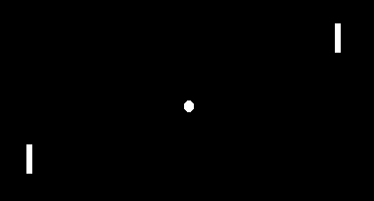
Pong from pixels
Image Credit: http://karpathy.github.io/2016/05/31/rl/

Slide 31
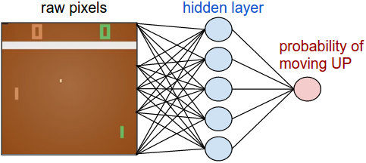
Pong from pixels
Image Credit: http://karpathy.github.io/2016/05/31/rl/

Slide 32
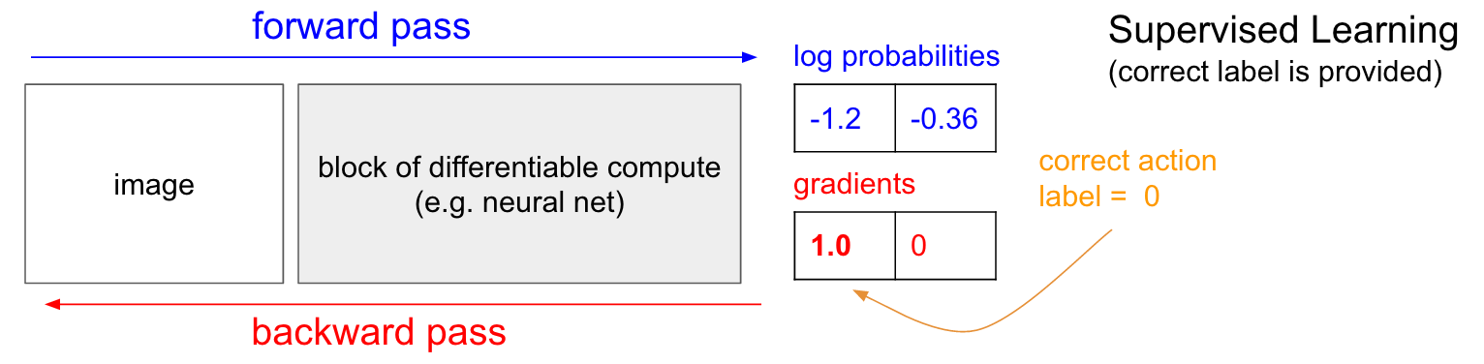
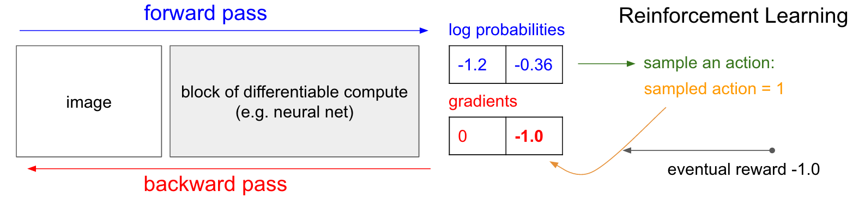
Pong from pixels
Image Credit: http://karpathy.github.io/2016/05/31/rl/

Slide 33
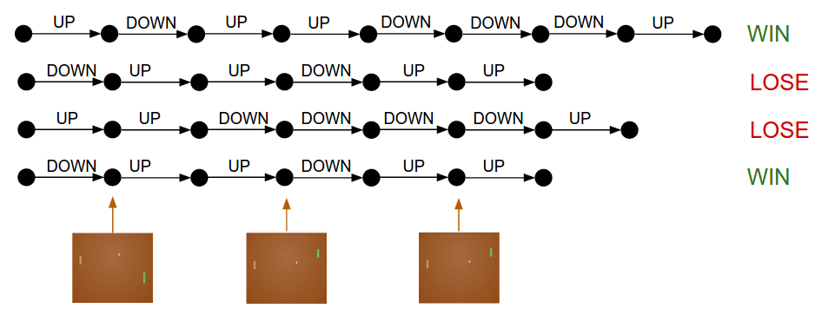
Intuition

Slide 34
Policy Gradients
Formalizes notion of “trial and error”:
If reward is high, probability of actions seen is increased
If reward is low, probability of actions seen is reduced

Slide 35
Issues with Policy Gradients
Credit assignment is hard!
  Which specific action led to increase in reward
  Suffers from high variance → leading to unstable training

Slide 36
Issues with Policy Gradients
Credit assignment is hard!
  Which specific action led to increase in reward
  Suffers from high variance → leading to unstable training
How to reduce the variance?
  Subtract a constant from the reward!

Slide 37
Issues with Policy Gradients
Credit assignment is hard!
  Which specific action led to increase in reward
  Suffers from high variance → leading to unstable training
How to reduce the variance?
  Subtract a constant from the reward!
  Why does it work?
  What is the best choice of b?
Homework!

Slide 38
Taking a step back
Policy Evaluation
(Recall Policy iteration)
REINFORCE: Evaluate and update policy based on Monte-Carlo estimates of the total reward – very noisy!
Other ways of policy evaluation?
  If we had the Q function, we could have used it!

Slide 39
Actor-Critic
Learn both policy and Q function
  Use the “actor” to sample trajectories
  Use the Q function to “evaluate” or “critic” the policy

Slide 40
Actor-Critic
Learn both policy and Q function
  Use the “actor” to sample trajectories
  Use the Q function to “evaluate” or “critic” the policy
REINFORCE:
Actor-critic:

Slide 41
Actor-Critic
Learn both policy and Q function
  Use the “actor” to sample trajectories
  Use the Q function to “evaluate” or “critic” the policy
REINFORCE:
Actor-critic:
Q function is unknown too! Update using

Slide 42
Actor-Critic
Initialize s, (policy network) and (Q network)

Slide 43
Actor-Critic
Initialize s, (policy network) and (Q network)
sample action

Slide 44
Actor-Critic
Initialize s, (policy network) and (Q network)
sample action
For each step:
  Sample reward and next state

Slide 45
Actor-Critic
Initialize s, (policy network) and (Q network)
sample action
For each step:
  Sample reward and next state
  evaluate “actor” using “critic”

Slide 46
Actor-Critic
Initialize s, (policy network) and (Q network)
sample action
For each step:
  Sample reward and next state
  evaluate “actor” using “critic” and update policy:

Slide 47
Actor-Critic
Initialize s, (policy network) and (Q network)
sample action
For each step:
  Sample reward and next state
  evaluate “actor” using “critic” and update policy:
  Update “critic”:
    Recall Q-learning

Slide 48
Actor-Critic
Initialize s, (policy network) and (Q network)
sample action
For each step:
  Sample reward and next state
  evaluate “actor” using “critic” and update policy:
  Update “critic”:
    Recall Q-learning
    Update Accordingly

Slide 49
Actor-critic
In general, replacing the policy evaluation or the “critic” leads to different flavors of the actor-critic
  REINFORCE:
  Q – Actor Critic

Slide 50
Actor-critic
In general, replacing the policy evaluation or the “critic” leads to different flavors of the actor-critic
  REINFORCE:
  Q – Actor Critic
  Advantage Actor Critic:
“how much better is an action than expected?

Slide 51
Summary
Policy Learning:
  Policy gradients
  REINFORCE
  Reducing Variance (Homework!)
Actor-Critic:
  Other ways of performing “policy evaluation”
  Variants of Actor-critic

