Slide 1
CS 4803 / 7643: Deep Learning
Topics:
  Dynamic Programming (Q-Value Iteration)
  Reinforcement Learning (Intro, Q-Learning, DQNs)
Nirbhay Modhe
Georgia Tech

Slide 2
Topics we’ll cover
Overview of RL
  RL vs other forms of learning
  RL “API”
  Applications
Framework: Markov Decision Processes (MDP’s)
  Definitions and notations
  Policies and Value Functions
  Solving MDP’s
    Value Iteration (recap)
    Q-Value Iteration (new)
    Policy Iteration
Reinforcement learning
  Value-based RL (Q-learning, Deep-Q Learning)
  Policy-based RL (Policy gradients)

Slide 3
Topics we’ll cover
Overview of RL
  RL vs other forms of learning
  RL “API”
  Applications
Framework: Markov Decision Processes (MDP’s)
  Definitions and notations
  Policies and Value Functions
  Solving MDP’s
    Value Iteration (recap)
    Q-Value Iteration (new)
    Policy Iteration
Reinforcement learning
  Value-based RL (Q-learning, Deep-Q Learning)
  Policy-based RL (Policy gradients)

Slide 4
Recap

Slide 5

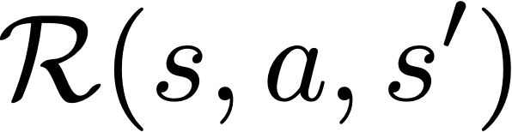
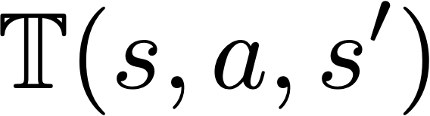
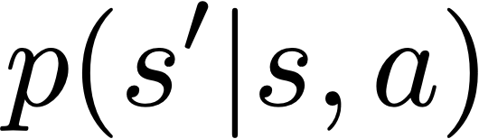

Recap
Markov Decision Process (MDP)
  Defined by
: set of possible states [start state = s_{0,} optional terminal / absorbing state]
: set of possible actions
: distribution of reward given (state, action, next state) tuple
: transition probability distribution, also written as
: discount factor

Slide 6
Recap
Markov Decision Process (MDP)
  Defined by
: set of possible states [start state = s_{0,} optional terminal / absorbing state]
: set of possible actions
: distribution of reward given (state, action, next state) tuple
: transition probability distribution, also written as
: discount factor
Value functions, optimal quantities, bellman equation
Algorithms for solving MDP’s
  Value Iteration

Slide 7

Value Function
Following policy that produces sample trajectories s₀, a₀, r₀, s₁, a₁, …
Slide Credit: Fei-Fei Li, Justin Johnson, Serena Yeung, CS 231n

Slide 8
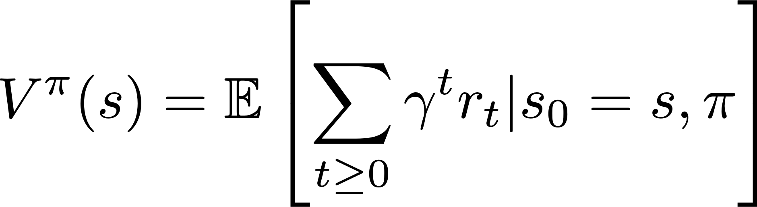
Value Function
Following policy that produces sample trajectories s₀, a₀, r₀, s₁, a₁, …
How good is a state?
The value function at state s, is the expected cumulative reward from state s (and following the policy thereafter):
Slide Credit: Fei-Fei Li, Justin Johnson, Serena Yeung, CS 231n

Slide 9
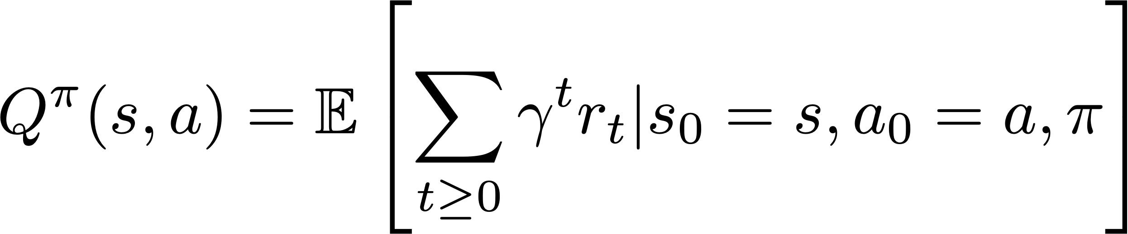
Value Function
Following policy that produces sample trajectories s₀, a₀, r₀, s₁, a₁, …
How good is a state?
The value function at state s, is the expected cumulative reward from state s (and following the policy thereafter):
How good is a state-action pair?
The Q-value function at state s and action a, is the expected cumulative reward from taking action a in state s (and following the policy thereafter):
Slide Credit: Fei-Fei Li, Justin Johnson, Serena Yeung, CS 231n

Slide 10
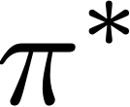
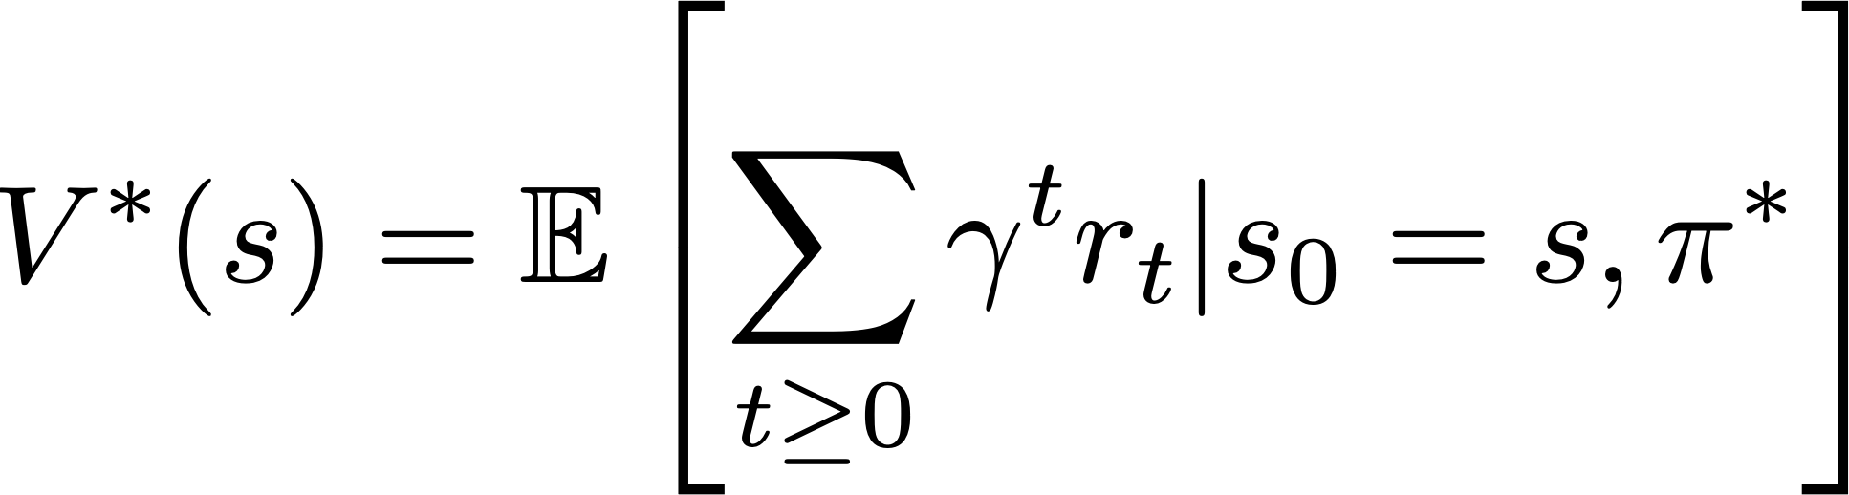
Optimal Quantities
Given optimal policy that produces sample trajectories s₀, a₀, r₀, s₁, a₁, …
How good is a state?
The optimal value function at state s, and acting optimally thereafter
Slide Credit: Fei-Fei Li, Justin Johnson, Serena Yeung, CS 231n

Slide 11
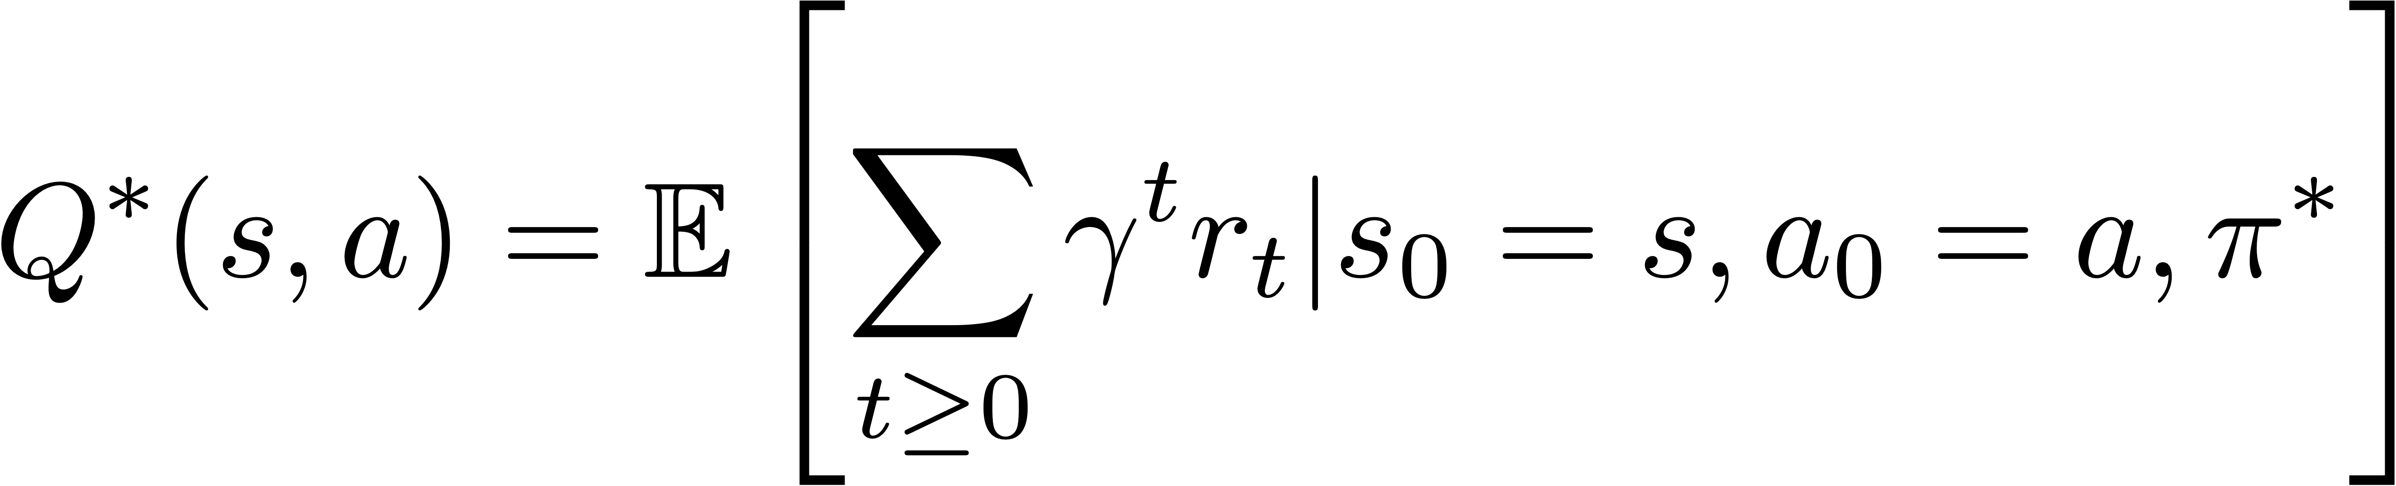
Optimal Quantities
Given optimal policy that produces sample trajectories s₀, a₀, r₀, s₁, a₁, …
How good is a state?
The optimal value function at state s, and acting optimally thereafter
How good is a state-action pair?
The optimal Q-value function at state s and action a, is the expected cumulative reward from taking action a in state s and acting optimally thereafter
Slide Credit: Fei-Fei Li, Justin Johnson, Serena Yeung, CS 231n

Slide 12
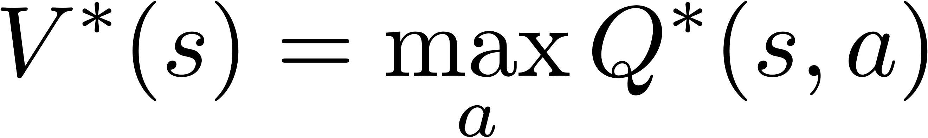
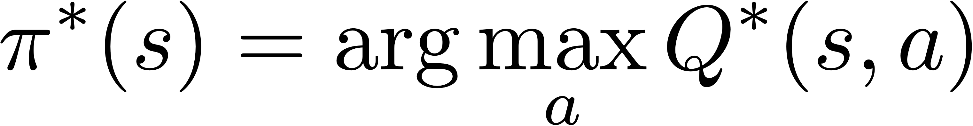
Bellman Optimality Equations
Relations:

Slide 13
Bellman Optimality Equations
Relations:
Recursive optimality equations:

Slide 14
Bellman Optimality Equations
Relations:
Recursive optimality equations:

Slide 15
Bellman Optimality Equations
Relations:
Recursive optimality equations:

Slide 16
Bellman Optimality Equations
Relations:
Recursive optimality equations:

Slide 17
Bellman Optimality Equations
Relations:
Recursive optimality equations:

Slide 18
Value Iteration (VI)
Based on the bellman optimality equation

Slide 19
Value Iteration (VI)
Based on the bellman optimality equation
Algorithm
  Initialize values of all states
  While not converged:
    For each state:
  Repeat until convergence (no change in values)
Homework
Time complexity per iteration

Slide 20
Q-Value Iteration
Value Iteration Update:
Q-Value Iteration Update:
The algorithm is same as value iteration, but it loops over actions as well as states

Slide 21
Q-Value Iteration
Value Iteration Update:
Q-Value Iteration Update:
The algorithm is same as value iteration, but it loops over actions as well as states

Slide 22
Policy Iteration

Slide 23
Policy Iteration
Policy iteration: Start with arbitrary and refine it.

Slide 24
Policy Iteration
Policy iteration: Start with arbitrary and refine it.
Involves repeating two steps:
  Policy Evaluation: Compute (similar to VI)
  Policy Refinement: Greedily change actions as per

Slide 25
Policy Iteration
Policy iteration: Start with arbitrary and refine it.
Involves repeating two steps:
  Policy Evaluation: Compute (similar to VI)
  Policy Refinement: Greedily change actions as per
Why do policy iteration?
  often converges to much sooner than

Slide 26
Summary
Value Iteration
  Bellman update to state value estimates
Q-Value Iteration
  Bellman update to (state, action) value estimates
Policy Iteration
  Policy evaluation + refinement

Slide 27
Learning Based Methods

Slide 28
Learning Based Methods
Typically, we don’t know the environment
  unknown, how actions affect the environment.
  unknown, what/when are the good actions?

Slide 29
Learning Based Methods
Typically, we don’t know the environment
  unknown, how actions affect the environment.
  unknown, what/when are the good actions?
But, we can learn by trial and error.
  Gather experience (data) by performing actions.
  Approximate unknown quantities from data.
Reinforcement Learning

Slide 30
Learning Based Methods
Old Dynamic Programming Demo
  https://cs.stanford.edu/people/karpathy/reinforcejs/gridworld_dp.html
RL Demo
  https://cs.stanford.edu/people/karpathy/reinforcejs/gridworld_td.html
Reinforcement Learning

Slide 31
(Deep) Learning Based Methods

Slide 32
(Deep) Learning Based Methods
In addition to not knowing the environment, sometimes the state space is too large.

Slide 33
(Deep) Learning Based Methods
In addition to not knowing the environment, sometimes the state space is too large.
A value iteration updates takes
  Not scalable to high dimensional states e.g.: RGB images.

Slide 34
(Deep) Learning Based Methods
In addition to not knowing the environment, sometimes the state space is too large.
A value iteration updates takes
  Not scalable to high dimensional states e.g.: RGB images.
Solution: Deep Learning!
  Use deep neural networks to learn low-dimensional representations.
Deep Reinforcement Learning

Slide 35
Reinforcement Learning

Slide 36
Reinforcement Learning
Value-based RL
  (Deep) Q-Learning, approximating with a deep Q-network

Slide 37
Reinforcement Learning
Value-based RL
  (Deep) Q-Learning, approximating with a deep Q-network
Policy-based RL
  Directly approximate optimal policy with a parametrized policy

Slide 38
Reinforcement Learning
Value-based RL
  (Deep) Q-Learning, approximating with a deep Q-network
Policy-based RL
  Directly approximate optimal policy with a parametrized policy
Model-based RL
  Approximate transition function and reward function
  Plan by looking ahead in the (approx.) future!

Slide 39
Reinforcement Learning
Value-based RL
  (Deep) Q-Learning, approximating with a deep Q-network
Policy-based RL
  Directly approximate optimal policy with a parametrized policy
Model-based RL
  Approximate transition function and reward function
  Plan by looking ahead in the (approx.) future!
Homework!

Slide 40
Value-based Reinforcement Learning
Deep Q-Learning

Slide 41
Deep Q-Learning
Q-Learning with linear function approximators
  Has some theoretical guarantees

Slide 42
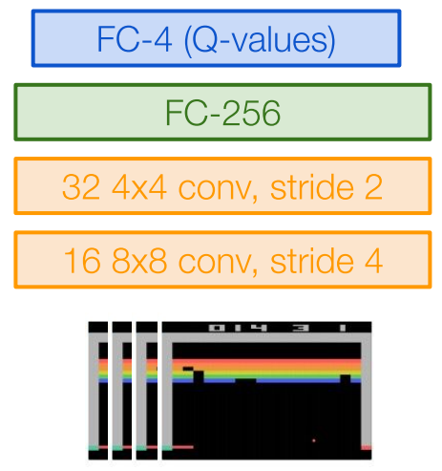
Deep Q-Learning
Q-Learning with linear function approximators
  Has some theoretical guarantees
Deep Q-Learning: Fit a deep Q-Network
  Works well in practice
  Q-Network can take RGB images
Image Credits: Fei-Fei Li, Justin Johnson,
Serena Yeung, CS 231n

Slide 43
Deep Q-Learning

Slide 44
Deep Q-Learning
Assume we have collected a dataset
We want a Q-function that satisfies:
Loss for a single data point:
Q-Value Bellman Optimality
Predicted Q-Value
Target Q-Value

Slide 45
Deep Q-Learning
Minibatch of
Forward pass:
State
Q-Network
Q-Values per action

Slide 46
Deep Q-Learning
Minibatch of
Forward pass:
State
Q-Network
Q-Values per action
Q-Network
State

Slide 47
Deep Q-Learning
Minibatch of
Forward pass:
Compute loss:
State
Q-Network
Q-Values per action

Slide 48
Deep Q-Learning
Minibatch of
Forward pass:
Compute loss:
Backward pass:
State
Q-Network
Q-Values per action

Slide 49
Deep Q-Learning
In practice, for stability:
  Freeze and update parameters
  Set at regular intervals

Slide 50
How to gather experience?
This is why RL is hard

Slide 51
How To Gather Experience?
Environment
Data
Train
Update
Notes:
Recalling the RL Demo we saw earlier, the algorithm there was using a strategy to address these challenges, and we will see next some of these techniques.

Slide 52
How To Gather Experience?
Environment
Data
Train
Update
Challenge 1: Exploration vs Exploitation
Challenge 2: Non iid, highly correlated data
Notes:
Recalling the RL Demo we saw earlier, the algorithm there was using a strategy to address these challenges, and we will see next some of these techniques.

Slide 53
Exploration Problem
What should be?
  Greedy? -> Local minimas, no exploration

Slide 54
Exploration Problem
What should be?
  Greedy? -> Local minimas, no exploration
An exploration strategy:

Slide 55
Correlated Data Problem
Samples are correlated => high variance gradients => inefficient learning
Current Q-network parameters determines next training samples => can lead to bad feedback loops
  e.g. if maximizing action is to move left, training samples will be dominated by samples from left-hand size.
Slide Credit: Fei-Fei Li, Justin Johnson, Serena Yeung, CS 231n

Slide 56
Experience Replay
Address this problem using experience replay
  A replay buffer stores transitions
Slide Credit: Fei-Fei Li, Justin Johnson, Serena Yeung, CS 231n

Slide 57
Experience Replay
Address this problem using experience replay
  A replay buffer stores transitions
  Continually update replay buffer as game (experience) episodes are played, older samples discarded
Slide Credit: Fei-Fei Li, Justin Johnson, Serena Yeung, CS 231n

Slide 58
Experience Replay
Address this problem using experience replay
  A replay buffer stores transitions
  Continually update replay buffer as game (experience) episodes are played, older samples discarded
  Train Q-network on random minibatches of transitions from the replay memory, instead of consecutive samples
Slide Credit: Fei-Fei Li, Justin Johnson, Serena Yeung, CS 231n

Slide 59
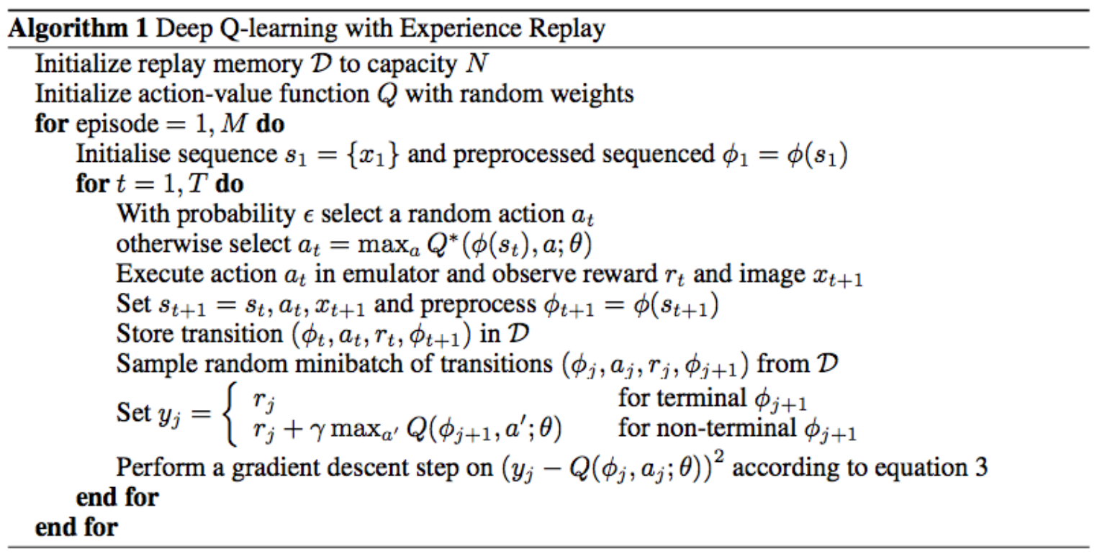
Q-Learning Algorithm
Experience Replay
Epsilon-greedy
Q Update
Slide Credit: Fei-Fei Li, Justin Johnson, Serena Yeung, CS 231n

Slide 60
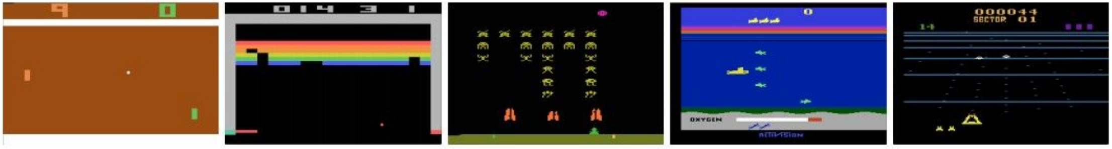
Case study: Playing Atari Games
Objective: Complete the game with the highest score
State: Raw pixel inputs from the game state
Action: Game controls e.g.: Left, Right, Up, Down
Reward: Score increase/decrease at each time step
Slide Credit: Fei-Fei Li, Justin Johnson, Serena Yeung, CS 231n

Slide 61
Playing Atari Games
Q-Network architecture
State:
  Stack of 4 image frames, grayscale conversion, down-sampling and cropping to (84 x 84 x 4)
Last FC layer has #(actions) dimensions (predicts Q-values)
Slide Credit: Fei-Fei Li, Justin Johnson, Serena Yeung, CS 231n

Slide 62
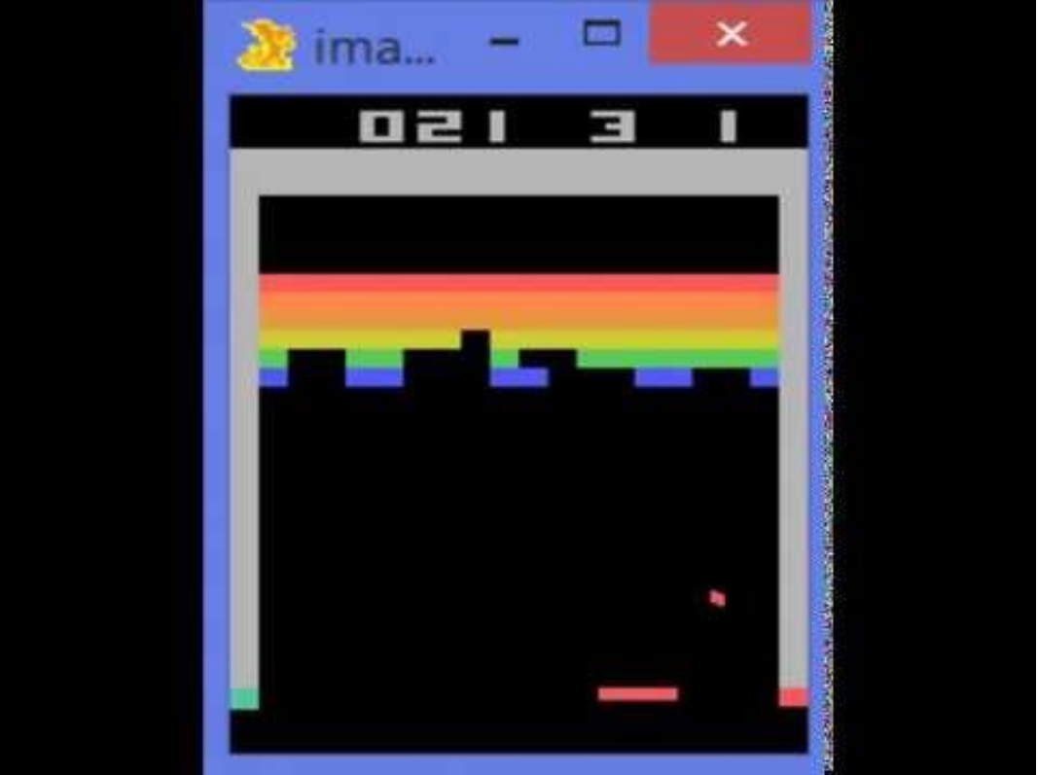
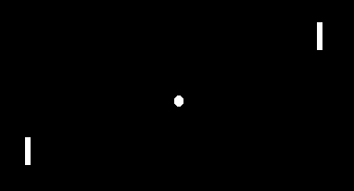
Atari Games
Breakout
Pong
https://www.youtube.com/watch?v=V1eYniJ0Rnk
Slide Credit: Fei-Fei Li, Justin Johnson, Serena Yeung, CS 231n

Slide 63
Summary
In today’s class, we looked at
Dynamic Programming
  Q-Value Iteration
  Policy Iteration
Reinforcement Learning (RL)
  The challenges of (deep) learning based methods
  Value-based RL algorithms
    Deep Q-Learning
Next class:
  Policy-based RL algorithms

Slide 64
Thanks!

