Slide 1
CS 4803 / 7643: Deep Learning
Topic:
  Reinforcement Learning (RL)
    Overview
    Markov Decision Processes
Viraj Prabhu
Georgia Tech

Slide 2
Topics we’ll cover
Overview of RL
  RL vs other forms of learning
  RL “API”
  Applications
Framework: Markov Decision Processes (MDP’s)
  Definitions and notations
  Policies and Value Functions
  Solving MDP’s
    Value Iteration
    Policy Iteration
Reinforcement learning
  Value-based RL (Q-learning, Deep-Q Learning)
  Policy-based RL (Policy gradients)
Slide Credit: Fei-Fei Li, Justin Johnson, Serena Yeung, CS 231n

Slide 3
Topics we’ll cover
Overview of RL
  RL vs other forms of learning
  RL “API”
  Applications
Framework: Markov Decision Processes (MDP’s)
  Definitions and notations
  Policies and Value Functions
  Solving MDP’s
    Value Iteration
    Policy Iteration
Reinforcement learning
  Value-based RL (Q-learning, Deep-Q Learning)
  Policy-based RL (Policy gradients)
  This lecture:
  – Focus on MDP’s
  – No learning (deep or otherwise)
Slide Credit: Fei-Fei Li, Justin Johnson, Serena Yeung, CS 231n

Slide 4
Topics we’ll cover
Overview of RL
  RL vs other forms of learning
  RL “API”
  Applications
Framework: Markov Decision Processes (MDP’s)
  Definitions and notations
  Policies and Value Functions
  Solving MDP’s
    Value Iteration
    Policy Iteration
Reinforcement learning
  Value-based RL (Q-learning, Deep-Q Learning)
  Policy-based RL (Policy gradients)
  This lecture:
  – Focus on MDP’s
  – No learning (deep or otherwise)
Slide Credit: Fei-Fei Li, Justin Johnson, Serena Yeung, CS 231n

Slide 5
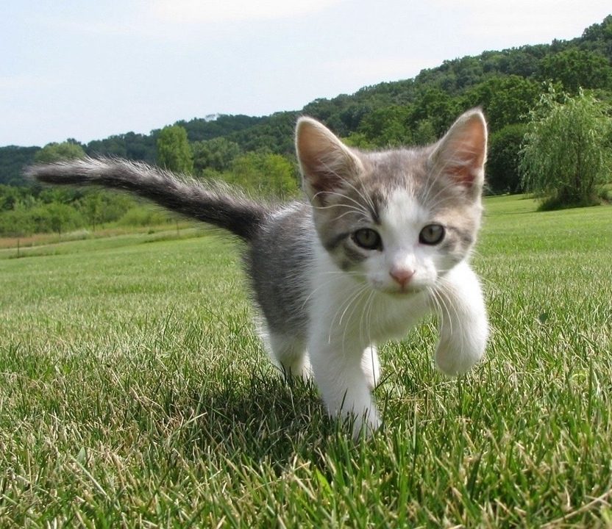
Supervised Learning
Data: (x, y)
x is data, y is label
Goal: Learn a function to map x -> y
Examples: Classification, regression, object detection, semantic segmentation, image captioning, etc.
Cat
Classification
This image is CC0 public domain
Slide Credit: Fei-Fei Li, Justin Johnson, Serena Yeung, CS 231n

Slide 6
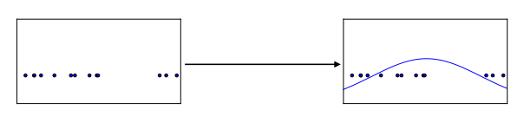
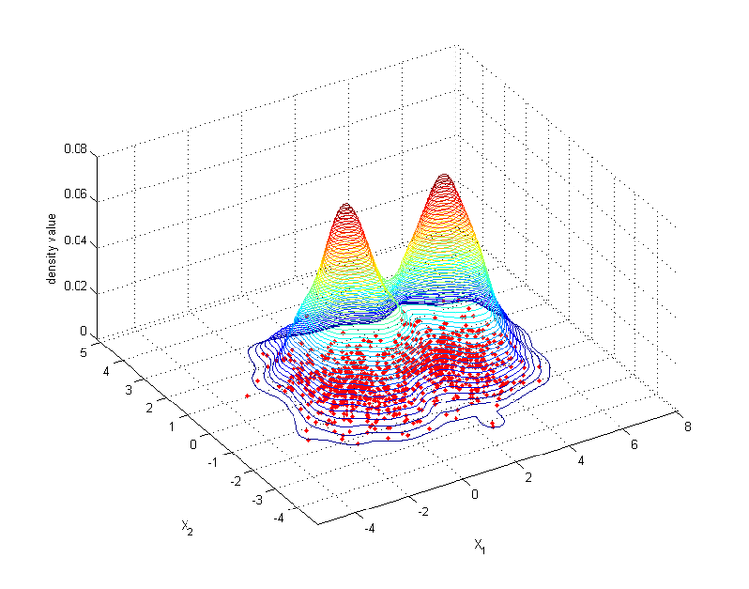
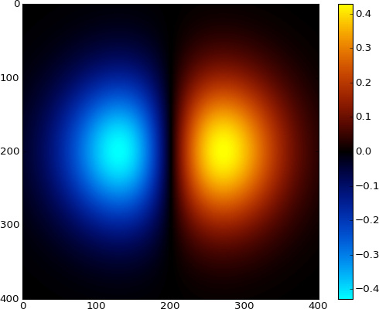
Unsupervised Learning
Data: x
Just data, no labels!
Goal: Learn some underlying hidden structure of the data
Examples: Clustering, dimensionality reduction, feature learning, density estimation, etc.
Figure copyright Ian Goodfellow, 2016. Reproduced with permission.
1-d density estimation
2-d density estimation
2-d density images left and right are CC0 public domain
Slide Credit: Fei-Fei Li, Justin Johnson, Serena Yeung, CS 231n

Slide 7
Types of Learning
Supervised learning
  Learning from a “teacher”
  Training data includes desired outputs
Unsupervised learning
  Discover structure in data
  Training data does not include desired outputs
Reinforcement learning
  Learning to act under evaluative feedback (rewards)

Slide 8

What is Reinforcement Learning?
Learning to make good sequences of decisions
Slide Credit: Rich Sutton, Emma Brunskill

Slide 9
What is Reinforcement Learning?
Learning to make good sequences of decisions
Agent-oriented learning—learning by interacting with an environment to achieve a goal
  more realistic and ambitious than other kinds of machine learning
Slide Credit: Rich Sutton, Emma Brunskill

Slide 10
What is Reinforcement Learning?
Learning to make good sequences of decisions
Agent-oriented learning—learning by interacting with an environment to achieve a goal
  more realistic and ambitious than other kinds of machine learning
Learning by trial and error, with only delayed evaluative feedback (reward)
  the kind of machine learning most like natural learning
  learning that can tell for itself when it is right or wrong
Slide Credit: Rich Sutton, Emma Brunskill

Slide 11
David Silver 2015

Slide 12
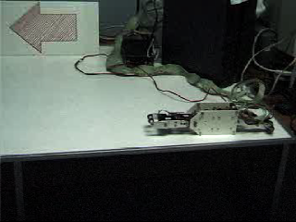
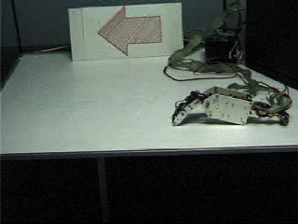
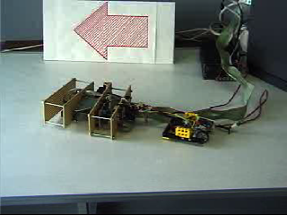
Example: Hajime Kimura’s RL Robots
Before
After
New Robot, Same algorithm

Slide 13
RL API
Agent
State,
Stimulus,
Situation
Reward,
Gain, Payoff,
Cost
Action,
Response,
Control
Environment
(world)
Environment may be unknown, nonlinear, stochastic and complex
Agent learns a policy mapping states to actions
  Seeking to maximize its cumulative reward in the long run
Slide Credit: Rich Sutton
Notes:
Agent and environment interact in real-time, continually learning and improving

Slide 14
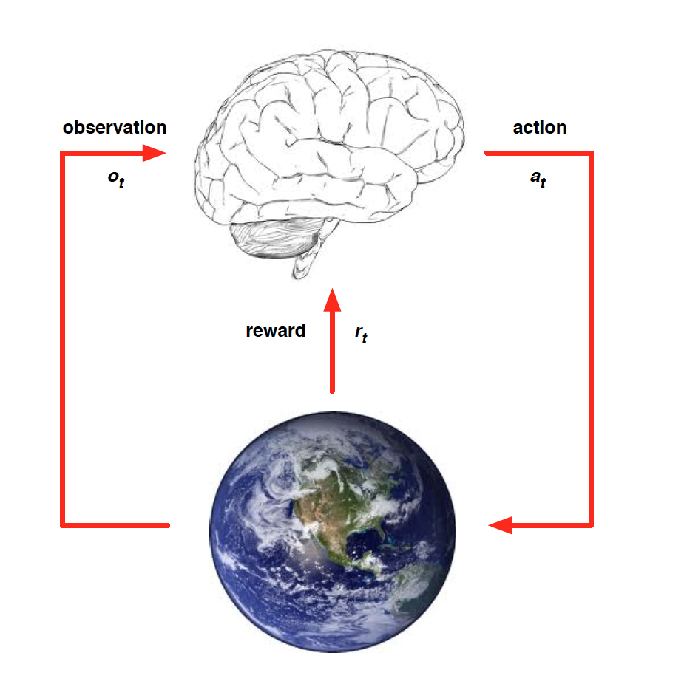
RL API
At each step t the agent:
  Executes action a_{t}
  Receives observation o_{t}
  Receives scalar reward r_{t}
The environment:
  Receives action a_{t}
  Emits observation o_{t+1}
  Emits scalar reward r_{t+1}
Slide Credit: David Silver

Slide 15
Signature challenges of RL
Evaluative feedback (reward)
Sequentiality, delayed consequences
Need for trial and error, to explore as well as exploit
Non-stationarity
The fleeting nature of time and online data
Slide Credit: Rich Sutton

Slide 16
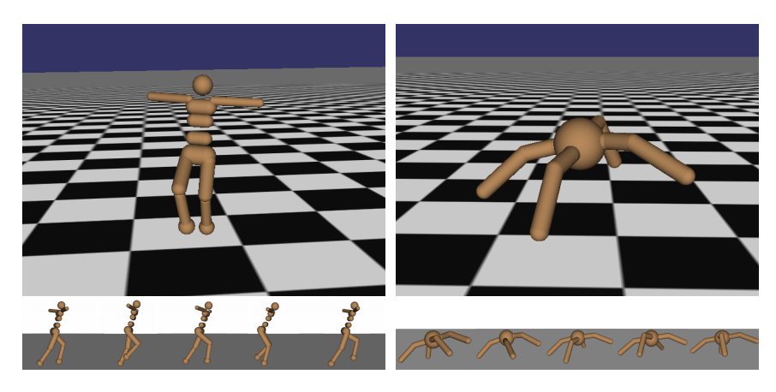
Robot Locomotion
Objective: Make the robot move forward
State: Angle and position of the joints
Action: Torques applied on joints
Reward: 1 at each time step upright + forward movement
Figures copyright John Schulman et al., 2016. Reproduced with permission.
Slide Credit: Fei-Fei Li, Justin Johnson, Serena Yeung, CS 231n

Slide 17
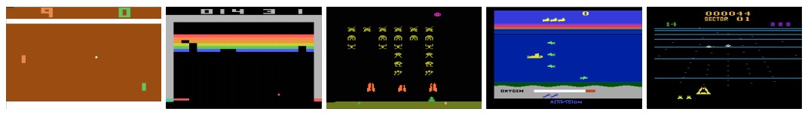
Atari Games
Objective: Complete the game with the highest score
State: Raw pixel inputs of the game state
Action: Game controls e.g. Left, Right, Up, Down
Reward: Score increase/decrease at each time step
Figures copyright Volodymyr Mnih et al., 2013. Reproduced with permission.
Slide Credit: Fei-Fei Li, Justin Johnson, Serena Yeung, CS 231n
Notes:
Games are also a big class of problems that can be formulated with RL
For example here we have atari games, which are a class success of deep RL

Slide 18
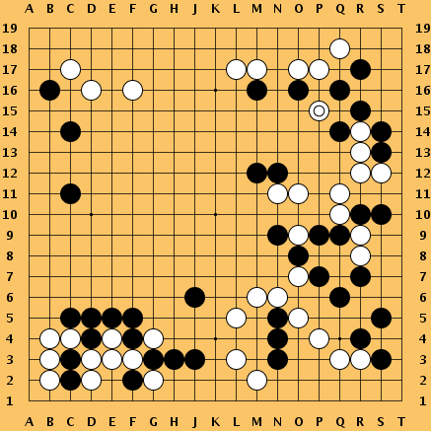
Go
Objective: Win the game!
State: Position of all pieces
Action: Where to put the next piece down
Reward: 1 if win at the end of the game, 0 otherwise
This image is CC0 public domain
Slide Credit: Fei-Fei Li, Justin Johnson, Serena Yeung, CS 231n
Notes:
Something that was a huge achievement last year when DeepMind’s AlphaGo beat Lee Sedol, the best Go player of the last few years, and just last night, competing again

Slide 19
Demo
http://projects.rajivshah.com/rldemo/
https://cs.stanford.edu/people/karpathy/convnetjs/demo/rldemo.html

Slide 20
Topics we’ll cover
Overview of RL
  RL vs other forms of learning
  RL “API”
  Applications
Framework: Markov Decision Processes (MDP’s)
  Definitions and notations
  Policies and Value Functions
  Solving MDP’s
    Value Iteration
    Policy Iteration
Reinforcement learning
  Value-based RL (Q-learning, Deep-Q Learning)
  Policy-based RL (Policy gradients)
  This lecture:
  – Focus on MDP’s
  – No learning (deep or otherwise)
Slide Credit: Fei-Fei Li, Justin Johnson, Serena Yeung, CS 231n

Slide 21
Markov Decision Process (MDP)
Slide Credit: Fei-Fei Li, Justin Johnson, Serena Yeung, CS 231n
Notes:
MDP satisfies Markov property
Define by tuple of objects

Slide 22
Markov Decision Process (MDP)
RL operates within a framework called a Markov Decision Process
MDP’s: General formulation for decision making under uncertainty
Slide Credit: Fei-Fei Li, Justin Johnson, Serena Yeung, CS 231n
Notes:
MDP satisfies Markov property
Define by tuple of objects

Slide 23

Markov Decision Process (MDP)
RL operates within a framework called a Markov Decision Process
MDP’s: General formulation for decision making under uncertainty
Defined by:
Slide Credit: Fei-Fei Li, Justin Johnson, Serena Yeung, CS 231n
Notes:
MDP’s are non-deterministic search problems

Slide 24
Markov Decision Process (MDP)
RL operates within a framework called a Markov Decision Process
MDP’s: General formulation for decision making under uncertainty
Defined by:
: set of possible states [start state = s_{0,} optional terminal / absorbing state]
Slide Credit: Fei-Fei Li, Justin Johnson, Serena Yeung, CS 231n
Notes:
MDP’s are non-deterministic search problems

Slide 25
Markov Decision Process (MDP)
RL operates within a framework called a Markov Decision Process
MDP’s: General formulation for decision making under uncertainty
Defined by:
: set of possible states [start state = s_{0,} optional terminal / absorbing state]
: set of possible actions
Slide Credit: Fei-Fei Li, Justin Johnson, Serena Yeung, CS 231n
Notes:
MDP’s are non-deterministic search problems

Slide 26
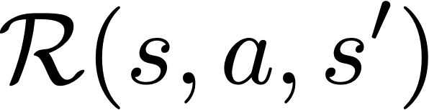
Markov Decision Process (MDP)
RL operates within a framework called a Markov Decision Process
MDP’s: General formulation for decision making under uncertainty
Defined by:
: set of possible states [start state = s_{0,} optional terminal / absorbing state]
: set of possible actions
: distribution of reward given (state, action, next state) tuple
Slide Credit: Fei-Fei Li, Justin Johnson, Serena Yeung, CS 231n
Notes:
MDP’s are non-deterministic search problems

Slide 27
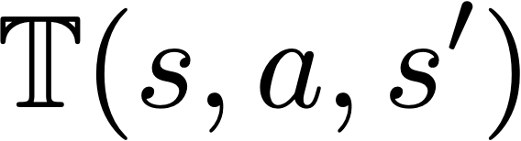
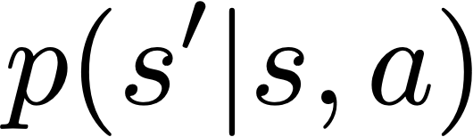
Markov Decision Process (MDP)
RL operates within a framework called a Markov Decision Process
MDP’s: General formulation for decision making under uncertainty
Defined by:
: set of possible states [start state = s_{0,} optional terminal / absorbing state]
: set of possible actions
: distribution of reward given (state, action, next state) tuple
: transition probability distribution, also written as
Slide Credit: Fei-Fei Li, Justin Johnson, Serena Yeung, CS 231n
Notes:
MDP’s are non-deterministic search problems

Slide 28

Markov Decision Process (MDP)
RL operates within a framework called a Markov Decision Process
MDP’s: General formulation for decision making under uncertainty
Defined by:
: set of possible states [start state = s_{0,} optional terminal / absorbing state]
: set of possible actions
: distribution of reward given (state, action, next state) tuple
: transition probability distribution, also written as
: discount factor
Slide Credit: Fei-Fei Li, Justin Johnson, Serena Yeung, CS 231n
Notes:
MDP’s are non-deterministic search problems

Slide 29
Markov Decision Process (MDP)
RL operates within a framework called a Markov Decision Process
MDP’s: General formulation for decision making under uncertainty
Life is trajectory:
Defined by:
: set of possible states [start state = s_{0,} optional terminal / absorbing state]
: set of possible actions
: distribution of reward given (state, action, next state) tuple
: transition probability distribution, also written as
: discount factor
Slide Credit: Fei-Fei Li, Justin Johnson, Serena Yeung, CS 231n
Notes:
MDP’s are non-deterministic search problems
T specifies the “world” and R specifies the task.

Slide 30
Markov Decision Process (MDP)
RL operates within a framework called a Markov Decision Process
MDP’s: General formulation for decision making under uncertainty
Life is trajectory:
Markov property: Current state completely characterizes state of the world
Assumption: Most recent observation is sufficient statistic of history
Defined by:
: set of possible states [start state = s_{0,} optional terminal / absorbing state]
: set of possible actions
: distribution of reward given (state, action, next state) tuple
: transition probability distribution, also written as
: discount factor
Slide Credit: Fei-Fei Li, Justin Johnson, Serena Yeung, CS 231n

Slide 31
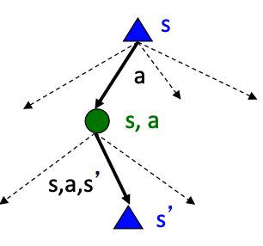
Markov Decision Process (MDP)
MDP state projects a search tree
Slide Credit: Emma Brunskill, Byron Boots
Notes:
MDP satisfies Markov property
Define by tuple of objects

Slide 32

Markov Decision Process (MDP)
MDP state projects a search tree
Observability:
  Full: In a fully observable MDP,
    Example: Chess
  Partial: In a partially observable MDP, agent constructs its own state, using history, of beliefs of world state, or an RNN, …
    Example: Poker
Slide Credit: Emma Brunskill, Byron Boots
Notes:
o_t is showing up for the first time here. Might want to take a second to introduce notation

Slide 33

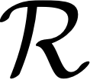
Markov Decision Process (MDP)
In RL, we don’t have access to or (i.e. the environment)
  Need to actually try actions and states out to learn
  Sometimes, need to model the environment
Notes:
Say something about how T specifies the “world” and R specifies the task.

Slide 34
Markov Decision Process (MDP)
In RL, we don’t have access to or (i.e. the environment)
  Need to actually try actions and states out to learn
  Sometimes, need to model the environment
For today, let’s assume we do have access to how the world works
Notes:
Say something about how T specifies the “world” and R specifies the task.

Slide 35
Markov Decision Process (MDP)
In RL, we don’t have access to or (i.e. the environment)
  Need to actually try actions and states out to learn
  Sometimes, need to model the environment
For today, let’s assume we do have access to how the world works
And that our goal is to find an optimal behavior strategy for an agent
Notes:
Say something about how T specifies the “world” and R specifies the task.

Slide 36
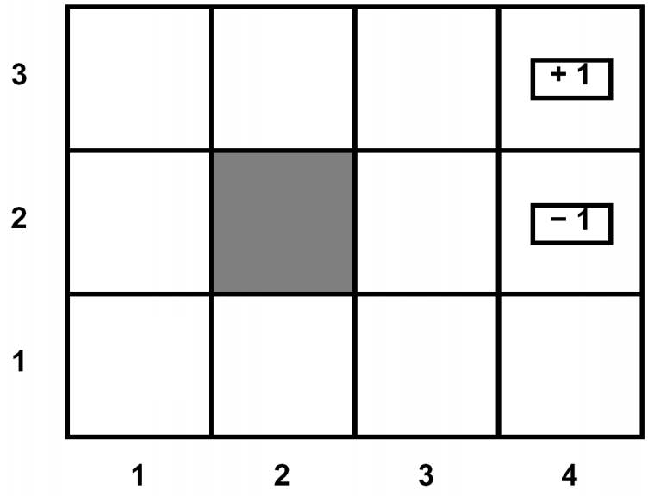
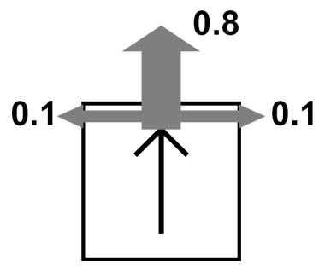
Canonical Example: Grid World
Agent lives in a grid
Walls block the agent’s path
Actions do not always go as planned
  80% of the time, action North takes the agent North (if there is no wall)
  10% of the time, North takes the agent West; 10% East
  If there is a wall, the agent stays put
State: Agent’s location
Actions: N, E, S, W
Rewards: +1 / -1 at absorbing states
Slide credit: Pieter Abbeel
Notes:
MDP satisfies Markov property
Define by tuple of objects

Slide 37
Solving MDP’s

Slide 38
Solving MDP’s
Policy
  How should an agent behave?

Slide 39
Solving MDP’s
Policy
  How should an agent behave?
Value function (Utility)
  How good is each state and/or state-action pair?

Slide 40
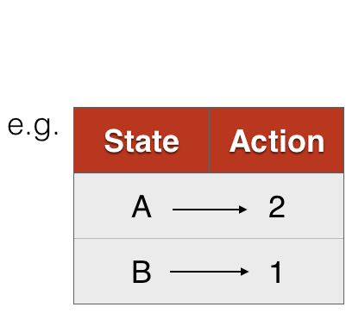
Policy
A policy is how the agent acts

Slide 41
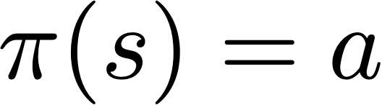
Policy
A policy is how the agent acts
Formally, map from states to actions
  Deterministic
  Stochastic

Slide 42
The optimal policy 𝝿*
What’s a good policy?
Notes:
Can work with maximizing the expected sum of rewards

Slide 43
The optimal policy 𝝿*
What’s a good policy?
Maximizes current reward? Sum of all future reward?
Notes:
Can work with maximizing the expected sum of rewards

Slide 44
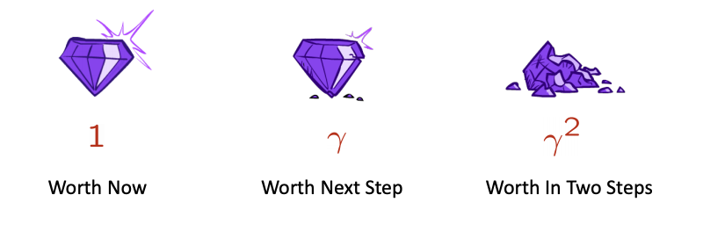
The optimal policy 𝝿*
What’s a good policy?
Maximizes current reward? Sum of all future reward?
Discounted future rewards!
Notes:
Can work with maximizing the expected sum of rewards

Slide 45
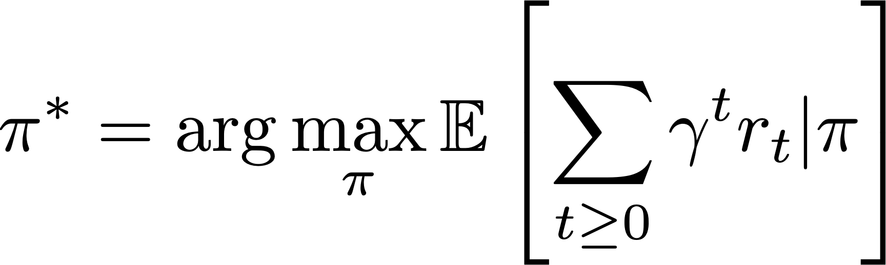
The optimal policy 𝝿*
What’s a good policy?
Maximizes current reward? Sum of all future reward?
Discounted future rewards!
Formally:
with
(Typically for a fixed horizon T)
Notes:
Can work with maximizing the expected sum of rewards

Slide 46
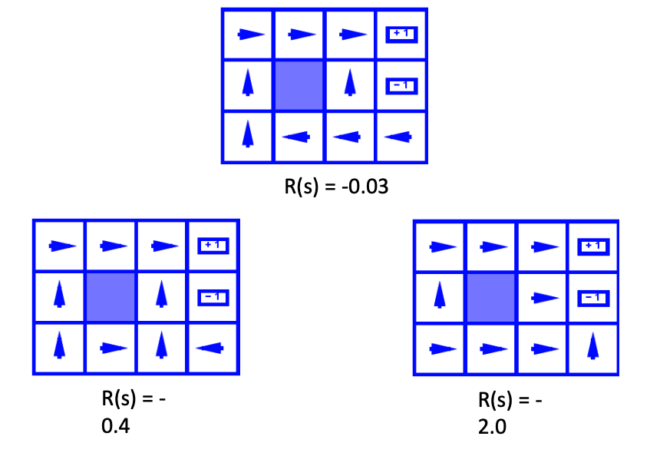
The optimal policy 𝝿*
Slide Credit: Byron Boots, CS 7641
Notes:
Can work with maximizing the expected sum of rewards

Slide 47
Discounting
Prefer rewards now to rewards later
Helps with convergence
Alternate interpretation: Contending with possibility of “death”
Slide Credit: Byron Boots, CS 7641
Notes:
Can work with maximizing the expected sum of rewards

Slide 48
Discounting
Prefer rewards now to rewards later
Helps with convergence
Alternate interpretation: Contending with possibility of “death”
Given an MDP:
  Actions: East, West, Exit (at first and last position)
  Deterministic transitions
What is the optimal policy for:
  = 1
  = 0.1
10 |  |  |  | 1
Slide credit: Byron Boots, CS 7641
Notes:
Can work with maximizing the expected sum of rewards

Slide 49
Value Function

Slide 50
Value Function
A value function is a prediction of future reward

Slide 51
Value Function
A value function is a prediction of future reward
State Value Function or simply Value Function
  How good is a state?
  Am I screwed? Am I winning this game?

Slide 52
Value Function
A value function is a prediction of future reward
State Value Function or simply Value Function
  How good is a state?
  Am I screwed? Am I winning this game?
Action-Value Function or Q-function
  How good is a state action-pair?
  Should I do this now?

Slide 53

Value Function
Following policy that produces sample trajectories s₀, a₀, r₀, s₁, a₁, …
Slide Credit: Fei-Fei Li, Justin Johnson, Serena Yeung, CS 231n

Slide 54
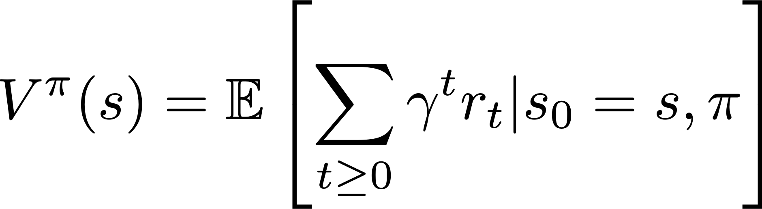
Value Function
Following policy that produces sample trajectories s₀, a₀, r₀, s₁, a₁, …
How good is a state?
The value function at state s, is the expected cumulative reward from state s (and following the policy thereafter):
Slide Credit: Fei-Fei Li, Justin Johnson, Serena Yeung, CS 231n

Slide 55
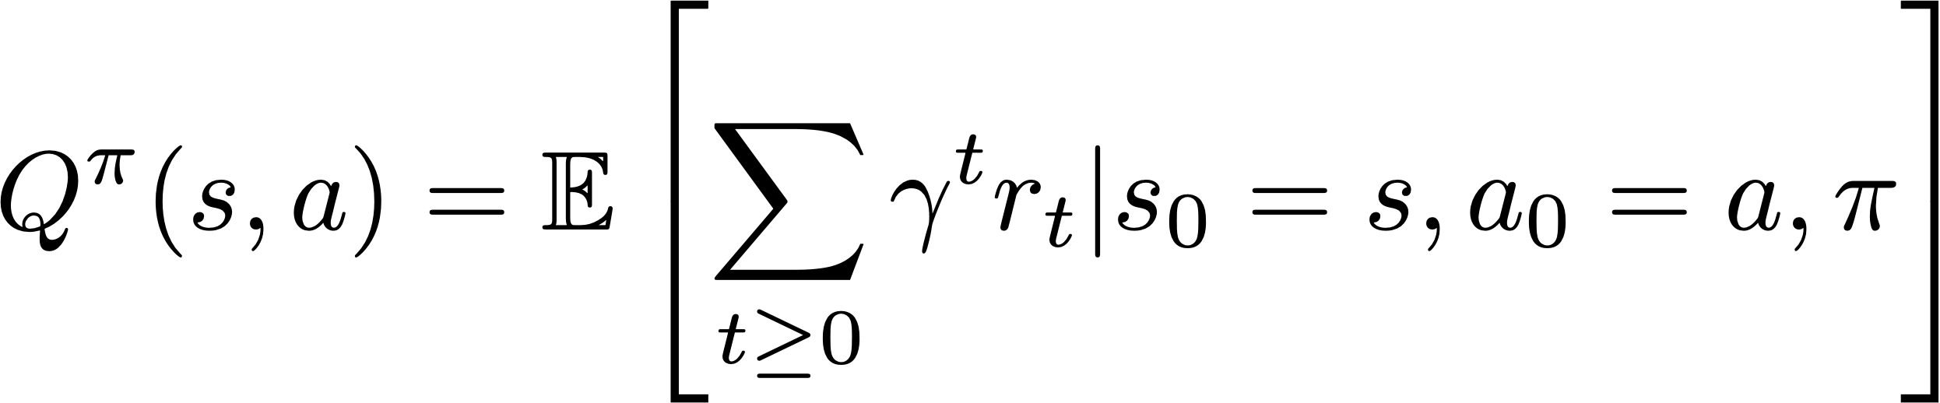
Value Function
Following policy that produces sample trajectories s₀, a₀, r₀, s₁, a₁, …
How good is a state?
The value function at state s, is the expected cumulative reward from state s (and following the policy thereafter):
How good is a state-action pair?
The Q-value function at state s and action a, is the expected cumulative reward from taking action a in state s (and following the policy thereafter):
Slide Credit: Fei-Fei Li, Justin Johnson, Serena Yeung, CS 231n

Slide 56
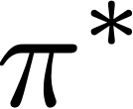
Optimal Quantities
Given optimal policy that produces sample trajectories s₀, a₀, r₀, s₁, a₁, …
Slide Credit: Fei-Fei Li, Justin Johnson, Serena Yeung, CS 231n

Slide 57
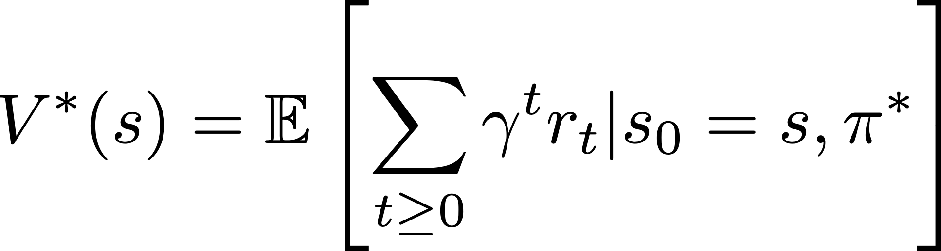
Optimal Quantities
Given optimal policy that produces sample trajectories s₀, a₀, r₀, s₁, a₁, …
How good is a state?
The optimal value function at state s, and acting optimally thereafter
Slide Credit: Fei-Fei Li, Justin Johnson, Serena Yeung, CS 231n

Slide 58
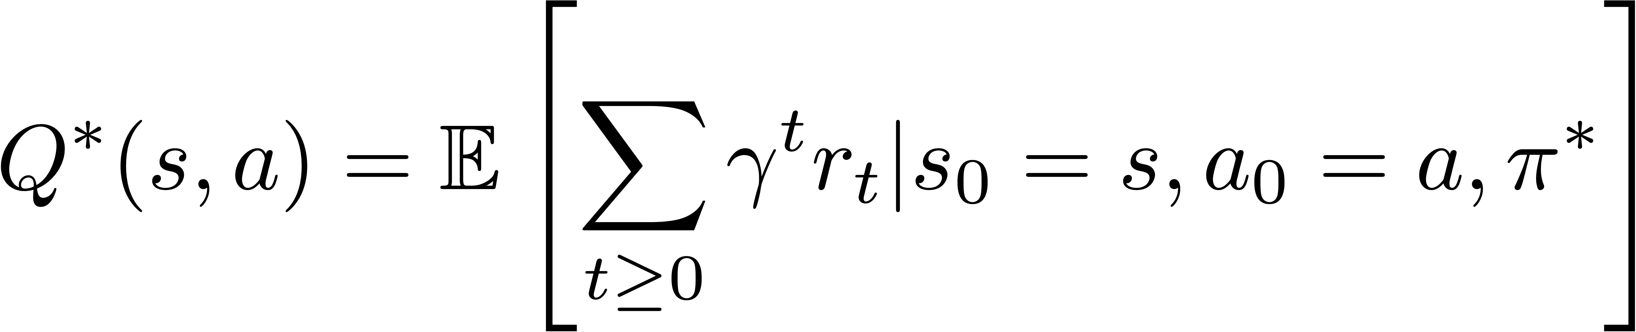
Optimal Quantities
Given optimal policy that produces sample trajectories s₀, a₀, r₀, s₁, a₁, …
How good is a state?
The optimal value function at state s, and acting optimally thereafter
How good is a state-action pair?
The optimal Q-value function at state s and action a, is the expected cumulative reward from taking action a in state s and acting optimally thereafter
Slide Credit: Fei-Fei Li, Justin Johnson, Serena Yeung, CS 231n

Slide 59
Recursive definition of value
Slide credit: Byron Boots, CS 7641

Slide 60
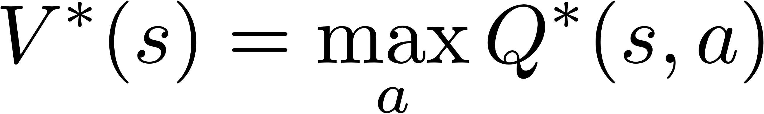
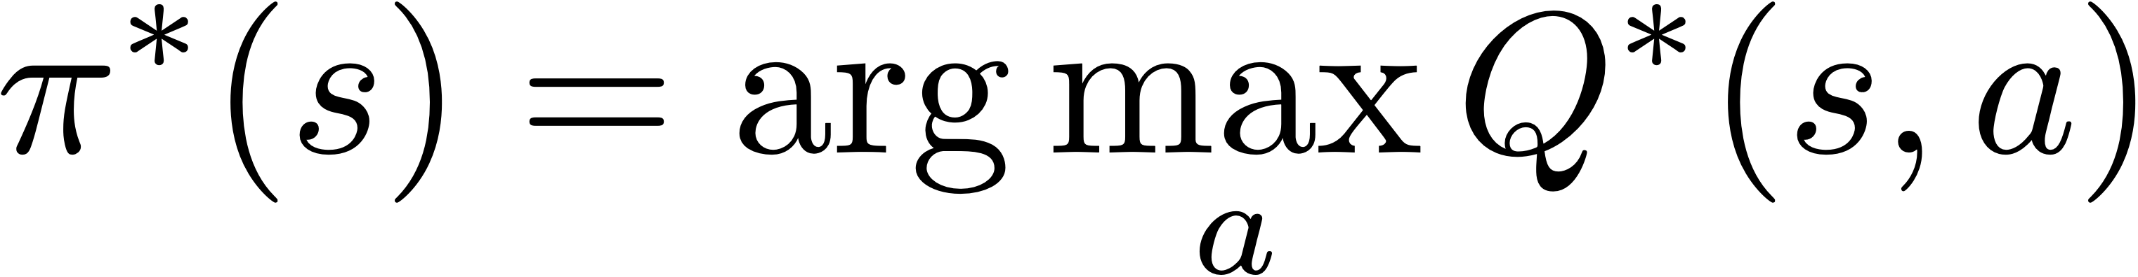
Recursive definition of value
Extracting optimal value / policy from Q-values:
Slide credit: Byron Boots, CS 7641

Slide 61
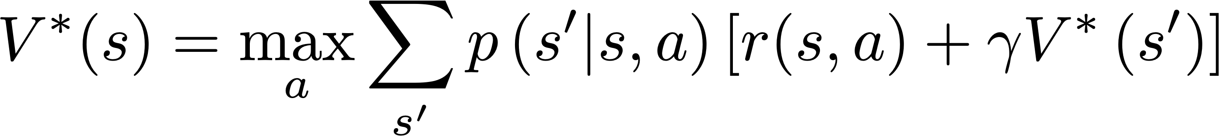
Recursive definition of value
Extracting optimal value / policy from Q-values:
Bellman Equations:
Slide credit: Byron Boots, CS 7641

Slide 62
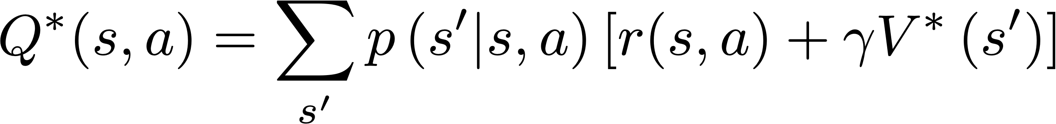
Recursive definition of value
Extracting optimal value / policy from Q-values:
Bellman Equations:
Slide credit: Byron Boots, CS 7641

Slide 63
Recursive definition of value
Extracting optimal value / policy from Q-values:
Bellman Equations:
Characterize optimal values in a way we’ll use over and over
Slide credit: Byron Boots, CS 7641

Slide 64
Value Iteration (VI)
Bellman equations characterize optimal values, VI is a fixed-point DP solution method to compute it
Slide credit: Byron Boots, CS 7641

Slide 65
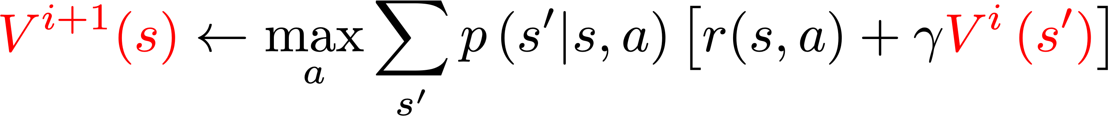
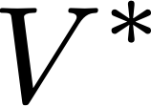
Value Iteration (VI)
Bellman equations characterize optimal values, VI is a fixed-point DP solution method to compute it
Algorithm
  Initialize values of all states V₀(s) = 0
  Update:
  Repeat until convergence (to )
Slide credit: Byron Boots, CS 7641

Slide 66
Value Iteration (VI)
Bellman equations characterize optimal values, VI is a fixed-point DP solution method to compute it
Algorithm
  Initialize values of all states V₀(s) = 0
  Update:
  Repeat until convergence (to )
Complexity per iteration (DP): O(|S|²|A|)
Slide credit: Byron Boots, CS 7641

Slide 67
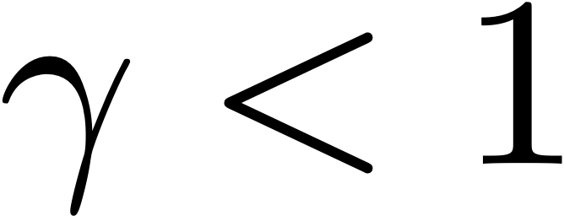
Value Iteration (VI)
Bellman equations characterize optimal values, VI is a fixed-point DP solution method to compute it
Algorithm
  Initialize values of all states V₀(s) = 0
  Update:
  Repeat until convergence (to )
Complexity per iteration (DP): O(|S|²|A|)
Convergence
  Guaranteed for
  Sketch: Approximations get refined towards optimal values
  In practice, policy may converge before values do
Slide credit: Byron Boots, CS 7641

Slide 68
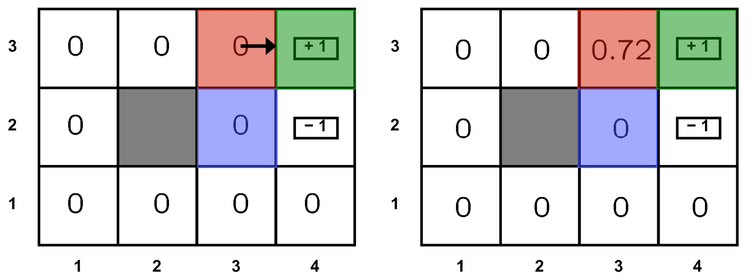
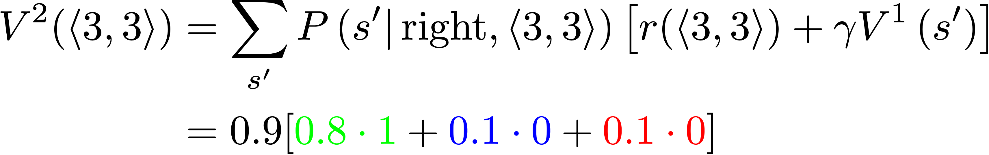
Value Iteration (VI)
Slide credit: Pieter Abbeel

Slide 69
Demo
https://cs.stanford.edu/people/karpathy/reinforcejs/gridworld_dp.html

Slide 70
Next class
Solving MDP’s
  Policy Iteration
Reinforcement learning
  Value-based RL
    Q-learning
    Deep Q Learning
Slide Credit: David Silver

