Slide 1
CS 4803 / 7643: Deep Learning
Topics:
  Visualizing CNNs
Ramprasaath R. Selvaraju
Georgia Tech
Notes:
Today
Learn about visualizing and understanding CNNs.
Pretty pictures

Slide 2
Plan for Today
What do individual neurons look for in images?
  Visualizing filters
  Last layer embeddings
  Visualizing activations
  Maximally activating patches
How pixels affect model decisions?
  Occlusion maps
  Salient or “important” pixels
    Gradient-based visualizations
Do CNNs look at same regions as humans?
  How to evaluate visualizations?
Can we synthesize network-specific images?
  Creating “prototypical” images for a class
  Creating adversarial images
  Deep dream
  Feature inversion
Notes:
Here is what we will cover today
What do individual neurons look for in images?
How every pixel affects model decisions?
Do CNNs look at the same regions as humans?
Can we synthesize images to see what networks are looking for?

Slide 3
Plan for Today
What do individual neurons look for in images?
  Visualizing filters
  Last layer embeddings
  Visualizing activations
  Maximally activating patches
How pixels affect decisions?
  Occlusion maps
  Salient or “important” pixels
    Gradient-based visualizations
Do CNNs look at same regions as humans?
  How to evaluate visualizations?
Can we synthesize network-specific images?
  Creating “prototypical” images for a class
  Creating adversarial images
  Deep dream
  Feature inversion

Slide 4
What do individual neurons look for in images?
Notes:
Today we will start by finding some answers to the question: What's really going on inside convolutional neural networks?

Slide 5
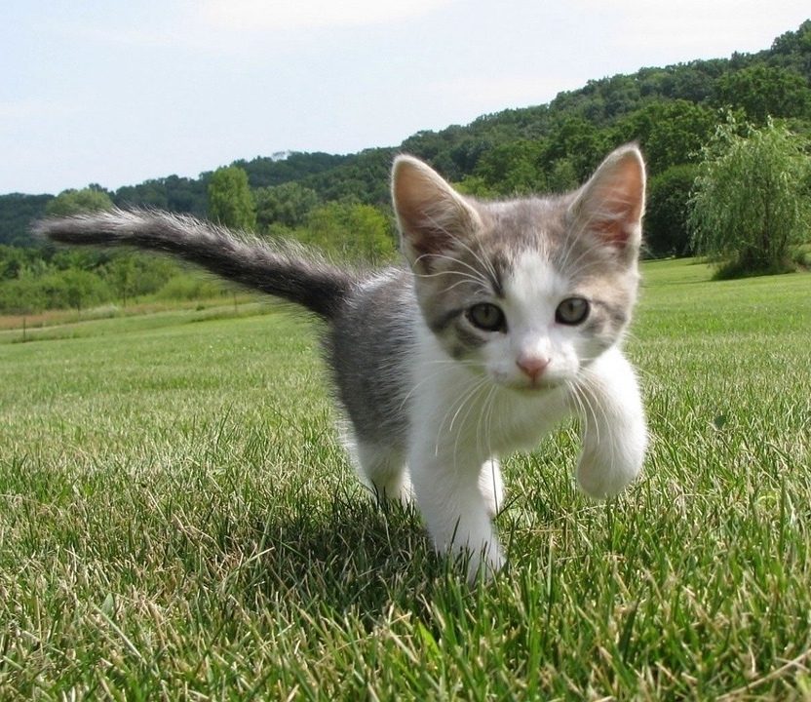
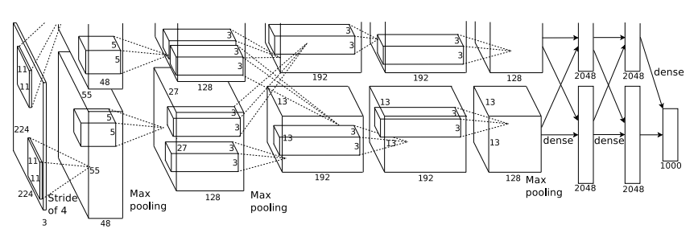
This image is CC0 public domain
Class Scores:
1000 numbers
Input Image:
3 x 224 x 224
What are the intermediate features looking for?
Krizhevsky et al, “ImageNet Classification with Deep Convolutional Neural Networks”, NIPS 2012.
Figure reproduced with permission.
Slide Credit: Fei-Fei Li, Justin Johnson, Serena Yeung, CS 231n
Notes:
How do they do what they do? What are they looking for?
So far we have seen convnet as a little bit of a black box
Input --> conv relu --> pooling--> conv relu --> pooling --> class score
Class scores which are interpretable --> bounding box coordinates/ labeled pixels
Question is, What are all these other middle layers doing? What kind of things in the input image are they looking for?
We will be looking into getting intuitions as to how CNNs work and what kind of techniques we have to analyze the internals of the network.

Slide 6
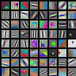



Visualizing filters in first layer
ResNet-18:
64 x 3 x 7 x 7
ResNet-101:
64 x 3 x 7 x 7
DenseNet-121:
64 x 3 x 7 x 7
AlexNet:
64 x 3 x 11 x 11
Krizhevsky, “One weird trick for parallelizing convolutional neural networks”, arXiv 2014
He et al, “Deep Residual Learning for Image Recognition”, CVPR 2016
Huang et al, “Densely Connected Convolutional Networks”, CVPR 2017
Slide Credit: Fei-Fei Li, Justin Johnson, Serena Yeung, CS 231n
Notes:
Visualizing first layer is relatively simple. The layer that directly attaches to the image is a convolutional layer.
In alexnet the first layer has 64 conv filters (or) neurons
Each filter is 11x11x3. These filters get places over the input image where the weighted sum is taken and this filter is slid at different locations.
First layer inner product taken directly with input, so we can just visualize the weights of the conv layer to see what they are looking for.
So for alexnet we will visualize these 64 11 x 11 filters in a grid.
We see lot of them looking for oriented edges in different angles and positions. The interesting thing is that for any network that is trained on natural images, you see the same kind of patterns emerging.
What is even more interesting is that this is somewhat similar to what happens in the human visual system where the early layers look at things like oriented edges.
human visual system is known to the detect things like oriented edges. At the very early layers of the human visual system. And it turns out of that these convolutional networks tend to do something, somewhat similar.
The first convolutional weights of pretty much any convolutional network looking at images ends up looking something like this.

Slide 7

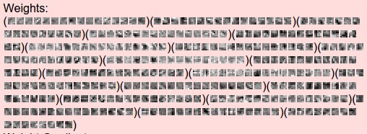
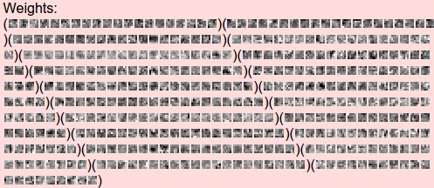
Visualizing filters in intermediate layers
layer 1 weights
Visualize the
filters/kernels
(raw weights)
16 x 3 x 7 x 7
layer 2 weights
We can visualize filters at higher layers, but not that interesting
20 x 16 x 7 x 7
layer 3 weights
20 x 20 x 7 x 7
Slide Credit: Fei-Fei Li, Justin Johnson, Serena Yeung, CS 231n
Notes:
Now can we do the same for the intermediate layers? It turns out, it’s actually a lot less interpretable for humans
Second conv receives 16 channel input. Now this layer does 7x7 convolutions with 20 neurons. The problem is that we humans cannot visualize 16 dimensional images.
What we can do is roll it as 16 7x7 grayscale images, and we will have 20 of them. They seem to be looking at some special structures. But nothing meaningful.
What this gives is, the kind of activation pattern that maximally activates the second layer neurons. But we need to come up with more fancier techniques.

Slide 8
What do neuron activations look like?
Notes:
So yes, the weights on the intermediate layers are not interpretable. Activations are somewhat interpretable in some cases.

Slide 9
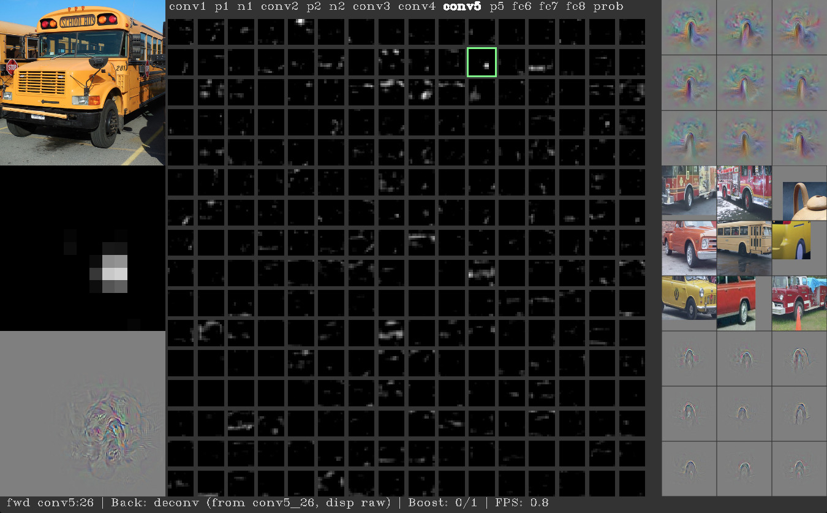
Visualizing activations in intermediate layers
Yosinski et al, “Understanding Neural Networks Through Deep Visualization”, ICML DL Workshop 2014.
Figure copyright Jason Yosinski, 2014. Reproduced with permission.
Notes:
Here is a visualization put together by jason yosenski. For different layers you can visualize the activation maps when you feed an input. Here you can see that when you feed this image of a school bus, in conv5, this particular neuron seems to be activated when it sees the wheel.
On the right are some other images that maximally activate this neuron. So you see that this neuron looks for the wheel, which is really cool.
Remember the, the conv5 layers of Alex Net. 128 by 13 by 13 dimensional tensor. But we can think of that as 128 different 13 by 13 2-D grids. So now we can actually go and visualize each of those 13 by 13 elements slices of the feature map as a grayscale image and this gives us some sense for what types of things in the input are each of those features in that convolutional layer looking for.

Slide 10
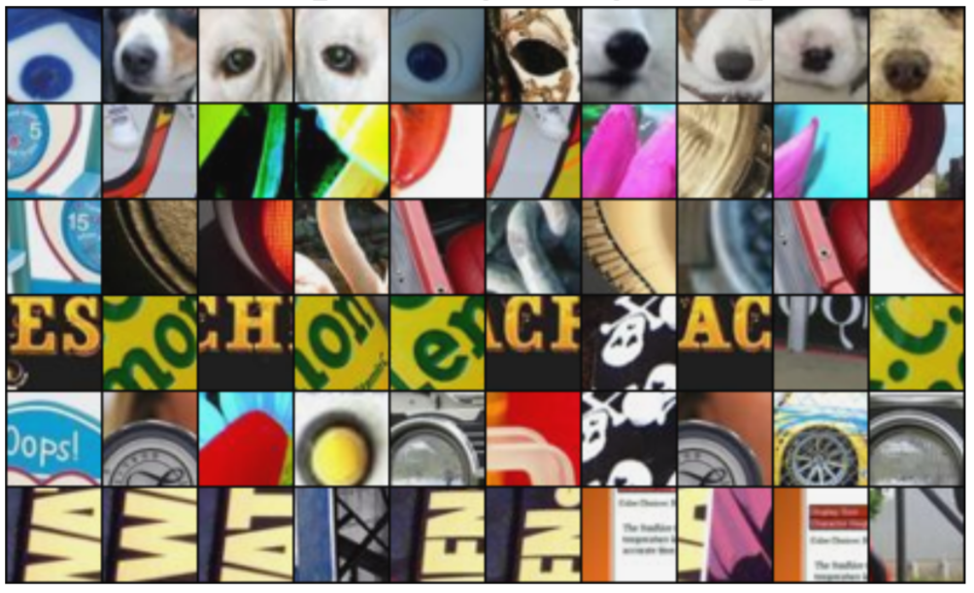
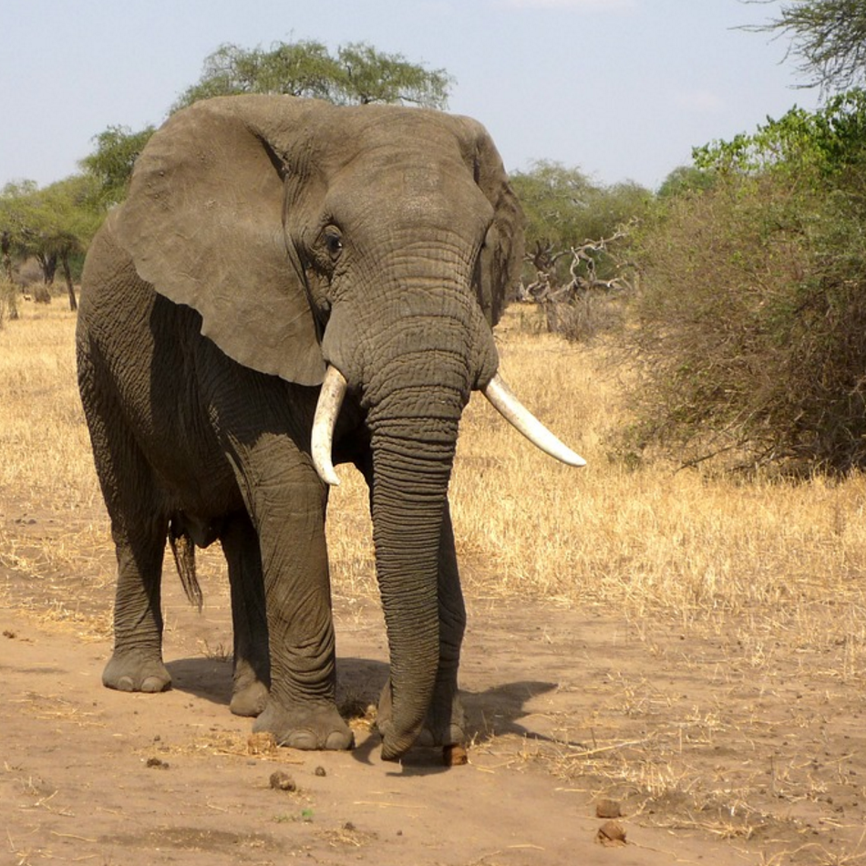
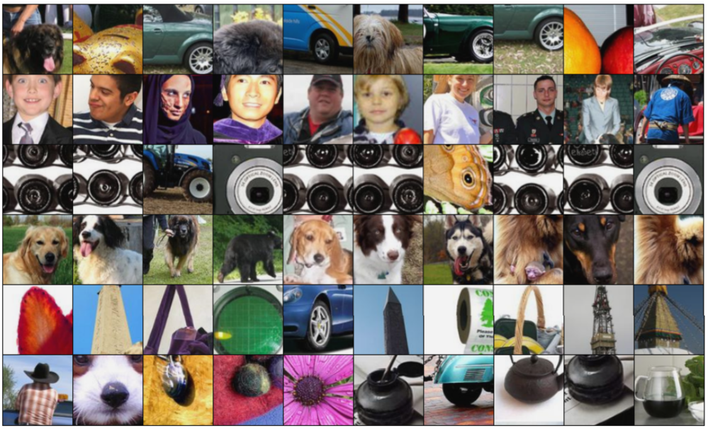
Maximally Activating Patches
Pick a layer and a channel; e.g. conv5 is 128 x 13 x 13, pick channel 17/128
Run many images through the network, record values of chosen channel
Visualize image patches that correspond to maximal activations
Springenberg et al, “Striving for Simplicity: The All Convolutional Net”, ICLR Workshop 2015
Figure copyright Jost Tobias Springenberg, Alexey Dosovitskiy, Thomas Brox, Martin Riedmiller, 2015; reproduced with permission.
Slide Credit: Fei-Fei Li, Justin Johnson, Serena Yeung, CS 231n
Notes:
Visualizing what types of patches from input images cause maximal activation of different neurons
Say we pick the same conv5 layer and choose a particular neuron. We feed in a bunch of images and see the images that active any particular neuron. Then what we'll do is visualize the patches from this large data set of images corresponding to the maximal activations of that that particular feature in that particular layer. And then we can sort these patches by their activation at that particular layer.
at the bottom we also see some maximally activating patches for neurons from a higher up layer in the same network. And now because they are coming from higher in the network they have a larger receptive field. So, they're looking at larger patches of the input image and we can also see that they're looking for maybe larger structures in the input image.

Slide 11
What does the last layer learn?
FC7 layer
4096-dimensional feature vector for an image
(layer immediately before the classifier)
Run the network on many images, collect the feature vectors
Slide Credit: Fei-Fei Li, Justin Johnson, Serena Yeung, CS 231n
Notes:
Let's get to the last layer. For most classification tasks it is common to have a fully connected layer at the end. Considering how less interpretable the 16 dimensional weights of the second layer, visualizing the 4096 dimensional weights of the final layer could be un imaginable.
But what we can do is try and feed dataset of images to the trained model and record the 4096 dimensional vector of each of those images.

Slide 12
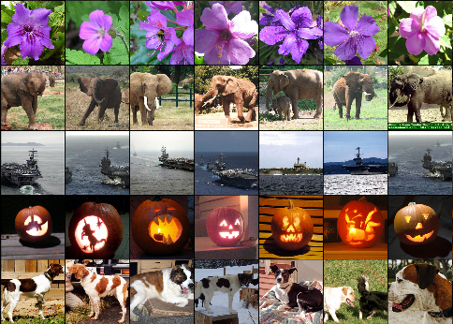
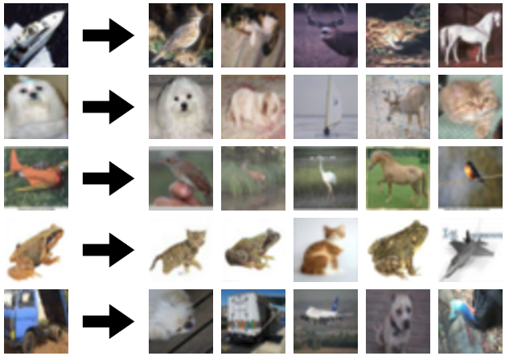
Last Layer: Nearest Neighbors
4096-dim vector
Test image
L2 Nearest neighbors in feature space
Recall: Nearest neighbors in pixel space
Krizhevsky et al, “ImageNet Classification with Deep Convolutional Neural Networks”, NIPS 2012.
Figures reproduced with permission.
Slide Credit: Fei-Fei Li, Justin Johnson, Serena Yeung, CS 231n
Notes:
Let’s do that. In the left we see NN in pixel space. For the image on left, we see similar looking images on the right. Raw pixels are similar.
And so for example this white dog that you see here, it's nearest neighbors are in pixel space are these kinds of white blobby things that may or may not be dogs, but at least the raw pixels of the image are quite similar.
Now lets compute nearest neighbours in the 4096 dimensional space.
First column -> test set images
Second column -> nearest neighbours in this space.
And you can see here that this is quite different from the pixel space nearest neighbors, because the pixels are often quite different between the image in it's nearest neighbors and feature space. However, the semantic content of those images tends to be similar in this feature space.
Different orientations of the elephant
Means - their features are capturing some of those semantic content in these images.
In the standard supervised learning procedure, there's nothing in the loss encouraging these features to be close together. It just kind of a happy accident that they end up being close to each other. Because we didn't tell the network during training these features should be close.

Slide 13
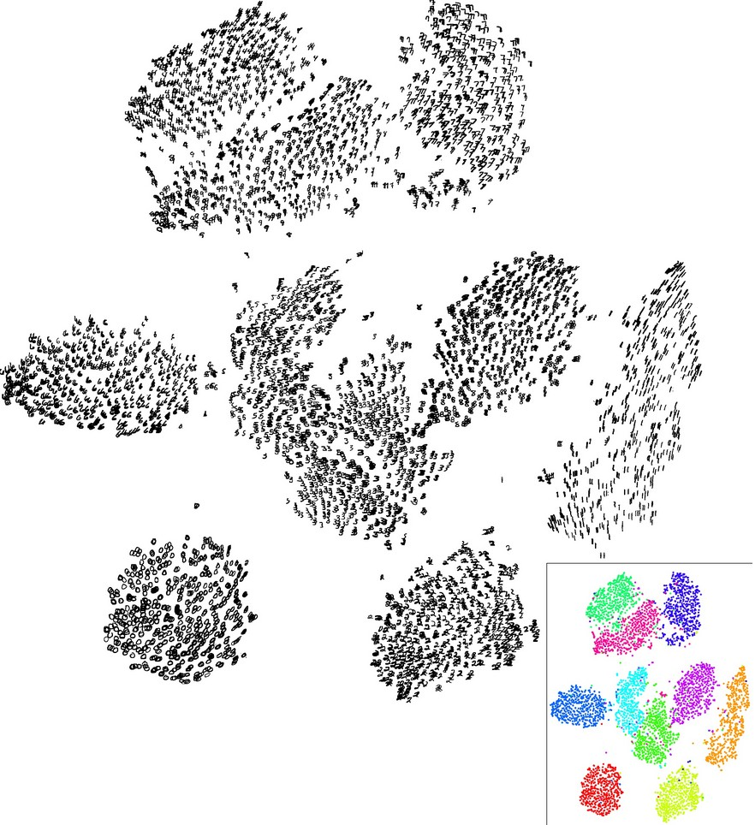
Last Layer: Dimensionality Reduction
Visualize the “space” of FC7 feature vectors by reducing dimensionality of vectors from 4096 to 2 dimensions
Simple algorithm: Principal Component Analysis (PCA)
More complex: t-SNE
Van der Maaten and Hinton, “Visualizing Data using t-SNE”, JMLR 2008
Figure copyright Laurens van der Maaten and Geoff Hinton, 2008. Reproduced with permission.
Slide Credit: Fei-Fei Li, Justin Johnson, Serena Yeung, CS 231n
Notes:
Yes, so the 4096 dimensional space is hard to visualize. Can we use some kind of dimensionality reduction to reduce it to 2, so we can visualize?
A popular powerful technique is t-SNE (t-distributed Stochastic neighbour embeddings)
Here is an example of what t-SNE can do. When we take MNIST digits 28x28 and feed them to a trained network and get the 4096 dimensional output and compress them to 2 using T-SNE. We see natural clusters being formed, where each cluster contains mostly a single digit.

Slide 14
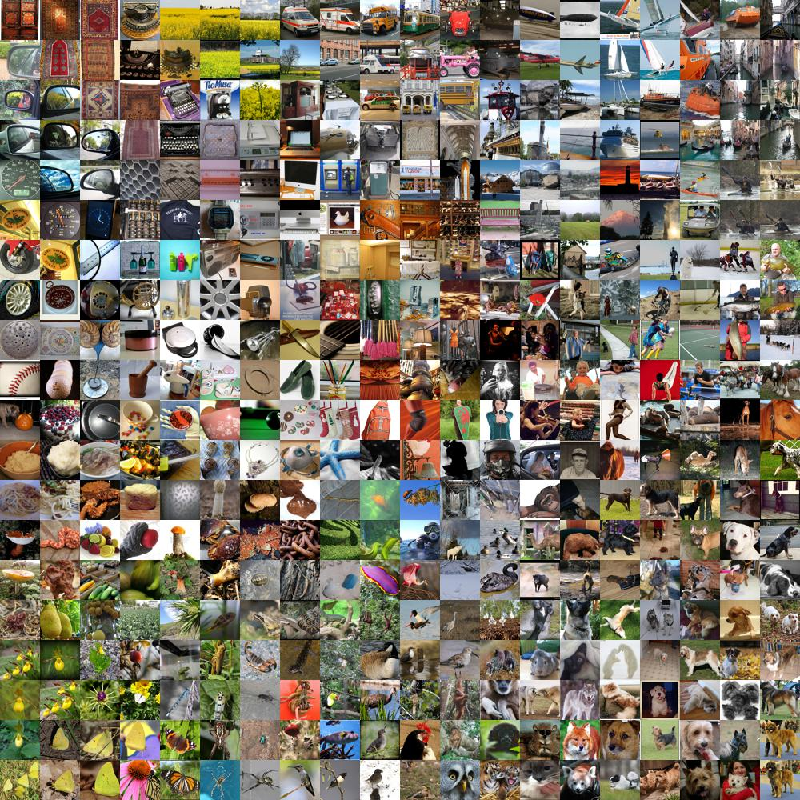
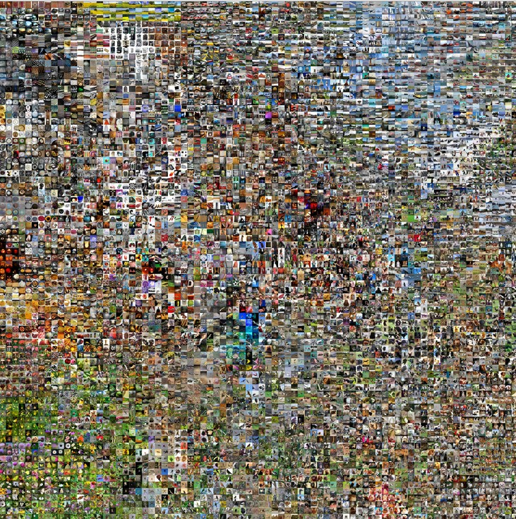
Last Layer: Dimensionality Reduction
Van der Maaten and Hinton, “Visualizing Data using t-SNE”, JMLR 2008
Krizhevsky et al, “ImageNet Classification with Deep Convolutional Neural Networks”, NIPS 2012.
Figure reproduced with permission.
See high-resolution versions at
http://cs.stanford.edu/people/karpathy/cnnembed/
Slide Credit: Fei-Fei Li, Justin Johnson, Serena Yeung, CS 231n
Notes:
we apply this t-SNE dimensionality reduction technique to the features from the last layer of our trained image net classifier.
To be a little more concrete, we take large sets of images and get 4096 vectors, reduce dimensionality and at each location in the grid we display the original image instead. We see different types of dog breeds animals and so on.
So there's sort of continuous semantic notion in this feature space, which we can explore by looking through this t-SNE dimensionality reduction version of the features.
Left is zoomed iin version of the right
So now we can do a similar type of visualization. Where we apply this t-SNE dimensionality reduction technique to the features from the last layer of our trained image net classifier.
But at least maybe on the left you can see that there's sort of one cluster in the bottom here of, of green things, is a different kind of flowers and there's other types of clusters for different types of dog breeds and another types of animals and, and locations. So there's sort of continuous semantic notion in this feature space. Which we can explore by looking through this t-SNE dimensionality reduction version of the features.

Slide 15
Plan for Today
What do individual neurons look for in images?
  Visualizing filters
  Last layer embeddings
  Visualizing activations
  Maximally activating patches
How pixels affect decisions from CNNs?
  Occlusion maps
  Salient or “important” pixels
    Gradient-based visualizations
Do CNNs look at same regions as humans?
  How to evaluate visualizations?
Can we synthesize network-specific images?
  Creating “prototypical” images for a class
  Creating adversarial images
  Deep dream
  Feature inversion
Notes:
Here is what we will cover today
What do individual neurons look for in images?
What do neuron activations look like?
How every pixel affects decisions?
Can we generate images/patches that maximally activate a neuron?
Can we fool learned networks?

Slide 16
How pixels affect decisions?

Slide 17
Visual Explanations
Where does an intelligent system
“look” to make its predictions?

Slide 18
Which pixels matter: Occlusion Maps
Idea: Mask part of the image before feeding to CNN, check how much predicted probabilities change
P(elephant) = 0.95
P(elephant) = 0.75
Zeiler and Fergus, “Visualizing and Understanding Convolutional Networks”, ECCV 2014
Boat image is CC0 public domain
Elephant image is CC0 public domain
Go-Karts image is CC0 public domain
Slide Credit: Fei-Fei Li, Justin Johnson, Serena Yeung, CS 231n
Notes:
A cool experiment we can do which comes from Zeiler and Fergus ECCV 2014 paper. is this idea of an exclusion experiment. So, what we want to do is figure out which parts of the input, of the input image cause the network to make it's classification decision. So, what we'll do is, we'll take our input image in this case an elephant and then we'll block out some part of that, some region in that input image and just replace it with the mean pixel value from the data set.
And now, run that occluded image throughout, through the network and then record what is the predicted probability of this occluded image? And now slide this occluded patch over every position in the input image and then repeat the same process.

Slide 19
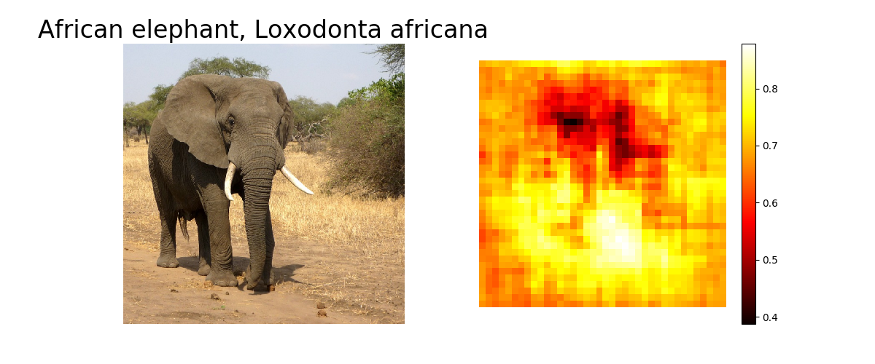
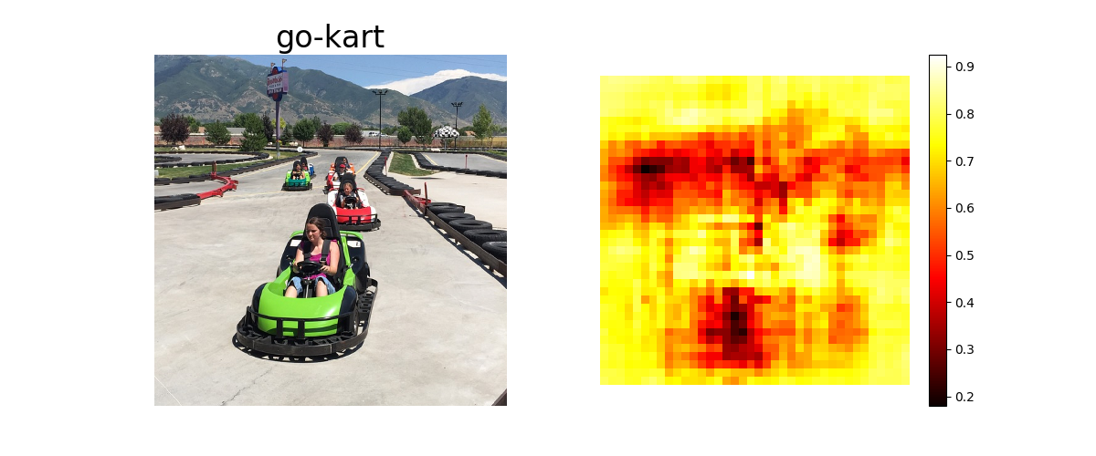
Which pixels matter: Occlusion Maps
Mask part of the image before feeding to CNN, check how much predicted probabilities change
Zeiler and Fergus, “Visualizing and Understanding Convolutional Networks”, ECCV 2014
Boat image is CC0 public domain
Elephant image is CC0 public domain
Go-Karts image is CC0 public domain
Faithful ☺
Very expensive ☹
Slide Credit: Fei-Fei Li, Justin Johnson, Serena Yeung, CS 231n
Notes:
And then draw this heat map showing, what was the predicted probability output from the network as a function of where did, which part of the input image did we occlude?
And the idea is that if when we block out some part of the image if that causes the network score to change drastically. Then probably that part of the input image was really important for the classification decision.
Expensive and heuristic.

Slide 20
Visual Explanations
Where does an `Intelligent System look’ to make its prediction?

Slide 21
What if our model was linear?

Slide 22
What if our model was linear?
100
0.1
-0.1
510
-200
1
0.9
-0.2
0.5
-0.9

Slide 23
But it’s not ☹

Slide 24
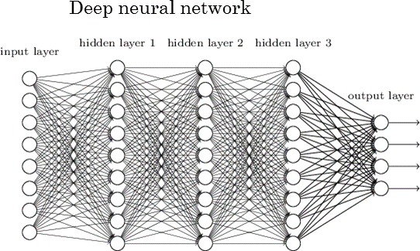
Can we make it linear?

Slide 25
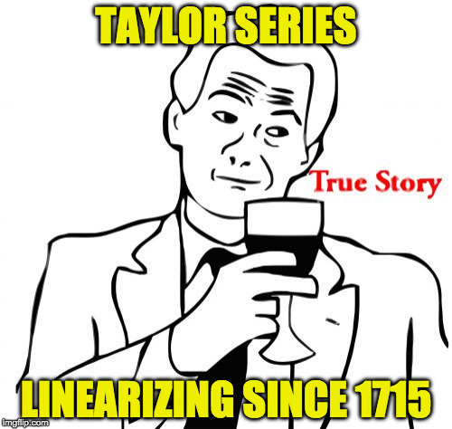
Taylor Series

Slide 26
Feature Importance in Deep Models
Backprop!

Slide 27

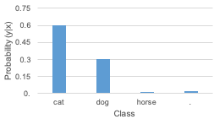

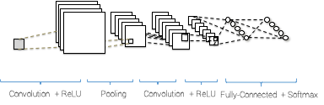

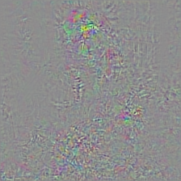
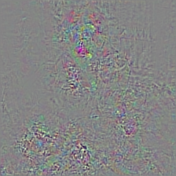


Gradient-based visualizations
Backpropagation
Backprop for `cat’
Backprop for `dog’
Noisy

Slide 28
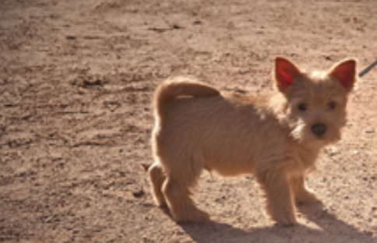
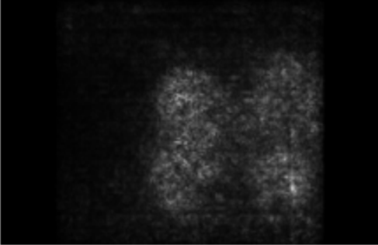
Which pixels matter: Saliency via Backprop
Forward pass: Compute probabilities
Dog
Compute gradient of (unnormalized) class score with respect to image pixels, take absolute value and max over RGB channels
Simonyan, Vedaldi, and Zisserman, “Deep Inside Convolutional Networks: Visualising Image Classification Models and Saliency Maps”, ICLR Workshop 2014.
Figures copyright Karen Simonyan, Andrea Vedaldi, and Andrew Zisserman, 2014; reproduced with permission.
Slide Credit: Fei-Fei Li, Justin Johnson, Serena Yeung, CS 231n
Notes:
And the question is, and one relatively simple idea
from Karen Simonenian's paper, a couple years ago.
Is, this is just computing the gradient
of the predicted class score
with respect to the pixels of the input image.
And this will directly tell us
in this sort of, first order approximation sense.
For each input, for each pixel in the input image
if we wiggle that pixel a little bit
then how much will the classification score
for the class change?
And this is another way to get at this question
of which pixels in the input matter for the classification.
And when we, and when we run
for example Saliency, where computer Saliency map
for this dog, we see kind of a nice
outline of a dog in the image.
Which tells us that these are probably the pixels
of that, network is actually looking at, for this image.
And when we repeat this type of process
for different images, we get some sense
that the network is sort of looking at the right regions.
Which is somewhat comforting.

Slide 29
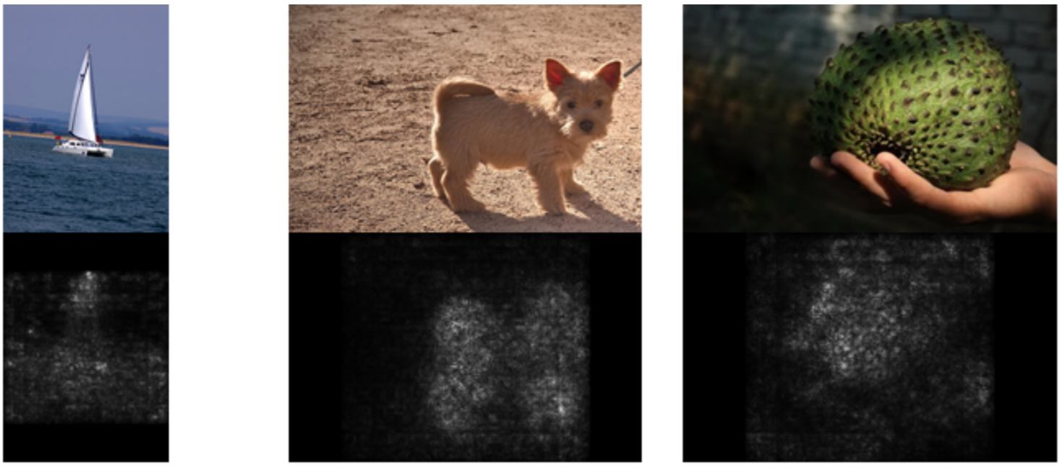
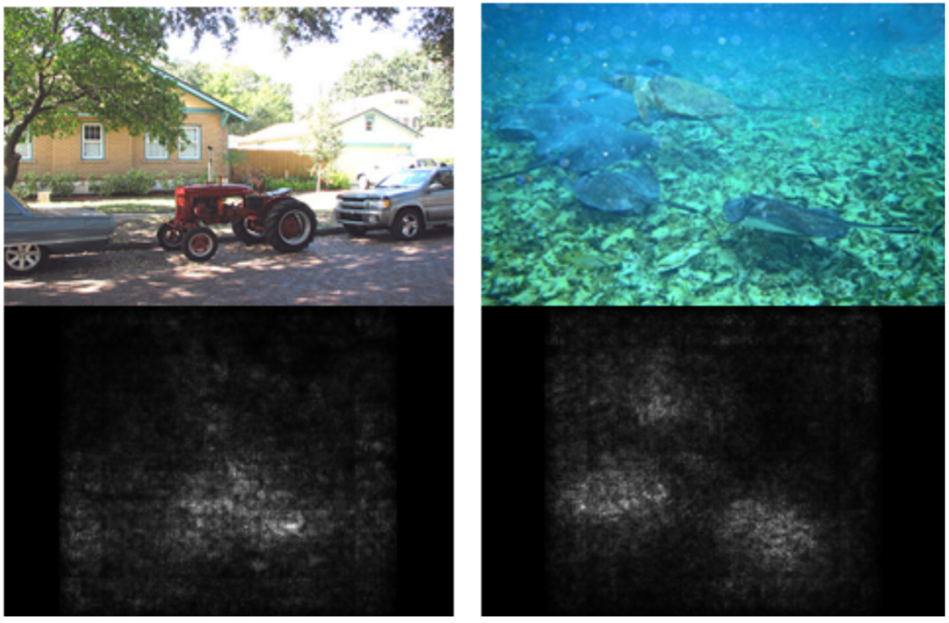
Saliency Maps
Simonyan, Vedaldi, and Zisserman, “Deep Inside Convolutional Networks: Visualising Image Classification Models and Saliency Maps”, ICLR Workshop 2014.
Figures copyright Karen Simonyan, Andrea Vedaldi, and Andrew Zisserman, 2014; reproduced with permission.
Slide Credit: Fei-Fei Li, Justin Johnson, Serena Yeung, CS 231n

Slide 30
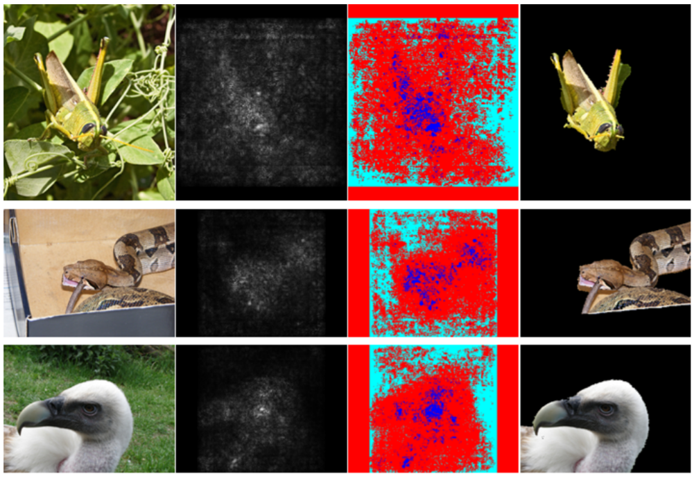
Saliency Maps: Segmentation without supervision
Use GrabCut on saliency map
Simonyan, Vedaldi, and Zisserman, “Deep Inside Convolutional Networks: Visualising Image Classification Models and Saliency Maps”, ICLR Workshop 2014.
Figures copyright Karen Simonyan, Andrea Vedaldi, and Andrew Zisserman, 2014; reproduced with permission.
Rother et al, “Grabcut: Interactive foreground extraction using iterated graph cuts”, ACM TOG 2004
Slide Credit: Fei-Fei Li, Justin Johnson, Serena Yeung, CS 231n
Notes:
Where there's this idea that maybe you can use these Saliency Maps to perform semantic segmentation without direct, without any labeled data
for the, for these, for these segments. So here they're using this Grabcut Segmentation Algorithm

Slide 31
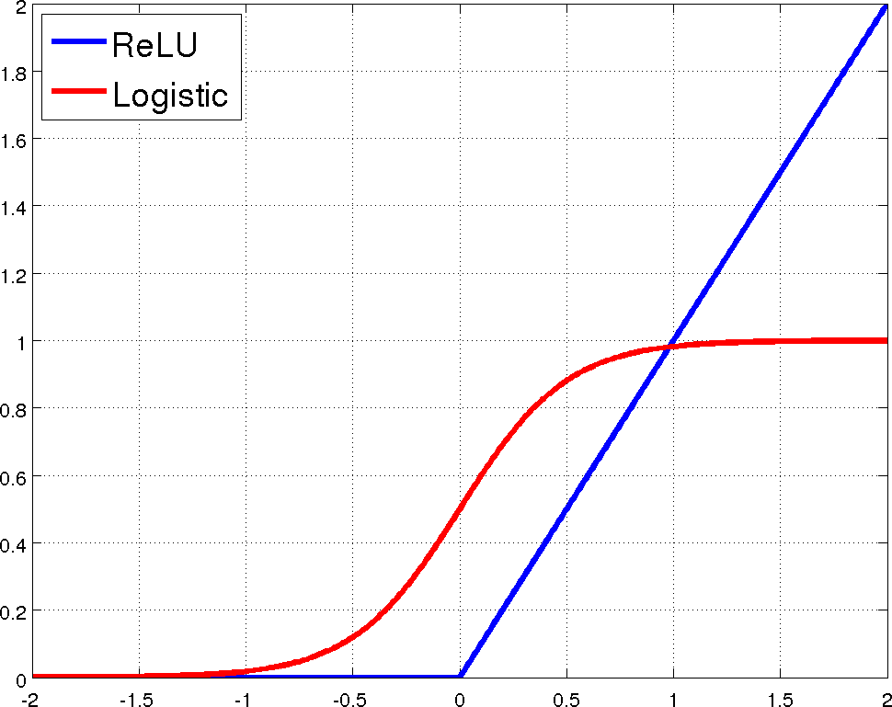
Remember ReLUs?

Slide 32
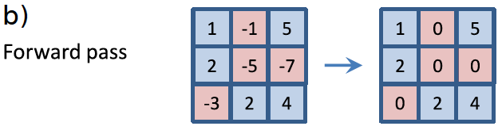
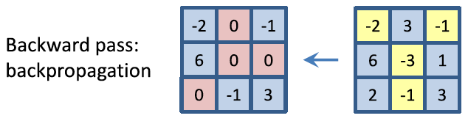
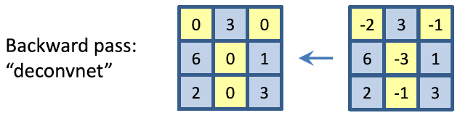
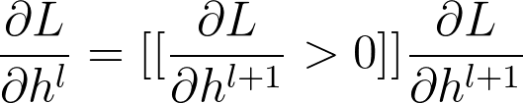
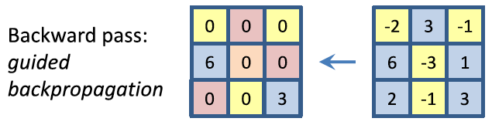
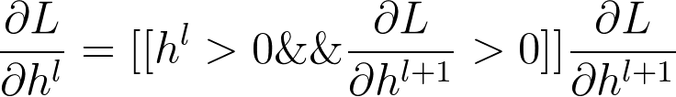

Slide 33
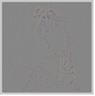
Gradient-based visualizations
Backpropagation
Backprop for `cat’
Backprop for `dog’
Guided Backprop for `cat’
Guided Backprop for `dog’
Noisy
Not Class-Discriminative

Slide 34










Grad-CAM
Visual Explanations from Deep Networks via Gradient-based Localization
[ICCV ‘17]
  Ramprasaath Selvaraju Michael Cogswell Abhishek Das Ramakrishna Vedantam
  Devi Parikh Dhruv Batra

Slide 35
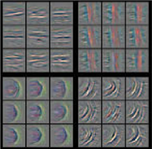
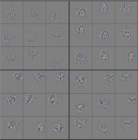
Grad-CAM Motivation
Perturb semantic neurons in the image and see how it affects the decision
Lower
Higher
Last convolutional layer forms a best compromise between high-level semantics and detailed spatial resolution
Notes:
Grad-CAM works by perturbing the semantic neurons in the image and see how it affects the decision
Earlier works showed that earlier layers capture low level details like edges, blobs and later layers capture high level details like faces, objects or parts of objects.
Hence the last last convolutional layer forms a best compromise between high-level semantics and detailed spatial resolution.

Slide 36
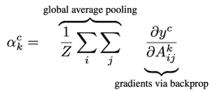
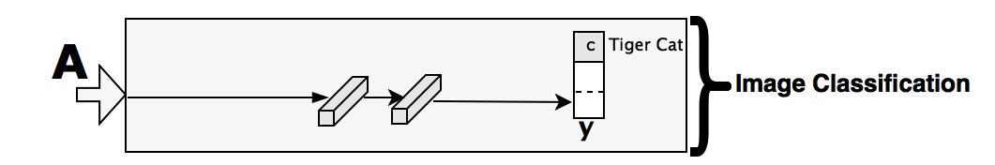
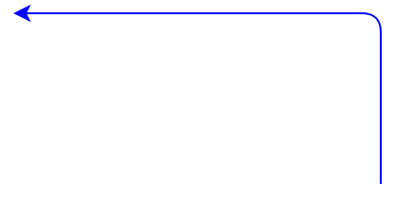
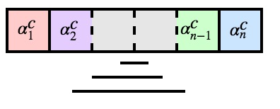
Grad-CAM
Guided Grad-CAM
Neuron Importance
Guided Backpropagation
Rectified Conv
Feature Maps
Guided Grad-CAM
+
Backprop till conv
Grad-CAM
Notes:
Given an image like this, we feed it through the convolutional layers of a CNN, the outputs of which can be used for any task. For illustration we can consider an image classification task which uses a couple of Fully connected layers followed by the final softmax over several classes. Let’s say the network predicted Tiger Cat, and we would like to visualize where in the image the model was looking at.
To do this we first determine the neurons that are most important for predicting Tiger Cat which can be obtained by the gradients flowing to the last convolutional layer. Performing a global pooling of these gradients gives an importance weight for each of the convolutional layer neuron.
We call these Global Average Pooled gradients, neuron importance
For providing an explanation for that particular input image, we take into account the forward activations and do a weighted sum with the importance weights and clamp the negative values because we are only interested in the features that have a positive influence.
This can be done for any differentiable network that follows a CNN. For example, you can follow it with an RNN that can be used for Image captioning, or have an additional input channel, and perform any kind of complex interactions like in the case of Visual Question Answering.
Combining Grad-CAM with existing visualizations which are high resolution but not class-discriminative, we obtain Guided Grad-CAM, which just highlights the most important pixels that are responsible for the decision tiger cat.

Slide 37
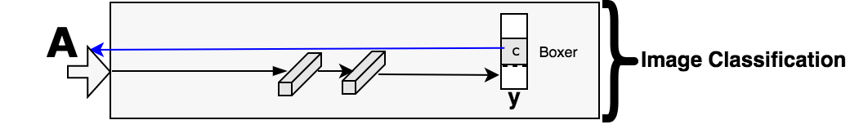
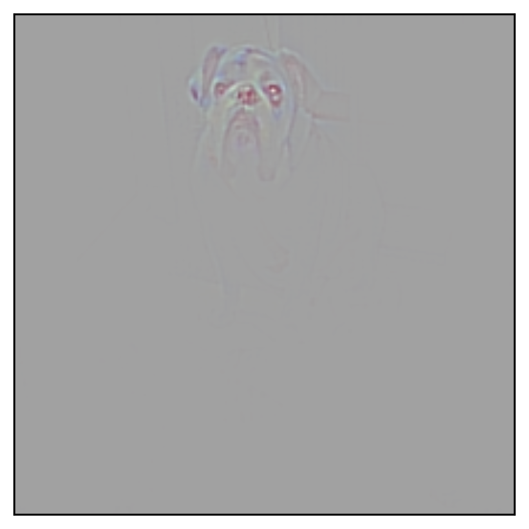
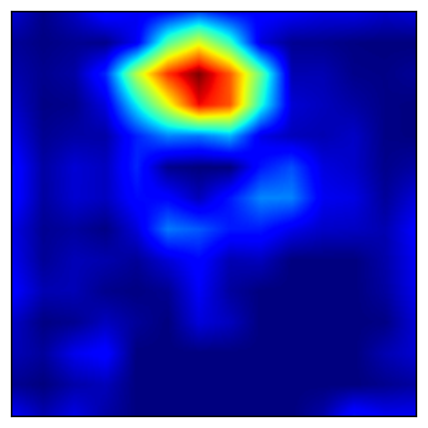
Grad-CAM
Guided Grad-CAM
Guided Backpropagation
Rectified Conv
Feature Maps
Guided Grad-CAM
+
Backprop till conv
Grad-CAM
Notes:
Given an image like this, we feed it through the convolutional layers of a CNN, the outputs of which can be used for any task. For illustration we can consider an image classification task which uses a couple of Fully connected layers followed by the final softmax over several classes. Let’s say the network predicted Tiger Cat, and we would like to visualize where in the image the model was looking at.
To do this we first determine the neurons that are most important for predicting Tiger Cat which can be obtained by the gradients flowing to the last convolutional layer. Performing a global pooling of these gradients gives an importance weight for each of the convolutional layer neuron.
For providing an explanation for that particular input image, we take into account the forward activations and do a weighted sum with the importance weights and clamp the negative values to obtain Grad-CAM.
This can be done for any differentiable network that follows a CNN. For example, you can follow it with an RNN that can be used for Image captioning, or have an additional input channel, and perform any kind of complex interactions like in the case of Visual Question Answering.
Combining Grad-CAM with existing visualizations which are high resolution but not class-discriminative, we obtain Guided Grad-CAM, which just highlights the most important pixels that are responsible for the decision tiger cat.

Slide 38
Interesting findings with Grad-CAM
Even simple non-attention based CNN + LSTM models learn to look at appropriate regions

Slide 39
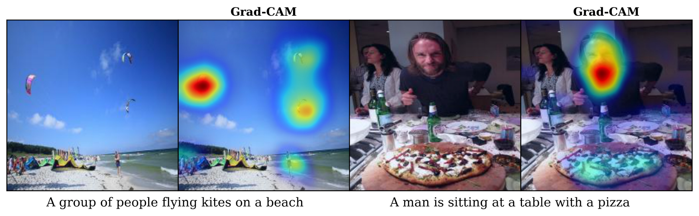
Grad-CAM for captioning
A group of people flying kites on a beach
A man is sitting at a table with a pizza
Notes:
For the image on the left, we use a simple non-attention based captioning model (NT2), which generated the particular caption "A group of people flying kites on a beach”
The Grad-CAM for that particular generated caption seems to look at the person and the kites which is intuitive

Slide 40
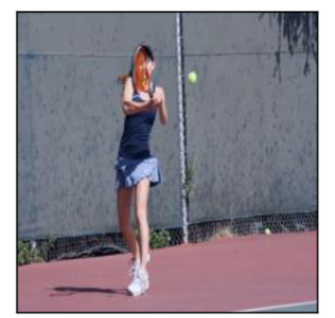
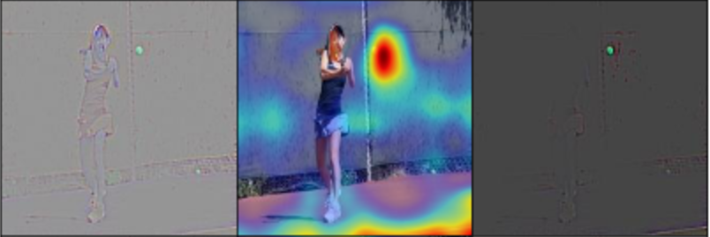
Grad-CAM for VQA
Guided Backprop
Grad-CAM
Guided Grad-CAM
VGG-16
Tennis ball
What is the person hitting?
Even simple non-attention based CNN+LSTM models attend to appropriate regions
Notes:
Here Is Grad-CAM applied to VQA where that task is, given an image such as this and a free-form question “What is the person hitting”, the model has to produce an answer.
Using Grad-CAM, in this case, we find that the model looks at the ball and a little bit of the context (in this case the court) to answer tennis ball.
So we see that even simple non-attention based CNN+LSTM models attend to appropriate regions.

Slide 41
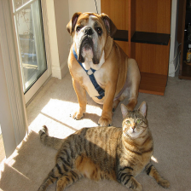
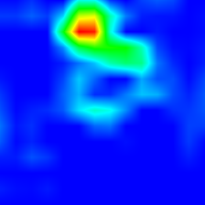
Grad-CAM Visual Explanations for VQA
What animal is in this picture? Dog
Slide Credit: Abhishek Das

Slide 42
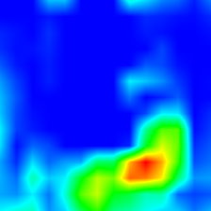
Grad-CAM Visual Explanations for VQA
What animal is in this picture? Cat
Slide Credit: Abhishek Das

Slide 43
Interesting findings with Grad-CAM
Even simple non-attention based CNN + LSTM models learn to look at appropriate regions
Unreasonable predictions often have reasonable explanations

Slide 44






Analyzing Failure modes with Grad-CAM
Even unreasonable predictions have reasonable explanations
Predicted: Car mirror
Predicted: Vine snake
Ground-truth: Volcano
Ground-truth: coil
Notes:
Given this image of the volcano, the model incorrectly predicted Car mirror. The Guided Grad-CAM explanation for this decision looks like a close-up of a car-mirror, which is very intuitive. And when we give it the ground-truth category it only looks at the volcano
Here is another example where the model predicted Vine Snake, and the visualization also looks like a vine snake. Again, Grad-CAM can localize the Ground-Truth category, coil.
This shows that reasonable predictions are made in many failure cases.

Slide 45

Demo

Slide 46
Plan for Today
What do individual neurons look for in images?
  Visualizing filters
  Last layer embeddings
  Visualizing activations
  Maximally activating patches
How pixels affect decisions?
  Occlusion maps
  Salient or “important” pixels
    Gradient-based visualizations
Do CNNs look at same regions as humans?
  How to evaluate visualizations?
Can we synthesize network-specific images?
  Creating “prototypical” images for a class
  Creating adversarial images
  Deep dream
  Feature inversion
Notes:
Here is what we will cover today
What do individual neurons look for in images?
What do neuron activations look like?
How every pixel affects decisions?
Can we generate images/patches that maximally activate a neuron?
Can we fool learned networks?

Slide 47
How we evaluate explanations?
Class-discriminative?
  Show what they say they found?
Building Trust with a User?
  Help users?
Human-like?
  Do machines look where humans look?

Slide 48

Is Grad-CAM more class discriminative?
Can people tell which class is being visualized?
    Images from Pascal VOC’07 with exactly 2 categories.
Intuition: A good explanation produces discriminative visualizations for the class of interest.
Slide Credit: Ram Selvaraju

Slide 49

Is Grad-CAM more class discriminative?
Human accuracy for 2-class classification
+17%
Grad-CAM makes existing visualizations class discriminative.
Slide Credit: Ram Selvaraju

Slide 50
Help establish trust with a user?
Given explanations from 2 models,
  VGG16 and AlexNet
which one is more trustworthy?
Pick images where both models = correct prediction
Show these to AMT workers and evaluate
Slide Credit: Ram Selvaraju

Slide 51




Help establish trust in a user?
Users place higher trust in a model that generalizes better.
Slide Credit: Ram Selvaraju

Slide 52
Do CNNs look at same regions as humans?

Slide 53


VQA-HAT (Human ATtention)

Slide 54

VQA-HAT (Human ATtention)
What food is on the table? Cake
Slide Credit: Abhishek Das

Slide 55

VQA-HAT (Human ATtention)
What animal is she riding? Horse
Slide Credit: Abhishek Das

Slide 56

VQA-HAT (Human ATtention)
What number of cats are laying on the bed? 2
Slide Credit: Abhishek Das

Slide 57



Are Grad-CAM explanations human-like?
Correlation with human attention maps
[Das & Agarwal et al. EMNLP’16]
What are they doing?
Grad-CAM for ‘eating’
Human ATtention map (HAT) for ‘eating’
Current models look at regions more similar to humans than baselines
HAT
Guided Backpropagation
0.122
Guided Grad-CAM
0.136
Slide Credit: Ram Selvaraju
Notes:
Das and Agrawal et al collected attention maps which indicate where the humans would have to look in-order to answer the question. Here are some quantitative and qualitative results showing how Grad-CAM maps from a simple non-attention based VQA model compares to human attention maps.
We see that current models look at regions more similar to humans than baselines.
(Compared to other approaches, Grad-CAM explanations indicate that current models somewhat look at the same regions as humans)

Slide 58
Plan for Today
What do individual neurons look for in images?
  Visualizing filters
  Last layer embeddings
  Visualizing activations
  Maximally activating patches
How pixels affect decisions?
  Occlusion maps
  Salient or “important” pixels
    Gradient-based visualizations
Do CNNs look at same regions as humans?
  How to evaluate visualizations?
Can we synthesize network-specific images?
  Creating “prototypical” images for a class
  Creating adversarial images
  Deep dream: amplifying detected features
  Feature inversion

Slide 59
Can we synthesize network-specific images?

Slide 60
Generating prototypical images for a class
Notes:
Can we get an image that is representative of a class?

Slide 61
Visualizing CNN features: Gradient Ascent on Pixels
(Guided) backprop:
Find the part of an image that a neuron responds to?
Gradient ascent on pixels:
Generate a synthetic image that maximally activates a neuron
I* = arg max_{I} f(I) + R(I)
Neuron value
Natural image regularizer
Slide Credit: Fei-Fei Li, Justin Johnson, Serena Yeung, CS 231n
Notes:
We are asking what type of input in general would cause this neuron to activate?
We can answer this question using a technique called Gradient ascent.
We always used Gradient decent to train our convolutional networks by minimizing the loss. Instead now, we want to fix the weight of our trained convolutional network and instead synthesizing image by performing Gradient ascent on the pixels of the image to try and maximize the score of some intermediate neuron or of some class.
Regularization terms to try to prevent the network weights from over fitting to the training data. Now, we need something kind of similar to prevent the pixels of our generated image from over fitting to the peculiarities of that particular network.

Slide 62

Visualizing CNN features: Gradient Ascent on Pixels
Initialize image to zeros
score for class c (before Softmax)
zero image
Repeat:
2. Forward image to compute current scores
3. Backprop to get gradient of neuron value with respect to image pixels
4. Make a small update to the image
Slide Credit: Fei-Fei Li, Justin Johnson, Serena Yeung, CS 231n
Notes:
What we'll do is start with some initial image either initializing to zeros or to uniform or noise.
We then forward your image through the network and compute the score for a class that you're interested. Now, back propagate to compute the Gradient of that neuron score with respect to the pixels of the image and then make a small Gradient ascent or Gradient ascent update to the pixels of the images itself. To try and maximize that score. And I'll repeat this process over and over again, until you have a beautiful image.

Slide 63
Visualizing CNN features: Gradient Ascent on Pixels
Simple regularizer: Penalize L2 norm of generated image
Simonyan, Vedaldi, and Zisserman, “Deep Inside Convolutional Networks: Visualising Image Classification Models and Saliency Maps”, ICLR Workshop 2014.
Figures copyright Karen Simonyan, Andrea Vedaldi, and Andrew Zisserman, 2014; reproduced with permission.
Slide Credit: Fei-Fei Li, Justin Johnson, Serena Yeung, CS 231n
Notes:
A very simple, a very simple idea for image regularizer is simply to penalize L2 norm of a generated image
This is not so semantically meaningful, it's just does something, and this was one of the earliest regularizer that we've seen in the literature
Without regularizer, you will see random noises imperceptible to human eyes
That kind of doesn't help you so much for understanding what things the network is looking for. So, if we want to understand, why the network thing makes its decisions then it's kind of useful to put regularizer on there to generate an image to look more natural.

Slide 64

Visualizing CNN features: Gradient Ascent on Pixels
Simple regularizer: Penalize L2 norm of generated image
Simonyan, Vedaldi, and Zisserman, “Deep Inside Convolutional Networks: Visualising Image Classification Models and Saliency Maps”, ICLR Workshop 2014.
Figures copyright Karen Simonyan, Andrea Vedaldi, and Andrew Zisserman, 2014; reproduced with permission.
Slide Credit: Fei-Fei Li, Justin Johnson, Serena Yeung, CS 231n
Notes:
And, when you run this on a trained network you can see that now we're trying to generate images that maximizes the dumbell score in the upper left hand corner here for example.

Slide 65


Slide 66

Visualizing CNN features: Gradient Ascent on Pixels
Simple regularizer: Penalize L2 norm of generated image
Yosinski et al, “Understanding Neural Networks Through Deep Visualization”, ICML DL Workshop 2014.
Figure copyright Jason Yosinski, Jeff Clune, Anh Nguyen, Thomas Fuchs, and Hod Lipson, 2014. Reproduced with permission.
Slide Credit: Fei-Fei Li, Justin Johnson, Serena Yeung, CS 231n

Slide 67
Can neural networks be fooled?

Slide 68
Fooling Images / Adversarial Examples
Start from an arbitrary image
Pick an arbitrary class
Modify the image to maximize the class
Repeat until network is fooled
Slide Credit: Fei-Fei Li, Justin Johnson, Serena Yeung, CS 231n
Notes:
So, what we can do is pick some arbitrary image (instead of a zero image), and then try to maximize the score for an arbitrary class. Repeat until the network is fooled

Slide 69


Fooling Images / Adversarial Examples
Boat image is CC0 public domain
Elephant image is CC0 public domain
Slide Credit: Fei-Fei Li, Justin Johnson, Serena Yeung, CS 231n
Notes:
so, say we take it picture of an elephant and then we tell the network that we want to, change the image to maximize the score of Koala bear instead So, then what we were doing is trying to change that image of an elephant to try and instead cause the network to classify as a Koala bear. And, what you might hope for is that, maybe that elephant was sort of thought more thing into a Koala bear and maybe he would sprout little cute ears or something like that. But, that's not what happens in practice, which is pretty surprising. Instead if you take this picture of a elephant and tell them that, tell them that and try to change the elephant image to instead cause it to be classified as a koala bear What you'll find is that, you is that this second image on the right actually is classified as koala bear but it looks the same to us. So that's pretty fishy and pretty surprising
So also on the bottom we've taken this picture of a boat. Schooner is the image in that class and then we told the network to classified as an iPod. So now the second example looks just, still looks like a boat to us but the network thinks it's an iPod and the difference is in pixels between these two images are basically nothing. And if you magnify those differences you don't really see any iPod or Koala like features on these differences, they're just kind of like random patterns of noise. So the question is what's going here? And like how can this possibly the case?

Slide 70

DeepDream: Amplify existing features
Rather than synthesizing an image to maximize a specific neuron, instead try to amplify the neuron activations at some layer in the network
Choose an image and a layer in a CNN; repeat:
Forward: compute activations at chosen layer
Set gradient of chosen layer equal to its activation
Backward: Compute gradient on image
Update image
Mordvintsev, Olah, and Tyka, “Inceptionism: Going Deeper into Neural Networks”, Google Research Blog. Images are licensed under CC-BY 4.0
Slide Credit: Fei-Fei Li, Justin Johnson, Serena Yeung, CS 231n
Notes:
So another cool thing we can do with this gradient based optimization of images is this idea of DeepDream. So this was a really cool blog post that came out from Google several years ago. The point of this exercise is mostly to generate cool images.

Slide 71
DeepDream: Amplify existing features
Rather than synthesizing an image to maximize a specific neuron, instead try to amplify the neuron activations at some layer in the network
Choose an image and a layer in a CNN; repeat:
Forward: compute activations at chosen layer
Set gradient of chosen layer equal to its activation
Backward: Compute gradient on image
Update image
Equivalent to:
I* = arg max_{I} ∑_{i} f_{i}(I)²
Mordvintsev, Olah, and Tyka, “Inceptionism: Going Deeper into Neural Networks”, Google Research Blog. Images are licensed under CC-BY 4.0
Slide Credit: Fei-Fei Li, Justin Johnson, Serena Yeung, CS 231n
Notes:
So we can do is, we take our input image we run it through the convolutional network up to some layer and now we back propagate and set the gradient of that, at that layer equal to the activation value. And now back propagate, back to the image and update the image and repeat, repeat, repeat. So this has the interpretation of trying to amplify existing features that were detected by the network in this image. Right?
Because whatever features existed on that layer now we set the gradient equal to the feature and we just tell the network to amplify whatever features you already saw in that image. And by the way you can also see this as trying to maximize the L2 norm of the features at that layer of the image.

Slide 72

Sky image is licensed under CC-BY SA 3.0
Slide Credit: Fei-Fei Li, Justin Johnson, Serena Yeung, CS 231n

Slide 73

Image is licensed under CC-BY 4.0
Slide Credit: Fei-Fei Li, Justin Johnson, Serena Yeung, CS 231n

Slide 74

Image is licensed under CC-BY 4.0
Slide Credit: Fei-Fei Li, Justin Johnson, Serena Yeung, CS 231n

Slide 75
Given the feature vector can you reconstruct the image?

Slide 76



Feature Inversion
Given a CNN feature vector for an image, find a new image that:
Matches the given feature vector
“looks natural” (image prior regularization)
Given feature vector
Features of new image
Total Variation regularizer (encourages spatial smoothness)
Mahendran and Vedaldi, “Understanding Deep Image Representations by Inverting Them”, CVPR 2015
Slide Credit: Fei-Fei Li, Justin Johnson, Serena Yeung, CS 231n
Notes:
With the same tools that we have seen before, we can determine what information the network retains and what information is lost and so on.
Say you have a black box cnn, now it gives a feature vector. Can you reconstruct the image from the feature vector?
So another kind of useful thing we can do is this concept of feature inversion. So this again gives us a sense what types of elements of the image are captured at different layers of the network. So what we're going to do now is we're going to take an image, run that image through network record the feature value for one of those images and now we're going to try to reconstruct that image from its feature representation. And the question, and now based on the how much, how much like what that reconstructed image looks like that'll give us some sense for what type of information about the image was captured in that feature vector. So again, we can do this with gradient ascent with some regularizer. Where now rather than maximizing some score instead we want to minimize the distance between this catch feature vector. And between the computed features of our generated image. To try and again synthesize a new image that matches the feature back to that we computed before. And another kind of regularizer that you frequently see here is the total variation regularizer
So here with the total variation regularizer is panelizing differences between adjacent pixels on both of the left and adjacent in left and right and adjacent top to bottom. To again try to encourage special smoothness in the generated image.

Slide 77

Feature Inversion
Reconstructing from different layers of VGG-16
Mahendran and Vedaldi, “Understanding Deep Image Representations by Inverting Them”, CVPR 2015
Figure from Johnson, Alahi, and Fei-Fei, “Perceptual Losses for Real-Time Style Transfer and Super-Resolution”, ECCV 2016. Copyright Springer, 2016. Reproduced for educational purposes.
Slide Credit: Fei-Fei Li, Justin Johnson, Serena Yeung, CS 231n
Notes:
Relu doesnt seem to lose all information.
This kind of visualization tells us what kind of information is retained what is lost and so on.
as we move up through the layers of the network it's kind of throwing away this low level information about the exact pixels of the image and instead is trying to keep around a little bit more semantic information
So now if we do this idea of feature inversion so this visualization here on the left we're showing some original image. The elephants or the fruits at the left. And then we run that, we run the image through a VGG-16 network. Record the features of that network at some layer and then try to synthesize a new image that matches the recorded features of that layer. And this is, this kind of give us a sense for what how much information is stored in this images. In these features of different layers. So for example if we try to reconstruct the image based on the relu2_2 features from VGC's, from VGG-16. We see that the image gets almost perfectly reconstructed. Which means that we're not really throwing away much information about the raw pixel values at that layer. But as we move up into the deeper parts of the network and try to reconstruct from relu4_3, relu5_1. We see that our reconstructed image now, we've kind of kept the general space, the general spatial structure of the image. You can still tell that, that it's a elephant or a banana or a, or an apple. But a lot of the low level details aren't exactly what the pixel values were and exactly what the colors were, exactly what the textures were. These are kind of low level details are kind of lost at these higher layers of this network. So that gives us some sense that maybe as we move up through the flairs of the network it's kind of throwing away this low level information about the exact pixels of the image and instead is maybe trying to keep around a little bit more semantic information, it's a little bit invariant for small changes in color and texture and things like that. So we're building towards a style transfer here

