Slide 1
CS 4803 / 7643: Deep Learning
Topics:
  Convolutional Neural Networks
    Pooling layers
    Fully-connected layers as convolutions
    Backprop in conv layers [Derived in notes]
    Toeplitz matrices and convolutions = matrix-mult
Dhruv Batra
Georgia Tech

Slide 2
Administrativia
HW1 Reminder
  Due: 09/26, 11:55pm
  https://evalai.cloudcv.org/web/challenges/challenge-page/431/leaderboard/1200
Project Teams Google Doc
  https://docs.google.com/spreadsheets/d/1ouD6ctaemV_3nb2MQHs7rUOAaW9DFLu8I5Zd3yOFs7E/edit?usp=sharing
  Project Title
  1-3 sentence project summary TL;DR
  Team member names

Slide 3

Administrativia
Guest Lecture: Dr. Zhile Ren
  Next class (09/26)
  CNN architectures for 2D & 3D Detection & Segmentation

Slide 4
Recap from last time

Slide 5
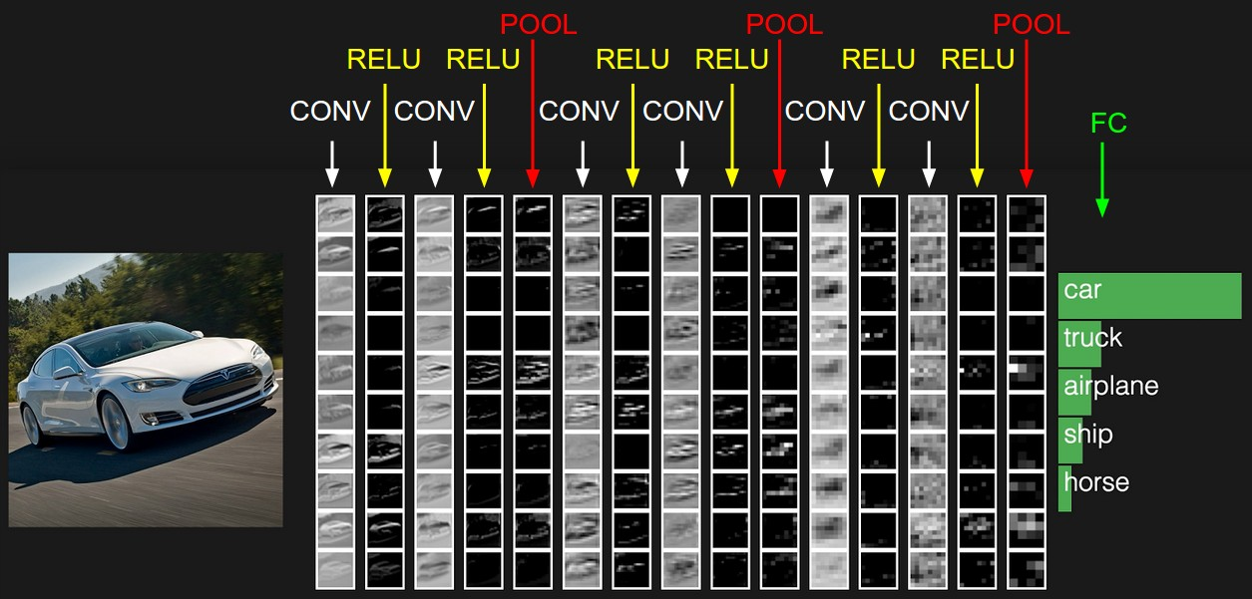
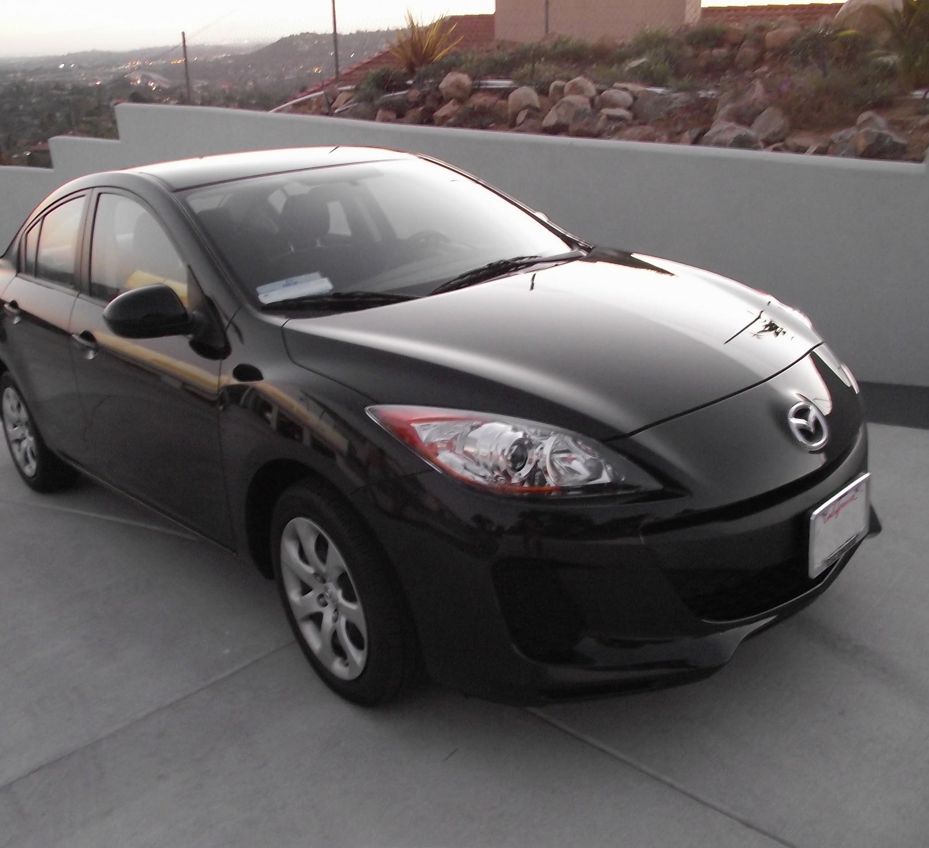
preview:
Slide Credit: Fei-Fei Li, Justin Johnson, Serena Yeung, CS 231n
Notes:
Convnet is stack of layers
Look at how an image progresses through the network, and sizes of output after each layer
Car image is photo taken by Lane McIntosh, permission to use.

Slide 6
A closer look at spatial dimensions:
7
7x7 input (spatially)
assume 3x3 filter
7
Slide Credit: Fei-Fei Li, Justin Johnson, Serena Yeung, CS 231n

Slide 7
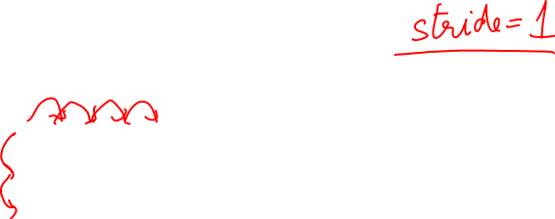
A closer look at spatial dimensions:
7
7x7 input (spatially)
assume 3x3 filter
=> 5x5 output
7
Slide Credit: Fei-Fei Li, Justin Johnson, Serena Yeung, CS 231n

Slide 8
A closer look at spatial dimensions:
7
7x7 input (spatially)
assume 3x3 filter
applied with stride 2
=> 3x3 output!
7
Slide Credit: Fei-Fei Li, Justin Johnson, Serena Yeung, CS 231n

Slide 9
A closer look at spatial dimensions:
7
7x7 input (spatially)
assume 3x3 filter
applied with stride 3?
7
Slide Credit: Fei-Fei Li, Justin Johnson, Serena Yeung, CS 231n

Slide 10
N
Output size:
(N - F) / stride + 1
e.g. N = 7, F = 3:
stride 1 => (7 - 3)/1 + 1 = 5
stride 2 => (7 - 3)/2 + 1 = 3
stride 3 => (7 - 3)/3 + 1 = 2.33 :\
F
N
Slide Credit: Fei-Fei Li, Justin Johnson, Serena Yeung, CS 231n

Slide 11
In practice: Common to zero pad the border
0 | 0 | 0 | 0 | 0 | 0
0
0
0
0
e.g. input 7x7
3x3 filter, applied with stride 1
pad with 1 pixel border => what is the output?
(recall:)
(N - F) / stride + 1
Slide Credit: Fei-Fei Li, Justin Johnson, Serena Yeung, CS 231n

Slide 12
In practice: Common to zero pad the border
0 | 0 | 0 | 0 | 0 | 0
0
0
0
0
e.g. input 7x7
3x3 filter, applied with stride 1
pad with 1 pixel border => what is the output?
7x7 output!
in general, common to see CONV layers with stride 1, filters of size FxF, and zero-padding with (F-1)/2. (will preserve size spatially)
e.g. F = 3 => zero pad with 1
F = 5 => zero pad with 2
F = 7 => zero pad with 3
Slide Credit: Fei-Fei Li, Justin Johnson, Serena Yeung, CS 231n

Slide 13
Can we have 1x1 filters?

Slide 14
1x1 convolution layers make perfect sense
1x1 CONV
with 32 filters
56
56
(each filter has size 1x1x64, and performs a 64-dimensional dot product)
56
56
64
32
Slide Credit: Fei-Fei Li, Justin Johnson, Serena Yeung, CS 231n

Slide 15
Plan for Today
Convolutional Neural Networks
  Pooling layers
  Fully-connected layers as convolutions
  Backprop in conv layers [Derived in notes]
  Toeplitz matrices and convolutions = matrix-mult

Slide 16
two more layers to go: POOL/FC
Slide Credit: Fei-Fei Li, Justin Johnson, Serena Yeung, CS 231n
Notes:
Car image is photo taken by Lane McIntosh, permission to use.

Slide 17
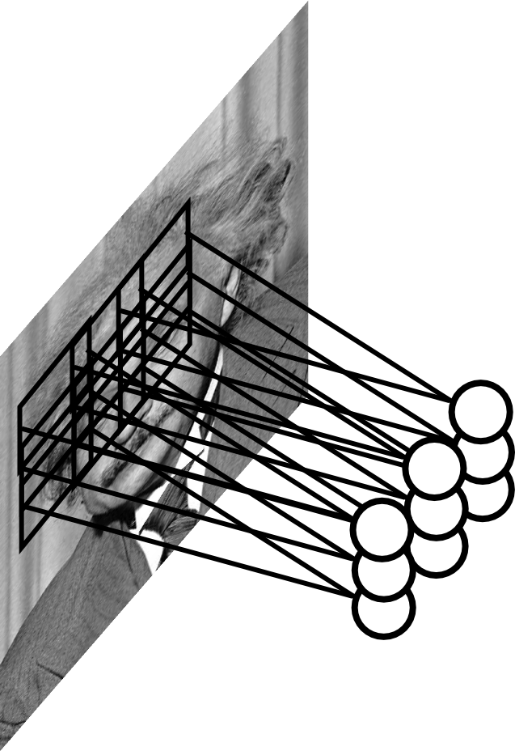
Pooling Layer
Let us assume filter is an “eye” detector.
Q.: how can we make the detection robust to the exact location of the eye?
Slide Credit: Marc'Aurelio Ranzato

Slide 18
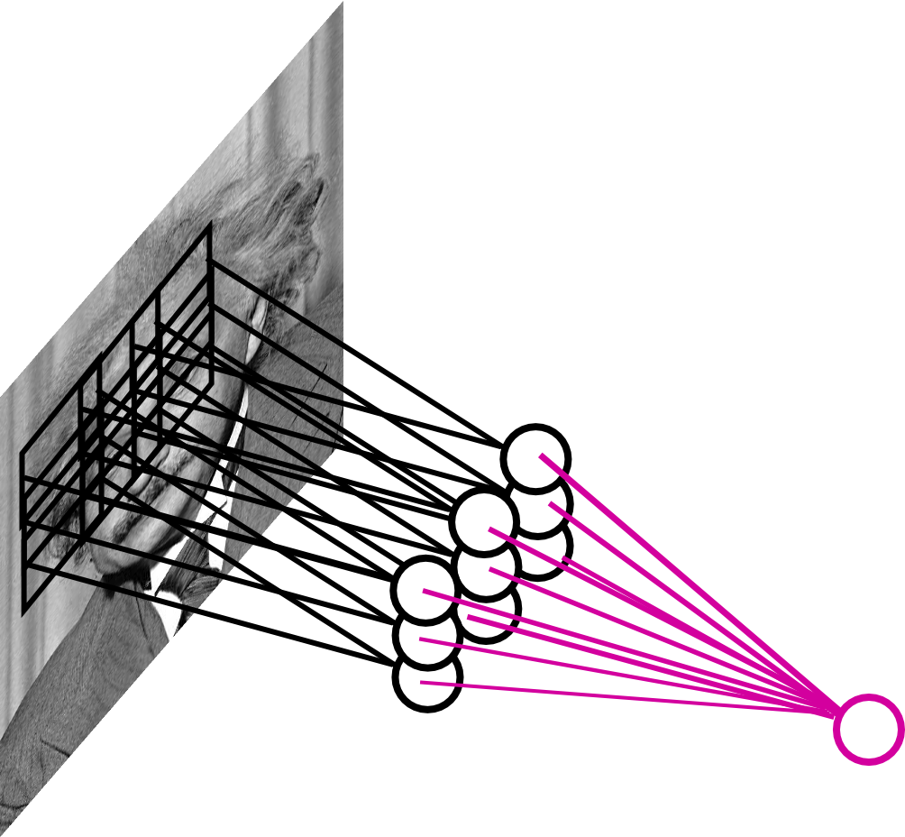
Pooling Layer
By “pooling” (e.g., taking max) filter
responses at different locations we gain robustness to the exact spatial location of features.
Slide Credit: Marc'Aurelio Ranzato

Slide 19
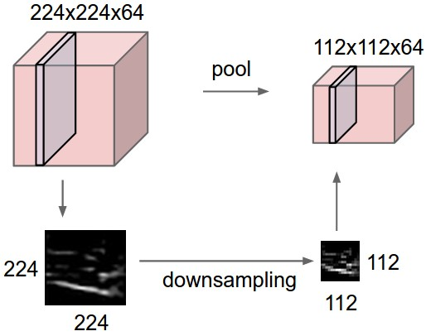
Pooling layer
makes the representations smaller and more manageable
operates over each activation map independently:
Slide Credit: Fei-Fei Li, Justin Johnson, Serena Yeung, CS 231n

Slide 20
MAX POOLING
Single depth slice
1 | 1 | 2 | 4
5 | 6 | 7 | 8
3 | 2 | 1 | 0
1 | 2 | 3 | 4
dim 1
max pool with 2x2 filters and stride 2
6 | 8
3 | 4
dim 2
Slide Credit: Fei-Fei Li, Justin Johnson, Serena Yeung, CS 231n

Slide 21
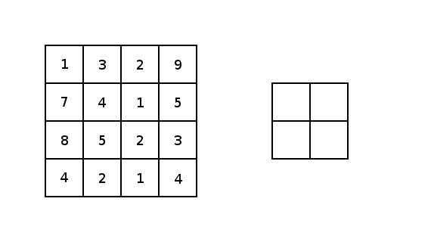
Image courtesy: Justin Francis.

Slide 22
Pooling Layer: Examples
Max-pooling:
Average-pooling:
L2-pooling:
Slide Credit: Marc'Aurelio Ranzato

Slide 23
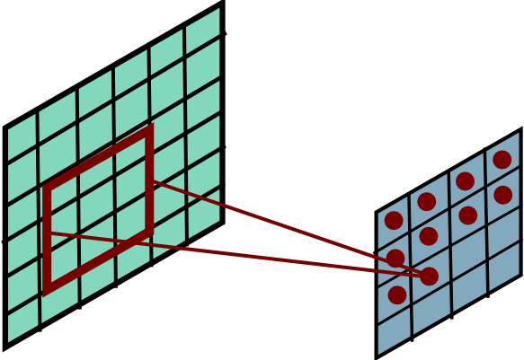
Receptive Field
Conv.
layer
Pool.
layer
Slide Credit: Marc'Aurelio Ranzato

Slide 24
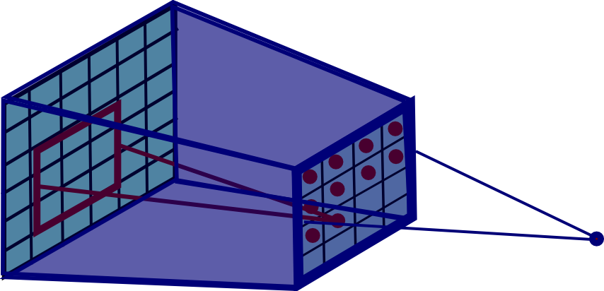
Pooling Layer: Receptive Field Size
Conv.
layer
Pool.
layer
Slide Credit: Marc'Aurelio Ranzato

Slide 25
Pooling Layer: Receptive Field Size
Conv.
layer
Pool.
layer
If convolutional filters are FxF and stride 1, and
pooling layer has pools of size PxP,
then each unit in the pooling layer depends upon a patch in h^{(l-1)} of size: (P+F-1)x(P+F-1)
Slide Credit: Marc'Aurelio Ranzato

Slide 26
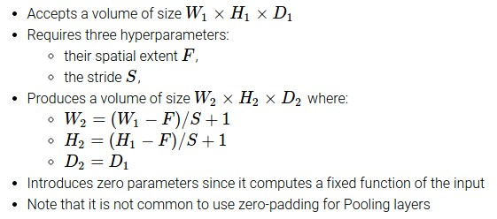
Slide Credit: Fei-Fei Li, Justin Johnson, Serena Yeung, CS 231n

Slide 27
Common settings:
F = 2, S = 2
F = 3, S = 2
Slide Credit: Fei-Fei Li, Justin Johnson, Serena Yeung, CS 231n

Slide 28
Fully Connected Layer (FC layer)
Contains neurons that connect to the entire input volume, as in ordinary Neural Networks
Slide Credit: Fei-Fei Li, Justin Johnson, Serena Yeung, CS 231n
Notes:
Car image is photo taken by Lane McIntosh, permission to use.

Slide 29
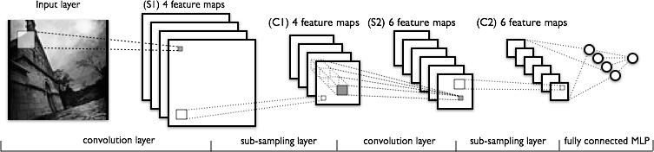
Convolutional Neural Networks
Image Credit: Yann LeCun, Kevin Murphy

Slide 30
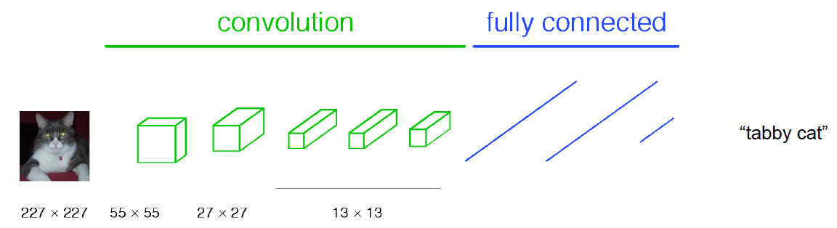
Classical View
Figure Credit: [Long, Shelhamer, Darrell CVPR15]

Slide 31
C₂ hidden units
NxNxC₁, N small
Fully conn. layer
Slide Credit: Marc'Aurelio Ranzato

Slide 32
Classical View
Figure Credit: [Long, Shelhamer, Darrell CVPR15]

Slide 33
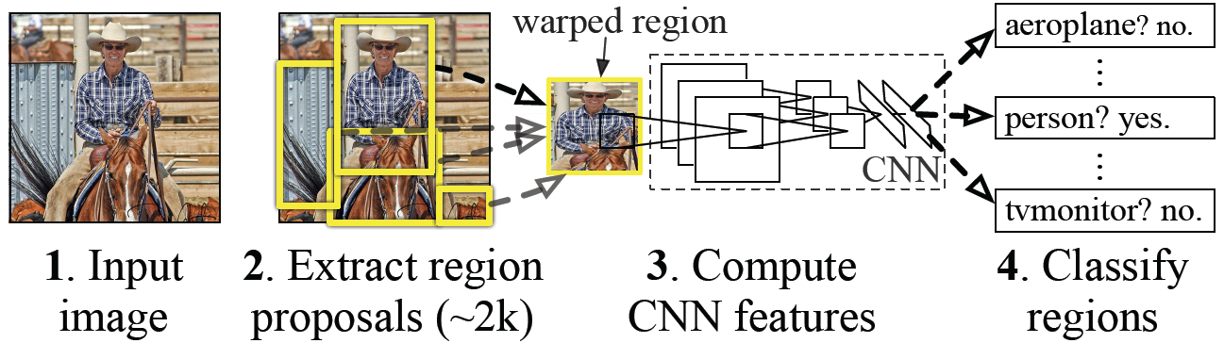
Classical View = Inefficient

Slide 34
Classical View
Figure Credit: [Long, Shelhamer, Darrell CVPR15]

Slide 35
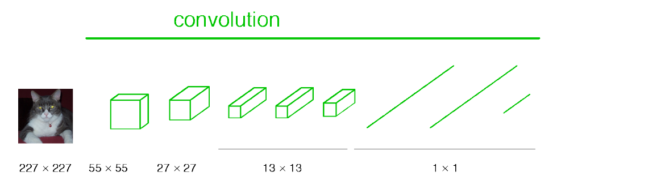
Re-interpretation
Just squint a little!
Figure Credit: [Long, Shelhamer, Darrell CVPR15]

Slide 36
C₂ hidden units /
1x1xC₂ feature maps
NxNxC₁, N small
Fully conn. layer /
Conv. layer (C₂ kernels of size NxNxC₁)
Slide Credit: Marc'Aurelio Ranzato

Slide 37
Re-interpretation
Just squint a little!
Figure Credit: [Long, Shelhamer, Darrell CVPR15]

Slide 38
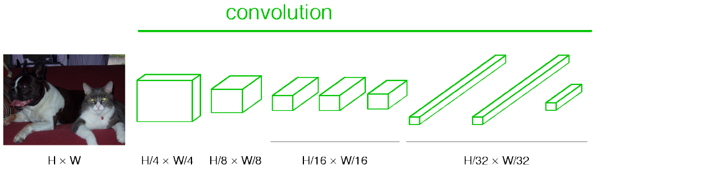
“Fully Convolutional” Networks
Can run on an image of any size!
Figure Credit: [Long, Shelhamer, Darrell CVPR15]

Slide 39
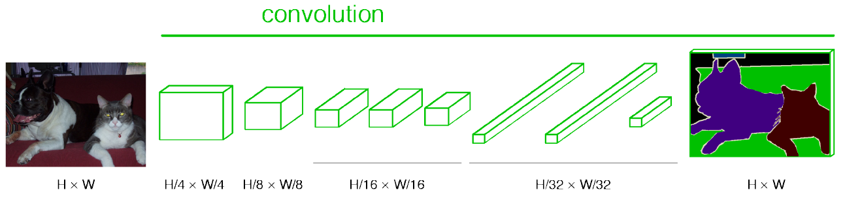
“Fully Convolutional” Networks
Up-sample to get segmentation maps
Figure Credit: [Long, Shelhamer, Darrell CVPR15]

Slide 40
Benefit of this thinking
Mathematically elegant
Efficiency
  Can run network on arbitrary image
  Without multiple crops

Slide 41
Plan for Today
Convolutional Neural Networks
  Pooling layers
  Fully-connected layers as convolutions
  Backprop in conv layers [Derived in notes]
  Toeplitz matrices and convolutions = matrix-mult

Slide 42
Computational Graph
Any DAG of differentiable modules is allowed!
Slide Credit: Marc'Aurelio Ranzato

Slide 43
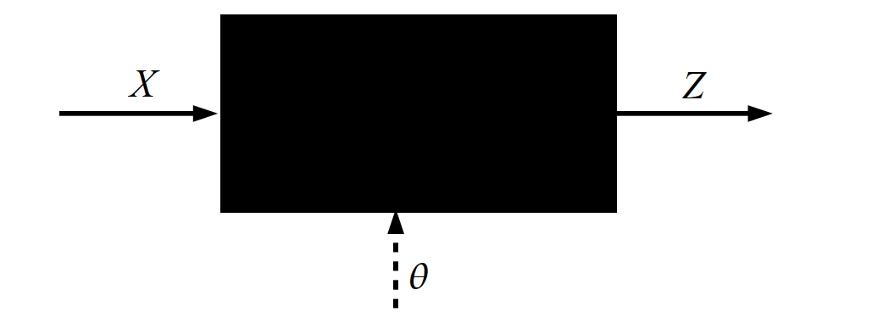
Key Computation: Forward-Prop
Slide Credit: Marc'Aurelio Ranzato, Yann LeCun

Slide 44
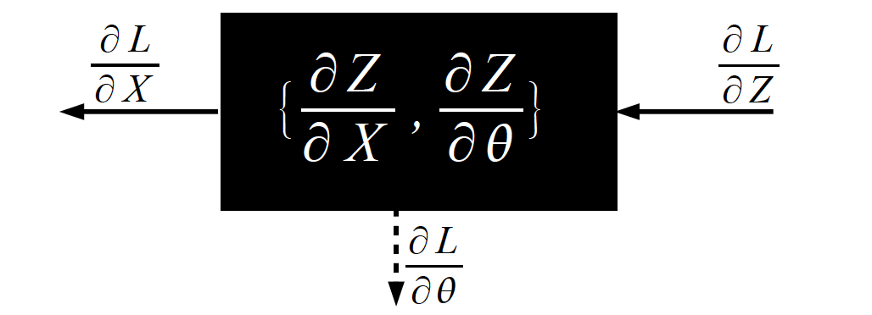
Key Computation: Back-Prop
Slide Credit: Marc'Aurelio Ranzato, Yann LeCun

Slide 45
Backprop in Convolutional Layers
Notes
  https://www.cc.gatech.edu/classes/AY2020/cs7643_fall/slides/L11_cnns_backprop_notes

Slide 46
Backprop in Convolutional Layers

Slide 47
Backprop in Convolutional Layers

Slide 48
Backprop in Convolutional Layers

Slide 49
Plan for Today
Convolutional Neural Networks
  Pooling layers
  Fully-connected layers as convolutions
  Backprop in conv layers [Derived in notes]
  Toeplitz matrices and convolutions = matrix-mult

Slide 50
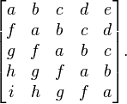
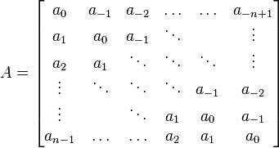
Toeplitz Matrix
Diagonals are constants
A_{ij} = a_{i-j}

Slide 51
Why do we care?
(Discrete) Convolution = Matrix Multiplication
  with Toeplitz Matrices
. . .

Slide 52
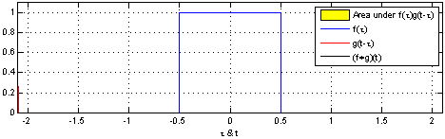
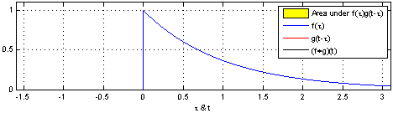
"Convolution of box signal with itself2" by Convolution_of_box_signal_with_itself.gif: Brian Ambergderivative work: Tinos (talk) - Convolution_of_box_signal_with_itself.gif. Licensed under CC BY-SA 3.0 via Commons - https://commons.wikimedia.org/wiki/File:Convolution_of_box_signal_with_itself2.gif#/media/File:Convolution_of_box_signal_with_itself2.gif

Slide 53
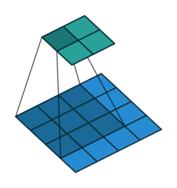
Figure Credit: Dumoulin and Visin, https://arxiv.org/pdf/1603.07285.pdf

Slide 54
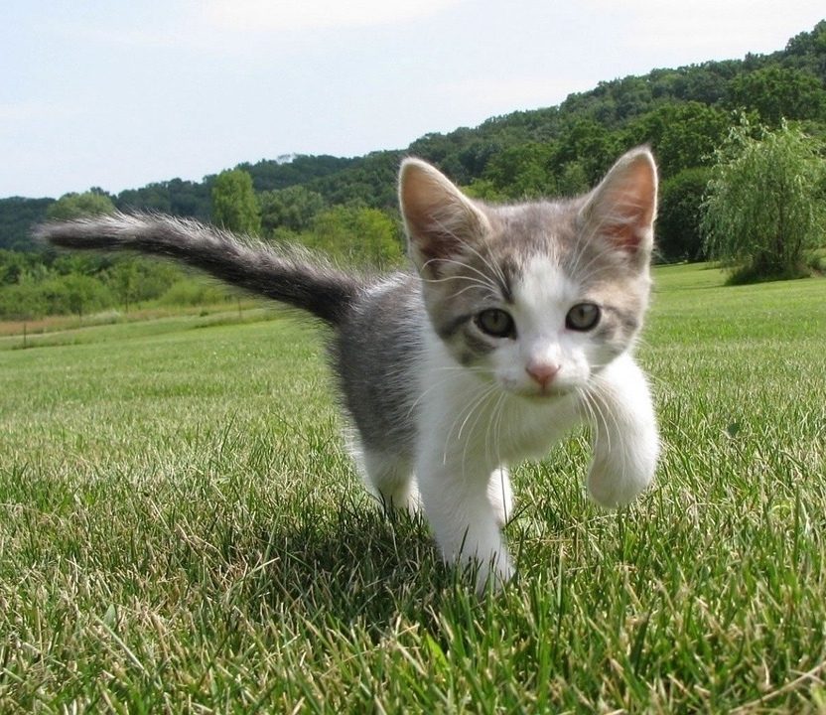
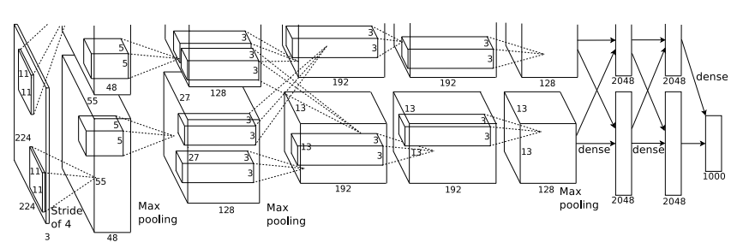
So far: Image Classification
Class Scores
Cat: 0.9
Dog: 0.05
Car: 0.01
...
Fully-Connected:
4096 to 1000
This image is CC0 public domain
Figure copyright Alex Krizhevsky, Ilya Sutskever, and Geoffrey Hinton, 2012. Reproduced with permission.
Vector:
4096
Slide Credit: Fei-Fei Li, Justin Johnson, Serena Yeung, CS 231n

Slide 55
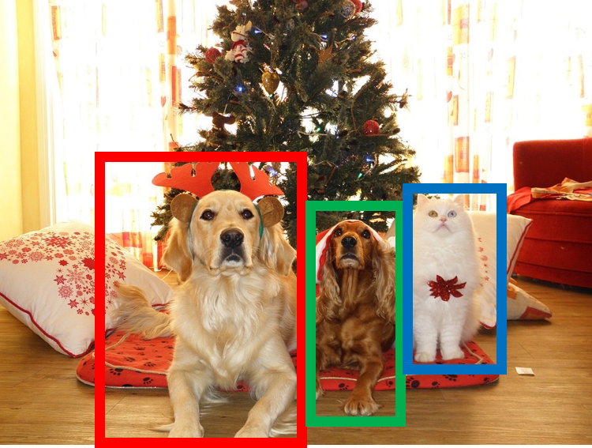
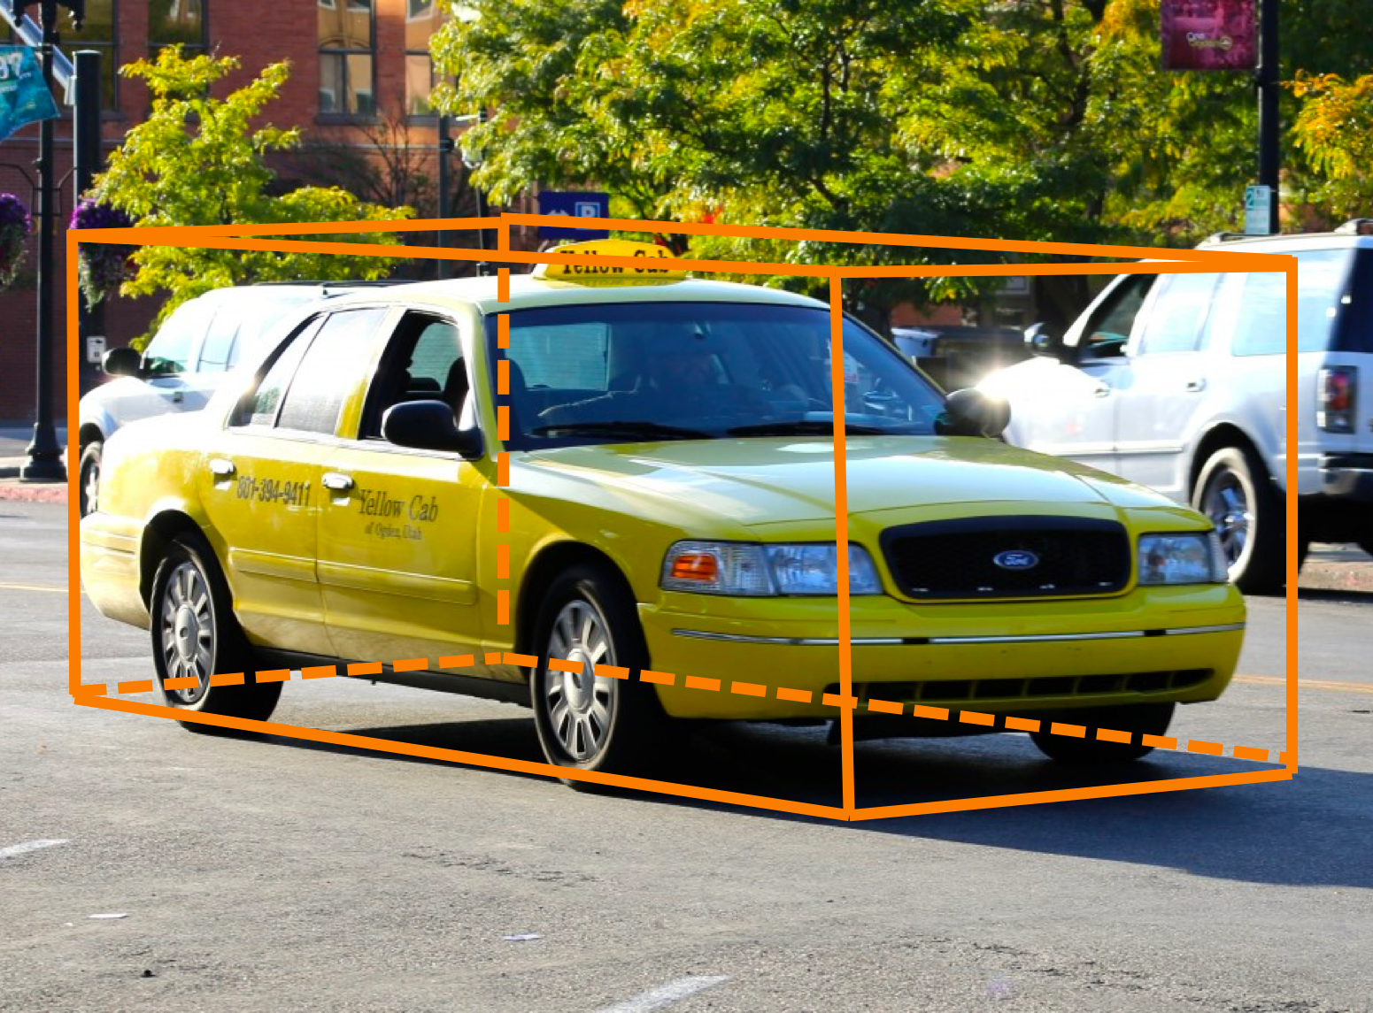
Other Computer Vision Tasks
Semantic
Segmentation
2D Object
Detection
3D Object
Detection
GRASS, CAT, TREE, SKY
DOG, DOG, CAT
Car
Object categories +
2D bounding boxes
Object categories +
3D bounding boxes
No objects, just pixels
This image is CC0 public domain
Slide Credit: Fei-Fei Li, Justin Johnson, Serena Yeung, CS 231n

Slide 56
Semantic Segmentation
Semantic
Segmentation
2D Object
Detection
3D Object
Detection
GRASS, CAT, TREE, SKY
DOG, DOG, CAT
Car
Object categories +
2D bounding boxes
Object categories +
3D bounding boxes
No objects, just pixels
This image is CC0 public domain
Notes:
Given this cute cat picture, the image classification task would be looking at this picture and ouput a single label cat

Slide 57
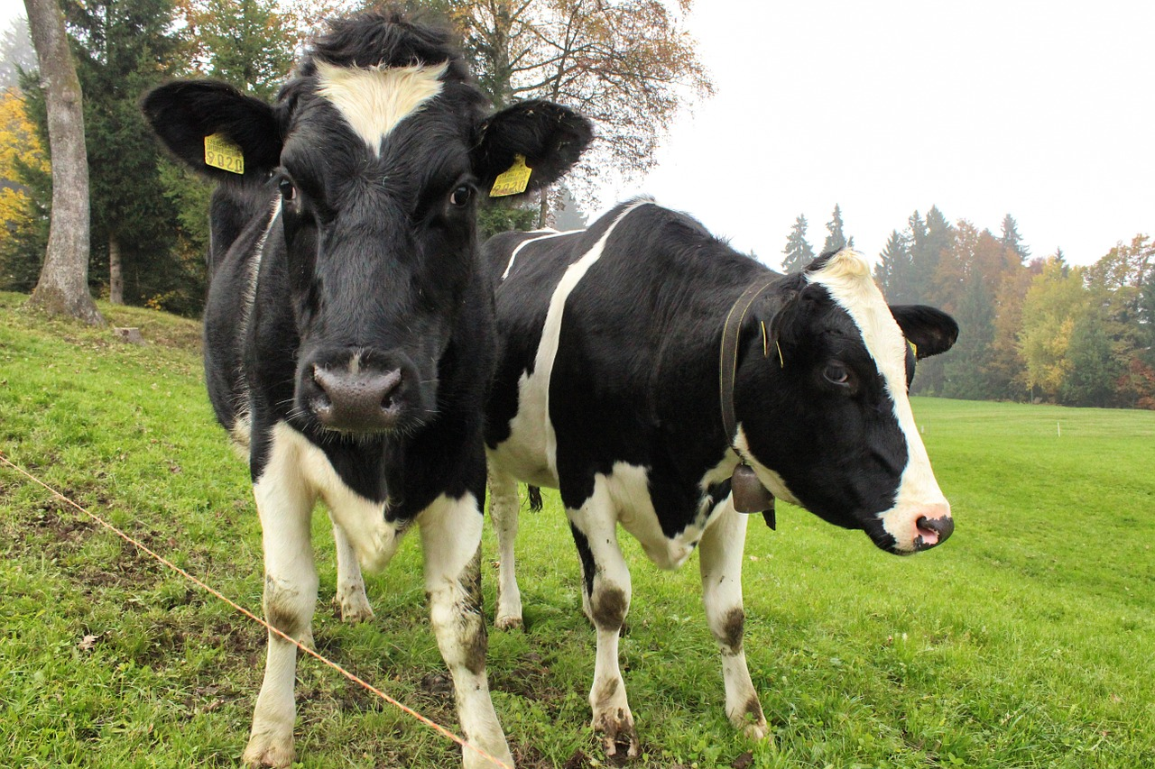
Semantic Segmentation
This image is CC0 public domain
Label each pixel in the image with a category label
Don’t differentiate instances, only care about pixels
Sky
Trees
Sky
Trees
Cat
Cow
Grass
Grass
Slide Credit: Fei-Fei Li, Justin Johnson, Serena Yeung, CS 231n

