Slide 1
CS 4803 / 7643: Deep Learning
Topics:
  (Finish) Computational Graphs
    Notation + example
  (Finish) Computing Gradients
    Forward mode vs Reverse mode AD
    Patterns in backprop
    Backprop in FC+ReLU NNs
Dhruv Batra
Georgia Tech

Slide 2
Administrativia
HW1 Reminder
  Due: 10/02, 11:55pm
    https://www.cc.gatech.edu/classes/AY2019/cs7643_fall/assets/hw1.pdf
    https://www.cc.gatech.edu/classes/AY2019/cs7643_fall/hw1-q6/

Slide 3
Recap from last time

Slide 4
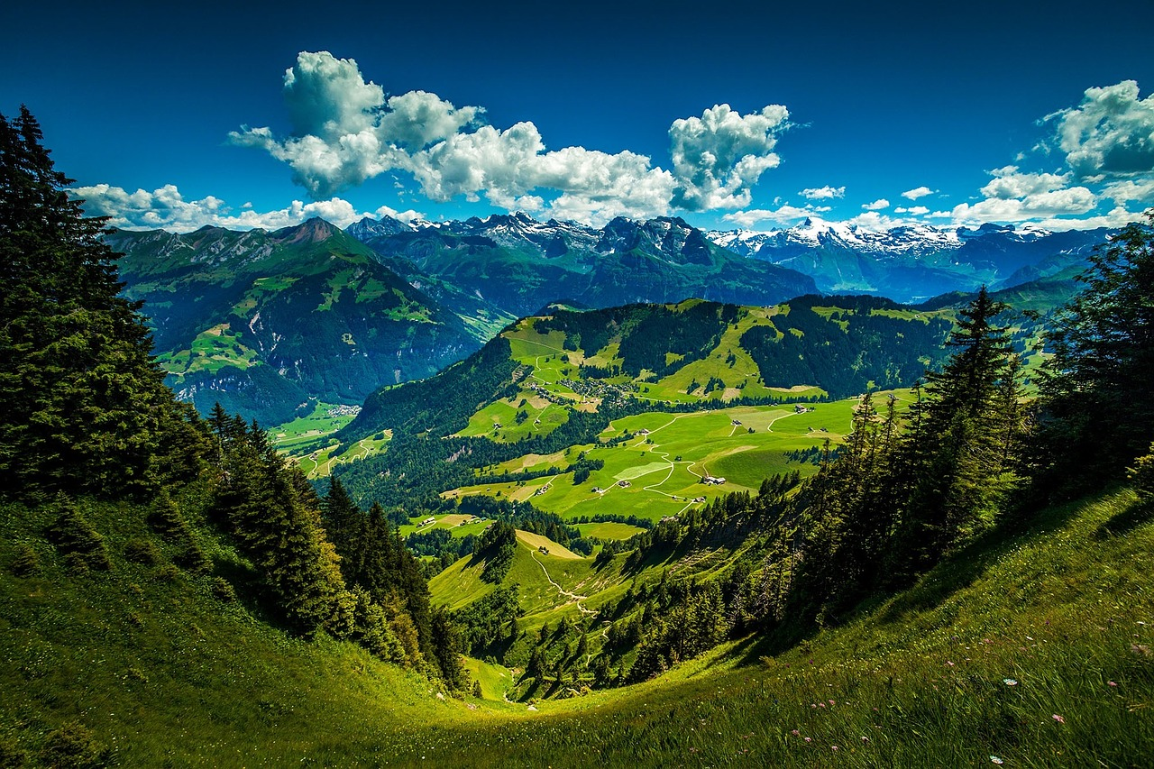

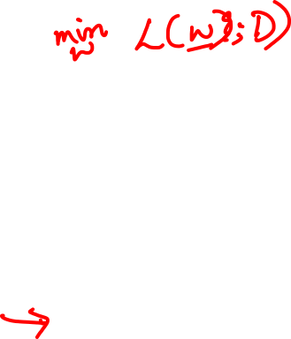
Strategy: Follow the slope
Slide Credit: Fei-Fei Li, Justin Johnson, Serena Yeung, CS 231n

Slide 5
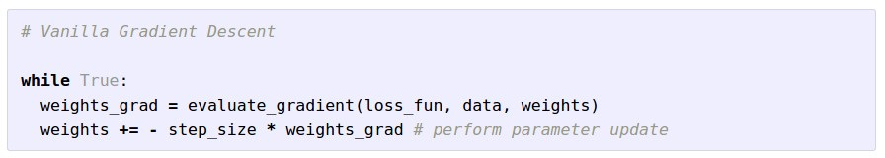

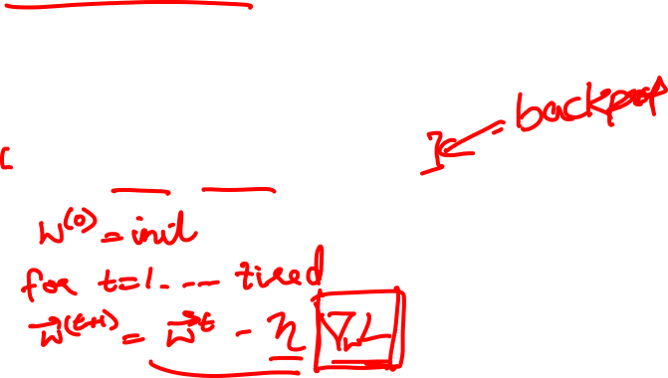
Gradient Descent
Slide Credit: Fei-Fei Li, Justin Johnson, Serena Yeung, CS 231n

Slide 6
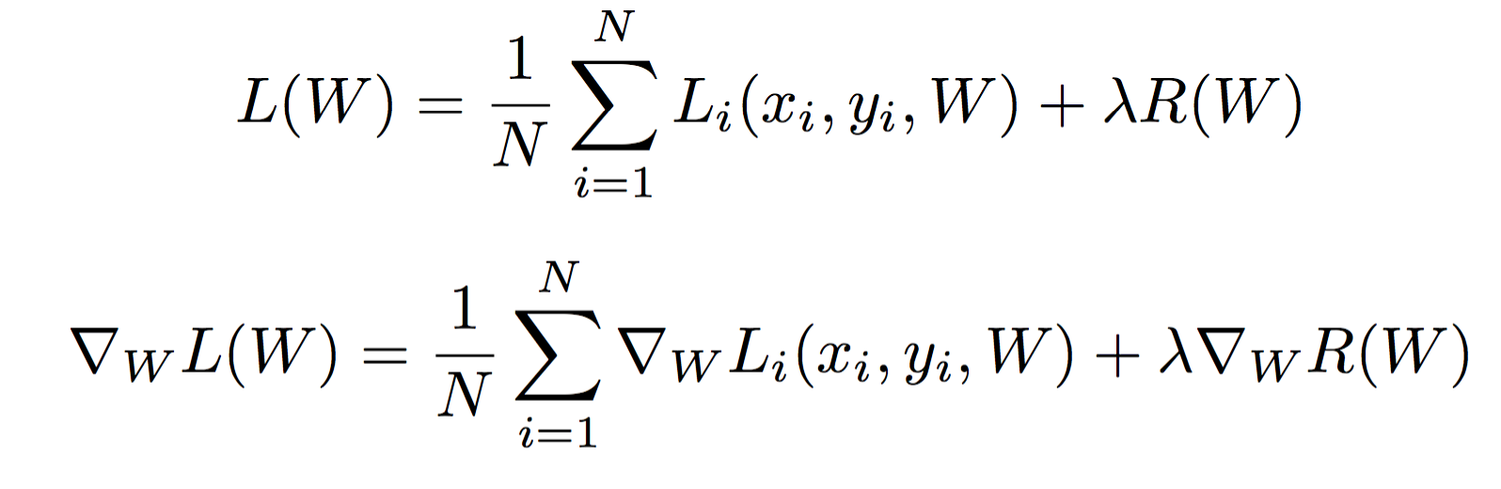
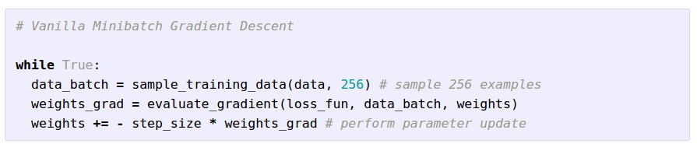

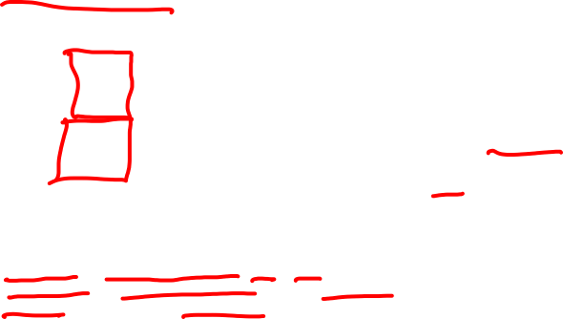
Stochastic Gradient Descent (SGD)
Full sum expensive when N is large!
Approximate sum using a minibatch of examples
32 / 64 / 128 common
Slide Credit: Fei-Fei Li, Justin Johnson, Serena Yeung, CS 231n

Slide 7
How do we compute gradients?
Analytic or “Manual” Differentiation
Symbolic Differentiation
Numerical Differentiation
Automatic Differentiation
  Forward mode AD
  Reverse mode AD
    aka “backprop”

Slide 9
How do we compute gradients?
Analytic or “Manual” Differentiation
Symbolic Differentiation
Numerical Differentiation
Automatic Differentiation
  Forward mode AD
  Reverse mode AD
    aka “backprop”

Slide 10
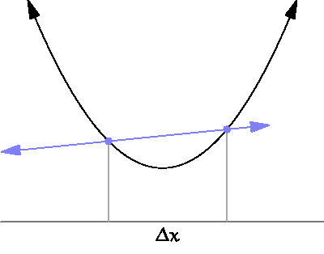
By Brnbrnz (Own work) [CC BY-SA 4.0 (http://creativecommons.org/licenses/by-sa/4.0)]

Slide 11
current W:
[0.34,
-1.11,
0.78,
0.12,
0.55,
2.81,
-3.1,
-1.5,
0.33,…]
loss 1.25347
gradient dW:
[?,
?,
?,
?,
?,
?,
?,
?,
?,…]
Slide Credit: Fei-Fei Li, Justin Johnson, Serena Yeung, CS 231n

Slide 12
current W:
[0.34,
-1.11,
0.78,
0.12,
0.55,
2.81,
-3.1,
-1.5,
0.33,…]
loss 1.25347
W + h (first dim):
[0.34 + 0.0001,
-1.11,
0.78,
0.12,
0.55,
2.81,
-3.1,
-1.5,
0.33,…]
loss 1.25322
gradient dW:
[?,
?,
?,
?,
?,
?,
?,
?,
?,…]
Slide Credit: Fei-Fei Li, Justin Johnson, Serena Yeung, CS 231n

Slide 13

current W:
[0.34,
-1.11,
0.78,
0.12,
0.55,
2.81,
-3.1,
-1.5,
0.33,…]
loss 1.25347
W + h (first dim):
[0.34 + 0.0001,
-1.11,
0.78,
0.12,
0.55,
2.81,
-3.1,
-1.5,
0.33,…]
loss 1.25322
gradient dW:
[-2.5,
?,
?,
?,
?,
?,
?,
?,
?,…]
(1.25322 - 1.25347)/0.0001
= -2.5
Slide Credit: Fei-Fei Li, Justin Johnson, Serena Yeung, CS 231n

Slide 14
current W:
[0.34,
-1.11,
0.78,
0.12,
0.55,
2.81,
-3.1,
-1.5,
0.33,…]
loss 1.25347
W + h (second dim):
[0.34,
-1.11 + 0.0001,
0.78,
0.12,
0.55,
2.81,
-3.1,
-1.5,
0.33,…]
loss 1.25353
gradient dW:
[-2.5,
?,
?,
?,
?,
?,
?,
?,
?,…]
Slide Credit: Fei-Fei Li, Justin Johnson, Serena Yeung, CS 231n

Slide 15
current W:
[0.34,
-1.11,
0.78,
0.12,
0.55,
2.81,
-3.1,
-1.5,
0.33,…]
loss 1.25347
W + h (second dim):
[0.34,
-1.11 + 0.0001,
0.78,
0.12,
0.55,
2.81,
-3.1,
-1.5,
0.33,…]
loss 1.25353
gradient dW:
[-2.5,
0.6,
?,
?,
?,
?,
?,
?,
?,…]
(1.25353 - 1.25347)/0.0001
= 0.6
Slide Credit: Fei-Fei Li, Justin Johnson, Serena Yeung, CS 231n

Slide 16
current W:
[0.34,
-1.11,
0.78,
0.12,
0.55,
2.81,
-3.1,
-1.5,
0.33,…]
loss 1.25347
W + h (third dim):
[0.34,
-1.11,
0.78 + 0.0001,
0.12,
0.55,
2.81,
-3.1,
-1.5,
0.33,…]
loss 1.25347
gradient dW:
[-2.5,
0.6,
?,
?,
?,
?,
?,
?,
?,…]
Slide Credit: Fei-Fei Li, Justin Johnson, Serena Yeung, CS 231n

Slide 17
current W:
[0.34,
-1.11,
0.78,
0.12,
0.55,
2.81,
-3.1,
-1.5,
0.33,…]
loss 1.25347
W + h (third dim):
[0.34,
-1.11,
0.78 + 0.0001,
0.12,
0.55,
2.81,
-3.1,
-1.5,
0.33,…]
loss 1.25347
gradient dW:
[-2.5,
0.6,
0,
?,
?,
?,
?,
?,
?,…]
(1.25347 - 1.25347)/0.0001
= 0
Slide Credit: Fei-Fei Li, Justin Johnson, Serena Yeung, CS 231n

Slide 18
Numerical vs Analytic Gradients
Numerical gradient: slow :(, approximate :(, easy to write :)
Analytic gradient: fast :), exact :), error-prone :(
In practice: Derive analytic gradient, check your implementation with numerical gradient.
This is called a gradient check.
Slide Credit: Fei-Fei Li, Justin Johnson, Serena Yeung, CS 231n

Slide 19
How do we compute gradients?
Analytic or “Manual” Differentiation
Symbolic Differentiation
Numerical Differentiation
Automatic Differentiation
  Forward mode AD
  Reverse mode AD
    aka “backprop”

Slide 20
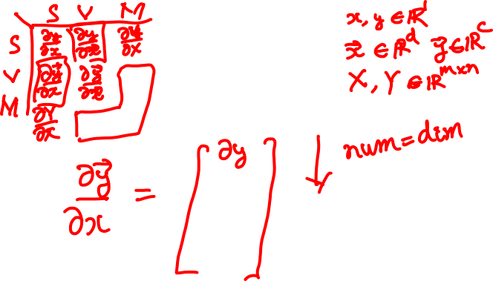
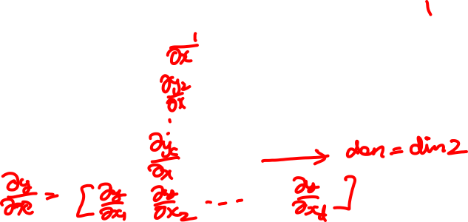
Matrix/Vector Derivatives Notation

Slide 21
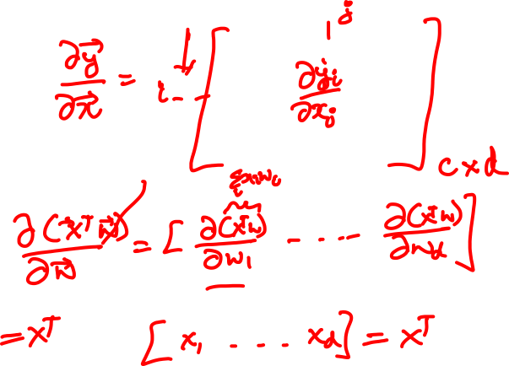
Matrix/Vector Derivatives Notation

Slide 22
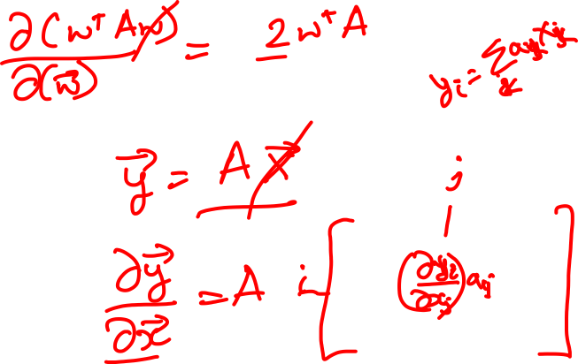
Vector Derivative Example

Slide 23
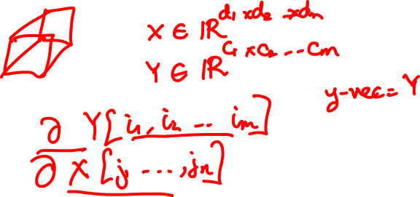
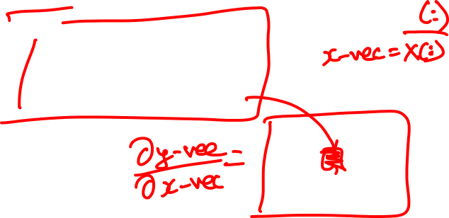
Extension to Tensors

Slide 24
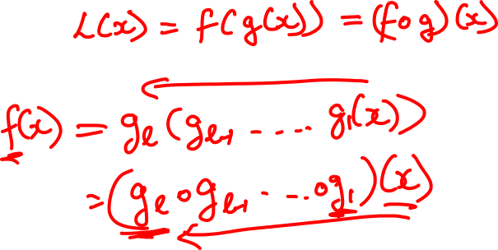
Chain Rule: Composite Functions

Slide 25
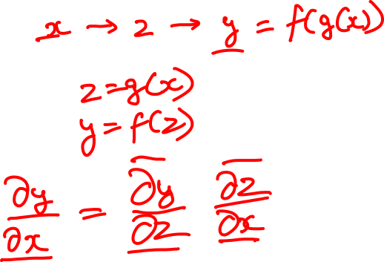
Chain Rule: Scalar Case

Slide 26
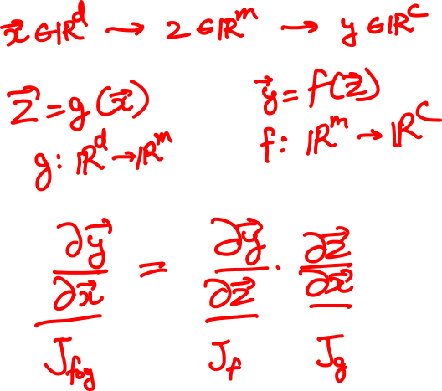
Chain Rule: Vector Case

Slide 27
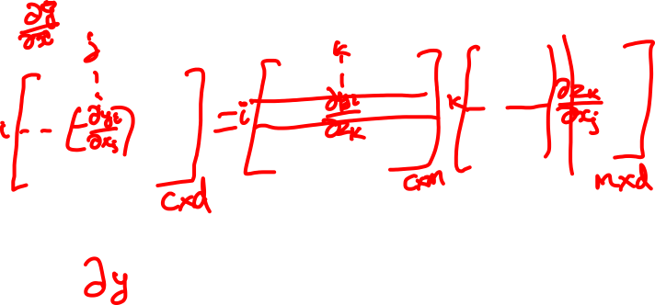
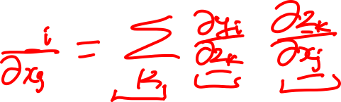
Chain Rule: Jacobian view

Slide 28
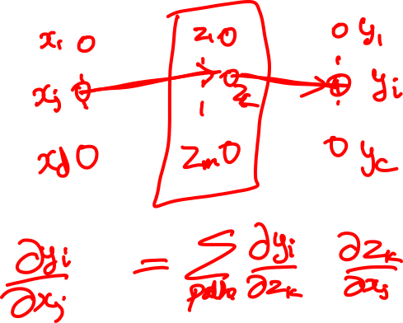
Chain Rule: Graphical view

Slide 29
Chain Rule: Cascaded

Slide 30
Chain Rule: How should we multiply?

Slide 31
Plan for Today
(Finish) Computational Graphs
  Notation + example
(Finish) Computing Gradients
  Forward mode vs Reverse mode AD
  Patterns in backprop
  Backprop in FC+ReLU NNs

Slide 32
Chain Rule: Tensors

Slide 33
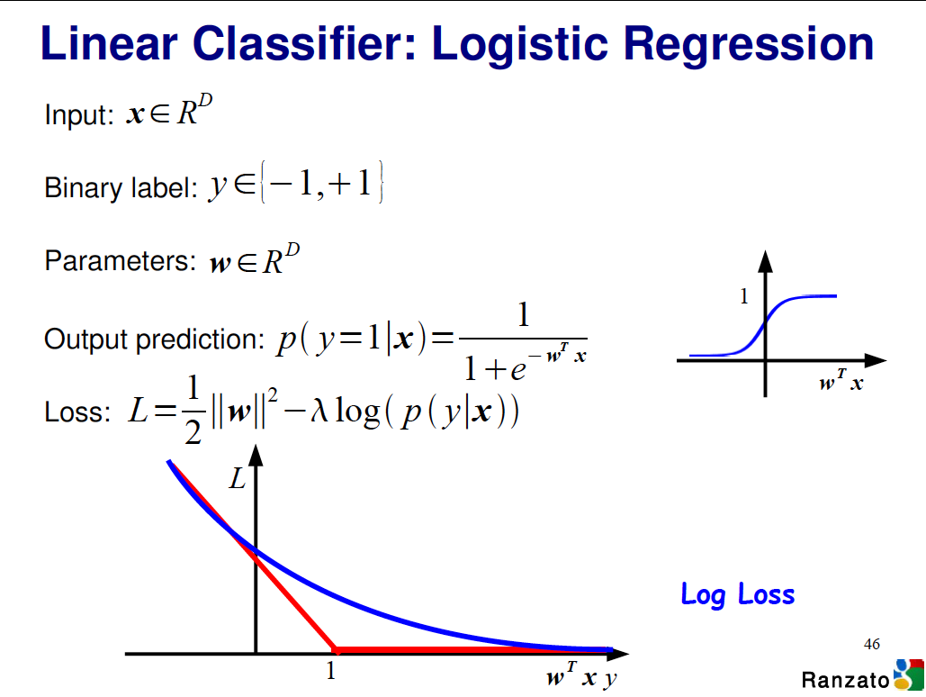

Slide 34
Logistic Regression Derivatives

Slide 35
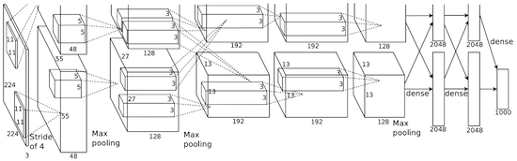
Convolutional network (AlexNet)
input image
weights
loss
Figure copyright Alex Krizhevsky, Ilya Sutskever, and Geoffrey Hinton, 2012. Reproduced with permission.
Slide Credit: Fei-Fei Li, Justin Johnson, Serena Yeung, CS 231n
Notes:
Becomes very useful when we work with complex functions

Slide 36
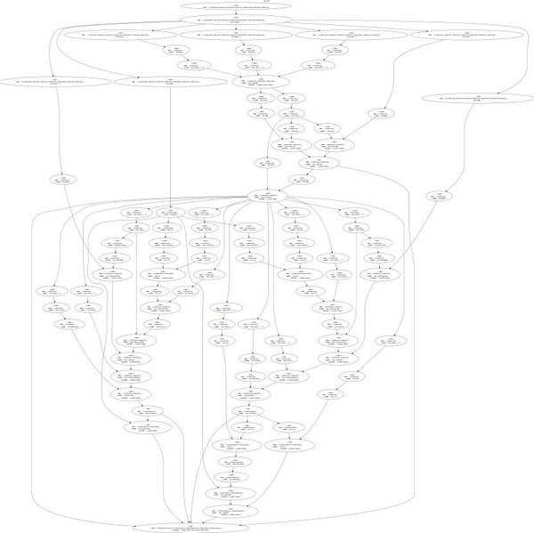
Neural Turing Machine
input image
loss
Figure reproduced with permission from a Twitter post by Andrej Karpathy.
Slide Credit: Fei-Fei Li, Justin Johnson, Serena Yeung, CS 231n
Notes:
Things get even crazier

Slide 37
How do we compute gradients?
Analytic or “Manual” Differentiation
Symbolic Differentiation
Numerical Differentiation
Automatic Differentiation
  Forward mode AD
  Reverse mode AD
    aka “backprop”

Slide 38



Computational Graph
x
*
s (scores)
hinge loss
+
L
W
R
Slide Credit: Fei-Fei Li, Justin Johnson, Serena Yeung, CS 231n
Notes:
How to compute the analytic gradient for arbitrarily complex functions using frame called computational graph
Can use computational graph to represent any function, where the nodes of the graph are steps of computation that we go through
Linear classifier example
Advantage is that once we express a function using a computational graph, can use a technique called backpropagation which recursively uses the chain rule to efficient compute gradient

Slide 39
Computational Graph
Any DAG of differentiable modules is allowed!
Slide Credit: Marc'Aurelio Ranzato

Slide 40
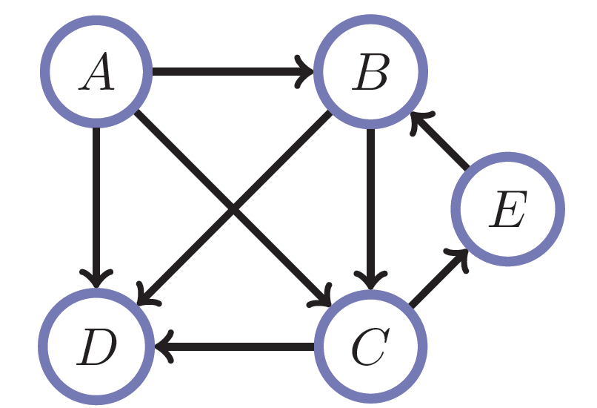
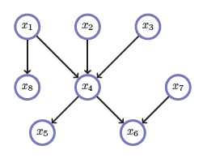
Directed Acyclic Graphs (DAGs)
Exactly what the name suggests
  Directed edges
  No (directed) cycles
  Underlying undirected cycles okay

Slide 41
Directed Acyclic Graphs (DAGs)
Concept
  Topological Ordering

Slide 42
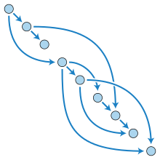
Directed Acyclic Graphs (DAGs)

Slide 43
Computational Graphs
Notation

Slide 44
Example
+
sin( )
*
x₁
x₂

Slide 45
HW0

Slide 46
HW0 Submission by Samyak Datta

Slide 47
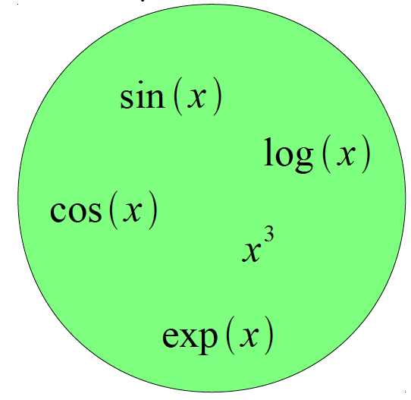
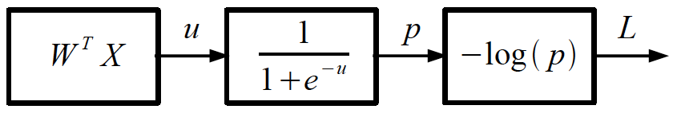
Logistic Regression as a Cascade
Given a library of simple functions
Compose into a
complicate function
Slide Credit: Marc'Aurelio Ranzato, Yann LeCun

Slide 48
Forward mode vs Reverse Mode
Key Computations

Slide 49
Forward mode AD
g
Notes:
What we’re doing in backprop is we have all these nodes in our computational graph, each node only aware of immediate surroundings
at each node have ...

Slide 50
Reverse mode AD
g
Notes:
What we’re doing in backprop is we have all these nodes in our computational graph, each node only aware of immediate surroundings
at each node have ...

Slide 51
Example: Forward mode AD
+
sin( )
*
x₁
x₂

Slide 52
Example: Forward mode AD
+
sin( )
*
x₁
x₂

Slide 53
Example: Forward mode AD
+
sin( )
*
x₁
x₂

Slide 54
Example: Forward mode AD
+
sin( )
*
x₁
x₂

Slide 55
Example: Forward mode AD
+
sin( )
*
x₁
x₂

Slide 56
Example: Reverse mode AD
+
sin( )
*
x₁
x₂

Slide 57
Example: Reverse mode AD
+
sin( )
*
x₁
x₂

Slide 58
Example: Reverse mode AD
+
sin( )
*
x₁
x₂

Slide 59
Forward Pass vs
Forward mode AD vs Reverse Mode AD
+
sin( )
*
x₁
x₂
+
+
sin( )
*
sin( )
*
x₁
x₂
x₁
x₂

Slide 60
Forward mode vs Reverse Mode
What are the differences?
+
+
sin( )
*
sin( )
*
x₁
x₂
x₁
x₂

Slide 61
Forward mode vs Reverse Mode
What are the differences?
Which one is faster to compute?
  Forward or backward?

Slide 62
Forward mode vs Reverse Mode
What are the differences?
Which one is faster to compute?
  Forward or backward?
Which one is more memory efficient (less storage)?
  Forward or backward?

Slide 63
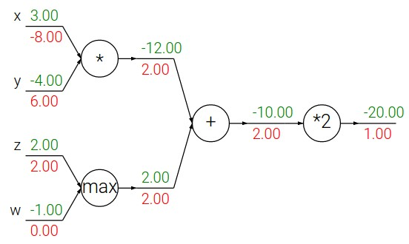
Patterns in backward flow
Slide Credit: Fei-Fei Li, Justin Johnson, Serena Yeung, CS 231n

Slide 64
Patterns in backward flow
Slide Credit: Fei-Fei Li, Justin Johnson, Serena Yeung, CS 231n

Slide 65
Patterns in backward flow
add gate: gradient distributor
Slide Credit: Fei-Fei Li, Justin Johnson, Serena Yeung, CS 231n

Slide 66
Patterns in backward flow
add gate: gradient distributor
Q: What is a max gate?
Slide Credit: Fei-Fei Li, Justin Johnson, Serena Yeung, CS 231n

Slide 67
Patterns in backward flow
add gate: gradient distributor
max gate: gradient router
Slide Credit: Fei-Fei Li, Justin Johnson, Serena Yeung, CS 231n

Slide 68
Patterns in backward flow
add gate: gradient distributor
max gate: gradient router
Q: What is a mul gate?
Slide Credit: Fei-Fei Li, Justin Johnson, Serena Yeung, CS 231n

Slide 69
Patterns in backward flow
add gate: gradient distributor
max gate: gradient router
mul gate: gradient switcher
Slide Credit: Fei-Fei Li, Justin Johnson, Serena Yeung, CS 231n
Notes:
Gradient switcher and scaler
Mul: scale upstream gradient by value of other branch

Slide 70
Gradients add at branches
+
Slide Credit: Fei-Fei Li, Justin Johnson, Serena Yeung, CS 231n
Notes:
Gradients add at branches, from multivariate chain rule
Since wiggling this node affects both connected nodes in the forward pass, then at backprop the upstream gradient coming into this node is the sum of the gradients flowing back from both nodes

Slide 71
Duality in Fprop and Bprop
FPROP
BPROP
SUM
+
COPY
+

Slide 72
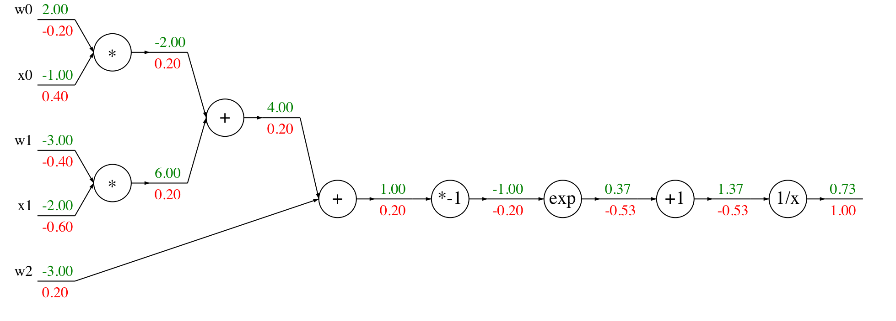
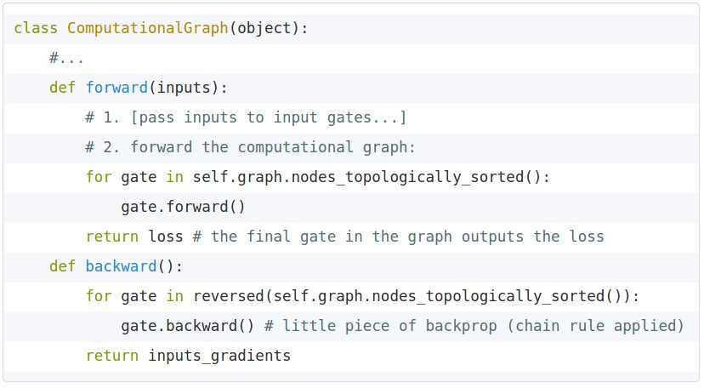
Modularized implementation: forward / backward API
Graph (or Net) object (rough psuedo code)
Slide Credit: Fei-Fei Li, Justin Johnson, Serena Yeung, CS 231n
Notes:
During forward pass cache intermediary computation

Slide 73
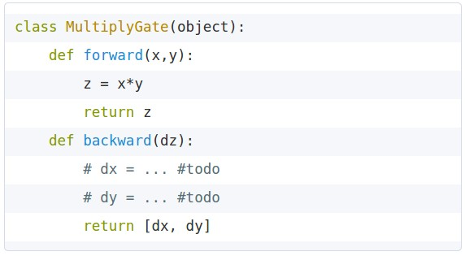


Modularized implementation: forward / backward API
x
z
*
y
(x,y,z are scalars)
Slide Credit: Fei-Fei Li, Justin Johnson, Serena Yeung, CS 231n
Notes:
The implementation exactly mirrors the algorithm in that it’s completely local

Slide 74
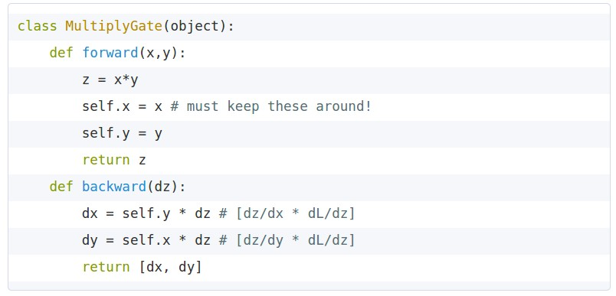
Modularized implementation: forward / backward API
x
z
*
y
(x,y,z are scalars)
Slide Credit: Fei-Fei Li, Justin Johnson, Serena Yeung, CS 231n

Slide 75
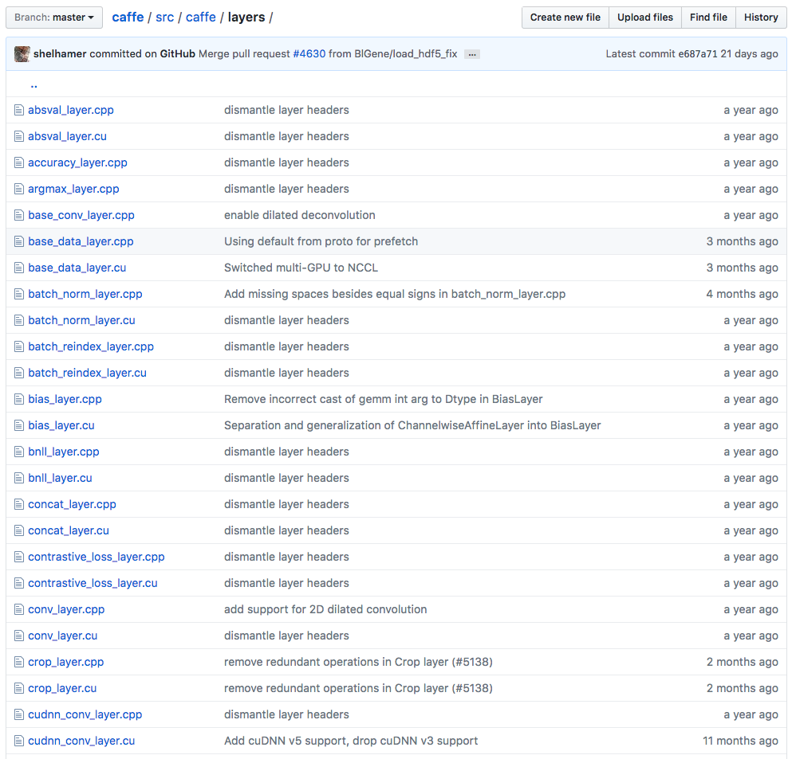
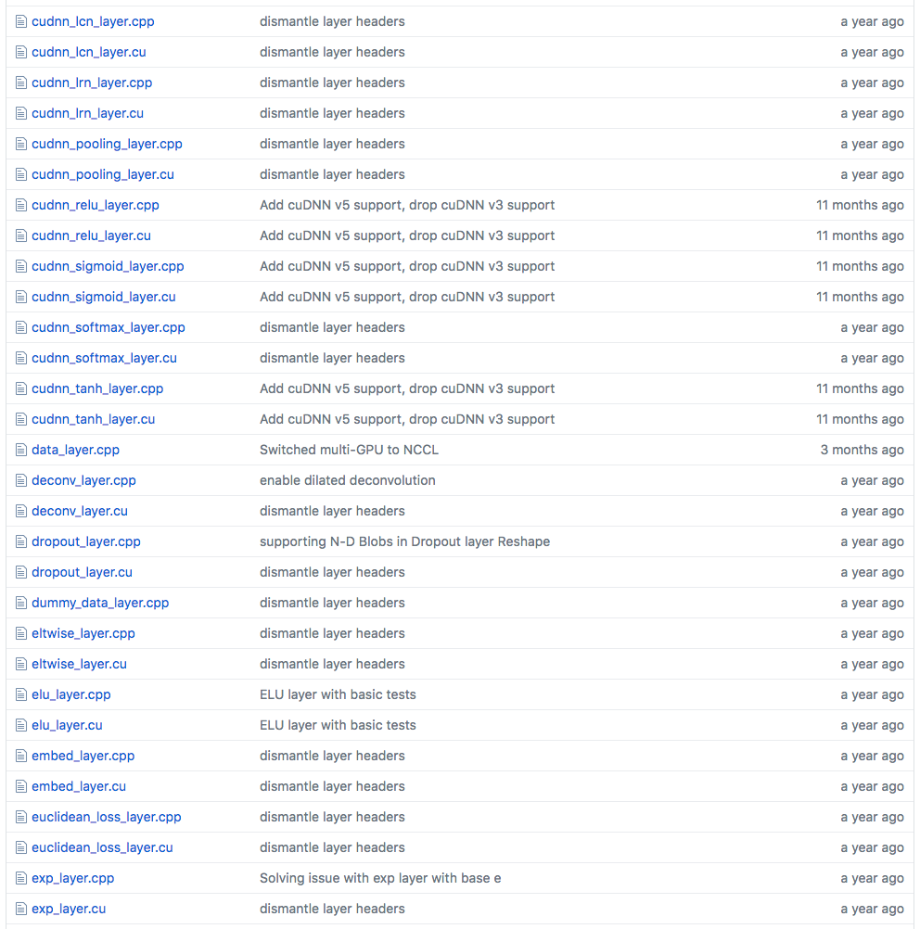
Example: Caffe layers
Caffe is licensed under BSD 2-Clause
Slide Credit: Fei-Fei Li, Justin Johnson, Serena Yeung, CS 231n
Notes:
Higher level node
Beautiful thing is only need to implement forward and backward

Slide 76
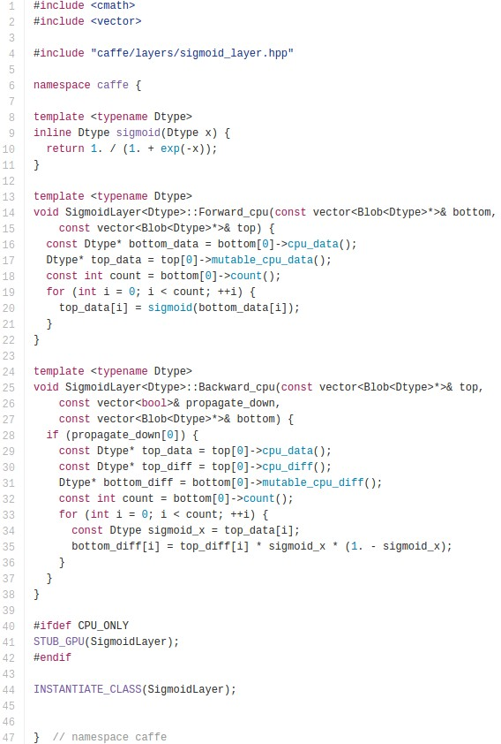

Caffe Sigmoid Layer
* top_diff (chain rule)
Caffe is licensed under BSD 2-Clause
Slide Credit: Fei-Fei Li, Justin Johnson, Serena Yeung, CS 231n

Slide 77
Figure Credit: Andrea Vedaldi

Slide 78
Figure Credit: Andrea Vedaldi

Slide 79
Jacobian of ReLU
g(x) = max(0,x)
(elementwise)
4096-d
input vector
4096-d
output vector
Slide Credit: Fei-Fei Li, Justin Johnson, Serena Yeung, CS 231n

Slide 80
Jacobian of ReLU
g(x) = max(0,x)
(elementwise)
4096-d
input vector
4096-d
output vector
Q: what is the size of the Jacobian matrix?
Slide Credit: Fei-Fei Li, Justin Johnson, Serena Yeung, CS 231n
Notes:
Partial deriv. Of each dimension of output with respect to each dimension of input

Slide 81
Jacobian of ReLU
g(x) = max(0,x)
(elementwise)
4096-d
input vector
4096-d
output vector
Q: what is the size of the Jacobian matrix?
[4096 x 4096!]
Slide Credit: Fei-Fei Li, Justin Johnson, Serena Yeung, CS 231n

Slide 82
Jacobian of ReLU
g(x) = max(0,x)
(elementwise)
4096-d
input vector
4096-d
output vector
Q: what is the size of the Jacobian matrix?
[4096 x 4096!]
in practice we process an entire minibatch (e.g. 100) of examples at one time:
i.e. Jacobian would technically be a
[409,600 x 409,600] matrix :\
Slide Credit: Fei-Fei Li, Justin Johnson, Serena Yeung, CS 231n

Slide 83
Jacobian of ReLU
g(x) = max(0,x)
(elementwise)
4096-d
input vector
4096-d
output vector
Q: what is the size of the Jacobian matrix?
[4096 x 4096!]
Q2: what does it look like?
Slide Credit: Fei-Fei Li, Justin Johnson, Serena Yeung, CS 231n
Notes:
For each elem in input, for each elem in output

Slide 84
Jacobians of FC-Layer

Slide 85
Jacobians of FC-Layer

Slide 86
Jacobians of FC-Layer

