Slide 1
CS 4803 / 7643: Deep Learning
Topics:
  Optimization
  Computing Gradients
Dhruv Batra
Georgia Tech

Slide 2
Administrativia
HW0 Reminder
  Due: 09/05, 11:55pm
A note on expectations
  Act like a responsible adult
Thursday 09/06
  Guest Lecture by Peter Anderson
No class next week
  09/11, 09/13
HW1 out next week (09/11)

Slide 3
Recap from last time

Slide 4

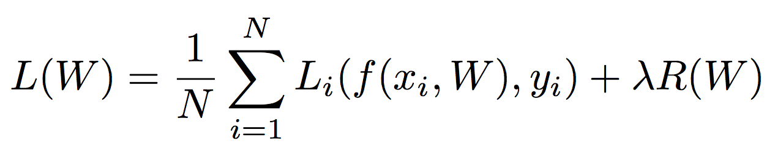
Regularization
= regularization strength
(hyperparameter)
Data loss: Model predictions should match training data
Regularization: Prevent the model from doing too well on training data
Occam’s Razor:
“Among competing hypotheses, the simplest is the best”
William of Ockham, 1285 - 1347
Slide Credit: Fei-Fei Li, Justin Johnson, Serena Yeung, CS 231n

Slide 5



Regularization
= regularization strength
(hyperparameter)
Data loss: Model predictions should match training data
Regularization: Prevent the model from doing too well on training data
Simple examples
L2 regularization:
L1 regularization:
Elastic net (L1 + L2):
More complex:
Dropout
Batch normalization
Stochastic depth, fractional pooling, etc
Slide Credit: Fei-Fei Li, Justin Johnson, Serena Yeung, CS 231n

Slide 6

Neural networks: without the brain stuff
(Before) Linear score function:
Slide Credit: Fei-Fei Li, Justin Johnson, Serena Yeung, CS 231n
Notes:
Have been using linear score function as running example of function to optimize

Slide 7

Neural networks: without the brain stuff
(Before) Linear score function:
(Now) 2-layer Neural Network
Slide Credit: Fei-Fei Li, Justin Johnson, Serena Yeung, CS 231n
Notes:
Instead of using single linear transformation, stack 2 together, get 2-layer network

Slide 8
Neural networks: without the brain stuff
(Before) Linear score function:
(Now) 2-layer Neural Network
x
h
W1
W2
s
3072
100
10
Slide Credit: Fei-Fei Li, Justin Johnson, Serena Yeung, CS 231n
Notes:
First have W1*x, then nonlinear function, then second linear layer
More broadly speaking, NN are class of functions where simpler functions are stacked on top of each other in a hierarchical way to make up a more complex, nonlinear function. Have multiple stages of hierarchical computation.

Slide 9
Neural networks: without the brain stuff
(Before) Linear score function:
(Now) 2-layer Neural Network
or 3-layer Neural Network
Slide Credit: Fei-Fei Li, Justin Johnson, Serena Yeung, CS 231n
Notes:
Can stack more of these layers to get deeper networks, where the term deep NN comes from

Slide 10
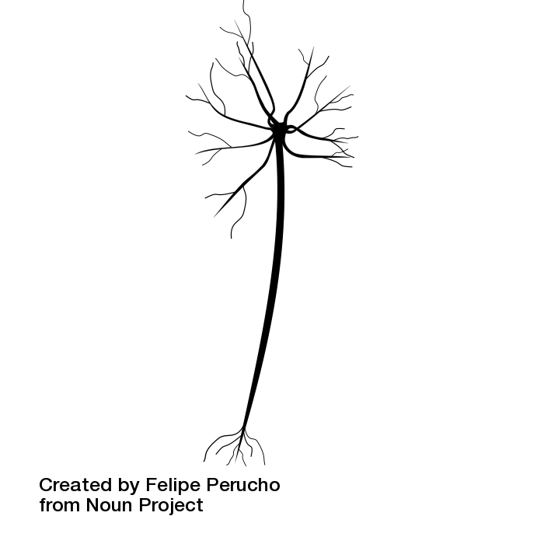
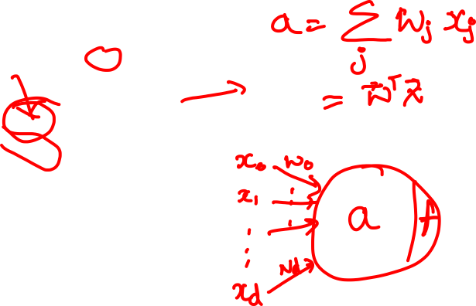
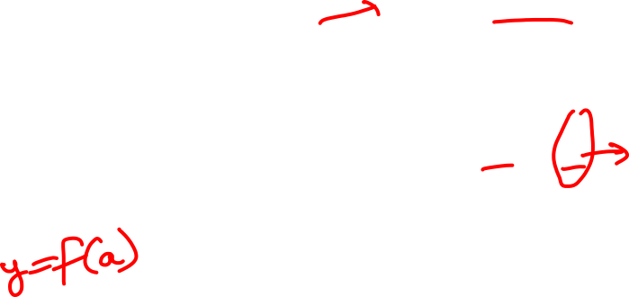
Impulses carried toward cell body
dendrite
presynaptic
terminal
axon
cell body
Impulses carried away from cell body
This image by Felipe Perucho
is licensed under CC-BY 3.0
Slide Credit: Fei-Fei Li, Justin Johnson, Serena Yeung, CS 231n

Slide 11
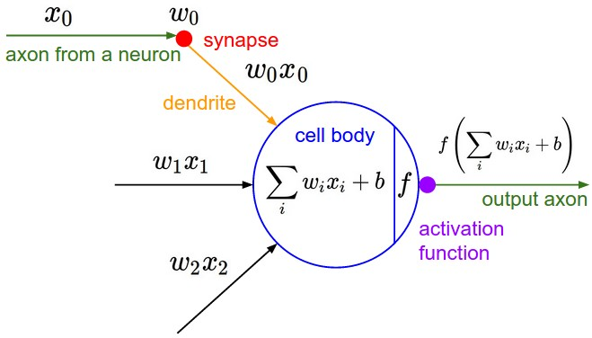
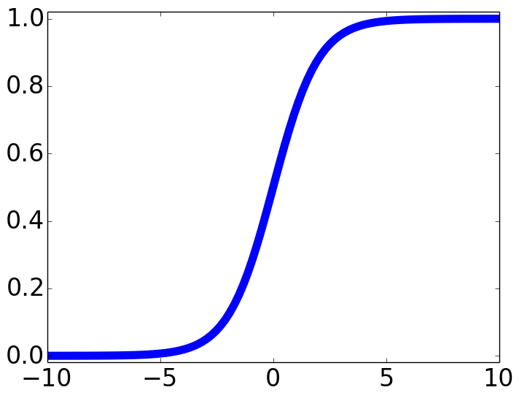

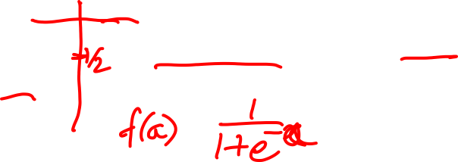
Impulses carried toward cell body
dendrite
presynaptic
terminal
axon
cell body
Impulses carried away from cell body
This image by Felipe Perucho
is licensed under CC-BY 3.0
sigmoid activation function
Slide Credit: Fei-Fei Li, Justin Johnson, Serena Yeung, CS 231n

Slide 12
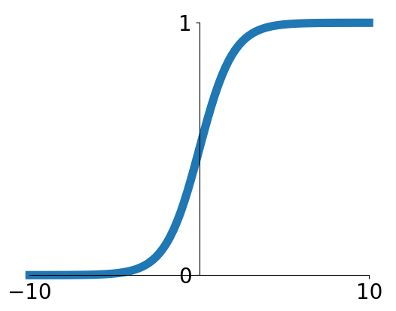
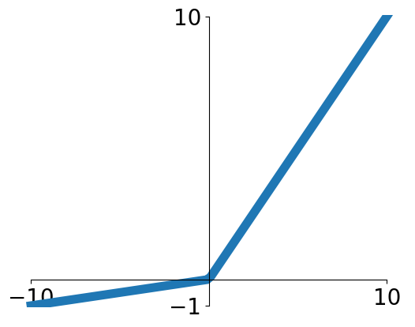


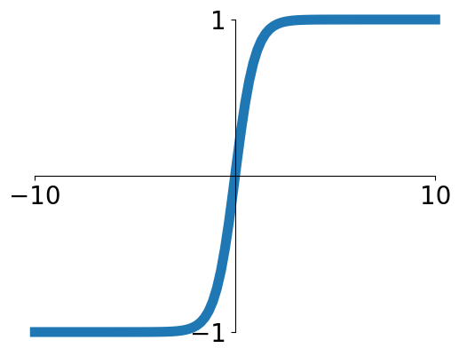


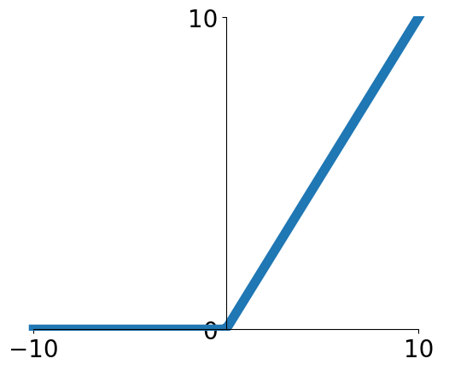
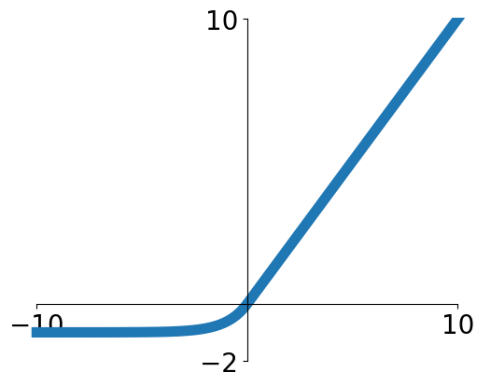

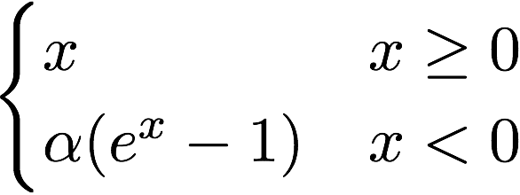
Activation functions
Sigmoid
Leaky ReLU
tanh
Maxout
ReLU
ELU
Slide Credit: Fei-Fei Li, Justin Johnson, Serena Yeung, CS 231n

Slide 13
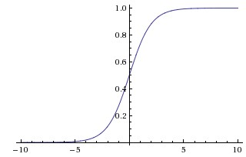
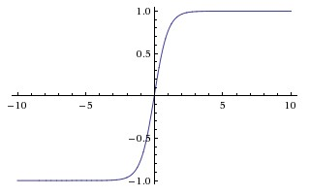
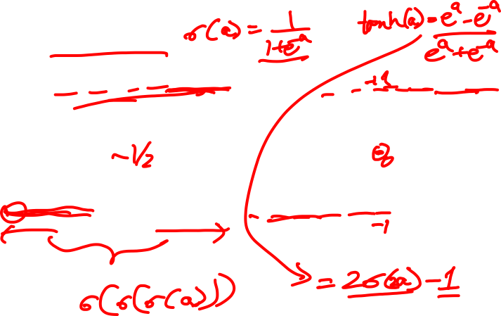
Activation Functions
sigmoid vs tanh

Slide 14
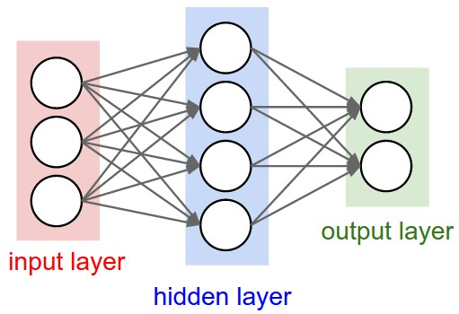

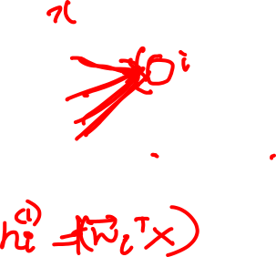
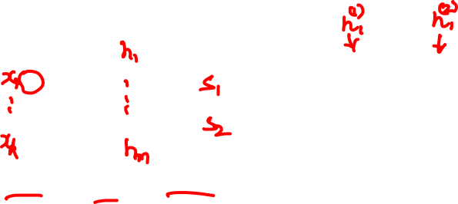
Multilayer Networks
Cascade Neurons together
The output from one layer is the input to the next
Each Layer has its own sets of weights
Image Credit: Andrej Karpathy, CS231n

Slide 15
Plan for Today
(Finish) Optimization
Computing Gradients

Slide 16
Optimization

Slide 17

This image is CC0 1.0 public domain
Slide Credit: Fei-Fei Li, Justin Johnson, Serena Yeung, CS 231n

Slide 18

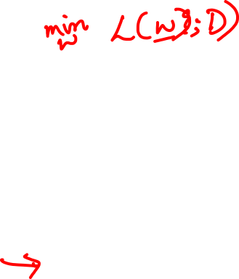
Strategy: Follow the slope
Slide Credit: Fei-Fei Li, Justin Johnson, Serena Yeung, CS 231n

Slide 19

Strategy: Follow the slope
In 1-dimension, the derivative of a function:
Slide Credit: Fei-Fei Li, Justin Johnson, Serena Yeung, CS 231n

Slide 20
Strategy: Follow the slope
In 1-dimension, the derivative of a function:
In multiple dimensions, the gradient is the vector of (partial derivatives) along each dimension
The slope in any direction is the dot product of the direction with the gradient
The direction of steepest descent is the negative gradient
Slide Credit: Fei-Fei Li, Justin Johnson, Serena Yeung, CS 231n

Slide 21
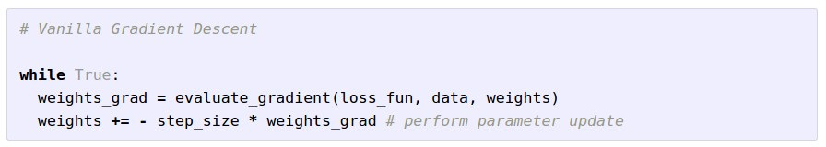
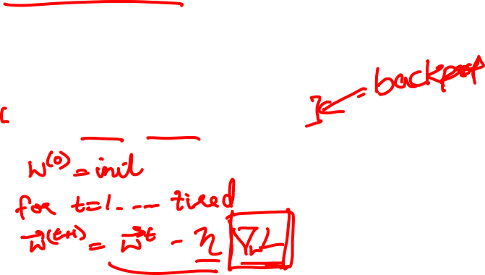
Gradient Descent
Slide Credit: Fei-Fei Li, Justin Johnson, Serena Yeung, CS 231n

Slide 22

W_2
original W
W_1
negative gradient direction
Slide Credit: Fei-Fei Li, Justin Johnson, Serena Yeung, CS 231n

Slide 23
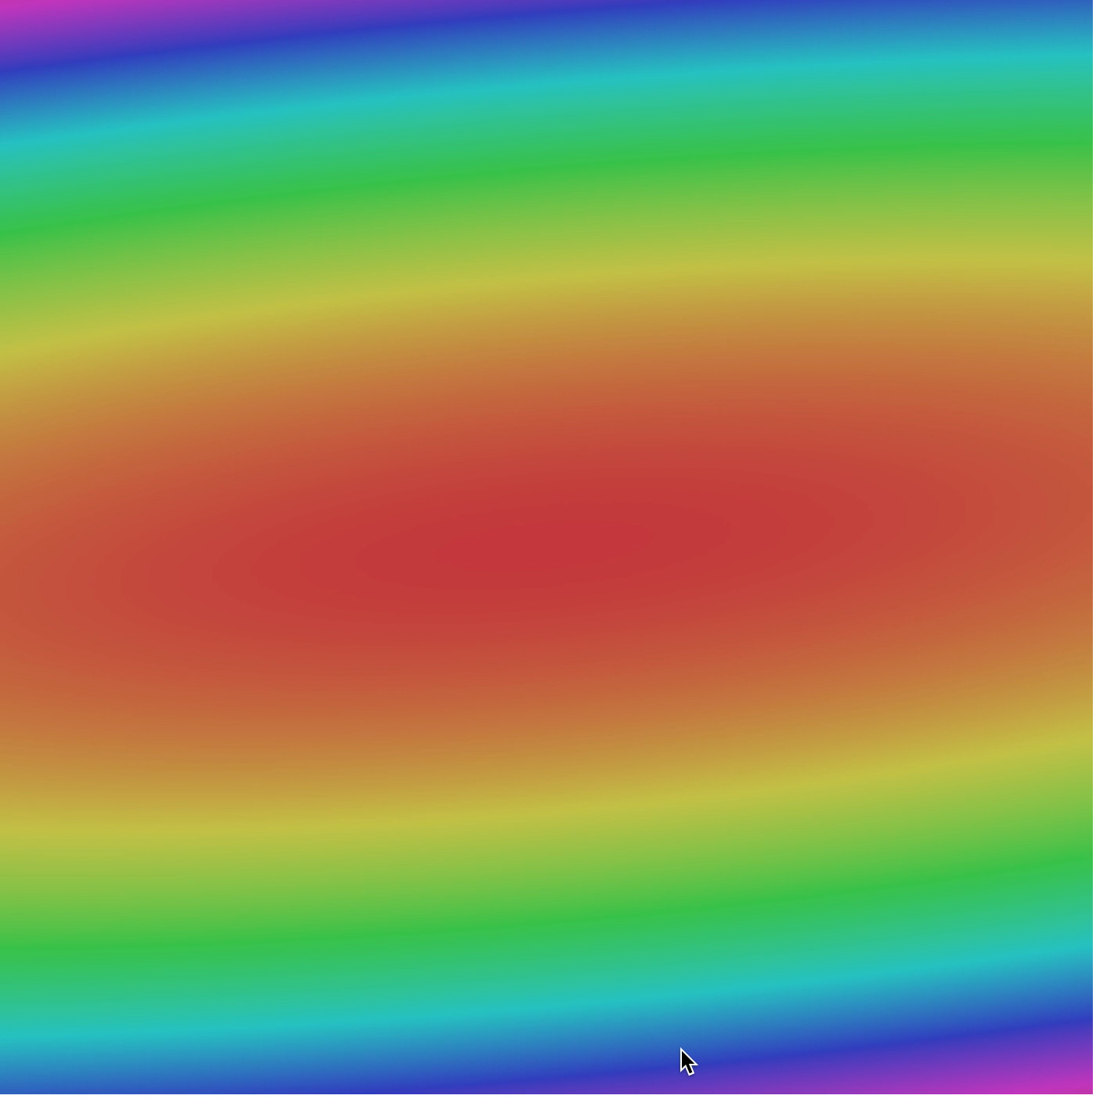
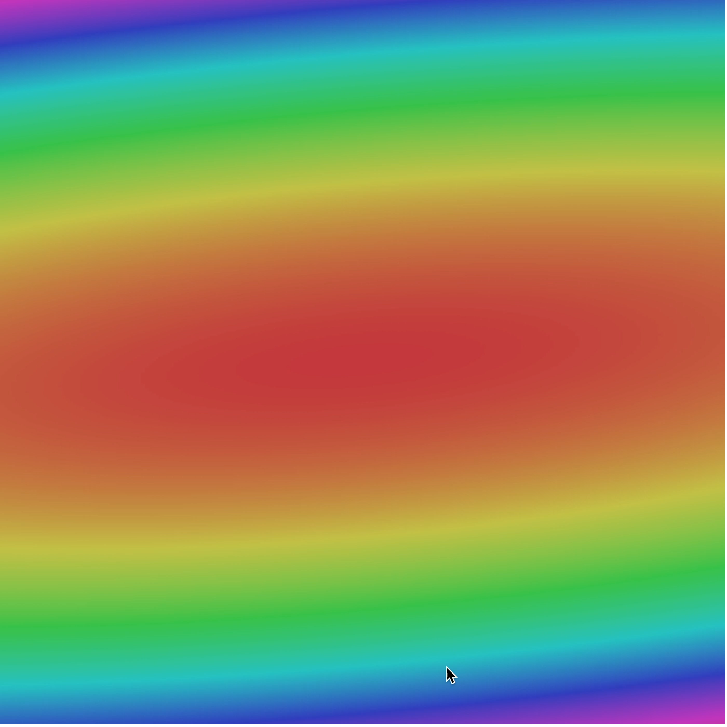
Slide Credit: Fei-Fei Li, Justin Johnson, Serena Yeung, CS 231n

Slide 24
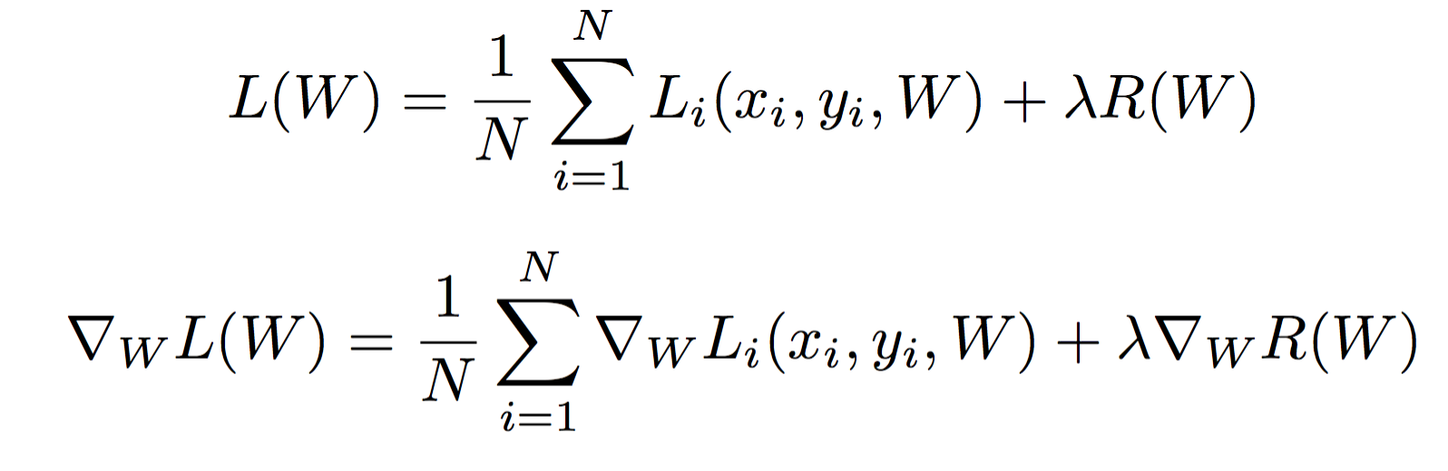
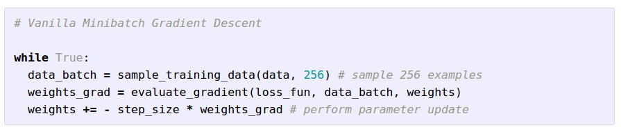
Stochastic Gradient Descent (SGD)
Full sum expensive when N is large!
Approximate sum using a minibatch of examples
32 / 64 / 128 common
Slide Credit: Fei-Fei Li, Justin Johnson, Serena Yeung, CS 231n

Slide 25
Stochastic Gradient Descent (SGD)
Slide Credit: Fei-Fei Li, Justin Johnson, Serena Yeung, CS 231n

Slide 26
Stochastic Gradient Descent (SGD)
Slide Credit: Fei-Fei Li, Justin Johnson, Serena Yeung, CS 231n

Slide 27
Stochastic Gradient Descent (SGD)
Full sum expensive when N is large!
Approximate sum using a minibatch of examples
32 / 64 / 128 common
Slide Credit: Fei-Fei Li, Justin Johnson, Serena Yeung, CS 231n

Slide 28
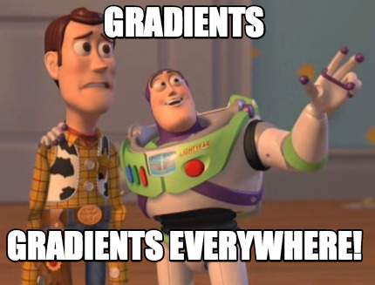

Slide 29
How do we compute gradients?
Analytic or “Manual” Differentiation
Symbolic Differentiation
Numerical Differentiation
Automatic Differentiation
  Forward mode AD
  Reverse mode AD
    aka “backprop”

Slide 31
How do we compute gradients?
Analytic or “Manual” Differentiation
Symbolic Differentiation
Numerical Differentiation
Automatic Differentiation
  Forward mode AD
  Reverse mode AD
    aka “backprop”

Slide 32
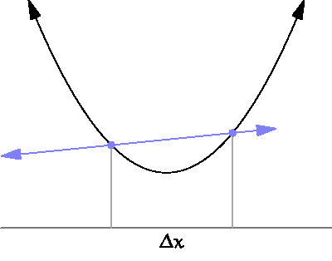
By Brnbrnz (Own work) [CC BY-SA 4.0 (http://creativecommons.org/licenses/by-sa/4.0)]

Slide 33
current W:
[0.34,
-1.11,
0.78,
0.12,
0.55,
2.81,
-3.1,
-1.5,
0.33,…]
loss 1.25347
gradient dW:
[?,
?,
?,
?,
?,
?,
?,
?,
?,…]
Slide Credit: Fei-Fei Li, Justin Johnson, Serena Yeung, CS 231n

Slide 34
current W:
[0.34,
-1.11,
0.78,
0.12,
0.55,
2.81,
-3.1,
-1.5,
0.33,…]
loss 1.25347
W + h (first dim):
[0.34 + 0.0001,
-1.11,
0.78,
0.12,
0.55,
2.81,
-3.1,
-1.5,
0.33,…]
loss 1.25322
gradient dW:
[?,
?,
?,
?,
?,
?,
?,
?,
?,…]
Slide Credit: Fei-Fei Li, Justin Johnson, Serena Yeung, CS 231n

Slide 35
current W:
[0.34,
-1.11,
0.78,
0.12,
0.55,
2.81,
-3.1,
-1.5,
0.33,…]
loss 1.25347
W + h (first dim):
[0.34 + 0.0001,
-1.11,
0.78,
0.12,
0.55,
2.81,
-3.1,
-1.5,
0.33,…]
loss 1.25322
gradient dW:
[-2.5,
?,
?,
?,
?,
?,
?,
?,
?,…]
(1.25322 - 1.25347)/0.0001
= -2.5
Slide Credit: Fei-Fei Li, Justin Johnson, Serena Yeung, CS 231n

Slide 36
current W:
[0.34,
-1.11,
0.78,
0.12,
0.55,
2.81,
-3.1,
-1.5,
0.33,…]
loss 1.25347
W + h (second dim):
[0.34,
-1.11 + 0.0001,
0.78,
0.12,
0.55,
2.81,
-3.1,
-1.5,
0.33,…]
loss 1.25353
gradient dW:
[-2.5,
?,
?,
?,
?,
?,
?,
?,
?,…]
Slide Credit: Fei-Fei Li, Justin Johnson, Serena Yeung, CS 231n

Slide 37
current W:
[0.34,
-1.11,
0.78,
0.12,
0.55,
2.81,
-3.1,
-1.5,
0.33,…]
loss 1.25347
W + h (second dim):
[0.34,
-1.11 + 0.0001,
0.78,
0.12,
0.55,
2.81,
-3.1,
-1.5,
0.33,…]
loss 1.25353
gradient dW:
[-2.5,
0.6,
?,
?,
?,
?,
?,
?,
?,…]
(1.25353 - 1.25347)/0.0001
= 0.6
Slide Credit: Fei-Fei Li, Justin Johnson, Serena Yeung, CS 231n

Slide 38
current W:
[0.34,
-1.11,
0.78,
0.12,
0.55,
2.81,
-3.1,
-1.5,
0.33,…]
loss 1.25347
W + h (third dim):
[0.34,
-1.11,
0.78 + 0.0001,
0.12,
0.55,
2.81,
-3.1,
-1.5,
0.33,…]
loss 1.25347
gradient dW:
[-2.5,
0.6,
?,
?,
?,
?,
?,
?,
?,…]
Slide Credit: Fei-Fei Li, Justin Johnson, Serena Yeung, CS 231n

Slide 39
current W:
[0.34,
-1.11,
0.78,
0.12,
0.55,
2.81,
-3.1,
-1.5,
0.33,…]
loss 1.25347
W + h (third dim):
[0.34,
-1.11,
0.78 + 0.0001,
0.12,
0.55,
2.81,
-3.1,
-1.5,
0.33,…]
loss 1.25347
gradient dW:
[-2.5,
0.6,
0,
?,
?,
?,
?,
?,
?,…]
(1.25347 - 1.25347)/0.0001
= 0
Slide Credit: Fei-Fei Li, Justin Johnson, Serena Yeung, CS 231n

Slide 40
Numerical vs Analytic Gradients
Numerical gradient: slow :(, approximate :(, easy to write :)
Analytic gradient: fast :), exact :), error-prone :(
In practice: Derive analytic gradient, check your implementation with numerical gradient.
This is called a gradient check.
Slide Credit: Fei-Fei Li, Justin Johnson, Serena Yeung, CS 231n

Slide 41
How do we compute gradients?
Analytic or “Manual” Differentiation
Symbolic Differentiation
Numerical Differentiation
Automatic Differentiation
  Forward mode AD
  Reverse mode AD
    aka “backprop”

Slide 42
Matrix/Vector Derivatives Notation

Slide 43
Matrix/Vector Derivatives Notation

Slide 44
Vector Derivative Example

Slide 45
Extension to Tensors

Slide 46
Chain Rule: Composite Functions

Slide 47
Chain Rule: Scalar Case

Slide 48
Chain Rule: Vector Case

Slide 49
Chain Rule: Jacobian view

Slide 50
Chain Rule: Graphical view

Slide 51
Chain Rule: Tensors

Slide 52
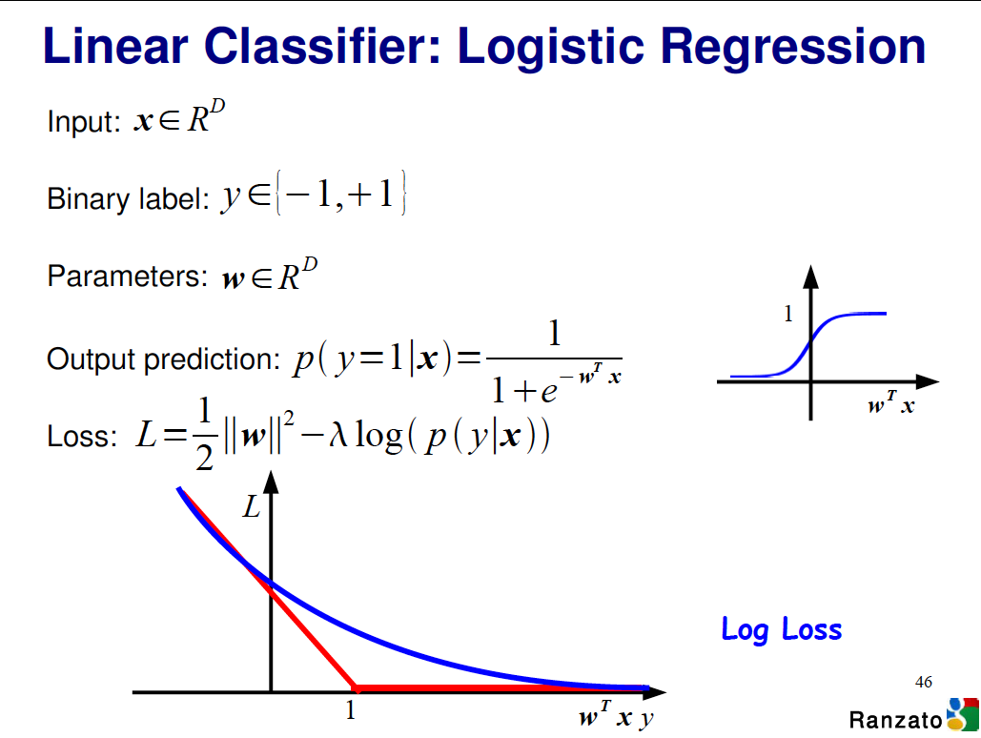

Slide 53
Logistic Regression Derivatives

Slide 54
Logistic Regression Derivatives

Slide 55
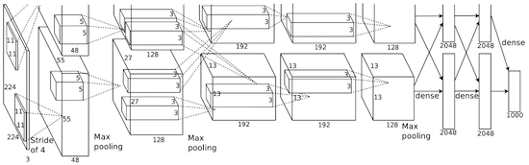
Convolutional network (AlexNet)
input image
weights
loss
Figure copyright Alex Krizhevsky, Ilya Sutskever, and Geoffrey Hinton, 2012. Reproduced with permission.
Slide Credit: Fei-Fei Li, Justin Johnson, Serena Yeung, CS 231n
Notes:
Becomes very useful when we work with complex functions

Slide 56
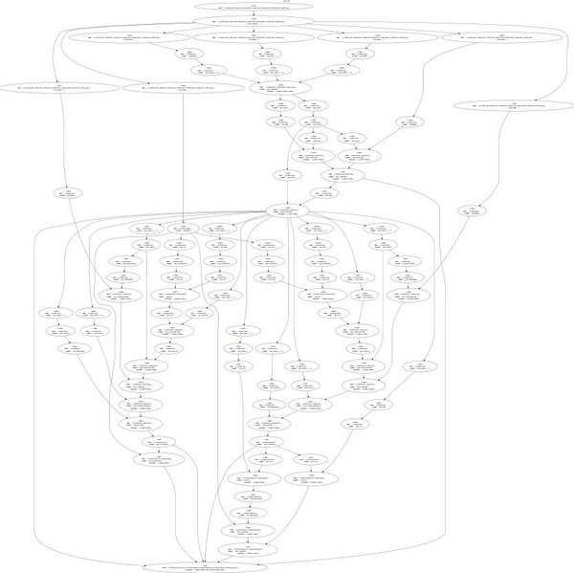
Neural Turing Machine
input image
loss
Figure reproduced with permission from a Twitter post by Andrej Karpathy.
Slide Credit: Fei-Fei Li, Justin Johnson, Serena Yeung, CS 231n
Notes:
Things get even crazier

Slide 57
How do we compute gradients?
Analytic or “Manual” Differentiation
Symbolic Differentiation
Numerical Differentiation
Automatic Differentiation
  Forward mode AD
  Reverse mode AD
    aka “backprop”

Slide 58



Computational Graph
x
*
s (scores)
hinge loss
+
L
W
R
Slide Credit: Fei-Fei Li, Justin Johnson, Serena Yeung, CS 231n
Notes:
How to compute the analytic gradient for arbitrarily complex functions using frame called computational graph
Can use computational graph to represent any function, where the nodes of the graph are steps of computation that we go through
Linear classifier example
Advantage is that once we express a function using a computational graph, can use a technique called backpropagation which recursively uses the chain rule to efficient compute gradient

Slide 59
Computational Graphs
Notation

Slide 60
Example
+
sin( )
*
x₁
x₂

Slide 61
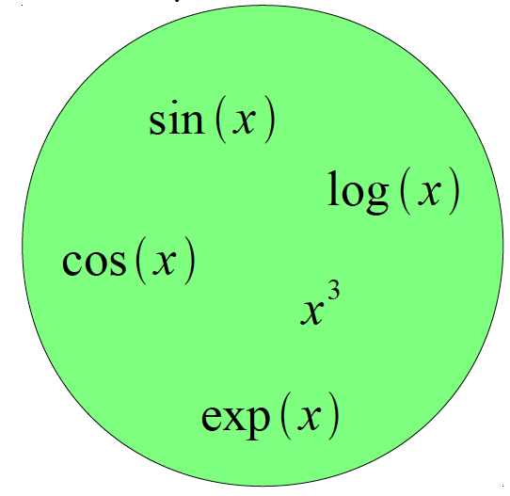
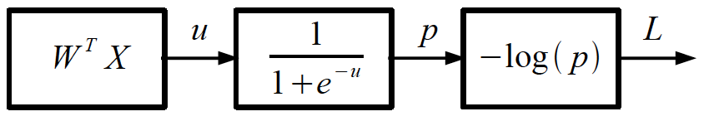
Logistic Regression as a Cascade
Given a library of simple functions
Compose into a
complicate function
Slide Credit: Marc'Aurelio Ranzato, Yann LeCun

Slide 62
Computational Graph
Any DAG of differentiable modules is allowed!
Slide Credit: Marc'Aurelio Ranzato

Slide 63
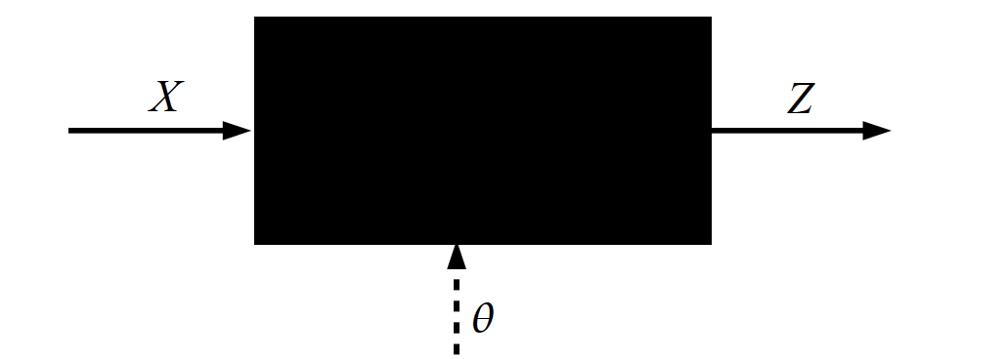
Key Computation: Forward-Prop
Slide Credit: Marc'Aurelio Ranzato, Yann LeCun

Slide 64
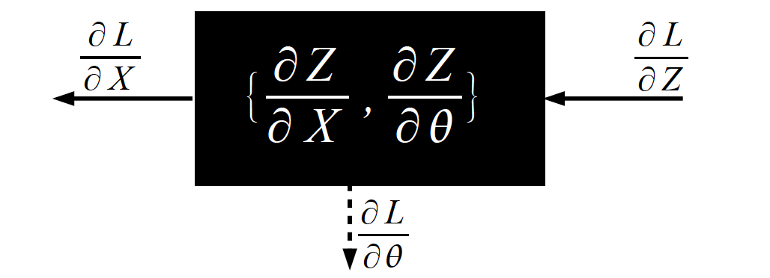
Key Computation: Back-Prop
Slide Credit: Marc'Aurelio Ranzato, Yann LeCun

Slide 65
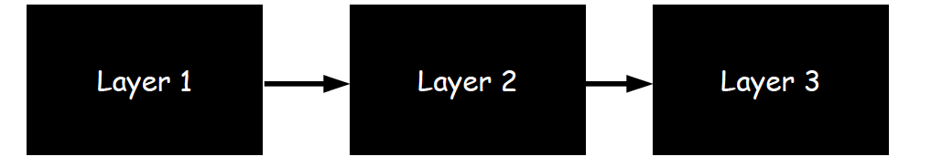
Neural Network Training
Step 1: Compute Loss on mini-batch [F-Pass]
Slide Credit: Marc'Aurelio Ranzato, Yann LeCun

Slide 66
Neural Network Training
Step 1: Compute Loss on mini-batch [F-Pass]
Slide Credit: Marc'Aurelio Ranzato, Yann LeCun

Slide 67
Neural Network Training
Step 1: Compute Loss on mini-batch [F-Pass]
Slide Credit: Marc'Aurelio Ranzato, Yann LeCun

Slide 68
Neural Network Training
Step 1: Compute Loss on mini-batch [F-Pass]
Step 2: Compute gradients wrt parameters [B-Pass]
Slide Credit: Marc'Aurelio Ranzato, Yann LeCun

Slide 69
Neural Network Training
Step 1: Compute Loss on mini-batch [F-Pass]
Step 2: Compute gradients wrt parameters [B-Pass]
Slide Credit: Marc'Aurelio Ranzato, Yann LeCun

Slide 70
Neural Network Training
Step 1: Compute Loss on mini-batch [F-Pass]
Step 2: Compute gradients wrt parameters [B-Pass]
Slide Credit: Marc'Aurelio Ranzato, Yann LeCun

Slide 71

Neural Network Training
Step 1: Compute Loss on mini-batch [F-Pass]
Step 2: Compute gradients wrt parameters [B-Pass]
Step 3: Use gradient to update parameters
Slide Credit: Marc'Aurelio Ranzato, Yann LeCun

Slide 72

Backpropagation: a simple example
Slide Credit: Fei-Fei Li, Justin Johnson, Serena Yeung, CS 231n
Notes:
How does backprop work. Start off with a simple example, where again goal is that we have a function and want to find gradients of the output of the function with respect to any variables

Slide 73
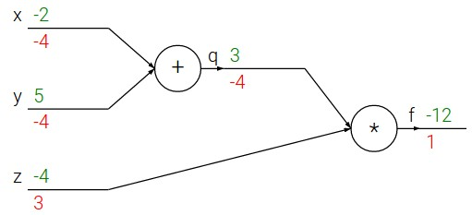
Backpropagation: a simple example
Slide Credit: Fei-Fei Li, Justin Johnson, Serena Yeung, CS 231n
Notes:
First step always represent as computational graph
Computational operations we go through

Slide 74
Backpropagation: a simple example
e.g. x = -2, y = 5, z = -4
Slide Credit: Fei-Fei Li, Justin Johnson, Serena Yeung, CS 231n
Notes:
The way we want to be using gradients in practice is want to iteratively evaluate at a point in the loss landscape, and take step
Whenever we want to do this, first make forward pass

Slide 75

Backpropagation: a simple example
e.g. x = -2, y = 5, z = -4
Want:
Slide Credit: Fei-Fei Li, Justin Johnson, Serena Yeung, CS 231n
Notes:
Want to give every intermediate variable a name.
Hae q = x+y, f = qz
Also written out gradients of q wrt
Want to find ...

Slide 76


Backpropagation: a simple example
e.g. x = -2, y = 5, z = -4
Want:
Slide Credit: Fei-Fei Li, Justin Johnson, Serena Yeung, CS 231n
Notes:
Want to give every intermediate variable a name.
Hae q = x+y, f = qz
Also written out gradients of q wrt
Want to find ...

Slide 77


Backpropagation: a simple example
e.g. x = -2, y = 5, z = -4
Want:
Slide Credit: Fei-Fei Li, Justin Johnson, Serena Yeung, CS 231n
Notes:
Want to give every intermediate variable a name.
Hae q = x+y, f = qz
Also written out gradients of q wrt
Want to find ...

Slide 78

Backpropagation: a simple example
e.g. x = -2, y = 5, z = -4
Want:
Slide Credit: Fei-Fei Li, Justin Johnson, Serena Yeung, CS 231n
Notes:
In order to find the gradients, going to use backprop technique, which is a recursive application of chain rule
Start at end of graph and make a backward pass, computing gradients along the way and evaluate at this point

Slide 79
Backpropagation: a simple example
e.g. x = -2, y = 5, z = -4
Want:
Slide Credit: Fei-Fei Li, Justin Johnson, Serena Yeung, CS 231n

Slide 80
Backpropagation: a simple example
e.g. x = -2, y = 5, z = -4
Want:
Slide Credit: Fei-Fei Li, Justin Johnson, Serena Yeung, CS 231n
Notes:
Is q, evaluated at this point is 3

Slide 81
Backpropagation: a simple example
e.g. x = -2, y = 5, z = -4
Want:
Slide Credit: Fei-Fei Li, Justin Johnson, Serena Yeung, CS 231n

Slide 82

Backpropagation: a simple example
e.g. x = -2, y = 5, z = -4
Want:
Slide Credit: Fei-Fei Li, Justin Johnson, Serena Yeung, CS 231n

Slide 83
Backpropagation: a simple example
e.g. x = -2, y = 5, z = -4
Want:
Slide Credit: Fei-Fei Li, Justin Johnson, Serena Yeung, CS 231n

Slide 84

Backpropagation: a simple example
e.g. x = -2, y = 5, z = -4
Chain rule:
Want:
Upstream gradient
Local
gradient
Slide Credit: Fei-Fei Li, Justin Johnson, Serena Yeung, CS 231n
Notes:
Y not directly connected to f in graph, connected through intermediate node q
Use chain rule, which says df/dy can be written as … where q is the intermediate node between y and f
Know df/dq, upstream gradient, need dq/dy, local

Slide 85
Backpropagation: a simple example
e.g. x = -2, y = 5, z = -4
Chain rule:
Want:
Upstream gradient
Local
gradient
Slide Credit: Fei-Fei Li, Justin Johnson, Serena Yeung, CS 231n
Notes:
Intuition of chain rule is take effect of q on f, compound with effect of y on q, to get effect of y on f
If wiggle y a little, q change by same factor. If q change a little, f by factor of -4
Compound: wiggle y a little, f…
For nodes that are not directly connected to the output, can use this recursive application of chain rule. Always know value of upstream gradient, compute and compound with value of local gradient.
Know dL/dy, want dL/dx, to find dL/dx, need to know how wiggling x affects wiggling y

Slide 86
Backpropagation: a simple example
e.g. x = -2, y = 5, z = -4
Chain rule:
Want:
Upstream gradient
Local
gradient
Slide Credit: Fei-Fei Li, Justin Johnson, Serena Yeung, CS 231n

Slide 87
Backpropagation: a simple example
e.g. x = -2, y = 5, z = -4
Chain rule:
Want:
Upstream gradient
Local
gradient
Slide Credit: Fei-Fei Li, Justin Johnson, Serena Yeung, CS 231n
Notes:
Computational graph analogous to what we are doing in implementing the actual code

Slide 88

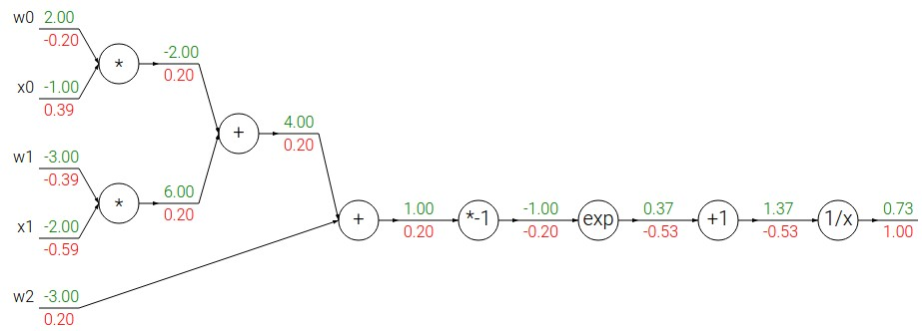
Another example:
Slide Credit: Fei-Fei Li, Justin Johnson, Serena Yeung, CS 231n
Notes:
Little more complex to see why backprop is useful
First multiple together w and x terms, add, then scale, …

Slide 89
Another example:
Slide Credit: Fei-Fei Li, Justin Johnson, Serena Yeung, CS 231n
Notes:
Want to obtain the gradient at a point. First forward pass.

Slide 90
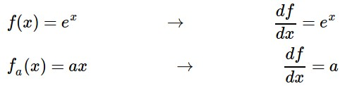
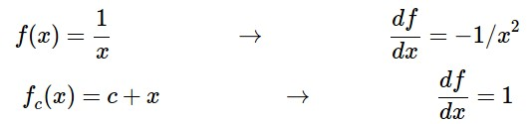
Another example:
Slide Credit: Fei-Fei Li, Justin Johnson, Serena Yeung, CS 231n
Notes:
Written some expressions for derivatives that will be helpful latero n
1st step is to express local gradient for each of the individual nodes

Slide 91
Another example:
Slide Credit: Fei-Fei Li, Justin Johnson, Serena Yeung, CS 231n
Notes:
As always, start with end of graph 1, bc df/df =1

Slide 92

Another example:
Upstream gradient
Local
gradient
Slide Credit: Fei-Fei Li, Justin Johnson, Serena Yeung, CS 231n

Slide 93
Another example:
Slide Credit: Fei-Fei Li, Justin Johnson, Serena Yeung, CS 231n

Slide 94
Another example:
Upstream gradient
Local
gradient
Slide Credit: Fei-Fei Li, Justin Johnson, Serena Yeung, CS 231n

Slide 95
Another example:
Slide Credit: Fei-Fei Li, Justin Johnson, Serena Yeung, CS 231n

Slide 96
Another example:
Upstream gradient
Local
gradient
Slide Credit: Fei-Fei Li, Justin Johnson, Serena Yeung, CS 231n

Slide 97
Another example:
Slide Credit: Fei-Fei Li, Justin Johnson, Serena Yeung, CS 231n

Slide 98
Another example:
Upstream gradient
Local
gradient
Slide Credit: Fei-Fei Li, Justin Johnson, Serena Yeung, CS 231n

Slide 99
Another example:
Slide Credit: Fei-Fei Li, Justin Johnson, Serena Yeung, CS 231n
Notes:
When addition node, local gradient wrt each input is 1

Slide 100
Another example:
[upstream gradient] x [local gradient]
[0.2] x [1] = 0.2
[0.2] x [1] = 0.2 (both inputs!)
Slide Credit: Fei-Fei Li, Justin Johnson, Serena Yeung, CS 231n

Slide 101
Another example:
Slide Credit: Fei-Fei Li, Justin Johnson, Serena Yeung, CS 231n

Slide 102
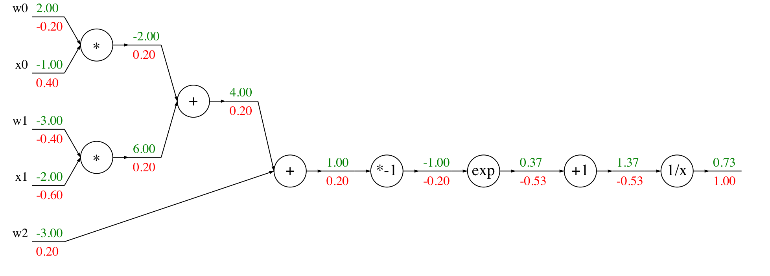
Another example:
[upstream gradient] x [local gradient]
x0: [0.2] x [2] = 0.4
w0: [0.2] x [-1] = -0.2
Slide Credit: Fei-Fei Li, Justin Johnson, Serena Yeung, CS 231n

Slide 103

Computational graph representation may not be unique. Choose one where local gradients at each node can be easily expressed!
sigmoid function
sigmoid gate
Slide Credit: Fei-Fei Li, Justin Johnson, Serena Yeung, CS 231n
Notes:
Can define computational nodes at any granularity we want
Can group operations together into more complex nodes, as long as can write down the local gradient
Trade-off between how simple the graph is and how much calculus we have to do

Slide 104
Computational graph representation may not be unique. Choose one where local gradients at each node can be easily expressed!
sigmoid function
sigmoid gate
[upstream gradient] x [local gradient]
[1.00] x [(1 - 0.73) (0.73)]= 0.2
Slide Credit: Fei-Fei Li, Justin Johnson, Serena Yeung, CS 231n
Notes:
See that we do find the same gradient value no matter how we break up the operation

