Slide 1
CS 4803 / 7643: Deep Learning
Topics:
  Regularization
  Neural Networks
  Optimization
  Computing Gradients
Dhruv Batra
Georgia Tech

Slide 2
Recap from last time

Slide 3
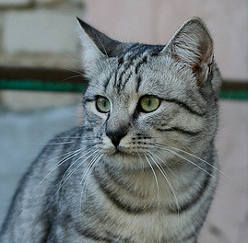
Parametric Approach: Linear Classifier
3072x1
f(x,W) = Wx + b
10x1
Image
10x1
10x3072
f(x,W)
10 numbers giving class scores
Array of 32x32x3 numbers
(3072 numbers total)
W
parameters
or weights
Slide Credit: Fei-Fei Li, Justin Johnson, Serena Yeung, CS 231n

Slide 4
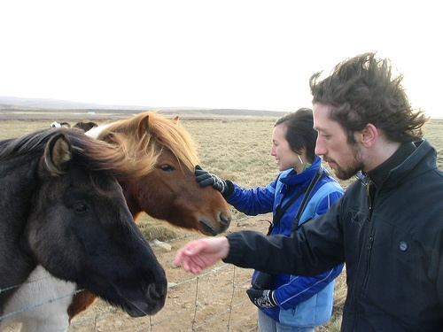
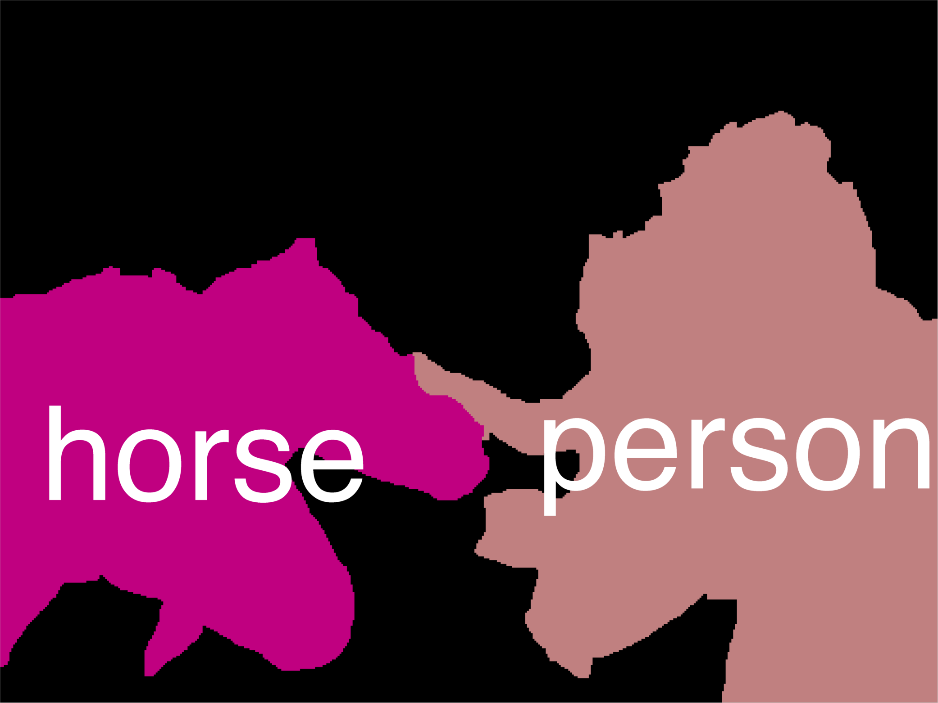
Error Decomposition
Reality
Multi-class Logistic Regression
Modeling Error
Softmax
FC HxWx3
Input
Estimation
Error
Optimization
Error = 0
model class

Slide 5
Example with an image with 4 pixels, and 3 classes (cat/dog/ship)
Stretch pixels into column
56
231
24
2
56 | 231
24 | 2
Input image
Slide Credit: Fei-Fei Li, Justin Johnson, Serena Yeung, CS 231n

Slide 6
Example with an image with 4 pixels, and 3 classes (cat/dog/ship)
Stretch pixels into column
56
231
24
2
0.2 | -0.5 | 0.1 | 2.0
1.5 | 1.3 | 2.1 | 0.0
0 | 0.25 | 0.2 | -0.3
1.1
3.2
-1.2
-96.8
437.9
61.95
Cat score
56 | 231
24 | 2
+
=
Dog score
Ship score
Input image
W
b
Slide Credit: Fei-Fei Li, Justin Johnson, Serena Yeung, CS 231n

Slide 7
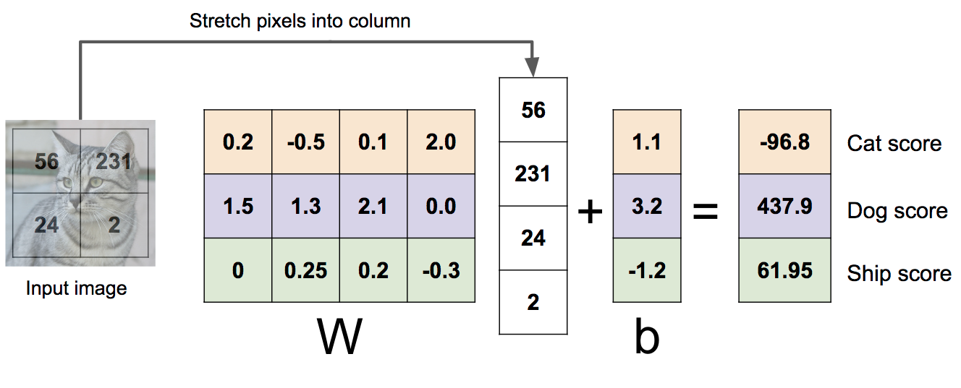

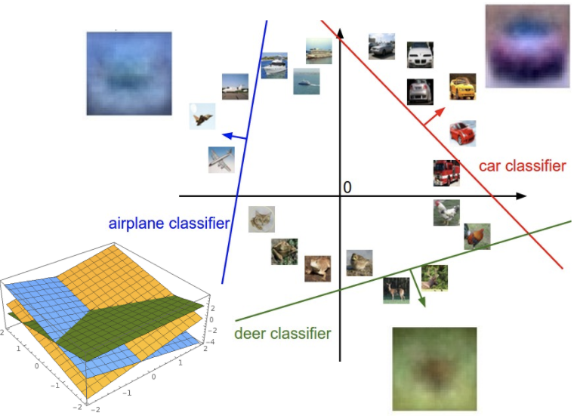
Linear Classifier: Three Viewpoints
Algebraic Viewpoint
Visual Viewpoint
Geometric Viewpoint
f(x,W) = Wx
One template per class
Hyperplanes cutting up space
Slide Credit: Fei-Fei Li, Justin Johnson, Serena Yeung, CS 231n

Slide 8
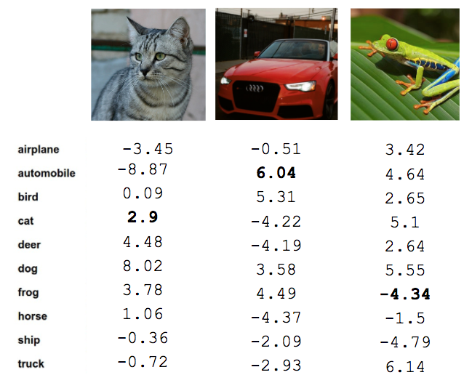
Recall from last time: Linear Classifier
TODO:
Define a loss function that quantifies our unhappiness with the scores across the training data.
Come up with a way of efficiently finding the parameters that minimize the loss function. (optimization)
Cat image by Nikita is licensed under CC-BY 2.0; Car image is CC0 1.0 public domain; Frog image is in the public domain
Slide Credit: Fei-Fei Li, Justin Johnson, Serena Yeung, CS 231n

Slide 9


Softmax vs. SVM
Slide Credit: Fei-Fei Li, Justin Johnson, Serena Yeung, CS 231n

Slide 10


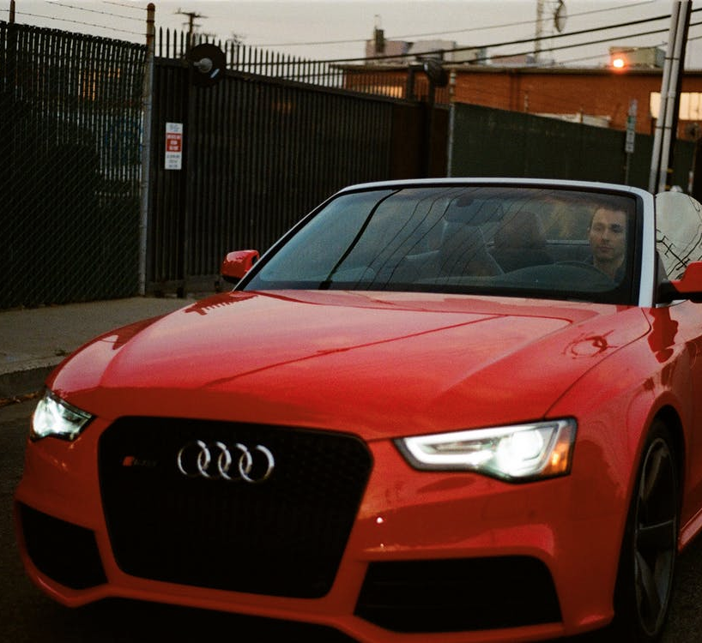
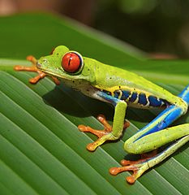




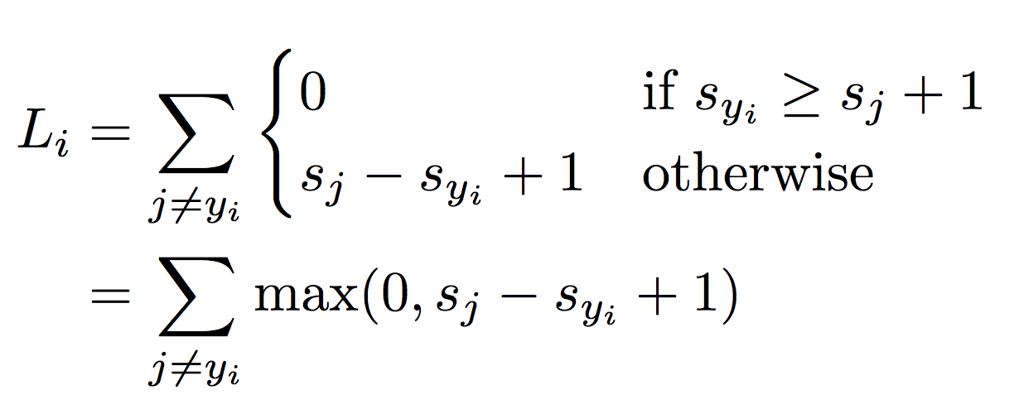
Suppose: 3 training examples, 3 classes.
With some W the scores are:
Multiclass SVM loss:
Given an example
where is the image and
where is the (integer) label,
and using the shorthand for the scores vector:
the SVM loss has the form:
“Hinge loss”
cat
3.2
1.3
2.2
car
5.1
4.9
2.5
frog
-1.7
2.0
-3.1
Slide Credit: Fei-Fei Li, Justin Johnson, Serena Yeung, CS 231n

Slide 11

Suppose: 3 training examples, 3 classes.
With some W the scores are:
Multiclass SVM loss:
Given an example
where is the image and
where is the (integer) label,
and using the shorthand for the scores vector:
the SVM loss has the form:
“Hinge loss”
cat
3.2
1.3
2.2
car
5.1
4.9
2.5
frog
-1.7
2.0
-3.1
Slide Credit: Fei-Fei Li, Justin Johnson, Serena Yeung, CS 231n

Slide 12
Softmax vs. SVM
Slide Credit: Fei-Fei Li, Justin Johnson, Serena Yeung, CS 231n

Slide 13


Softmax Classifier (Multinomial Logistic Regression)
Want to interpret raw classifier scores as probabilities
Softmax Function
cat
3.2
car
5.1
frog
-1.7
Slide Credit: Fei-Fei Li, Justin Johnson, Serena Yeung, CS 231n

Slide 14
Softmax Classifier (Multinomial Logistic Regression)
Want to interpret raw classifier scores as probabilities
Softmax Function
Probabilities must be >= 0
cat
3.2
24.5
exp
car
5.1
164.0
frog
-1.7
0.18
unnormalized probabilities
Slide Credit: Fei-Fei Li, Justin Johnson, Serena Yeung, CS 231n

Slide 15
Softmax Classifier (Multinomial Logistic Regression)
Want to interpret raw classifier scores as probabilities
Softmax Function
Probabilities must be >= 0
Probabilities must sum to 1
cat
3.2
24.5
0.13
exp
normalize
car
5.1
164.0
0.87
frog
-1.7
0.18
0.00
unnormalized probabilities
probabilities
Slide Credit: Fei-Fei Li, Justin Johnson, Serena Yeung, CS 231n

Slide 16
Softmax Classifier (Multinomial Logistic Regression)
Want to interpret raw classifier scores as probabilities
Softmax Function
Probabilities must be >= 0
Probabilities must sum to 1
cat
3.2
24.5
0.13
exp
normalize
car
5.1
164.0
0.87
frog
-1.7
0.18
0.00
Unnormalized log-probabilities / logits
unnormalized probabilities
probabilities
Slide Credit: Fei-Fei Li, Justin Johnson, Serena Yeung, CS 231n

Slide 17

Softmax Classifier (Multinomial Logistic Regression)
Want to interpret raw classifier scores as probabilities
Softmax Function
Probabilities must be >= 0
Probabilities must sum to 1
cat
3.2
24.5
0.13
L_{i} = -log(0.13)
= 2.04
exp
normalize
car
5.1
164.0
0.87
frog
-1.7
0.18
0.00
Unnormalized log-probabilities / logits
unnormalized probabilities
probabilities
Slide Credit: Fei-Fei Li, Justin Johnson, Serena Yeung, CS 231n

Slide 18
Softmax Classifier (Multinomial Logistic Regression)
Want to interpret raw classifier scores as probabilities
Softmax Function
Probabilities must be >= 0
Probabilities must sum to 1
cat
3.2
24.5
0.13
L_{i} = -log(0.13)
= 2.04
exp
normalize
car
5.1
164.0
0.87
-1.7
0.18
0.00
Maximum Likelihood Estimation
Choose probabilities to maximize the likelihood of the observed data
frog
Unnormalized log-probabilities / logits
unnormalized probabilities
probabilities
Slide Credit: Fei-Fei Li, Justin Johnson, Serena Yeung, CS 231n

Slide 19
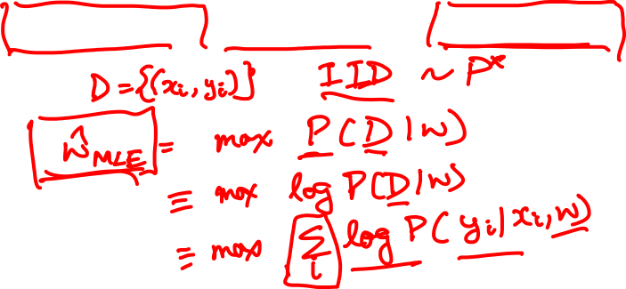
Log-Likelihood / KL-Divergence / Cross-Entropy

Slide 20
Softmax Classifier (Multinomial Logistic Regression)
Want to interpret raw classifier scores as probabilities
Softmax Function
Probabilities must be >= 0
Probabilities must sum to 1
cat
3.2
24.5
0.13
compare
1.00
exp
normalize
car
5.1
164.0
0.87
0.00
frog
-1.7
0.18
0.00
0.00
Unnormalized log-probabilities / logits
unnormalized probabilities
probabilities
Correct
probs
Slide Credit: Fei-Fei Li, Justin Johnson, Serena Yeung, CS 231n

Slide 21
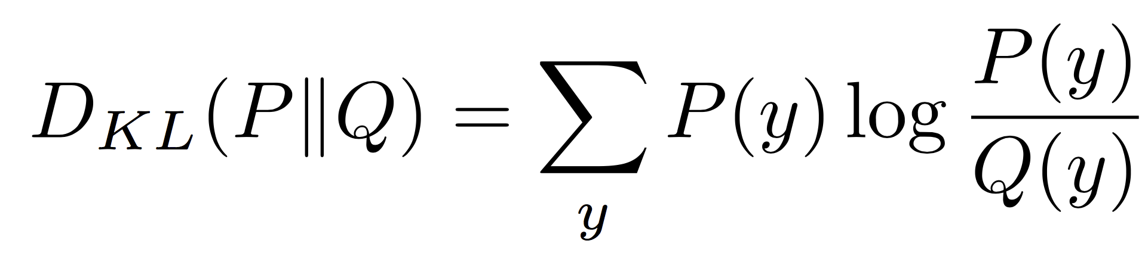
Softmax Classifier (Multinomial Logistic Regression)
Want to interpret raw classifier scores as probabilities
Softmax Function
Probabilities must be >= 0
Probabilities must sum to 1
cat
3.2
24.5
0.13
compare
1.00
exp
normalize
Kullback–Leibler divergence
car
5.1
164.0
0.87
0.00
frog
-1.7
0.18
0.00
0.00
Unnormalized log-probabilities / logits
unnormalized probabilities
probabilities
Correct
probs
Slide Credit: Fei-Fei Li, Justin Johnson, Serena Yeung, CS 231n
Notes:
Mention that this is useful for cases where you might have some target probability distribution instead of just one correct class, due to uncertainty in the model; also mention distillation

Slide 22
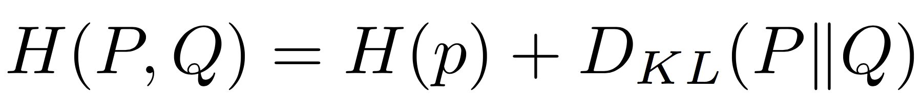
Softmax Classifier (Multinomial Logistic Regression)
Want to interpret raw classifier scores as probabilities
Softmax Function
Probabilities must be >= 0
Probabilities must sum to 1
cat
3.2
24.5
0.13
compare
1.00
exp
normalize
car
5.1
164.0
0.87
Cross Entropy
0.00
frog
-1.7
0.18
0.00
0.00
Unnormalized log-probabilities / logits
unnormalized probabilities
probabilities
Correct
probs
Slide Credit: Fei-Fei Li, Justin Johnson, Serena Yeung, CS 231n
Notes:
Mention that this is useful for cases where you might have some target probability distribution instead of just one correct class, due to uncertainty in the model; also mention distillation

Slide 23
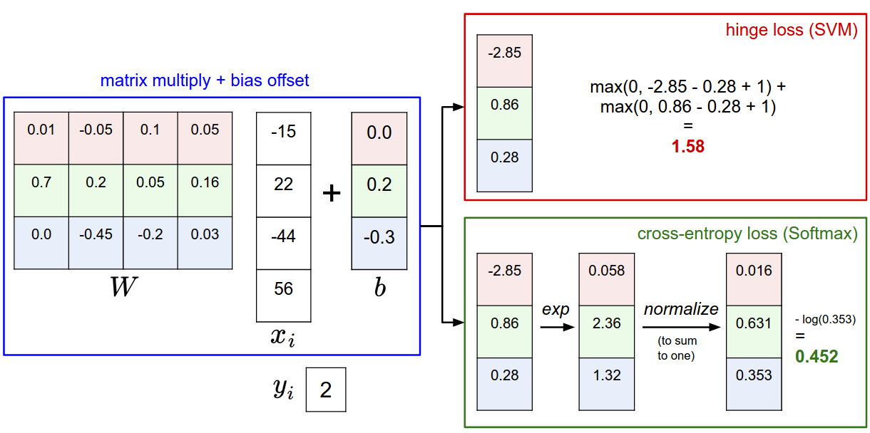
Slide Credit: Fei-Fei Li, Justin Johnson, Serena Yeung, CS 231n

Slide 24
Plan for Today
Regularization
Neural Networks
Optimization
Computing Gradients

Slide 25
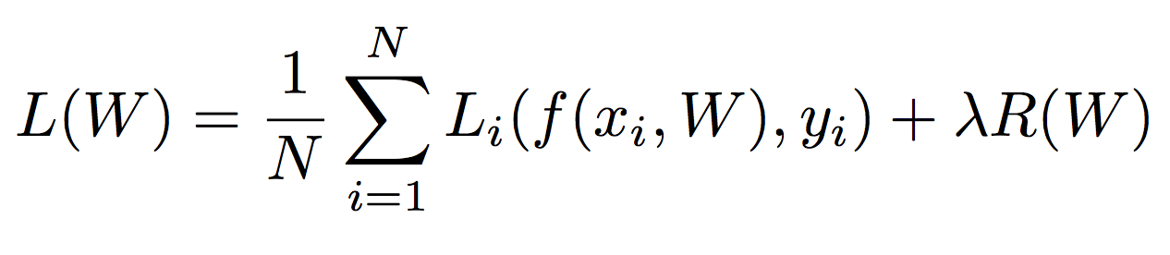
Regularization
Data loss: Model predictions should match training data
Slide Credit: Fei-Fei Li, Justin Johnson, Serena Yeung, CS 231n

Slide 26
Regularization
Data loss: Model predictions should match training data
Regularization: Prevent the model from doing too well on training data
Slide Credit: Fei-Fei Li, Justin Johnson, Serena Yeung, CS 231n

Slide 27

Regularization
= regularization strength
(hyperparameter)
Data loss: Model predictions should match training data
Regularization: Prevent the model from doing too well on training data
Slide Credit: Fei-Fei Li, Justin Johnson, Serena Yeung, CS 231n

Slide 28
Regularization: Prefer Simpler Models
y
x
Slide Credit: Fei-Fei Li, Justin Johnson, Serena Yeung, CS 231n

Slide 29
Polynomial Regression

Slide 30
Polynomial Regression

Slide 31
Polynomial Regression
f
y
x
Slide Credit: Fei-Fei Li, Justin Johnson, Serena Yeung, CS 231n

Slide 32
Polynomial Regression
Demo:
  https://arachnoid.com/polysolve/
Data:
  10 6
  15 9
  20 11
  25 12
  29 13
  40 11
  50 10
  60 9

Slide 33
Regularization: Prefer Simpler Models
f₁
f₂
y
x
Regularization pushes against fitting the data too well so we don’t fit noise in the data
Slide Credit: Fei-Fei Li, Justin Johnson, Serena Yeung, CS 231n

Slide 34
Regularization
= regularization strength
(hyperparameter)
Data loss: Model predictions should match training data
Regularization: Prevent the model from doing too well on training data
Slide Credit: Fei-Fei Li, Justin Johnson, Serena Yeung, CS 231n

Slide 35



Regularization
= regularization strength
(hyperparameter)
Data loss: Model predictions should match training data
Regularization: Prevent the model from doing too well on training data
Simple examples
L2 regularization:
L1 regularization:
Elastic net (L1 + L2):
Slide Credit: Fei-Fei Li, Justin Johnson, Serena Yeung, CS 231n

Slide 36
Regularization
= regularization strength
(hyperparameter)
Data loss: Model predictions should match training data
Regularization: Prevent the model from doing too well on training data
Simple examples
L2 regularization:
L1 regularization:
Elastic net (L1 + L2):
More complex:
Dropout
Batch normalization
Stochastic depth, fractional pooling, etc
Slide Credit: Fei-Fei Li, Justin Johnson, Serena Yeung, CS 231n

Slide 37
Regularization
= regularization strength
(hyperparameter)
Data loss: Model predictions should match training data
Regularization: Prevent the model from doing too well on training data
Why regularize?
Express preferences over weights
Make the model simple so it works on test data
Improve optimization by adding curvature
Slide Credit: Fei-Fei Li, Justin Johnson, Serena Yeung, CS 231n

Slide 38




Regularization: Expressing Preferences
L2 Regularization
Slide Credit: Fei-Fei Li, Justin Johnson, Serena Yeung, CS 231n

Slide 39
Regularization: Expressing Preferences
L2 Regularization
L2 regularization likes to “spread out” the weights
Slide Credit: Fei-Fei Li, Justin Johnson, Serena Yeung, CS 231n

Slide 40

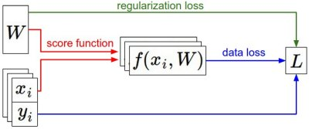

Recap
We have some dataset of (x,y)
We have a score function:
We have a loss function:
e.g.
Softmax
SVM
Full loss
Slide Credit: Fei-Fei Li, Justin Johnson, Serena Yeung, CS 231n

Slide 41
Recap
How do we find the best W?
We have some dataset of (x,y)
We have a score function:
We have a loss function:
e.g.
Softmax
SVM
Full loss
Slide Credit: Fei-Fei Li, Justin Johnson, Serena Yeung, CS 231n

Slide 42
Error Decomposition
Reality
Multi-class Logistic Regression
Modeling Error
Softmax
FC HxWx3
Input
Estimation
Error
Optimization
Error = 0
model class

Slide 43
Next: Neural Networks
Slide Credit: Fei-Fei Li, Justin Johnson, Serena Yeung, CS 231n

Slide 44

Neural networks: without the brain stuff
(Before) Linear score function:
Slide Credit: Fei-Fei Li, Justin Johnson, Serena Yeung, CS 231n
Notes:
Have been using linear score function as running example of function to optimize

Slide 45

Neural networks: without the brain stuff
(Before) Linear score function:
(Now) 2-layer Neural Network
Slide Credit: Fei-Fei Li, Justin Johnson, Serena Yeung, CS 231n
Notes:
Instead of using single linear transformation, stack 2 together, get 2-layer network

Slide 46
Neural networks: without the brain stuff
(Before) Linear score function:
(Now) 2-layer Neural Network
x
h
W1
W2
s
3072
100
10
Slide Credit: Fei-Fei Li, Justin Johnson, Serena Yeung, CS 231n
Notes:
First have W1*x, then nonlinear function, then second linear layer
More broadly speaking, NN are class of functions where simpler functions are stacked on top of each other in a hierarchical way to make up a more complex, nonlinear function. Have multiple stages of hierarchical computation.

Slide 47
Neural networks: without the brain stuff
(Before) Linear score function:
(Now) 2-layer Neural Network
x
h
W1
W2
s
3072
100
10
Slide Credit: Fei-Fei Li, Justin Johnson, Serena Yeung, CS 231n
Notes:
Biological inspirations to neurons in brain that we’ll discuss later
Looking at it mathematically first, one thing this can help solve, is if we look back to our linear score function, each row of W corresponded to a template
Problem that there can be only one template per class, can’t look for multiple modes
Now intermediate layers can represent anonymous templates that later get recombined
Intermediate layers anonymous templates that get recombined. solves mode problems

Slide 48
Neural networks: without the brain stuff
(Before) Linear score function:
(Now) 2-layer Neural Network
or 3-layer Neural Network
Slide Credit: Fei-Fei Li, Justin Johnson, Serena Yeung, CS 231n
Notes:
Can stack more of these layers to get deeper networks, where the term deep NN comes from

Slide 49
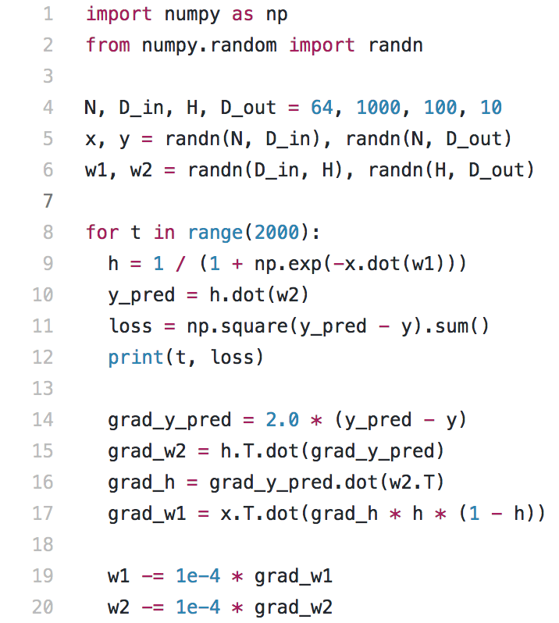
Full implementation of training a 2-layer Neural Network needs ~20 lines:
Slide Credit: Fei-Fei Li, Justin Johnson, Serena Yeung, CS 231n

Slide 50
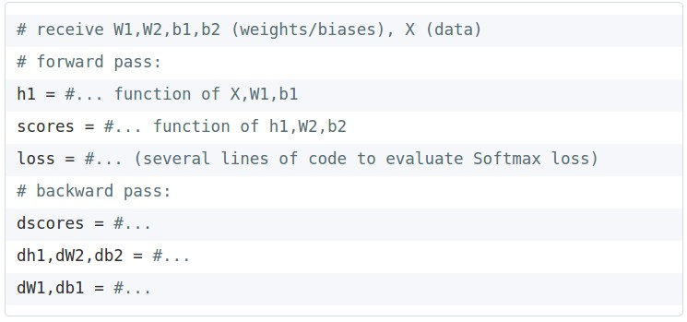
In Assignment 2: Writing a 2-layer net
Slide Credit: Fei-Fei Li, Justin Johnson, Serena Yeung, CS 231n

Slide 51
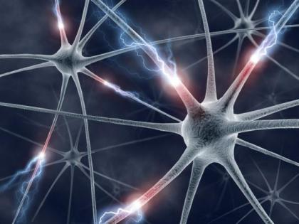
This image by Fotis Bobolas is licensed under CC-BY 2.0
Slide Credit: Fei-Fei Li, Justin Johnson, Serena Yeung, CS 231n
Notes:
Even though… still loosely inspired by brain, still interesting to understand where this comes from

Slide 52
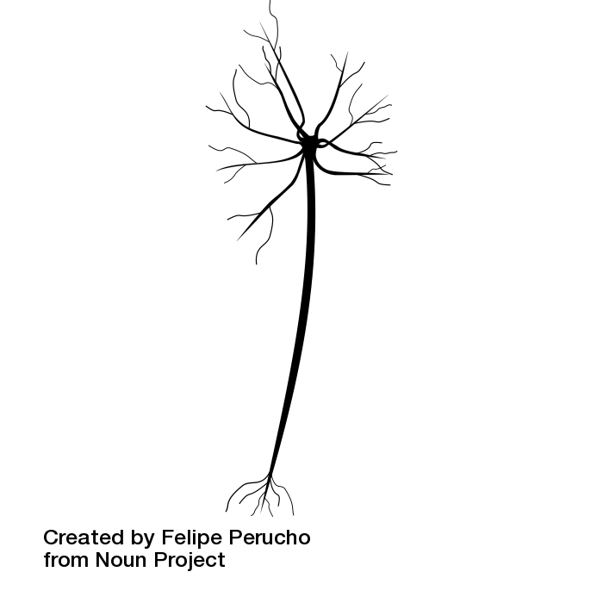
Impulses carried toward cell body
dendrite
presynaptic
terminal
axon
cell body
Impulses carried away from cell body
This image by Felipe Perucho
is licensed under CC-BY 3.0
Slide Credit: Fei-Fei Li, Justin Johnson, Serena Yeung, CS 231n

Slide 53
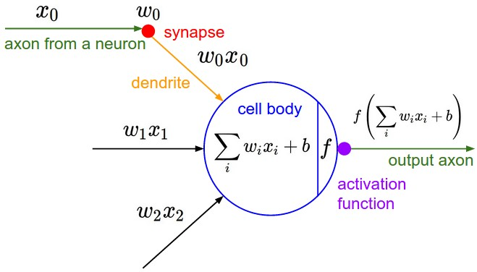
Impulses carried toward cell body
dendrite
presynaptic
terminal
axon
cell body
Impulses carried away from cell body
This image by Felipe Perucho
is licensed under CC-BY 3.0
Slide Credit: Fei-Fei Li, Justin Johnson, Serena Yeung, CS 231n

Slide 54
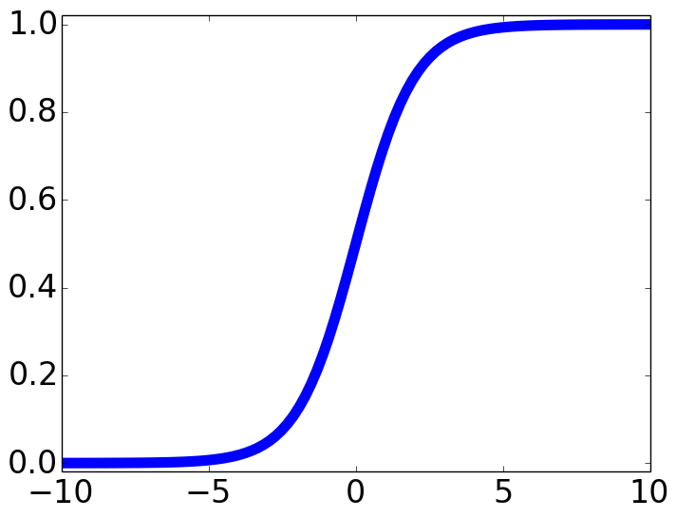

Impulses carried toward cell body
dendrite
presynaptic
terminal
axon
cell body
Impulses carried away from cell body
This image by Felipe Perucho
is licensed under CC-BY 3.0
sigmoid activation function
Slide Credit: Fei-Fei Li, Justin Johnson, Serena Yeung, CS 231n

Slide 56
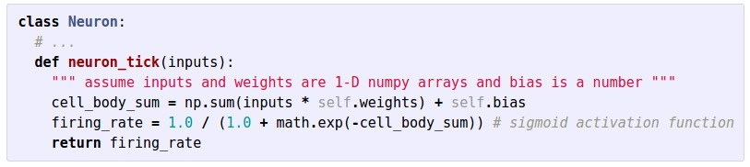
Impulses carried toward cell body
dendrite
presynaptic
terminal
axon
cell body
Impulses carried away from cell body
This image by Felipe Perucho
is licensed under CC-BY 3.0
Slide Credit: Fei-Fei Li, Justin Johnson, Serena Yeung, CS 231n

Slide 57
Be very careful with your brain analogies!
Biological Neurons:
Many different types
Dendrites can perform complex non-linear computations
Synapses are not a single weight but a complex non-linear dynamical system
Rate code may not be adequate
[Dendritic Computation. London and Hausser]
Slide Credit: Fei-Fei Li, Justin Johnson, Serena Yeung, CS 231n

Slide 58
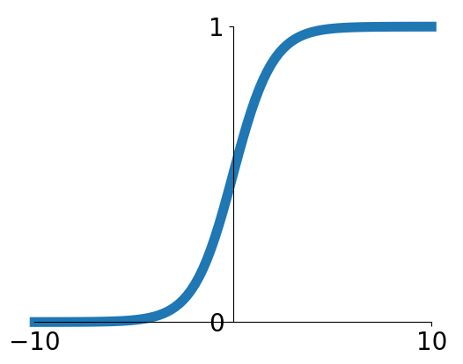
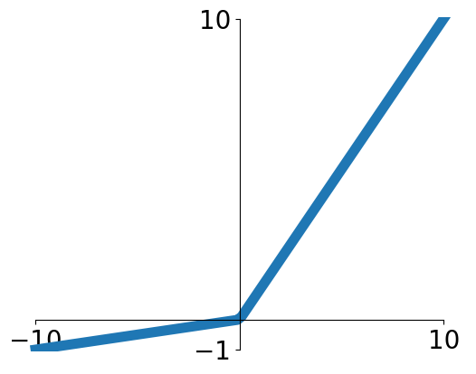


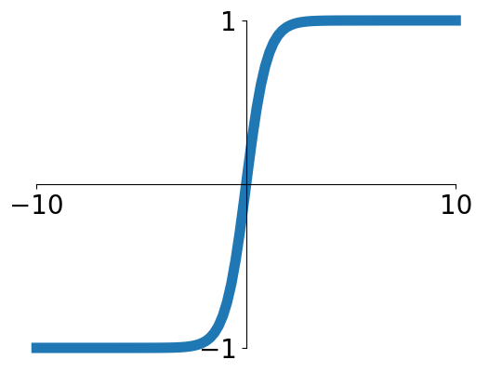


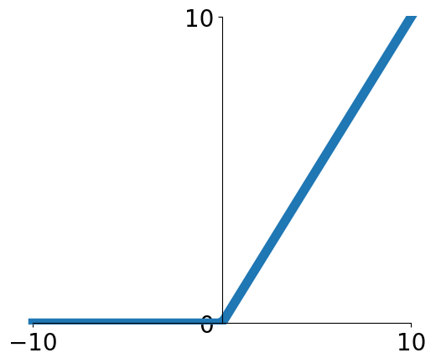
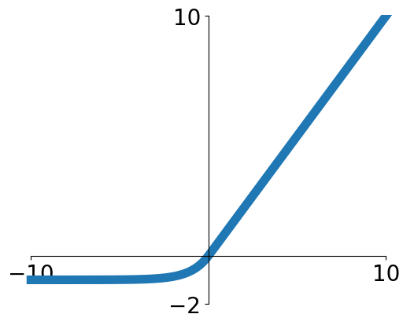

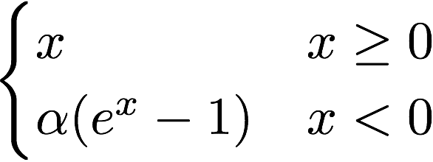
Activation functions
Sigmoid
Leaky ReLU
tanh
Maxout
ReLU
ELU
Slide Credit: Fei-Fei Li, Justin Johnson, Serena Yeung, CS 231n

Slide 59
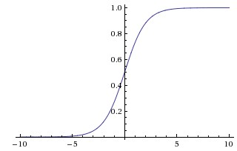
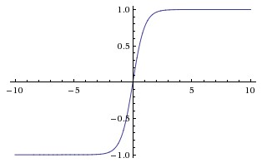
Activation Functions
sigmoid vs tanh

Slide 60
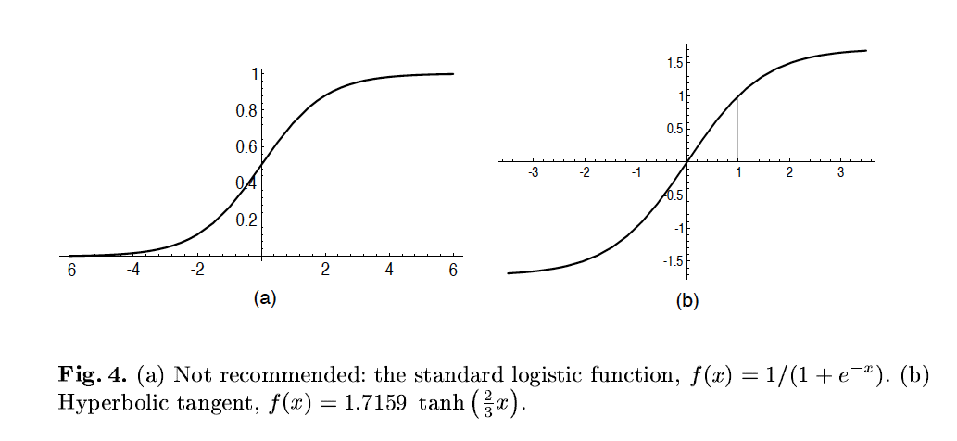
A quick note
Image Credit: LeCun et al. ‘98

Slide 61
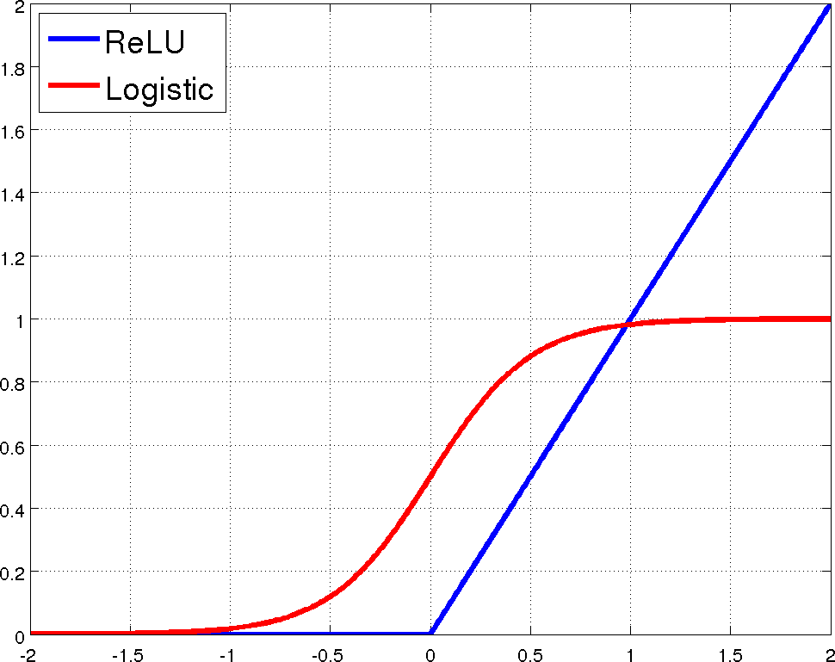
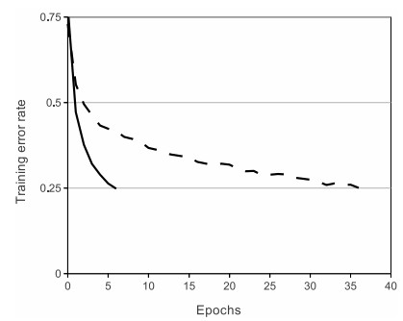
Rectified Linear Units (ReLU)
[Krizhevsky et al., NIPS12]

Slide 62
Limitation
A single “neuron” is still a linear decision boundary
What to do?
Idea: Stack a bunch of them together!

Slide 63
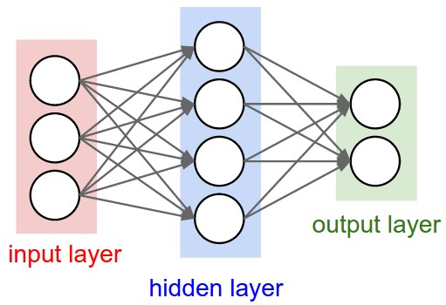
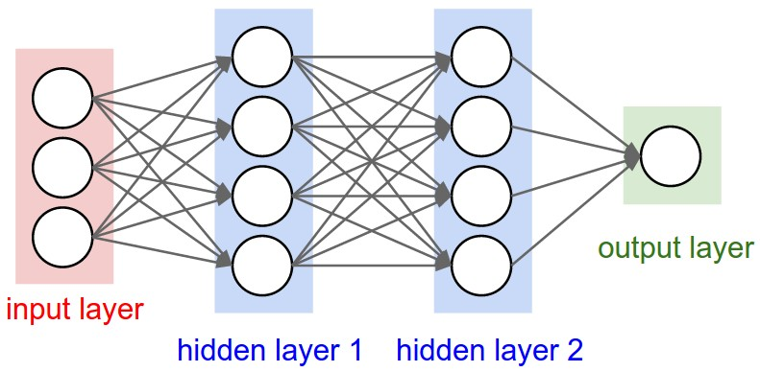
Multilayer Networks
Cascade Neurons together
The output from one layer is the input to the next
Each Layer has its own sets of weights
Image Credit: Andrej Karpathy, CS231n

Slide 64
Neural networks: Architectures
“3-layer Neural Net”, or
“2-hidden-layer Neural Net”
“2-layer Neural Net”, or
“1-hidden-layer Neural Net”
“Fully-connected” layers
Slide Credit: Fei-Fei Li, Justin Johnson, Serena Yeung, CS 231n

Slide 65
Demo Time
https://playground.tensorflow.org

Slide 66
Example feed-forward computation of a neural network
We can efficiently evaluate an entire layer of neurons.
Slide Credit: Fei-Fei Li, Justin Johnson, Serena Yeung, CS 231n

Slide 67
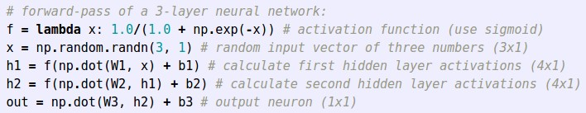
Example feed-forward computation of a neural network
Slide Credit: Fei-Fei Li, Justin Johnson, Serena Yeung, CS 231n

Slide 68
Optimization

Slide 69

This image is CC0 1.0 public domain
Slide Credit: Fei-Fei Li, Justin Johnson, Serena Yeung, CS 231n

Slide 70

Strategy: Follow the slope
Slide Credit: Fei-Fei Li, Justin Johnson, Serena Yeung, CS 231n

Slide 71

Strategy: Follow the slope
In 1-dimension, the derivative of a function:
In multiple dimensions, the gradient is the vector of (partial derivatives) along each dimension
The slope in any direction is the dot product of the direction with the gradient
The direction of steepest descent is the negative gradient
Slide Credit: Fei-Fei Li, Justin Johnson, Serena Yeung, CS 231n

Slide 72
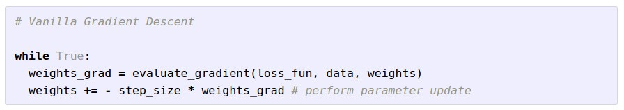
Gradient Descent
Slide Credit: Fei-Fei Li, Justin Johnson, Serena Yeung, CS 231n

Slide 73

W_2
original W
W_1
negative gradient direction
Slide Credit: Fei-Fei Li, Justin Johnson, Serena Yeung, CS 231n

Slide 74
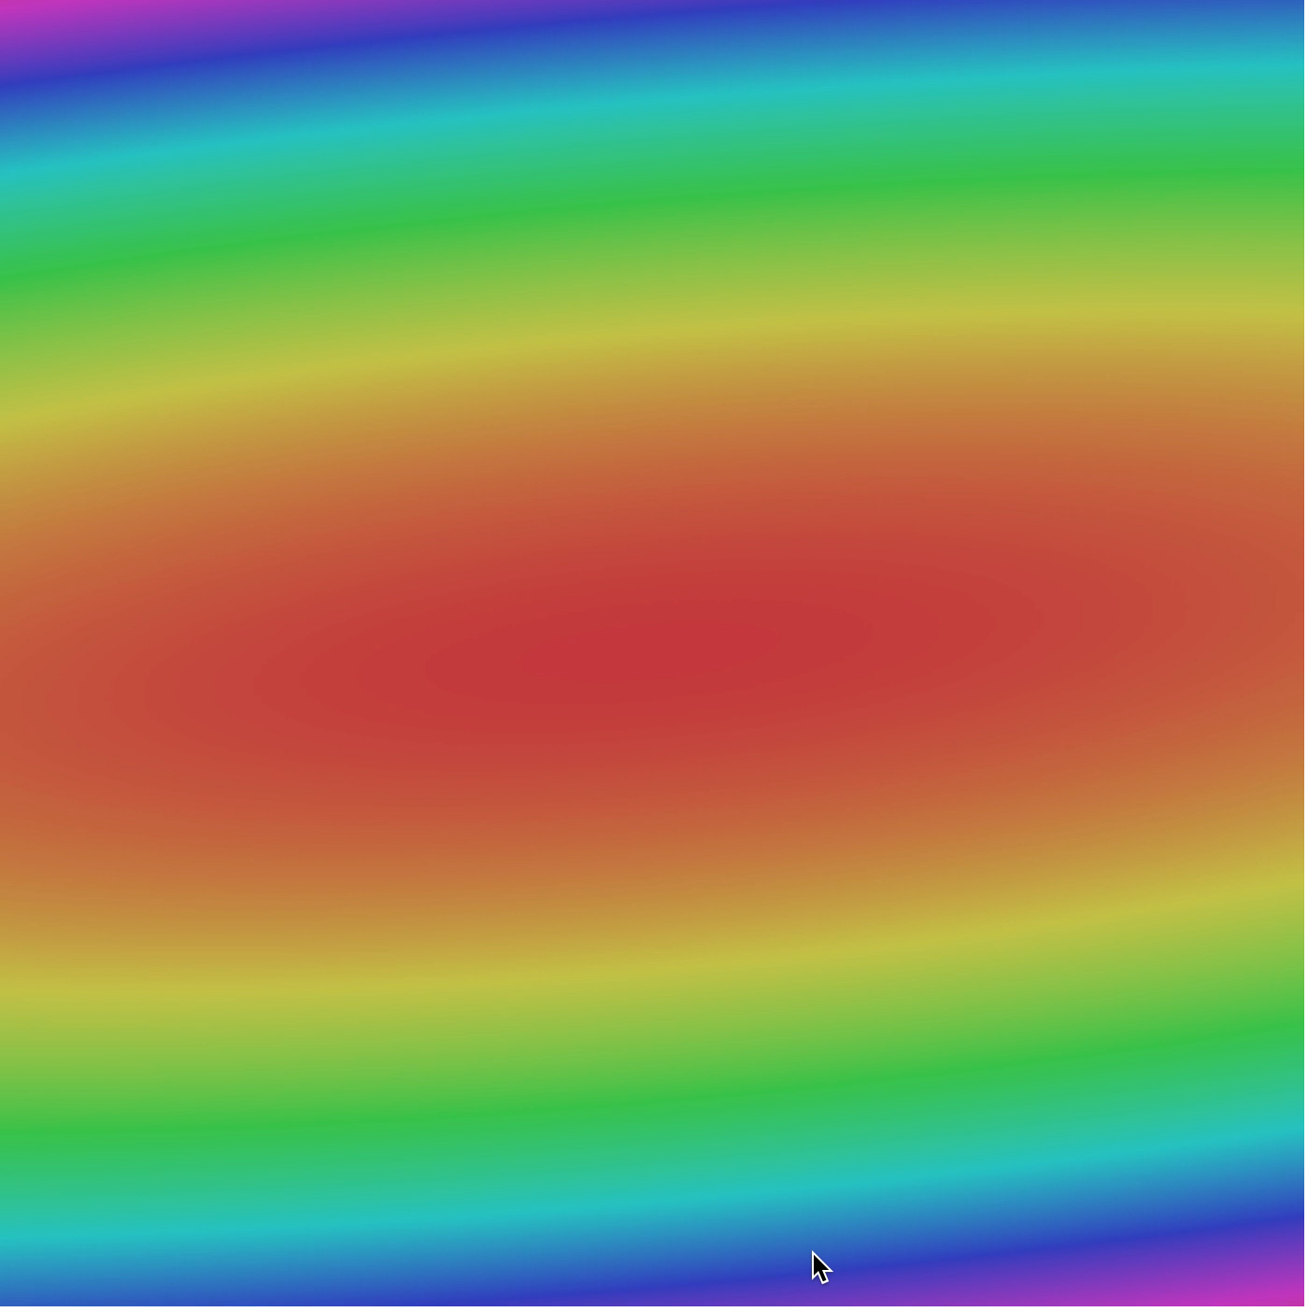
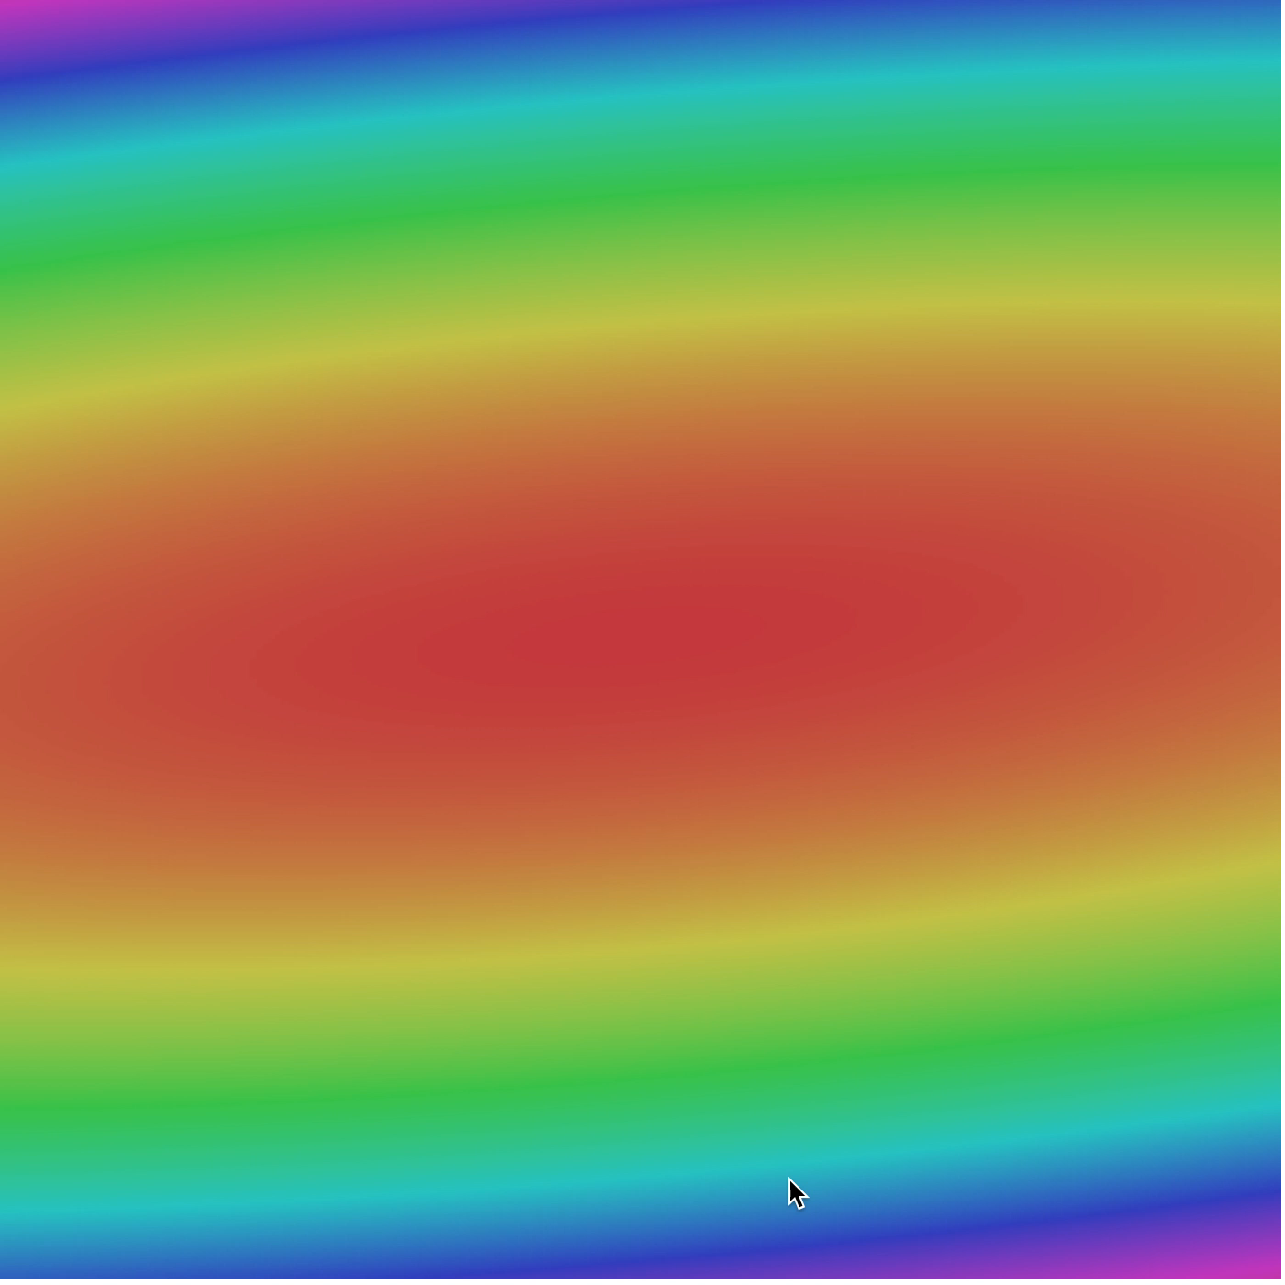
Slide Credit: Fei-Fei Li, Justin Johnson, Serena Yeung, CS 231n

