Slide 1
CS 4803 / 7643: Deep Learning
Topics:
  Generative Adversarial Networks (GANs)
  Reinforcement Learning (RL)
Dhruv Batra
Georgia Tech

Slide 2
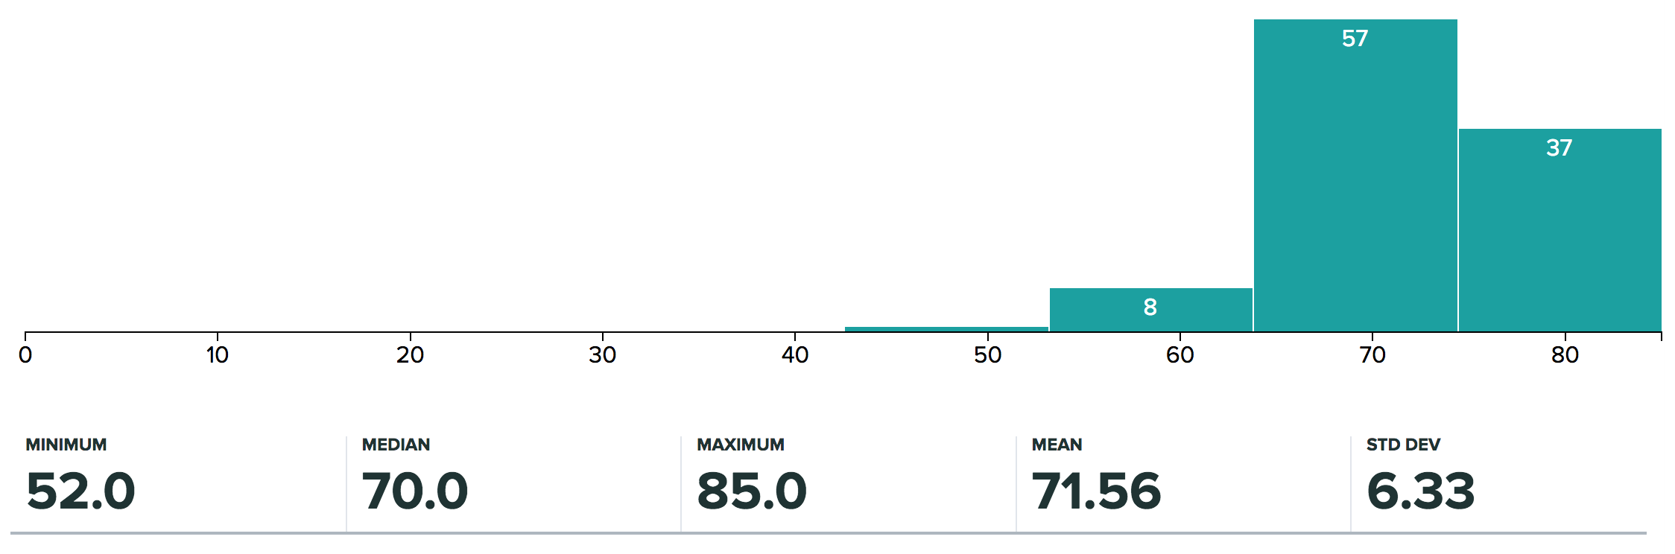
Administrativia
HW3 Grades Released
  Max regular points: 62 (4803), 66 (7643)
  Regrade requests close: 12/04, 11:55pm

Slide 3
Administrativia
Project submission instructions released
  Due: 12/04, 11:55pm
  Last deliverable in the class
  Can’t use late days
  https://piazza.com/class/jkujs03pgu75cd?cid=225

Slide 4
Recap from last time

Slide 5

Variational Auto Encoders
VAEs are a combination of the following ideas:
Auto Encoders
Variational Approximation
  Variational Lower Bound / ELBO
Amortized Inference Neural Networks
“Reparameterization” Trick

Slide 6
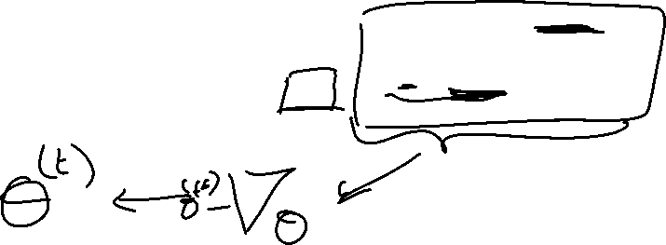
Basic Problem
Goal

Slide 7
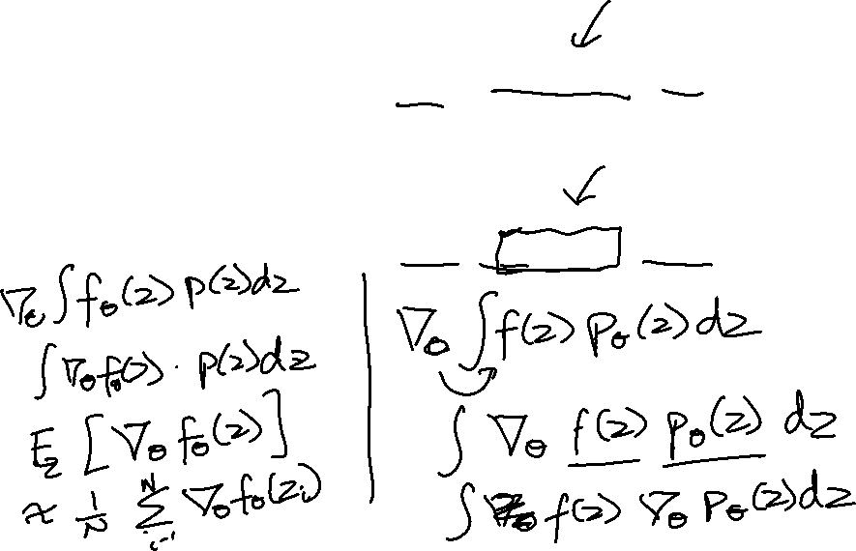
Basic Problem
Goal
Need to compute:

Slide 8
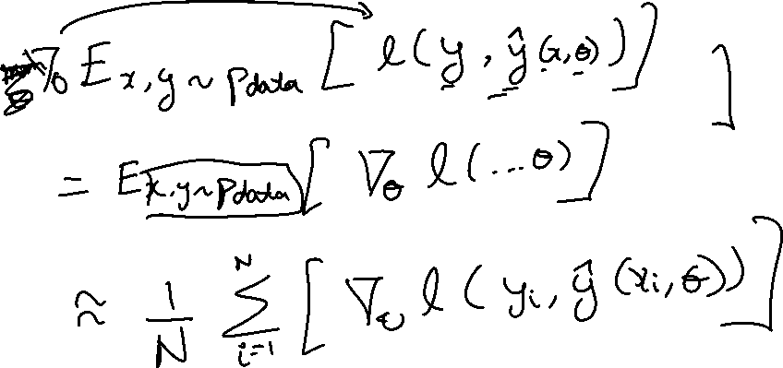
Does this happen in supervised learning?
Goal

Slide 9
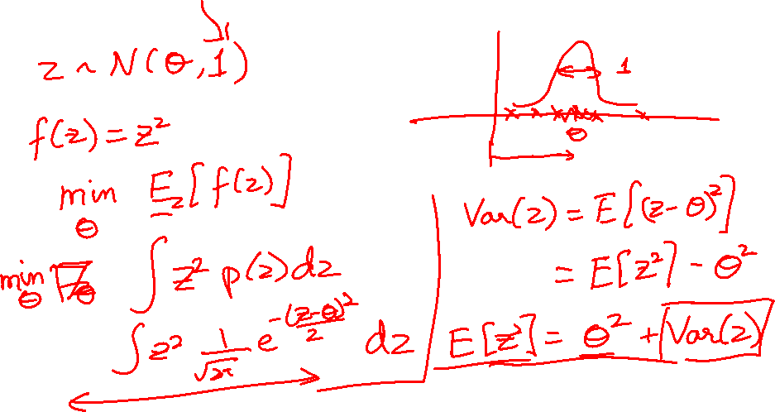
Example

Slide 10
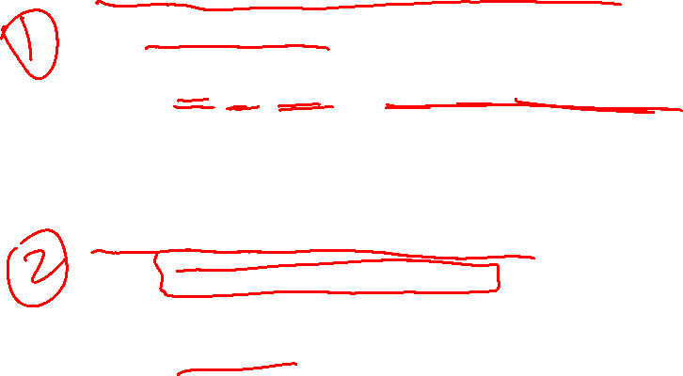
Two Options
Score Function based Gradient Estimator
aka REINFORCE (and variants)
Path Derivative Gradient Estimator
aka “reparameterization trick”

Slide 11
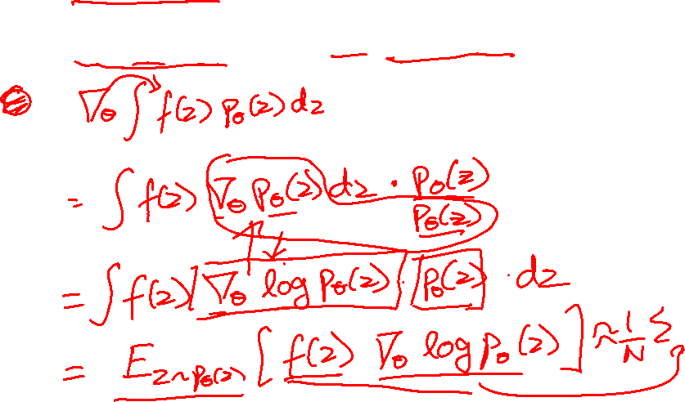
Option 1
Score Function based Gradient Estimator
aka REINFORCE (and variants)

Slide 12
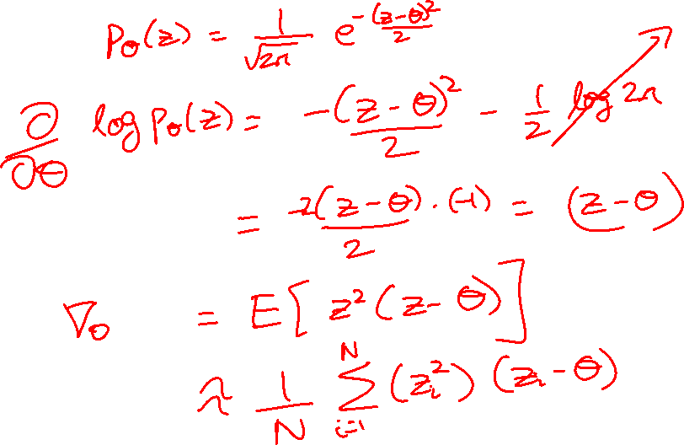
Example

Slide 13
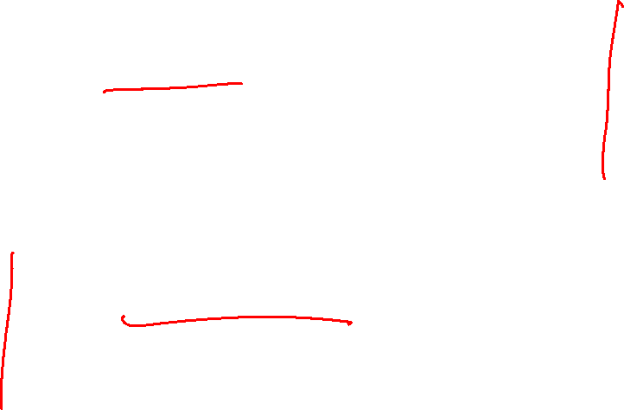
Two Options
Score Function based Gradient Estimator
aka REINFORCE (and variants)
Path Derivative Gradient Estimator
aka “reparameterization trick”

Slide 14
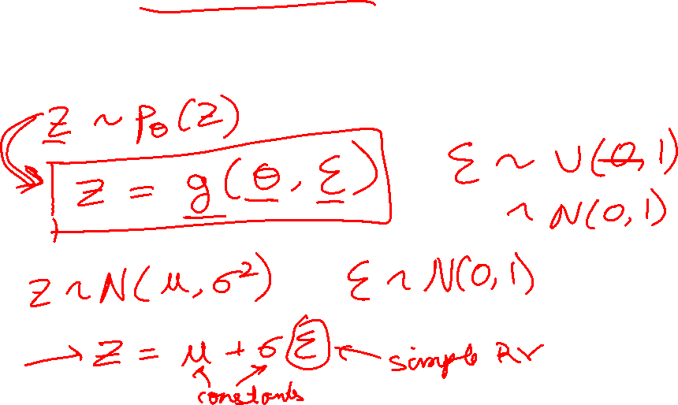
Option 2
Path Derivative Gradient Estimator
aka “reparameterization trick”

Slide 15
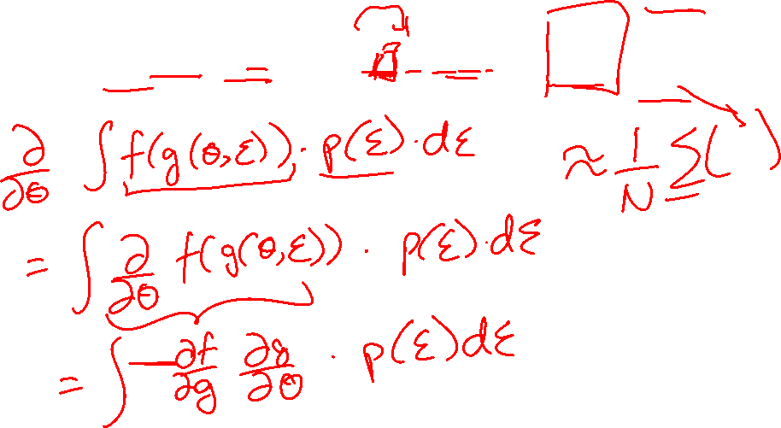
Option 2
Path Derivative Gradient Estimator
aka “reparameterization trick”

Slide 16
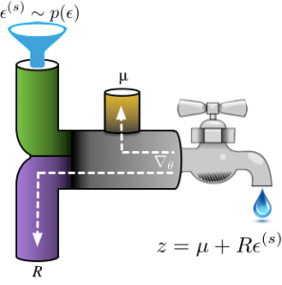
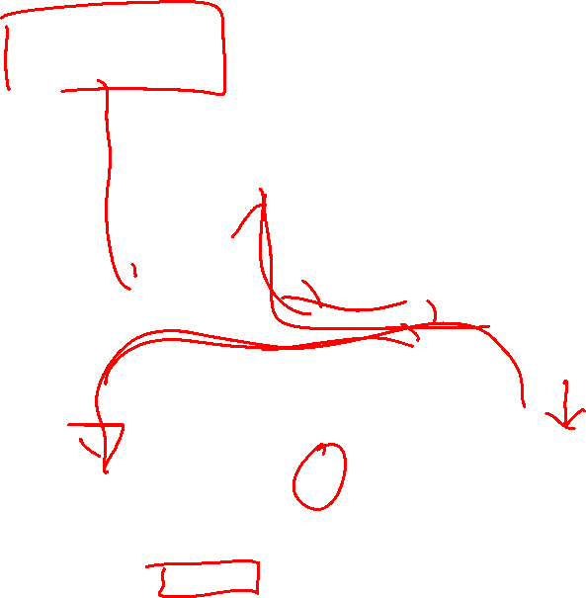
Reparameterization Intuition
Figure Credit: http://blog.shakirm.com/2015/10/machine-learning-trick-of-the-day-4-reparameterisation-tricks/

Slide 17
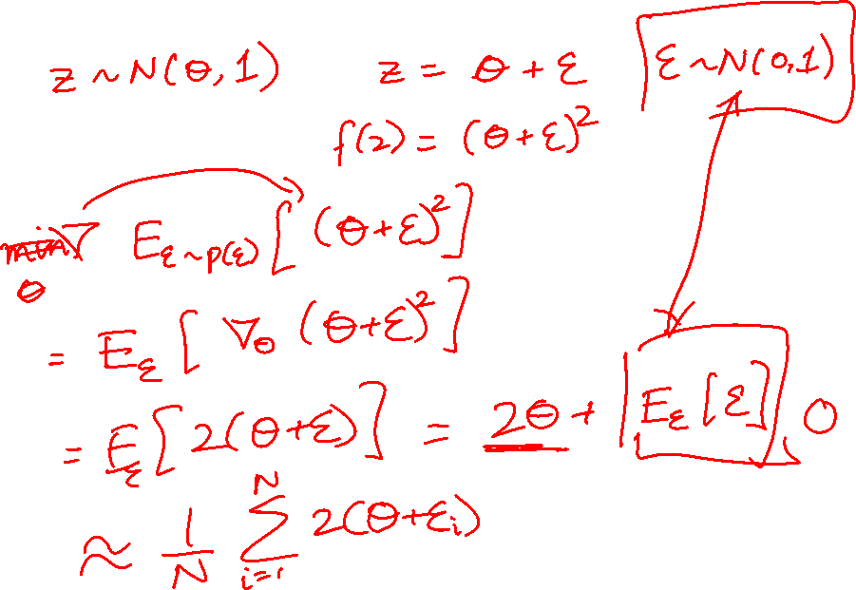
Example

Slide 18
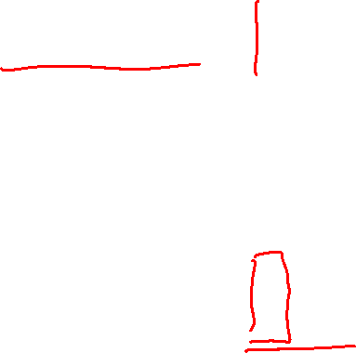
Two Options
Score Function based Gradient Estimator
aka REINFORCE (and variants)
Path Derivative Gradient Estimator
aka “reparameterization trick”

Slide 19
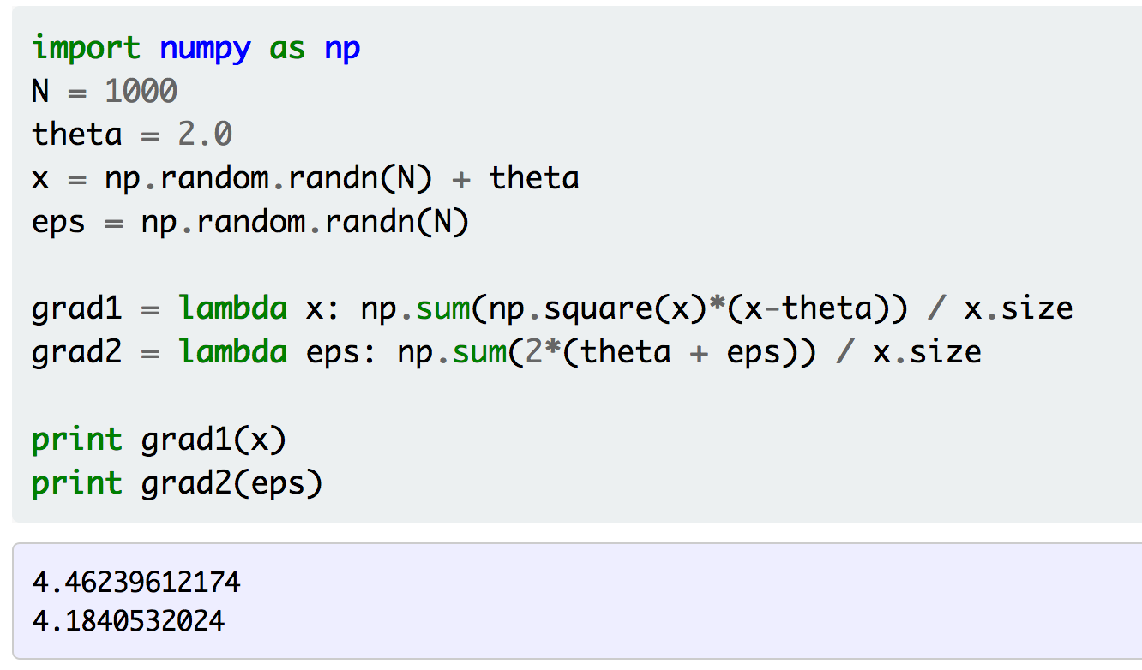
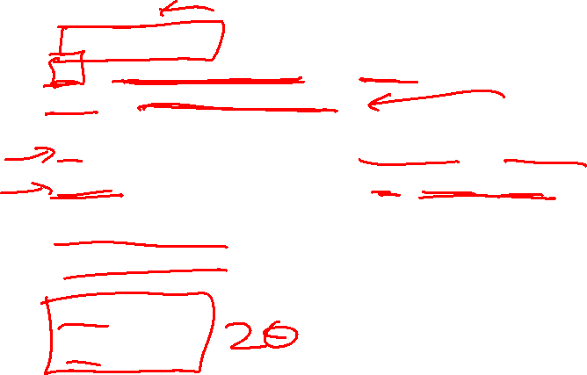
Example
Figure Credit: http://gokererdogan.github.io/2016/07/01/reparameterization-trick/

Slide 20
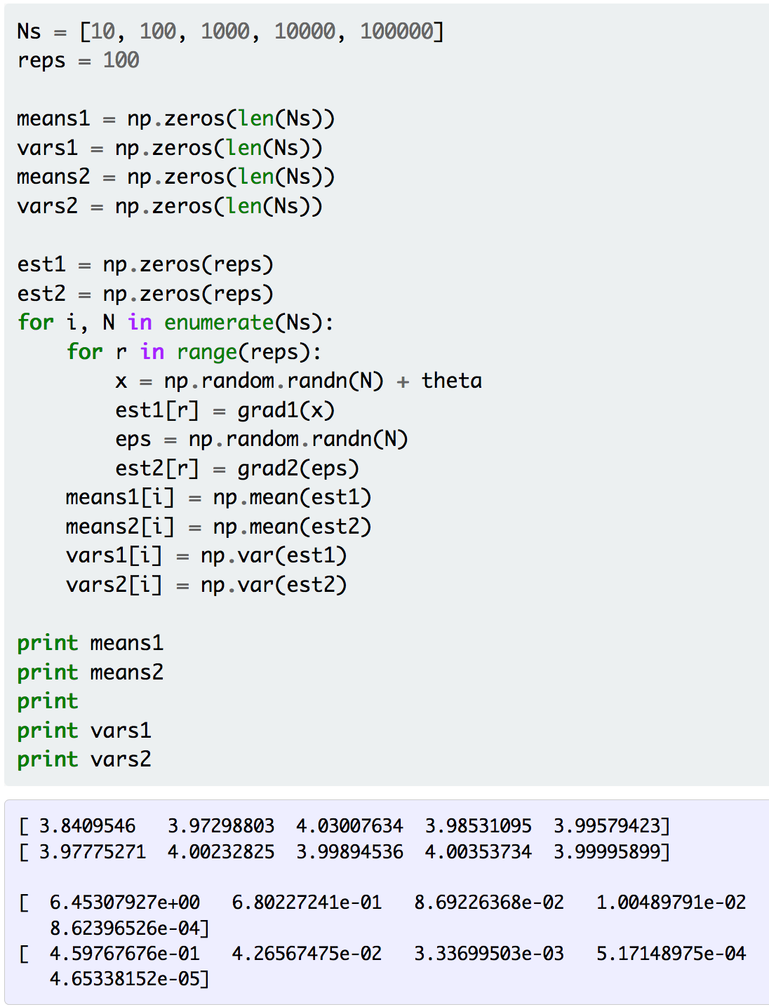
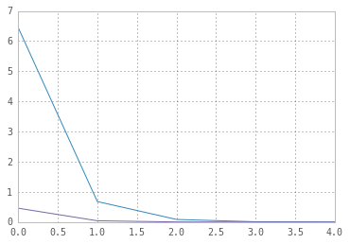
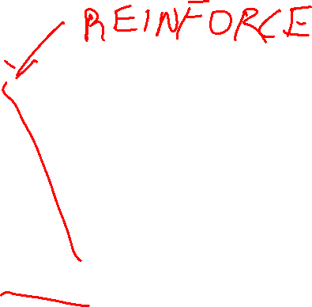
Example
Figure Credit: http://gokererdogan.github.io/2016/07/01/reparameterization-trick/

Slide 21
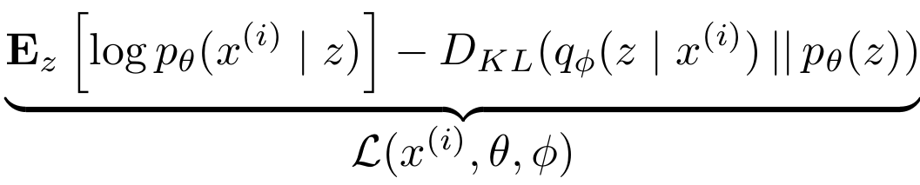





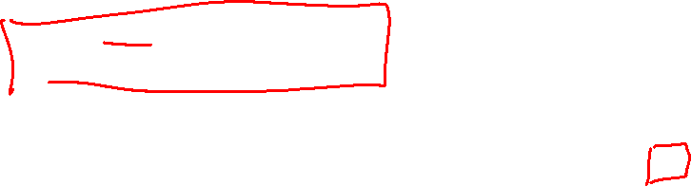
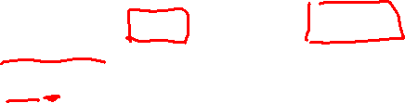
Variational Auto Encoders
Putting it all together: maximizing the likelihood lower bound
Decoder network
Sample z from
Make approximate posterior distribution close to prior
Encoder network
Input Data
Slide Credit: Fei-Fei Li, Justin Johnson, Serena Yeung, CS 231n

Slide 22
Generative Adversarial Networks (GAN)

Slide 23
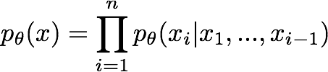

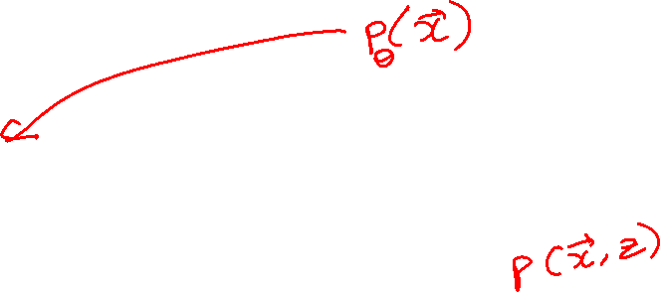
So far...
PixelCNNs define tractable density function, optimize likelihood of training data:
VAEs define intractable density function with latent z:
Cannot optimize directly, derive and optimize lower bound on likelihood instead
Slide Credit: Fei-Fei Li, Justin Johnson, Serena Yeung, CS 231n

Slide 24
So far...
PixelCNNs define tractable density function, optimize likelihood of training data:
VAEs define intractable density function with latent z:
Cannot optimize directly, derive and optimize lower bound on likelihood instead
What if we give up on explicitly modeling density, and just want ability to sample?
GANs: don’t work with any explicit density function!
Slide Credit: Fei-Fei Li, Justin Johnson, Serena Yeung, CS 231n

Slide 25
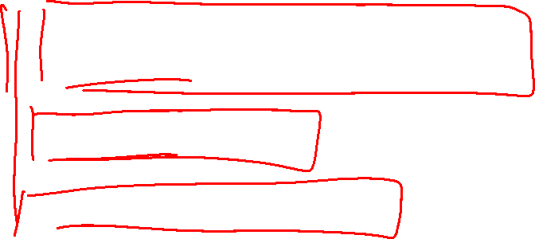
Generative Adversarial Networks (GANs)
GANs are a combination of the following ideas:
Learning to Sample
  Connection to Inverse Transform Sampling
Adversarial Training
“Reparameterization” Trick

Slide 26

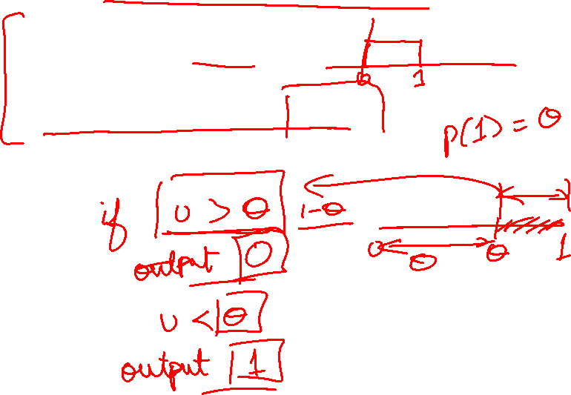
Easy Interview Question
I give you u ~ U(0,1)
Produce a sample from Bern($θ$)

Slide 27

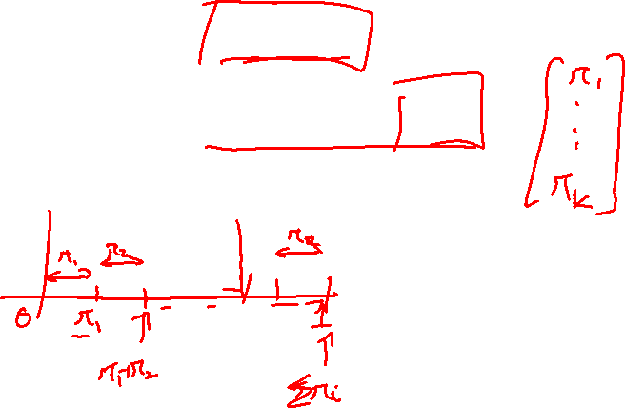
Slightly Harder Interview Question
I give you u ~ U(0,1)
Produce a sample from Cat($π$)

Slide 28
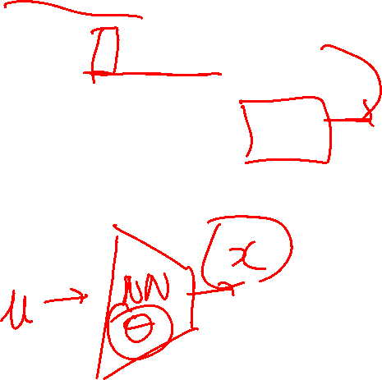
Harder Interview Question
I give you u ~ U(0,1)
Produce a sample from F_{X}(x)

Slide 29
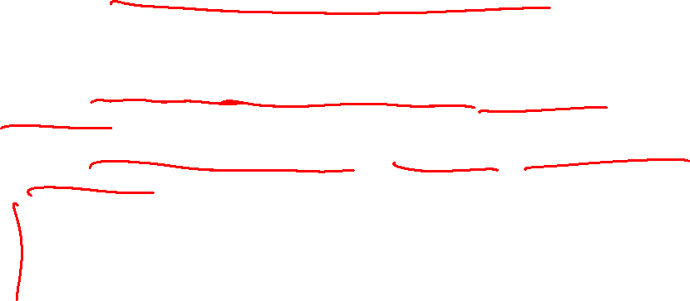
Generative Adversarial Networks
Ian Goodfellow et al., “Generative Adversarial Nets”, NIPS 2014
Problem: Want to sample from complex, high-dimensional training distribution. No direct way to do this!
Solution: Sample from a simple distribution, e.g. random noise. Learn transformation to training distribution.
Q: What can we use to represent this complex transformation?
Slide Credit: Fei-Fei Li, Justin Johnson, Serena Yeung, CS 231n
Notes:
Mapping z to data manifold?
Hard to sample from high dimensional distribution. Take random noise, transform to real distribution

Slide 30
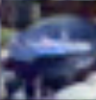
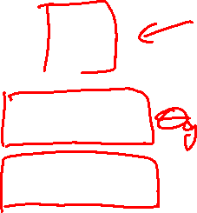
Generative Adversarial Networks
Ian Goodfellow et al., “Generative Adversarial Nets”, NIPS 2014
Problem: Want to sample from complex, high-dimensional training distribution. No direct way to do this!
Solution: Sample from a simple distribution, e.g. random noise. Learn transformation to training distribution.
Q: What can we use to represent this complex transformation?
Output: Sample from training distribution
A: A neural network!
Generator Network
Input: Random noise
z
Slide Credit: Fei-Fei Li, Justin Johnson, Serena Yeung, CS 231n
Notes:
Mapping z to data manifold?
Hard to sample from high dimensional distribution. Take random noise, transform to real distribution

Slide 31
Plan for Today
(Finish) Generative Adversarial Networks (GANs)
Reinforcement Learning

Slide 32
Generative Adversarial Networks (GANs)
GANs are a combination of the following ideas:
Learning to Sample
  Connection to Inverse Transform Sampling
Adversarial Training
“Reparameterization” Trick

Slide 33
Training GANs: Two-player game
Ian Goodfellow et al., “Generative Adversarial Nets”, NIPS 2014
Generator network: try to fool the discriminator by generating real-looking images
Discriminator network: try to distinguish between real and fake images
Slide Credit: Fei-Fei Li, Justin Johnson, Serena Yeung, CS 231n
Notes:
Mapping z to data manifold?

Slide 34





Training GANs: Two-player game
Ian Goodfellow et al., “Generative Adversarial Nets”, NIPS 2014
Generator network: try to fool the discriminator by generating real-looking images
Discriminator network: try to distinguish between real and fake images
Real or Fake
Discriminator Network
Fake Images
(from generator)
Real Images
(from training set)
Generator Network
Random noise
z
Fake and real images copyright Emily Denton et al. 2015. Reproduced with permission.
Slide Credit: Fei-Fei Li, Justin Johnson, Serena Yeung, CS 231n
Notes:
Mapping z to data manifold?

Slide 35
Training GANs: Two-player game
Ian Goodfellow et al., “Generative Adversarial Nets”, NIPS 2014
Generator network: try to fool the discriminator by generating real-looking images
Discriminator network: try to distinguish between real and fake images
Train jointly in minimax game
Minimax objective function:
Slide Credit: Fei-Fei Li, Justin Johnson, Serena Yeung, CS 231n
Notes:
Mapping z to data manifold?

Slide 36
Training GANs: Two-player game
Ian Goodfellow et al., “Generative Adversarial Nets”, NIPS 2014
Generator network: try to fool the discriminator by generating real-looking images
Discriminator network: try to distinguish between real and fake images
Train jointly in minimax game
Minimax objective function:
Discriminator outputs likelihood in (0,1) of real image
Discriminator output for real data x
Discriminator output for generated fake data G(z)
Slide Credit: Fei-Fei Li, Justin Johnson, Serena Yeung, CS 231n
Notes:
Mapping z to data manifold?

Slide 37
Training GANs: Two-player game
Ian Goodfellow et al., “Generative Adversarial Nets”, NIPS 2014
Generator network: try to fool the discriminator by generating real-looking images
Discriminator network: try to distinguish between real and fake images
Train jointly in minimax game
Minimax objective function:
Discriminator outputs likelihood in (0,1) of real image
Discriminator output for real data x
Discriminator output for generated fake data G(z)
Discriminator (θ_{d}) wants to maximize objective such that D(x) is close to 1 (real) and D(G(z)) is close to 0 (fake)
Generator (θ_{g}) wants to minimize objective such that D(G(z)) is close to 1 (discriminator is fooled into thinking generated G(z) is real)
Slide Credit: Fei-Fei Li, Justin Johnson, Serena Yeung, CS 231n
Notes:
Mapping z to data manifold?

Slide 38

Training GANs: Two-player game
Ian Goodfellow et al., “Generative Adversarial Nets”, NIPS 2014
Minimax objective function:
Alternate between:
Gradient ascent on discriminator
2. Gradient descent on generator
Slide Credit: Fei-Fei Li, Justin Johnson, Serena Yeung, CS 231n
Notes:
Mapping z to data manifold?

Slide 39
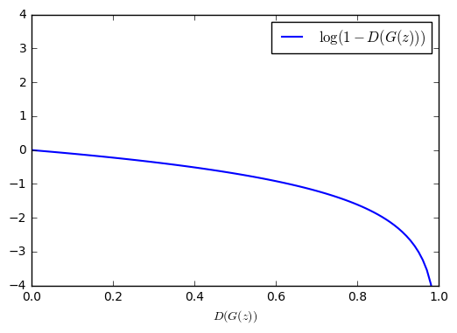
Training GANs: Two-player game
Ian Goodfellow et al., “Generative Adversarial Nets”, NIPS 2014
Minimax objective function:
Gradient signal dominated by region where sample is already good
Alternate between:
Gradient ascent on discriminator
2. Gradient descent on generator
When sample is likely fake, want to learn from it to improve generator. But gradient in this region is relatively flat!
In practice, optimizing this generator objective does not work well!
Slide Credit: Fei-Fei Li, Justin Johnson, Serena Yeung, CS 231n
Notes:
Mapping z to data manifold?

Slide 40
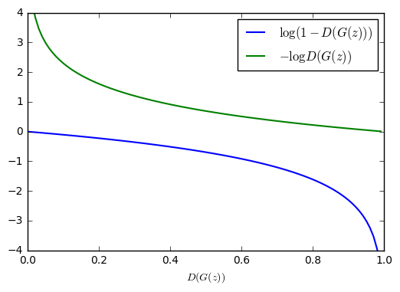

Training GANs: Two-player game
Ian Goodfellow et al., “Generative Adversarial Nets”, NIPS 2014
Minimax objective function:
Alternate between:
Gradient ascent on discriminator
2. Instead: Gradient ascent on generator, different objective
Instead of minimizing likelihood of discriminator being correct, now maximize likelihood of discriminator being wrong.
Same objective of fooling discriminator, but now higher gradient signal for bad samples => works much better! Standard in practice.
High gradient signal
Low gradient signal
Slide Credit: Fei-Fei Li, Justin Johnson, Serena Yeung, CS 231n
Notes:
Mapping z to data manifold?

Slide 41
Training GANs: Two-player game
Ian Goodfellow et al., “Generative Adversarial Nets”, NIPS 2014
Minimax objective function:
Aside: Jointly training two networks is challenging, can be unstable. Choosing objectives with better loss landscapes helps training, is an active area of research.
Alternate between:
Gradient ascent on discriminator
2. Instead: Gradient ascent on generator, different objective
Instead of minimizing likelihood of discriminator being correct, now maximize likelihood of discriminator being wrong.
Same objective of fooling discriminator, but now higher gradient signal for bad samples => works much better! Standard in practice.
High gradient signal
Low gradient signal
Slide Credit: Fei-Fei Li, Justin Johnson, Serena Yeung, CS 231n
Notes:
Mapping z to data manifold?

Slide 42
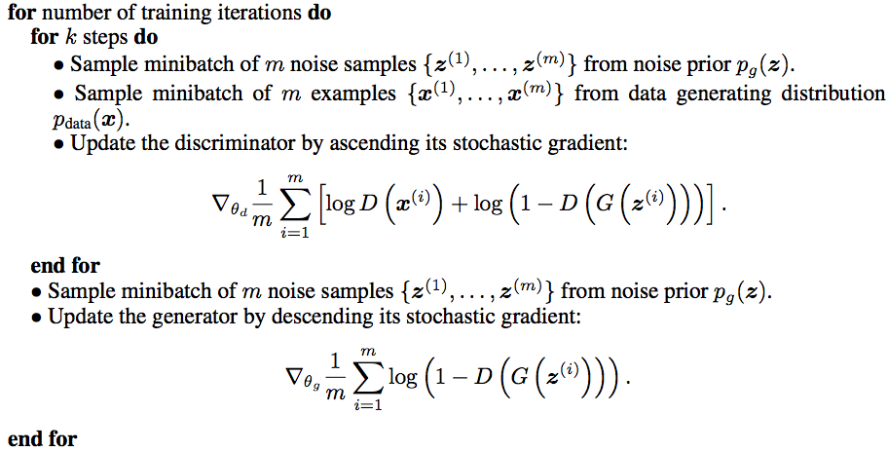
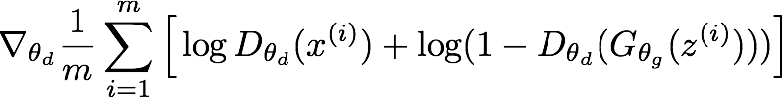
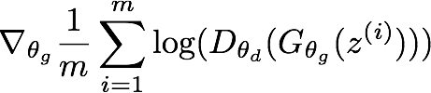
Training GANs: Two-player game
Ian Goodfellow et al., “Generative Adversarial Nets”, NIPS 2014
Putting it together: GAN training algorithm
Slide Credit: Fei-Fei Li, Justin Johnson, Serena Yeung, CS 231n
Notes:
Train discriminator for a bit
Then train generator for a bit

Slide 43
Training GANs: Two-player game
Ian Goodfellow et al., “Generative Adversarial Nets”, NIPS 2014
Putting it together: GAN training algorithm
Some find k=1 more stable, others use k > 1, no best rule.
Recent work (e.g. Wasserstein GAN) alleviates this problem, better stability!
Slide Credit: Fei-Fei Li, Justin Johnson, Serena Yeung, CS 231n
Notes:
Mapping z to data manifold?
**No clear rule. Sometimes train 1 step discriminator, 1 step gen. Some train disc. More

Slide 44
Training GANs: Two-player game
Ian Goodfellow et al., “Generative Adversarial Nets”, NIPS 2014
Generator network: try to fool the discriminator by generating real-looking images
Discriminator network: try to distinguish between real and fake images
Real or Fake
Discriminator Network
Fake Images
(from generator)
Real Images
(from training set)
Generator Network
After training, use generator network to generate new images
Random noise
z
Fake and real images copyright Emily Denton et al. 2015. Reproduced with permission.
Slide Credit: Fei-Fei Li, Justin Johnson, Serena Yeung, CS 231n
Notes:
Mapping z to data manifold?

Slide 45
GANs
Demo
  https://poloclub.github.io/ganlab/

Slide 46
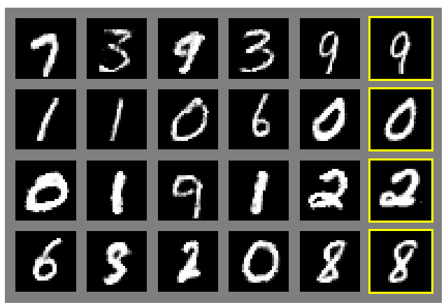
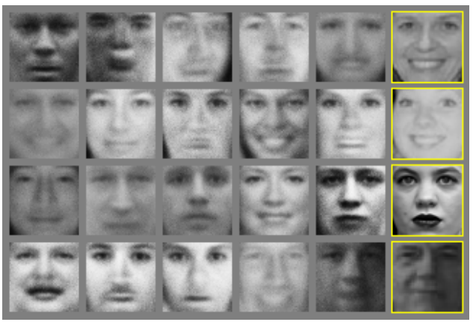
Generative Adversarial Nets
Ian Goodfellow et al., “Generative Adversarial Nets”, NIPS 2014
Generated samples
Nearest neighbor from training set
Figures copyright Ian Goodfellow et al., 2014. Reproduced with permission.
Slide Credit: Fei-Fei Li, Justin Johnson, Serena Yeung, CS 231n
Notes:
Realistic samples, never directly memorizes training set

Slide 47
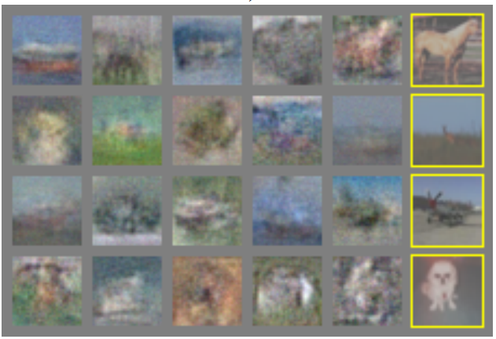
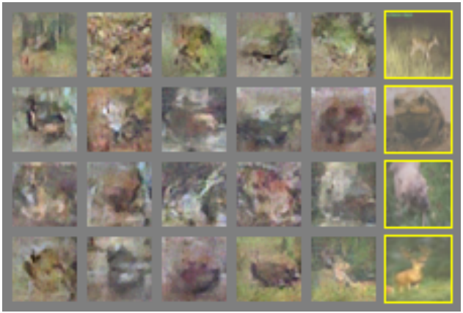
Generative Adversarial Nets
Ian Goodfellow et al., “Generative Adversarial Nets”, NIPS 2014
Generated samples (CIFAR-10)
Nearest neighbor from training set
Figures copyright Ian Goodfellow et al., 2014. Reproduced with permission.
Slide Credit: Fei-Fei Li, Justin Johnson, Serena Yeung, CS 231n
Notes:
Original work from 2014, not such great quality yet

Slide 48
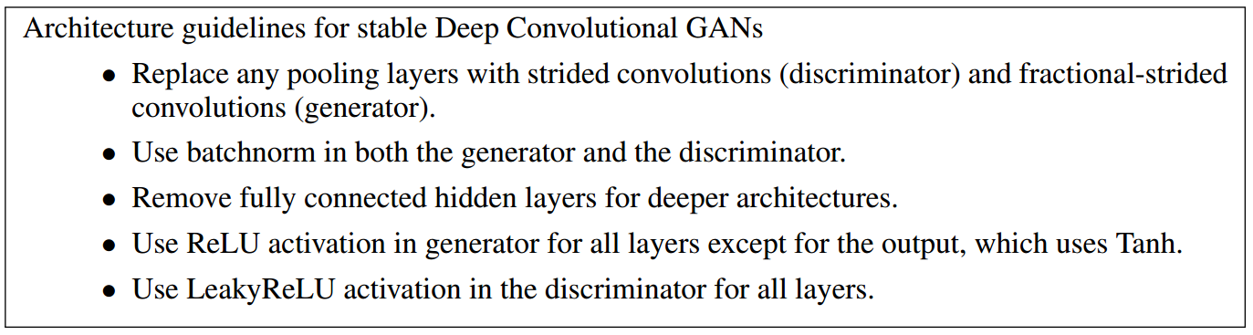
Generative Adversarial Nets: Convolutional Architectures
Generator is an upsampling network with fractionally-strided convolutions
Discriminator is a convolutional network
Radford et al, “Unsupervised Representation Learning with Deep Convolutional Generative Adversarial Networks”, ICLR 2016
Slide Credit: Fei-Fei Li, Justin Johnson, Serena Yeung, CS 231n
Notes:
Since this time, a lot of work on improving GANs.
This work ICLR2016 on adding convolutional architectures to GANs

Slide 49
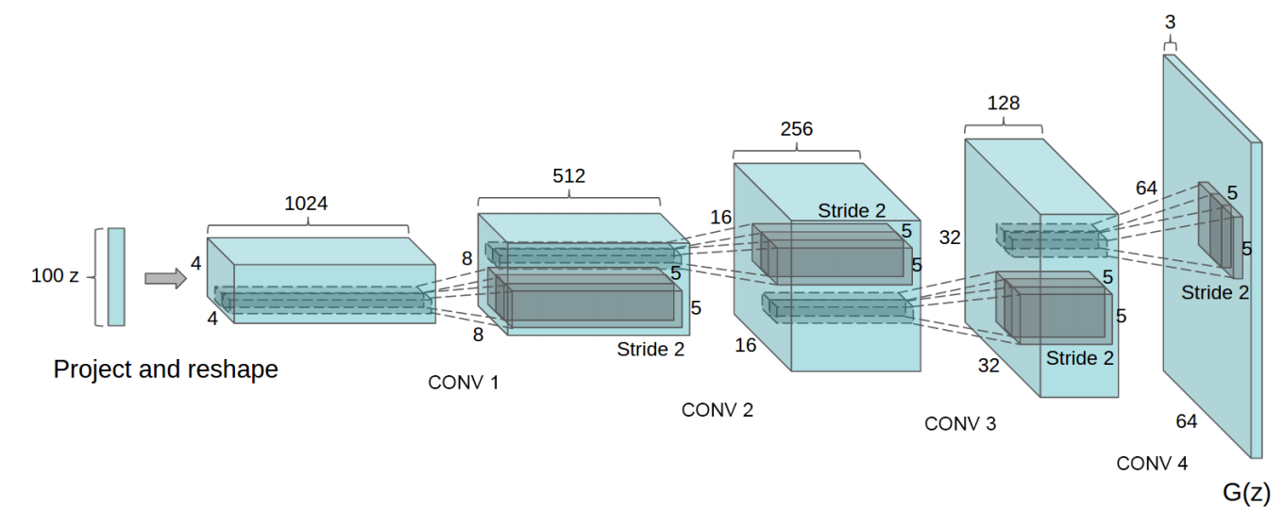
Generative Adversarial Nets: Convolutional Architectures
Generator
Radford et al, “Unsupervised Representation Learning with Deep Convolutional Generative Adversarial Networks”, ICLR 2016
Slide Credit: Fei-Fei Li, Justin Johnson, Serena Yeung, CS 231n

Slide 50
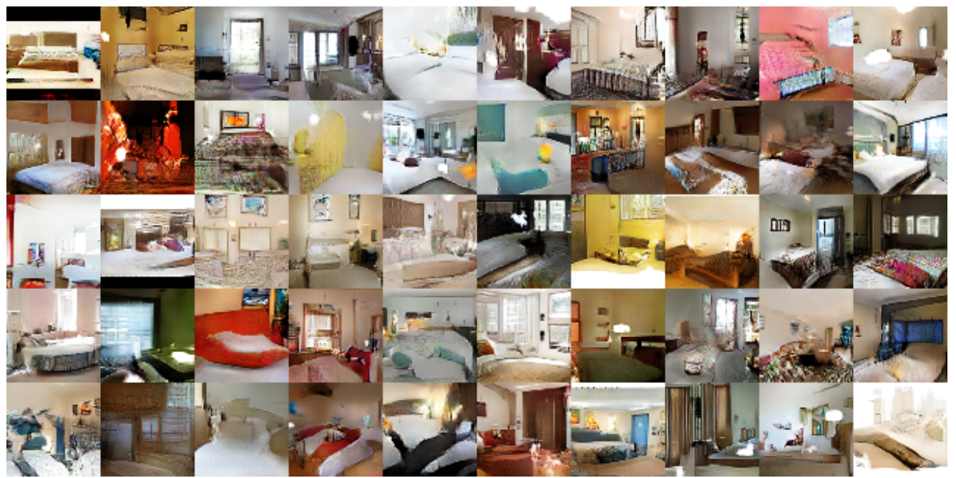
Generative Adversarial Nets: Convolutional Architectures
Samples from the model look much better!
Radford et al,
ICLR 2016
Slide Credit: Fei-Fei Li, Justin Johnson, Serena Yeung, CS 231n

Slide 51
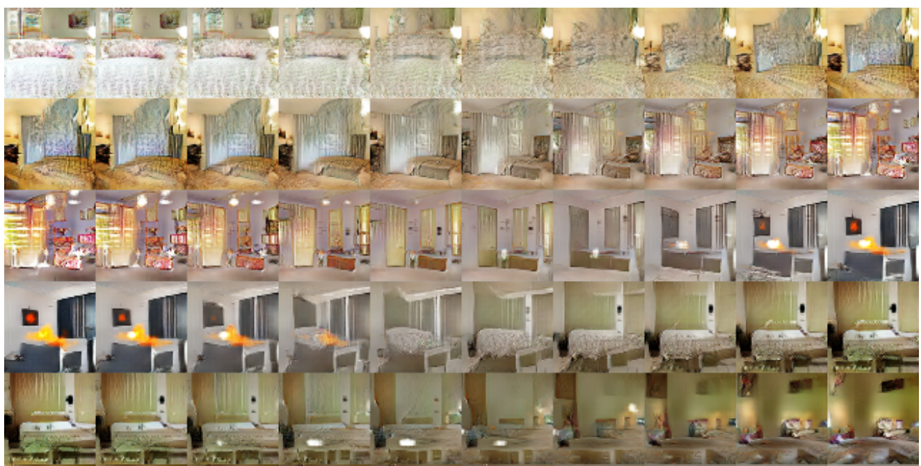
Generative Adversarial Nets: Convolutional Architectures
Interpolating between random
points in latent space
Radford et al,
ICLR 2016
Slide Credit: Fei-Fei Li, Justin Johnson, Serena Yeung, CS 231n
Notes:
Take 2 points of z (2 random vectors), and interpolate between these points

Slide 52
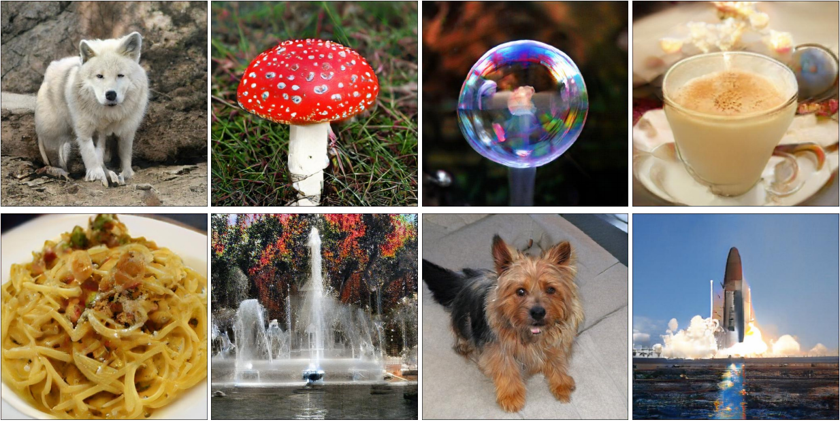
BigGAN
Large Scale GAN Training for High Fidelity Natural Image Synthesis
Andrew Brock, Jeff Donahue, Karen Simonyan https://arxiv.org/abs/1809.11096

Slide 53
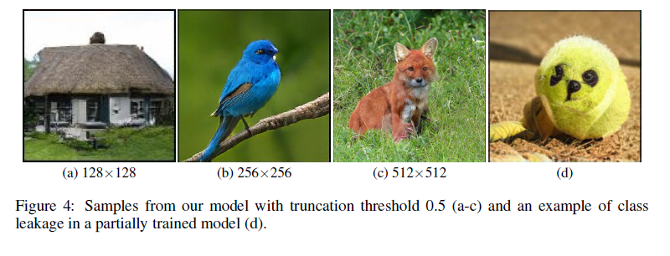
BigGAN
Large Scale GAN Training for High Fidelity Natural Image Synthesis
Andrew Brock, Jeff Donahue, Karen Simonyan https://arxiv.org/abs/1809.11096

Slide 54
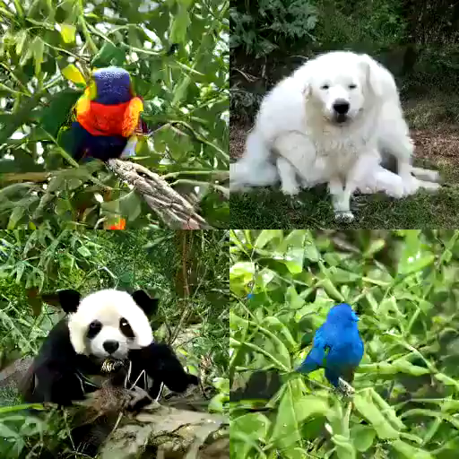
BigGAN
https://gist.github.com/phillipi/d2921f2d4726d7e3cdac7a4780c6050a

Slide 55


2017: Explosion of GANs
“The GAN Zoo”
“The GAN Zoo”
https://github.com/hindupuravinash/the-gan-zoo
Slide Credit: Fei-Fei Li, Justin Johnson, Serena Yeung, CS 231n

Slide 56
“The GAN Zoo”
2017: Explosion of GANs
See also: https://github.com/soumith/ganhacks for tips and tricks for trainings GANs
https://github.com/hindupuravinash/the-gan-zoo
Slide Credit: Fei-Fei Li, Justin Johnson, Serena Yeung, CS 231n

Slide 57
GANs
Don’t work with an explicit density function
Take game-theoretic approach: learn to generate from training distribution through 2-player game
Pros:
Beautiful, state-of-the-art samples!
Cons:
Trickier / more unstable to train
Can’t solve inference queries such as p(x), p(z|x)
Active areas of research:
Better loss functions, more stable training (Wasserstein GAN, LSGAN, many others)
Conditional GANs, GANs for all kinds of applications
Slide Credit: Fei-Fei Li, Justin Johnson, Serena Yeung, CS 231n

Slide 58
Plan for Today
(Finish) Generative Adversarial Networks (GANs)
Reinforcement Learning

Slide 59

Supervised Learning
Data: (x, y)
x is data, y is label
Goal: Learn a function to map x -> y
Examples: Classification, regression, object detection, semantic segmentation, image captioning, etc.
Cat
Classification
This image is CC0 public domain
Slide Credit: Fei-Fei Li, Justin Johnson, Serena Yeung, CS 231n

Slide 60



Unsupervised Learning
Data: x
Just data, no labels!
Goal: Learn some underlying hidden structure of the data
Examples: Clustering, dimensionality reduction, feature learning, density estimation, etc.
Figure copyright Ian Goodfellow, 2016. Reproduced with permission.
1-d density estimation
2-d density estimation
2-d density images left and right are CC0 public domain
Slide Credit: Fei-Fei Li, Justin Johnson, Serena Yeung, CS 231n

Slide 61
Types of Learning
Supervised learning
  Learning from a “teacher”
  Training data includes desired outputs
Unsupervised learning
  Discover structure in data
  Training data does not include desired outputs
Reinforcement learning
  Learning to act under evaluative feedback (rewards)

Slide 62

What is Reinforcement Learning?
Agent-oriented learning—learning by interacting with an environment to achieve a goal
  more realistic and ambitious than other kinds of machine learning
Learning by trial and error, with only delayed evaluative feedback (reward)
  the kind of machine learning most like natural learning
  learning that can tell for itself when it is right or wrong
Slide Credit: Rich Sutton

Slide 63
David Silver 2015

Slide 64




Example: Hajime Kimura’s RL Robots
Before
After
Slide Credit: Rich Sutton
Backward
New Robot, Same algorithm

Slide 65
The RL Interface
Agent
State,
Stimulus,
Situation
Reward,
Gain, Payoff,
Cost
Action,
Response,
Control
Environment
(world)
Environment may be unknown, nonlinear, stochastic and complex
Agent learns a policy mapping states to actions
  Seeking to maximize its cumulative reward in the long run
Notes:
Agent and environment interact in real-time, continually learning and improving

Slide 66
RL API
Agent
State,
Stimulus,
Situation
Reward,
Gain, Payoff,
Cost
Action,
Response,
Control
Environment
(world)
Environment may be unknown, nonlinear, stochastic and complex
Agent learns a policy mapping states to actions
  Seeking to maximize its cumulative reward in the long run
Slide Credit: Rich Sutton
Notes:
Agent and environment interact in real-time, continually learning and improving

Slide 67

RL API
Slide Credit: David Silver

Slide 68
Signature challenges of RL
Evaluative feedback (reward)
Sequentiality, delayed consequences
Need for trial and error, to explore as well as exploit
Non-stationarity
The fleeting nature of time and online data
Slide Credit: Rich Sutton

Slide 69
State

Slide 70

Robot Locomotion
Objective: Make the robot move forward
State: Angle and position of the joints
Action: Torques applied on joints
Reward: 1 at each time step upright + forward movement
Figures copyright John Schulman et al., 2016. Reproduced with permission.
Slide Credit: Fei-Fei Li, Justin Johnson, Serena Yeung, CS 231n

Slide 71

Atari Games
Objective: Complete the game with the highest score
State: Raw pixel inputs of the game state
Action: Game controls e.g. Left, Right, Up, Down
Reward: Score increase/decrease at each time step
Figures copyright Volodymyr Mnih et al., 2013. Reproduced with permission.
Slide Credit: Fei-Fei Li, Justin Johnson, Serena Yeung, CS 231n
Notes:
Games are also a big class of problems that can be formulated with RL
For example here we have atari games, which are a class success of deep RL

Slide 72

Go
Objective: Win the game!
State: Position of all pieces
Action: Where to put the next piece down
Reward: 1 if win at the end of the game, 0 otherwise
This image is CC0 public domain
Slide Credit: Fei-Fei Li, Justin Johnson, Serena Yeung, CS 231n
Notes:
Something that was a huge achievement last year when DeepMind’s AlphaGo beat Lee Sedol, the best Go player of the last few years, and just last night, competing again

Slide 73
Demo
http://projects.rajivshah.com/rldemo/
https://cs.stanford.edu/people/karpathy/convnetjs/demo/rldemo.html

Slide 74

Markov Decision Process
Mathematical formulation of the RL problem
Defined by:
: set of possible states
: set of possible actions
: distribution of reward given (state, action) pair
: transition probability i.e. distribution over next state given (state, action) pair
: discount factor
Slide Credit: Fei-Fei Li, Justin Johnson, Serena Yeung, CS 231n
Notes:
MDP satisfies Markov property
Define by tuple of objects

Slide 75
Markov Decision Process
Mathematical formulation of the RL problem
Life is trajectory:
Defined by:
: set of possible states
: set of possible actions
: distribution of reward given (state, action) pair
: transition probability i.e. distribution over next state given (state, action) pair
: discount factor
Slide Credit: Fei-Fei Li, Justin Johnson, Serena Yeung, CS 231n
Notes:
MDP satisfies Markov property
Define by tuple of objects

Slide 76
Markov Decision Process
Mathematical formulation of the RL problem
Life is trajectory:
Markov property: Current state completely characterizes the state of the world
Defined by:
: set of possible states
: set of possible actions
: distribution of reward given (state, action) pair
: transition probability i.e. distribution over next state given (state, action) pair
: discount factor
Slide Credit: Fei-Fei Li, Justin Johnson, Serena Yeung, CS 231n
Notes:
MDP satisfies Markov property
Define by tuple of objects

Slide 77
Components of an RL Agent
Policy
  How does an agent behave?
Value function
  How good is each state and/or state-action pair?
Model
  Agent’s representation of the environment

Slide 78

Policy
A policy is how the agent acts
Formally, map from states to actions

Slide 79
The optimal policy 𝝿*
What’s a good policy?
Notes:
Can work with maximizing the expected sum of rewards

Slide 80
The optimal policy 𝝿*
What’s a good policy?
Maximizes current reward? Sum of all future reward?
Notes:
Can work with maximizing the expected sum of rewards

Slide 81
The optimal policy 𝝿*
What’s a good policy?
Maximizes current reward? Sum of all future reward?
Discounted future rewards!
Notes:
Can work with maximizing the expected sum of rewards

Slide 82

The optimal policy 𝝿*
What’s a good policy?
Maximizes current reward? Sum of all future reward?
Discounted future rewards!
Formally:
with
Notes:
Can work with maximizing the expected sum of rewards

Slide 83
RL vs Optimal Control
Notes:
Can work with maximizing the expected sum of rewards

Slide 84
Value Function
A value function is a prediction of future reward
“State Value Function” or simply “Value Function”
  How good is a state?
  Am I screwed? Am I winning this game?
“Action Value Function” or Q-function
  How good is a state action-pair?
  Should I do this now?

Slide 85
Definitions: Value function and Q-value function
Following a policy produces sample trajectories (or paths) s₀, a₀, r₀, s₁, a₁, r₁, …
Slide Credit: Fei-Fei Li, Justin Johnson, Serena Yeung, CS 231n

Slide 86

Definitions: Value function and Q-value function
Following a policy produces sample trajectories (or paths) s₀, a₀, r₀, s₁, a₁, r₁, …
How good is a state?
The value function at state s, is the expected cumulative reward from state s
(and following the policy thereafter):
Slide Credit: Fei-Fei Li, Justin Johnson, Serena Yeung, CS 231n

Slide 87

Definitions: Value function and Q-value function
Following a policy produces sample trajectories (or paths) s₀, a₀, r₀, s₁, a₁, r₁, …
How good is a state?
The value function at state s, is the expected cumulative reward from state s
(and following the policy thereafter):
How good is a state-action pair?
The Q-value function at state s and action a, is the expected cumulative reward from taking action a in state s (and following the policy thereafter):
Slide Credit: Fei-Fei Li, Justin Johnson, Serena Yeung, CS 231n

Slide 88
Model
Slide Credit: David Silver

Slide 89
Model
Model predicts what the world will do next
Slide Credit: David Silver

