Slide 1
CS 4803 / 7643: Deep Learning
Topics:
  Variational Auto-Encoders (VAEs)
    Reparameterization trick
  Generative Adversarial Networks (GANs)
Dhruv Batra
Georgia Tech

Slide 2
Administrativia
Project submission instructions released
  Due: 12/04, 11:55pm
  Last deliverable in the class
  Can’t use late days
  https://piazza.com/class/jkujs03pgu75cd?cid=225

Slide 3
Recap from last time

Slide 4
Variational Autoencoders (VAE)

Slide 5
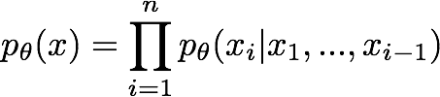

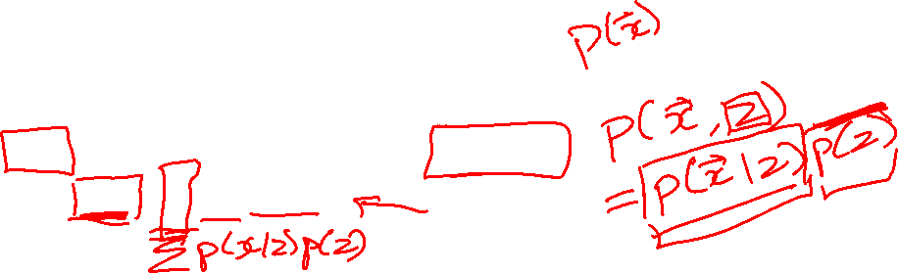
So far...
PixelCNNs define tractable density function, optimize likelihood of training data:
VAEs define intractable density function with latent z:
Cannot optimize directly, derive and optimize lower bound on likelihood instead
Slide Credit: Fei-Fei Li, Justin Johnson, Serena Yeung, CS 231n

Slide 6
Variational Auto Encoders
VAEs are a combination of the following ideas:
Auto Encoders
Variational Approximation
  Variational Lower Bound / ELBO
Amortized Inference Neural Networks
“Reparameterization” Trick

Slide 7
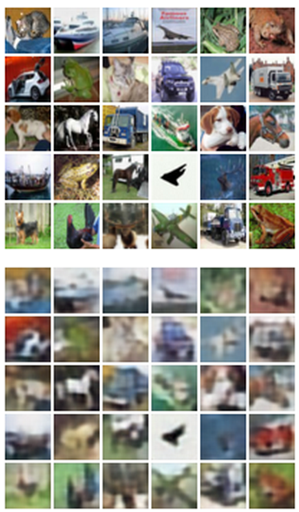

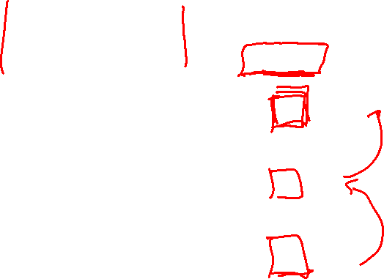
Autoencoders
Reconstructed data
Train such that features can be used to reconstruct original data
L2 Loss function:
Reconstructed input data
Encoder: 4-layer conv
Decoder: 4-layer upconv
Decoder
Input data
Features
Encoder
Input data
Slide Credit: Fei-Fei Li, Justin Johnson, Serena Yeung, CS 231n

Slide 8
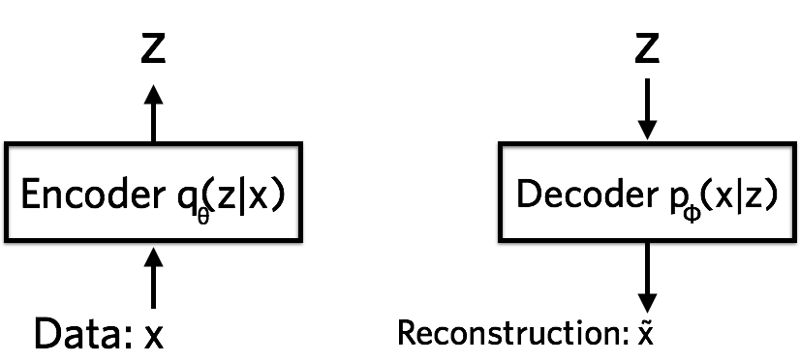


Variational Autoencoders
Probabilistic spin on autoencoders - will let us sample from the model to generate data!
$$qφ\left(z | x\right)$$
$$pθ\left(x | z\right)$$
Image Credit: https://jaan.io/what-is-variational-autoencoder-vae-tutorial/

Slide 9
Variational Auto Encoders
VAEs are a combination of the following ideas:
Auto Encoders
Variational Approximation
  Variational Lower Bound / ELBO
Amortized Inference Neural Networks
“Reparameterization” Trick

Slide 10
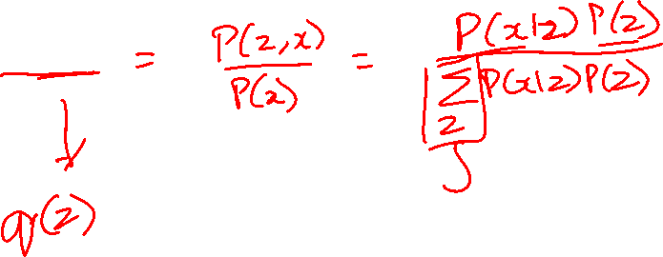
Key problem
P(z|x)

Slide 11
What is Variational Inference?
Key idea
  Reality is complex
  Can we approximate it with something “simple”?
  Just need to make sure the simple thing is “close” to the complex thing.

Slide 12
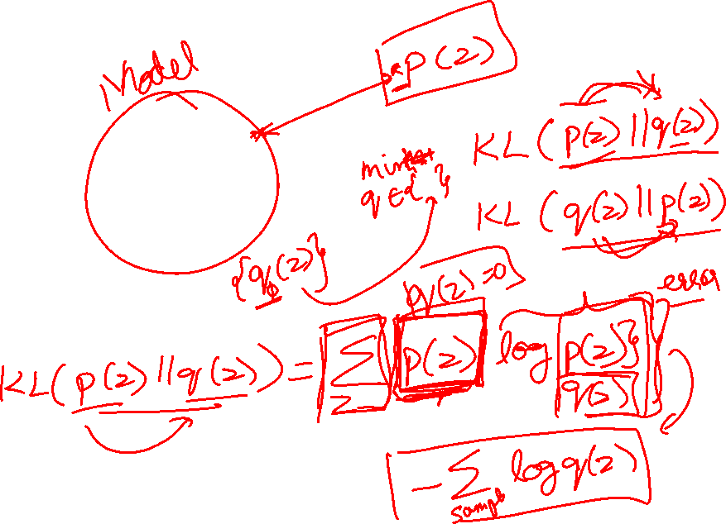
Intuition

Slide 13
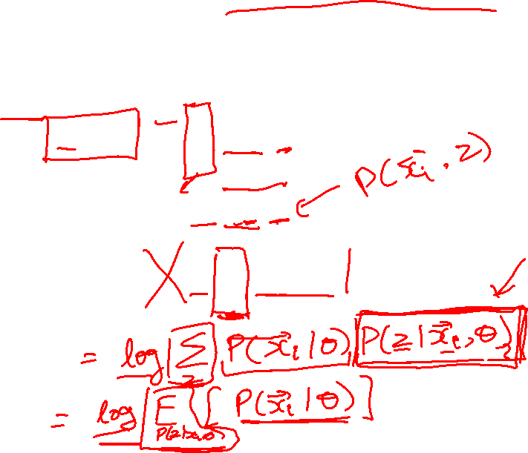
The general learning problem with missing data
Marginal likelihood – x is observed, z is missing:

Slide 14
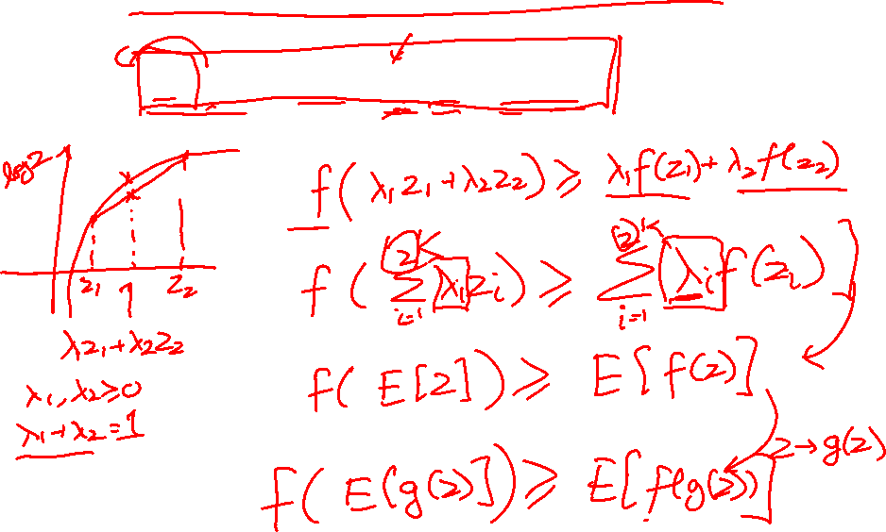
Applying Jensen’s inequality
Use: log ∑_{z} P(z) g(z) ≥ ∑_{z} P(z) log g(z)

Slide 15
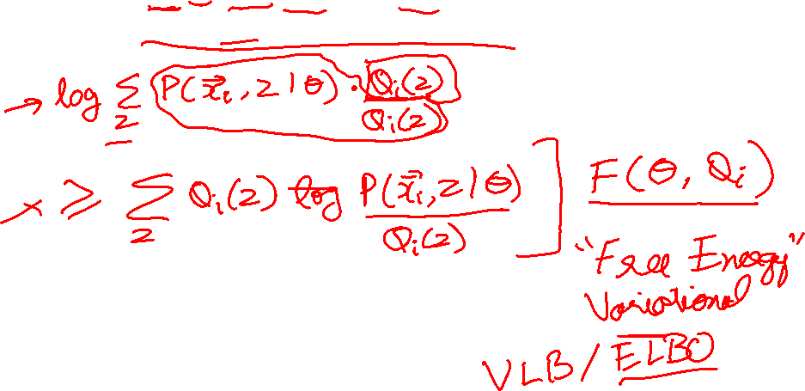
Applying Jensen’s inequality
Use: log ∑_{z} P(z) g(z) ≥ ∑_{z} P(z) log g(z)

Slide 16
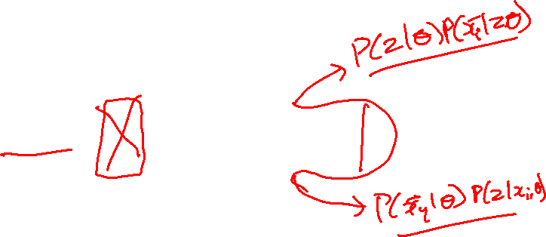
Applying Jensen’s inequality
Use: log ∑_{z} P(z) g(z) ≥ ∑_{z} P(z) log g(z)

Slide 17
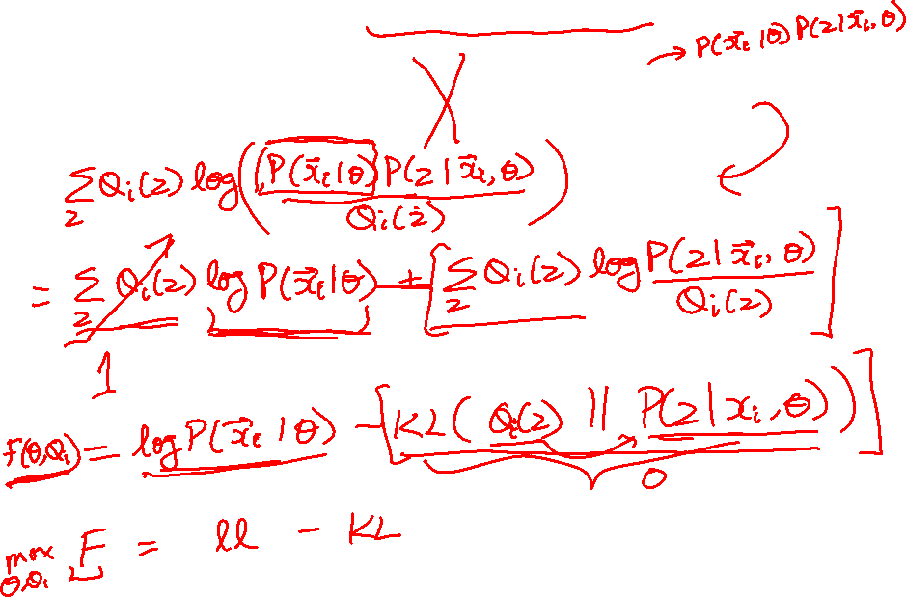
ELBO: Factorization #1

Slide 18
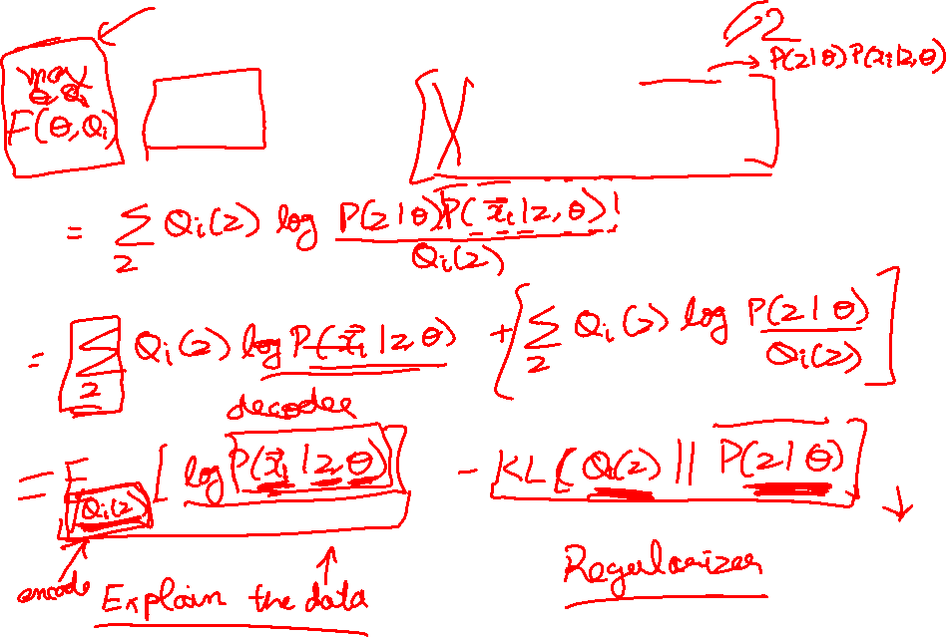
ELBO: Factorization #1

Slide 19
Variational Auto Encoders
VAEs are a combination of the following ideas:
Auto Encoders
Variational Approximation
  Variational Lower Bound / ELBO
Amortized Inference Neural Networks
“Reparameterization” Trick

Slide 20
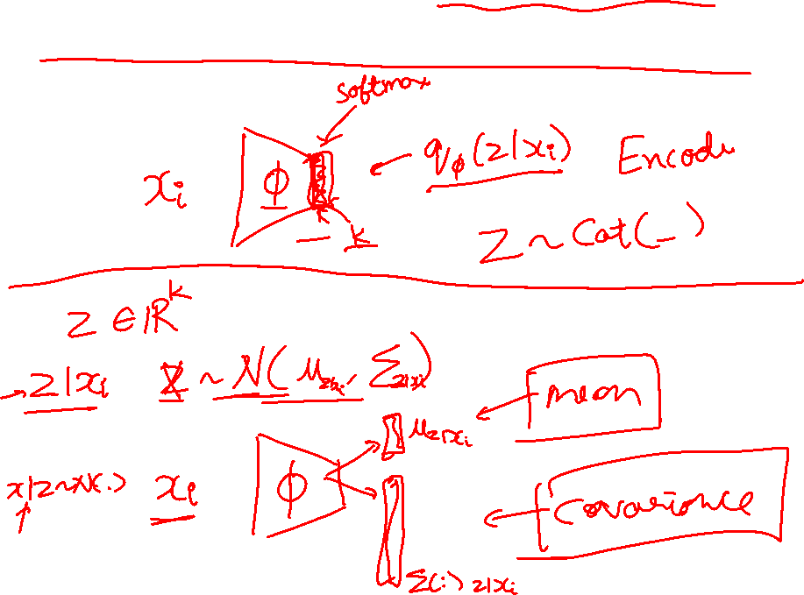
Amortized Inference Neural Networks

Slide 21
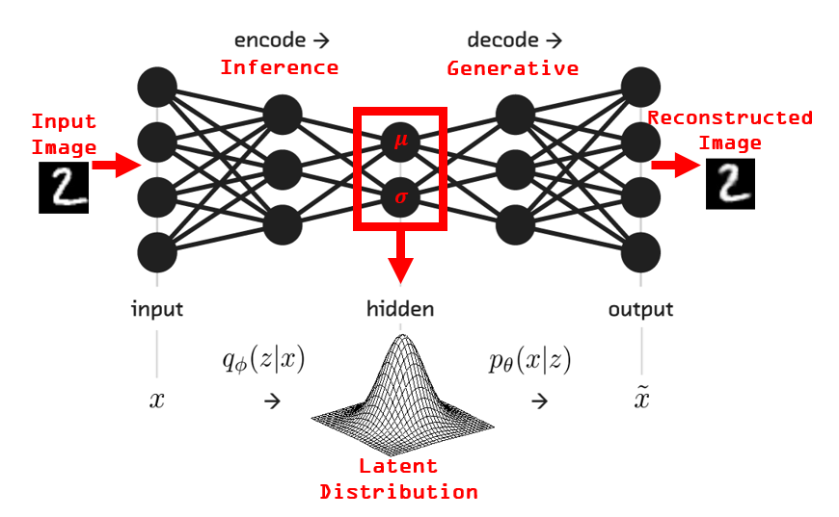
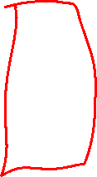
VAEs
Image Credit: https://www.kaggle.com/rvislaywade/visualizing-mnist-using-a-variational-autoencoder

Slide 22
Variational Autoencoders
Probabilistic spin on autoencoders - will let us sample from the model to generate data!
$$qφ\left(z | x\right)$$
$$pθ\left(x | z\right)$$
Image Credit: https://jaan.io/what-is-variational-autoencoder-vae-tutorial/

Slide 23
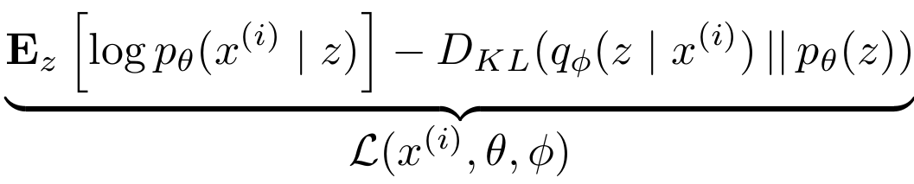



Variational Auto Encoders
Putting it all together: maximizing the likelihood lower bound
Encoder network
Input Data
Slide Credit: Fei-Fei Li, Justin Johnson, Serena Yeung, CS 231n

Slide 24
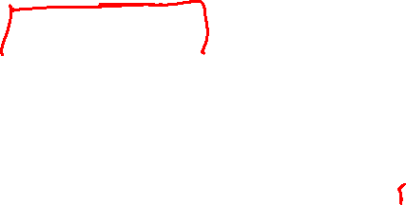
Variational Auto Encoders
Putting it all together: maximizing the likelihood lower bound
Make approximate posterior distribution close to prior
Encoder network
Input Data
Slide Credit: Fei-Fei Li, Justin Johnson, Serena Yeung, CS 231n

Slide 25

Variational Auto Encoders
Putting it all together: maximizing the likelihood lower bound
Sample z from
Make approximate posterior distribution close to prior
Encoder network
Input Data
Slide Credit: Fei-Fei Li, Justin Johnson, Serena Yeung, CS 231n

Slide 26


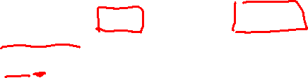
Variational Auto Encoders
Putting it all together: maximizing the likelihood lower bound
Decoder network
Sample z from
Make approximate posterior distribution close to prior
Encoder network
Input Data
Slide Credit: Fei-Fei Li, Justin Johnson, Serena Yeung, CS 231n

Slide 27

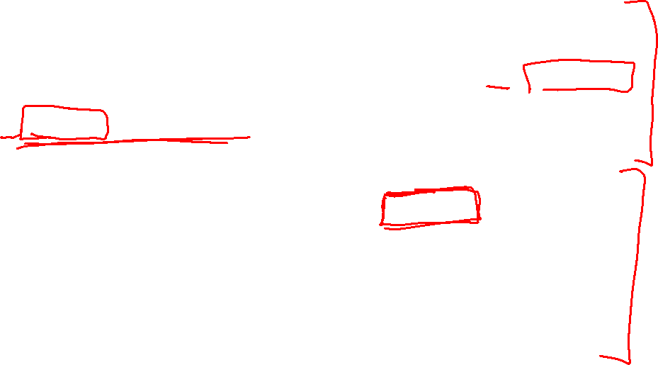
Variational Auto Encoders
Putting it all together: maximizing the likelihood lower bound
Maximize likelihood of original input being reconstructed
Sample x|z from
Decoder network
Sample z from
Make approximate posterior distribution close to prior
Encoder network
Input Data
Slide Credit: Fei-Fei Li, Justin Johnson, Serena Yeung, CS 231n

Slide 28
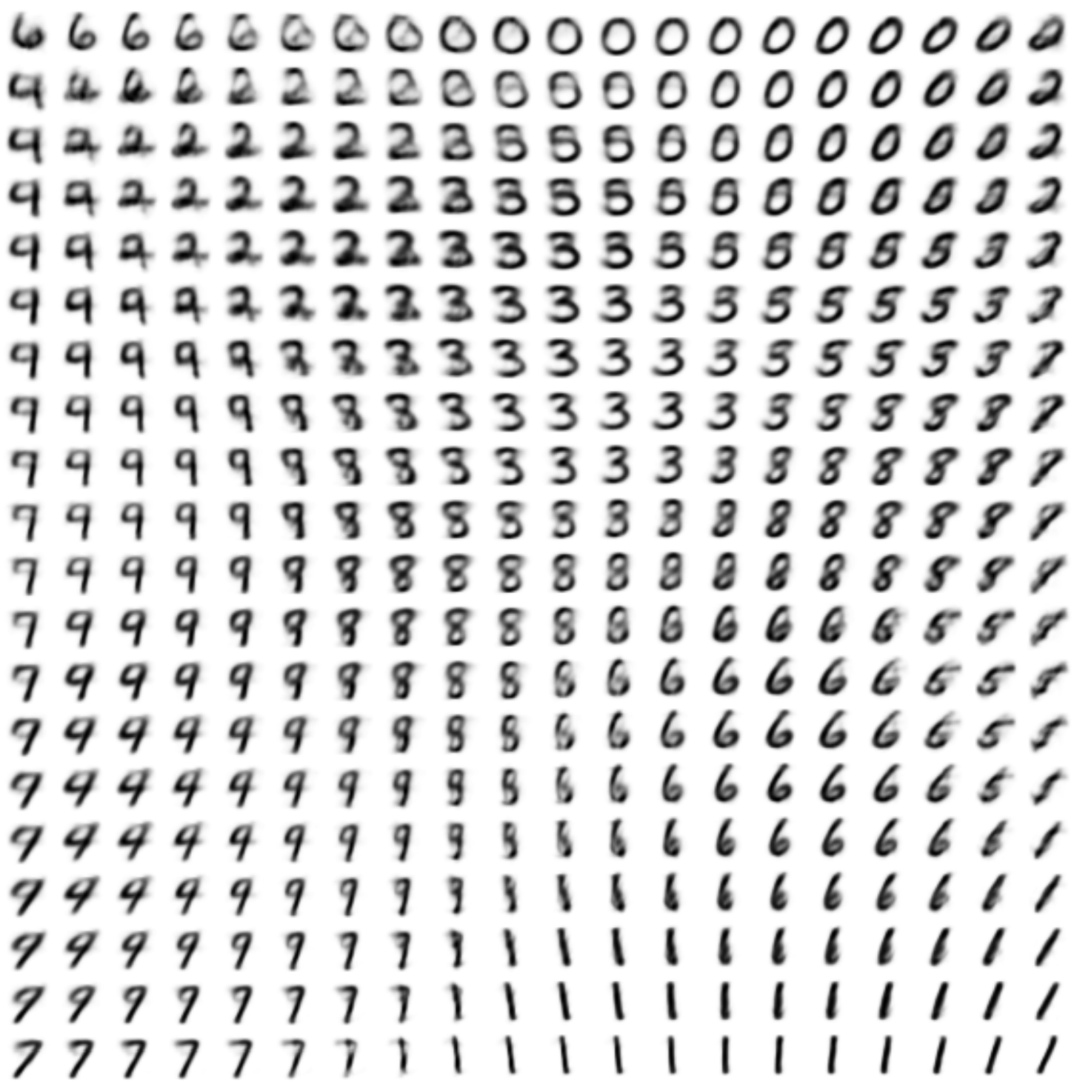

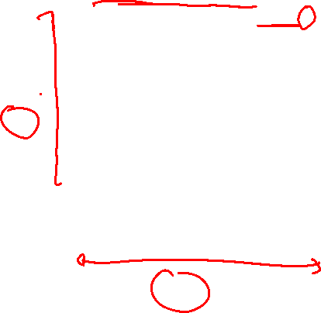
Variational Auto Encoders: Generating Data
Use decoder network. Now sample z from prior!
Data manifold for 2-d z
Sample x|z from
Vary z₁
Decoder network
Sample z from
Kingma and Welling, “Auto-Encoding Variational Bayes”, ICLR 2014
Vary z₂
Slide Credit: Fei-Fei Li, Justin Johnson, Serena Yeung, CS 231n

Slide 29
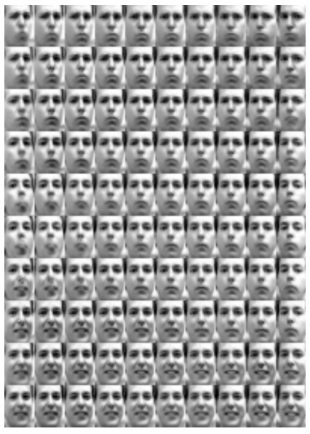
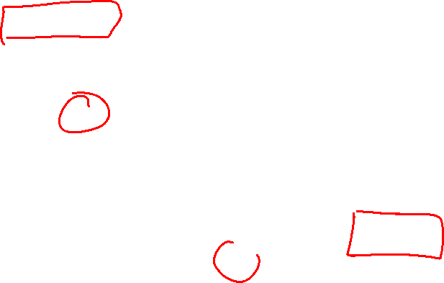
Variational Auto Encoders: Generating Data
Diagonal prior on z => independent latent variables
Different dimensions of z encode interpretable factors of variation
Degree of smile
Vary z₁
Vary z₂
Head pose
Kingma and Welling, “Auto-Encoding Variational Bayes”, ICLR 2014
Slide Credit: Fei-Fei Li, Justin Johnson, Serena Yeung, CS 231n

Slide 30
Plan for Today
VAEs
  Reparameterization trick
Generative Adversarial Networks (GANs)

Slide 31
Variational Auto Encoders
VAEs are a combination of the following ideas:
Auto Encoders
Variational Approximation
  Variational Lower Bound / ELBO
Amortized Inference Neural Networks
“Reparameterization” Trick

Slide 32
Basic Problem
Goal

Slide 33
Basic Problem
Goal
Need to compute:

Slide 34
Does this happen in supervised learning?
Goal

Slide 35
Example

Slide 36
Example

Slide 37
Two Options
Score Function based Gradient Estimator
aka REINFORCE (and variants)
Path Derivative Gradient Estimator
aka “reparameterization trick”

Slide 38
Option 1
Score Function based Gradient Estimator
aka REINFORCE (and variants)

Slide 39
Example

Slide 40
Two Options
Score Function based Gradient Estimator
aka REINFORCE (and variants)
Path Derivative Gradient Estimator
aka “reparameterization trick”

Slide 41
Option 2
Path Derivative Gradient Estimator
aka “reparameterization trick”

Slide 42
Option 2
Path Derivative Gradient Estimator
aka “reparameterization trick”

Slide 43
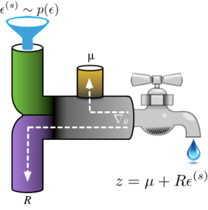
Reparameterization Intuition
Figure Credit: http://blog.shakirm.com/2015/10/machine-learning-trick-of-the-day-4-reparameterisation-tricks/

Slide 44
Example

Slide 45
Two Options
Score Function based Gradient Estimator
aka REINFORCE (and variants)
Path Derivative Gradient Estimator
aka “reparameterization trick”

Slide 46
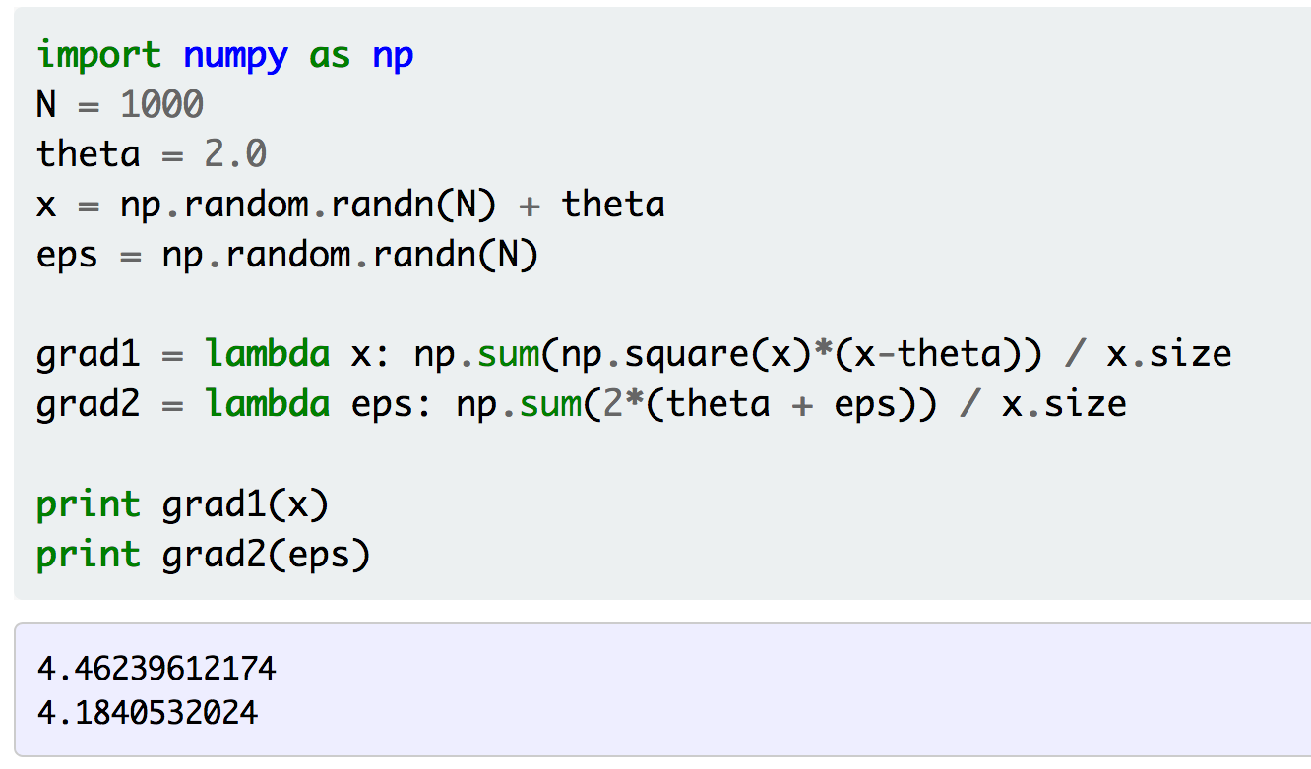
Example
Figure Credit: http://gokererdogan.github.io/2016/07/01/reparameterization-trick/

Slide 47
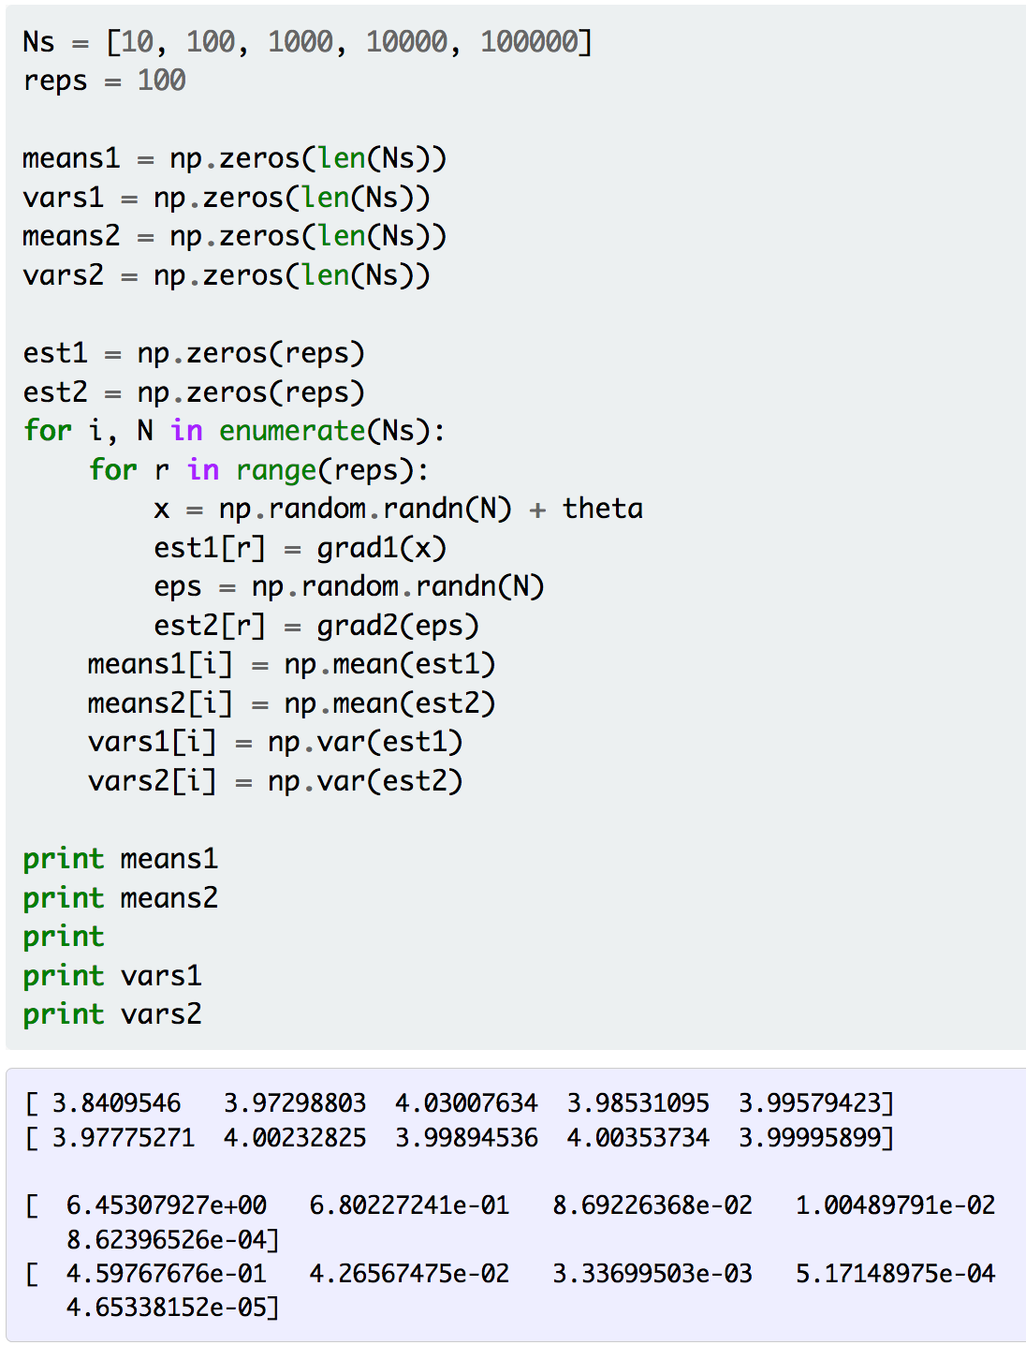
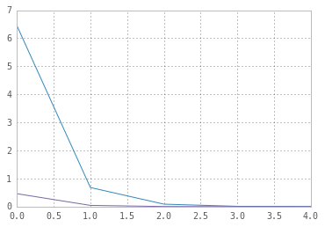
Example
Figure Credit: http://gokererdogan.github.io/2016/07/01/reparameterization-trick/

Slide 48
Aside: Gumbel Softmax
Meet the Gumbel Softmax “trick”

Slide 49
Aside: Gumbel Softmax
Sampling on the Simplex

Slide 50
Variational Auto Encoders
VAEs are a combination of the following ideas:
Auto Encoders
Variational Approximation
  Variational Lower Bound / ELBO
Amortized Inference Neural Networks
“Reparameterization” Trick

Slide 51
Variational Auto Encoders
Putting it all together: maximizing the likelihood lower bound
Encoder network
Input Data
Slide Credit: Fei-Fei Li, Justin Johnson, Serena Yeung, CS 231n

Slide 52
Variational Auto Encoders
Putting it all together: maximizing the likelihood lower bound
Make approximate posterior distribution close to prior
Encoder network
Input Data
Slide Credit: Fei-Fei Li, Justin Johnson, Serena Yeung, CS 231n

Slide 53
Variational Auto Encoders
Putting it all together: maximizing the likelihood lower bound
Sample z from
Make approximate posterior distribution close to prior
Encoder network
Input Data
Slide Credit: Fei-Fei Li, Justin Johnson, Serena Yeung, CS 231n

Slide 54
Variational Auto Encoders
Putting it all together: maximizing the likelihood lower bound
Decoder network
Sample z from
Make approximate posterior distribution close to prior
Encoder network
Input Data
Slide Credit: Fei-Fei Li, Justin Johnson, Serena Yeung, CS 231n

Slide 55
Generative Adversarial Networks (GAN)

Slide 56
So far...
PixelCNNs define tractable density function, optimize likelihood of training data:
VAEs define intractable density function with latent z:
Cannot optimize directly, derive and optimize lower bound on likelihood instead
Slide Credit: Fei-Fei Li, Justin Johnson, Serena Yeung, CS 231n

Slide 57
Taxonomy of Generative Models
Direct
Today: discuss 3 most popular types of generative models today
GAN
Generative models
Explicit density
Implicit density
Tractable density
Approximate density
Markov Chain
Fully Visible Belief Nets
NADE
MADE
PixelRNN/CNN
Change of variables models (nonlinear ICA)
GSN
Variational
Markov Chain
Variational Autoencoder
Boltzmann Machine
Figure copyright and adapted from Ian Goodfellow, Tutorial on Generative Adversarial Networks, 2017.
Slide Credit: Fei-Fei Li, Justin Johnson, Serena Yeung, CS 231n
Notes:
Refer to goodfellow tutorial which has a good overview of this
Today discuss 3 most popular types of generative models

Slide 58
So far...
PixelCNNs define tractable density function, optimize likelihood of training data:
VAEs define intractable density function with latent z:
Cannot optimize directly, derive and optimize lower bound on likelihood instead
What if we give up on explicitly modeling density, and just want ability to sample?
Slide Credit: Fei-Fei Li, Justin Johnson, Serena Yeung, CS 231n

Slide 59
So far...
PixelCNNs define tractable density function, optimize likelihood of training data:
VAEs define intractable density function with latent z:
Cannot optimize directly, derive and optimize lower bound on likelihood instead
What if we give up on explicitly modeling density, and just want ability to sample?
GANs: don’t work with any explicit density function!
Slide Credit: Fei-Fei Li, Justin Johnson, Serena Yeung, CS 231n

Slide 60
Generative Adversarial Networks (GANs)
GANs are a combination of the following ideas:
Learning to Sample
  Connection to Inverse Transform Sampling
Adversarial Training
“Reparameterization” Trick

Slide 61

Easy Interview Question
I give you u ~ U(0,1)
Produce a sample from Bern($θ$)

Slide 62

Slightly Harder Interview Question
I give you u ~ U(0,1)
Produce a sample from Cat($π$)

Slide 63
Harder Interview Question
I give you u ~ U(0,1)
Produce a sample from F_{X}(x)

Slide 64
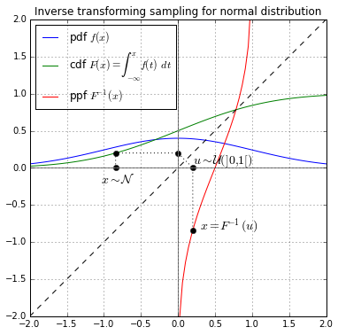
Inverse Transform Sampling

Slide 65
Generative Adversarial Networks
Ian Goodfellow et al., “Generative Adversarial Nets”, NIPS 2014
Problem: Want to sample from complex, high-dimensional training distribution. No direct way to do this!
Solution: Sample from a simple distribution, e.g. random noise. Learn transformation to training distribution.
Q: What can we use to represent this complex transformation?
Slide Credit: Fei-Fei Li, Justin Johnson, Serena Yeung, CS 231n
Notes:
Mapping z to data manifold?
Hard to sample from high dimensional distribution. Take random noise, transform to real distribution

Slide 66
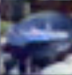
Generative Adversarial Networks
Ian Goodfellow et al., “Generative Adversarial Nets”, NIPS 2014
Problem: Want to sample from complex, high-dimensional training distribution. No direct way to do this!
Solution: Sample from a simple distribution, e.g. random noise. Learn transformation to training distribution.
Q: What can we use to represent this complex transformation?
Output: Sample from training distribution
A: A neural network!
Generator Network
Input: Random noise
z
Slide Credit: Fei-Fei Li, Justin Johnson, Serena Yeung, CS 231n
Notes:
Mapping z to data manifold?
Hard to sample from high dimensional distribution. Take random noise, transform to real distribution

Slide 67
Generative Adversarial Networks (GANs)
GANs are a combination of the following ideas:
Learning to Sample
  Connection to Inverse Transform Sampling
Adversarial Training
“Reparameterization” Trick

Slide 68
Training GANs: Two-player game
Ian Goodfellow et al., “Generative Adversarial Nets”, NIPS 2014
Generator network: try to fool the discriminator by generating real-looking images
Discriminator network: try to distinguish between real and fake images
Slide Credit: Fei-Fei Li, Justin Johnson, Serena Yeung, CS 231n
Notes:
Mapping z to data manifold?

Slide 69





Training GANs: Two-player game
Ian Goodfellow et al., “Generative Adversarial Nets”, NIPS 2014
Generator network: try to fool the discriminator by generating real-looking images
Discriminator network: try to distinguish between real and fake images
Real or Fake
Discriminator Network
Fake Images
(from generator)
Real Images
(from training set)
Generator Network
Random noise
z
Fake and real images copyright Emily Denton et al. 2015. Reproduced with permission.
Slide Credit: Fei-Fei Li, Justin Johnson, Serena Yeung, CS 231n
Notes:
Mapping z to data manifold?

Slide 70
Training GANs: Two-player game
Ian Goodfellow et al., “Generative Adversarial Nets”, NIPS 2014
Generator network: try to fool the discriminator by generating real-looking images
Discriminator network: try to distinguish between real and fake images
Train jointly in minimax game
Minimax objective function:
Slide Credit: Fei-Fei Li, Justin Johnson, Serena Yeung, CS 231n
Notes:
Mapping z to data manifold?

Slide 71
Training GANs: Two-player game
Ian Goodfellow et al., “Generative Adversarial Nets”, NIPS 2014
Generator network: try to fool the discriminator by generating real-looking images
Discriminator network: try to distinguish between real and fake images
Train jointly in minimax game
Minimax objective function:
Discriminator outputs likelihood in (0,1) of real image
Discriminator output for real data x
Discriminator output for generated fake data G(z)
Slide Credit: Fei-Fei Li, Justin Johnson, Serena Yeung, CS 231n
Notes:
Mapping z to data manifold?

Slide 72
Training GANs: Two-player game
Ian Goodfellow et al., “Generative Adversarial Nets”, NIPS 2014
Generator network: try to fool the discriminator by generating real-looking images
Discriminator network: try to distinguish between real and fake images
Train jointly in minimax game
Minimax objective function:
Discriminator outputs likelihood in (0,1) of real image
Discriminator output for real data x
Discriminator output for generated fake data G(z)
Discriminator (θ_{d}) wants to maximize objective such that D(x) is close to 1 (real) and D(G(z)) is close to 0 (fake)
Generator (θ_{g}) wants to minimize objective such that D(G(z)) is close to 1 (discriminator is fooled into thinking generated G(z) is real)
Slide Credit: Fei-Fei Li, Justin Johnson, Serena Yeung, CS 231n
Notes:
Mapping z to data manifold?

Slide 73

Training GANs: Two-player game
Ian Goodfellow et al., “Generative Adversarial Nets”, NIPS 2014
Minimax objective function:
Alternate between:
Gradient ascent on discriminator
2. Gradient descent on generator
Slide Credit: Fei-Fei Li, Justin Johnson, Serena Yeung, CS 231n
Notes:
Mapping z to data manifold?

Slide 74
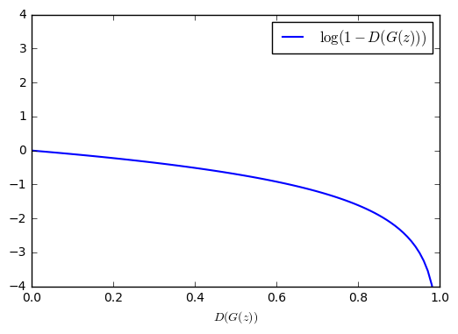
Training GANs: Two-player game
Ian Goodfellow et al., “Generative Adversarial Nets”, NIPS 2014
Minimax objective function:
Gradient signal dominated by region where sample is already good
Alternate between:
Gradient ascent on discriminator
2. Gradient descent on generator
When sample is likely fake, want to learn from it to improve generator. But gradient in this region is relatively flat!
In practice, optimizing this generator objective does not work well!
Slide Credit: Fei-Fei Li, Justin Johnson, Serena Yeung, CS 231n
Notes:
Mapping z to data manifold?

Slide 75
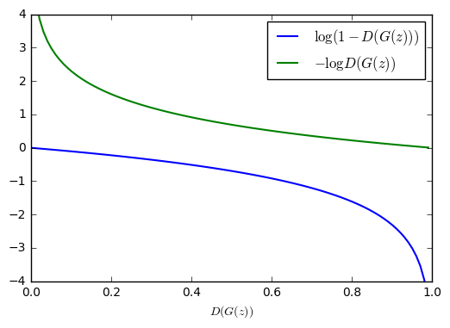

Training GANs: Two-player game
Ian Goodfellow et al., “Generative Adversarial Nets”, NIPS 2014
Minimax objective function:
Alternate between:
Gradient ascent on discriminator
2. Instead: Gradient ascent on generator, different objective
Instead of minimizing likelihood of discriminator being correct, now maximize likelihood of discriminator being wrong.
Same objective of fooling discriminator, but now higher gradient signal for bad samples => works much better! Standard in practice.
High gradient signal
Low gradient signal
Slide Credit: Fei-Fei Li, Justin Johnson, Serena Yeung, CS 231n
Notes:
Mapping z to data manifold?

Slide 76
Training GANs: Two-player game
Ian Goodfellow et al., “Generative Adversarial Nets”, NIPS 2014
Minimax objective function:
Aside: Jointly training two networks is challenging, can be unstable. Choosing objectives with better loss landscapes helps training, is an active area of research.
Alternate between:
Gradient ascent on discriminator
2. Instead: Gradient ascent on generator, different objective
Instead of minimizing likelihood of discriminator being correct, now maximize likelihood of discriminator being wrong.
Same objective of fooling discriminator, but now higher gradient signal for bad samples => works much better! Standard in practice.
High gradient signal
Low gradient signal
Slide Credit: Fei-Fei Li, Justin Johnson, Serena Yeung, CS 231n
Notes:
Mapping z to data manifold?

Slide 77
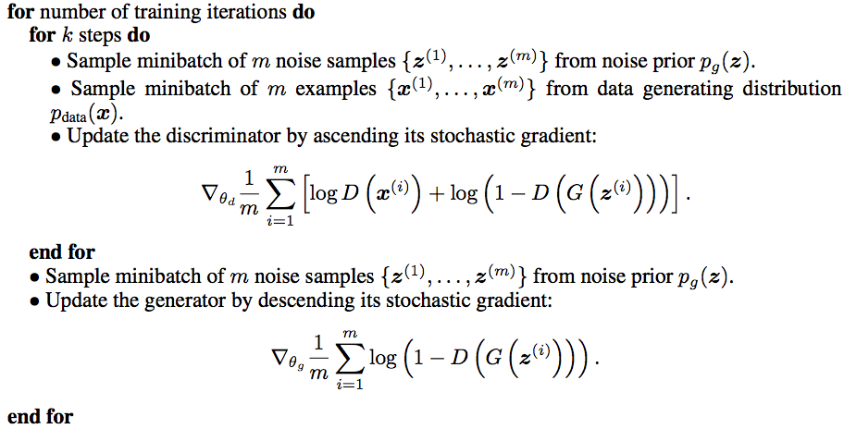
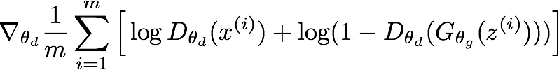
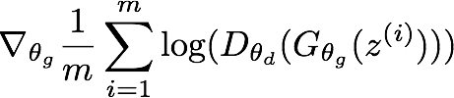
Training GANs: Two-player game
Ian Goodfellow et al., “Generative Adversarial Nets”, NIPS 2014
Putting it together: GAN training algorithm
Slide Credit: Fei-Fei Li, Justin Johnson, Serena Yeung, CS 231n
Notes:
Train discriminator for a bit
Then train generator for a bit

Slide 78
Training GANs: Two-player game
Ian Goodfellow et al., “Generative Adversarial Nets”, NIPS 2014
Putting it together: GAN training algorithm
Some find k=1 more stable, others use k > 1, no best rule.
Recent work (e.g. Wasserstein GAN) alleviates this problem, better stability!
Slide Credit: Fei-Fei Li, Justin Johnson, Serena Yeung, CS 231n
Notes:
Mapping z to data manifold?
**No clear rule. Sometimes train 1 step discriminator, 1 step gen. Some train disc. More

Slide 79
Training GANs: Two-player game
Ian Goodfellow et al., “Generative Adversarial Nets”, NIPS 2014
Generator network: try to fool the discriminator by generating real-looking images
Discriminator network: try to distinguish between real and fake images
Real or Fake
Discriminator Network
Fake Images
(from generator)
Real Images
(from training set)
Generator Network
After training, use generator network to generate new images
Random noise
z
Fake and real images copyright Emily Denton et al. 2015. Reproduced with permission.
Slide Credit: Fei-Fei Li, Justin Johnson, Serena Yeung, CS 231n
Notes:
Mapping z to data manifold?

Slide 80
GANs
Demo
  https://poloclub.github.io/ganlab/

Slide 81
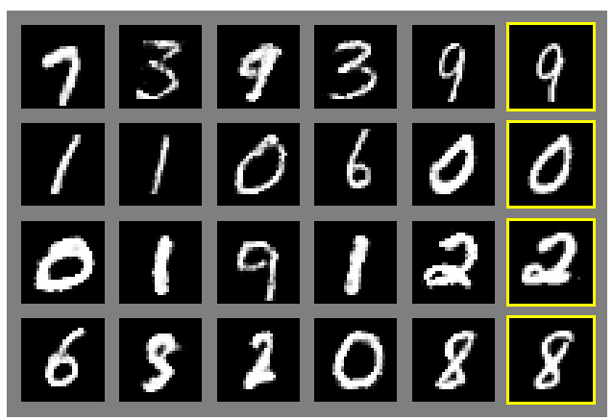
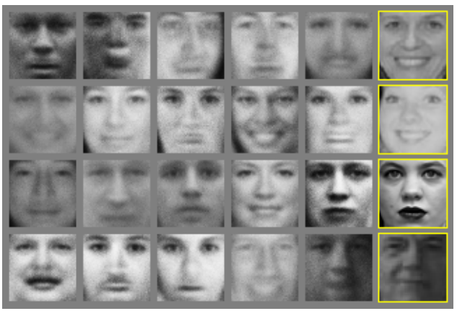
Generative Adversarial Nets
Ian Goodfellow et al., “Generative Adversarial Nets”, NIPS 2014
Generated samples
Nearest neighbor from training set
Figures copyright Ian Goodfellow et al., 2014. Reproduced with permission.
Slide Credit: Fei-Fei Li, Justin Johnson, Serena Yeung, CS 231n
Notes:
Realistic samples, never directly memorizes training set

Slide 82
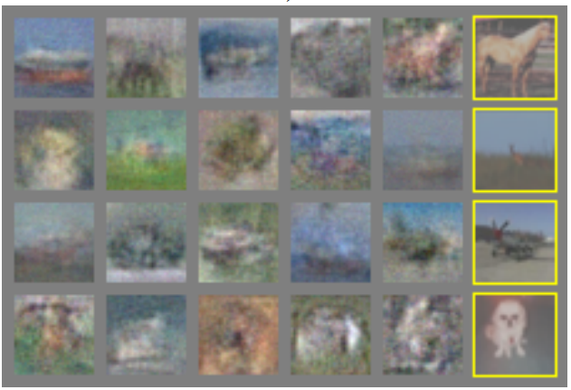
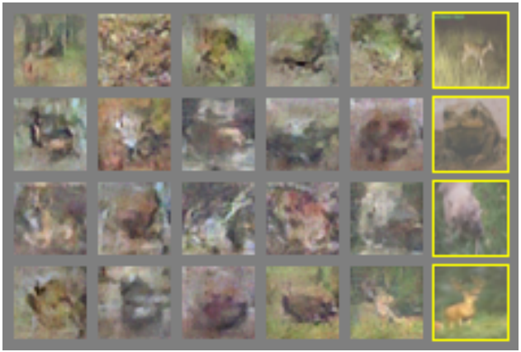
Generative Adversarial Nets
Ian Goodfellow et al., “Generative Adversarial Nets”, NIPS 2014
Generated samples (CIFAR-10)
Nearest neighbor from training set
Figures copyright Ian Goodfellow et al., 2014. Reproduced with permission.
Slide Credit: Fei-Fei Li, Justin Johnson, Serena Yeung, CS 231n
Notes:
Original work from 2014, not such great quality yet

Slide 83
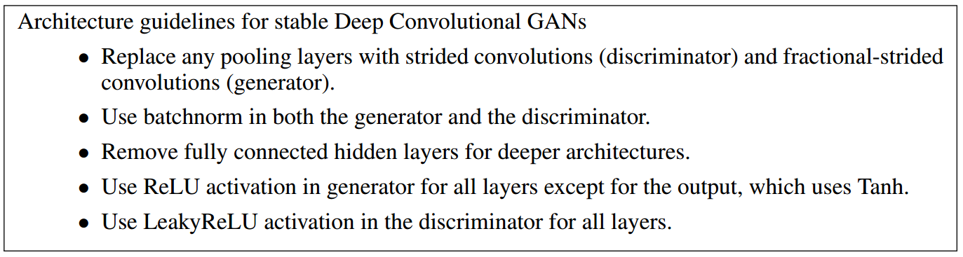
Generative Adversarial Nets: Convolutional Architectures
Generator is an upsampling network with fractionally-strided convolutions
Discriminator is a convolutional network
Radford et al, “Unsupervised Representation Learning with Deep Convolutional Generative Adversarial Networks”, ICLR 2016
Slide Credit: Fei-Fei Li, Justin Johnson, Serena Yeung, CS 231n
Notes:
Since this time, a lot of work on improving GANs.
This work ICLR2016 on adding convolutional architectures to GANs

Slide 84
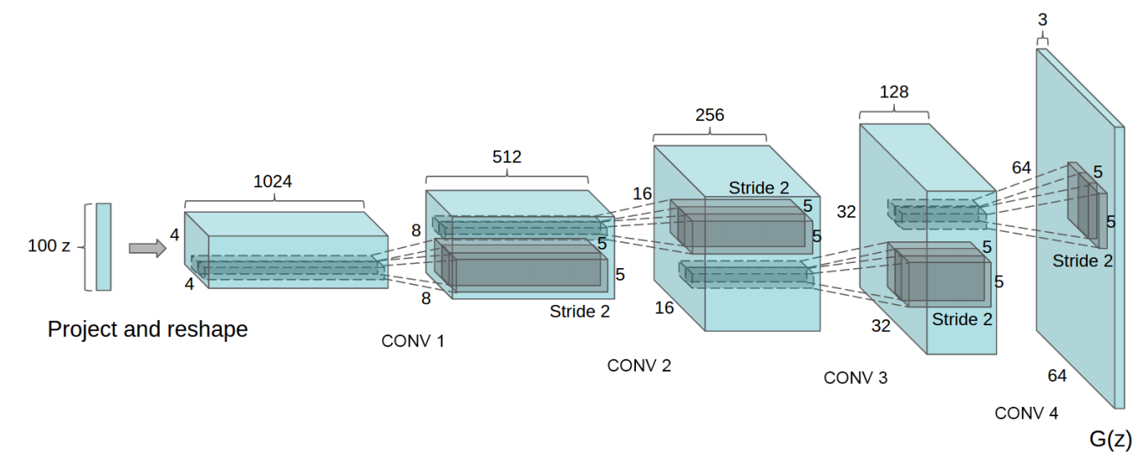
Generative Adversarial Nets: Convolutional Architectures
Generator
Radford et al, “Unsupervised Representation Learning with Deep Convolutional Generative Adversarial Networks”, ICLR 2016
Slide Credit: Fei-Fei Li, Justin Johnson, Serena Yeung, CS 231n

Slide 85
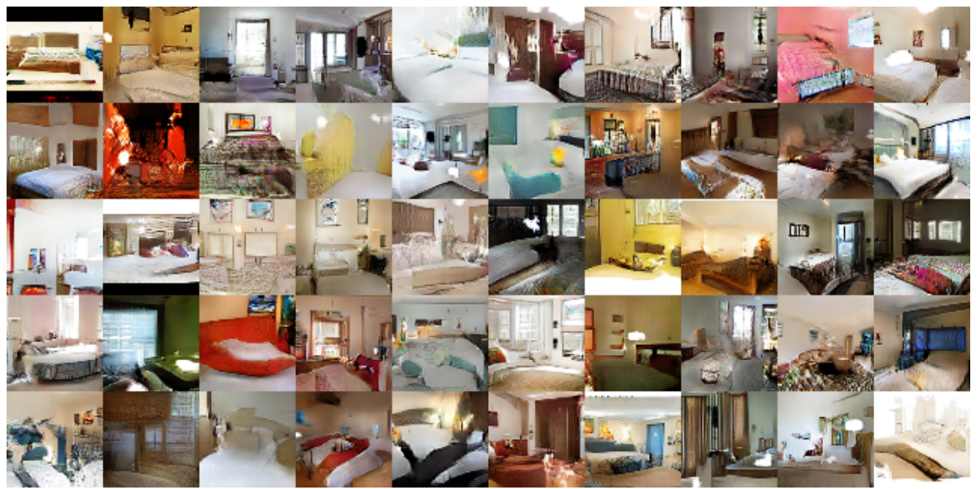
Generative Adversarial Nets: Convolutional Architectures
Samples from the model look much better!
Radford et al,
ICLR 2016
Slide Credit: Fei-Fei Li, Justin Johnson, Serena Yeung, CS 231n

Slide 86
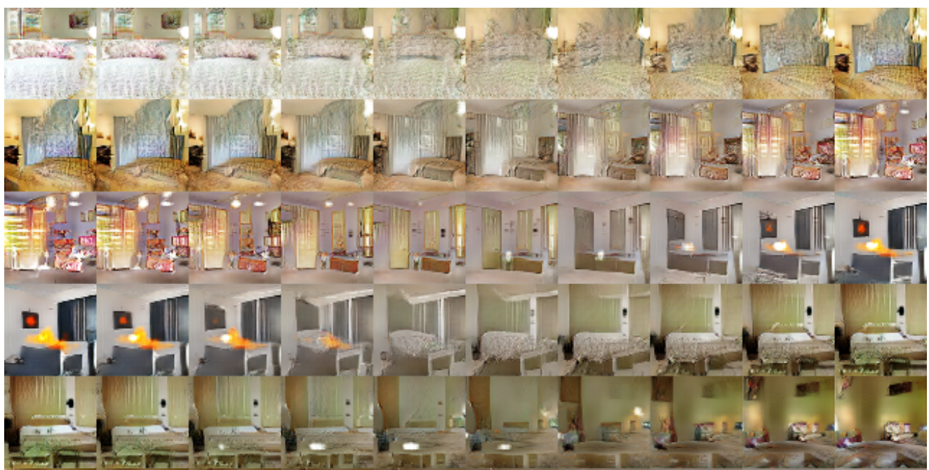
Generative Adversarial Nets: Convolutional Architectures
Interpolating between random
points in latent space
Radford et al,
ICLR 2016
Slide Credit: Fei-Fei Li, Justin Johnson, Serena Yeung, CS 231n
Notes:
Take 2 points of z (2 random vectors), and interpolate between these points

Slide 87
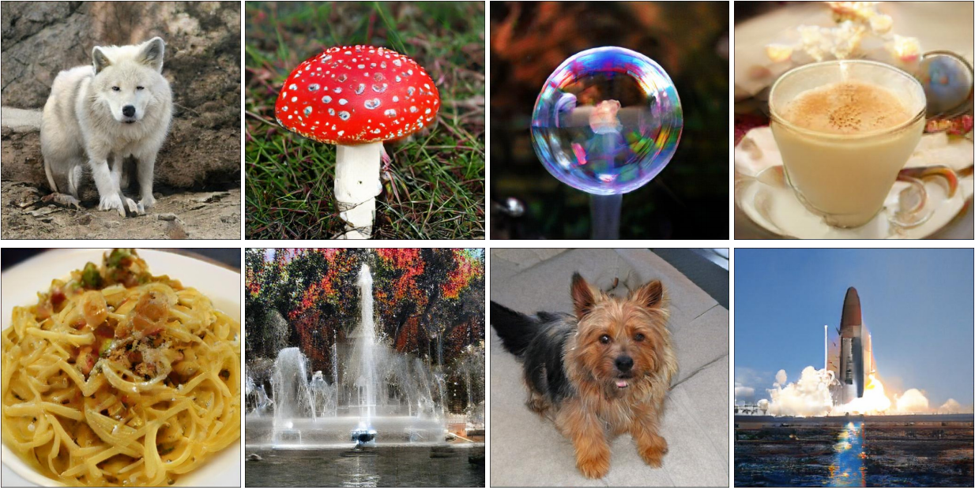
BigGAN

Slide 88
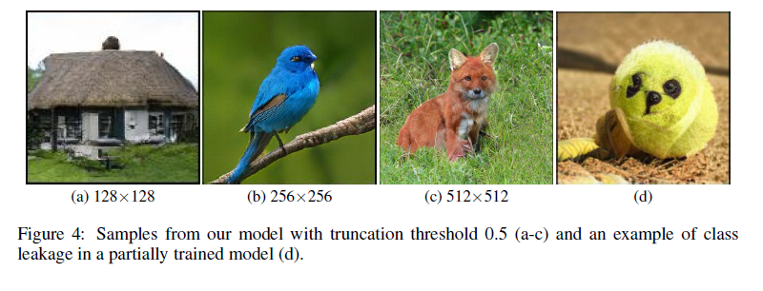
BigGAN

Slide 89
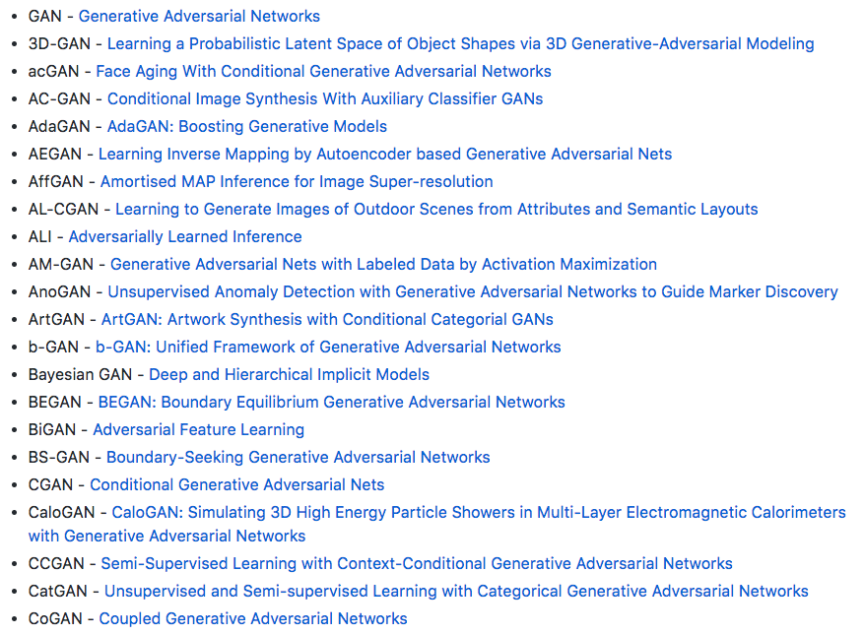
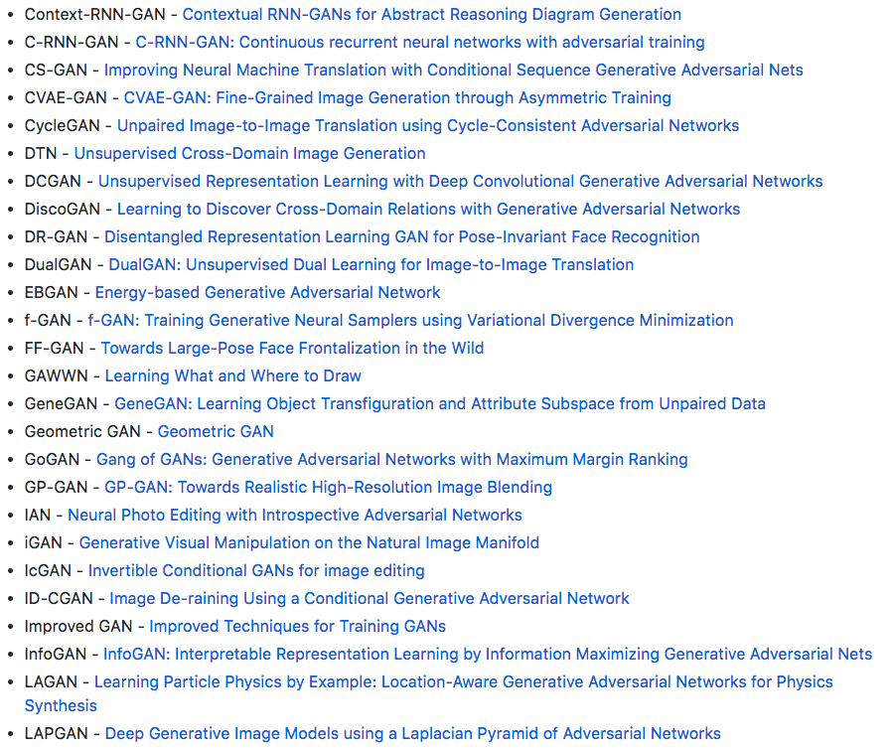
2017: Explosion of GANs
“The GAN Zoo”
“The GAN Zoo”
https://github.com/hindupuravinash/the-gan-zoo
Slide Credit: Fei-Fei Li, Justin Johnson, Serena Yeung, CS 231n

Slide 90
“The GAN Zoo”
2017: Explosion of GANs
See also: https://github.com/soumith/ganhacks for tips and tricks for trainings GANs
https://github.com/hindupuravinash/the-gan-zoo
Slide Credit: Fei-Fei Li, Justin Johnson, Serena Yeung, CS 231n

Slide 91
GANs
Don’t work with an explicit density function
Take game-theoretic approach: learn to generate from training distribution through 2-player game
Pros:
Beautiful, state-of-the-art samples!
Cons:
Trickier / more unstable to train
Can’t solve inference queries such as p(x), p(z|x)
Active areas of research:
Better loss functions, more stable training (Wasserstein GAN, LSGAN, many others)
Conditional GANs, GANs for all kinds of applications
Slide Credit: Fei-Fei Li, Justin Johnson, Serena Yeung, CS 231n

