Slide 1
CS 4803 / 7643: Deep Learning
Topics:
  Recurrent Neural Networks (RNNs)
    Truncated BackProp Through Time (BPTT)
    LSTMs
Dhruv Batra
Georgia Tech

Slide 2
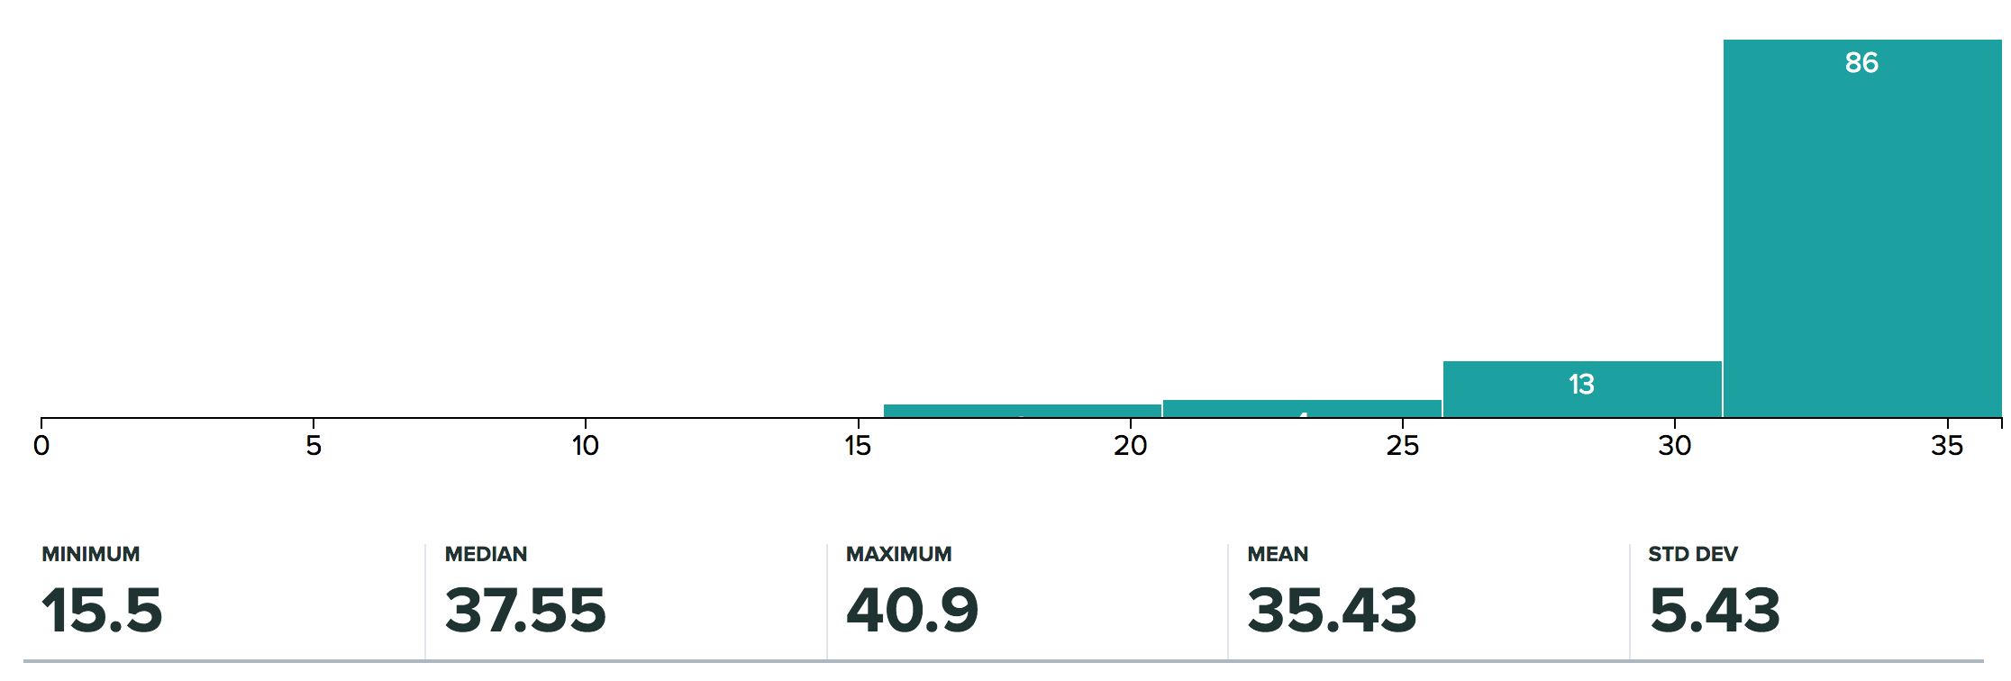
Administrativia
HW1 Grades Released
  Max regular points: 31 (4803), 36 (7643)
  Regrade requests close: 11/01, 11:55pm
  https://docs.google.com/spreadsheets/d/1hLlswTKhk_QeC81a5ylfsOCICidL9qLcO-tO2wngJOk/edit#gid=1468043323

Slide 3
Administrativia
HW3 Released
  Due: 11/06, 11:55pm
  Last HW
  Focus on projects after this
  https://www.cc.gatech.edu/classes/AY2019/cs7643_fall/assets/hw3.pdf
Guest Lecture by Peter Anderson
  Tuesday 10/30
  Topic: Vision + Language (CNNs + RNNs)

Slide 4
Recap from last time

Slide 5
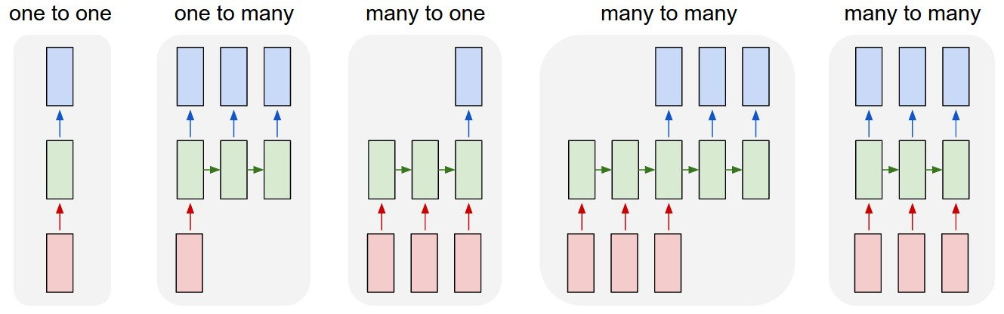
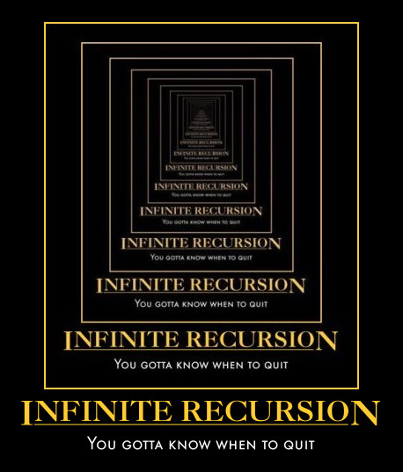
New Topic: RNNs
Image Credit: Andrej Karpathy

Slide 6
New Words
Recurrent Neural Networks (RNNs)
Recursive Neural Networks
  General family; think graphs instead of chains
Types:
  “Vanilla” RNNs (Elman Networks)
  Long Short Term Memory (LSTMs)
  Gated Recurrent Units (GRUs)
  …
Algorithms
  BackProp Through Time (BPTT)
  BackProp Through Structure (BPTS)

Slide 7
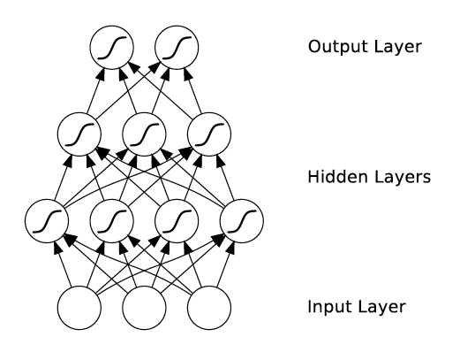
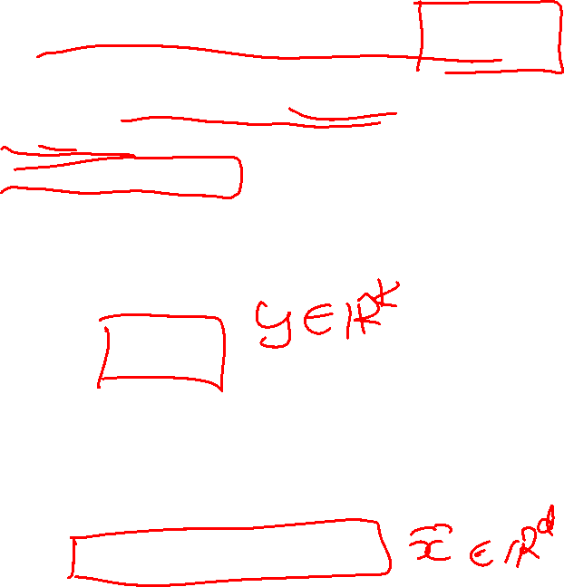
What’s wrong with MLPs?
Problem 1: Can’t model sequences
  Fixed-sized Inputs & Outputs
  No temporal structure
Problem 2: Pure feed-forward processing
  No “memory”, no feedback
Image Credit: Alex Graves, book

Slide 8
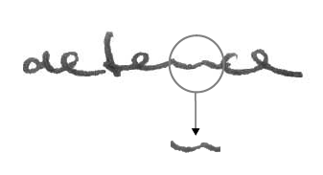
Why model sequences?
Image Credit: Alex Graves

Slide 9
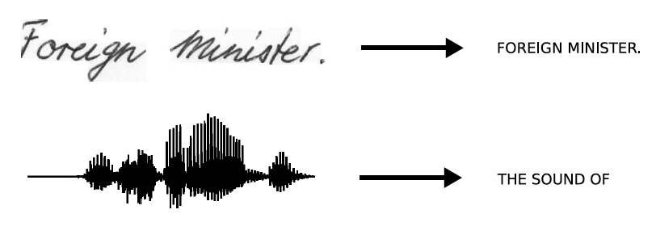
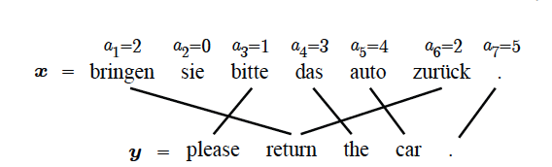
Sequences are everywhere…
Image Credit: Alex Graves and Kevin Gimpel

Slide 10
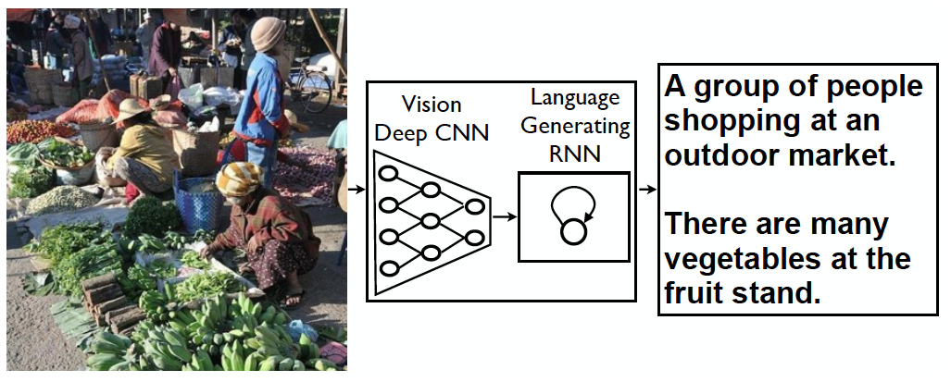
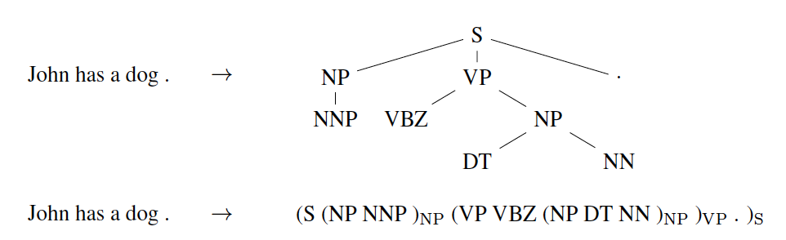
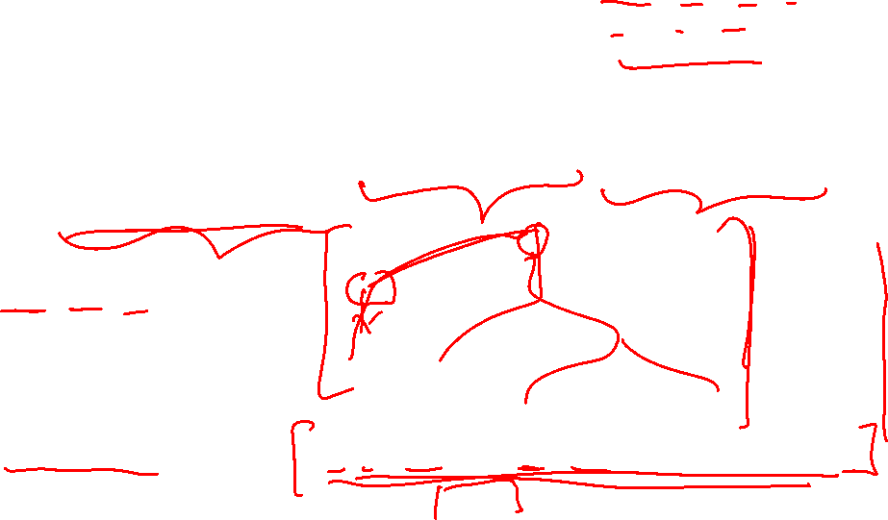
Even where you might not expect a sequence…
Image Credit: Vinyals et al.

Slide 11
Sequences in Input or Output?
It’s a spectrum…
Input: No sequence
Output: No sequence
Example: “standard” classification /
regression problems
Input: No sequence
Output: Sequence
Example: Im2Caption
Input: Sequence
Output: No sequence
Example: sentence classification, multiple-choice question answering
Input: Sequence
Output: Sequence
Example: machine translation, video classification,
video captioning, open-ended question answering
Image Credit: Andrej Karpathy

Slide 12
2 Key Ideas
Parameter Sharing
  in computation graphs = adding gradients

Slide 13
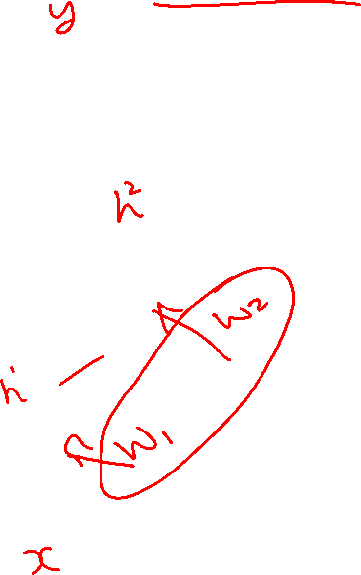
Computational Graph
Slide Credit: Marc'Aurelio Ranzato

Slide 14
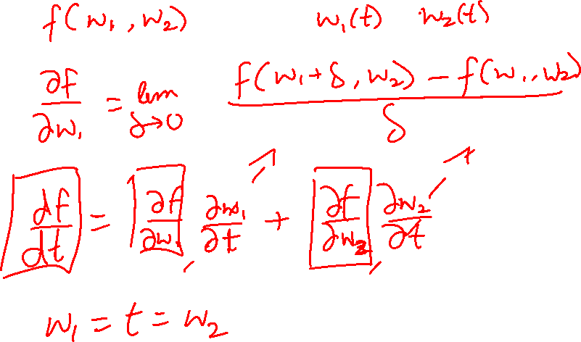

Slide 15
2 Key Ideas
Parameter Sharing
  in computation graphs = adding gradients
“Unrolling”
  in computation graphs with parameter sharing

Slide 16

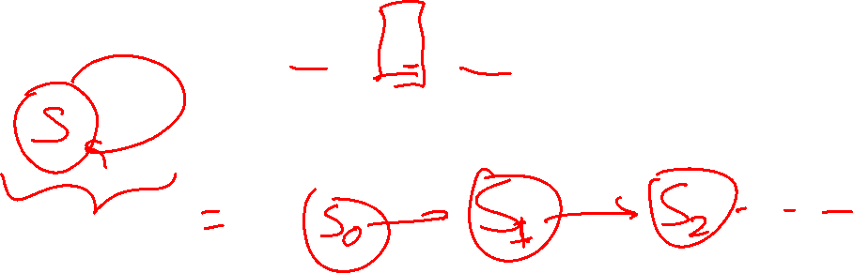
How do we model sequences?
No input
Image Credit: Bengio, Goodfellow, Courville

Slide 17
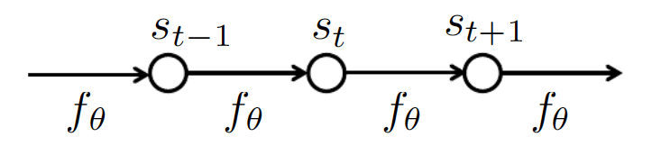
How do we model sequences?
No input
Image Credit: Bengio, Goodfellow, Courville

Slide 18

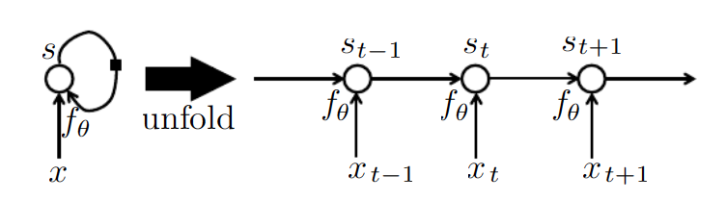
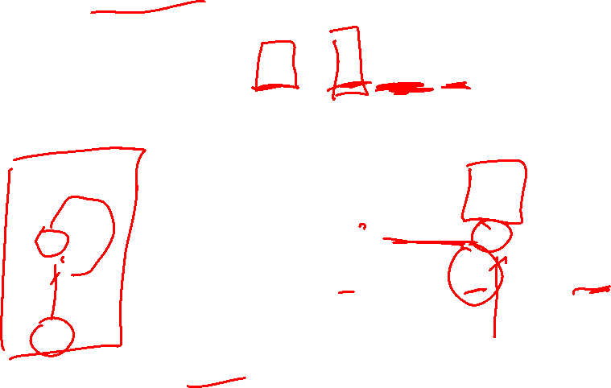
How do we model sequences?
With inputs
Image Credit: Bengio, Goodfellow, Courville

Slide 19
2 Key Ideas
Parameter Sharing
  in computation graphs = adding gradients
“Unrolling”
  in computation graphs with parameter sharing
Parameter sharing + Unrolling
  Allows modeling arbitrary sequence lengths!
  Keeps numbers of parameters in check

Slide 20
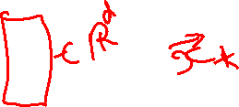
Recurrent Neural Network
RNN
x
Slide Credit: Fei-Fei Li, Justin Johnson, Serena Yeung, CS 231n

Slide 21
Recurrent Neural Network
y
usually want to predict a vector at some time steps
RNN
x
Slide Credit: Fei-Fei Li, Justin Johnson, Serena Yeung, CS 231n

Slide 22

Recurrent Neural Network
We can process a sequence of vectors x by applying a recurrence formula at every time step:
y
RNN
new state
old state
input vector at some time step
some function
with parameters W
x
Slide Credit: Fei-Fei Li, Justin Johnson, Serena Yeung, CS 231n

Slide 23
Recurrent Neural Network
We can process a sequence of vectors x by applying a recurrence formula at every time step:
y
RNN
Notice: the same function and the same set of parameters are used at every time step.
x
Slide Credit: Fei-Fei Li, Justin Johnson, Serena Yeung, CS 231n

Slide 24
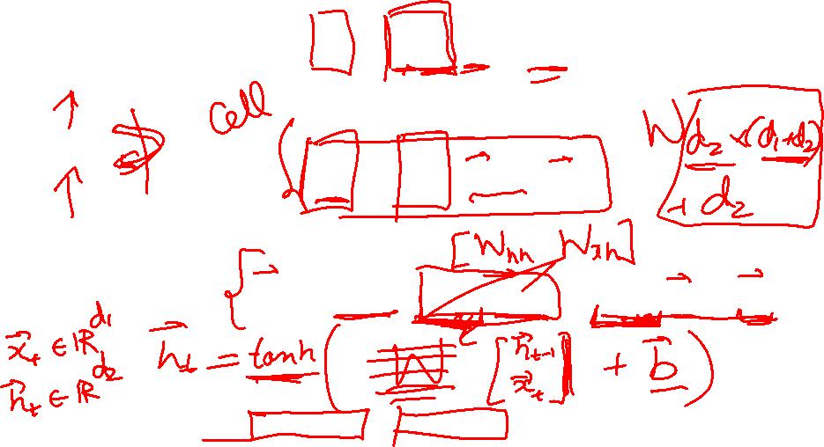
(Vanilla) Recurrent Neural Network
The state consists of a single “hidden” vector h:
y
RNN
x
Sometimes called a “Vanilla RNN” or an “Elman RNN” after Prof. Jeffrey Elman
Slide Credit: Fei-Fei Li, Justin Johnson, Serena Yeung, CS 231n

Slide 25
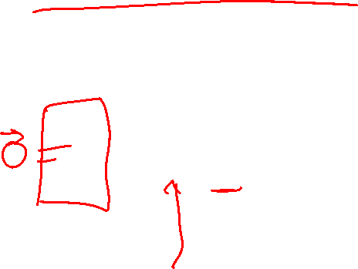
RNN: Computational Graph
h₀
f_{W}
h₁
x₁
Slide Credit: Fei-Fei Li, Justin Johnson, Serena Yeung, CS 231n

Slide 26
RNN: Computational Graph
h₀
h₁
h₂
h₃
…
h_{T}
f_{W}
f_{W}
f_{W}
x₁
x₂
x₃
Slide Credit: Fei-Fei Li, Justin Johnson, Serena Yeung, CS 231n

Slide 27
RNN: Computational Graph
Re-use the same weight matrix at every time-step
h₀
h₁
h₂
h₃
…
h_{T}
f_{W}
f_{W}
f_{W}
x₁
x₂
x₃
W
Slide Credit: Fei-Fei Li, Justin Johnson, Serena Yeung, CS 231n

Slide 28
L
RNN: Computational Graph: Many to Many
y₁
y₂
y₃
y_{T}
L₁
L₂
L₃
L_{T}
h₀
h₁
h₂
h₃
…
h_{T}
f_{W}
f_{W}
f_{W}
x₁
x₂
x₃
W
Slide Credit: Fei-Fei Li, Justin Johnson, Serena Yeung, CS 231n

Slide 29
RNN: Computational Graph: Many to One
y
h₀
h₁
h₂
h₃
…
h_{T}
f_{W}
f_{W}
f_{W}
x₁
x₂
x₃
W
Slide Credit: Fei-Fei Li, Justin Johnson, Serena Yeung, CS 231n

Slide 30
RNN: Computational Graph: One to Many
y₁
y₂
y₃
y_{T}
h₀
h₁
h₂
h₃
…
h_{T}
f_{W}
f_{W}
f_{W}
x
W
Slide Credit: Fei-Fei Li, Justin Johnson, Serena Yeung, CS 231n

Slide 31
Sequence to Sequence: Many-to-one + one-to-many
One to many: Produce output sequence from single input vector
Many to one: Encode input sequence in a single vector
y₁
y₂
h₀
f_{W}
h₁
f_{W}
h₂
f_{W}
h₃
…
h_{T}
h₁
h₂
…
f_{W}
f_{W}
f_{W}
x₁
x₂
x₃
W₁
W₂
Slide Credit: Fei-Fei Li, Justin Johnson, Serena Yeung, CS 231n

Slide 32
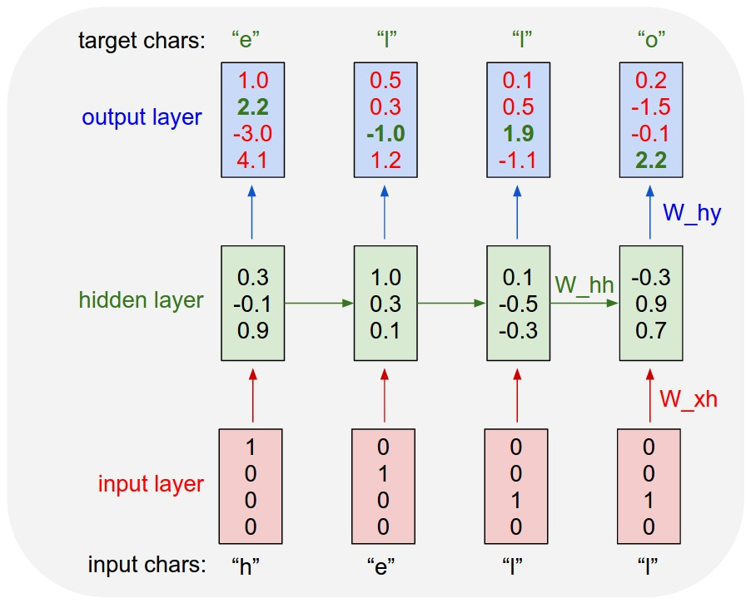
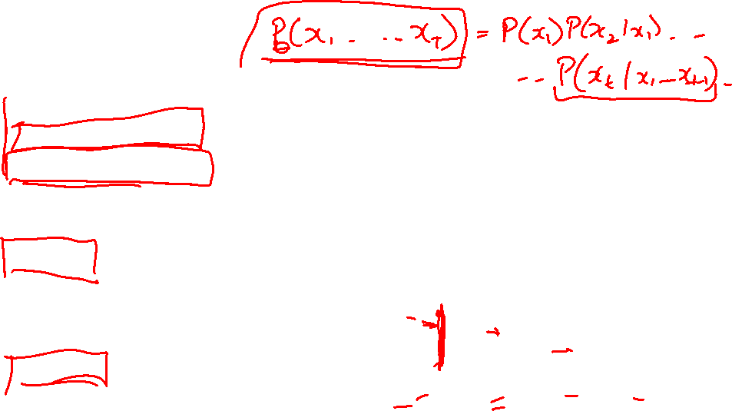
Example: Character-level
Language Model
Vocabulary:
[h,e,l,o]
Example training
sequence:
“hello”
Slide Credit: Fei-Fei Li, Justin Johnson, Serena Yeung, CS 231n

Slide 33
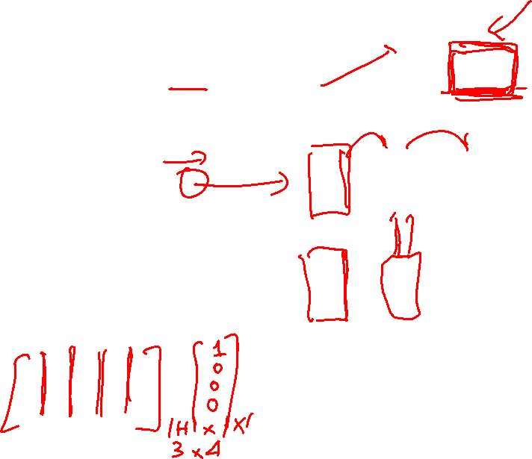
Example: Character-level
Language Model
Vocabulary:
[h,e,l,o]
Example training
sequence:
“hello”
Slide Credit: Fei-Fei Li, Justin Johnson, Serena Yeung, CS 231n

Slide 34
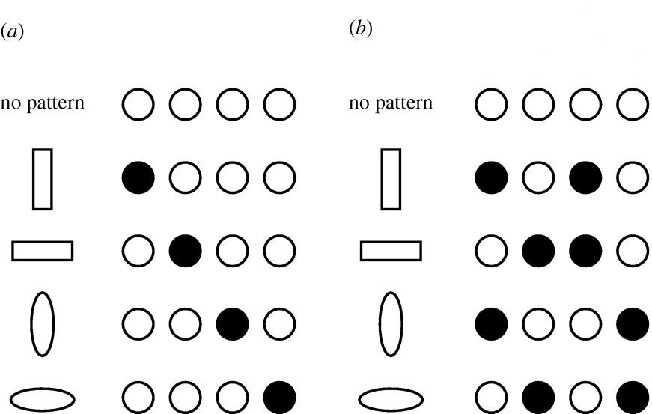
Distributed Representations Toy Example
Local vs Distributed
Slide Credit: Moontae Lee

Slide 35
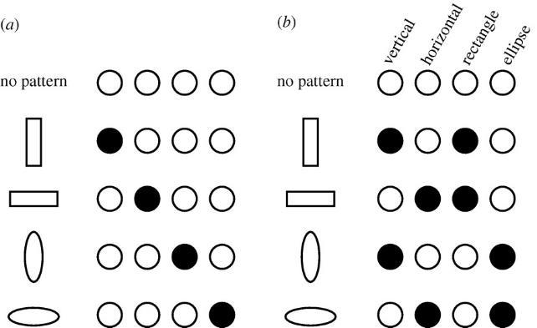
Distributed Representations Toy Example
Can we interpret each dimension?
Slide Credit: Moontae Lee

Slide 36
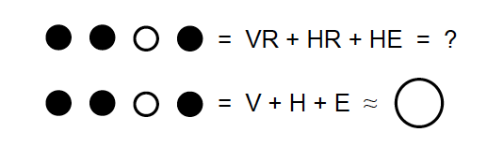
Power of distributed representations!
Local
Distributed
Slide Credit: Moontae Lee

Slide 37
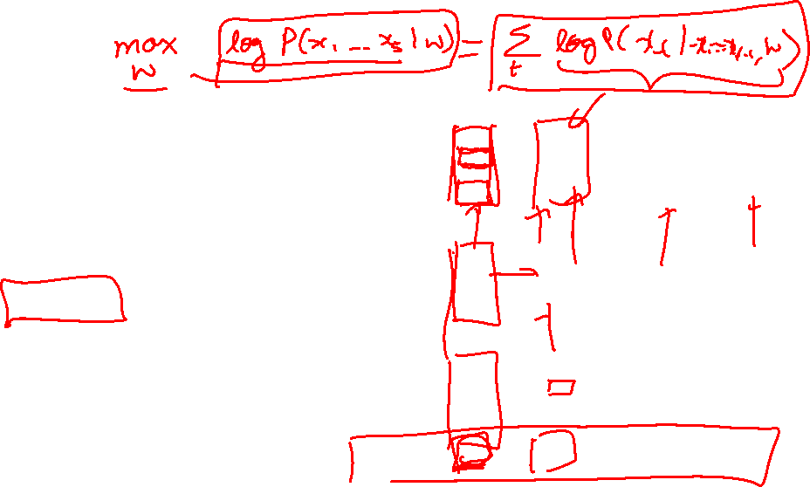
Example: Character-level
Language Model
Vocabulary:
[h,e,l,o]
Example training
sequence:
“hello”
Slide Credit: Fei-Fei Li, Justin Johnson, Serena Yeung, CS 231n

Slide 38
Training Time: MLE / “Teacher Forcing”
Example: Character-level
Language Model
Vocabulary:
[h,e,l,o]
Example training
sequence:
“hello”
Slide Credit: Fei-Fei Li, Justin Johnson, Serena Yeung, CS 231n

Slide 39
Test Time: Sample / Argmax / Beam Search
Example: Character-level
Language Model
Sampling
Vocabulary:
[h,e,l,o]
At test-time sample characters one at a time, feed back to model
“e”
“l”
“l”
“o”
Sample
.03
.13
.00
.84
.25
.20
.05
.50
.11
.17
.68
.03
.11
.02.08
.79
Softmax
Slide Credit: Fei-Fei Li, Justin Johnson, Serena Yeung, CS 231n

Slide 40
Test Time: Sample / Argmax / Beam Search
Example: Character-level
Language Model
Sampling
Vocabulary:
[h,e,l,o]
At test-time sample characters one at a time, feed back to model
“e”
“l”
“l”
“o”
Sample
.03
.13
.00
.84
.25
.20
.05
.50
.11
.17
.68
.03
.11
.02.08
.79
Softmax
Slide Credit: Fei-Fei Li, Justin Johnson, Serena Yeung, CS 231n

Slide 41
Test Time: Sample / Argmax / Beam Search
Example: Character-level
Language Model
Sampling
Vocabulary:
[h,e,l,o]
At test-time sample characters one at a time, feed back to model
“e”
“l”
“l”
“o”
Sample
.03
.13
.00
.84
.25
.20
.05
.50
.11
.17
.68
.03
.11
.02.08
.79
Softmax
Slide Credit: Fei-Fei Li, Justin Johnson, Serena Yeung, CS 231n

Slide 42
Test Time: Sample / Argmax / Beam Search
Example: Character-level
Language Model
Sampling
Vocabulary:
[h,e,l,o]
At test-time sample characters one at a time, feed back to model
“e”
“l”
“l”
“o”
Sample
.03
.13
.00
.84
.25
.20
.05
.50
.11
.17
.68
.03
.11
.02.08
.79
Softmax
Slide Credit: Fei-Fei Li, Justin Johnson, Serena Yeung, CS 231n

Slide 43
Plan for Today
Model
  Recurrent Neural Network Variants
Learning
  (Truncated) BackProp Through Time (BPTT)

Slide 44
Forward through entire sequence to compute loss, then backward through entire sequence to compute gradient
Backpropagation through time
Loss
Slide Credit: Fei-Fei Li, Justin Johnson, Serena Yeung, CS 231n

Slide 45
Truncated Backpropagation through time
Loss
Run forward and backward through chunks of the sequence instead of whole sequence
Slide Credit: Fei-Fei Li, Justin Johnson, Serena Yeung, CS 231n

Slide 46
Truncated Backpropagation through time
Loss
Carry hidden states forward in time forever, but only backpropagate for some smaller number of steps
Slide Credit: Fei-Fei Li, Justin Johnson, Serena Yeung, CS 231n

Slide 47
Truncated Backpropagation through time
Loss
Slide Credit: Fei-Fei Li, Justin Johnson, Serena Yeung, CS 231n

Slide 48
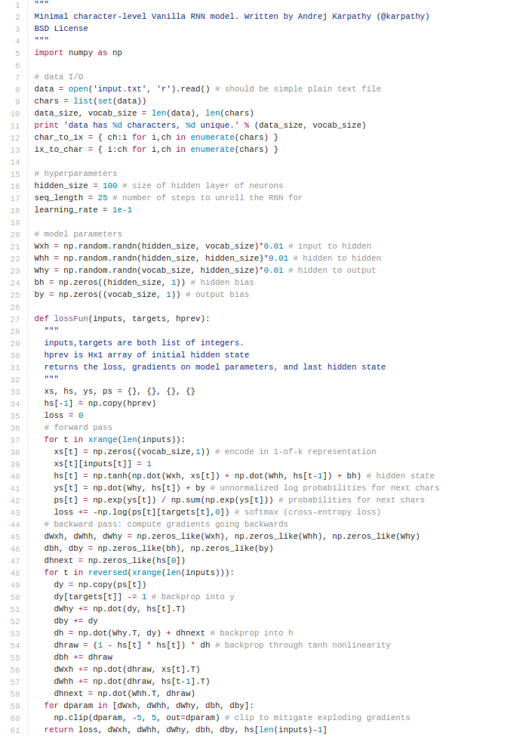
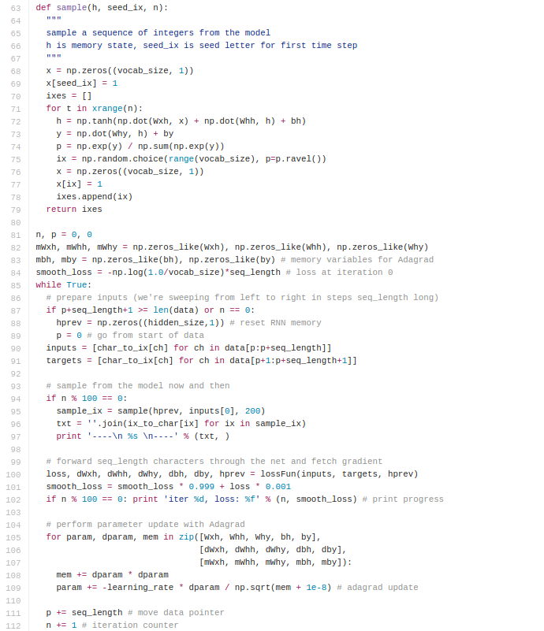
min-char-rnn.py gist: 112 lines of Python
(https://gist.github.com/karpathy/d4dee566867f8291f086)
Slide Credit: Fei-Fei Li, Justin Johnson, Serena Yeung, CS 231n

Slide 49
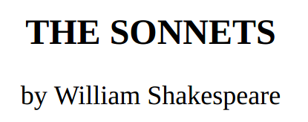
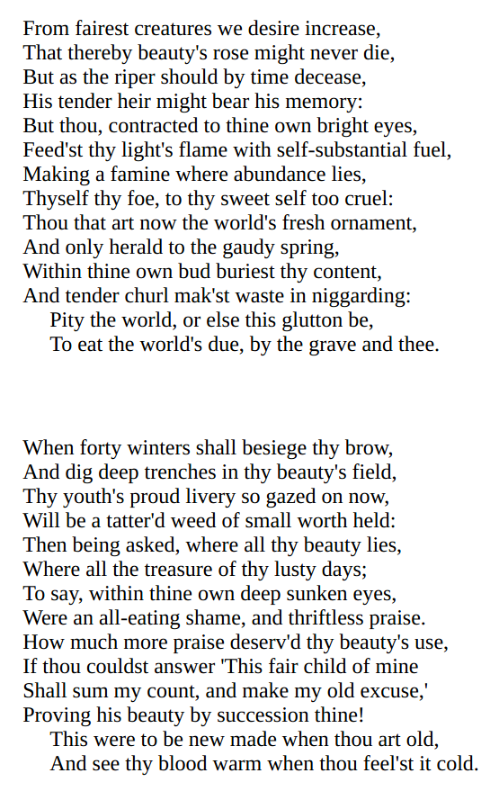
y
RNN
x
Slide Credit: Fei-Fei Li, Justin Johnson, Serena Yeung, CS 231n

Slide 50
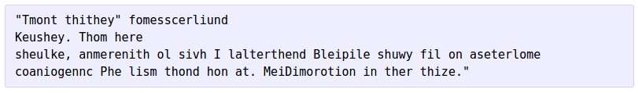


at first:
train more
train more
train more
Slide Credit: Fei-Fei Li, Justin Johnson, Serena Yeung, CS 231n

Slide 51
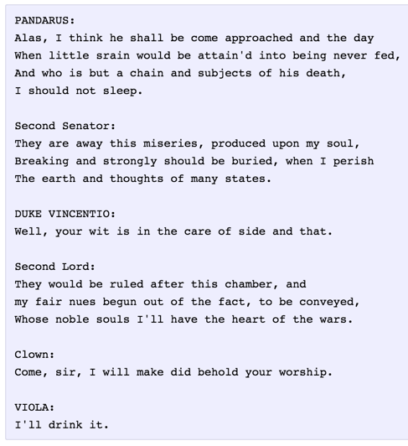
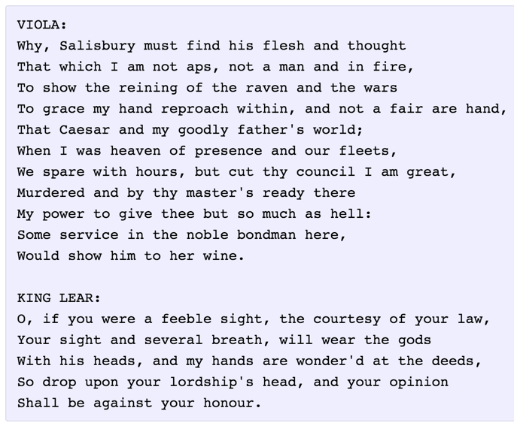
Slide Credit: Fei-Fei Li, Justin Johnson, Serena Yeung, CS 231n

Slide 52
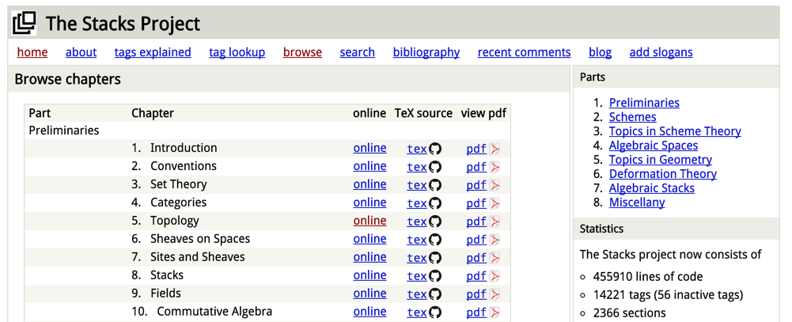
The Stacks Project: open source algebraic geometry textbook
Latex source
http://stacks.math.columbia.edu/
The stacks project is licensed under the GNU Free Documentation License
Slide Credit: Fei-Fei Li, Justin Johnson, Serena Yeung, CS 231n

Slide 53
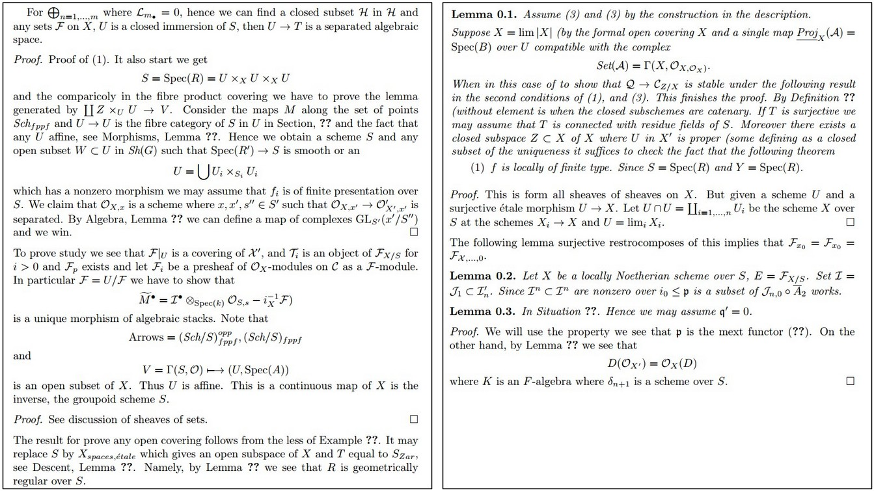
Slide Credit: Fei-Fei Li, Justin Johnson, Serena Yeung, CS 231n

Slide 54
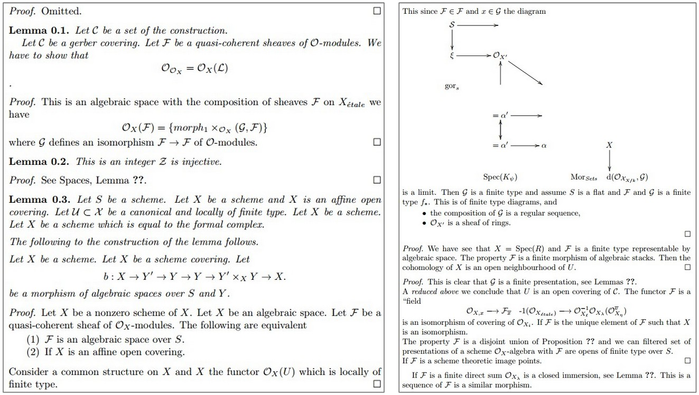
Slide Credit: Fei-Fei Li, Justin Johnson, Serena Yeung, CS 231n

Slide 55
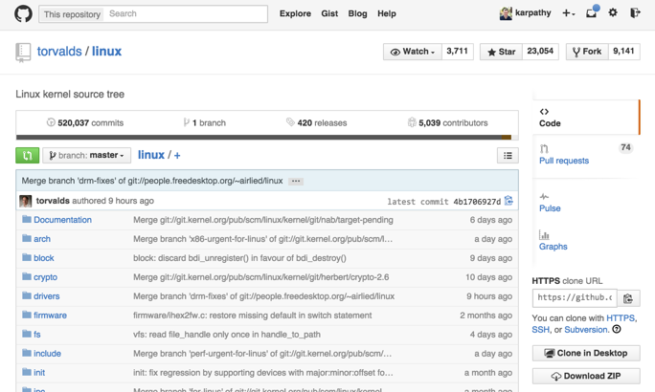
Slide Credit: Fei-Fei Li, Justin Johnson, Serena Yeung, CS 231n

Slide 56
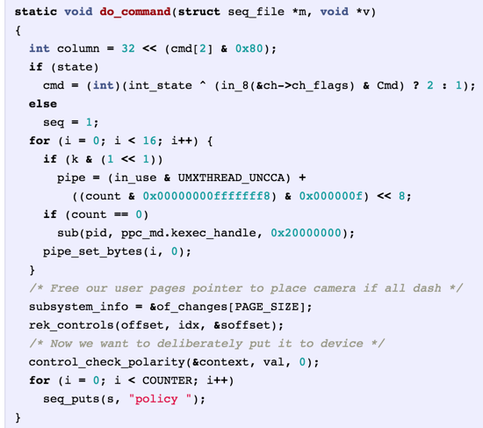
Generated
C code
Slide Credit: Fei-Fei Li, Justin Johnson, Serena Yeung, CS 231n

Slide 57
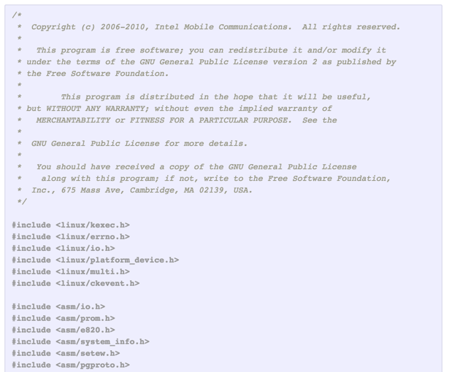
Slide Credit: Fei-Fei Li, Justin Johnson, Serena Yeung, CS 231n

Slide 58
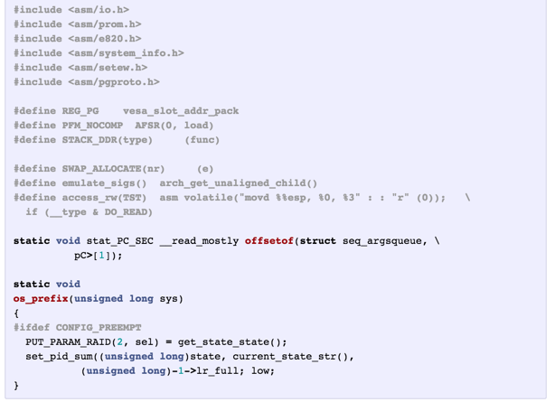
Slide Credit: Fei-Fei Li, Justin Johnson, Serena Yeung, CS 231n

Slide 59
Searching for interpretable cells
Karpathy, Johnson, and Fei-Fei: Visualizing and Understanding Recurrent Networks, ICLR Workshop 2016
Slide Credit: Fei-Fei Li, Justin Johnson, Serena Yeung, CS 231n

Slide 60
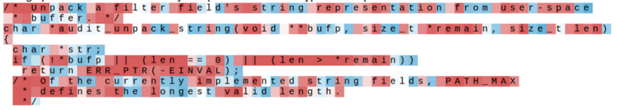
Searching for interpretable cells
Karpathy, Johnson, and Fei-Fei: Visualizing and Understanding Recurrent Networks, ICLR Workshop 2016
Figures copyright Karpathy, Johnson, and Fei-Fei, 2015; reproduced with permission
Slide Credit: Fei-Fei Li, Justin Johnson, Serena Yeung, CS 231n

Slide 61
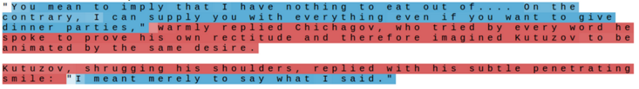
Searching for interpretable cells
quote detection cell
Karpathy, Johnson, and Fei-Fei: Visualizing and Understanding Recurrent Networks, ICLR Workshop 2016
Figures copyright Karpathy, Johnson, and Fei-Fei, 2015; reproduced with permission
Slide Credit: Fei-Fei Li, Justin Johnson, Serena Yeung, CS 231n

Slide 62
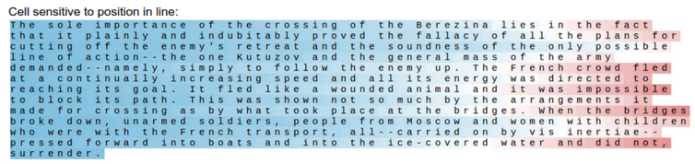
Searching for interpretable cells
line length tracking cell
Karpathy, Johnson, and Fei-Fei: Visualizing and Understanding Recurrent Networks, ICLR Workshop 2016
Figures copyright Karpathy, Johnson, and Fei-Fei, 2015; reproduced with permission
Slide Credit: Fei-Fei Li, Justin Johnson, Serena Yeung, CS 231n

Slide 63
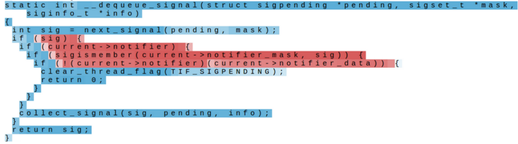
Searching for interpretable cells
if statement cell
Karpathy, Johnson, and Fei-Fei: Visualizing and Understanding Recurrent Networks, ICLR Workshop 2016
Figures copyright Karpathy, Johnson, and Fei-Fei, 2015; reproduced with permission
Slide Credit: Fei-Fei Li, Justin Johnson, Serena Yeung, CS 231n

Slide 64
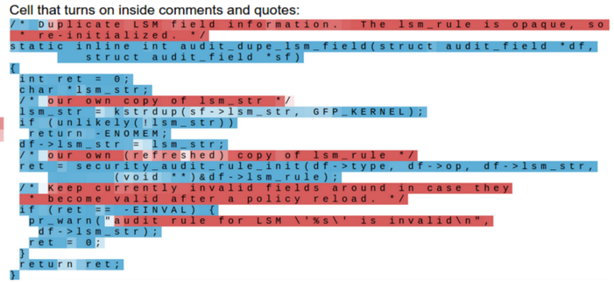
Searching for interpretable cells
quote/comment cell
Karpathy, Johnson, and Fei-Fei: Visualizing and Understanding Recurrent Networks, ICLR Workshop 2016
Figures copyright Karpathy, Johnson, and Fei-Fei, 2015; reproduced with permission
Slide Credit: Fei-Fei Li, Justin Johnson, Serena Yeung, CS 231n

Slide 65
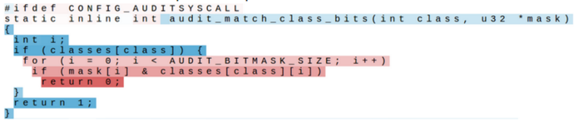
Searching for interpretable cells
code depth cell
Karpathy, Johnson, and Fei-Fei: Visualizing and Understanding Recurrent Networks, ICLR Workshop 2016
Figures copyright Karpathy, Johnson, and Fei-Fei, 2015; reproduced with permission
Slide Credit: Fei-Fei Li, Justin Johnson, Serena Yeung, CS 231n

Slide 66
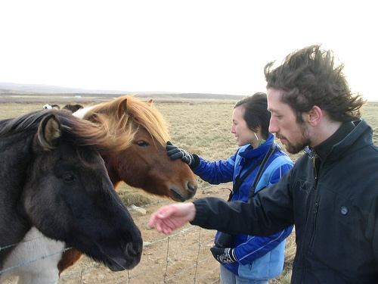
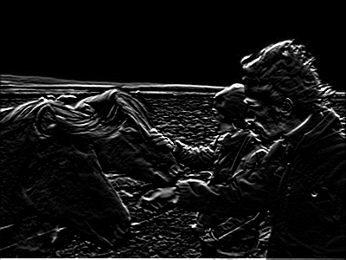
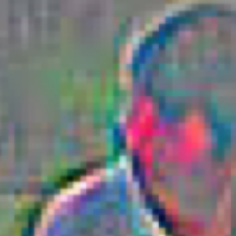
Neural Image Captioning
Image Embedding (VGGNet)
4096-dim
Convolution Layer
+ Non-Linearity
Pooling Layer
Convolution Layer
+ Non-Linearity
Pooling Layer
Fully-Connected MLP

Slide 67
Neural Image Captioning
Image Embedding (VGGNet)
4096-dim
Convolution Layer
+ Non-Linearity
Pooling Layer
Convolution Layer
+ Non-Linearity
Pooling Layer
Fully-Connected MLP

Slide 68
Neural Image Captioning
P(next)
P(next)
P(next)
P(next)
P(next)
P(next)
Linear
RNN
RNN
RNN
RNN
RNN
RNN
<start>
Two
people
and
two
horses.

Slide 69
Neural Image Captioning
P(next)
P(next)
P(next)
P(next)
P(next)
P(next)
Linear
RNN
RNN
RNN
RNN
RNN
RNN
<start>
Two
people
and
two
horses.

Slide 70
Sequence Model Factor Graph

Slide 71
Beam Search Demo
http://dbs.cloudcv.org/captioning&mode=interactive

Slide 72








Image Captioning: Example Results
Captions generated using neuraltalk2
All images are CC0 Public domain: cat suitcase, cat tree, dog, bear, surfers, tennis, giraffe, motorcycle
A cat sitting on a suitcase on the floor
A cat is sitting on a tree branch
A dog is running in the grass with a frisbee
A white teddy bear sitting in the grass
Two people walking on the beach with surfboards
A tennis player in action on the court
Two giraffes standing in a grassy field
A man riding a dirt bike on a dirt track
Slide Credit: Fei-Fei Li, Justin Johnson, Serena Yeung, CS 231n

Slide 73





Image Captioning: Failure Cases
Captions generated using neuraltalk2
All images are CC0 Public domain: fur coat, handstand, spider web, baseball
A bird is perched on a tree branch
A woman is holding a cat in her hand
A man in a baseball uniform throwing a ball
A woman standing on a beach holding a surfboard
A person holding a computer mouse on a desk
Slide Credit: Fei-Fei Li, Justin Johnson, Serena Yeung, CS 231n

Slide 74

Image Captioning with Attention
CNN
h0
Features:
L x D
Image:
H x W x 3
Xu et al, “Show, Attend and Tell: Neural Image Caption Generation with Visual Attention”, ICML 2015
Slide Credit: Fei-Fei Li, Justin Johnson, Serena Yeung, CS 231n

Slide 75
Image Captioning with Attention
Distribution over L locations
a1
CNN
h0
Features:
L x D
Image:
H x W x 3
Xu et al, “Show, Attend and Tell: Neural Image Caption Generation with Visual Attention”, ICML 2015
Slide Credit: Fei-Fei Li, Justin Johnson, Serena Yeung, CS 231n

Slide 76

Image Captioning with Attention
Distribution over L locations
a1
CNN
h0
Features:
L x D
Image:
H x W x 3
Weighted features: D
z1
Weighted combination of features
Xu et al, “Show, Attend and Tell: Neural Image Caption Generation with Visual Attention”, ICML 2015
Slide Credit: Fei-Fei Li, Justin Johnson, Serena Yeung, CS 231n

Slide 77
Image Captioning with Attention
Distribution over L locations
a1
CNN
h0
h1
Features:
L x D
Image:
H x W x 3
Weighted features: D
z1
y1
Weighted combination of features
Xu et al, “Show, Attend and Tell: Neural Image Caption Generation with Visual Attention”, ICML 2015
First word
Slide Credit: Fei-Fei Li, Justin Johnson, Serena Yeung, CS 231n

Slide 78
Image Captioning with Attention
Distribution over L locations
Distribution
over vocab
a1
a2
d1
CNN
h0
h1
Features:
L x D
Image:
H x W x 3
Weighted features: D
z1
y1
Weighted combination of features
Xu et al, “Show, Attend and Tell: Neural Image Caption Generation with Visual Attention”, ICML 2015
First word
Slide Credit: Fei-Fei Li, Justin Johnson, Serena Yeung, CS 231n

Slide 79
Image Captioning with Attention
Distribution over L locations
Distribution
over vocab
a1
a2
d1
CNN
h0
h1
h2
Features:
L x D
Image:
H x W x 3
Weighted features: D
z1
y1
z2
y2
Weighted combination of features
Xu et al, “Show, Attend and Tell: Neural Image Caption Generation with Visual Attention”, ICML 2015
First word
Slide Credit: Fei-Fei Li, Justin Johnson, Serena Yeung, CS 231n

Slide 80
Image Captioning with Attention
Distribution over L locations
Distribution
over vocab
a1
a2
d1
a3
d2
CNN
h0
h1
h2
Features:
L x D
Image:
H x W x 3
Weighted features: D
z1
y1
z2
y2
Weighted combination of features
Xu et al, “Show, Attend and Tell: Neural Image Caption Generation with Visual Attention”, ICML 2015
First word
Slide Credit: Fei-Fei Li, Justin Johnson, Serena Yeung, CS 231n

Slide 81

Image Captioning with Attention
Soft attention
Hard attention
Xu et al, “Show, Attend, and Tell: Neural Image Caption Generation with Visual Attention”, ICML 2015
Figure copyright Kelvin Xu, Jimmy Lei Ba, Jamie Kiros, Kyunghyun Cho, Aaron Courville, Ruslan Salakhutdinov, Richard S. Zemel, and Yoshua Benchio, 2015. Reproduced with permission.
Slide Credit: Fei-Fei Li, Justin Johnson, Serena Yeung, CS 231n

Slide 82

Image Captioning with Attention
Xu et al, “Show, Attend, and Tell: Neural Image Caption Generation with Visual Attention”, ICML 2015
Figure copyright Kelvin Xu, Jimmy Lei Ba, Jamie Kiros, Kyunghyun Cho, Aaron Courville, Ruslan Salakhutdinov, Richard S. Zemel, and Yoshua Benchio, 2015. Reproduced with permission.
Slide Credit: Fei-Fei Li, Justin Johnson, Serena Yeung, CS 231n

Slide 83

Typical VQA Models
Neural Network
Softmax
over top K answers
Embedding (VGGNet)
Image
4096-dim
Convolution Layer
+ Non-Linearity
Pooling Layer
Convolution Layer
+ Non-Linearity
Pooling Layer
Fully-Connected MLP
Question
Embedding (LSTM)
“How many horses are in this image?”

Slide 84


Visual Question Answering: RNNs with Attention
Zhu et al, “Visual 7W: Grounded Question Answering in Images”, CVPR 2016
Figures from Zhu et al, copyright IEEE 2016. Reproduced for educational purposes.
Slide Credit: Fei-Fei Li, Justin Johnson, Serena Yeung, CS 231n

Slide 85

Multilayer RNNs
depth
time
Slide Credit: Fei-Fei Li, Justin Johnson, Serena Yeung, CS 231n

Slide 86

Vanilla RNN Gradient Flow
Bengio et al, “Learning long-term dependencies with gradient descent is difficult”, IEEE Transactions on Neural Networks, 1994
Pascanu et al, “On the difficulty of training recurrent neural networks”, ICML 2013
W
tanh
h_{t-1}
h_{t}
stack
x_{t}
Slide Credit: Fei-Fei Li, Justin Johnson, Serena Yeung, CS 231n

Slide 87
Vanilla RNN Gradient Flow
Bengio et al, “Learning long-term dependencies with gradient descent is difficult”, IEEE Transactions on Neural Networks, 1994
Pascanu et al, “On the difficulty of training recurrent neural networks”, ICML 2013
Backpropagation from h_{t} to h_{t-1} multiplies by W (actually W_{hh}^{T})
W
tanh
h_{t-1}
h_{t}
stack
x_{t}
Slide Credit: Fei-Fei Li, Justin Johnson, Serena Yeung, CS 231n

Slide 88

Vanilla RNN Gradient Flow
Bengio et al, “Learning long-term dependencies with gradient descent is difficult”, IEEE Transactions on Neural Networks, 1994
Pascanu et al, “On the difficulty of training recurrent neural networks”, ICML 2013
h₀
h₁
h₂
h₃
h₄
x₁
x₂
x₃
x₄
Computing gradient of h₀ involves many factors of W
(and repeated tanh)
Slide Credit: Fei-Fei Li, Justin Johnson, Serena Yeung, CS 231n

Slide 89
Vanilla RNN Gradient Flow
Bengio et al, “Learning long-term dependencies with gradient descent is difficult”, IEEE Transactions on Neural Networks, 1994
Pascanu et al, “On the difficulty of training recurrent neural networks”, ICML 2013
h₀
h₁
h₂
h₃
h₄
x₁
x₂
x₃
x₄
Largest singular value > 1: Exploding gradients
Largest singular value < 1:
Vanishing gradients
Computing gradient of h₀ involves many factors of W
(and repeated tanh)
Slide Credit: Fei-Fei Li, Justin Johnson, Serena Yeung, CS 231n

Slide 90

Vanilla RNN Gradient Flow
Bengio et al, “Learning long-term dependencies with gradient descent is difficult”, IEEE Transactions on Neural Networks, 1994
Pascanu et al, “On the difficulty of training recurrent neural networks”, ICML 2013
h₀
h₁
h₂
h₃
h₄
x₁
x₂
x₃
x₄
Largest singular value > 1: Exploding gradients
Largest singular value < 1:
Vanishing gradients
Gradient clipping: Scale gradient if its norm is too big
Computing gradient of h₀ involves many factors of W
(and repeated tanh)
Slide Credit: Fei-Fei Li, Justin Johnson, Serena Yeung, CS 231n

Slide 91
Vanilla RNN Gradient Flow
Bengio et al, “Learning long-term dependencies with gradient descent is difficult”, IEEE Transactions on Neural Networks, 1994
Pascanu et al, “On the difficulty of training recurrent neural networks”, ICML 2013
h₀
h₁
h₂
h₃
h₄
x₁
x₂
x₃
x₄
Largest singular value > 1: Exploding gradients
Largest singular value < 1:
Vanishing gradients
Computing gradient of h₀ involves many factors of W
(and repeated tanh)
Change RNN architecture
Slide Credit: Fei-Fei Li, Justin Johnson, Serena Yeung, CS 231n

Slide 92


Long Short Term Memory (LSTM)
Vanilla RNN
LSTM
Hochreiter and Schmidhuber, “Long Short Term Memory”, Neural Computation 1997
Slide Credit: Fei-Fei Li, Justin Johnson, Serena Yeung, CS 231n

Slide 93

Illustration [Pascanu et al]
Intuition
    Error surface of a single hidden unit RNN; High curvature walls
    Solid lines: standard gradient descent trajectories
    Dashed lines: gradient rescaled to fix problem

Slide 94

Fix #1
Pseudocode
Image Credit: Richard Socher

Slide 95

Fix #2
Smart Initialization and ReLus
  [Socher et al 2013]
  A Simple Way to Initialize Recurrent Networks of Rectified Linear Units, Le et al. 2015

Slide 96


Meet LSTMs
Image Credit: Christopher Olah (http://colah.github.io/posts/2015-08-Understanding-LSTMs/)

Slide 97

LSTMs Intuition: Memory
Cell State / Memory
Image Credit: Christopher Olah (http://colah.github.io/posts/2015-08-Understanding-LSTMs/)

Slide 98

LSTMs Intuition: Forget Gate
Should we continue to remember this “bit” of information or not?
Image Credit: Christopher Olah (http://colah.github.io/posts/2015-08-Understanding-LSTMs/)

Slide 99

LSTMs Intuition: Input Gate
Should we update this “bit” of information or not?
  If so, with what?
Image Credit: Christopher Olah (http://colah.github.io/posts/2015-08-Understanding-LSTMs/)

Slide 100

LSTMs Intuition: Memory Update
Forget that + memorize this
Image Credit: Christopher Olah (http://colah.github.io/posts/2015-08-Understanding-LSTMs/)

Slide 101

LSTMs Intuition: Output Gate
Should we output this “bit” of information to “deeper” layers?
Image Credit: Christopher Olah (http://colah.github.io/posts/2015-08-Understanding-LSTMs/)

Slide 102
LSTMs Intuition: Additive Updates
Backpropagation from c_{t} to c_{t-1} only elementwise multiplication by f, no matrix multiply by W
Image Credit: Christopher Olah (http://colah.github.io/posts/2015-08-Understanding-LSTMs/)

Slide 103
LSTMs Intuition: Additive Updates
Uninterrupted gradient flow!
Image Credit: Christopher Olah (http://colah.github.io/posts/2015-08-Understanding-LSTMs/)

Slide 104
LSTMs Intuition: Additive Updates
Uninterrupted gradient flow!
Similar to ResNet!
3x3 conv, 128
...
3x3 conv, 128
3x3 conv, 128
3x3 conv, 64
3x3 conv, 128
3x3 conv, 64
3x3 conv, 64
7x7 conv, 64 / 2
3x3 conv, 64
FC 1000
3x3 conv, 128 / 2
3x3 conv, 128
3x3 conv, 64
3x3 conv, 64
3x3 conv, 64
Pool
3x3 conv, 64
3x3 conv, 64
Input
3x3 conv, 64
3x3 conv, 64
3x3 conv, 64
Pool
Softmax
Image Credit: Christopher Olah (http://colah.github.io/posts/2015-08-Understanding-LSTMs/)

Slide 105
LSTMs
A pretty sophisticated cell
Image Credit: Christopher Olah (http://colah.github.io/posts/2015-08-Understanding-LSTMs/)

Slide 106

LSTM Variants #1: Peephole Connections
Let gates see the cell state / memory
Image Credit: Christopher Olah (http://colah.github.io/posts/2015-08-Understanding-LSTMs/)

Slide 107

LSTM Variants #2: Coupled Gates
Only memorize new if forgetting old
Image Credit: Christopher Olah (http://colah.github.io/posts/2015-08-Understanding-LSTMs/)

Slide 108

LSTM Variants #3: Gated Recurrent Units
Changes:
  No explicit memory; memory = hidden output
  Z = memorize new and forget old
Image Credit: Christopher Olah (http://colah.github.io/posts/2015-08-Understanding-LSTMs/)

Slide 109

Other RNN Variants
[An Empirical Exploration of
Recurrent Network Architectures,
Jozefowicz et al., 2015]

Slide 110
Summary
RNNs allow a lot of flexibility in architecture design
Vanilla RNNs are simple but don’t work very well
Common to use LSTM or GRU: their additive interactions improve gradient flow
Backward flow of gradients in RNN can explode or vanish. Exploding is controlled with gradient clipping. Vanishing is controlled with additive interactions (LSTM)
Better/simpler architectures are a hot topic of current research
Better understanding (both theoretical and empirical) is needed.

