Slide 1
CS 4803 / 7643: Deep Learning
Topics:
  Recurrent Neural Networks (RNNs)
  BackProp Through Time (BPTT)
Dhruv Batra
Georgia Tech

Slide 2
Administrativia
HW3 Released
  Due: 11/06, 11:55pm
  Last HW
  Focus on projects after this
  https://www.cc.gatech.edu/classes/AY2019/cs7643_fall/assets/hw3.pdf

Slide 3
Plan for Today
Model
  Recurrent Neural Networks (RNNs)
Learning
  BackProp Through Time (BPTT)

Slide 4
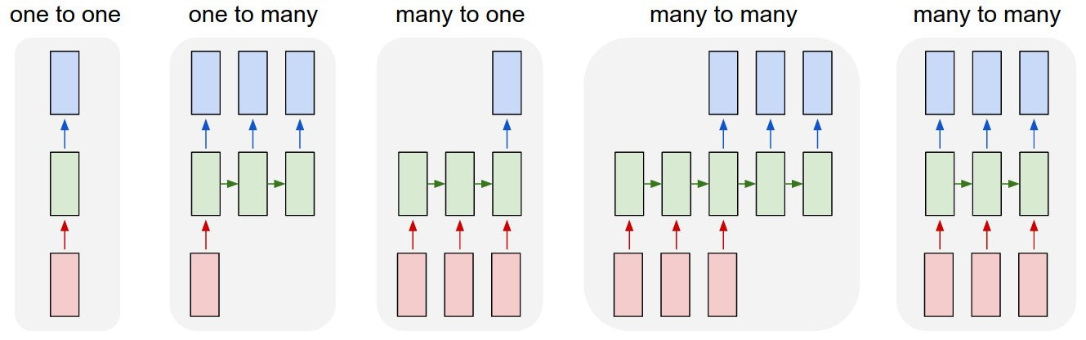
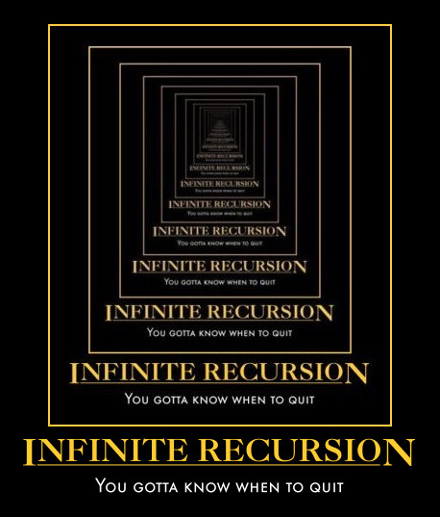
New Topic: RNNs
Image Credit: Andrej Karpathy

Slide 5
New Words
Recurrent Neural Networks (RNNs)
Recursive Neural Networks
  General family; think graphs instead of chains
Types:
  “Vanilla” RNNs (Elman Networks)
  Long Short Term Memory (LSTMs)
  Gated Recurrent Units (GRUs)
  …
Algorithms
  BackProp Through Time (BPTT)
  BackProp Through Structure (BPTS)

Slide 6
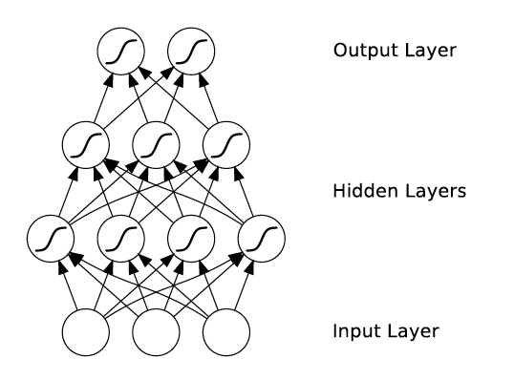
What’s wrong with MLPs?
Problem 1: Can’t model sequences
  Fixed-sized Inputs & Outputs
  No temporal structure
Image Credit: Alex Graves, book

Slide 7
What’s wrong with MLPs?
Problem 1: Can’t model sequences
  Fixed-sized Inputs & Outputs
  No temporal structure
Problem 2: Pure feed-forward processing
  No “memory”, no feedback
Image Credit: Alex Graves, book

Slide 8
Why model sequences?
Figure Credit: Carlos Guestrin

Slide 9
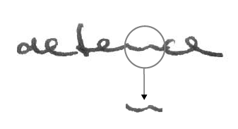
Why model sequences?
Image Credit: Alex Graves

Slide 10
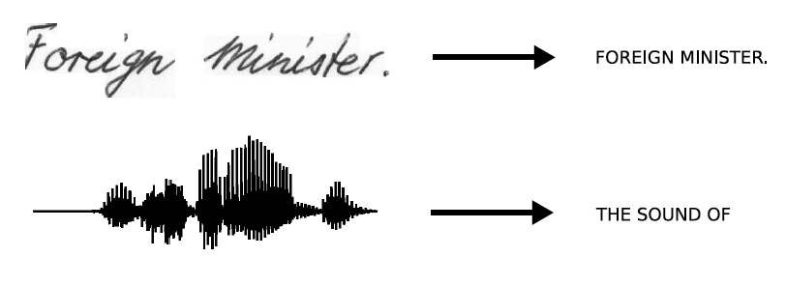
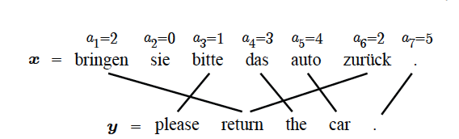
Sequences are everywhere…
Image Credit: Alex Graves and Kevin Gimpel

Slide 11
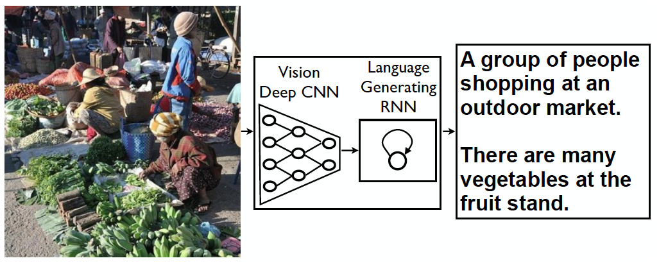
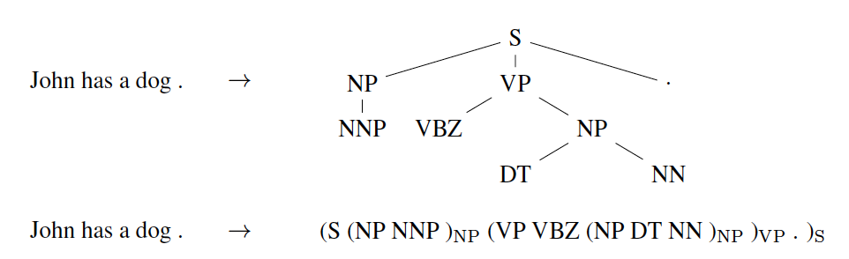
Even where you might not expect a sequence…
Image Credit: Vinyals et al.

Slide 12
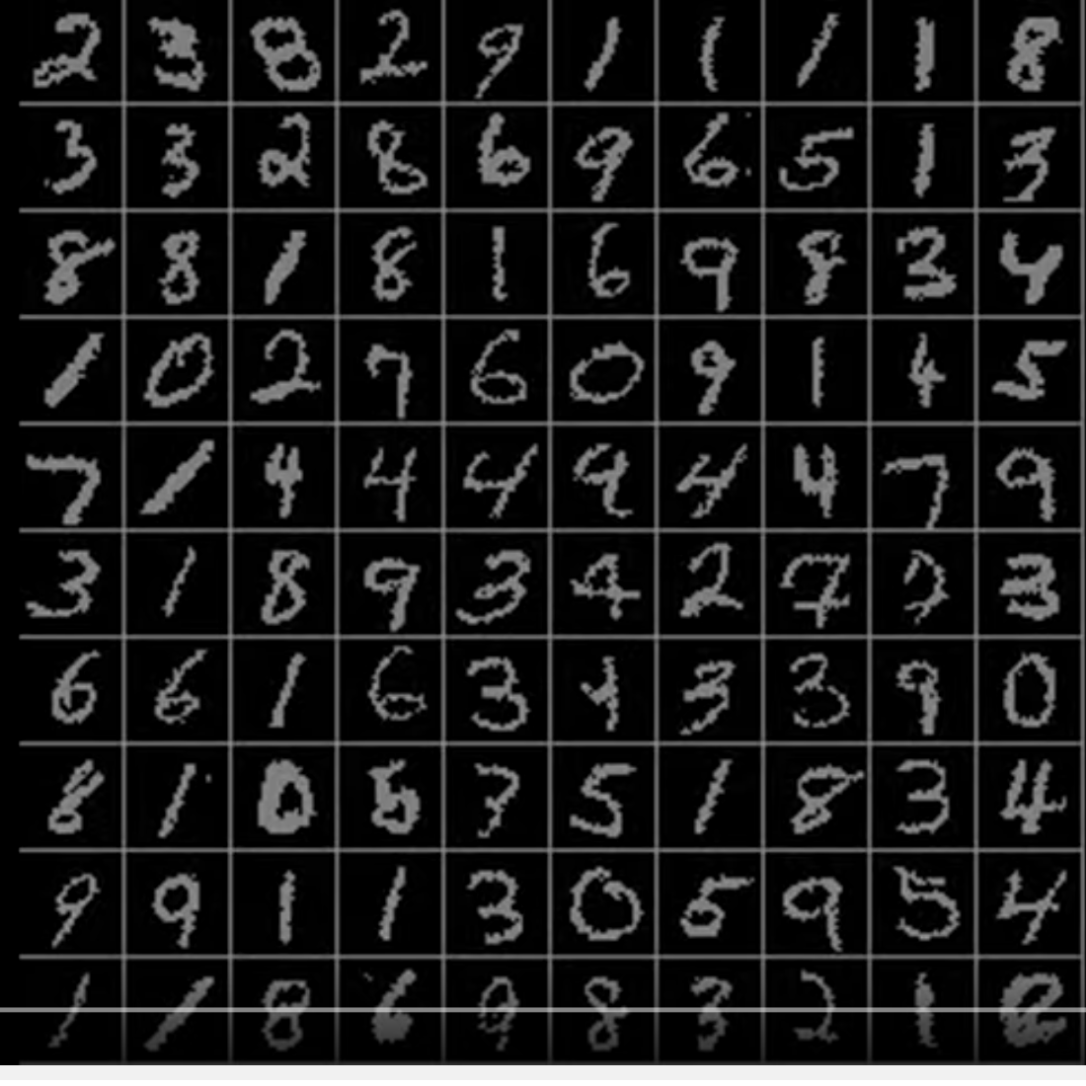
Even where you might not expect a sequence…
Classify images by taking a series of “glimpses”
Ba, Mnih, and Kavukcuoglu, “Multiple Object Recognition with Visual Attention”, ICLR 2015.
Gregor et al, “DRAW: A Recurrent Neural Network For Image Generation”, ICML 2015
Figure copyright Karol Gregor, Ivo Danihelka, Alex Graves, Danilo Jimenez Rezende, and Daan Wierstra, 2015. Reproduced with permission.
Slide Credit: Fei-Fei Li, Justin Johnson, Serena Yeung, CS 231n

Slide 13
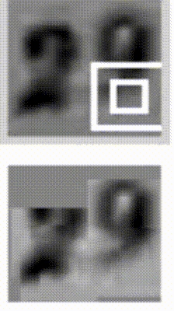
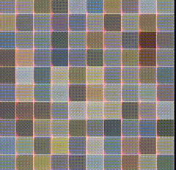
Even where you might not expect a sequence…
Output ordering = sequence
Image Credit: Ba et al.; Gregor et al

Slide 14
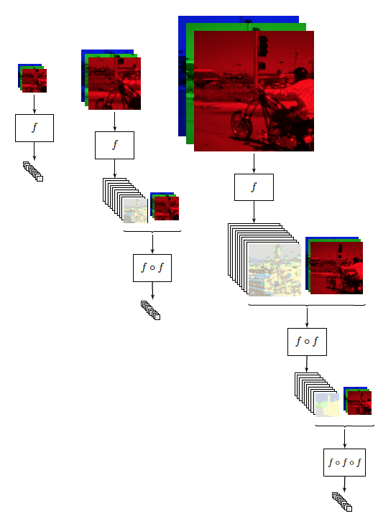
Image Credit: [Pinheiro and Collobert, ICML14]

Slide 15
Sequences in Input or Output?
It’s a spectrum…
Input: No sequence
Output: No sequence
Example: “standard” classification /
regression problems
Image Credit: Andrej Karpathy

Slide 16
Sequences in Input or Output?
It’s a spectrum…
Input: No sequence
Output: No sequence
Example: “standard” classification /
regression problems
Input: No sequence
Output: Sequence
Example: Im2Caption
Image Credit: Andrej Karpathy

Slide 17
Sequences in Input or Output?
It’s a spectrum…
Input: No sequence
Output: No sequence
Example: “standard” classification /
regression problems
Input: No sequence
Output: Sequence
Example: Im2Caption
Input: Sequence
Output: No sequence
Example: sentence classification, multiple-choice question answering
Image Credit: Andrej Karpathy

Slide 18
Sequences in Input or Output?
It’s a spectrum…
Input: No sequence
Output: No sequence
Example: “standard” classification /
regression problems
Input: No sequence
Output: Sequence
Example: Im2Caption
Input: Sequence
Output: No sequence
Example: sentence classification, multiple-choice question answering
Input: Sequence
Output: Sequence
Example: machine translation, video classification,
video captioning, open-ended question answering
Image Credit: Andrej Karpathy

Slide 19
2 Key Ideas
Parameter Sharing
  in computation graphs = adding gradients

Slide 20
Computational Graph
Slide Credit: Marc'Aurelio Ranzato

Slide 22
Gradients add at branches
+
Slide Credit: Fei-Fei Li, Justin Johnson, Serena Yeung, CS 231n
Notes:
Gradients add at branches, from multivariate chain rule
Since wiggling this node affects both connected nodes in the forward pass, then at backprop the upstream gradient coming into this node is the sum of the gradients flowing back from both nodes

Slide 23
Duality in Fprop and Bprop
FPROP
BPROP
SUM
+
COPY
+

Slide 24
2 Key Ideas
Parameter Sharing
  in computation graphs = adding gradients
“Unrolling”
  in computation graphs with parameter sharing

Slide 25
Name that model
Y₁ = {a,…z}
Y₂ = {a,…z}
Y₃ = {a,…z}
Y₄ = {a,…z}
Y₅ = {a,…z}
X₁ =
X₂ =
X₃ =
X₄ =
X₅ =
Hidden Markov Model (HMM)
Figure Credit: Carlos Guestrin

Slide 26

How do we model sequences?
No input
Image Credit: Bengio, Goodfellow, Courville

Slide 27
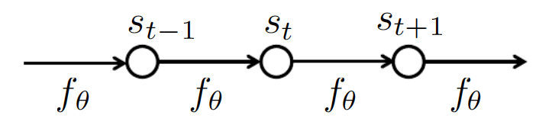
How do we model sequences?
No input
Image Credit: Bengio, Goodfellow, Courville

Slide 28

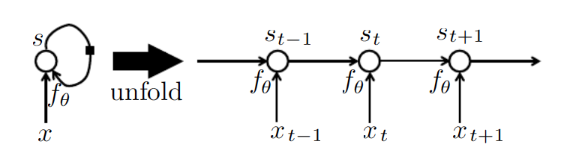
How do we model sequences?
With inputs
Image Credit: Bengio, Goodfellow, Courville

Slide 29
2 Key Ideas
Parameter Sharing
  in computation graphs = adding gradients
“Unrolling”
  in computation graphs with parameter sharing
Parameter sharing + Unrolling
  Allows modeling arbitrary sequence lengths!
  Keeps numbers of parameters in check

Slide 30
Recurrent Neural Network
RNN
x
Slide Credit: Fei-Fei Li, Justin Johnson, Serena Yeung, CS 231n

Slide 31
Recurrent Neural Network
y
usually want to predict a vector at some time steps
RNN
x
Slide Credit: Fei-Fei Li, Justin Johnson, Serena Yeung, CS 231n

Slide 32

Recurrent Neural Network
We can process a sequence of vectors x by applying a recurrence formula at every time step:
y
RNN
new state
old state
input vector at some time step
some function
with parameters W
x
Slide Credit: Fei-Fei Li, Justin Johnson, Serena Yeung, CS 231n

Slide 33
Recurrent Neural Network
We can process a sequence of vectors x by applying a recurrence formula at every time step:
y
RNN
Notice: the same function and the same set of parameters are used at every time step.
x
Slide Credit: Fei-Fei Li, Justin Johnson, Serena Yeung, CS 231n

Slide 34
(Vanilla) Recurrent Neural Network
The state consists of a single “hidden” vector h:
y
RNN
x
Sometimes called a “Vanilla RNN” or an “Elman RNN” after Prof. Jeffrey Elman
Slide Credit: Fei-Fei Li, Justin Johnson, Serena Yeung, CS 231n

Slide 35
RNN: Computational Graph
h₀
f_{W}
h₁
x₁
Slide Credit: Fei-Fei Li, Justin Johnson, Serena Yeung, CS 231n

Slide 36
RNN: Computational Graph
h₀
f_{W}
h₁
f_{W}
h₂
x₁
x₂
Slide Credit: Fei-Fei Li, Justin Johnson, Serena Yeung, CS 231n

Slide 37
RNN: Computational Graph
h₀
h₁
h₂
h₃
…
h_{T}
f_{W}
f_{W}
f_{W}
x₁
x₂
x₃
Slide Credit: Fei-Fei Li, Justin Johnson, Serena Yeung, CS 231n

Slide 38
RNN: Computational Graph
Re-use the same weight matrix at every time-step
h₀
h₁
h₂
h₃
…
h_{T}
f_{W}
f_{W}
f_{W}
x₁
x₂
x₃
W
Slide Credit: Fei-Fei Li, Justin Johnson, Serena Yeung, CS 231n

Slide 39
RNN: Computational Graph: Many to Many
y₁
y₂
y₃
y_{T}
h₀
h₁
h₂
h₃
…
h_{T}
f_{W}
f_{W}
f_{W}
x₁
x₂
x₃
W
Slide Credit: Fei-Fei Li, Justin Johnson, Serena Yeung, CS 231n

Slide 40
RNN: Computational Graph: Many to Many
y₁
y₂
y₃
y_{T}
L₁
L₂
L₃
L_{T}
h₀
h₁
h₂
h₃
…
h_{T}
f_{W}
f_{W}
f_{W}
x₁
x₂
x₃
W
Slide Credit: Fei-Fei Li, Justin Johnson, Serena Yeung, CS 231n

Slide 41
L
RNN: Computational Graph: Many to Many
y₁
y₂
y₃
y_{T}
L₁
L₂
L₃
L_{T}
h₀
h₁
h₂
h₃
…
h_{T}
f_{W}
f_{W}
f_{W}
x₁
x₂
x₃
W
Slide Credit: Fei-Fei Li, Justin Johnson, Serena Yeung, CS 231n

Slide 42
RNN: Computational Graph: Many to One
y
h₀
h₁
h₂
h₃
…
h_{T}
f_{W}
f_{W}
f_{W}
x₁
x₂
x₃
W
Slide Credit: Fei-Fei Li, Justin Johnson, Serena Yeung, CS 231n

Slide 43
RNN: Computational Graph: One to Many
y₁
y₂
y₃
y_{T}
h₀
h₁
h₂
h₃
…
h_{T}
f_{W}
f_{W}
f_{W}
x
W
Slide Credit: Fei-Fei Li, Justin Johnson, Serena Yeung, CS 231n

Slide 44
Sequence to Sequence: Many-to-one + one-to-many
Many to one: Encode input sequence in a single vector
h₀
f_{W}
h₁
f_{W}
h₂
f_{W}
h₃
…
h_{T}
x₁
x₂
x₃
W₁
Slide Credit: Fei-Fei Li, Justin Johnson, Serena Yeung, CS 231n

Slide 45
Sequence to Sequence: Many-to-one + one-to-many
One to many: Produce output sequence from single input vector
Many to one: Encode input sequence in a single vector
y₁
y₂
h₀
f_{W}
h₁
f_{W}
h₂
f_{W}
h₃
…
h_{T}
h₁
h₂
…
f_{W}
f_{W}
f_{W}
x₁
x₂
x₃
W₁
W₂
Slide Credit: Fei-Fei Li, Justin Johnson, Serena Yeung, CS 231n

Slide 46
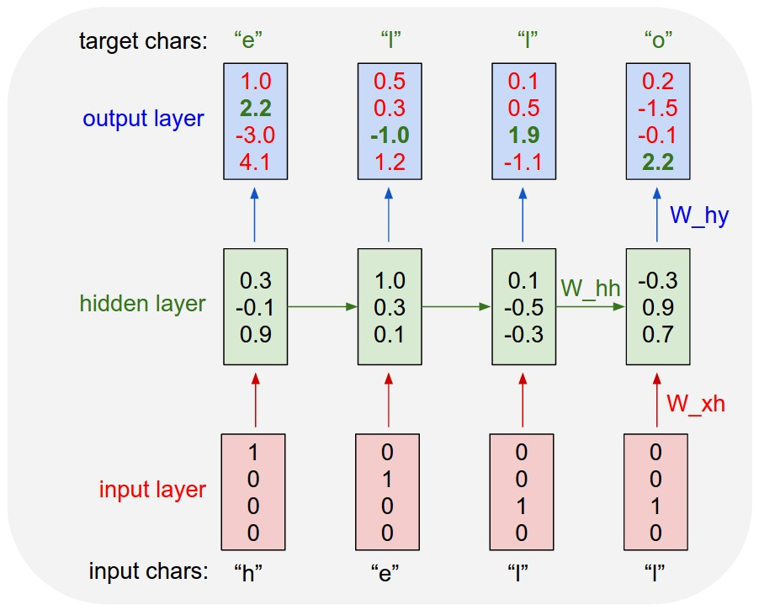
Example: Character-level
Language Model
Vocabulary:
[h,e,l,o]
Example training
sequence:
“hello”
Slide Credit: Fei-Fei Li, Justin Johnson, Serena Yeung, CS 231n

Slide 47
Example: Character-level
Language Model
Vocabulary:
[h,e,l,o]
Example training
sequence:
“hello”
Slide Credit: Fei-Fei Li, Justin Johnson, Serena Yeung, CS 231n

Slide 48
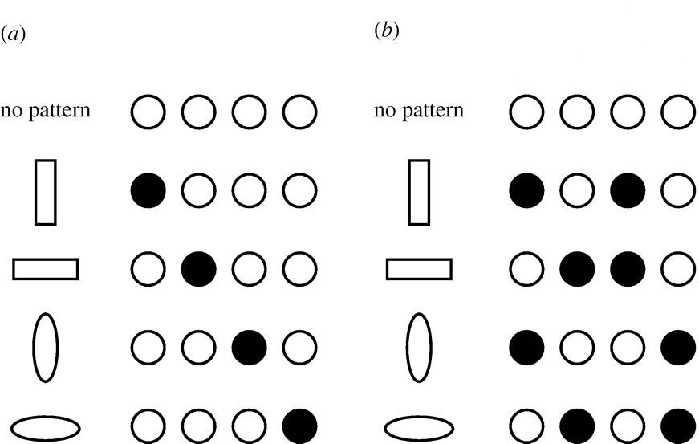
Distributed Representations Toy Example
Local vs Distributed
Slide Credit: Moontae Lee

Slide 49
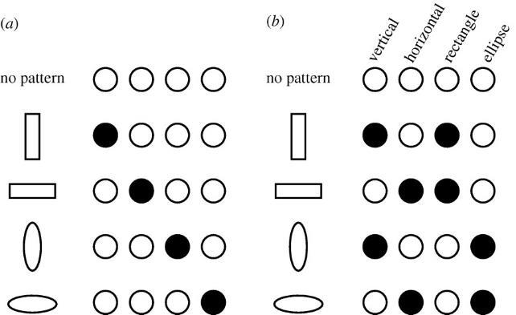
Distributed Representations Toy Example
Can we interpret each dimension?
Slide Credit: Moontae Lee

Slide 50
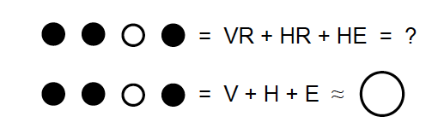
Power of distributed representations!
Local
Distributed
Slide Credit: Moontae Lee

Slide 51
Example: Character-level
Language Model
Vocabulary:
[h,e,l,o]
Example training
sequence:
“hello”
Slide Credit: Fei-Fei Li, Justin Johnson, Serena Yeung, CS 231n

Slide 52
Training Time: MLE / “Teacher Forcing”
Example: Character-level
Language Model
Vocabulary:
[h,e,l,o]
Example training
sequence:
“hello”
Slide Credit: Fei-Fei Li, Justin Johnson, Serena Yeung, CS 231n

Slide 53
Test Time: Sample / Argmax / Beam Search
Example: Character-level
Language Model
Sampling
Vocabulary:
[h,e,l,o]
At test-time sample characters one at a time, feed back to model
“e”
“l”
“l”
“o”
Sample
.03
.13
.00
.84
.25
.20
.05
.50
.11
.17
.68
.03
.11
.02.08
.79
Softmax
Slide Credit: Fei-Fei Li, Justin Johnson, Serena Yeung, CS 231n

Slide 54
Test Time: Sample / Argmax / Beam Search
Example: Character-level
Language Model
Sampling
Vocabulary:
[h,e,l,o]
At test-time sample characters one at a time, feed back to model
“e”
“l”
“l”
“o”
Sample
.03
.13
.00
.84
.25
.20
.05
.50
.11
.17
.68
.03
.11
.02.08
.79
Softmax
Slide Credit: Fei-Fei Li, Justin Johnson, Serena Yeung, CS 231n

Slide 55
Test Time: Sample / Argmax / Beam Search
Example: Character-level
Language Model
Sampling
Vocabulary:
[h,e,l,o]
At test-time sample characters one at a time, feed back to model
“e”
“l”
“l”
“o”
Sample
.03
.13
.00
.84
.25
.20
.05
.50
.11
.17
.68
.03
.11
.02.08
.79
Softmax
Slide Credit: Fei-Fei Li, Justin Johnson, Serena Yeung, CS 231n

Slide 56
Test Time: Sample / Argmax / Beam Search
Example: Character-level
Language Model
Sampling
Vocabulary:
[h,e,l,o]
At test-time sample characters one at a time, feed back to model
“e”
“l”
“l”
“o”
Sample
.03
.13
.00
.84
.25
.20
.05
.50
.11
.17
.68
.03
.11
.02.08
.79
Softmax
Slide Credit: Fei-Fei Li, Justin Johnson, Serena Yeung, CS 231n

