Slide 1
3D CNNs
Zhile Ren
Postdoc @ Georgia Tech
http://cs.brown.edu/people/zr1/

Slide 2
3D Deep Learning (on point sets)
Zhile Ren
Postdoc @ Georgia Tech
http://cs.brown.edu/people/zr1/

Slide 3
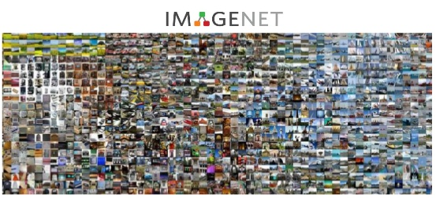
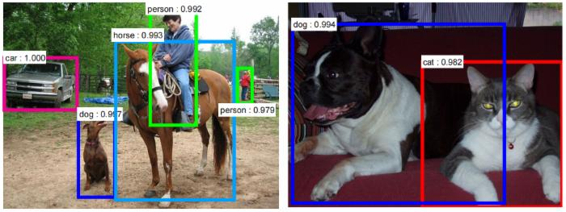
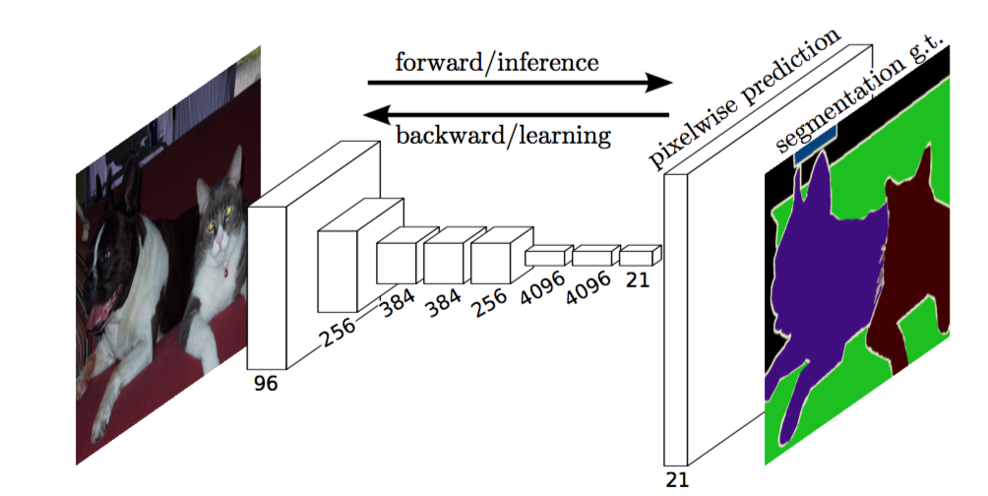
Scene Understanding on RGB Images
[Image courtesy: Koltun, Russakovsky, Gupta]

Slide 4
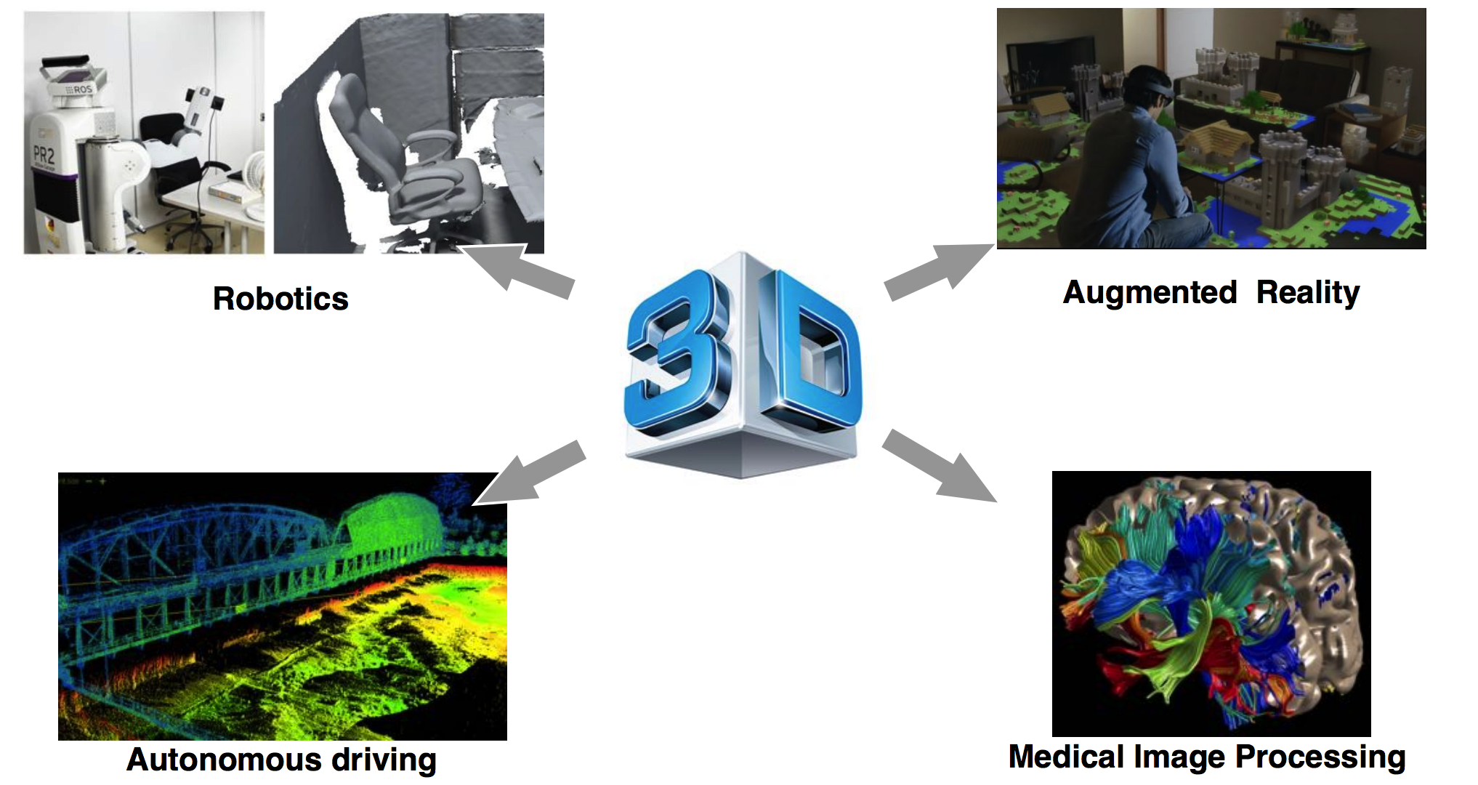
3D Scene Understanding

Slide 5
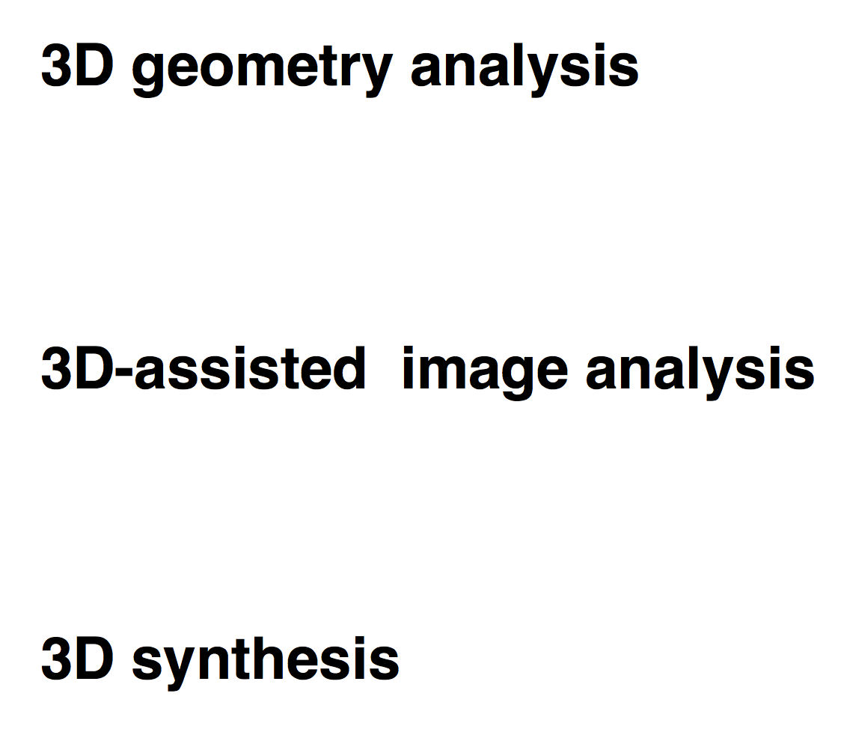
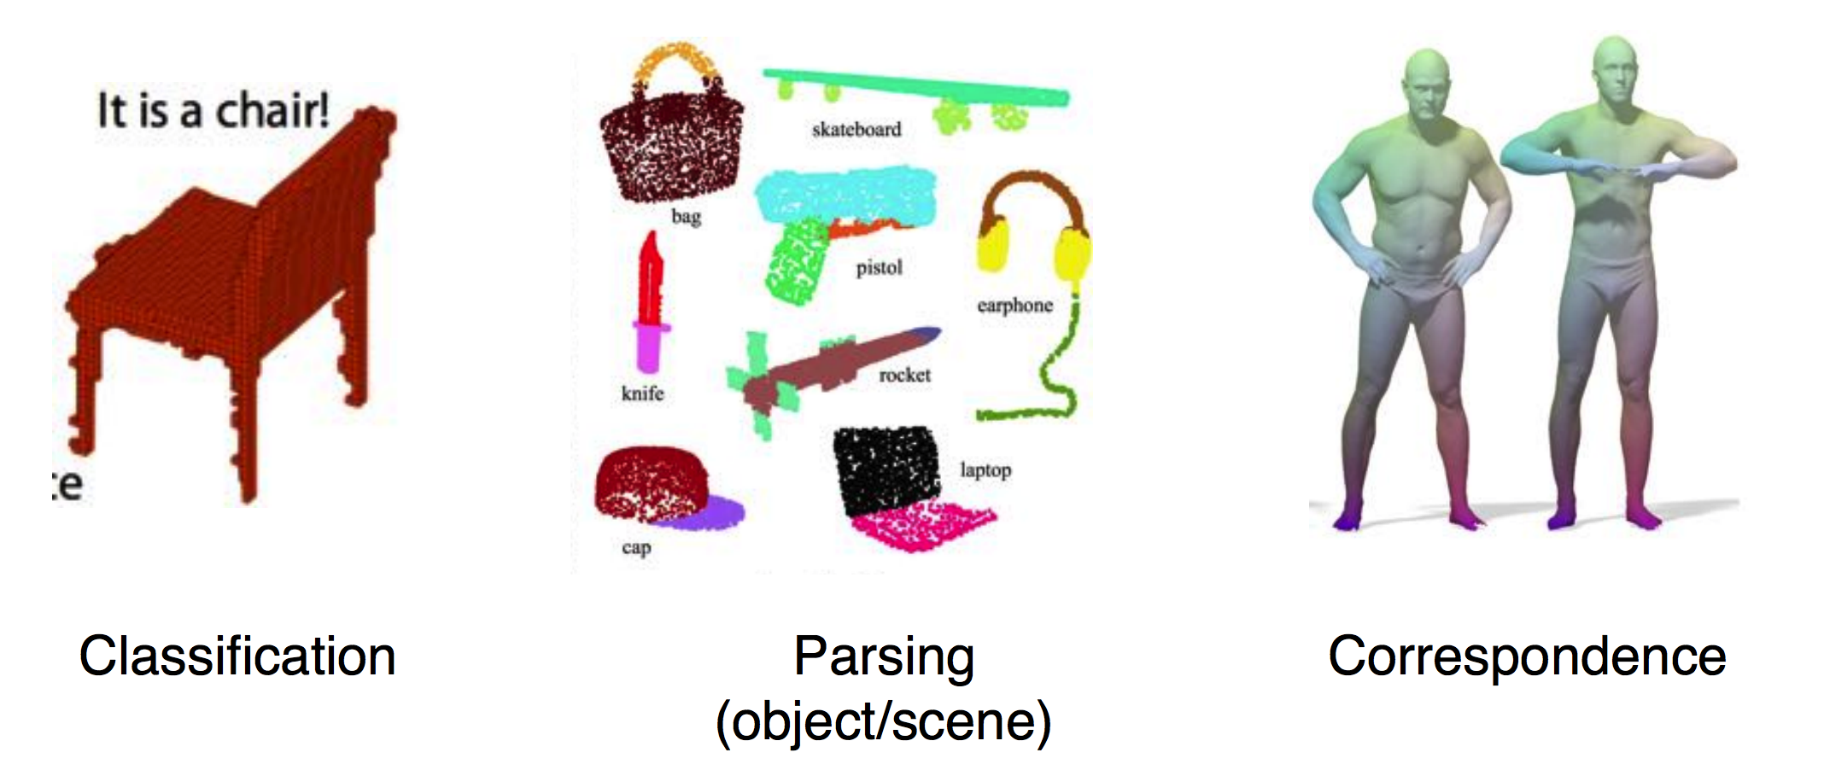
3D Deep Learning Tasks

Slide 6
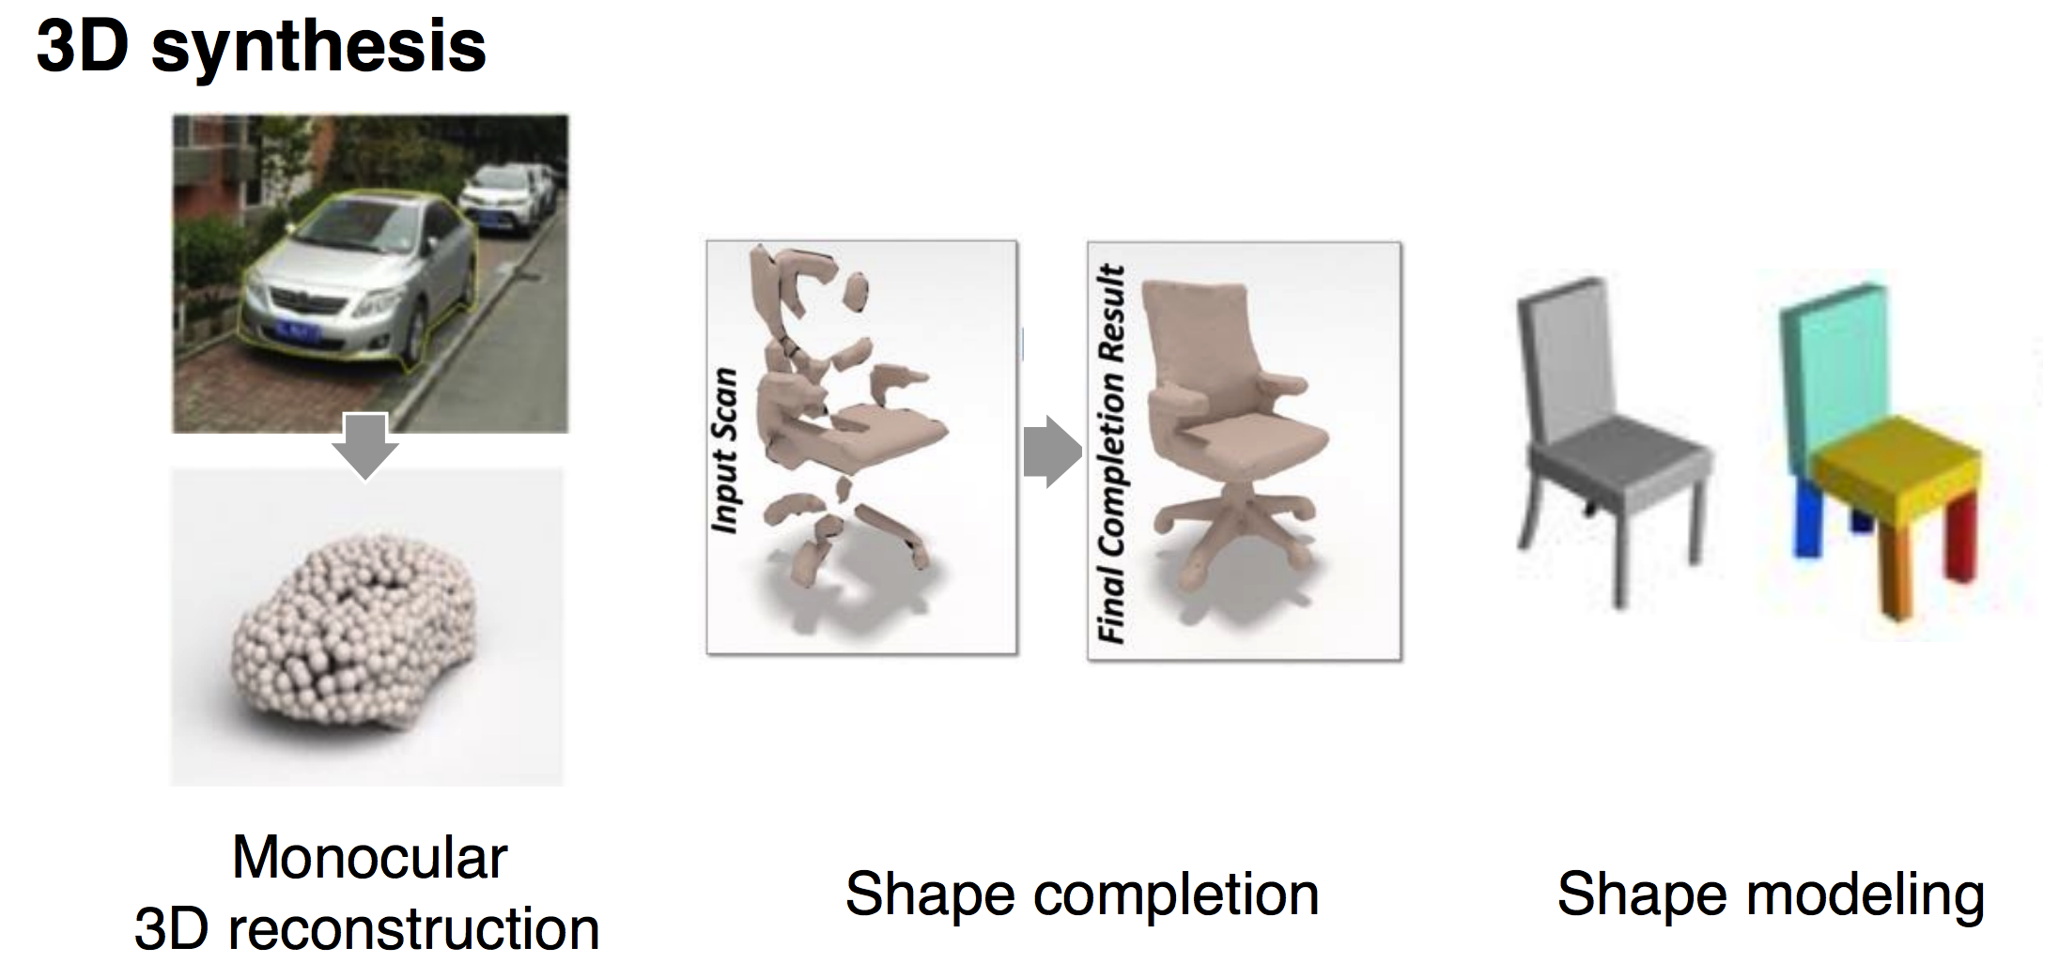
3D Deep Learning Tasks

Slide 7
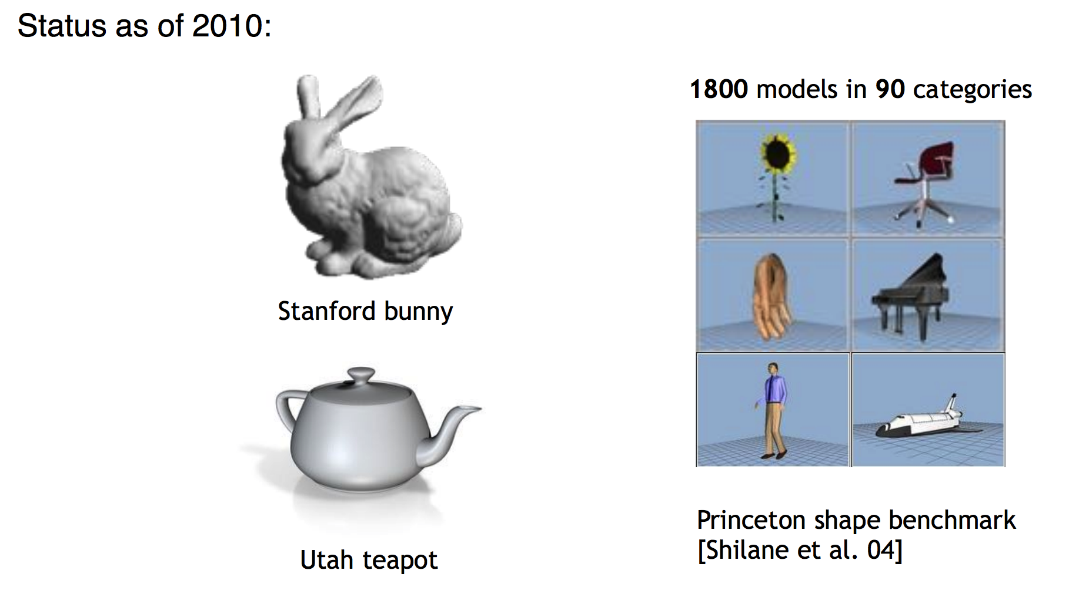
The Lack of 3D Data

Slide 8
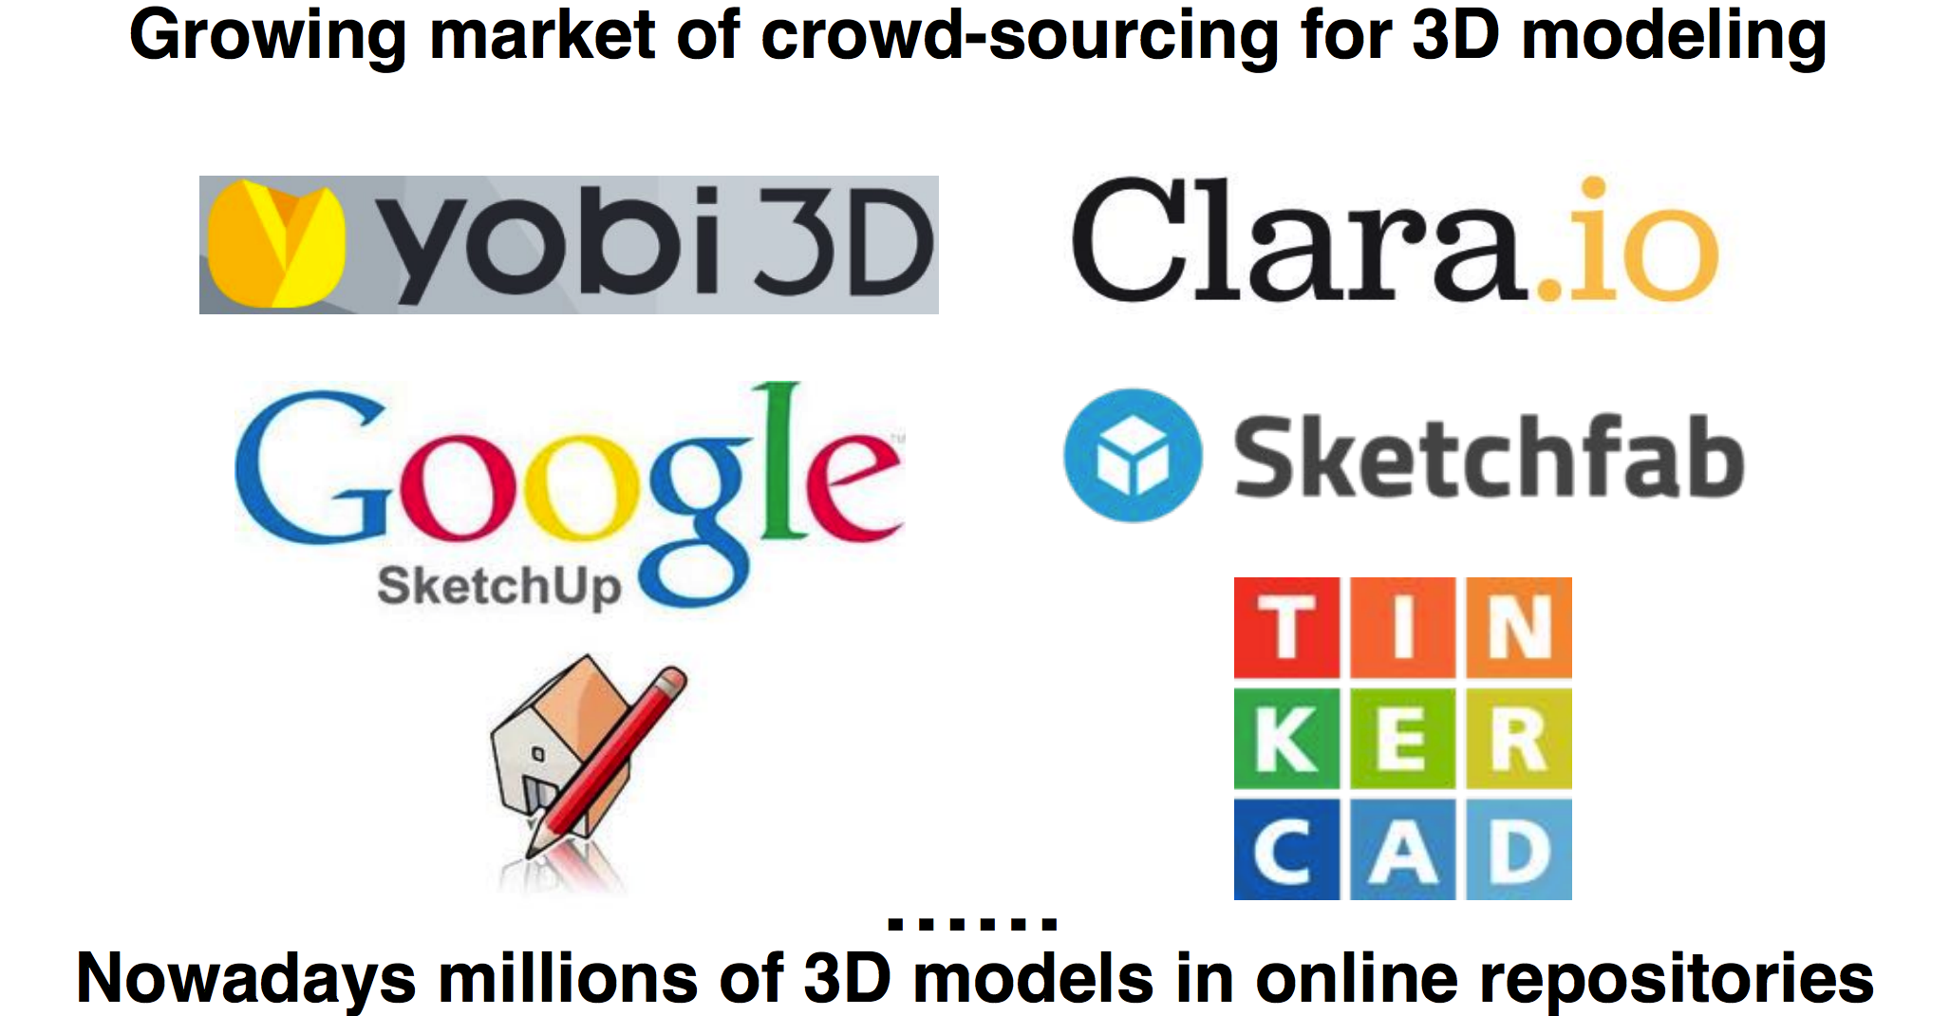
3D Repositories on the Internet

Slide 9

3D Repositories on the Internet
Notes:
Show interface

Slide 10
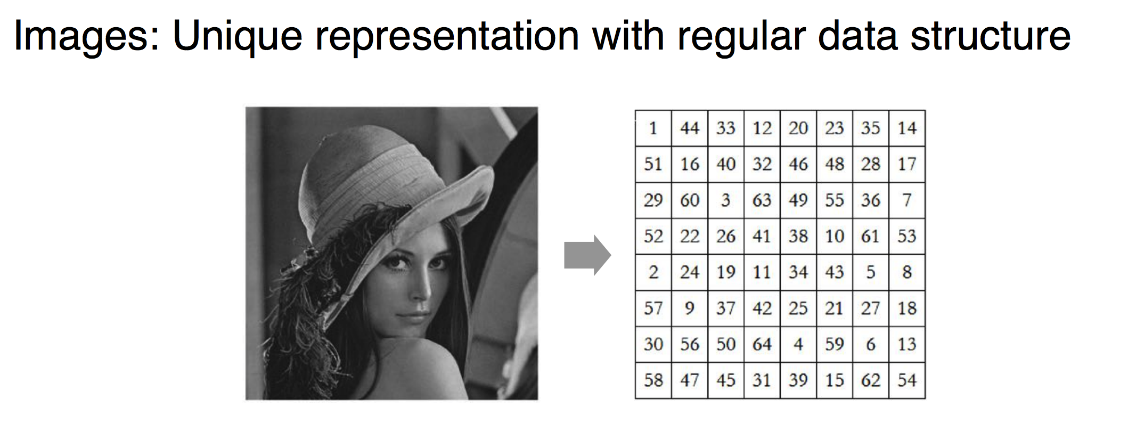
Deep Learning on RGB Images

Slide 11
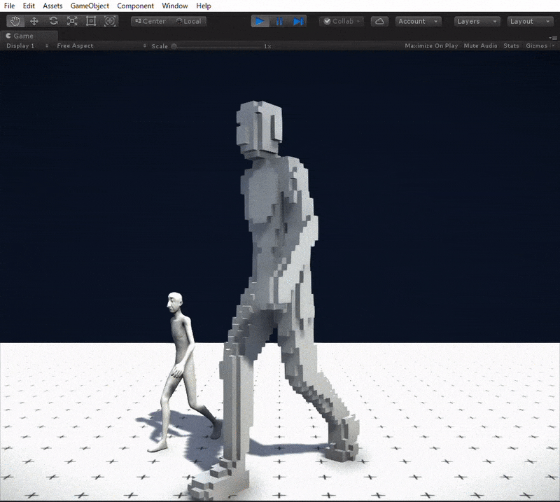
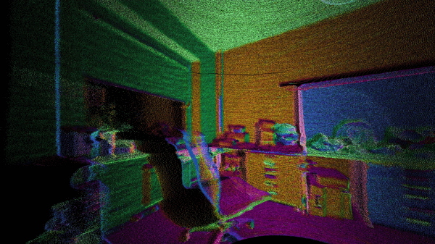
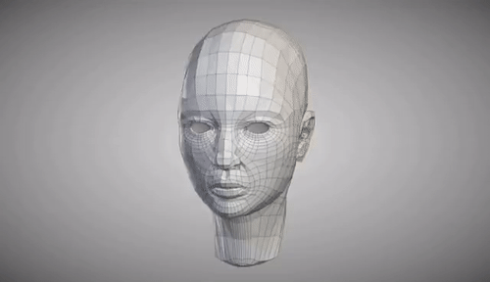
3D Representations
Point cloud
3D Mesh
3D Voxels

Slide 12
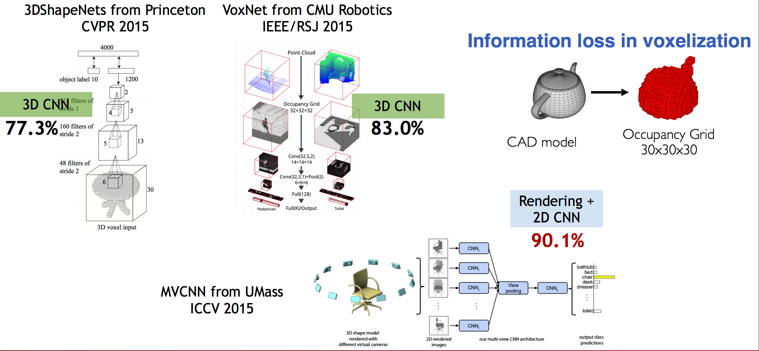
3D CNNs on Voxelized Data

Slide 13
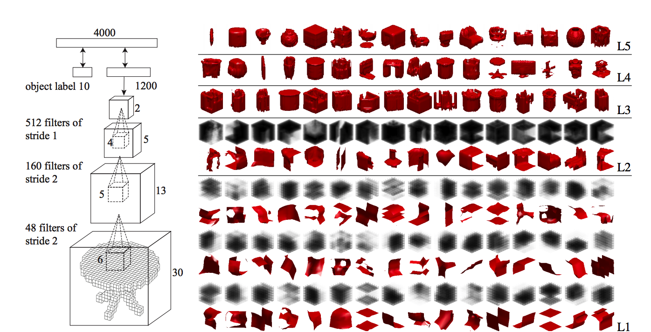
3D ShapeNet
3D CNNs applied to 3D input

Slide 14
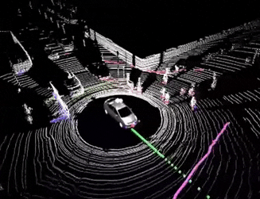
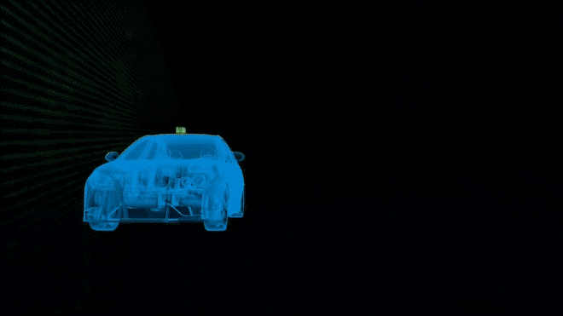
Unordered Point Set
Lidar scan from autonomous vehicles

Slide 15
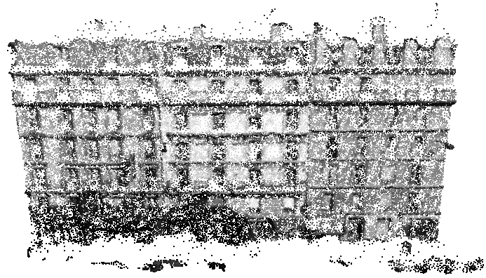
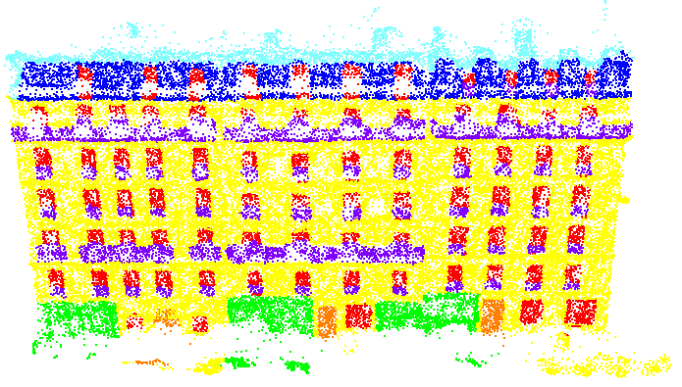
(Deep) Learning on 3D point sets
  This Lecture:
  PointNet [Qi et al., CVPR 2017]
  PointNet++ [Qi et al., NIPS 2017]
3D Network
Input 3D point cloud
3D prediction
Most slides in this lecture are from: Hao Su, Charles Qi, Hang Su

Slide 16
(Deep) Learning on 3D point sets
  This Lecture:
  PointNet [Qi et al., CVPR 2017]
  PointNet++ [Qi et al., NIPS 2017]
3D Network
Input 3D point cloud
3D prediction
Most slides in this lecture are from: Hao Su, Charles Qi, Hang Su

Slide 17
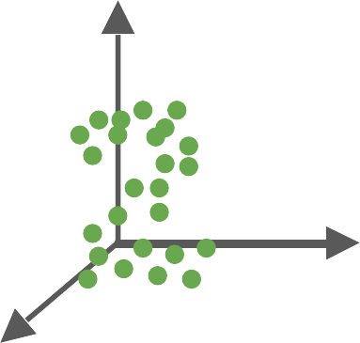
PointNet
End-to-end learning for scattered, unordered point data
PointNet

Slide 18
PointNet
End-to-end learning for scattered, unordered point data
Unified framework for various tasks
Object Classification
PointNet
Object Part Segmentation
Semantic Scene Parsing
...

Slide 19
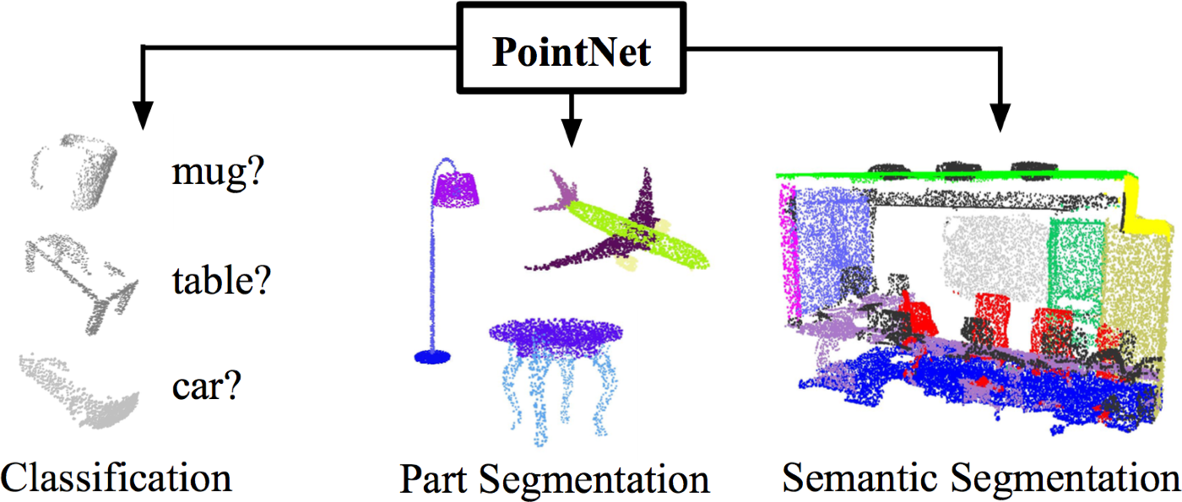
PointNet
End-to-end learning for scattered, unordered point data
Unified framework for various tasks

Slide 20
Challenges
Unordered point set as input
Model needs to be invariant to N! permutations.
Invariance under geometric transformations
Point cloud rotations should not alter classification results.

Slide 21
Challenges
Unordered point set as input
Model needs to be invariant to N! permutations.
Invariance under geometric transformations
Point cloud rotations should not alter classification results.

Slide 22


Unordered Input
Point cloud: N orderless points, each represented by a D dim vector
D
N

Slide 23

Unordered Input
Point cloud: N orderless points, each represented by a D dim vector
D
D
N
represents the same set as
N

Slide 24

Unordered Input
Point cloud: N orderless points, each represented by a D dim vector
D
D
N
represents the same set as
N
Model needs to be invariant to N! permutations

Slide 25
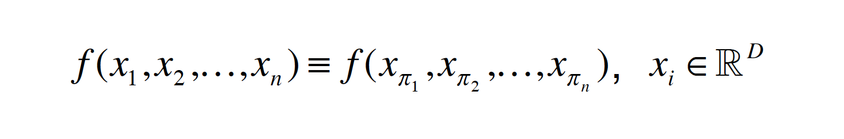
Permutation Invariance: Symmetric Function

Slide 26
Permutation Invariance: Symmetric Function
Examples:
f (x₁, x₂ ,…, x_{n} ) = max{x₁, x₂ ,…, x_{n} }
f (x₁, x₂ ,…, x_{n} ) = x₁ + x₂ + …+ x_{n}
…

Slide 27
Permutation Invariance: Symmetric Function
Examples:
f (x₁, x₂ ,…, x_{n} ) = max{x₁, x₂ ,…, x_{n} }
f (x₁, x₂ ,…, x_{n} ) = x₁ + x₂ + …+ x_{n}
…
How can we construct a family of symmetric functions by neural networks?

Slide 28
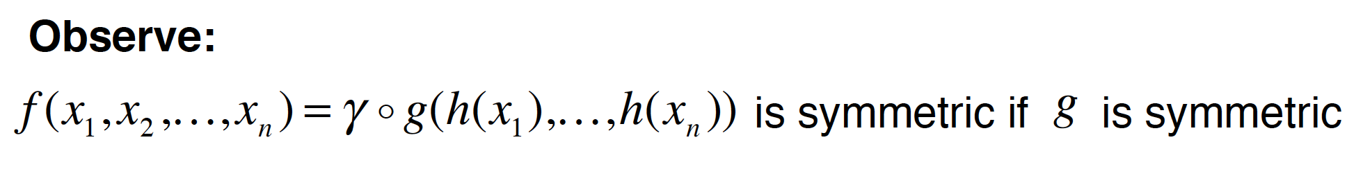
Permutation Invariance: Symmetric Function

Slide 29
Permutation Invariance: Symmetric Function
Observe:
f (x₁, x₂ ,…, x_{n} ) = γ ! g(h(x₁ ),…, h(x_{n} )) is symmetric if g is symmetric
h
(1,2,3)
(1,1,1)
(2,3,2)
(2,3,4)
…

Slide 30
Permutation Invariance: Symmetric Function
Observe:
f (x₁, x₂ ,…, x_{n} ) = γ ! g(h(x₁ ),…, h(x_{n} )) is symmetric if g is symmetric
h
(1,2,3)
simple symmetric function
(1,1,1)
g
(2,3,2)
(2,3,4)
…

Slide 31
Permutation Invariance: Symmetric Function
Observe:
f (x₁, x₂ ,…, x_{n} ) = γ ! g(h(x₁ ),…, h(x_{n} )) is symmetric if g is symmetric
h
(1,2,3)
simple symmetric function
(1,1,1)
g
γ
(2,3,2)
…
(2,3,4)
PointNet (vanilla)

Slide 32

Permutation Invariance: Symmetric Function
What symmetric functions can be constructed by PointNet?
Symmetric functions
PointNet (vanilla)

Slide 33
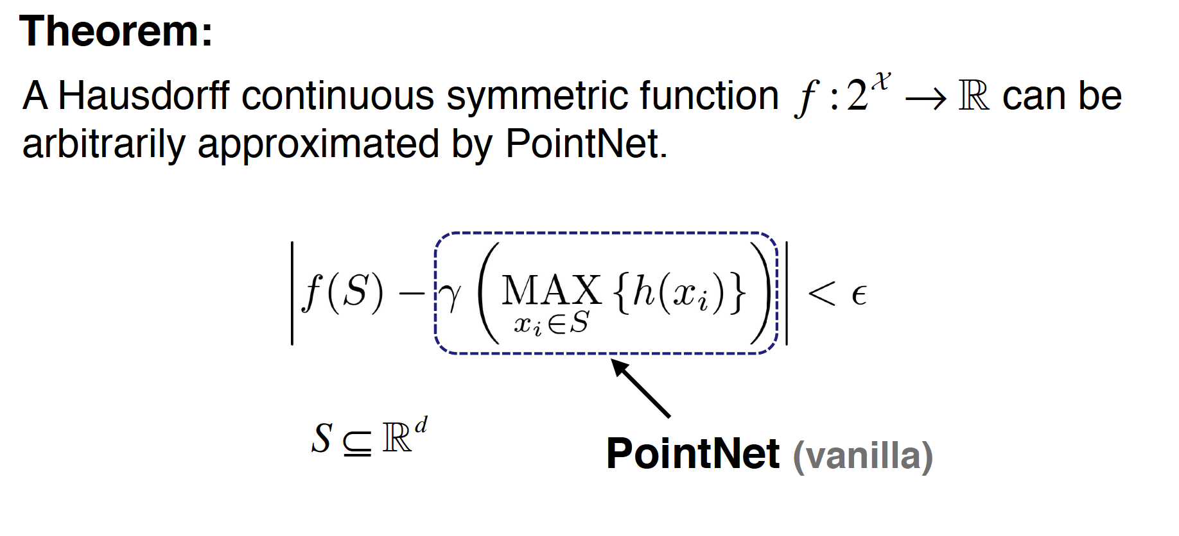
Universal Set Function Approximator

Slide 34
Basic PointNet Architecture
Empirically, we use multi-layer perceptron (MLP) and max pooling:
h
MLP
(1,2,3)
g
(1,1,1)
γ
MLP
MLP
max
(2,3,2)
MLP
…
(2,3,4)
PointNet (vanilla)
MLP

Slide 35
Challenges
Unordered point set as input
Model needs to be invariant to N! permutations.
Invariance under geometric transformations
Point cloud rotations should not alter classification results.

Slide 36
Input Alignment by Transformer Network
Idea: Data dependent transformation for automatic alignment
3
T-Net
transform params
3
N
Transform
N
Transformed Data
Data

Slide 37
Input Alignment by Transformer Network
The transformation is just matrix multiplication!
3
T-Net
transform
3
params: 3x3
Matrix Mult.
N
Transformed Data
Data

Slide 38

Embedding Space Alignment
transform params: 64x64
T-Net
Matrix Mult.
Input embeddings: Nx64
Transformed embeddings: Nx64

Slide 39

Embedding Space Alignment
transform params: 64x64
T-Net
Regularization:
Transform matrix A 64x64 close to orthogonal:
Matrix Mult.
Input embeddings: Nx64
Transformed embeddings: Nx64

Slide 40
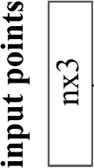
PointNet Classification Network

Slide 41
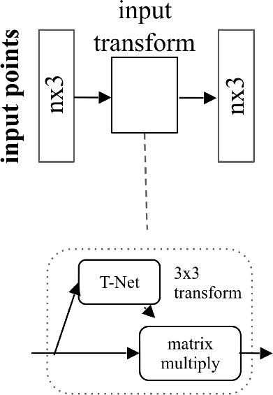
PointNet Classification Network

Slide 42
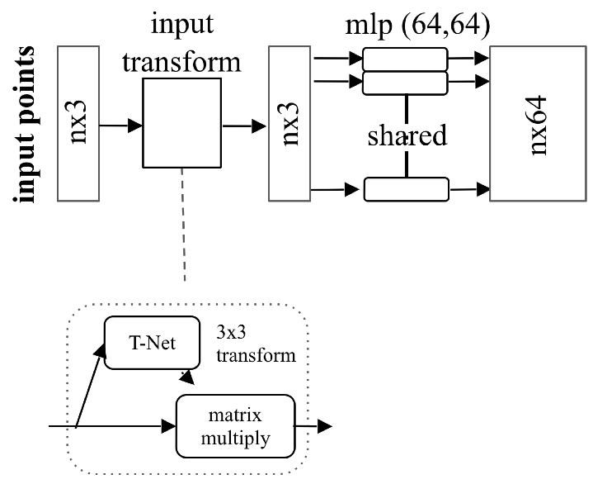
PointNet Classification Network

Slide 43
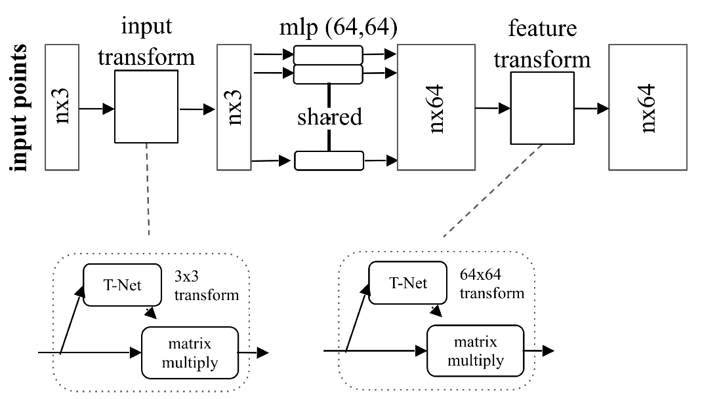
PointNet Classification Network

Slide 44
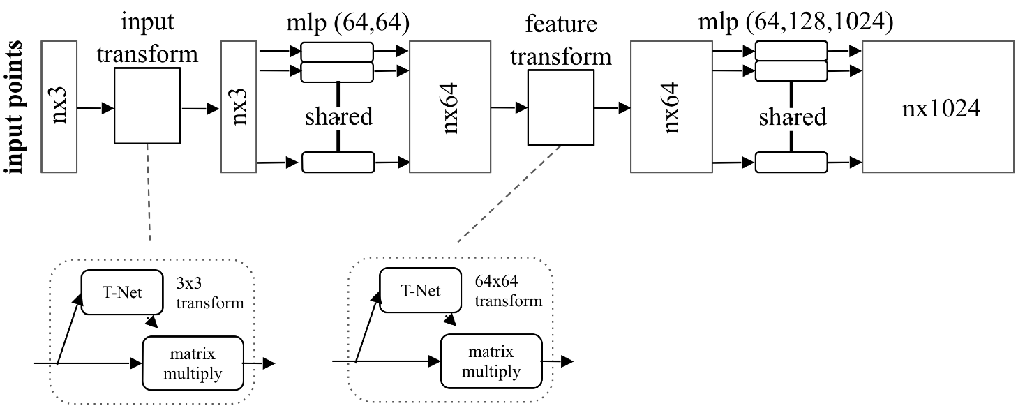
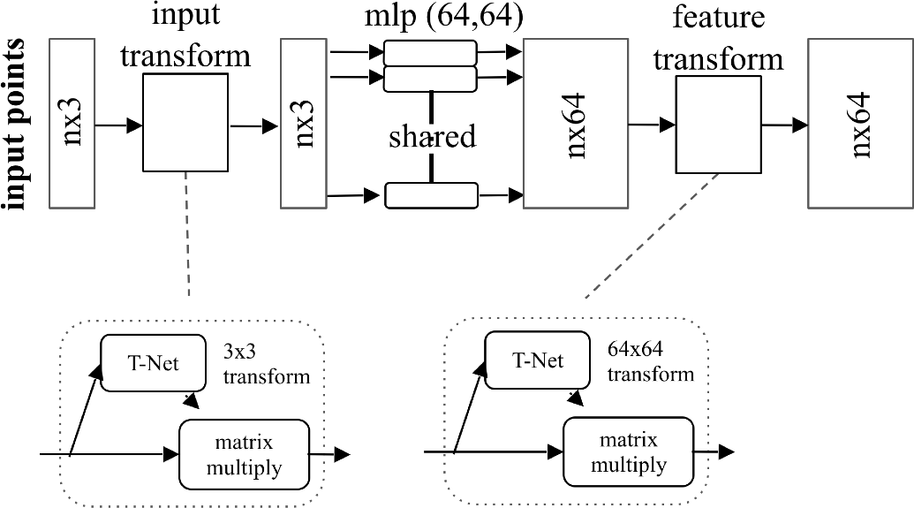
PointNet Classification Network

Slide 45
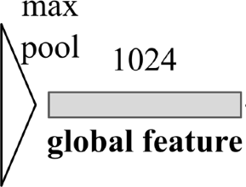
PointNet Classification Network

Slide 46
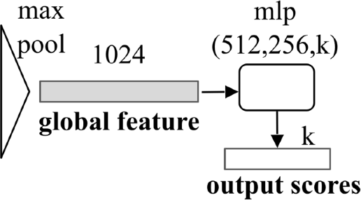
PointNet Classification Network

Slide 47
Extension to PointNet Segmentation Network
local embedding
global feature

Slide 48
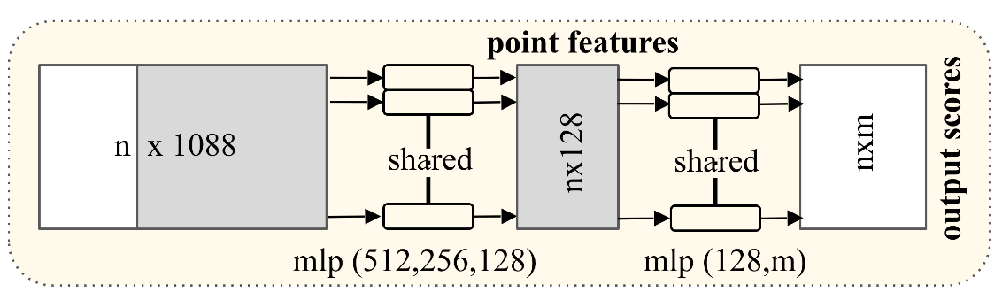
Extension to PointNet Segmentation Network
local embedding
global feature

Slide 49
Results

Slide 50
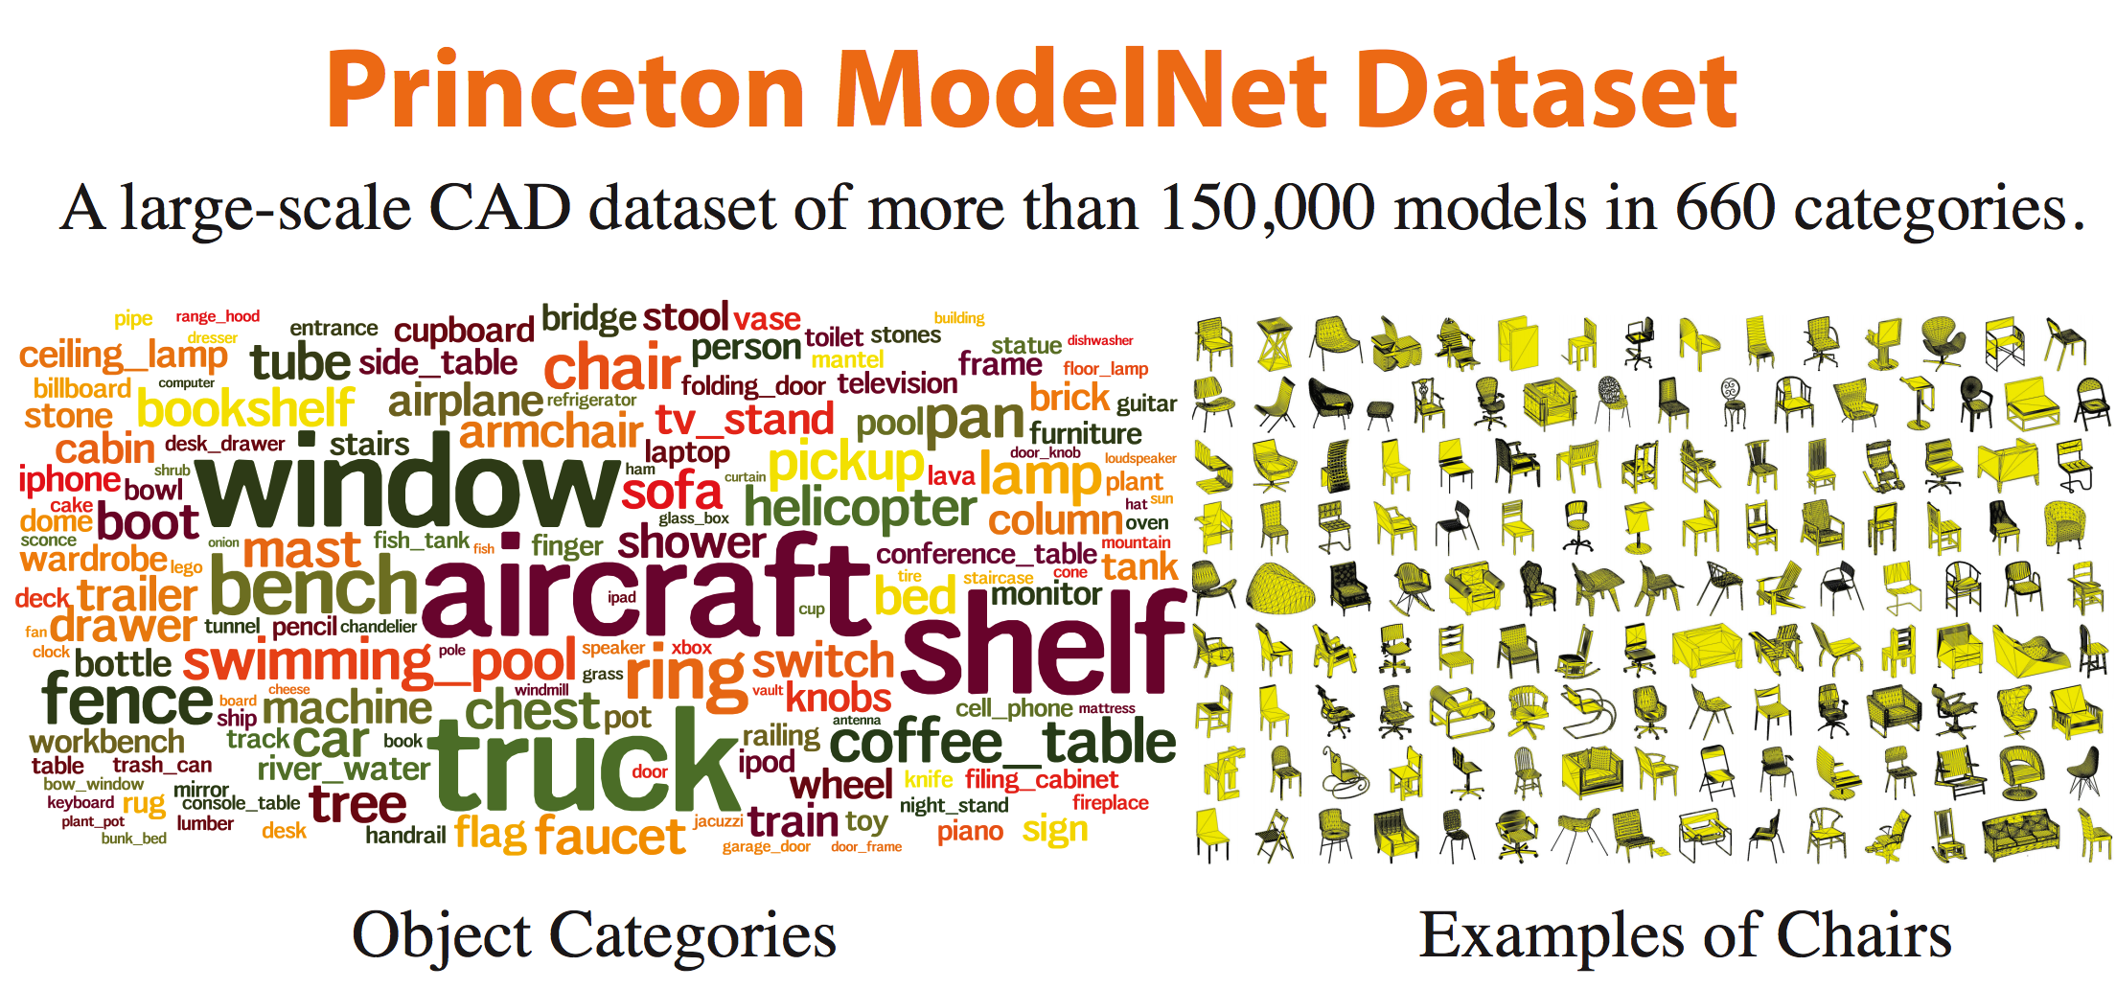
Dataset

Slide 51
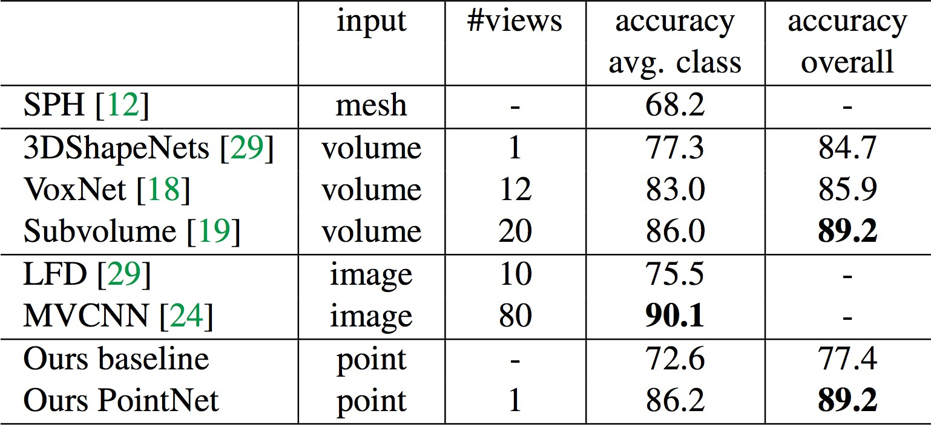
Results on Object Classification
3D CNNs
dataset: ModelNet40; metric: 40-class classification accuracy (%)

Slide 52
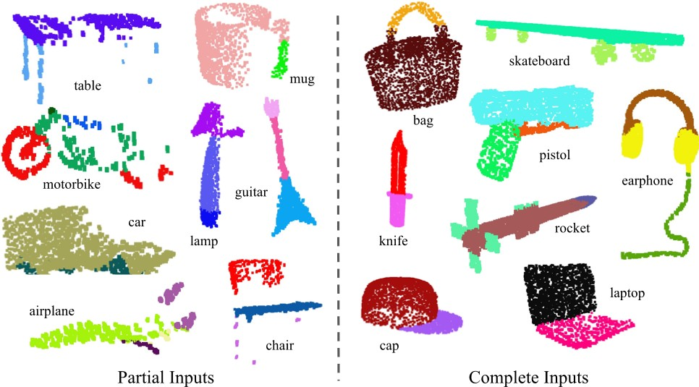
Results on Object Part Segmentation

Slide 53
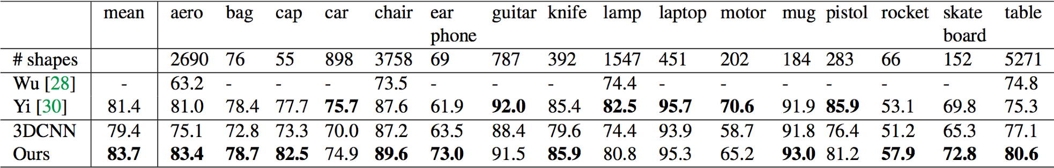
Results on Object Part Segmentation
dataset: ShapeNetPart; metric: mean IoU (%)

Slide 54
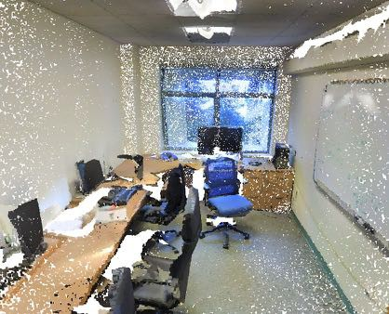
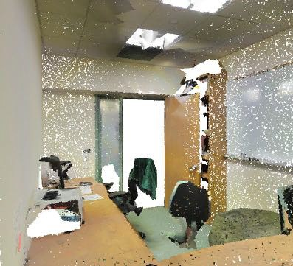
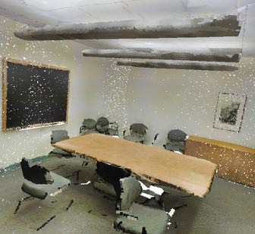
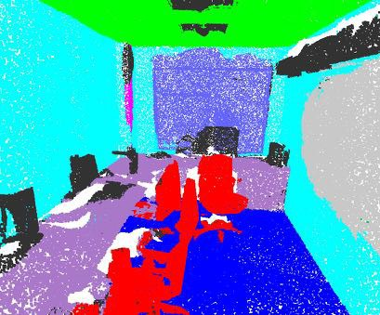
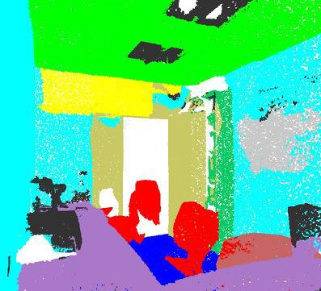
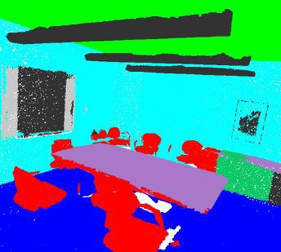
Results on Semantic Scene Parsing
Input
Output
dataset: Stanford 2D-3D-S (Matterport scans)

Slide 55
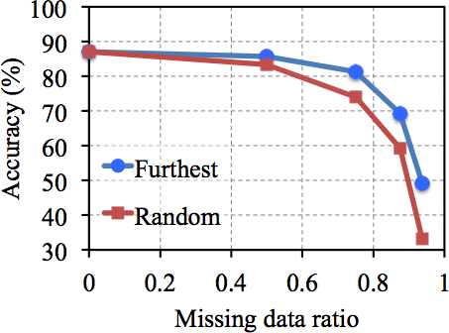
Robustness to Data Corruption
dataset: ModelNet40; metric: 40-class classification accuracy (%)

Slide 56
Robustness to Data Corruption
Less than 2% accuracy drop with 50% missing data
dataset: ModelNet40; metric: 40-class classification accuracy (%)

Slide 57
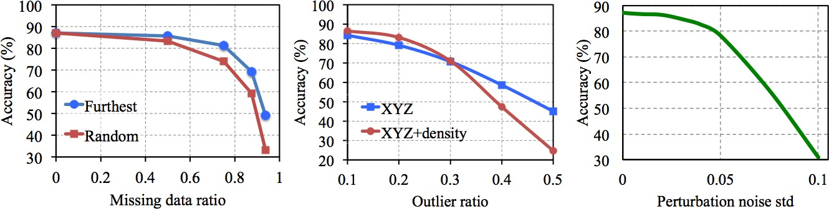
Robustness to Data Corruption
dataset: ModelNet40; metric: 40-class classification accuracy (%)

Slide 58
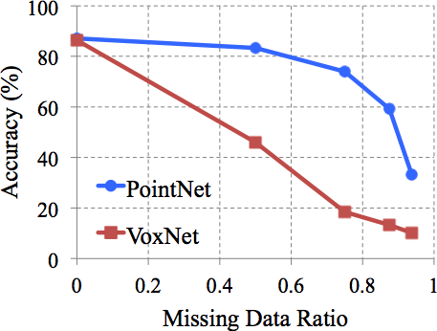
Robustness to Data Corruption
Why is PointNet so robust to missing data?
3D CNN

Slide 59
Visualizing Global Point Cloud Features
3
MLP
1024
maxpool
n
shared
global feature
Which input points are contributing to the global feature?
(critical points)

Slide 60
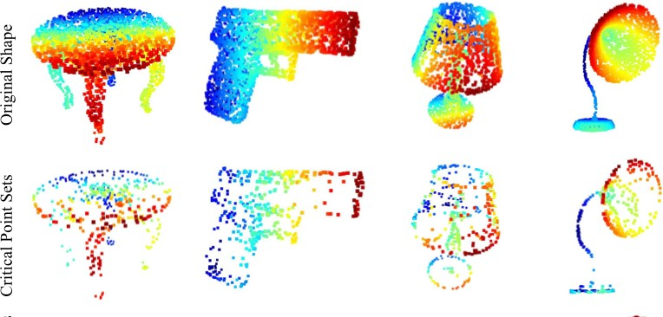
Visualizing Global Point Cloud Features
Original Shape:
Critical Point Sets:

Slide 61
Conclusion
PointNet is a novel deep neural network that directly consumes point cloud.
A unified approach to various 3D recognition tasks.
Rich theoretical analysis and experimental results.
Code & Data Available!
http://stanford.edu/~rqi/pointnet
See you at Poster 9!

Slide 62
(Deep) Learning on 3D point sets
  This Lecture:
  PointNet [Qi et al., CVPR 2017]
  PointNet++ [Qi et al., NIPS 2017]
3D Network
Input 3D point cloud
3D prediction
Most slides in this lecture are from: Hao Su, Charles Qi, Hang Su

Slide 63
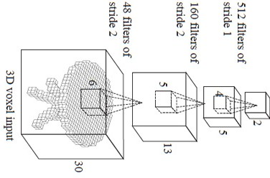
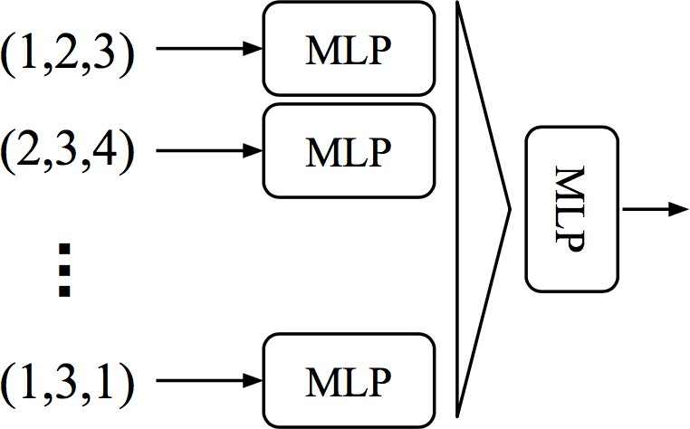
Limitations of PointNet
Hierarchical feature learning Multiple levels of abstraction
Global feature learning Either one point or all points
3D CNN (Wu et al.)
PointNet (vanilla) (Qi et al.)

Slide 64
Limitations of PointNet
Hierarchical feature learning Multiple levels of abstraction
Global feature learning Either one point or all points
No local context for each point!
3D CNN (Wu et al.)
PointNet (vanilla) (Qi et al.)

Slide 65
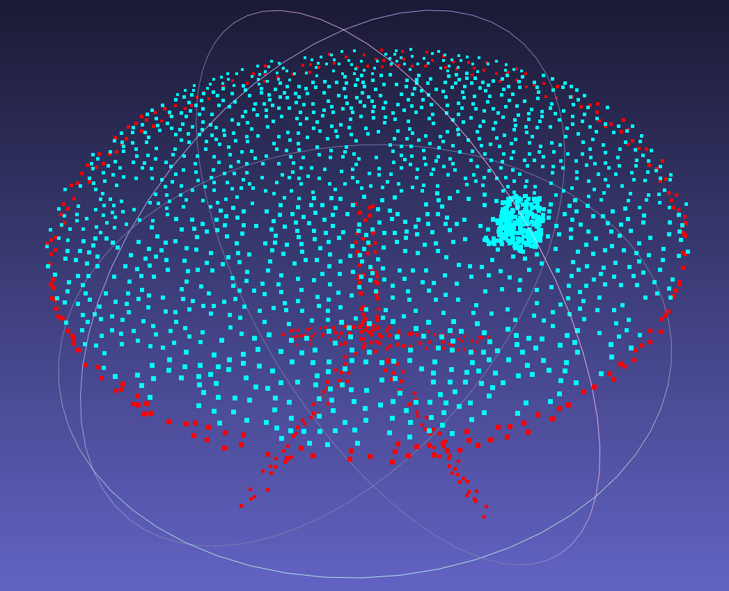

Limitation of PointNet
Lack of local context => artifacts in segmentation tasks
Semantic segmentation of randomly translated table-cup scene
Instance mask prediction in table- chair-cup scene

Slide 66
Limitation of PointNet
Lack of local context => artifacts in segmentation tasks
Global feature depends on absolute coordinate. Hard to generalize to unseen scene configurations!
Semantic segmentation of randomly Instance mask prediction in table-
translated table-cup scene chair-cup scene

Slide 67


PointNet++
Use pointnet in local regions, aggregate local features by pointnet again
=> Hierarchical feature learning
pointnet

Slide 68

PointNet++
Use pointnet in local regions, aggregate local features by pointnet again
=> Hierarchical feature learning
pointnet
Common issue: inconsistent sampling density
=> Robust to non-uniform sampling density

Slide 69


Hierarchical Point Set Feature Learning
(N,d+C)
(N1,K,d+C)
Sampling: Farthest Point Sampling (FPS) Grouping: radius based ball query
sampling & grouping

Slide 70

Hierarchical Point Set Feature Learning
(N,d+C)
(N1,K,d+C)
(N1,d+C1)
Shared pointnet applied in each local region using local coord.
sampling & grouping
pointnet
set abstraction

Slide 71
Hierarchical Point Set Feature Learning
Recursively apply pointnet:
(N,d+C)
(N1,K,d+C)
(N1,d+C1)
(N2,K,d+C1)
(N2,d+C2)
sampling & grouping
pointnet
sampling & grouping
pointnet
set abstraction
set abstraction

Slide 72

PointNet layer v.s. Convolution layer
PointNet layer
Convolution layer
PointNet
Input:
Point set
Dense array
Convolution (index-ordered)
Array index
(fixed #pixel/voxel)
Operation:
PointNet (order invariant)
Neighborhood:
Radius ball query (varying #points)

Slide 73









PointNet++ for Classification and Segmentation
skip link concatenation
+C¹⁾ _{,d+C}³⁾ +C) ,k)
Segmentation _{,d+C}² _{(N1} ³ (N
_{(N1 (N},d+C
-poi^{nt}
pe^{r} ore^{s}
interpolate ^{unit} interpolate ^{unit sc}
pointnet pointnet
Hierarchical point set feature learning
)
)
)
1
1
2
(N,d+C)
,K,d+C)
,d+C
,K,d+C
,d+C
1
2
1
(N
2
(N
(N
(N
Classification
(1,C4)
(k)
class scores
sampling & grouping
pointnet
sampling & grouping
pointnet
set abstraction
set abstraction
pointnet
fully connected layers

Slide 74

PointNet++ Results: Classification
By hierarchical feature learning, we can achieve even better results than the original PointNet. By using normals, we can even beat best view-CNN based method.

Slide 75


PointNet++ Results: Non-Euclidean Space
For organic shape recognition, PointNet++ can generalize to non-Euclidean space: intrinsic point features (HKS, WKS, Gaussian curvature)
intrinsic distance metric (geodesic)

Slide 76

PointNet++ Output
Notes:
3d vis

Slide 77



Other Methods for Point Set Analysis

Slide 78
3D Deep Learning: What’s Next?
Leveraging synthetic environments
  Reliable ground truth, benchmarking algorithms
  Training 3D deep networks in large scale

Slide 79

3D Deep Learning: What’s Next?
Leveraging simulation environments
  New tasks: Embodied-QA, Visual Navigation

Slide 80

EmbodiedQA
Agents that can See, Talk, Act, and Reason

Slide 81




Slide 83


Slide 84


Slide 86


Slide 87


Forward

Slide 88

Forward

Slide 89


Turn Left

Slide 90
<STOP>

Slide 91


Slide 92


Q: What color is the bathtub?
A: Light grey
Q: What color is the fishtank in the living room?
A: Light blue

Slide 93
3D Deep Learning: What’s Next?
Dealing with objects in multiple views
Understanding why 3D CNNs cannot work off-the-shelf
Connecting 3D & 2D deep learning
…

Slide 94
Thanks!

