Slide 1
CS 4803 / 7643: Deep Learning
Topics:
  Convolutional Neural Networks
    (Finish) Backprop in conv layers
    Toeplitz matrices and convolutions = matrix-mult
    Dilated/a-trous convolutions
    Transposed convolutions
Dhruv Batra
Georgia Tech

Slide 2
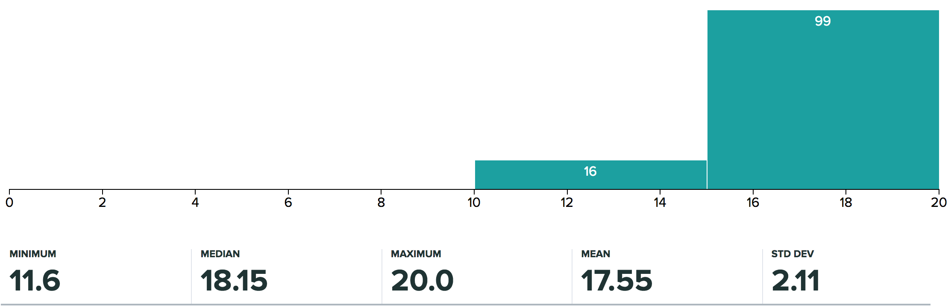
Administrativia
HW0 Grades Released
  1 week to talk to TAs about any concerns.

Slide 3
Administrativia
HW1 Analysis
  https://evalai.cloudcv.org/web/challenges/challenge-page/132/leaderboard/377
  https://docs.google.com/spreadsheets/d/1k-ePFv77CUMhnzLFvVmR2k9JP0MYLX3eaLQS84vsVtI/edit#gid=1412360458
  Overfitting plots

Slide 4
Administrativia
HW2 Released
  Due: 10/18, 11:55pm
  https://www.cc.gatech.edu/classes/AY2019/cs7643_fall/assets/hw2.pdf
Project Sign-up
  Due: 10/05
  https://reproducibility-challenge.github.io/iclr_2019/
  https://docs.google.com/spreadsheets/d/1BipWLvvWb7Fu6OSDd-uOCF1Lr_4drKOCRVdhxm_eSHc/edit#gid=0

Slide 5
Recap from last time

Slide 6
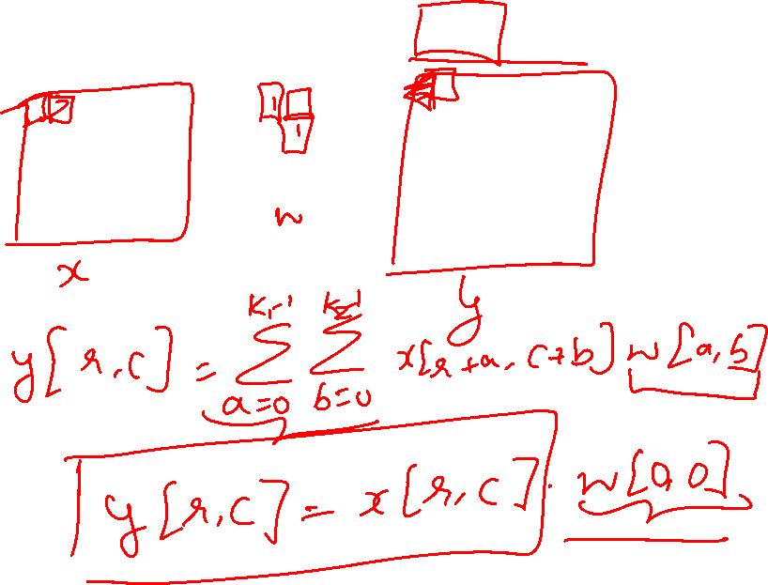
Can we have 1x1 filters?

Slide 7
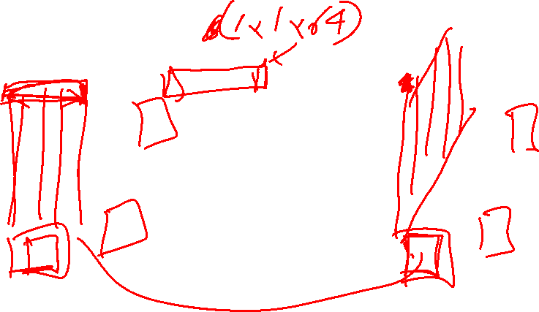
(btw, 1x1 convolution layers make perfect sense)
1x1 CONV
with 32 filters
56
56
(each filter has size 1x1x64, and performs a 64-dimensional dot product)
56
56
64
32
Slide Credit: Fei-Fei Li, Justin Johnson, Serena Yeung, CS 231n

Slide 8
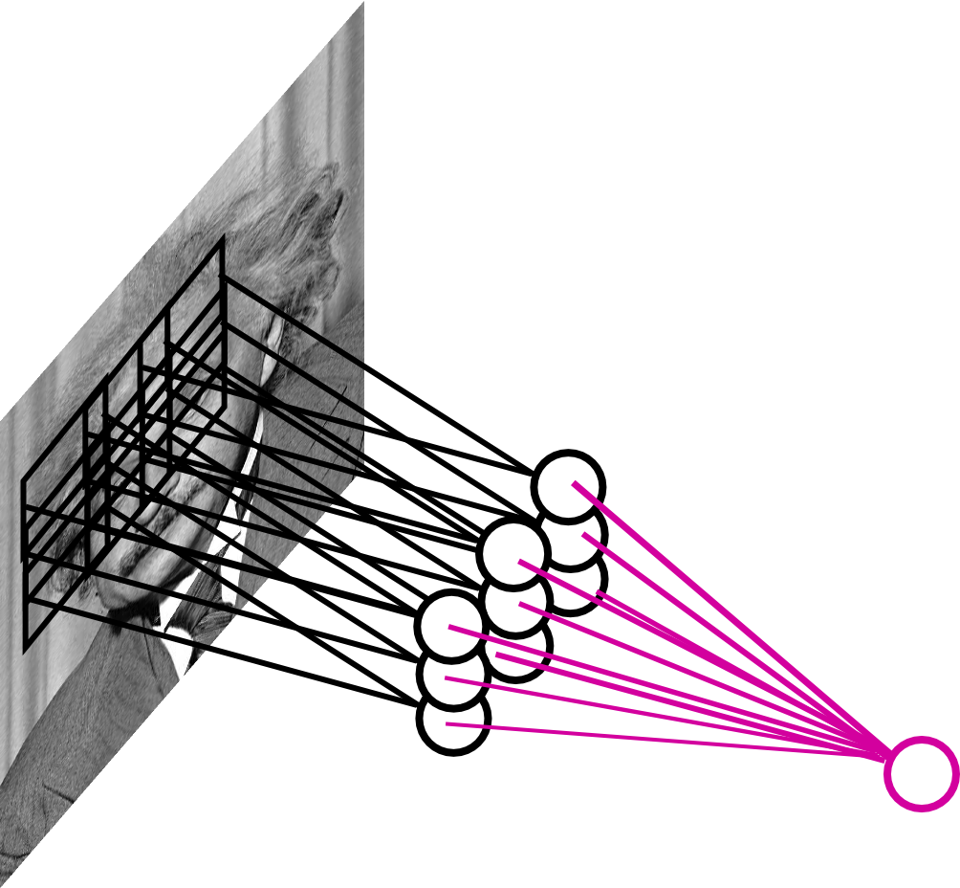
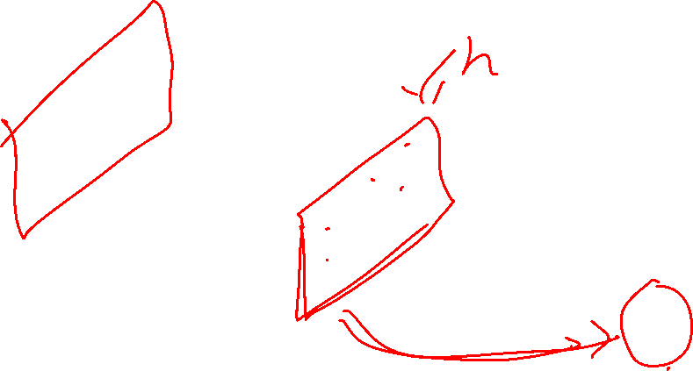
Pooling Layer
By “pooling” (e.g., taking max) filter
responses at different locations we gain robustness to the exact spatial location of features.
Slide Credit: Marc'Aurelio Ranzato

Slide 9
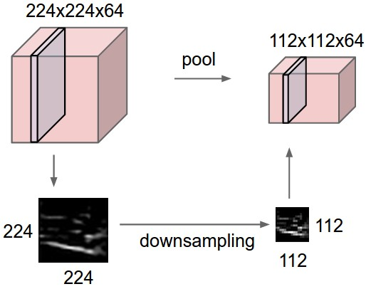
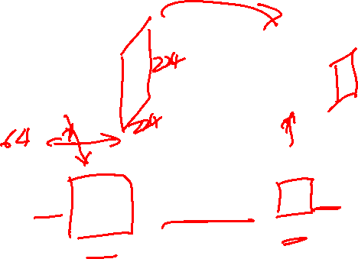
Pooling layer
makes the representations smaller and more manageable
operates over each activation map independently:
Slide Credit: Fei-Fei Li, Justin Johnson, Serena Yeung, CS 231n

Slide 10
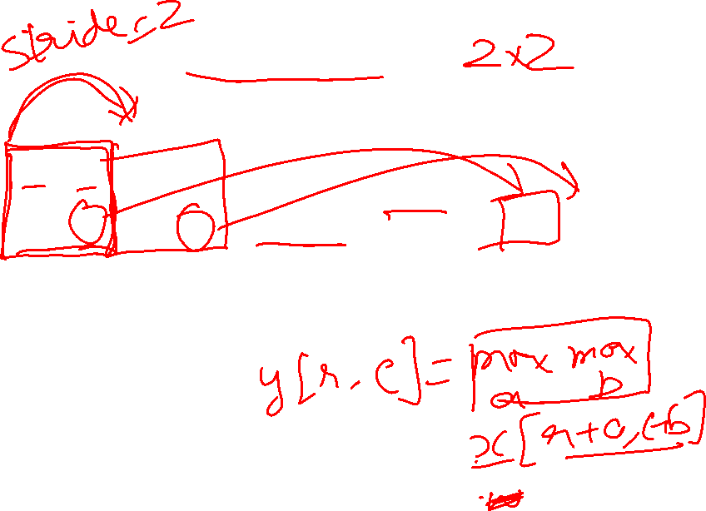
MAX POOLING
Single depth slice
1 | 1 | 2 | 4
5 | 6 | 7 | 8
3 | 2 | 1 | 0
1 | 2 | 3 | 4
dim 1
max pool with 2x2 filters and stride 2
6 | 8
3 | 4
dim 2
Slide Credit: Fei-Fei Li, Justin Johnson, Serena Yeung, CS 231n

Slide 11
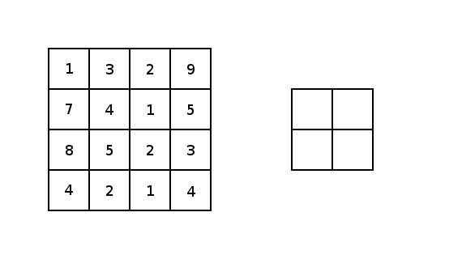
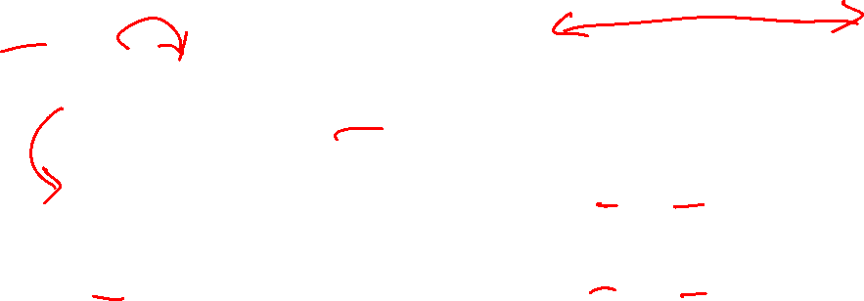
Image courtesy: Justin Francis.

Slide 12
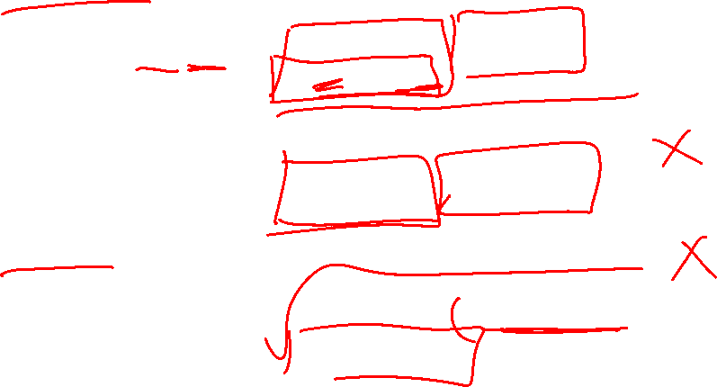
Pooling Layer: Examples
Max-pooling:
Average-pooling:
L2-pooling:
Slide Credit: Marc'Aurelio Ranzato

Slide 13
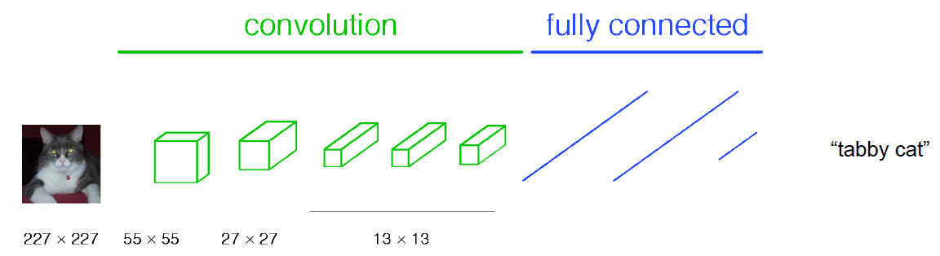
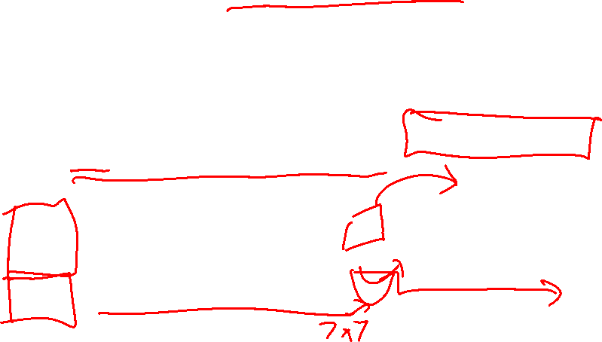
Classical View
Figure Credit: [Long, Shelhamer, Darrell CVPR15]

Slide 14
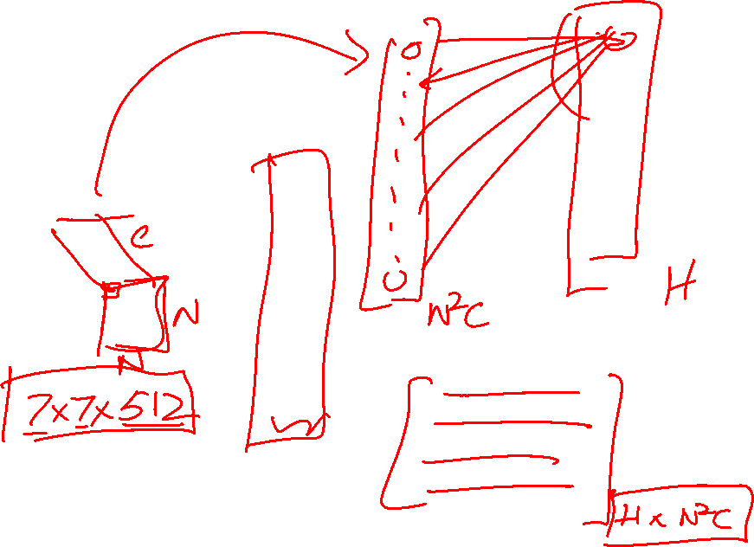
H hidden units
NxNxC, N small
Fully conn. layer
Slide Credit: Marc'Aurelio Ranzato

Slide 15
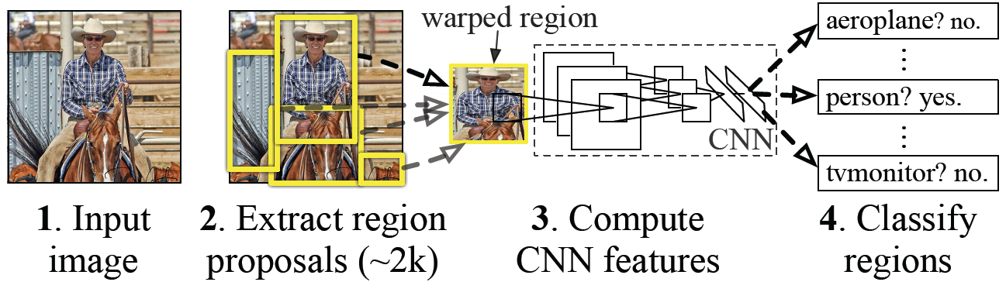
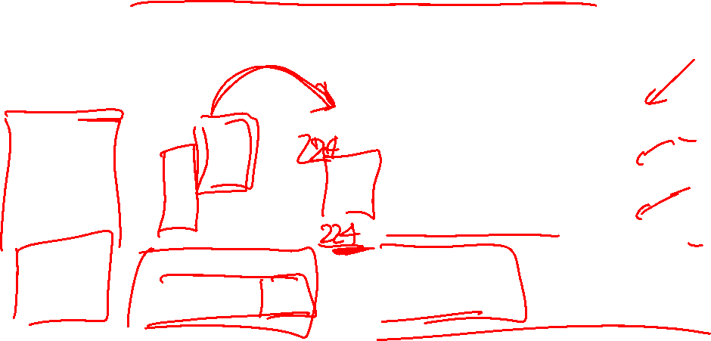
Classical View = Inefficient

Slide 16

Classical View
Figure Credit: [Long, Shelhamer, Darrell CVPR15]

Slide 17
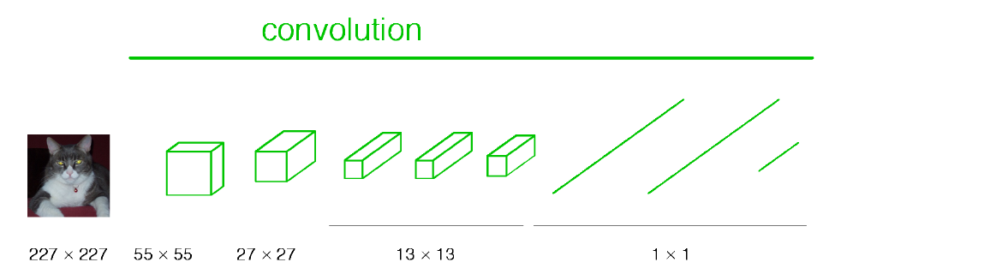
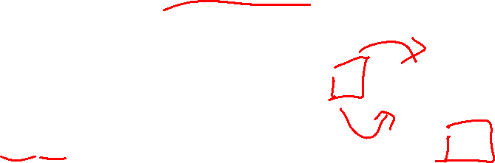
Re-interpretation
Just squint a little!
Figure Credit: [Long, Shelhamer, Darrell CVPR15]

Slide 18
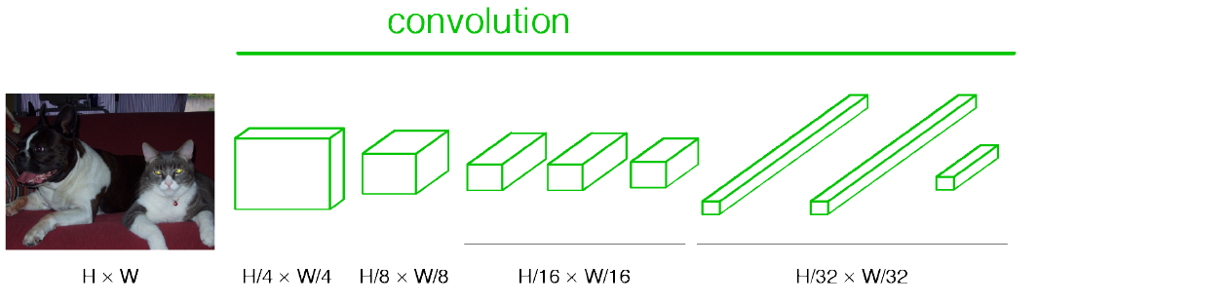
“Fully Convolutional” Networks
Can run on an image of any size!
Figure Credit: [Long, Shelhamer, Darrell CVPR15]

Slide 19
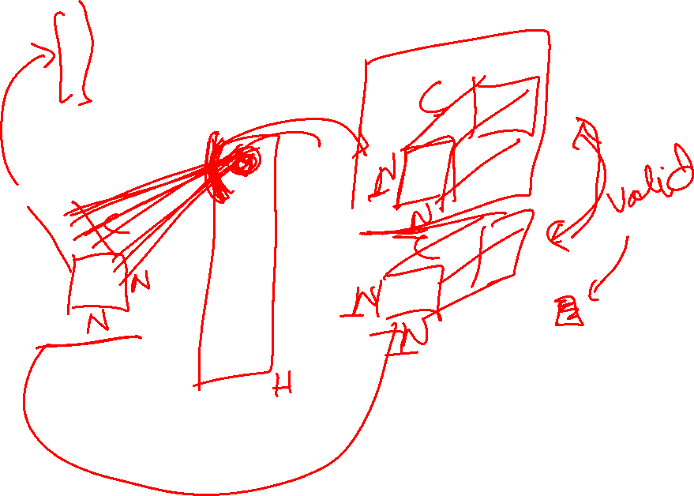
H hidden units /
1x1xH feature maps
NxNxC, N small
Fully conn. layer /
Conv. layer (H kernels of size NxNxC)
Slide Credit: Marc'Aurelio Ranzato

Slide 20

Benefit of this thinking
Mathematically elegant
Efficiency
  Can run network on arbitrary image
  Without multiple crops

Slide 21
Plan for Today
Convolutional Neural Networks
  (Finish) Backprop in conv layers
  Dilated/a-trous convolutions
  Toeplitz matrices and convolutions = matrix-mult
  Transposed convolutions

Slide 22
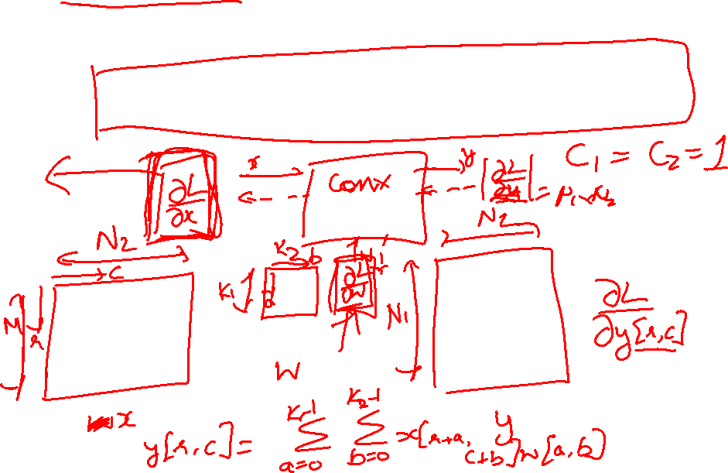
Backprop in Convolutional Layers
Notes
  https://www.cc.gatech.edu/classes/AY2018/cs7643_fall/slides/L6_cnns_backprop_notes.pdf

Slide 23
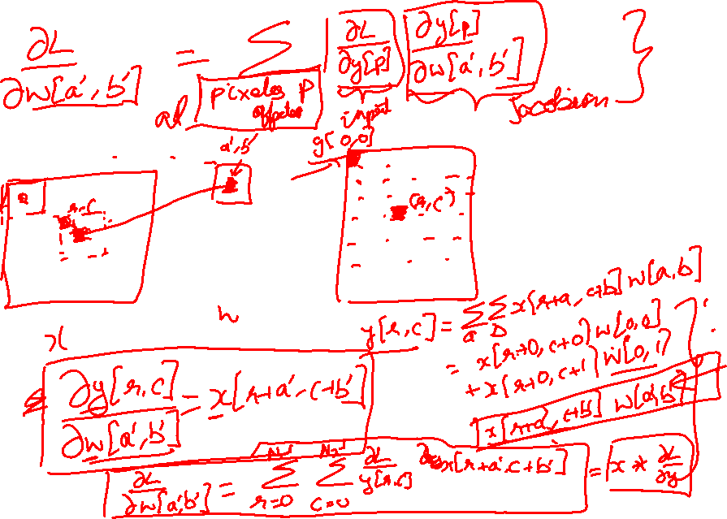
Backprop in Convolutional Layers

Slide 24
Backprop in Convolutional Layers

Slide 25
Backprop in Convolutional Layers

Slide 26
Backprop in Convolutional Layers

Slide 27
Backprop in Convolutional Layers

Slide 28
Backprop in Convolutional Layers

Slide 29
Backprop in Convolutional Layers

Slide 30
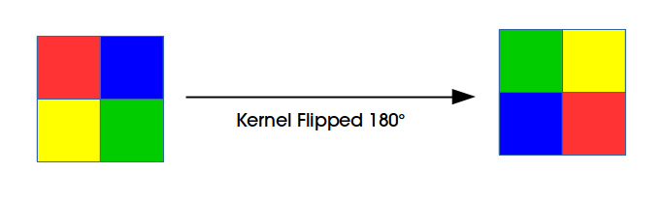
Backprop in Convolutional Layers

Slide 31
Plan for Today
Convolutional Neural Networks
  (Finish) Backprop in conv layers
  Dilated/a-trous convolutions
  Toeplitz matrices and convolutions = matrix-mult
  Transposed convolutions

Slide 32
Dilated Convolutions

Slide 33
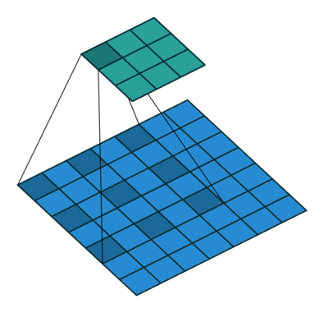
Dilated Convolutions
Figure Credit: Dumoulin and Visin, https://arxiv.org/pdf/1603.07285.pdf

Slide 34
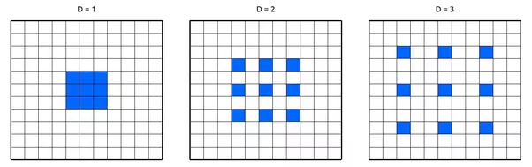

Slide 35
(recall:)
(N - k) / stride + 1
Figure Credit: Dumoulin and Visin, https://arxiv.org/pdf/1603.07285.pdf

Slide 36
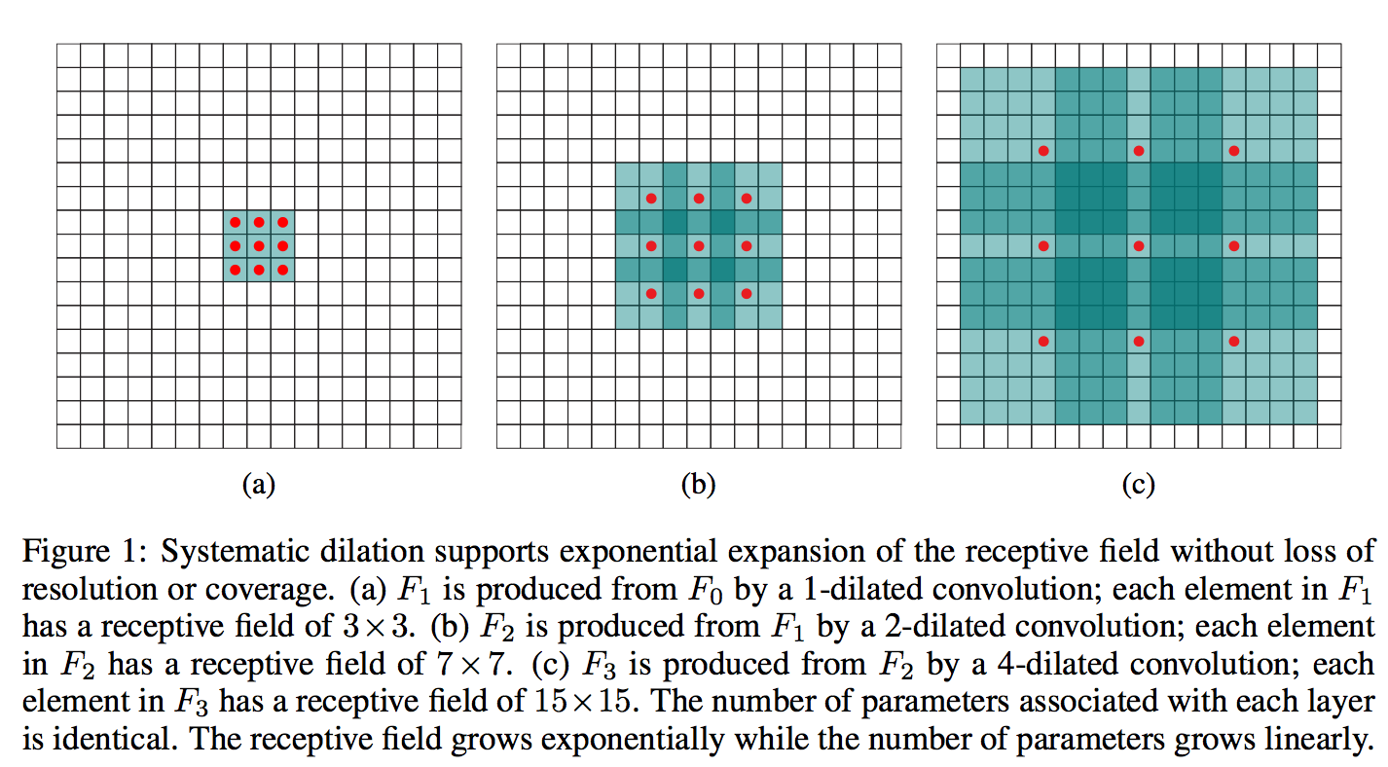
Figure Credit: Yu and Koltun, ICLR16

Slide 37
Plan for Today
Convolutional Neural Networks
  (Finish) Backprop in conv layers
  Dilated/a-trous convolutions
  Toeplitz matrices and convolutions = matrix-mult
  Transposed convolutions

Slide 38
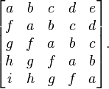
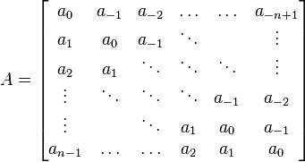
Toeplitz Matrix
Diagonals are constants
A_{ij} = a_{i-j}

Slide 39
Why do we care?
(Discrete) Convolution = Matrix Multiplication
  with Toeplitz Matrices

Slide 40
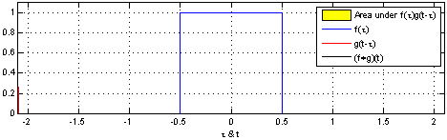
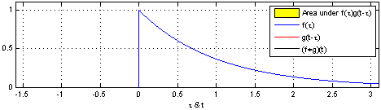
"Convolution of box signal with itself2" by Convolution_of_box_signal_with_itself.gif: Brian Ambergderivative work: Tinos (talk) - Convolution_of_box_signal_with_itself.gif. Licensed under CC BY-SA 3.0 via Commons - https://commons.wikimedia.org/wiki/File:Convolution_of_box_signal_with_itself2.gif#/media/File:Convolution_of_box_signal_with_itself2.gif

Slide 41
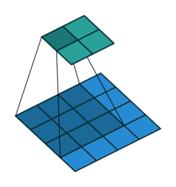
Figure Credit: Dumoulin and Visin, https://arxiv.org/pdf/1603.07285.pdf

Slide 42
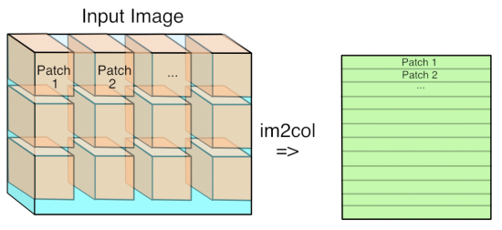
Im2Col
Figure Credit: https://petewarden.com/2015/04/20/why-gemm-is-at-the-heart-of-deep-learning/

Slide 43
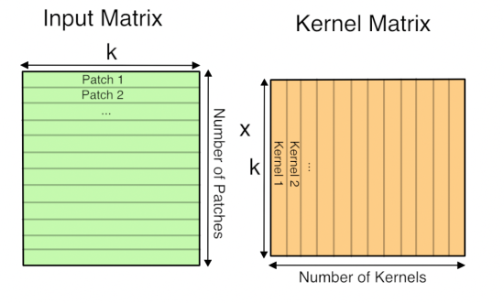
GEMM
Figure Credit: https://petewarden.com/2015/04/20/why-gemm-is-at-the-heart-of-deep-learning/

Slide 44
Plan for Today
Convolutional Neural Networks
  (Finish) Backprop in conv layers
  Dilated/a-trous convolutions
  Toeplitz matrices and convolutions = matrix-mult
  Transposed convolutions

Slide 45
Transposed Convolutions
Deconvolution (bad)
Upconvolution
Fractionally strided convolution
Backward strided convolution

Slide 46
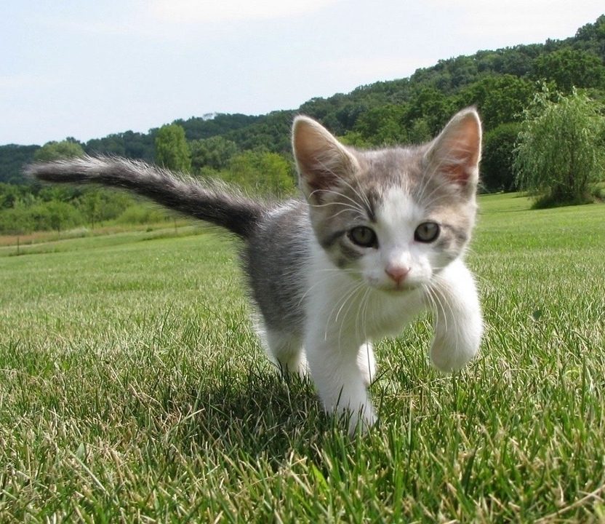
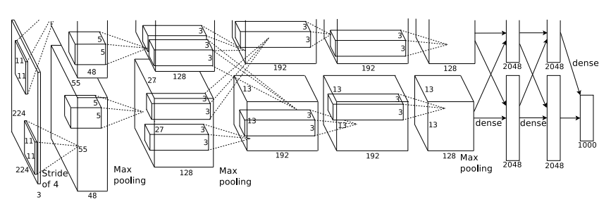
So far: Image Classification
Class Scores
Cat: 0.9
Dog: 0.05
Car: 0.01
...
Fully-Connected:
4096 to 1000
This image is CC0 public domain
Figure copyright Alex Krizhevsky, Ilya Sutskever, and Geoffrey Hinton, 2012. Reproduced with permission.
Vector:
4096
Slide Credit: Fei-Fei Li, Justin Johnson, Serena Yeung, CS 231n

Slide 47
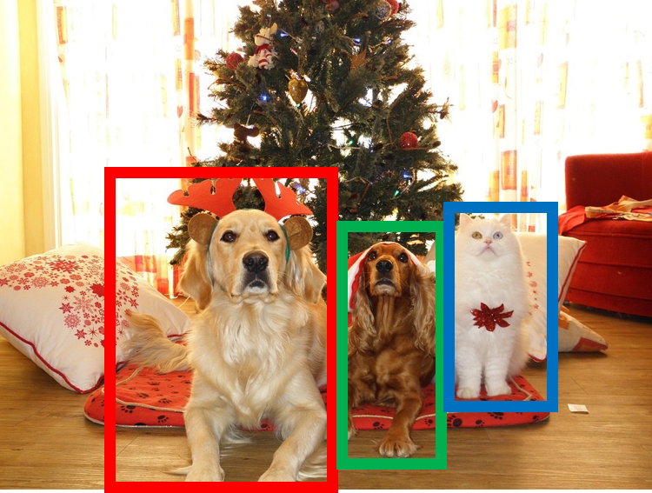
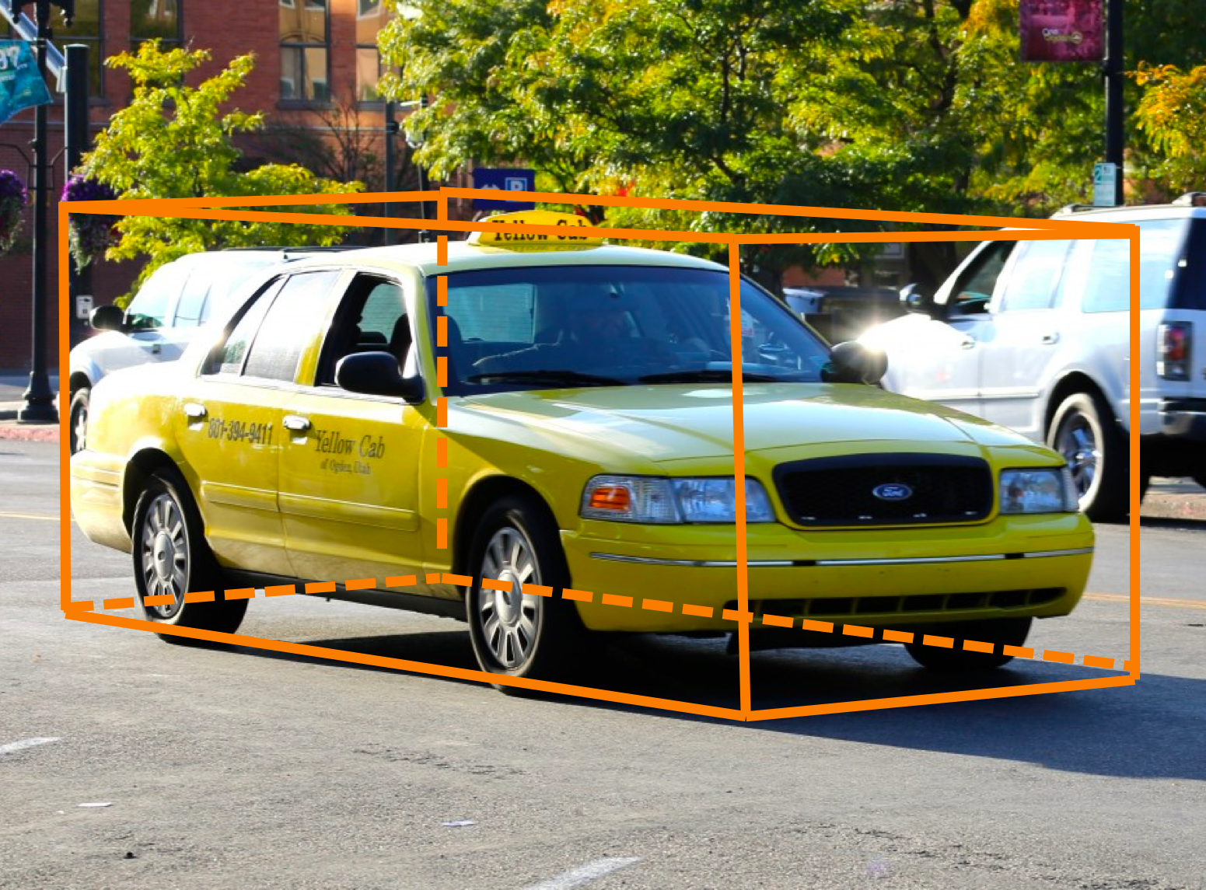
Other Computer Vision Tasks
Semantic
Segmentation
2D Object
Detection
3D Object
Detection
GRASS, CAT, TREE, SKY
DOG, DOG, CAT
Car
Object categories +
2D bounding boxes
Object categories +
3D bounding boxes
No objects, just pixels
This image is CC0 public domain
Slide Credit: Fei-Fei Li, Justin Johnson, Serena Yeung, CS 231n

Slide 48
Semantic Segmentation
Semantic
Segmentation
2D Object
Detection
3D Object
Detection
GRASS, CAT, TREE, SKY
DOG, DOG, CAT
Car
Object categories +
2D bounding boxes
Object categories +
3D bounding boxes
No objects, just pixels
This image is CC0 public domain
Notes:
Given this cute cat picture, the image classification task would be looking at this picture and ouput a single label cat

Slide 49
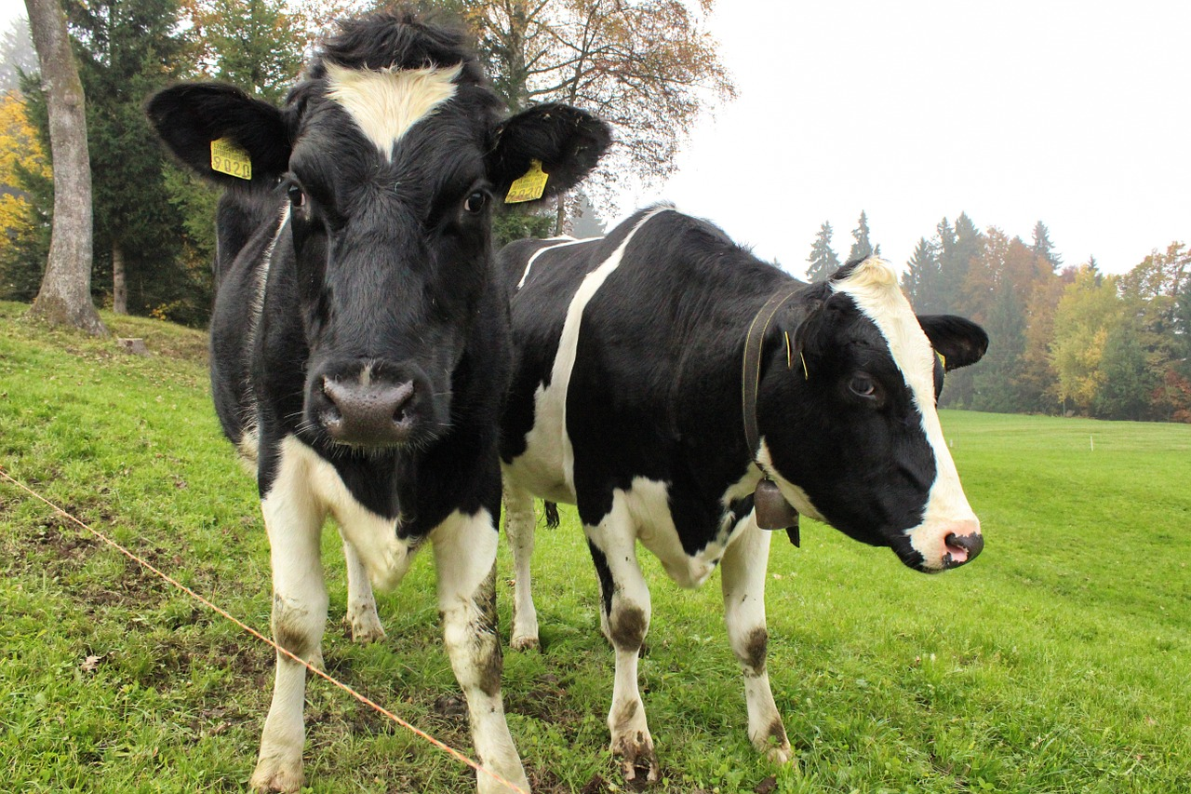
Semantic Segmentation
This image is CC0 public domain
Label each pixel in the image with a category label
Don’t differentiate instances, only care about pixels
Sky
Trees
Sky
Trees
Cat
Cow
Grass
Grass
Slide Credit: Fei-Fei Li, Justin Johnson, Serena Yeung, CS 231n

Slide 50
Semantic Segmentation Idea: Sliding Window
Extract patch
Classify center pixel with CNN
Full image
Cow
Cow
Grass
Farabet et al, “Learning Hierarchical Features for Scene Labeling,” TPAMI 2013
Pinheiro and Collobert, “Recurrent Convolutional Neural Networks for Scene Labeling”, ICML 2014
Slide Credit: Fei-Fei Li, Justin Johnson, Serena Yeung, CS 231n

Slide 51
Semantic Segmentation Idea: Sliding Window
Extract patch
Classify center pixel with CNN
Full image
Cow
Cow
Grass
Problem: Very inefficient! Not reusing shared features between overlapping patches
Farabet et al, “Learning Hierarchical Features for Scene Labeling,” TPAMI 2013
Pinheiro and Collobert, “Recurrent Convolutional Neural Networks for Scene Labeling”, ICML 2014
Slide Credit: Fei-Fei Li, Justin Johnson, Serena Yeung, CS 231n

Slide 52
Semantic Segmentation Idea: Fully Convolutional
Design a network as a bunch of convolutional layers to make predictions for pixels all at once!
Conv
Conv
Conv
Conv
argmax
Input:
3 x H x W
Predictions:
H x W
Scores:
C x H x W
Convolutions:
D x H x W
Slide Credit: Fei-Fei Li, Justin Johnson, Serena Yeung, CS 231n

Slide 53
Semantic Segmentation Idea: Fully Convolutional
Design a network as a bunch of convolutional layers to make predictions for pixels all at once!
Conv
Conv
Conv
Conv
argmax
Input:
3 x H x W
Predictions:
H x W
Scores:
C x H x W
Problem: convolutions at original image resolution will be very expensive ...
Convolutions:
D x H x W
Slide Credit: Fei-Fei Li, Justin Johnson, Serena Yeung, CS 231n

Slide 54
Semantic Segmentation Idea: Fully Convolutional
Design network as a bunch of convolutional layers, with downsampling and upsampling inside the network!
Med-res:
D₂ x H/4 x W/4
Med-res:
D₂ x H/4 x W/4
Low-res:
D₃ x H/4 x W/4
Input:
3 x H x W
High-res:
D₁ x H/2 x W/2
High-res:
D₁ x H/2 x W/2
Predictions:
H x W
Long, Shelhamer, and Darrell, “Fully Convolutional Networks for Semantic Segmentation”, CVPR 2015
Noh et al, “Learning Deconvolution Network for Semantic Segmentation”, ICCV 2015
Slide Credit: Fei-Fei Li, Justin Johnson, Serena Yeung, CS 231n

Slide 55
Semantic Segmentation Idea: Fully Convolutional
Downsampling:
Pooling, strided convolution
Design network as a bunch of convolutional layers, with downsampling and upsampling inside the network!
Upsampling:
???
Med-res:
D₂ x H/4 x W/4
Med-res:
D₂ x H/4 x W/4
Low-res:
D₃ x H/4 x W/4
Input:
3 x H x W
High-res:
D₁ x H/2 x W/2
High-res:
D₁ x H/2 x W/2
Predictions:
H x W
Long, Shelhamer, and Darrell, “Fully Convolutional Networks for Semantic Segmentation”, CVPR 2015
Noh et al, “Learning Deconvolution Network for Semantic Segmentation”, ICCV 2015
Slide Credit: Fei-Fei Li, Justin Johnson, Serena Yeung, CS 231n

Slide 56
In-Network upsampling: “Unpooling”
Nearest Neighbor
“Bed of Nails”
1 | 0 | 2 | 0
0 | 0 | 0 | 0
3 | 0 | 4 | 0
0 | 0 | 0 | 0
1 | 1 | 2 | 2
1 | 1 | 2 | 2
3 | 3 | 4 | 4
3 | 3 | 4 | 4
1 | 2
3 | 4
1 | 2
3 | 4
Input: 2 x 2
Output: 4 x 4
Input: 2 x 2
Output: 4 x 4
Slide Credit: Fei-Fei Li, Justin Johnson, Serena Yeung, CS 231n

Slide 57
In-Network upsampling: “Max Unpooling”
Max Pooling
Remember which element was max!
Max Unpooling
Use positions from pooling layer
1 | 2 | 6 | 3
3 | 5 | 2 | 1
1 | 2 | 2 | 1
7 | 3 | 4 | 8
0 | 0 | 2 | 0
0 | 1 | 0 | 0
0 | 0 | 0 | 0
3 | 0 | 0 | 4
5 | 6
7 | 8
…
1 | 2
3 | 4
Rest of the network
Input: 4 x 4
Output: 2 x 2
Input: 2 x 2
Output: 4 x 4
Corresponding pairs of downsampling and upsampling layers
Slide Credit: Fei-Fei Li, Justin Johnson, Serena Yeung, CS 231n

