Slide 1



Tracking down
Traffic
Dario Bonfiglio
Marco Mellia
Michela Meo
Nicolo’ Ritacca
Dario Rossi

Slide 2
Agenda
A few words about Skype
  Known facts
  Preliminary definitions
Investigate Skype “Traffic”
  Voice traffic
    Reaction to network performance degradation
  Signaling traffic
    Signaling patterns & peer selection
  Users’ behavior
    Please, see the paper

Slide 3
Why Skype ?
Skype is very popular
  More than 100M users, 5% of all VoIP traffic
  Easy to use, many free services
    voice / video / chat / data transfer over IP
Understanding Skype is a challenging task
  Closed design, proprietary solutions
  Almost everything is encrypted
  Uses a P2P architecture
  Lot of different flavors

Slide 4
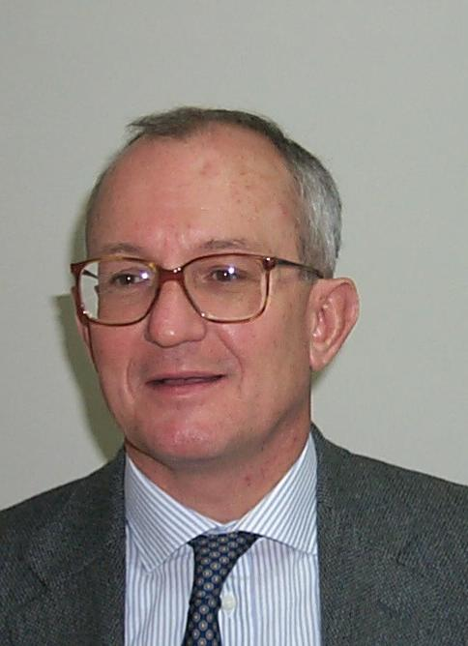

Skype for Dummies
Architecture
  P2P design

Slide 5
Skype for Dummies
Architecture
  P2P design
Service traffic
  Voice calls
  Video calls
  Chat
  Data transmission

Slide 6

Skype for Dummies
Architecture
  P2P design
Service traffic
  Voice calls
  Video calls
  Chat
  Data transmission
  Skypeout/Skypein

Slide 7
Skype for Dummies
Architecture
  P2P design
Service traffic
  Voice calls
  Video calls
  Chat
  Data transmission
  Skypeout/Skypein
Signaling traffic
  Login & auth.
  Look for buddies
  ….

Slide 8



Methodolody
Service traffic
  Small scale active testbed
  Controlled bandwidth, packet loss
  voice service,
  many Codecs, TCP/UDP traffic
Signaling traffic
  Passive measurement technique
  Adopt a black-box approach
  Inspect and quantify UDP signaling
  Classification framework:
    300.10³
    external
    peers
    7000 hosts
    1700 peers
D.Bonfiglio, M.Mellia, M.Meo, D.Rossi, P.Tofanelli, Revealing Skype Traffic: When Randomness
Plays with You, SIGCOMM'07

Slide 9
Preliminary Definition
Useful information
  At installation, Skype chooses
  a port at random
  The port is never changed
  (unless forced by the user)
  All traffic multiplexed over the same socket (UDP preferably)
Skype flow
  A sequence of packets originated from a Skype peer (and destined to
  another skype peer)
  Flow starts when the first packet is observed
  Flow ends when no packet
  is observed for a given inactivity timeout (200s)
Skype peer
  A Skype peer can be identified
  by its endpoint
  Consider only peers that were
  ever observed making a call
  (IP addr, UDP port)

Slide 10
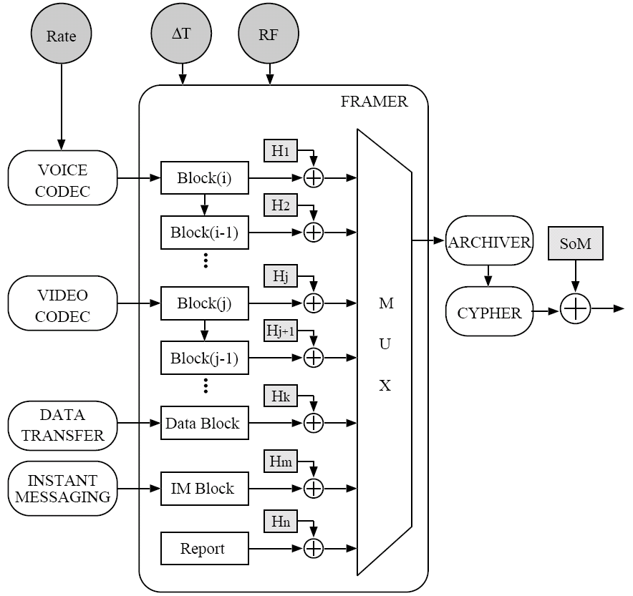
Skype Source Model
Skype
Message
TCP/UDP
IP

Slide 11
Service traffic
    Codec Impact

Slide 12
Service Traffic: Normal Condition
250
Smooth
Transient
ISAC
iLBC
iPCM-WB
PCM
200
G729
Bitrate
[kbps]
Normal
Behavior
150
Aggressive
Startup
100
50
0
0
10
20
30
40
50
60
Time [s]

Slide 13
Service Traffic: Normal Condition
Message
Payload
[Bytes]
Time [s]

Slide 14
Service Traffic: Normal Condition
IPG
[ms]
Time [s]

Slide 15
Service traffic
    Transport Layer Impact

Slide 16
Service Traffic: TCP vs UDP
80
B - UDP
B - TCP
60
40
20
0
TCP/UDP have no impact
90
IPG - UDP
Time [s]
IPG - TCP
60
30
0
250
L - UDP
200
L -TCP
Time [s]
150
100
50
0
0
10
20
30
40
50
60
Time [s]

Slide 17
Service traffic
    Network Impact

Slide 18
Service Traffic: Bandwidth Limit
Skype performs congestion control
Time [s]
Time [s]

Slide 19
Service Traffic: Packet Loss
Loss %
Inter-Pkt
Gap [ms]
Aggressively tries
to deal with losses…
Skype performs loss recovery
Loss profile
Payload
[Bytes]
...by multiplexing old
and new voice blocks
Time [s]

Slide 20
Service traffic
    Video Traffic

Slide 21
Service Traffic: Video Source
Skype multiplexes different sources
Video messages
are Bigger
Time [s]
Voice messages
are the same
  Usual IPG for
  pure audio messages
Time [s]
  Back-to-back video
  Massages => frame

Slide 22
Signaling traffic

Slide 23
Signaling Traffic: Activity Pattern
Legend
  Consider a single client
  Each dot is a packet
  Top: outgoing,
  Bottom: incoming
  For every new peer, increment the ID
  For every old peer,
  use the previous ID
Out
In
  Rather different patterns
  emerge from the plot
Time [Hr]

Slide 24
Signaling Traffic: Activity Pattern
Probes
  Single packet
  Sent toward unknown peers
  Reply possibly follows
  No further traffic between
  the same peers pair
  Majority of the flows
Out
In
  Peer discovery is a
  continuous task
Time [Hr]

Slide 25
Signaling Traffic: Activity Pattern
Non-Probes
  Flows longer than one packet
  Series of single-packet flows
  Sent toward the same peer
  Carry most signaling bytes
Out
In
  Talk to super peers, notify
  buddies of status change,
  …
Time [Hr]

Slide 26
Signaling Traffic: All Peers
Out
Probes
  Majority of the flows
Non-probes
  Carry most signaling bytes
Signaling bandwidth
  95% generate <100 bps
  Only 1% exceeds 1 Kbps
Signaling spread
  95% of peers contact
  <40 peers (in 5 min)
  1% exceeds >75 (in 5 min)
In
Time [Hr]

Slide 27
Conclusions
Service traffic
  Active testbed
  Skype implements a congestion control
    Aggressive with losses
    Conservative with bottlenecks
Signaling traffic
  Passive measurement
  Two different threads shapes the overlay
    Probes
    Non-Probes
  Signaling rate and spread
    Very limited bitrate
    Large number contacted peers
User Characterization
  Number of calls per unit of time
  Call duration for different services
  Peer Lifetime
Details are in the paper, not in this talk ☺
Future Work
  Extensive measurement in different networks
    Campus LAN
    ADSL installation
    Cellular Network

Slide 28
Signaling Traffic: Peer Selection
0.012
pdf
Non-Probe
RTT distance
  RTT between first request-reply packets
  Probe RTT smaller w.r.t. non-probe traffic
Probe
0.008
0.004
0
10
100
1000
Round Trip Time [ms]
Geolocation breakdown
  Probes favor discovery
  of nearby hosts
  Non-probes driven by social network
60%
Non-Probe
Probe
40%
20%
0%
Europe
North
Asia
South
Africa
Oceania
America
America

Slide 31


Signaling Traffic: Peer Selection

Slide 32
Signaling Traffic: Inferring Churn
0.08
PDF
Peer Lifetime
0.07
Peer Deathtime
0.06
0.05
0.04
0.03
0.02
0.01
0
6
12
18
24
Time [h]

