Slide 1
Planetary-Scale Views on a Large Instant-Messaging Network
Jure Leskovec (jure@cs.stanford.edu)
Joint work with Eric Horvitz, Microsoft Research

Slide 2

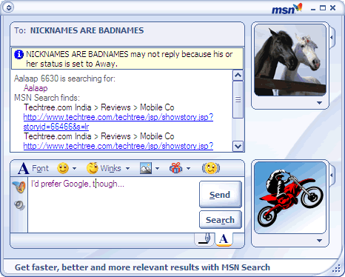
Instant Messaging
Contact (buddy) list
Messaging window

Slide 3
Instant Messaging as a Network
Buddy
Conversation

Slide 4
IM – Phenomena at planetary scale
Observe social and communication phenomena at a planetary scale
Largest social network analyzed to date
Research questions:
How does communication change with user demographics (age, sex, language, country)?
How does geography affect communication?
What is the structure of the communication network?

Slide 5
Data description: Communication
For every conversation (session) a list of participants:
  User Id
  Time Joined
  Time Left
  Number of Messages Sent
  Number of Messages Received
There can be multiple participants per conversation
  Everything is anonymized. No message text

Slide 6
Data description: Demographics
User demographic data (self-reported):
  Age
  Gender
  Location (Country, ZIP)
  Language

Slide 7
Data statistics: Total activity
We collected the data for June 2006
Log size:
150Gb/day (compressed)
Total: 1 month of communication data:
4.5Tb of compressed data
Activity over June 2006 (30 days)
  245 million users logged in
  180 million users engaged in conversations
  17,5 million new accounts activated
  More than 30 billion conversations
  More than 255 billion exchanged messages

Slide 8
Data statistics: Typical day
Activity on a typical day (June 1 2006):
1 billion conversations
93 million users login
65 million different users talk (exchange messages)
1.5 million invitations for new accounts sent

Slide 9
User & Communication characteristics
How does user demographics influence communication?

Slide 10
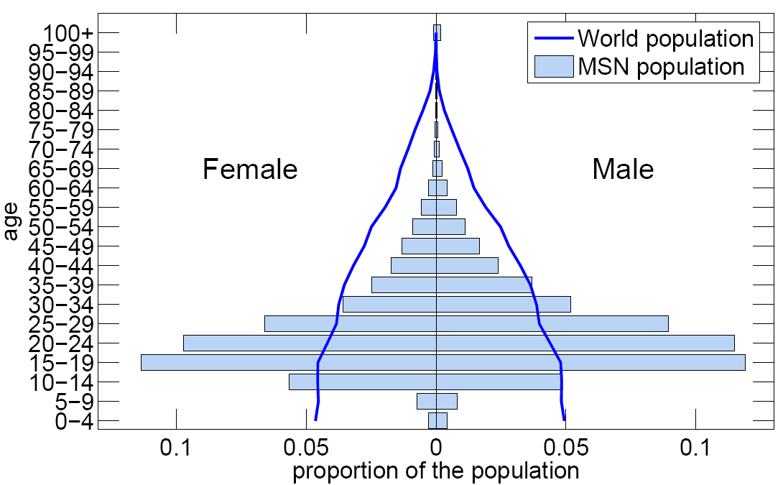
User Age: MSN vs. the world

Slide 11
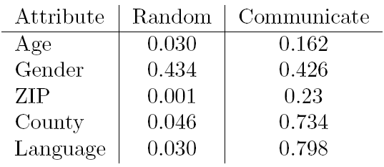
Communication: Demographics
How do people’s attributes (age, gender) influence communication?
Probability that users share an attribute
People tend to talk to similar people (except gender)

Slide 12
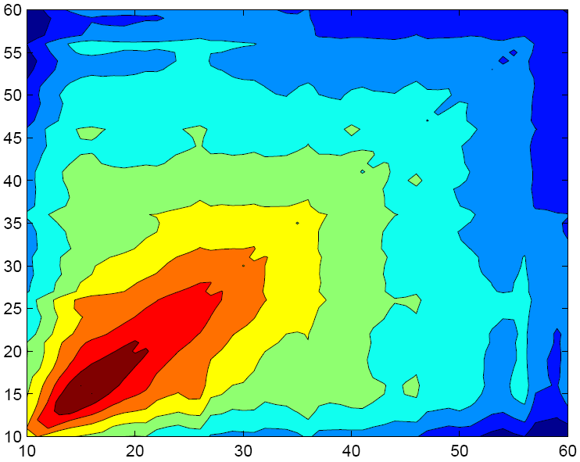
Age: Number of conversations
High
User self reported age
1) Young people communicate with same age
2) Older people communicate uniformly across ages
Low

Slide 13
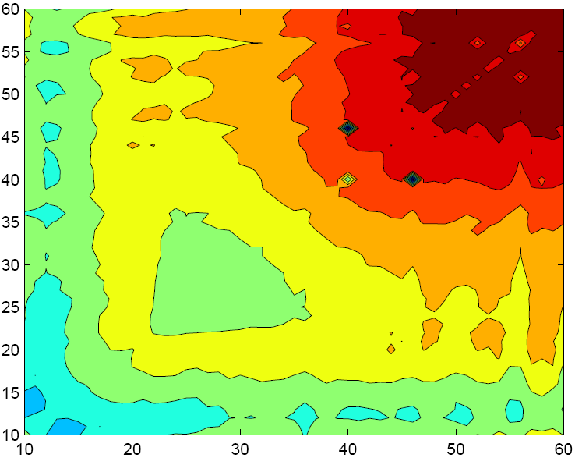
Age: Total conversation duration
High
User self reported age
1) Old people talk long
2) Working ages (25-40) talk short
Low

Slide 14
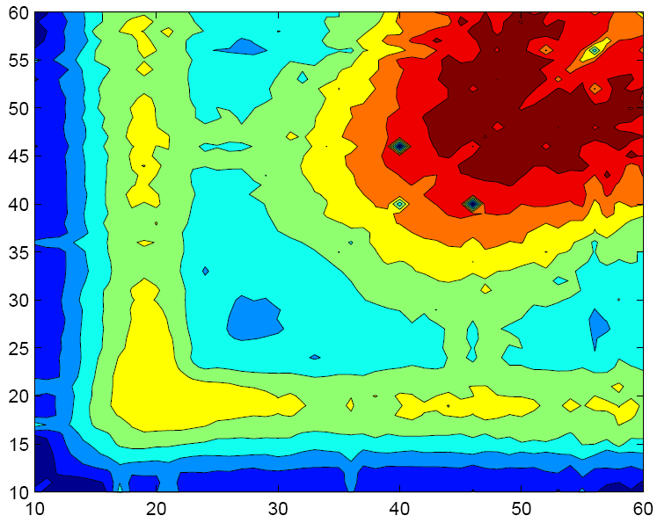
Age: Messages per conversation
High
User self reported age
1) Old people talk long
2) Working ages (25-40) talk quick
Low

Slide 15
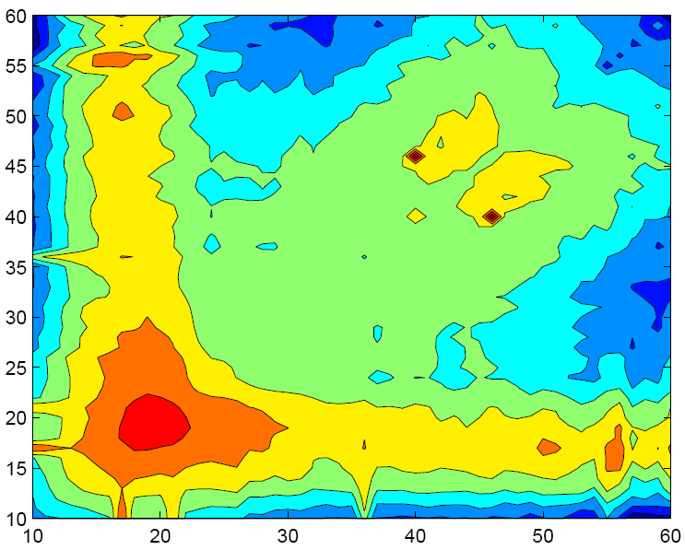
Age: Messages per unit time
High
User self reported age
1) Old people talk slow
2) Young talk fast
Low

Slide 16
Communication: Gender
Is gender communication biased?
  Homophily: Do female talk more among themselves?
  Heterophily: Do male-female conversations took longer?
Findings:
  Num. of. conversations is not biased (follows chance)
  Cross-gender conversations take longer and are more intense (more attention invested)
M
49%
F
M
5 min
F
M
7.6
F
21%
4.5 min
5.9
6.6
20%
4min
Conversations
Duration
Messages/conversation

Slide 17
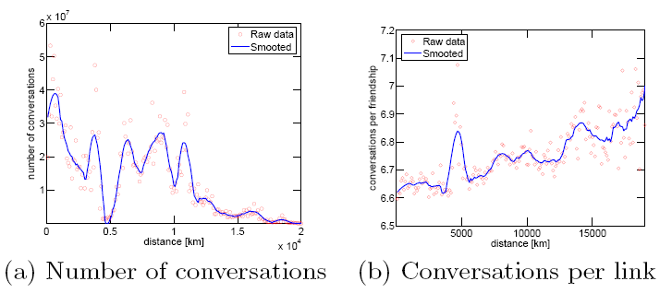
Communication: Geo distance
Longer links are used more

Slide 18
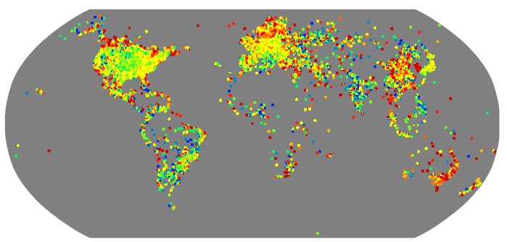
Communication: Geography (1)
Map of the world appears!
Costal regions dominate
Each dot represents number of users at geo location

Slide 19
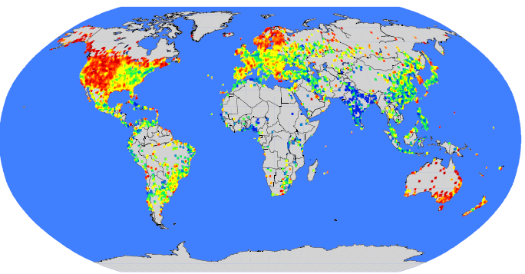
Communication: Geography (2)
Fraction of country’s population on MSN:
Iceland: 35%
Spain: 28%
Netherlands, Canada, Sweden, Norway: 26%
France, UK: 18%
USA, Brazil: 8%
Users per capita

Slide 20
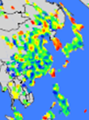
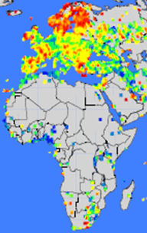
Communication: Geography (3)
Digital darkness,
“Digital Divide”

Slide 21
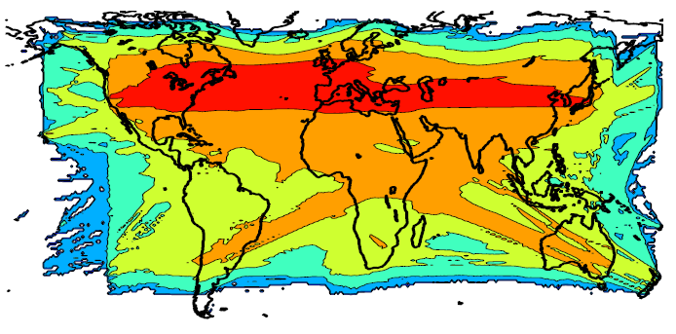
World communication axis
For each conversation between geo points (A,B) we increase the intensity on the line between A and B

Slide 22
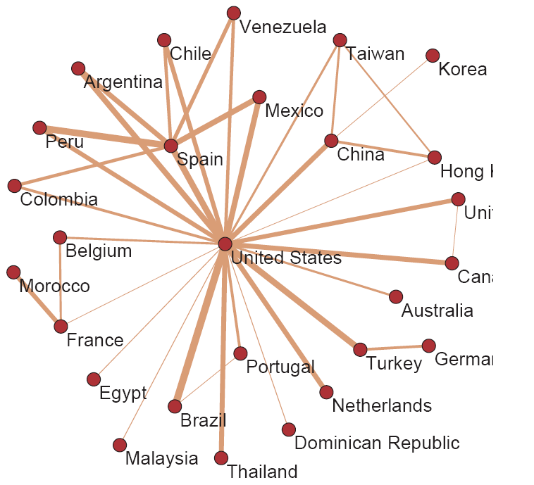
Who talks to whom:
Number of conversations

Slide 23
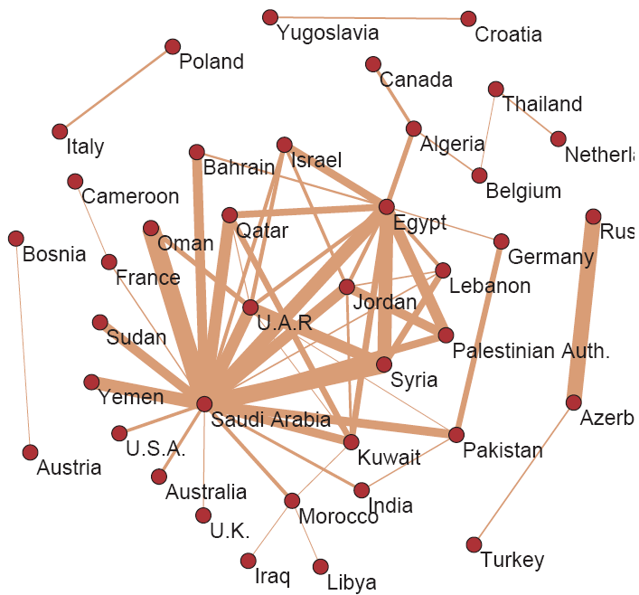
Who talks to whom:
Conversation duration

Slide 24
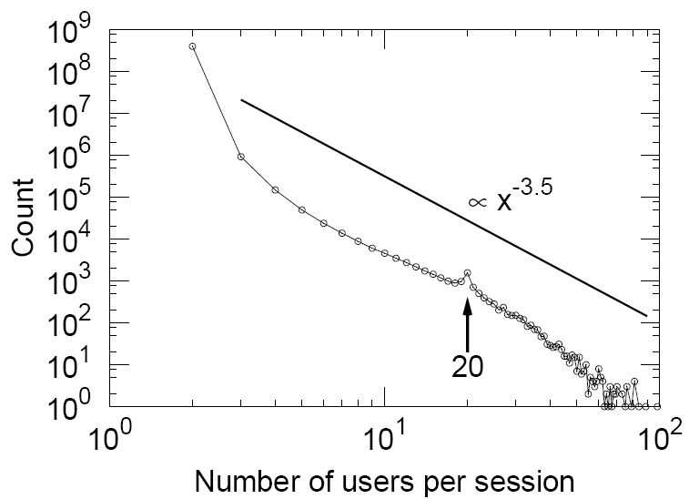
Number of people per conversation
Max number of people simultaneously talking is 20, but conversation can have more people

Slide 25
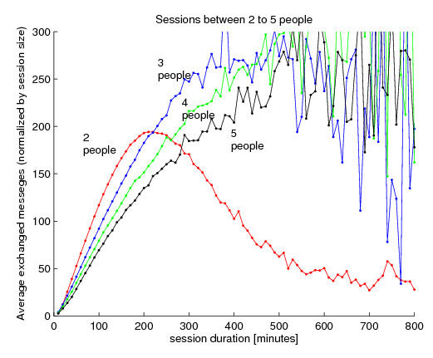
Conversations: number of messages
Sessions between fewer people run out of steam

Slide 26
Messaging as a Network
At least 1 message exchanged

Slide 27
IM Communication Network
Buddy graph
  240 million people (people that login in June ’06)
  9.1 billion buddy edges (friendship links)
Communication graph (take only 2-user conversations)
  Edge if the users exchanged at least 1 message
  180 million people
  1.3 billion edges
  30 billion conversations

Slide 28
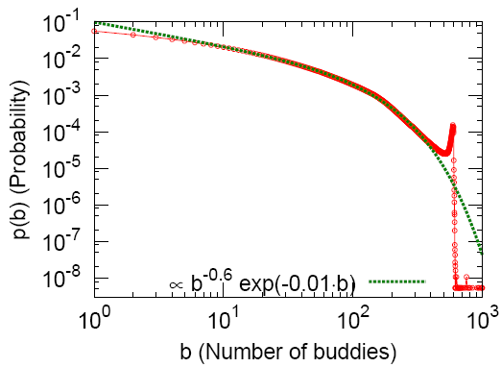
Network: Number of buddies
Limit of 600 buddies
Number of buddies follows power-law with exponential cutoff distribution

Slide 29
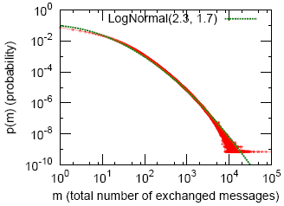
Network: Communication degree
There is “no average” degree. But degrees are heavily skewed.
“Heavy tailed” or “power law” distributions

Slide 30
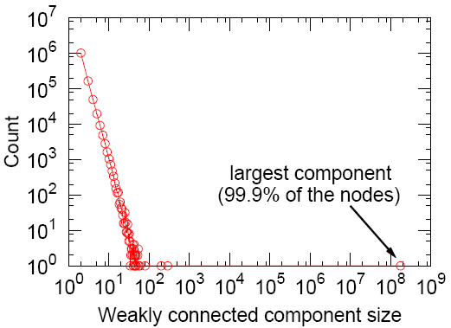
Network: Connectivity

Slide 31
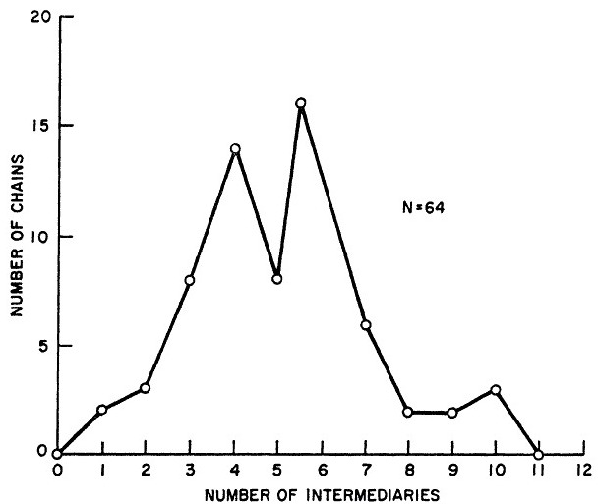
Is the world Small-world?
Small-world experiment [Milgram ‘67]
  People send letters from Nebraska to Boston
How many steps does it take?
Messenger social network of the whole planet Eart
  240M people, 1.3B edges
Milgram’s small world experiment
6 degrees of separation
(i.e., hops + 1)

Slide 32
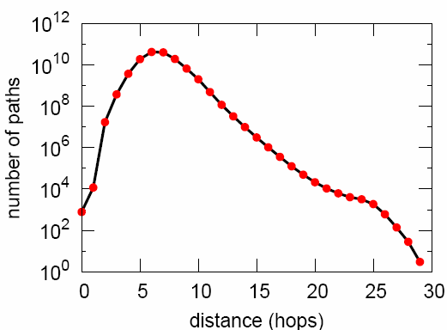
Network: Small world
Hops | Nodes
0 | 1
1 | 10
2 | 78
3 | 3,96
4 | 8,648
5 | 3,299,252
6 | 28,395,849
7 | 79,059,497
8 | 52,995,778
9 | 10,321,008
10 | 1,955,007
11 | 518,410
12 | 149,945
13 | 44,616
14 | 13,740
15 | 4,476
16 | 1,542
17 | 536
18 | 167
19 | 71
20 | 29
21 | 16
22 | 10
23 | 3
24 | 2
25 | 3
MSN Messenger network
Number of steps between pairs of people
Avg. path length 6.6
90% of the people can be reached in < 8 hops

Slide 33
Distance of links on a shortest path
Closer to the target node

Slide 34
Where do shortest paths go?
What are characteristic of nodes on a shortest paths?
t
Good nodes:
d=h-1
c
d(c,t)=h
Bad nodes: d≥h
Forwarding messages

Slide 35
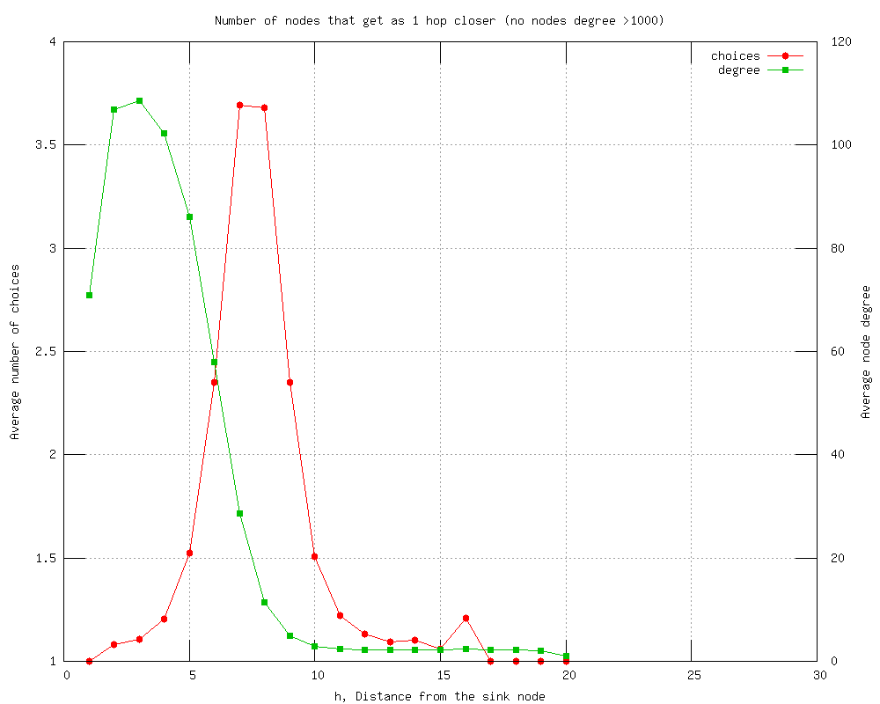
How hard it is to forward?
t
Number of choices (degree)
Good nodes:
d=h-1
Number of nodes that get me closer to target
c
d(c,t)=h
Bad nodes: d≥h

Slide 36
Random routing: Success prob.
If I forward the message at random, what is the success probability?
t
Good nodes:
d=h-1
c
d(c,t)=h
Bad nodes: d≥h

Slide 37
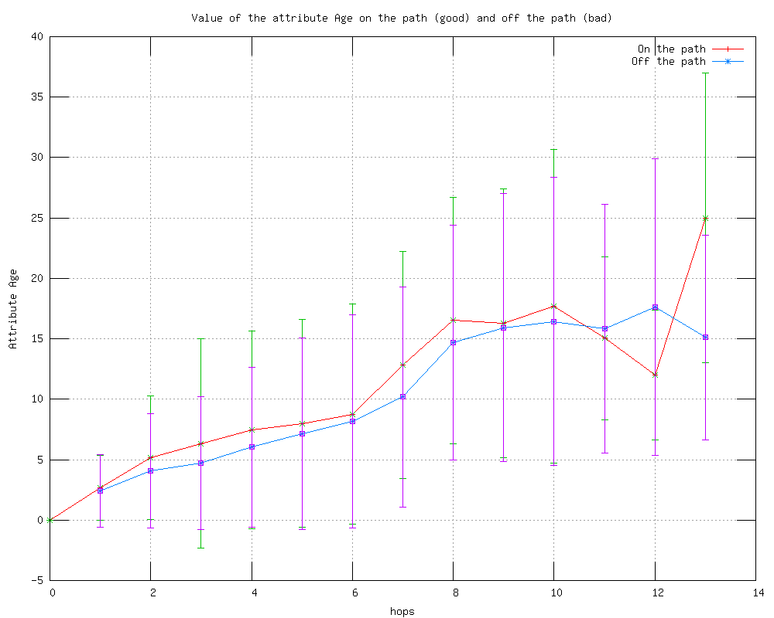
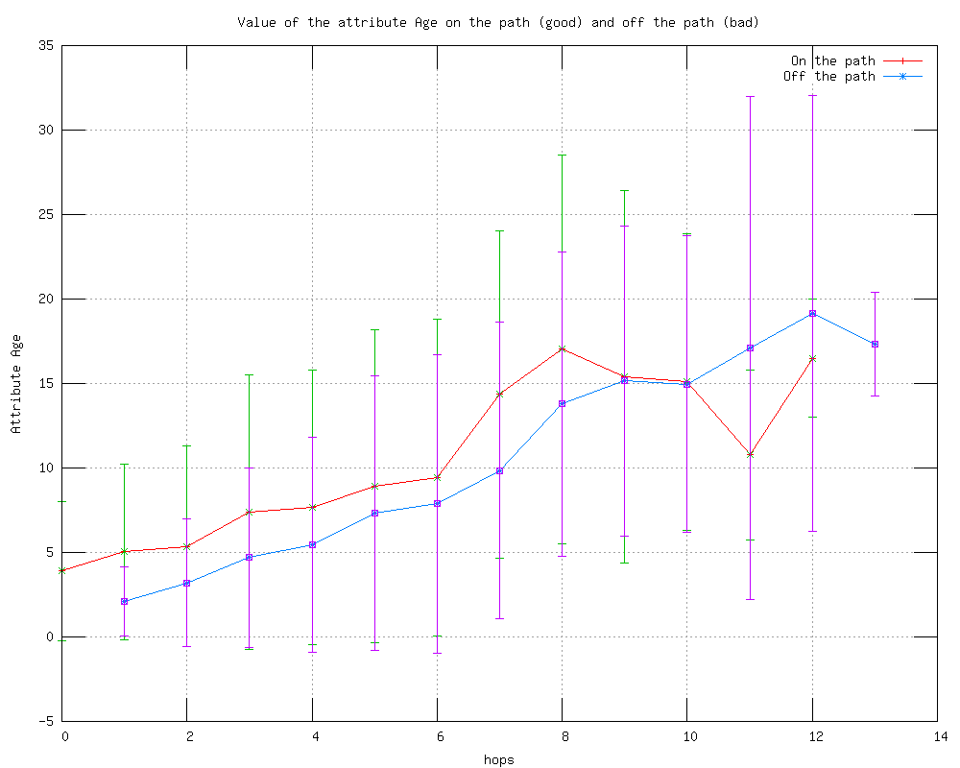
Using node attributes: age
Age difference between c and t
Age difference between c and c’
As we get closer to target more similar the current node’s age is
Nodes on path have actually larger age difference than nodes off the path

Slide 38
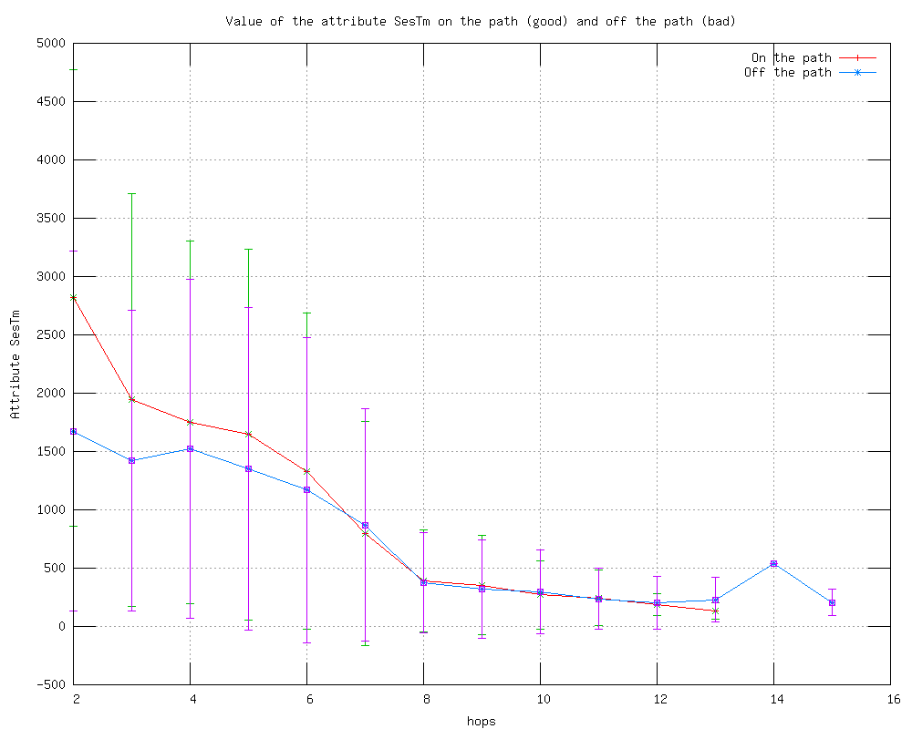
Paths go through heavy users
Total usage time in minutes
Shortest paths get through the heavy users

Slide 39
Compact nations
County | Country | Avg Path Len [hops]
Turkey | Turkey | 5.18
Brazil | Brazil | 5.60
Belgium | Belgium | 5.63
United Kingdom | United Kingdom | 5.63
Spain | Spain | 5.72
Mexico | Mexico | 5.72
France | France | 6.03
China | China | 6.38
United States | United States | 6.96
Degrees of separation (avg. shortest path length) inside the country

Slide 40
USA: Degrees of separation
County | Country | Avg Path Len [hops]
United States | Lebanon | 6.17
United States | Australia | 6.22
United States | Norway | 6.23
United States | Albania | 6.24
United States | Malta | 6.24
United States | United Kingdom | 6.28
United States | Bahamas | 6.29
United States | Sweden | 6.37
United States | Bahrain | 6.37
United States | Canada | 6.38
County | Country | Avg Path Len [hops]
United States | Bulgaria | 7.28
United States | Poland | 7.39
United States | Russia | 7.42
United States | Romania | 7.48
United States | Lithuania | 7.57
United States | Slovakia | 7.84
United States | Korea, South | 8.03
United States | Czech Republic | 8.05
United States | Japan | 8.85
Top “close” countries
Top “far” countries

Slide 41
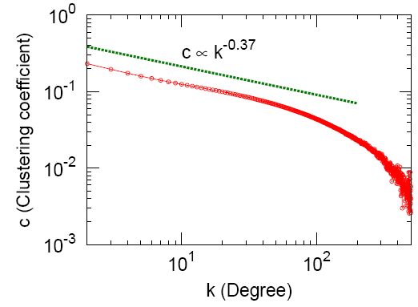
Network: Clustering
How many triangles are closed?
Clustering normally decays as k⁻¹
High clustering
Low clustering
Communication network is highly clustered: k^{-0.37}

Slide 42
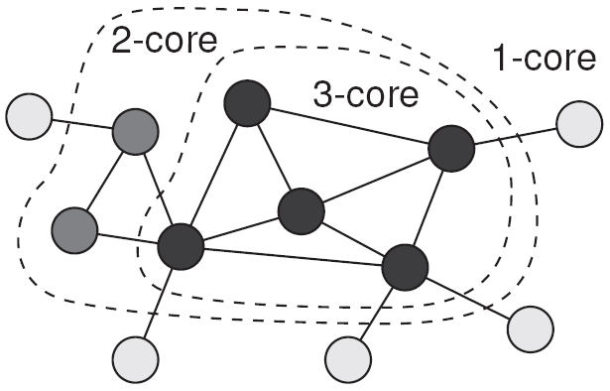
Network: k-Cores decomposition
[Batagelj & Zaveršnik, 2002]
What is the structure of the core of the network?

Slide 43
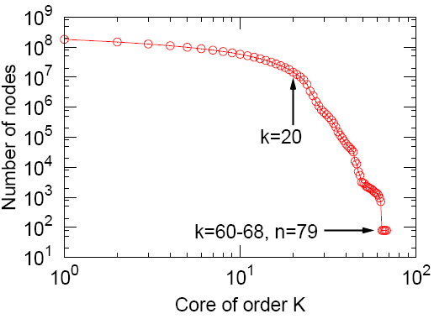
Network: Robustness
People with k<20 are the periphery
Core is composed of 79 people, each having 68 edges among them

Slide 44
Network: Tie-strength
Remove nodes (in some order) and observe how network falls apart:
  Number of edges deleted
  Size of largest connected component
Order nodes by:
  Number of links
  Total conversations
  Total conv. Duration
  Messages/conversation
  Avg. sent, avg. duration

Slide 45
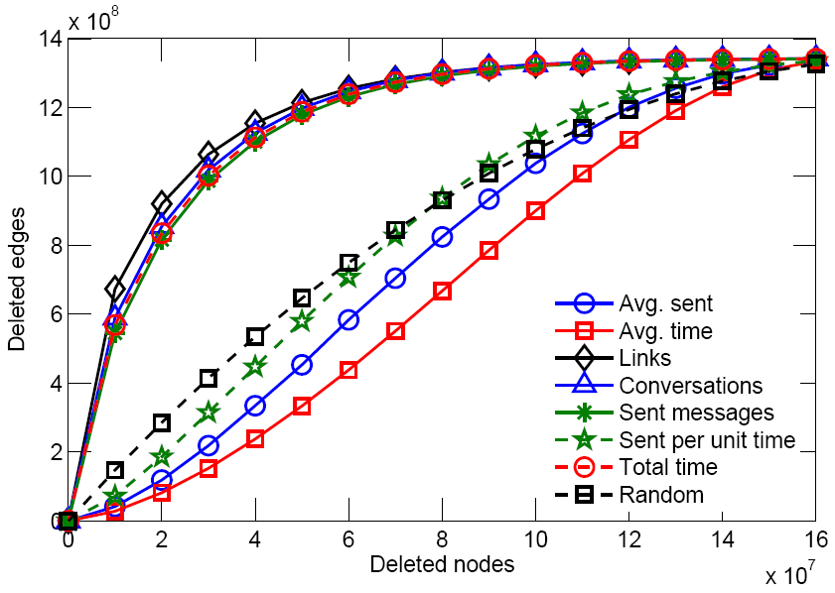
Strength: Nodes vs. Edges

Slide 46
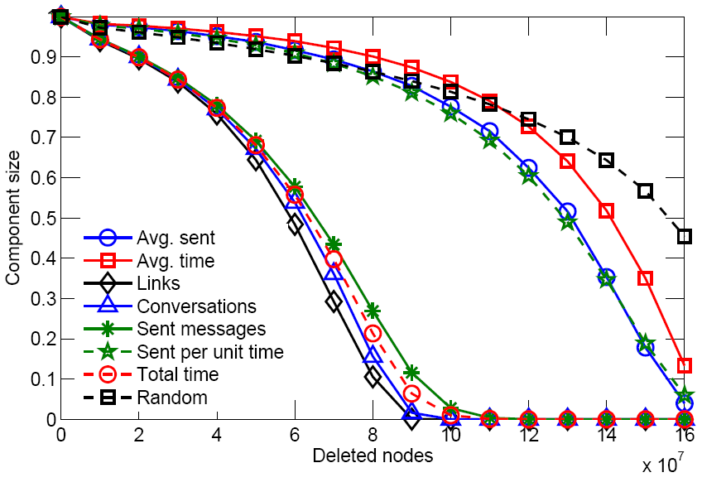
Strength: Connectivity

Slide 47
Conclusion
Social network of the whole planet Earth
  The largest social network analyzed
Strong presence of homophily
  people that communicate are similar (except gender)
Well connected Small-world
  in only few hops one can research most of the network
Very robust
  many (random) people can be removed and the network is still connected

Slide 48
References
J. Leskovec and E. Horvitz: Worldwide Buzz: Planetary-Scale Views on an Instant-Messaging Network, WWW 2008
http://www.cs.cmu.edu/~jure

