Slide 1
Analyzing and
Improving BitTorrent
Ashwin R. Bharambe (Carnegie Mellon University)
Cormac Herley (Microsoft Research, Redmond)
Venkat Padmanabhan (Microsoft Research, Redmond)
April 27, 2006 @ IEEE INFOCOM, Barcelona

Slide 2
How BitTorrent Works
Content Distribution Tool
…
1
…
Seed
3
2
…
…
…
5
4
…
…
…
1
File is chopped into pieces
3
Seed

Slide 3
How BitTorrent works
Downloaders exchange blocks with each other
  Utilizes perpendicular bandwidth
Tracker keeps track of connected peers
Salient features
  Which block to download first?
    Locally rarest block
  Which peers should I upload blocks to?
    Tit-for-tat: peers which give best download rates

Slide 4
Why study BitTorrent (again) ?
Very popular, successful: empirically
  What exactly makes it perform so well? Which parameter it chose is crucial?
Motivating Questions
  Are download rates optimal? Can we do better?
  Is the Rarest First policy really beneficial?
  Does rate-based Tit-for-tat (TFT) work?
  Must nodes continue seeding after downloading?
Answers depend on many parameters!
  Hard to control in measurements or analytically

Slide 5
Talk Outline
Goal: Analyze and understand BitTorrent
under various scenarios
Evaluation Methodology
  Simulation-based
Scalability under homogeneous settings
  Impact of block-choosing policy, degree, etc.
Fairness under heterogeneous settings
  Impact of Tit-for-tat
Post-flash-crowd scenario: pre-seeded nodes
Conclusion

Slide 6
Experimental Setup
Discrete-event simulator
  Models BitTorrent joins, leaves, block exchanges
  Models queuing delays, no propagation delay
  Fluid model of link sharing, no TCP dynamics
  Assumes bw-bottlenecks only at the edge
Common parameters
  100 MB file; 400 blocks of 256 KB
  1 seed always on, flash-crowd: 100 joins/sec
  Seed-uplink = 6 Mbps, Nodes = 1500/400 kbps
  #nodes = 1000, #neighbors = 7

Slide 7
Scalability
Questions:
  Does BitTorrent scale as the size of the flash crowd increases?
  Does it perform optimally?
    High uplink utilization
    High fairness (in the heterogeneous case)
Measurement Metrics
  Mean uplink utilization
    Mean over time, across all nodes
    Mean download time is directly related

Slide 8
Scalability: Uplink Utilization
Upload utilization is constantly very high

Slide 9
Problem Case: Slow Seed
Node capacities
  Uplink: 400 kbps
  Downlink: 1500 kbps
Seed capacity
  Uplink: varies from 200 kbps → 1000 kbps
Scenario: seed uplink = 400 kbps
  If BitTorrent is performing optimally, we should see near 100% uplink utilizatoin

Slide 10
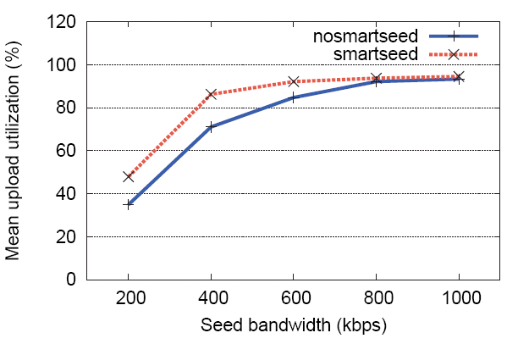
Problem Case: Slow Seed
Vanilla BitTorrent:
Connected nodes decide
which blocks to request from seed
The seed node decides
which blocks to serve
Avoid sending duplicate blocks from seed at all costs

Slide 11
Neighbor Count and Block Policy
Questions:
  How many neighbors required to guarantee good uplink utilization?
  When does Local Rarest First matter?

Slide 12
Neighbor Count and Block Policy
Very low neighbor count
is sub-optimal
Beyond a threshold,
neighbor count does not
affect utilization
Local Rarest First policy
works better than Random
block picking
However, differences are
discernible only when the
seed bandwidth is low!

Slide 13
Improving Fairness
Goal: ensure nodes upload as much as they download
  ISPs have begun to charge heavy P2P users
  Uploaders will bear the brunt of the charges
BitTorrent’s rate-based TFT and optimistic unchoke can result in high unfairness
Proposed solution: pair-wise block-based TFT
  Bound the difference between blocks uploaded and downloaded

Slide 14
Improving Fairness
Questions:
  In the worst case, how many blocks does a node serve?
    Measure as ratio to #blocks downloaded
  What is the overall uplink utilization?
    TFT advocates blocking a link even when there is data to send
    Can hurt link utilization

Slide 15
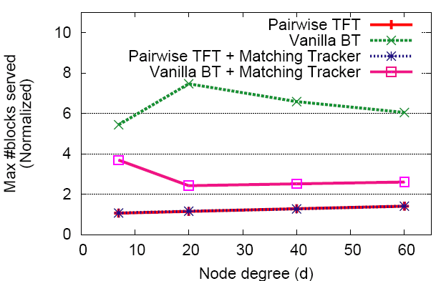
Improving Fairness: Blocks served
Vanilla BitTorrent results
in high unfairness
Block-level TFT effective
Matching Tracker useful

Slide 16
Improving Fairness: Uplink Utilization
Matching Tracker helps
increase utilization
Pairwise TFT needs
higher node degrees
for better utilization

Slide 17
Other Workloads: Pre-seeded Nodes
Scenario
  Some nodes join a flash crowd
  Partially finish the download
  Re-join a flash crowd later
Question:
  Other nodes start afresh; hence not so choosy
  These nodes are looking for specific blocks
    Do they require more time to finish?

Slide 18
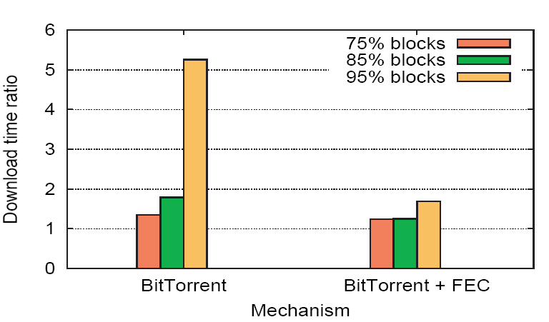
Pre-seeded nodes: Download Time
LRF “equalizes” rate of
block “flow” ➔ pre-seeded
nodes takes longer
Small amount of FEC
improves performance
significantly!

Slide 19
Conclusion
Focus: upload utilization and (un)fairness
Findings
  BitTorrent scales well
    Local Rarest First eliminates last-block problem
    Design decisions crucial when seed uplink is slow
  Rate-based TFT can result in unfairness in heterogeneous settings
    Block-based TFT can alleviate it
  LRF may be sub-optimal if nodes have differing objectives
    Source-based FEC sometimes useful

Slide 20
Thank You!
Find simulator-code (C#) at:
http://research.microsoft.com/projects/btsim
Questions?

