Slide 1
Measurement-based Characterization of a Collection of On-line Games
Chris Chambers
Wu-chang Feng
Portland State University
Sambit Sahu
Debanjan Saha
IBM Research

Slide 2
Background
On-line games are big business
  60% of all Americans play video games (IDSA report, 2003)
  MMO games
    4,000,000 World of Warcraft subscribers paying monthly fees
  FPS games
    100,000 Counter-strike players at any given time
  RTS games
    >8 million Warcraft game copies sold
    200,000 Warcraft 3 games played online / day
Hosting games very costly (30% of revenue)

Slide 3
Research questions
How can we ease the burden of hosting an on-line game?
How tolerant are gamers to bad service?
How predictable is the gaming workload? How tightly can we provision?
Can games be hosted with other interactive applications ?

Slide 4
Data Sources for On-line Gaming
Traditionally difficult to acquire
  Game companies don’t want to share data (NDA)
  On-line games are costly to host
Measurement research focused on short timescales
  Packet sizes, distribution
  On the order of hours

Slide 5
Data Sources for On-line Gaming
Content delivery network for FPS games
Individual player information from a Counter-strike server
Total population of a variety of games
STEAM
Sept 2004 – Apr 2004
6.19TB served
3.14 GB/s average
GAMESPY
Nov 2002-Jan 2005
550 games
337.8k player years
CS.MSHMRO.COM
April 2003-April 2004
2,886,992 connections
493,889 unique players

Slide 6
Observations
Observations are specific to our data sources (FPS, public-server)
Hope is techniques can be applied to other game data
Gamers
Games
Content
Delivery

Slide 7
Gamers as individuals
Gamers are impatient
  Negative exponential response to full server
  Only 16% will tolerate one retry at connection
Gamers have short attention spans
  Average session time: 15 minutes
  Many departures after a few minutes

Slide 8
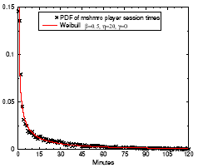
Gamers have short attention spans
Measure session times
Results
  Not negative exponential:
  high rate of departure for short sessions
Fitted with Weibull
Why? Many servers to choose from

Slide 9
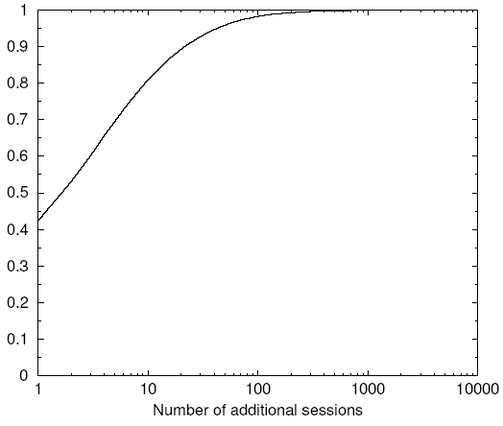
Gamers are not loyal
Why would they be?
  Simplicity
  Community
  Stickiness
Why wouldn’t they be?
  Many choices
Measuring: repeated sessions on our server
Results:
  42% return once
  81% return < 10 times
  Dedicated players exist

Slide 10
Gamers reveal waning interest
Interest in a game varies per user, but eventually they all quit
Game providers would love to know how to predict this
Measure individual’s play history: session times and intersession times
Compute average player history
Our data is too sparse to predict player interest individually

Slide 11
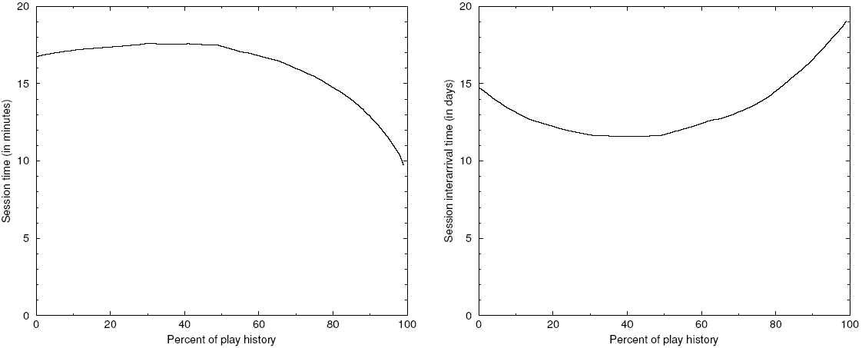
Gamers reveal waning interest

Slide 12
Game populations
Measuring the Gamespy dataset
Key Questions
  What is the distribution of game popularity?
  Over what timescales are game populations predictable?
  What is the likelihood of multiplexing games with other applications?
Gamers
Games
Content
Delivery

Slide 13
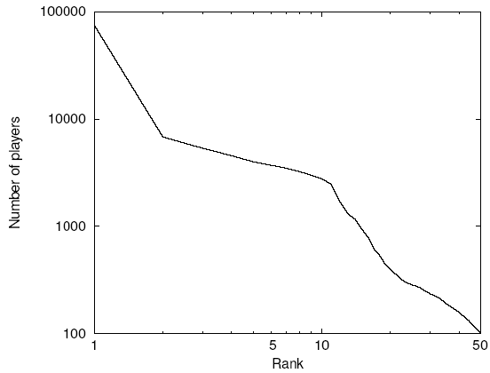
Game popularity follows a power law
Measure: top 50 games in rank order once a day
Average rankings over the year
  Independent of game popularity fluctuations
Roughly straight line on log-log graph
Popularity between ranks differs by orders of magnitude
MMO’s also seem this way

Slide 14
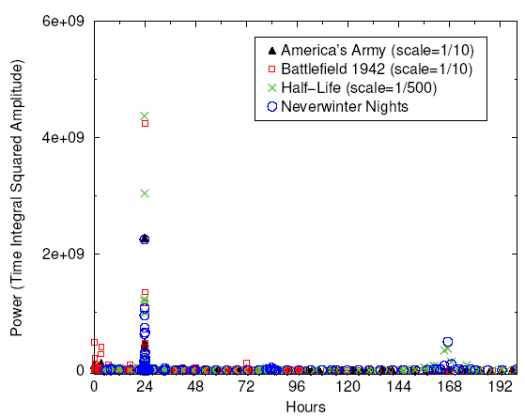
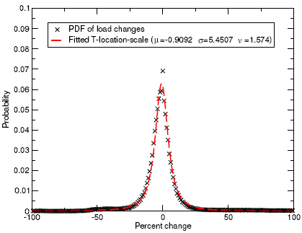
Game workloads: predictable over short timescales
Games are periodic
  Daily / weekly
Variation from week to week very small

Slide 15
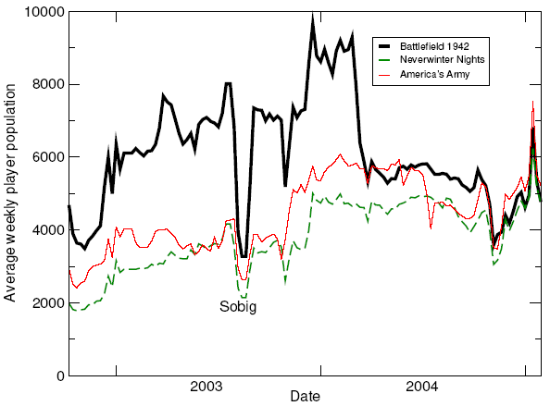
Game workloads: unpredictable over long term
No monthly periodicities
Synchronized by external events

Slide 16
Game multiplexing
Is there benefit to hosting multiple games together?
Is there benefit to hosting games and web servers together?

Slide 17
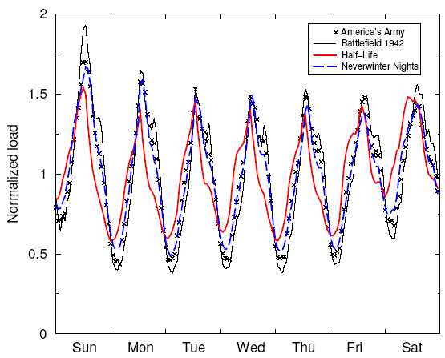
Game loads are synchronized
4 games
Varying popularities normalized
Little opportunity for multiplexing

Slide 18
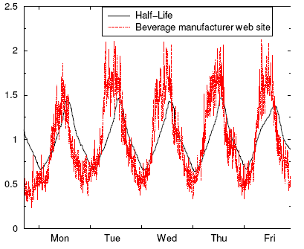
Game and web loads are synchronized
Web data source:
  One week
  International beverage corp.
Half-life vs. web
Little opportunity for multiplexing

Slide 19
Conclusions
Gamers
  Not loyal to public-servers
  Predictable lifecycles
Games
  Hard to provision for popularity
  Easy to predict load from week-to-week
  Multiplexing games/web or games/games unlikely
Patching
  Significant resource consumption

Slide 20
OPTIONAL SLIDES

