Slide 1


Donnybrook: Enabling Large-Scale, High-Speed, Peer-to-Peer Games
Ashwin Bharambe
Jeffrey Pang
Srinivasan Seshan
Xinyu Zhuang
John R. Douceur
Jacob R. Lorch
Thomas Moscibroda
Notes:
As ___ said, I’m Jeff Pang and I’ll be presenting our system called Donnybrook. This is joint work with my colleagues at CMU and Microsoft research listed on this slide.

Slide 2


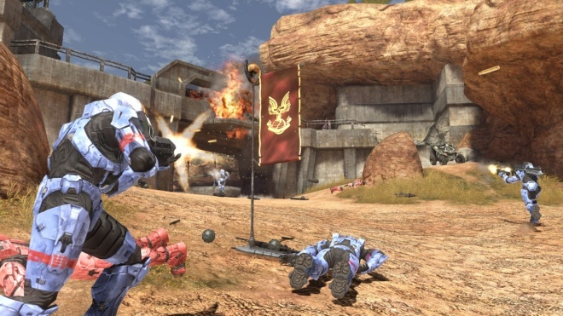

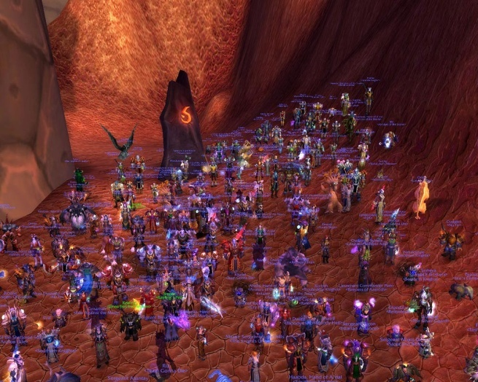

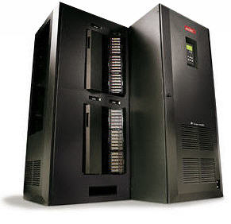


High-Speed, Large-Scale, P2P: Pick 2
Many console games are peer hosted to save costs
Limits high-speed games to 32 players
1000+ player games need dedicated servers
P2P
High-speed
Question: Can we achieve all 3?
Large-scale
Notes:
Multiplayer console games, like many xbox live games, are often hosted on the machines participating in the game rather than on dedicated servers in order to save costs and administrative overheads. However, this limits the scale of popular high-speed games, such as first person shooters, to a small number of players. Large-scale games, such as massively multiplayer games, support 1000 or 10s of thousands of players and are also very popular but they currently require dedicated servers.
So far, no game architecture has been able to support games that are high-speed, large-scale, and peer hosted. The question we ask in this talk is whether we can support all three.

Slide 3
Game Execution Model
Donnybrook | Jeffrey Pang (CMU) | SIGCOMM 2008
3
Game State:
  Collection of distinct objects (players, missiles, items, etc.)
Game Execution:
  Each object has a Think function:
  Think() { ReadPlayerInput(); DoActions(); ... }
  Execute each object once per frame:
  Each 50ms do {
  foreach object do {
  object->Think();
  }
  }
Notes:
3

Slide 4






P2P
Local View
Replica objects
Internet
Primary object
Notes:
To understand why this is hard, lets consider an example. In peer-to-peer games, the objects in the game such as player avatars are hosted on the peers themselves. Sometimes one peer acts as a server and hosts all the objects but we’re going to look at the case when each peer hosts its own player to leverage all peers’ bandwidth resources.
Each peer sends updates about its object to all others so that everyone can create a replica and render the current view.

Slide 5

High-Speed
Local View
Replica objects
Internet
Primary object
Inter-object writes
must be reflected
very quickly
Notes:
In high-speed games, interactions between objects, such as when one player shoots another, must be reflected very quickly, otherwise the game is no longer fun.

Slide 6
High-Speed
Local View
Replica objects
Internet
Primary object
20 updates/sec
≈ 16 kbps per player
Delay must be < 150ms
[Beigbeder ‘04]
Notes:
This implies that each peer must send updates very frequently so that when interactions occur, they appear consistently for the players involved. In practice, updates for FPS games are sent each game frame or 20 times per second and must be delivered within 150 milliseconds or else their staleness degrades the game play experience.

Slide 7

Large-Scale
Bandwidth per Player (Mbps)
Internet
Notes:
Finally, to achieve large-scale, a copy of each update must be delivered to each new player that enters the game. Thus, the aggregate upload capacity needed scales quadratically with the number of players. Because of the high-update rate, the constant factor is also very large.

Slide 8
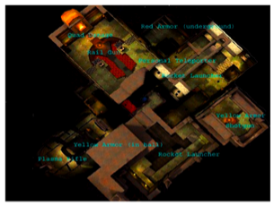
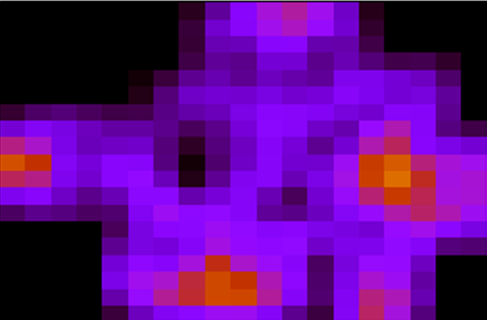

Area-of-Interest (AOI) Filtering
Only receive updates from players in your AOI
  Colyseus [Bharambe ‘06]
  VON [Hu ‘06]
  SimMUD [Knutsson ’04]
Problems:
  Open-area maps, large battles
  Region populations naturally follow a power-law
  [Bharambe ‘06, Pittman ‘07]
Quake 3 region popularity
Low population
High population
Requirement: ~1000 players in same AOI
Notes:
Previous work has tried to address this problem by using area-of-interest filtering. Some game worlds can be partitioned into different regions and players only need to receive updates from others in the same region, such as those that are currently visible. However, area-of-interest filtering can not help when the map can not be partitioned or when game developers want to engineer a large scale game event such as a large battle.
Furthermore, it has been shown that even in maps that are partitioned, the population in different regions follows a power-law. Thus, if there are 1000s or 10s of thousands of players in the game, it is still likely that there are about 1000 players in a single region.

Slide 9
Projected Scalability
Typical broadband peer
Mean of all peers (see paper)
Goal
Projection
Notes:
This graph shows the maximum number of players that we can support as we increase the upload capacity per peer on the x-axis. The grey line shows how far we get using existing approaches.
These blue boxes give you a sense of where we are today. Clearly, if we only rely on home broadband users, we can not even reach 100 players. But even if we could aggregate the bandwidth of all typical peers in a game, including those with better connectivity at universities, we would still be no where near our goal of 1000 players.

Slide 10
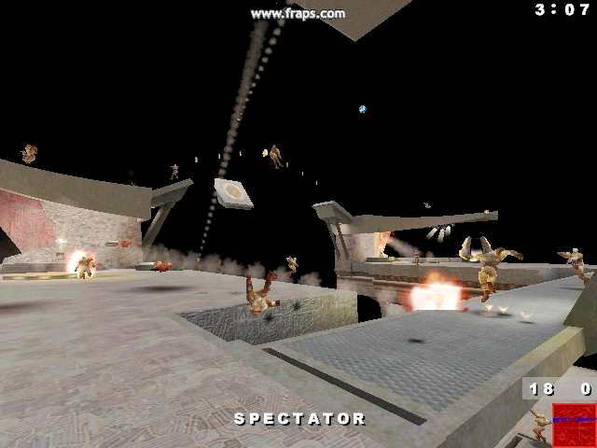
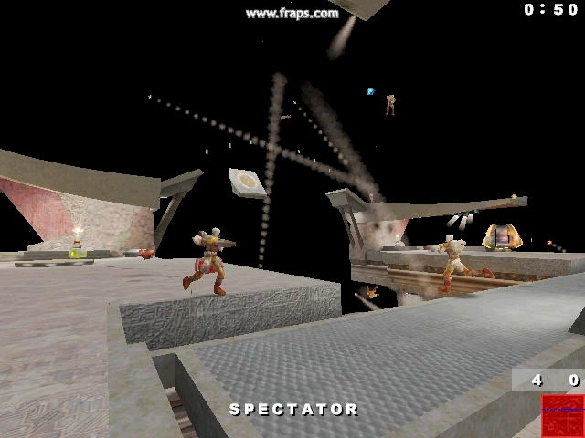
Not Enough Bandwidth
Ideal
20 updates/sec
Cable Modem (128 kbps)
5 updates/sec
[P2P Quake 3]
Notes:
If we tried to play this game without enough upload capacity, then it becomes choppy and unsatisfying. For example, the left shows an ideal 32-player game and you can see that player movement is smooth. On the right shows the same game on a low-speed cable modem and you can see that player movement is more choppy, especially the ones jumping in the air. Of course, this effect gets worse as the number of players increases.

Slide 11
Talk Outline
Motivation and Goals
Donnybrook: Interest Sets
  Reduces mean bandwidth demands
Donnybrook: Update Dissemination
  Handles interest and bandwidth heterogeneity
Evaluation
Notes:
In the remainder of this talk I will present Donnybrook, our solution to this problem. Donnybrook uses two main novel techniques to achieve large-scale, high-speed, peer-to-peer games. First, I will describe interest sets which reduces the total bandwidth demand in the system. Second, I will describe a novel update dissemination scheme that allows us to handle extreme interest and bandwidth heterogeneity. Finally, I will present a few evaluation results.

Slide 12



Smoothing Infrequent Updates
Send guidance (predictions) instead of state updates
Guidable AI extrapolates transitions between points
  E.g., game path-finding code
Problem: Predictions are not always accurate
  Interactions appear inconsistent
  Jarring if player is paying attention
Actual path
Replica object
?
guidance
guidance
Notes:
Since we don’t have enough bandwidth to send updates at the ideal rate, we employ a novel technique to smooth infrequent updates. Players send guidance or predictions instead of state updates and we use guidable AI to smoothly extrapolate the transition between each guidance.
For example, we use existing path-finding code to make replicas move between each predicted position. Of course, if this was sufficient, we would never have needed to send frequent updates to begin with.
The problem is that predictions can still be wrong.
This means interactions between players will appear inconsistent. This is even more jarring than choppy movement when players are paying attention.

Slide 13


Donnybrook: Interest Sets
Intuition: A human can only focus on a constant number of objects at once
[Cowan ‘01, Robson ‘81]
  Only need a constant number of high-accuracy replicas
Interest Set: The 5 players that I am most interested in
  Subscribe to these players to receive 20 updates/sec
  Only get 1 update/sec from everyone else
My Interest Set
Me
Notes:
The intuition behind interest sets is that even when many players are visible, a human can only focus on a constant number of them at once. Thus, we should only need to have high-accuracy replicas of these objects.
We define my interest set as the five other players that I am most interested in. I subscribe to these players to receive frequent updates from them, while they receive only 1 update per second from everyone else. Other players replicas use guidable AI.

Slide 14
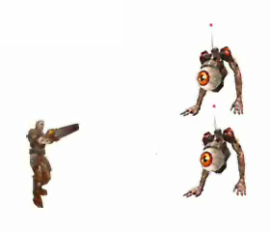
Donnybrook: Interest Sets
How to estimate human attention?
  Attention(i) = how much I am focused on player i
Attention(i) =
f_{proximity}(d_{i})
+
f_{aim}(θ_{i})
+
f_{interaction-recency}(t_{i})
θ₁
θ₂
d₁
d₂
Player 1
Player 2
Notes:
How does the game estimate what I am paying attention to?
We leverage the fact that several measurable metrics are often heavily correlated with attention in first person shooter games and compute attention as a weighted sum of these metrics:
-Proximity, because I am more likely to focus on players closer to me
Aim, because I am more likely to focus on players I am aiming at
And interaction-recentcy, because I am more likely to focus on a player I interacted with recently, such as if I shot them recently
We found that these simple metrics were a fairly good indicator of player focus in Quake III

Slide 15
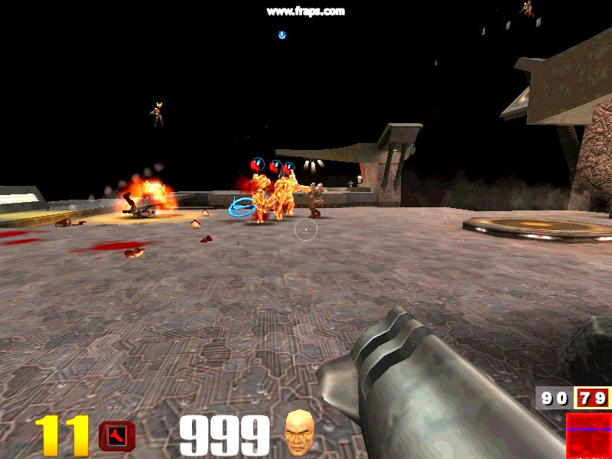

Not in Interest Set
= Interest Set
Notes:
To illustrate, lets look at a Quake III game. Here, the players in my interest set are glowing and have a marker over their head. Of course, we wouldn’t actually show which players these are in a real game. These players are in my interest set because they are closer to me and close to my center of aim, shown as a circle and a dot at the center of the screen.
As I move around and follow the player I am trying to shoot, my interest set changes, but intuitively, those in my interest set are probably those that I am paying most attention to.

Slide 16
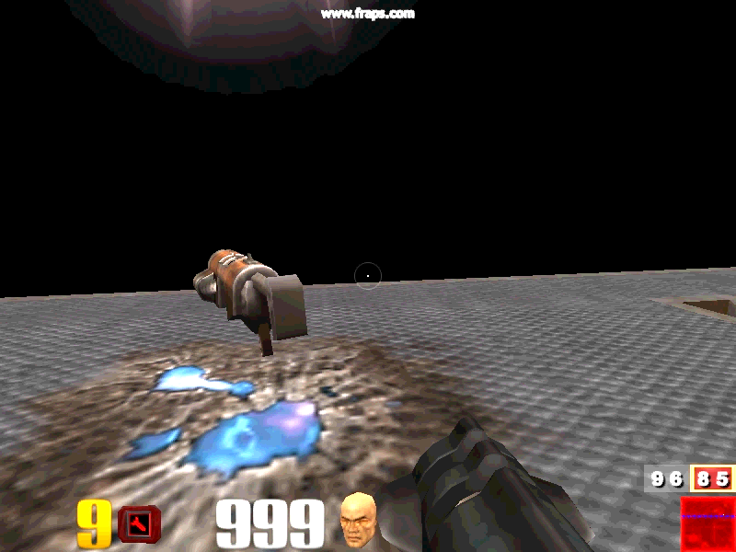
Notes:
Of course, sometimes I will pick up a sniper weapon and then aim will be more important than proximity.

Slide 17
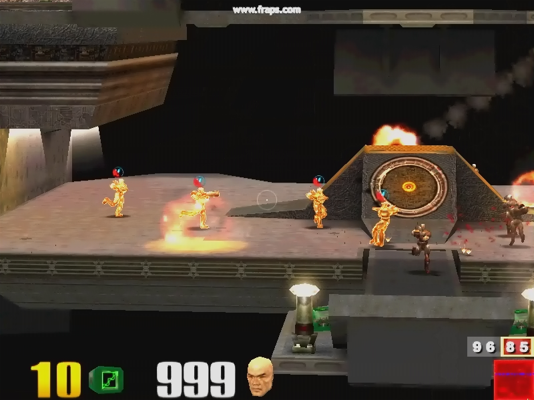
Notes:
Here we see that while some players are closer to me, the ones closer to the center of my screen are in my interest set because I am more likely to be aiming to shoot one of them.

Slide 18
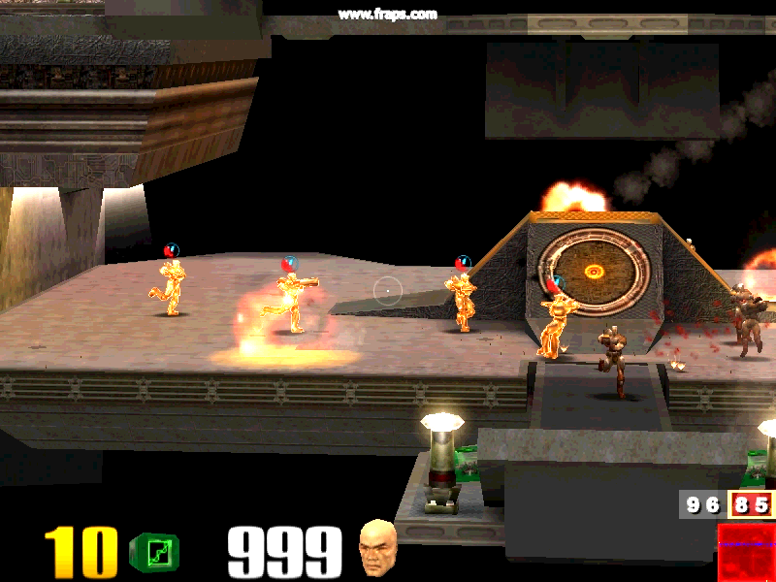
Notes:
Thus, interest sets allow the game to replay players I am paying attention to with higher accuracy, which makes interactions more likely to appear consistent.

Slide 19

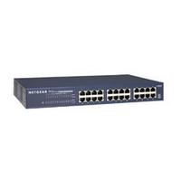
Interest Set Evaluation
Question: Do Interest Sets improve fun in LoBW games?
Question: Do they make LoBW games as fun as HiBW?
User study: each pair of players compares 2 of 3 versions:
30 bots
curr
curr
curr
…
curr
IS
IS
IS
…
IS
curr
curr
curr
…
curr
Internet
(simulated)
Internet
(simulated)
Cable
Modem
Cable
Modem
LAN
(simulated)
curr
curr
IS
IS
curr
curr
2 humans
LoBW
LoBW-IS
HiBW
Notes:
Of course, the real questions are whether interest sets improve fun in low bandwidth games and how closely they can approximate a high-bandwidth, ideal game. To answer these questions, we conducted a user study with 44 pairs of players that played the game I just showed. Each pair compared one of two versions: a low bandwidth scenario using conventional approaches, a low bandwidth game using interest sets, and a high-bandwidth ideal game.

Slide 20
User Study Results
LoBW vs LoBW-IS
LoBW-IS vs HiBW
Survey: How fun was each version?
Notes:
This graph shows one of several metrics in our paper that all support the same conclusions. The x-axis shows the versions used in each head-to-head comparison and the y-axis shows the “fun score” that each player gave to each version. The error bars show 95 percentile confidence intervals. We see that players clearly preferred the game with interest sets than without in a low bandwidth setting. In addition, the difference in scores between the ideal case and a low bandwidth game with interest sets is statistically insignificant. We conclude that interest sets effectively preserve game fun when there is not enough bandwidth to send all updates.

Slide 21
Projected Scalability
Typical broadband peer
Mean of all peers (see paper)
Goal
With Interest Sets
Without Interest Sets
Notes:
We again show the scaling graph but here the red line shows how far we can get if we use interest sets. The bandwidth demand is still linear per player because each player still has to send infrequent updates to every other. But 20 updates per second are only received from 5 other players so the constant factor is much smaller. We see that we can probably support several hundred players if all peers only ever needed broadband capacities, but in order to meet out goal we still need some way to leverage the bandwidth resources of higher bandwidth peers to get the expected mean.

Slide 22
Talk Outline
Motivation and Goals
Donnybrook: Interest Sets
  Reduces mean bandwidth demands
Donnybrook: Update Dissemination
  Handles interest and bandwidth heterogeneity
Evaluation
Notes:
Thus, I will next describe Donnybrook’s update dissemination scheme to handle this heterogeneity.

Slide 23


Problem: Bandwidth Heterogeneity
6Mbps
1Mbps
128kbps
512kbps
Notes:
The first problem, of course, is that while the mean bandwidth is sufficient, some peers have much less bandwidth than others and still don’t individually have sufficient capacity.

Slide 24
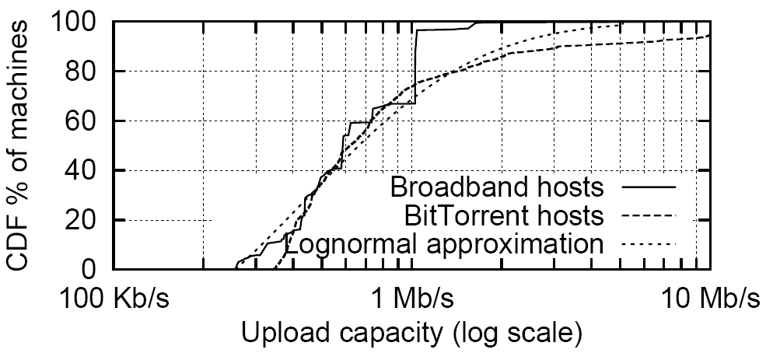
Bandwidth Distributions
Most peers have < 768 kbps, some have much more
Donnybrook | Jeffrey Pang (CMU) | SIGCOMM 2008
24

Slide 25


Problem: Interest Heterogeneity
6Mbps
1Mbps
128kbps
512kbps
Attention
Notes:
A second, equally important problem is that interest is not uniformly distributed. Suppose I am the non-eyeball player here. We have one other player paying attention to me, so I only need to send updates to them.
But if I were to pickup an important item such as a flag in a capture the flag game or otherwise become more important, many more players will probably start paying attention to me and I may not have enough bandwidth alone to send updates to them all even if I have high capacity.

Slide 26
Why not Overlay Multicast?
Main requirements:
  Strict delay bound (150ms)
  Frequent membership changes (68% turnover/sec)
  Bandwidth heterogeneity
  Many overlapping groups
Previous overlay multicast:
  Unstructured [Narada, NICE]: Hard to meet 2 and 4
  Structured [Splitstream]:
  Hard to meet 1 and 3
6Mbps
1Mbps
?
?
128kbps
512kbps
Join red
group
Problem: subscriber-initiated tree construction
needs lots of coordination overhead or is inflexible
Notes:
Overlay multicast is the traditional solution to this problem. High bandwidth peers can help forward updates for low bandwidth peers. For game updates, we have 4 main requirements: first, we have a strict delay bound because updates older than 150ms are too stale; second, group membership changes very frequently because games are fast paced and attention shifts within seconds; third, we have bandwidth heterogeneity; and finally, we have many overlapping groups because each player is a source.
The problem with existing approaches is that they generally require subscribers to find good places to join the multicast tree themselves. For example, when this new eyeball player joins my group, it would have to figure out where to become a leaf node.
In unstructured approaches, this requires lots of coordination overhead which we can not amortize because groups change too frequently. In structured approaches, node placement is less flexible which makes meeting tight delay bounds difficult.

Slide 27

Donnybrook: Update Dissemination
Forwarding Pool
Well connected peers join forwarding pool
  Based on relative bandwidth and latency thresholds
These nodes advertise their forwarding capacity
  Piggy-backed on low freq. updates
Sources randomly pick enough forwarders to satisfy needs each frame
  Avoids need for coordination
  Fixed tree depth to bound delay
6Mbps
1Mbps
Frame #1
128kbps
512kbps
Randomized source-initiated tree construction
Notes:
Instead, we take the following approach:
We have well connected peers join a forwarding pool. Nodes detect locally whether they are a member of this pool using relative bandwidth and latency thresholds. These nodes advertise spare capacity to others. These advertisements are piggybacked on low frequency updates which recall are sent once per second.
Finally, when a low bandwidth node needs extra bandwidth to send its updates, it randomly picks enough forwarders in this pool to satisfy its needs.

Slide 28
Donnybrook: Update Dissemination
Forwarding Pool
Well connected peers join forwarding pool
  Based on relative bandwidth and latency thresholds
These nodes advertise their forwarding capacity
  Piggy-backed on low freq. updates
Sources randomly pick enough forwarders to satisfy needs each frame
  Avoids need for coordination
  Fixed tree depth to bound delay
6Mbps
1Mbps
Frame #2
Frame #1
128kbps
512kbps
Join red
group
Randomized source-initiated tree construction
Notes:
Since a node’s subscribers change very quickly --- for example, this eyeball can again join my group --- each node carries out this process again each frame. Thus, the tree may be different each frame.

Slide 29

Donnybrook: Update Dissemination
Main requirements:
  Strict delay bound: constant tree depth
  Freq. membership changes: uncoordinated tree construction
  Bandwidth heterogeneity: high bandwidth forwarding pool
  Many overlapping groups: shared forwarding resources
Trade-off: If too many sources pick the same forwarder then the forwarder must drop some updates
  Leave some headroom (advertise only ½ forwarder capacity)
  ⇒ drops happen rarely and only cause loss for 1 frame
  5-10% loss is OK [Beigbeder ‘04]
Notes:
Thus, this approach meets all our main requirements.
The main trade-off of our approach is that many sources may randomly pick the same forwarder one frame. This forwarder will not have enough capacity to forward all the updates so it will have to drop some. To address this, we simply leave some headroom so some collisions are tolerated. Drops happen rarely and probably only causes loss for a single frame since a new randomized tree is constructed each frame. This is OK for games because a small amount of loss is imperceptible.

Slide 30
Update Dissemination Evaluation
Question: Does this approach deliver enough
updates on time to preserve fun game play?
  (i.e. 90-95% of updates in 150ms [Beigbeder ‘04])
Evaluation setup (see paper for details)
Implementation | Quake 3 with interest sets and update dissemination
Workload | Synthetic 100-1000 player games using “bots” based on real 32 player CTF games [Bharambe ‘06]
Network | Packet-level network simulator bandwidth model: P2P hosts [Piatek ‘07] latency model: Halo 3 players [Lee ‘08] loss model: two-state Gilbert model [Zhang ‘01]
Notes:
The main question we want to answer however, is whether this approach can deliver enough updates on time to preserve fun game play. As mentioned before, this means delivering 90-95% of updates within 150ms.
To evaluate our approach, we implemented it with Quake 3. Like previous work, we used synthetic large-scale game workloads based on small scale capture the flag games. Finally, we simulated the network between nodes using empirical models for likely gaming hosts which are described in detail in the paper.

Slide 31
Evaluation Results
Updates Received
Updates Required
Enough updates are delivered on time at all scales
Notes:
Here we show the percentage of updates that were received on time, averaged across several trials, as we increase the number of players in the game. Error bars show 95 percentile confidence intervals. The gray line shows the percentage of updates we want in order to preserve fun game play. We see that the red line is always above the grey line, so enough updates are delivered on time at all scales up to 1000 players.

Slide 32

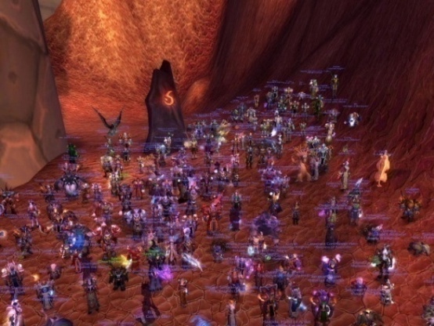


Donnybrook Summary
Key techniques:
  Interest sets:
  reduce bandwidth demands
  Update dissemination:
  handles heterogeneity
Ongoing work:
  1000 player deployment
Goal
With Donnybrook
Without Donnybrook
P2P
High-speed
Large-scale
+
+
Notes:
We conclude that Donnybrook can preserve the fun of large-scale, high-speed games in peer-to-peer environments. We are currently working on a large scale deployment which hopefully you will be able to play soon.

Slide 33
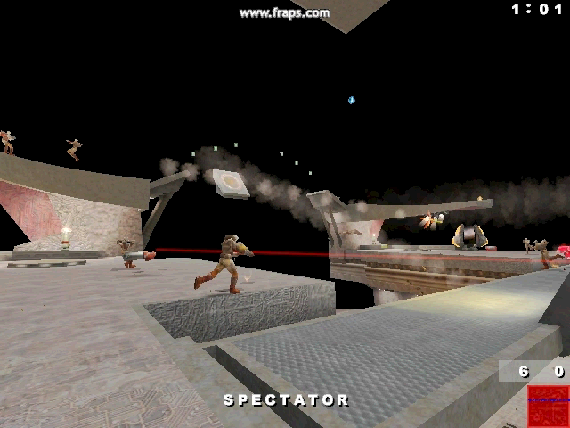
Questions?
Cable Modem
Cable Modem with Donnybrook
http://www.epicbattle.us

Slide 34
======= Clarification Slides =======

Slide 35
Mitigating Cheating
Existing defenses can prevent software cheats
  Deploy on consoles (relatively closed platforms)
  Use trusted hardware (e.g., Xbox 360 TPM)
  Encrypt all packets between nodes
Donnybrook is uniquely vulnerable to traffic analysis
  Examine update packets you send to determine receivers
  ⇒ Allows you to see who is paying attention to you
  Drop update/guidance packets that you receive
  ⇒ Causes all replicas on your node to act using “dumb” AI
Ongoing work on traffic analysis defense
  Choose forwarders to conceal packet source/destinations
  Punish player if expected message rates are not maintained

Slide 36
Pairwise Rapid Agreement
Interaction: when player A modifies player B
(i.e. A performs a write on B)
Goal: modification is consistent and applied quickly
Insight: # interactions scales slowly
  Occur at human time scales ⇒ infrequent
  Involve only 2 players ⇒ unicast
Solution: prioritize all inter-object writes
  Player A sends mod to Player B
  Player B applies mod, sends result to A
PRAs required in Quake III:
  Damage, Death, Item Pickup, Door Opening
[Pang, IPTPS ’07]

Slide 37
Guidance
Motivation: state updates get stale fast
  Example: players can travel the diameter of a Quake 3 map in seconds
  Goal: send prediction of state at time of next expected guidance
  Example: predict where a player will be at the next guidance
Predicted Properties:
  Predict position: simulate where physics brings player in next second
  Predict viewing angle: use view angles to estimate player’s target aim
  Predict Events: use #-shots-fired to estimate when a player is “shooty”

Slide 38
Guidable AI
Problem: Guidable AI peers receive very infrequent guidance
Solution: Smooth state changes with AI
  Position: use existing path finding code to make replica move smoothly
  Angle: have AI turn smoothly toward predicted targets
Convergence
  Motivation: Players in focus should be represented more accurately,
  but should not “warp” to actual position
  Solution: Converge to actual state when receiving frequent updates
    Focus on player B
    ⇒ In player B’s Focus Set, get frequent updates
    ⇒ Error(replica, actual) decreases with each update
    When Error() < ε, use player B’s update snapshots instead of AI
    Error(a,b) = distance(a.position, b.position)

Slide 39
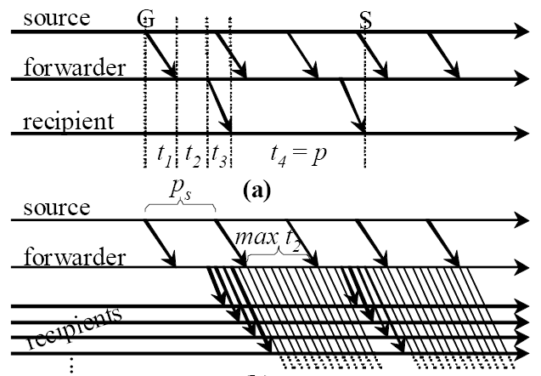
Guidance Forwarding
Every player needs guidance from every other once a sec
Non-forwarding pool players contribute spare bandwidth to forwarding guidance
Nodes coordinate to match sources to forwarders
(configuration changes rarely)
Sources send fresh guidance to a forwarder once a frame
Forwarders stagger guidance to avoid queuing delay
⇒ Ensures all recipients get guidance at most 1 frame old (plus transmission delay)

Slide 40
======= User Study Slides =======

Slide 41


User Study Setup
15 min
User Study Procedure
  Before experiment, practice on HiBW
  Tell players two Quake III “servers” exist: A and B
  Start playing on A, can vote to switch to B
A
This sucks
Switch!
  When both players vote, game continues on B
B
  Can vote to switch back and forth
  Analog to how players choose game servers
  (if good, stay, otherwise leave and try another)
Switch back
OK
  Play new game on least-used version so they can compare
5 min

Slide 42
User Study Stats
LoBW-IS vs. LoBW: 12 trials
LoBW-IS vs. HiBW: 32 trials
88 total participants
How often did you play
FPS games in the past?
Every Day
62%
Every Week
25%
Less Often
13%

Slide 43
User Study: Total Stay Time
LoBW vs. LoBW-Donny
LoBW-Donny vs. HiBW
How long does a pair play on each version?
Notes:
One metric we measure from this experiment is the total stay time, that is when comparing two versions, how much time does each pair spend on each version
This graph shows the mean stay time in our two comparisons, with error bars showing 95 percentile confidence intervals
On the left we show the results when comparing lobw with lowbw-donny. Of course, ½ the peers in these experiments started on lobw while the other ½ started on lobw-donny so we don’t bias the result toward the version they started on.
As you can see, players spent the vast majority of their time on lobw-donny.
In comparison, on the right, we show the results when comparing lobw-donny and the hibw scenario
Players slightly prefer the hibw version but only slightly. The difference in our experiment is actually not statistically signicant
Therefore, we conclude that donnybrook does substantially improve the playability of games in lobw environments and players are nearly as satisfied in a lobw scenario as they are on a hibw lan

Slide 44
User Study: Departure Time
Time until first vote
Time until second vote
How long before a player wants to switch?

Slide 45
User Study: Preference
4%
LoBW
No Pref.
17%
52%
HiBW
LoBW-
Donny
96%
31%
LoBW-
Donny
LoBW-Donny vs. LoBW
LoBW-Donny vs. HiBW
Survey: Was A or B more Fun?

Slide 46
Interest Sets: Fairness
Random bots
All bots level 5
HiBW
LoBW-
Donny
LoBW
[Experiment with 16 bots at different skill levels]
Donnybrook preserves coarse skill-level differences

Slide 47
======= Game Stats Slides =======

Slide 48
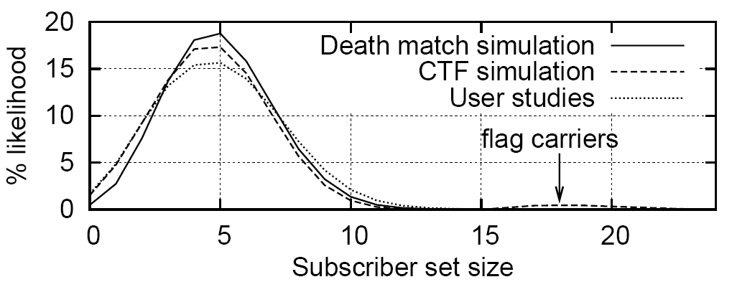
Subscriber Set Size
[32 player game]
Some players have lots of subscribers

Slide 49
======= Evaluation Slides =======

Slide 50
Evaluation: Broadband Only
Enough updates are delivered at all supported scales

Slide 51
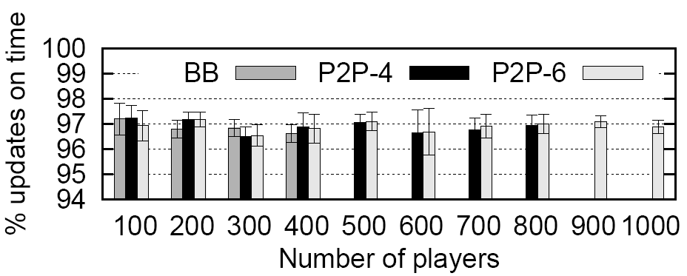
Evaluation: Other BW Distributions
Enough updates are delivered at all supported scales

Slide 52
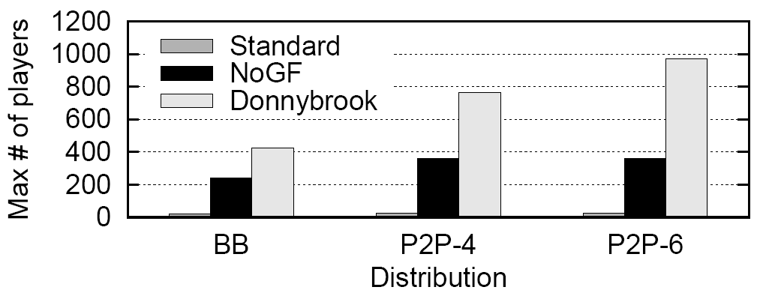
Evaluation: Scale
Donnybrook enables 100s of players in many BW models

Slide 53
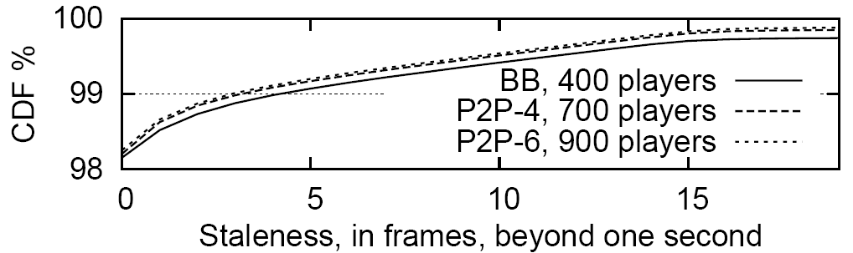
Evaluation: Guidance Staleness
Guidance is almost never stale

Slide 54
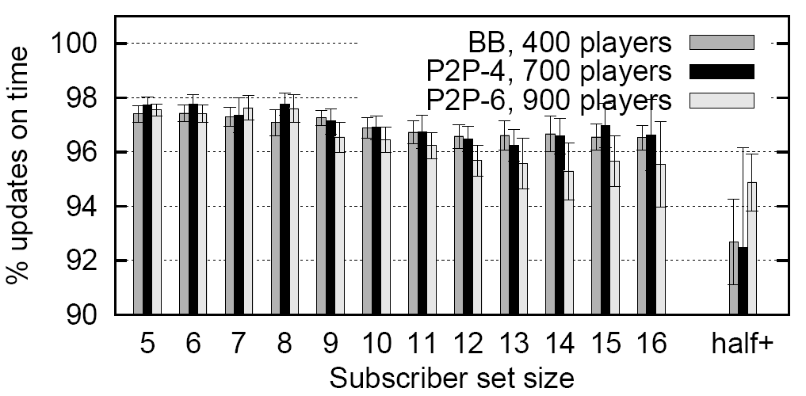
Evaluation: Subscriber Set Size
Players with lots of subscribers still get enough updates

Slide 55
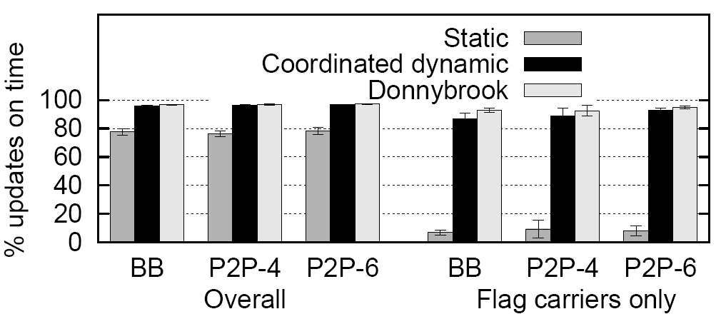
Evaluation: Other Approaches
Donnybrook performs better than other approaches

Slide 56
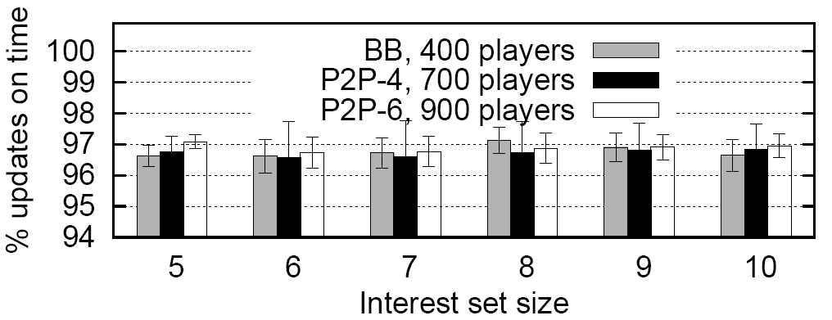
Evaluation: Interest Set Size
Performance is not sensitive to interest set size

Slide 57
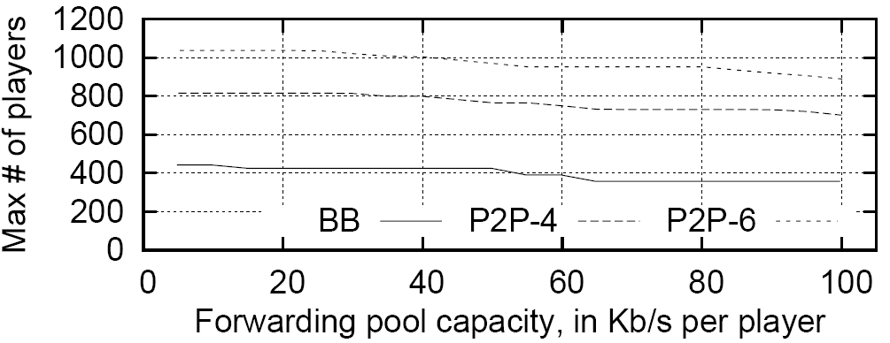
Evaluation: Forwarding Pool Capacity
Capacity set aside does not significantly affect scale

Slide 58
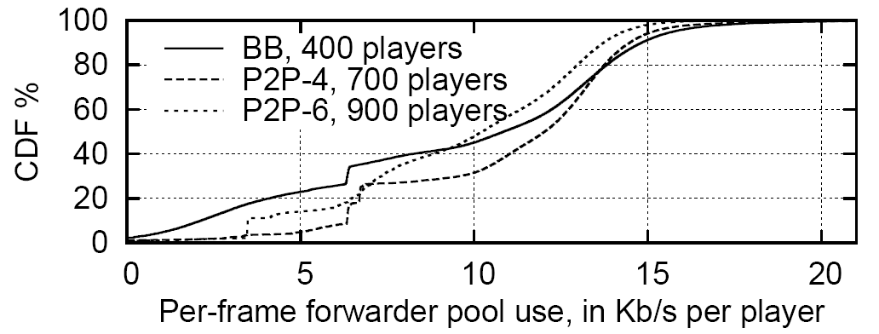
Evaluation: Forwarding Pool Demands
Most forwarding pool requests are small

